Slide 1
BlackRock industry project · UC Berkeley Haas MFE
Macroeconomic Surprises, DTW Price Patterns and the Intraday Response of ES, NQ, YM and ZN Futures
E-mini S&P 500 (ES) · E-mini Nasdaq-100 (NQ) · E-mini Dow (YM) · 10-Year Treasury Note (ZN)
Reza Zamani
Team: Jack Duncan, Hoshea Zeng, Aaryen Mehta, Reza Zamani (UC Berkeley MFE)
Supervisor: Benjamin Steel, BlackRock
MFE program coordinators: Ian Kaufman and Chris Pohalski, Haas School of Business
UC Berkeley Haas
Notes:
Title. This project asks whether a trader who reacts after a US macro release can profit from the market's response, net of realistic costs, in three futures markets: ES, NQ and ZN. We compare three model families: the macro surprise alone, the surprise conditioned on the pre-event market state, and the surprise combined with DTW price patterns.

Slide 2
Structure of the presentation
1
The answer and the questions
slides 3–4
6
RQ5 · Scaling to ~10 releases
slides 21–23
Headline results · motivation · 7 research questions
Notebooks 05, 05b: ~100 trades a year per market
2
Markets, signals and method
slides 5–9
7
RQ6 · DTW and the five-window ladder
slides 24–27
ES, NQ, YM, ZN · jump vs drift · surprise, DTW, state · walk-forward design
Notebooks 06, 06b: surprise + pattern
3
RQ1–RQ2 · What moves, what is tradeable
slides 10–12
8
RQ7 · Portfolio and team comparison
slides 28–35
Notebooks 02, 02b: CPI dominates; the drift after the first minute
Notebooks 07, 07b, 08, 08b: ES + NQ + YM; team books at equal costs
4
RQ3 · Pre-event market state
slides 13–14
9
Discussion and conclusions
slides 36–39
Notebooks 03, 03b: volatility and the CPI response
Why equities not bonds · final comparison · recommendations · future work
RQ4 · CPI walk-forward strategy
slides 15–20
Slide 40 · Acknowledgements and questions
5
Notebooks 04, 04b: performance, regime, real-time detection, robustness
UC Berkeley Haas · MFE · BlackRock industry project
2
Notes:
The talk has nine parts. After the headline answer and the questions, we set up the markets, signals and method, then go through the seven research questions in the order of the notebooks, and finish with discussion, recommendations and future work.

Slide 3
The answer in one slide
Walk-forward 2019–2026, entry one minute after the release, net of 2 ticks + $4.50 per round trip
≈1.0
0.78
30 min
0 / 0
Net Sharpe of the CPI surprise strategy on ES (0.8–1.0 on NQ and YM)
Net Sharpe of the ES + NQ + YM multi-release book, ~290 trades a year
How long the tradeable drift lasts after the first minute
Out-of-sample gain from pre-event state / from DTW patterns
Works
Macro surprise in equity-index futures (ES, NQ, YM)
CPI is the core release
~100 trades a year per market with ~10 releases
Does not help
Pre-event state: predicts the size of the move, not its direction
DTW price patterns: no reliable directional information (YM blend 1.06, not significant)
More windows per release
Does not work
ZN (10-year T-note): priced in the first minute; every strategy loses after costs
UC Berkeley Haas · MFE · BlackRock industry project
3
Notes:
Start with the conclusion. The surprise-sign strategy works in equity-index futures: Sharpe about 1 on CPI alone, 0.72 on the ES plus NQ book with about 195 trades a year. The edge is a drift that lasts about 30 minutes after the first minute. Neither the pre-event state nor DTW improves direction out of sample, and ZN is not tradeable because the bond market prices the news in the first minute.

Slide 4
Why macro releases, and what we asked
Scheduled information shocks: known time, published expectation, immediate repricing
The opportunity and the problem
The release time and the consensus are known in advance
Theory predicts the direction: hot inflation → higher rates → lower equities and bond prices
But the first move happens in milliseconds: a strategy that decides after seeing the number can only trade what comes after the first minute
RQ1
Which releases move ES, NQ, YM and ZN, and by how much?
RQ2
How much of the reaction is tradeable after the first minute?
RQ3
Does the pre-event state change the reaction?
RQ4
Can it be traded in real time after costs? Does state help?
RQ5
How many trades a year across many releases?
RQ6
Does DTW add information? Do more windows help?
RQ7
Do markets combine? How does the team compare at equal costs?
UC Berkeley Haas · MFE · BlackRock industry project
4
Notes:
Macro releases are scheduled information shocks. Direction is predictable from theory, but the first reaction is not tradeable. Seven research questions structure the talk; each result slide maps to one of them.

Slide 5
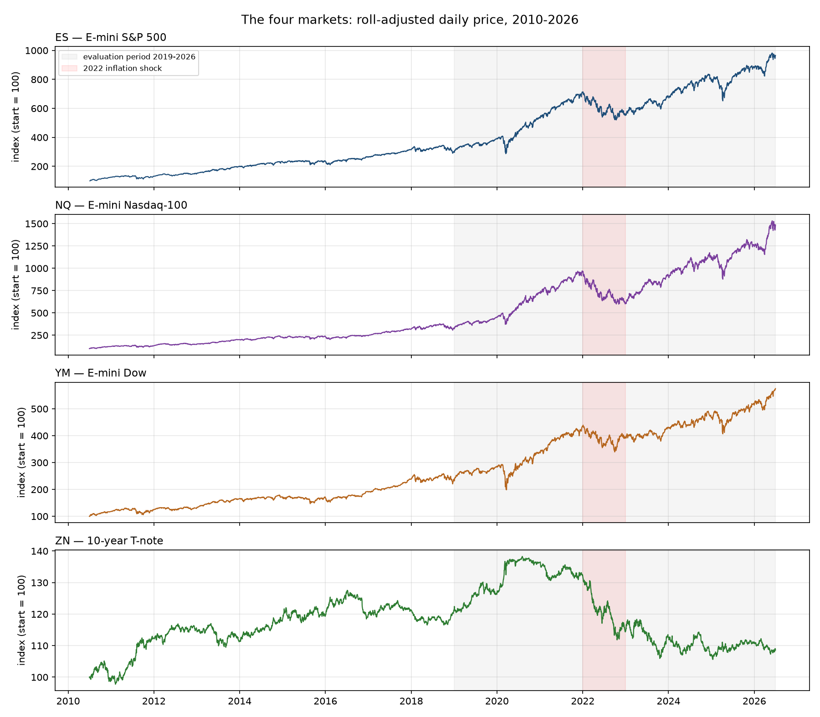
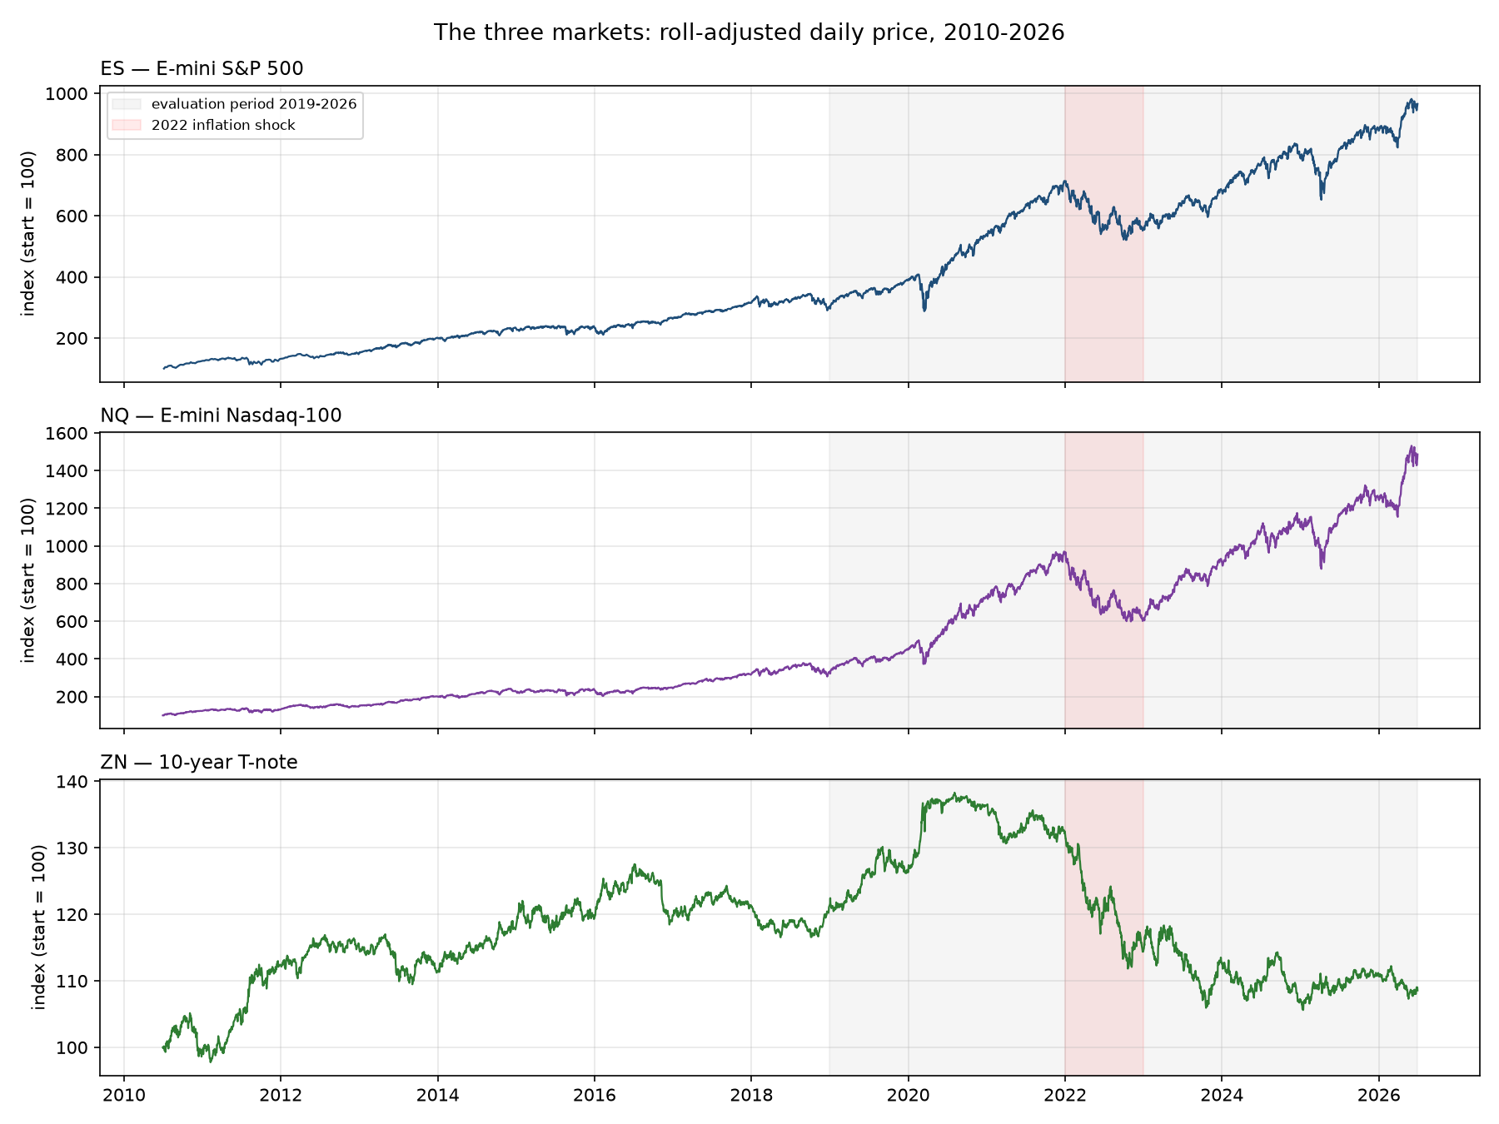
Four markets, three ways to react to the same news
 | ES | NQ | YM | ZN
Underlying | S&P 500 | Nasdaq-100 | Dow | 10-yr T-note
Value of a tick | $12.50 | $5.00 | $5.00 | $15.63
Cost (2 ticks + $4.50) | ≈1.7 bps | ≈0.7 bps | ≈1.0 bps | ≈3.0 bps
Buy & hold 2019–26 | +218% | +348% | +141% | −10.5%
Hot CPI print | down | down more | down | down (yields up)
Why these four
Is the effect a property of one contract, of equity indices, or of rate-sensitive markets?
NQ: long-duration tech → more rate-sensitive
YM: the same index family with more industrials and banks, added later as an out-of-sample check
UC Berkeley Haas · MFE · BlackRock industry project
5
Notes:
ES is the main market. NQ is a second equity index with more long-duration tech, so it should react more to rates. ZN is a bond price: it moves opposite to yields. Costs differ a lot in basis points: NQ is cheapest at about 0.7 bps, ZN most expensive at about 3 bps. The grey band is the evaluation period, red is the 2022 inflation shock.

Slide 6
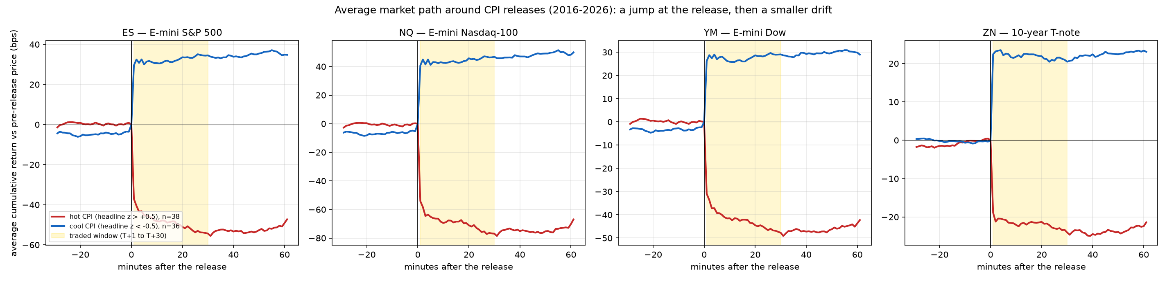
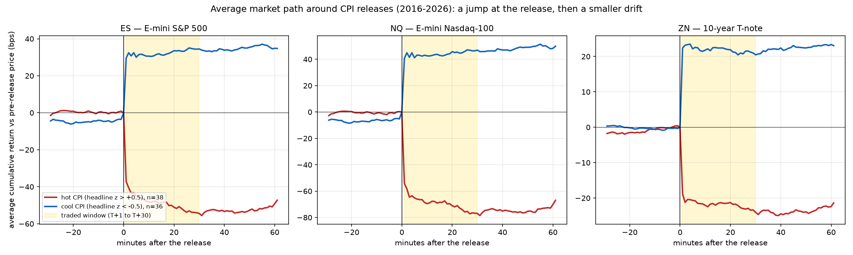
A release produces a jump, then a drift
Average path around 74 CPI releases with |surprise| > 0.5 SD, 2016–2026
−37 → −55 bps
−55 → −77 bps
−31 → −48 bps
−19 → −24 bps
ES after a hot CPI print: first-minute jump, then T+30
NQ: larger jump and larger drift
YM: a slightly smaller ES
ZN: almost nothing left after the first minute
UC Berkeley Haas · MFE · BlackRock industry project
6
Notes:
This one figure summarises the project. At the release prices jump in the direction theory predicts. In ES and NQ the price keeps moving for about 30 minutes, especially after hot prints: that continuation, the yellow window, is what we can trade. In ZN the continuation is only 4-5 bps, and ZN costs about 3 bps per round trip.

Slide 7
Two signal families, plus the market state
1 · Macro surprise
Surprise = actual − Bloomberg consensus
Standardised causally by the SD of previous surprises (≥ 24), capped at ±5σ
Line signs from the historical jump; lines released together form a family
x > 0 always means good news for that market (NFP sign reversed for ZN)
2 · DTW price pattern (team spec)
Query: z-scored 31-minute path ending at entry
Library: earlier releases at the same clock time, 3-year lookback, ≤ 600
k = 15 nearest, band 5, weights 1/distance × 2-year half-life
Trade the neighbours' average next-30-min return if outside the middle 40%
3 · Pre-event state
Six pre-registered states: 20-day vol, 1-day vol, 20-day momentum, 60-day drawdown, overnight move, previous surprise
Causal percentiles against a trailing one-year window
Used to scale or filter the surprise trade
UC Berkeley Haas · MFE · BlackRock industry project
7
Notes:
The surprise is actual minus consensus, standardised using only earlier releases. DTW is the method the rest of the team uses: it matches the shape of today's price path to similar historical releases. The state variables are pre-registered with an economic hypothesis each, and converted to causal percentiles.

Slide 8
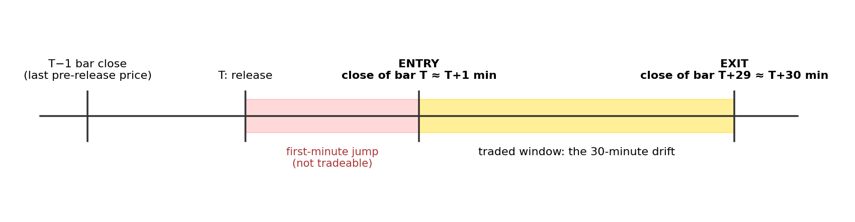
Method: executable, walk-forward, cost-aware
Entry
Close of the first post-release bar (≈ T+1 min); exit at T+30. The jump is never traded
Walk-forward
Every sign, screen, model and gate uses only earlier releases; evaluation 2019–2026
Costs
2 ticks + $4.50 per round trip; sensitivity 0–8 ticks and the team's ¼ tick per side
Statistics
HC3 errors, BH-FDR, permutation and random-sign tests, block-bootstrap Sharpe
UC Berkeley Haas · MFE · BlackRock industry project
8
Notes:
The single most important design choice is the entry: one minute after the release, at the close of the first bar. Everything is estimated walk-forward. Costs are 2 ticks plus commission as the base case. Every notebook reproduces the previous one's trade returns exactly, which guards against coding errors.

Slide 9
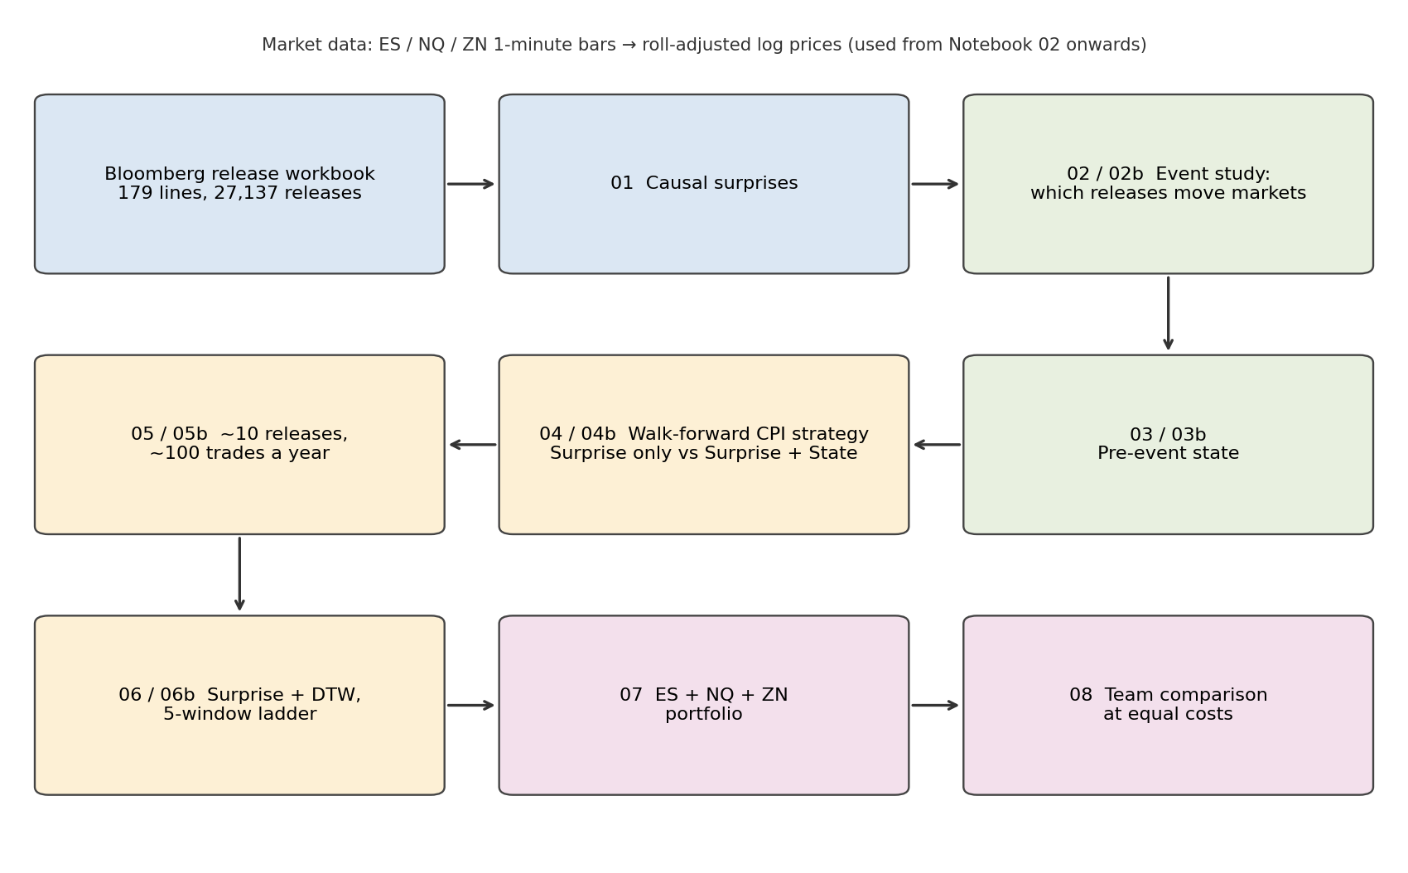
Research pipeline: 8 notebooks, repeated for NQ, YM and ZN
UC Berkeley Haas · MFE · BlackRock industry project
9
Notes:
The pipeline runs from raw Bloomberg releases and minute bars to a team comparison. Notebooks 03 to 06 were repeated on NQ and ZN with identical code, the b-notebooks.

Slide 10
RQ1 · CPI is the release that moves all four markets
Notebooks 02 and 02b: 363 CPI, NFP and PCE releases, 2016–2026
 | CPI | NFP | PCE
Mean |30-min move|, ES | 38.5 bps | 29.6 bps | 14.7 bps
R², 5 min, ES | 0.27 | 0.03 | 0.10
R², 5 min, NQ | 0.30 | 0.01 | 0.10
R², 5 min, YM | 0.27 | 0.07 | 0.09
R², 5 min, ZN | 0.30 | 0.03 | 0.04
Takeaway
CPI: large move and a predictable direction in every market
NFP moves markets as much, but its surprise explains only 1–3%: jobs, unemployment and wages often disagree
NQ reacts ~35% more than ES (rate-sensitive tech); YM ~92% of ES
UC Berkeley Haas · MFE · BlackRock industry project
10
Notes:
A one-SD hot CPI print lowers ES by about 21 bps, NQ by 28 and ZN by 10 within five minutes, and explains 27 to 30 percent of the reaction in all three. NFP moves markets almost as much as CPI but its direction is not explained by the surprise.

Slide 11
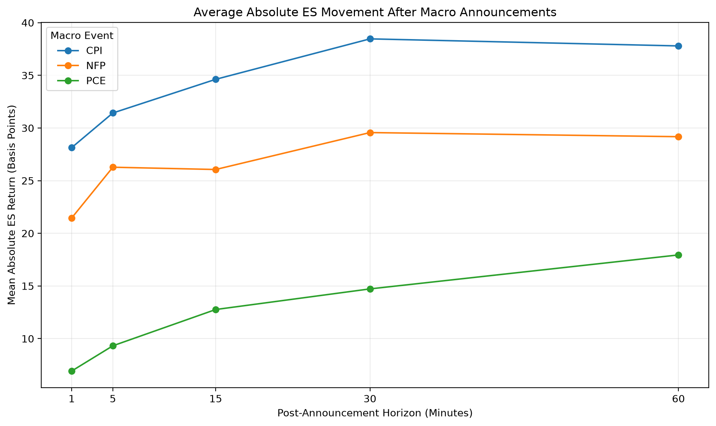
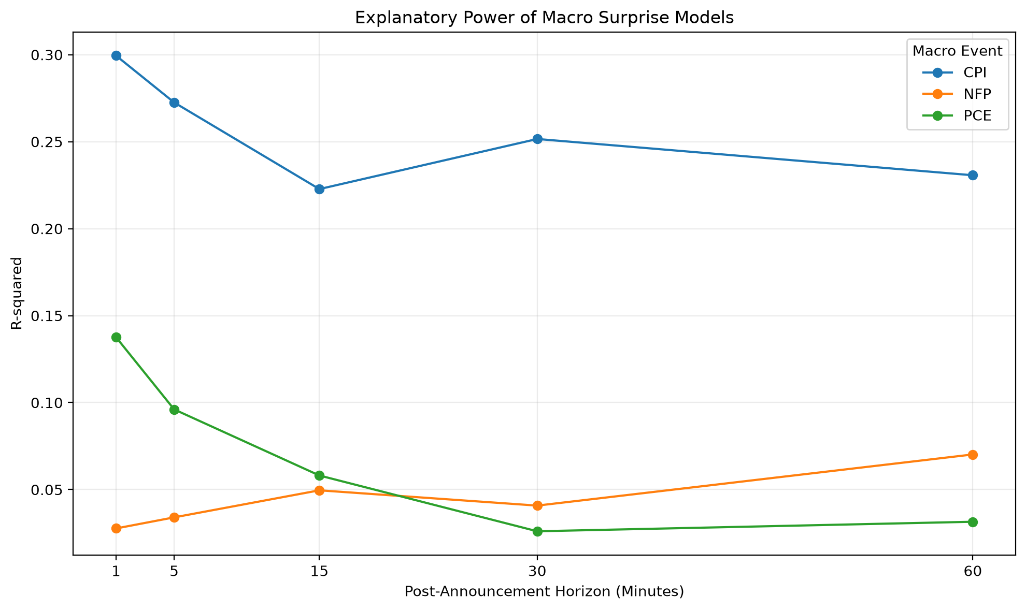
RQ1 · How much ES moves, and how much the surprise explains
Notebook 02, ES: 122 CPI, 122 NFP and 121 PCE releases, 2016–2026
Figure 3 · Mean absolute ES reaction by release and horizon (bps)
Figure 4 · Share of the ES reaction explained by the surprise (R²)
CPI moves ES most (38 bps at 30 min) and its surprise explains 22–30% of the move at every horizon. NFP moves ES almost as much (30 bps) but explains only 3–7%; PCE is informative only in the first minutes.
UC Berkeley Haas · MFE · BlackRock industry project
11
Notes:
Left: how much ES moves after each release. CPI and NFP both move the market a lot; PCE much less. Right: how much of that move the surprise explains. CPI stands out at 22 to 30 percent at every horizon; NFP stays below 7 percent. So CPI is the release with both size and predictable direction.

Slide 12
RQ2 · Most of the reaction is untradeable
CPI surprise beta (bps per 1 SD): 5-minute reaction from the pre-release price vs 30-minute drift after entry
~⅕–¼
of the CPI reaction remains as a drift in ES, NQ and YM
0.8 bps
ZN drift per 1 SD, below its 3 bps cost
Drift vs cost decides the rest of the study: ES 5.9 vs 1.7 bps, NQ 8.5 vs 0.7 bps, YM 4.4 vs 1.0 bps, ZN 0.8 vs 3.0 bps.
UC Berkeley Haas · MFE · BlackRock industry project
12
Notes:
The five-minute reaction includes the untradeable jump. Measured from entry, the 30-minute drift is about 9 bps per SD in ES and 8.5 in NQ, several times the cost. In ZN it is 0.8 bps, below the 3 bps cost. This comparison explains most of the trading results.

Slide 13
RQ3 · In volatile markets CPI hits equities much harder
Notebook 03: CPI surprise beta on the 5-min reaction by tercile of 20-day volatility (bps per 1 SD)
 | ES | NQ | YM | ZN
Best interaction t | 3.8 | 3.0 | 3.7 | −3.2
Survive FDR | 2 | 0 | 3 | 1
Size tests surviving FDR | 198/360 | 154/360 | 156/360 | 0/360
But
The effect is mostly on the first-minute jump
Significant only after 2021
The state reliably predicts the size of the move, not its direction
UC Berkeley Haas · MFE · BlackRock industry project
13
Notes:
In sample, the CPI beta in ES is about 11 bps in calm markets and 50-68 in volatile ones; NQ is similar. ZN shows no volatility pattern. Most robust finding: state predicts how much the market moves, 198 of 360 tests survive FDR in ES. The direction effect is mostly on the jump and mostly after 2021.

Slide 14
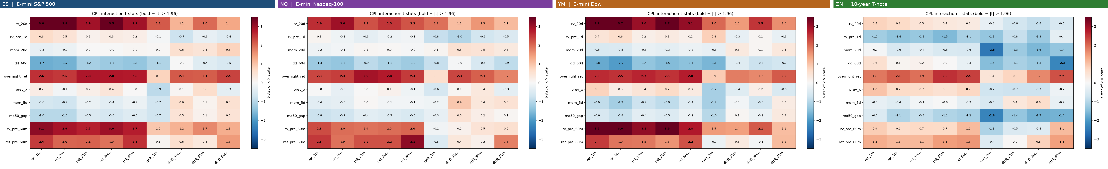
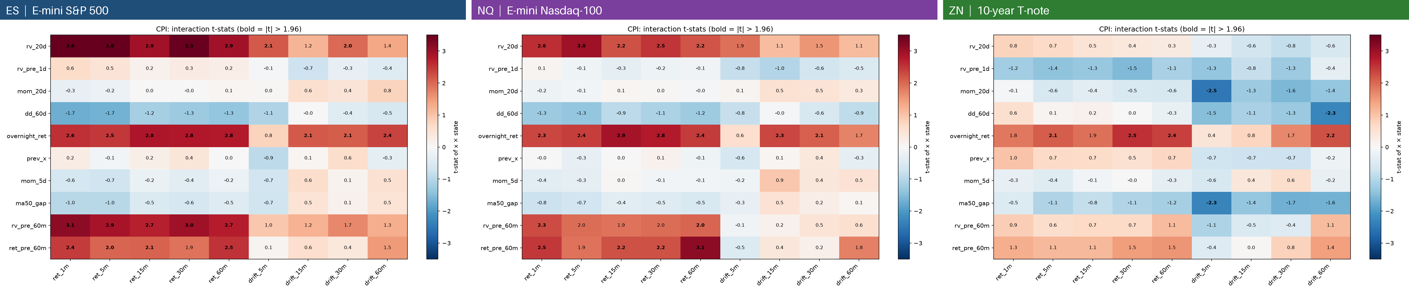
RQ3 · The same pattern in ES, NQ and YM, a different one in ZN
Reading the t-statistics (CPI × state; rows = states, columns = horizons)
ES: 20-day volatility row dark red on the reactions (t up to 3.8), much lighter on the drifts
NQ: the same red rows, slightly weaker (t up to 3.0) — not a fluke of one contract
Overnight return strengthens the response in all three markets
ZN: no volatility effect; strong recent trends weaken the post-release drift
Selected for trading: ES rv_20d × CPI; NQ none; ZN 1-day vol × all releases
UC Berkeley Haas · MFE · BlackRock industry project
14
Notes:
Each row is a state, each column a horizon. A credible effect is a whole row of the same colour. ES and NQ share the volatility and overnight rows, strongest on the short reactions. ZN is different. The pre-registered selection rule carried only a few pairs into Notebook 04.

Slide 15
RQ4 · CPI surprises are tradeable in ES, NQ and YM, not in ZN
Notebook 04: CPI walk-forward net Sharpe, 2019–2026, 2 ticks + $4.50
Takeaways
ES surprise only: 12.8 bps per trade, t = 2.8, CI 0.25–1.72
The naive sign is as good as any fitted model (NQ: significantly better; YM 0.99)
No state model beats surprise only
ZN: +2.7 bps gross per trade, eaten by the 3 bps cost
UC Berkeley Haas · MFE · BlackRock industry project
15
Notes:
CPI alone gives a Sharpe of about 1 in ES and 0.8 to 1 in NQ. The naive sign rule, with no estimation, is as good as the fitted models: the edge is the economic direction of the surprise. No state model beats surprise only. ZN has a small gross edge but costs eat it; the fitted models correctly refuse to trade.

Slide 16
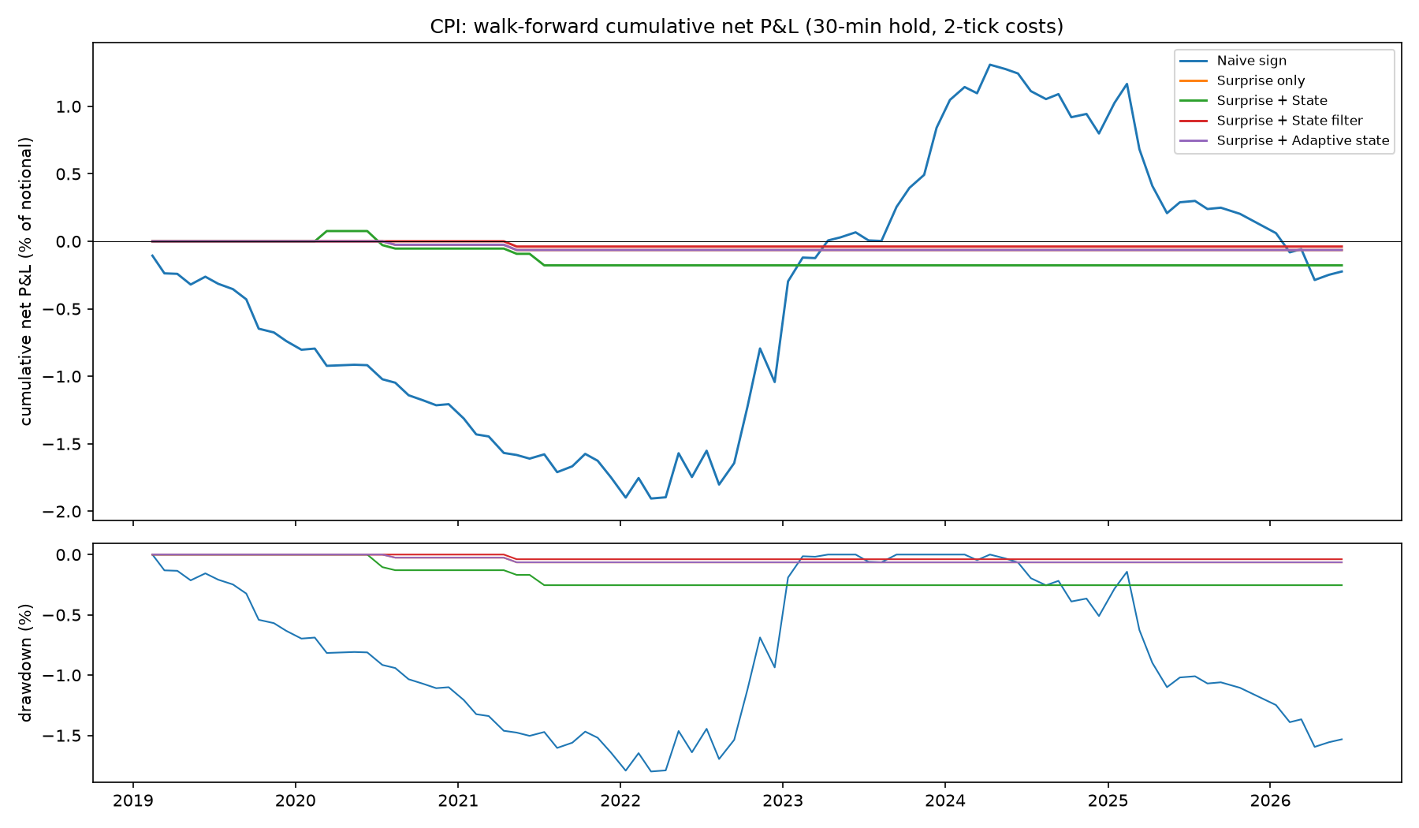
RQ4 · ZN: the fitted models correctly refuse to trade
+2.7 bps
Naive CPI gross profit per trade in ZN (gross Sharpe 0.53)
−0.3 bps
the same after the 3 bps round-trip cost (Sharpe −0.05)
Why the lines are flat
The surprise model trades only if the predicted move exceeds the cost
In ZN that happened 1–5 times in 7.5 years
Figure 16 · ZN: walk-forward cumulative net P&L of the CPI strategies and drawdowns
UC Berkeley Haas · MFE · BlackRock industry project
16
Notes:
In ZN the naive CPI rule has a small positive edge before costs, but it is the same size as the cost. The fitted models predict moves smaller than the cost, so they almost never trade: that is the right decision.

Slide 17
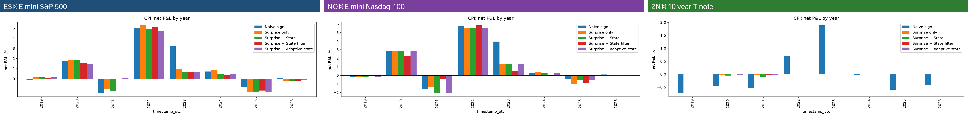
RQ4 · The edge is concentrated in the 2022 inflation shock
CPI net P&L by year (% of notional), five strategies: ES, NQ, YM, ZN
79% / 74% / 86%
Why it matters
CPI pays when inflation drives policy expectations
The state effect was invisible in real time until 2022 (t = 0.5 in 2019, 3.3 in 2022)
The 'best' state changed every few years: none → 20-day vol → overnight move
Implication: scale exposure with the macro regime, not with a state model
Share of CPI P&L from 2022 (ES / NQ / YM, surprise only)
0.58 / 0.68 / 0.53
Naive CPI Sharpe excluding 2022 (ES / NQ / YM)
UC Berkeley Haas · MFE · BlackRock industry project
17
Notes:
Most of the CPI profit came in 2022. Excluding 2022 the naive rule still has a Sharpe of 0.58 in ES and 0.68 in NQ. The state interaction only became detectable in 2022, and the adaptive model kept changing its choice, so state conditioning is not stable enough to trade.

Slide 18
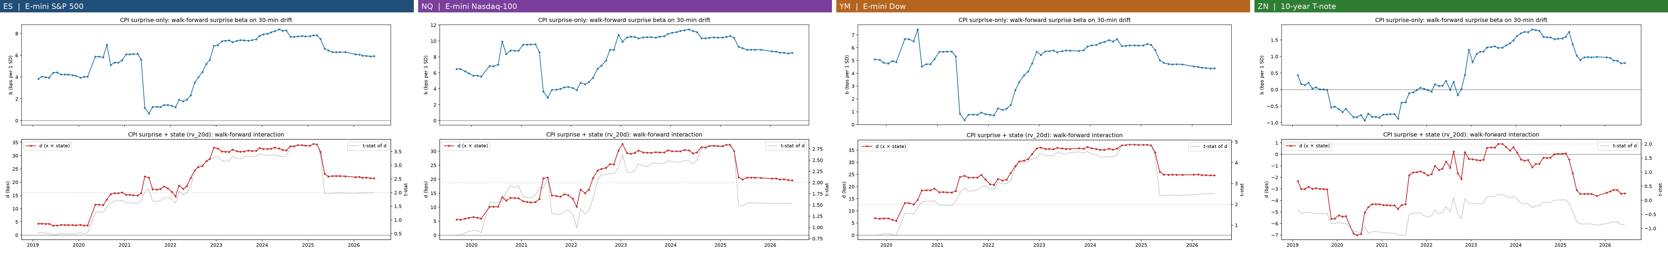
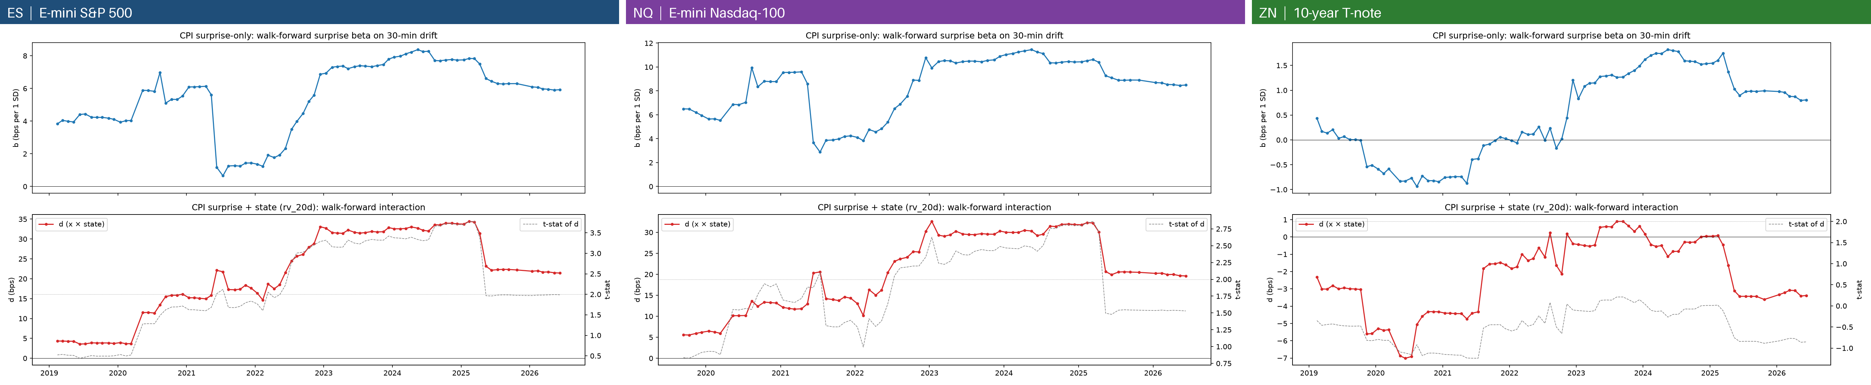
RQ4 · When could a trader have known about the state effect?
Figure 17 · Walk-forward CPI surprise beta (top) and CPI × 20-day-vol interaction with its t-statistic (bottom): ES, NQ, YM, ZN
ES
Beta 4 bps (2019) → ~1 bp (mid-2021) → ~8 bps (2023–24)
Interaction t crosses 2 only in mid-2022, ~3.5 in 2023–25
NQ
Same shape at a higher level: 6 → 3 → 10–11 bps
Interaction t peaks ~2.8 in 2024–25, falls to 1.5. YM: same shape, t 0.6 (2019) → 4–5 (2022–24) → 2.5
ZN
Beta between −0.9 and +1.8 bps for the whole period
Interaction never significant (t between −1.2 and +0.2)
UC Berkeley Haas · MFE · BlackRock industry project
18
Notes:
These are the coefficients a trader would have estimated in real time. In both equity markets the state interaction was invisible until 2022, which is why state conditioning does not help out of sample. In ZN there was never a drift to predict.

Slide 19
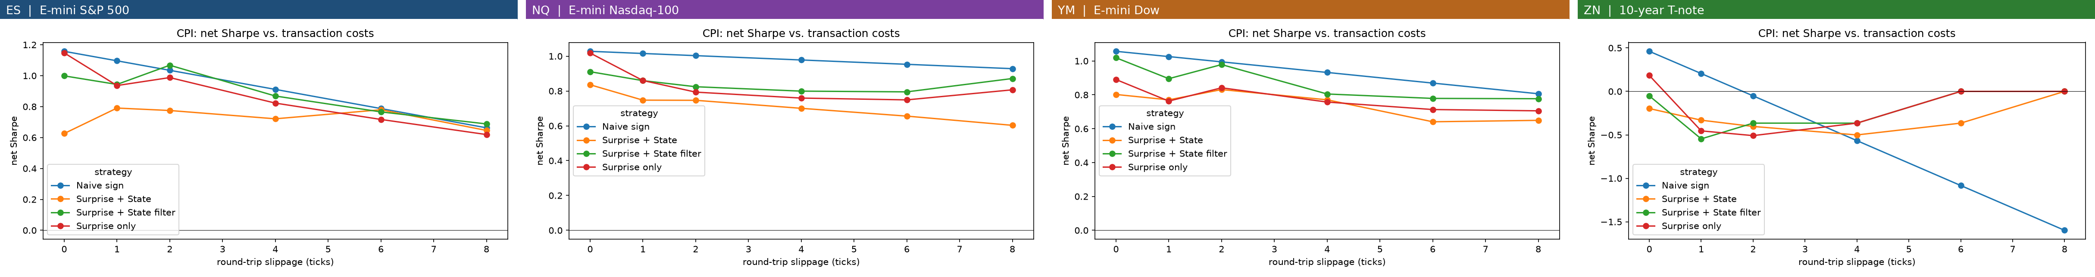
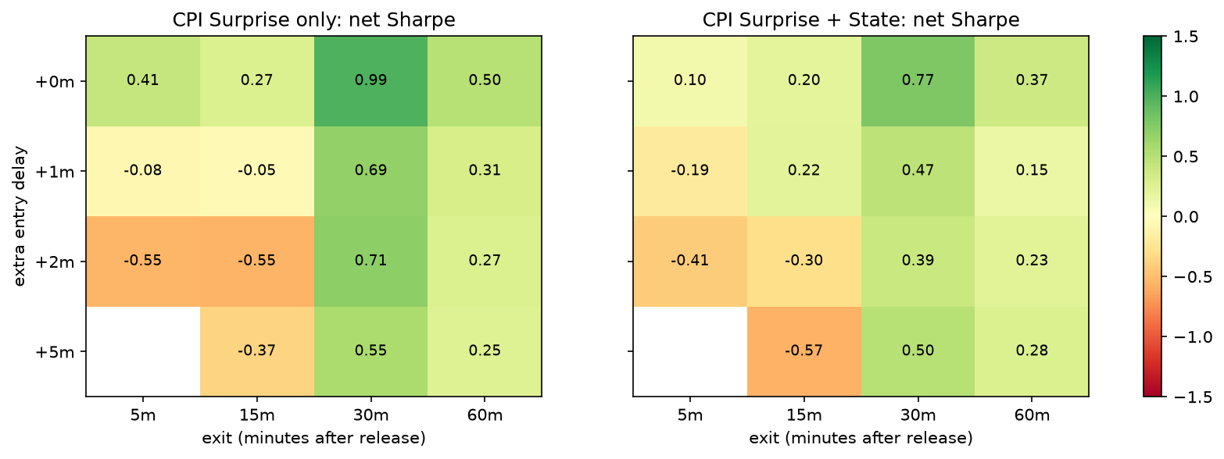
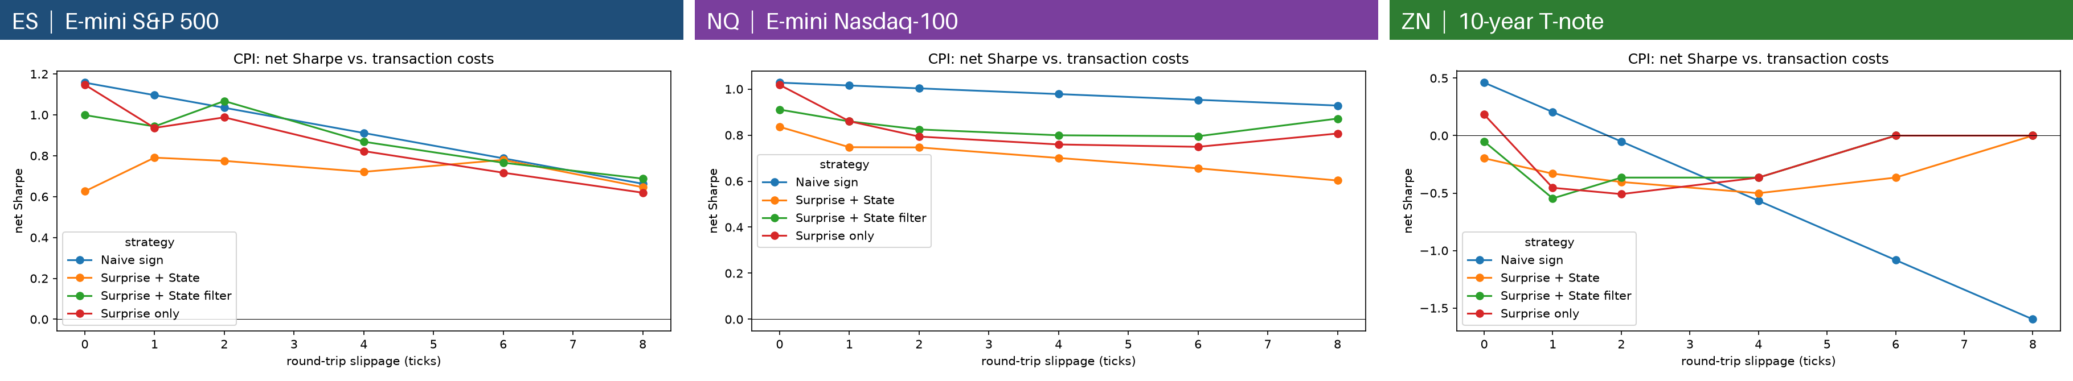
RQ4 · Robust to costs and delays in equities
CPI net Sharpe vs round-trip slippage (0–8 ticks): ES, NQ, YM, ZN
Robustness
ES: 1.15 → 0.62 from 0 to 8 ticks
NQ: almost flat (0.75–1.02); YM: 0.89 → 0.71
ZN: turns negative at ~2 ticks
30-min hold survives 1–5 min delays; 5-min holds collapse
A slow 30-minute continuation, not a speed race
ES: Sharpe by entry delay (rows) and holding period (columns)
UC Berkeley Haas · MFE · BlackRock industry project
19
Notes:
The CPI strategy keeps a positive Sharpe up to 8 ticks in ES and is almost insensitive to cost in NQ. Entering one to five minutes late barely hurts the 30-minute hold, while short holds collapse: this is a slow continuation, not a latency game.

Slide 20
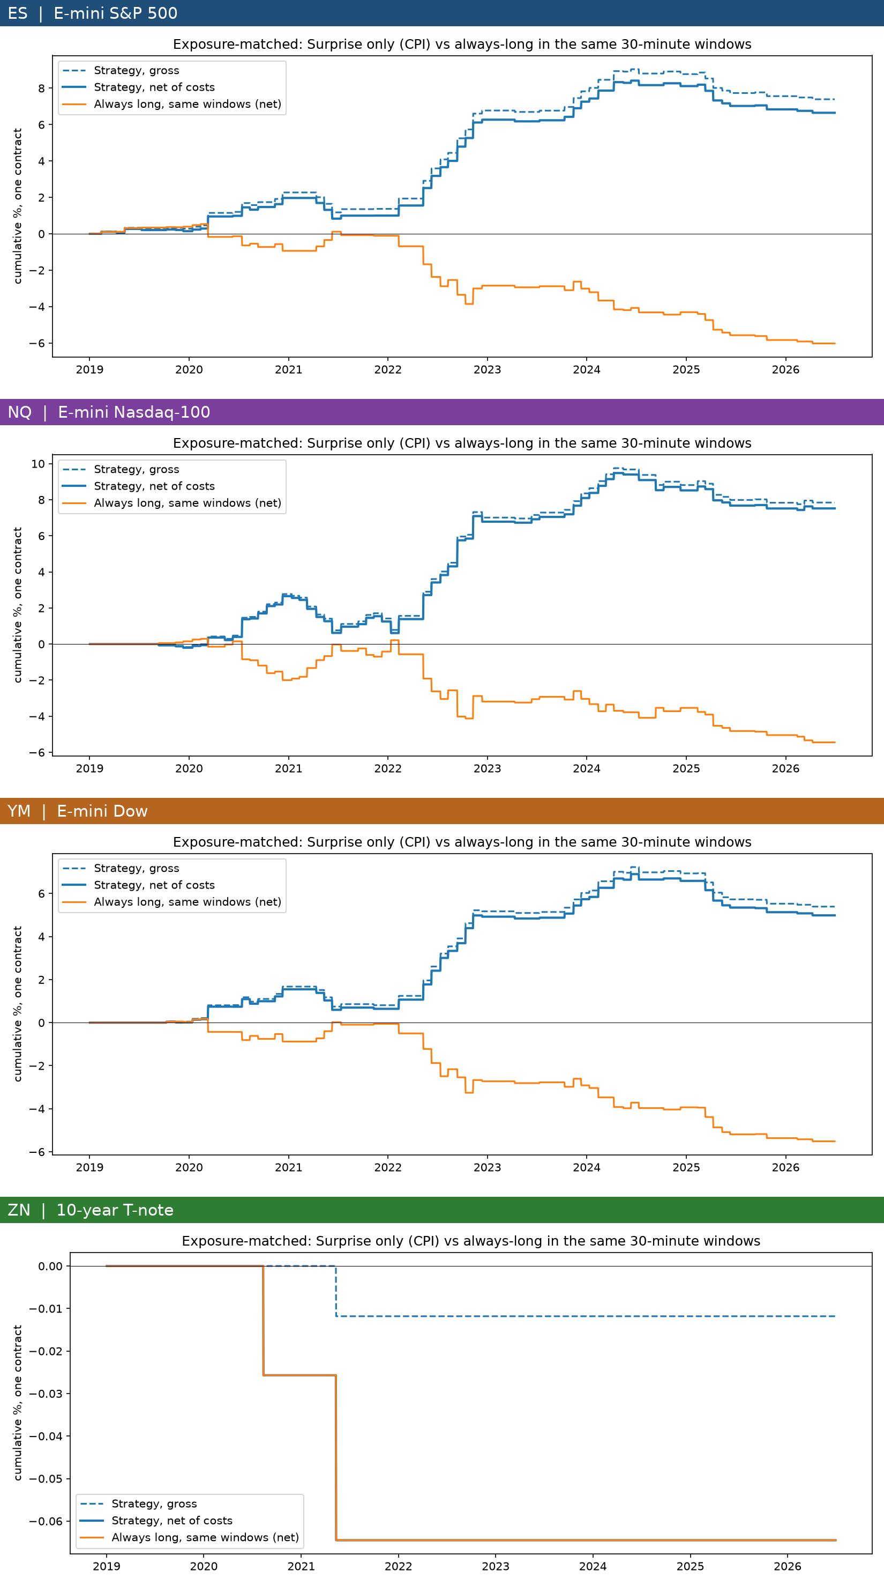
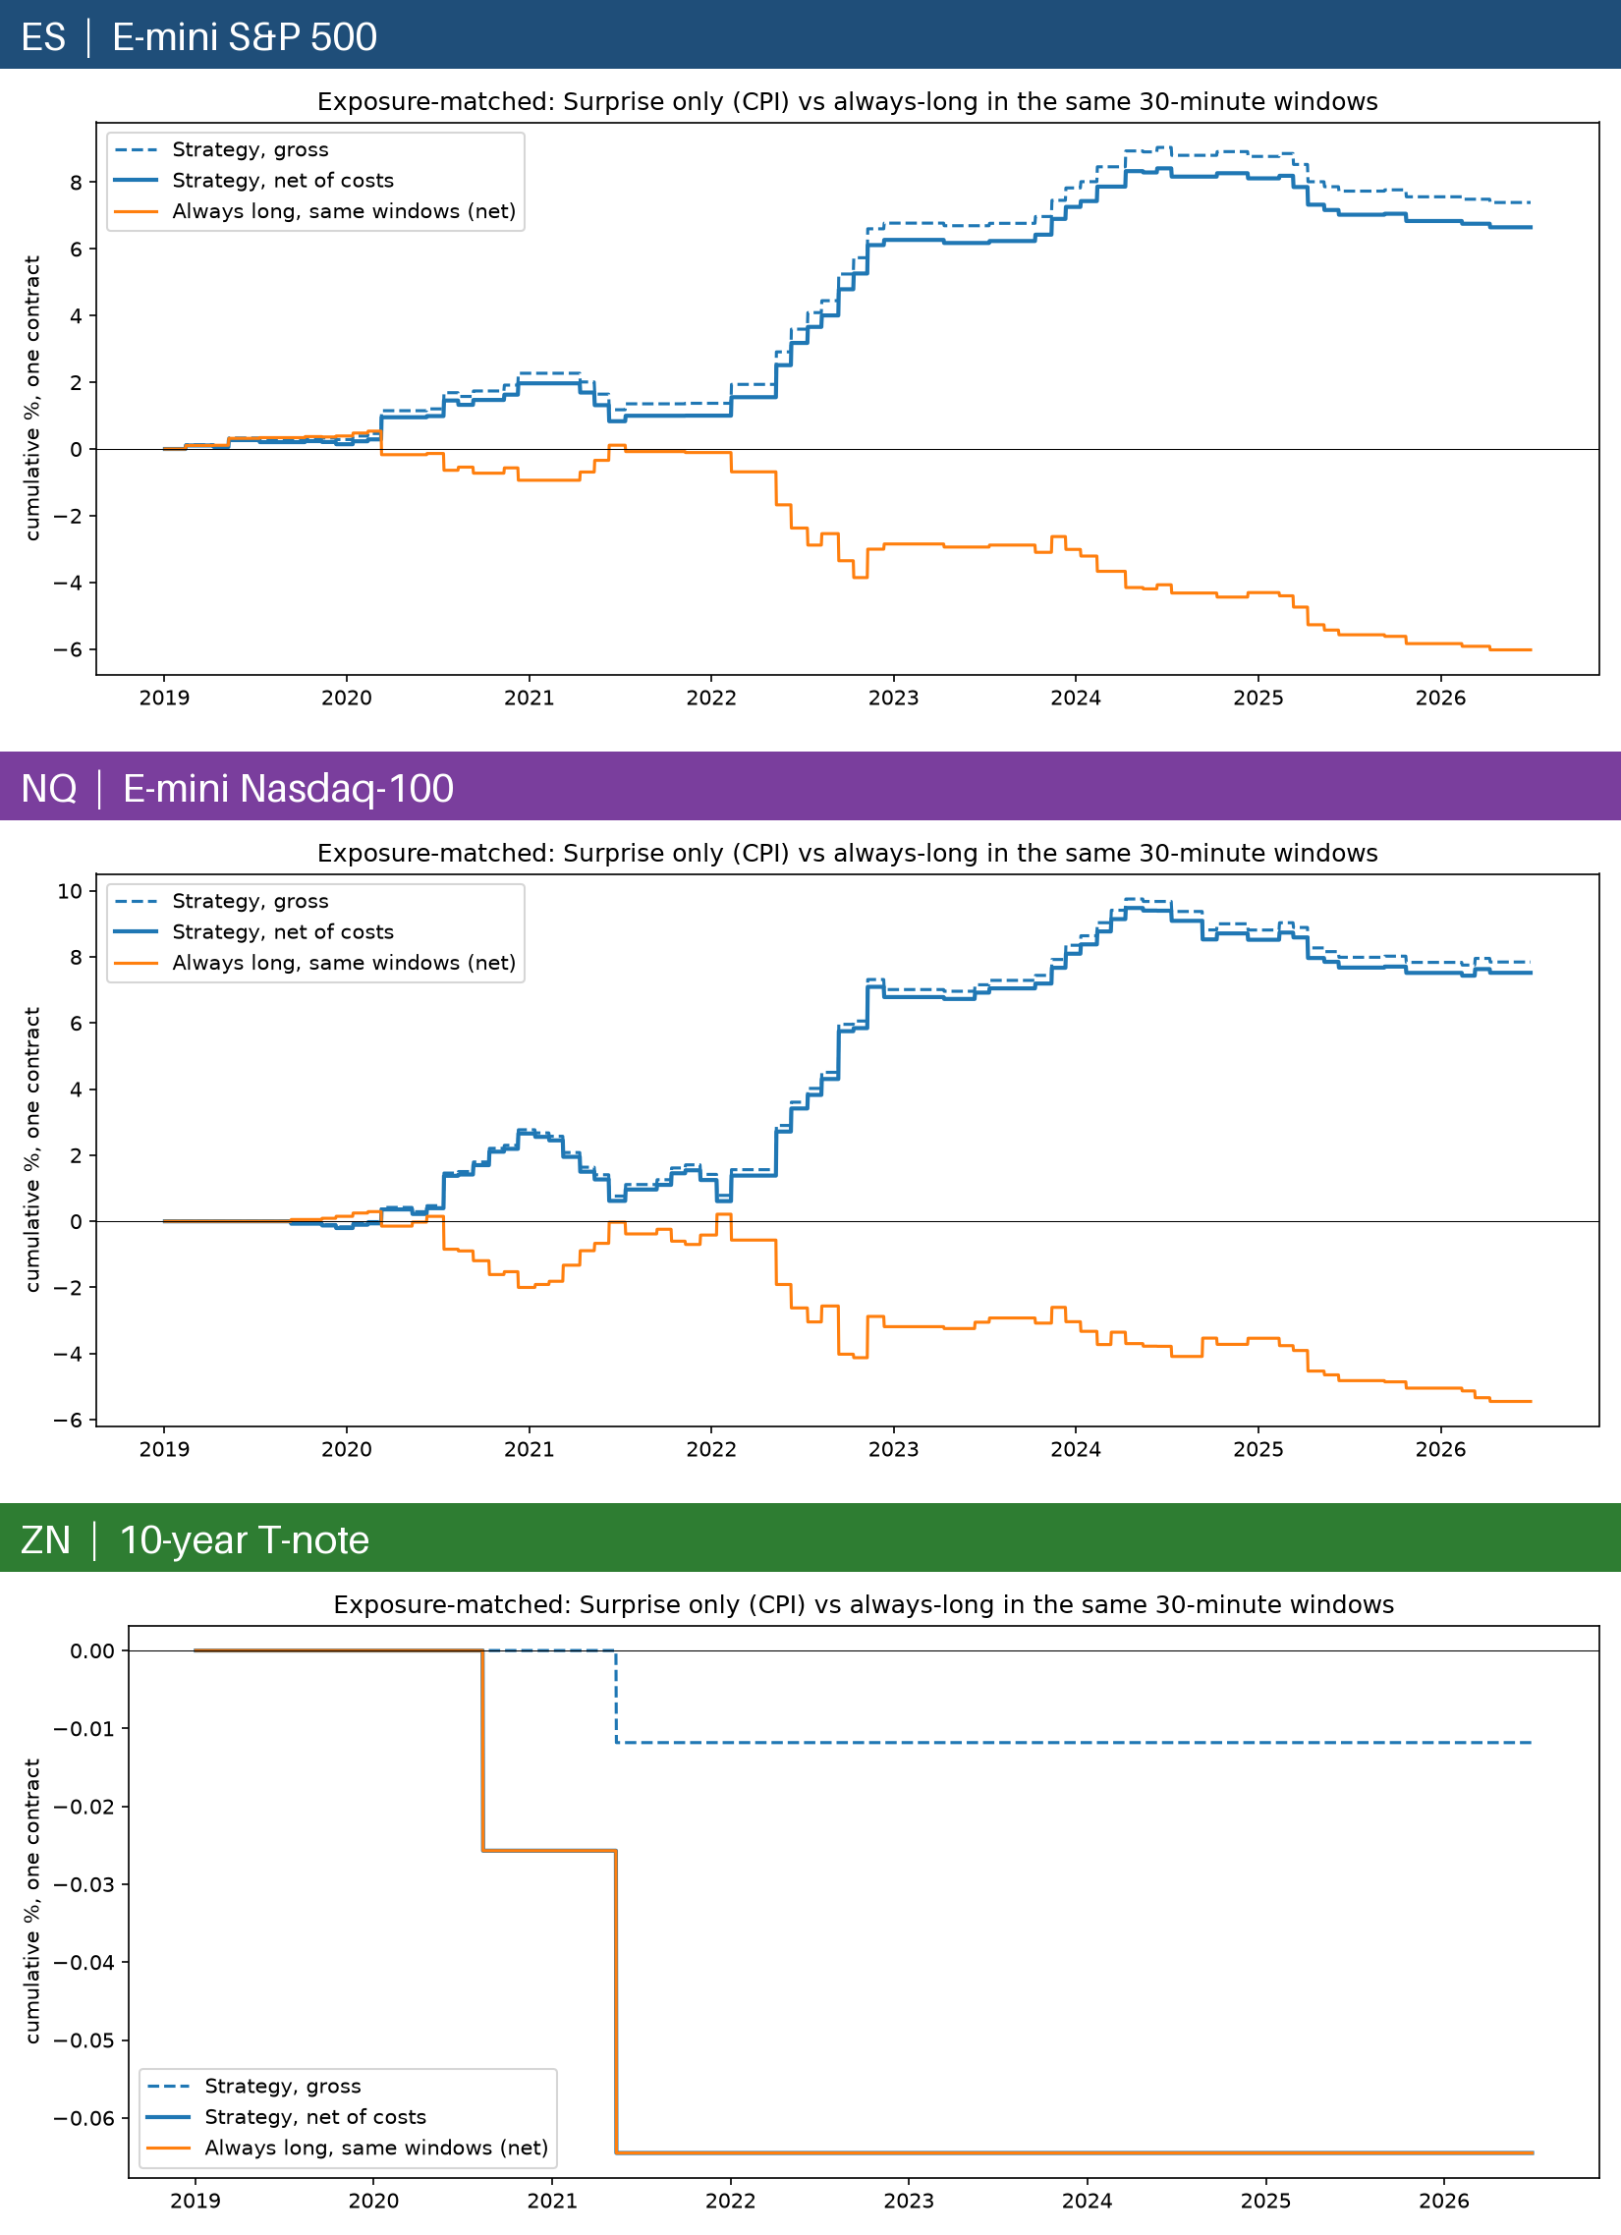
RQ4 · The direction is what earns the money
+6.6% vs −6.0%
+7.5% vs −5.4%
ES: CPI surprise strategy vs always long in the same 30-minute windows
NQ: same comparison · YM: +5.0% vs −5.5%
Figure 22 · the peer (DTW team) chart format
Solid blue: strategy net of costs; dashed: gross; orange: always long in the same windows
Being in the market at CPI time earns nothing by itself; the profit comes from the sign of the surprise (≈13 percentage points in ES and NQ, 10.5 in YM)
Gross and net lines are close: costs are not the binding constraint for CPI
Beta to buy-and-hold ≈ 0: the strategy is market-neutral (0.06–0.1% time in market)
UC Berkeley Haas · MFE · BlackRock industry project
20
Notes:
This is the chart format the DTW team uses. The always-long line in exactly the same windows loses money, while the strategy gains: the value is entirely in calling the direction of the surprise.

Slide 21
RQ5 · Ten releases give ~100 trades a year per market
Notebook 05: top-10 families by an impact screen (history only), naive sign, one 30-min trade per release
All · naive | ES | NQ | YM | ZN
Trades / year | 98 | 97 | 93 | 82
Net bps / trade | 1.7 | 2.4 | 1.7 | −3.4
Total net P&L | 12.8% | 17.5% | 12.0% | −20.5%
Sharpe ex-2022 | 0.28 | 0.44 | 0.40 | −2.53
Random-sign p | <0.001 | 0.005 | 0.006 | 0.81
Sharpe at 4 ticks | 0.20 | 0.60 | 0.45 | −4.24
2nd window alone | −0.79 | −0.23 | −0.15 | −3.08
Tenfold more trades with the edge intact in equities; the edge is gone within 30 minutes.
UC Berkeley Haas · MFE · BlackRock industry project
21
Notes:
Trading the surprises of about ten screened releases raises the trade count from about ten to about a hundred a year per market, with a Sharpe of 0.65 in ES and 0.71 in NQ, both far from random. The NQ book is less dependent on 2022 and much more robust to costs. A second window after each release loses money everywhere.

Slide 22
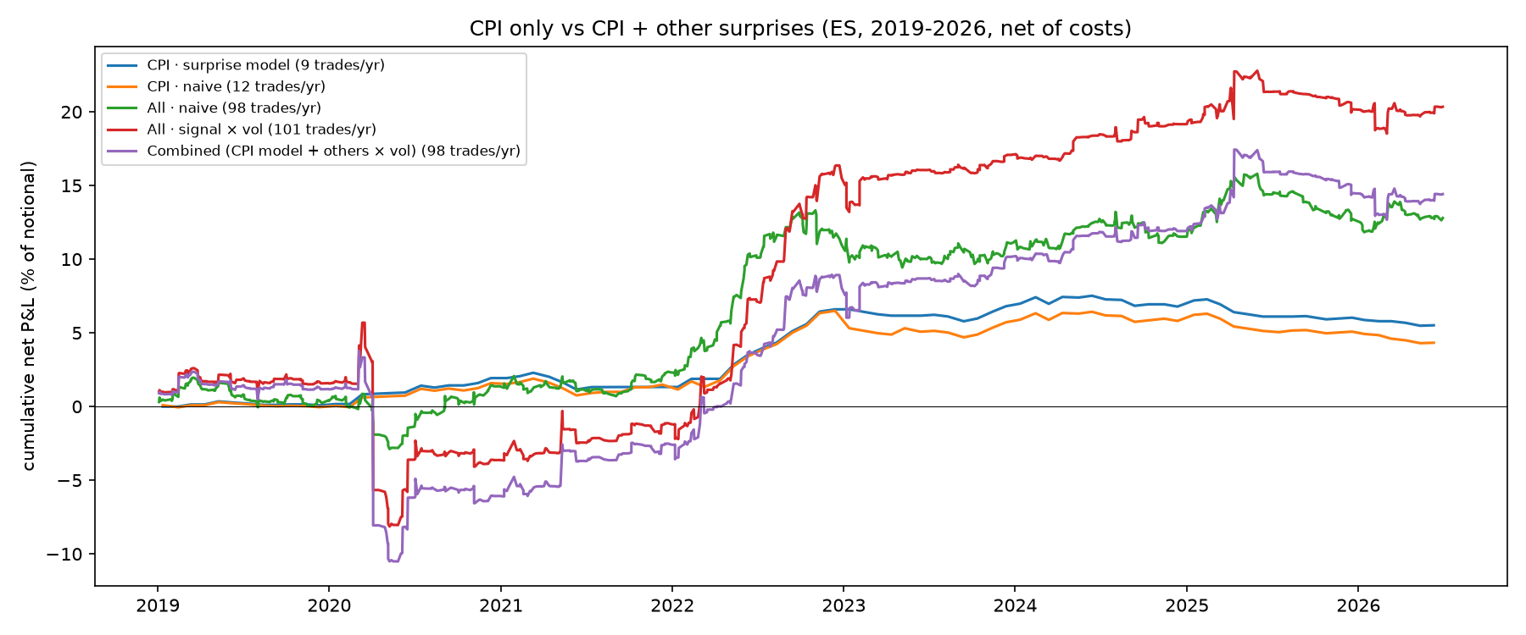
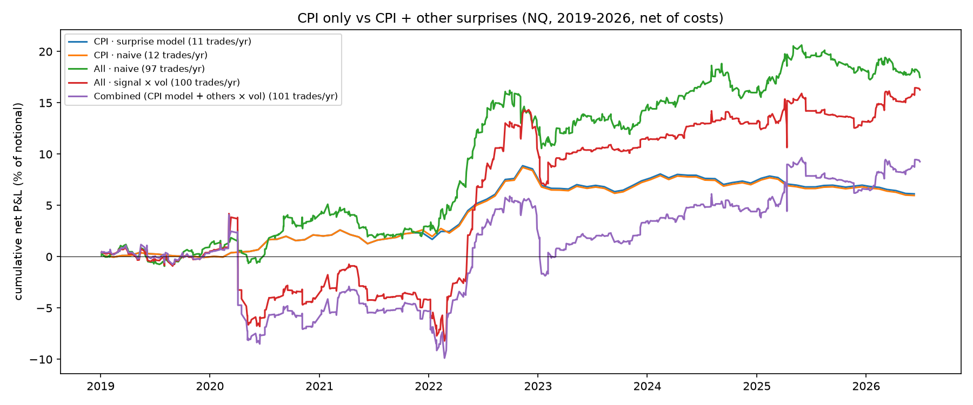
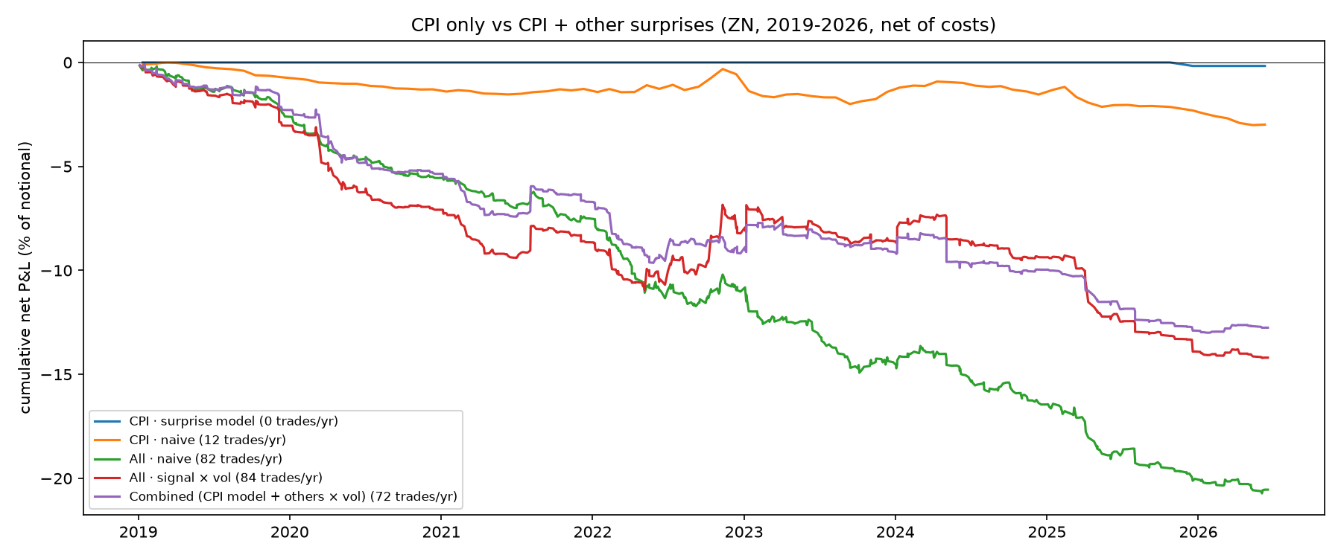
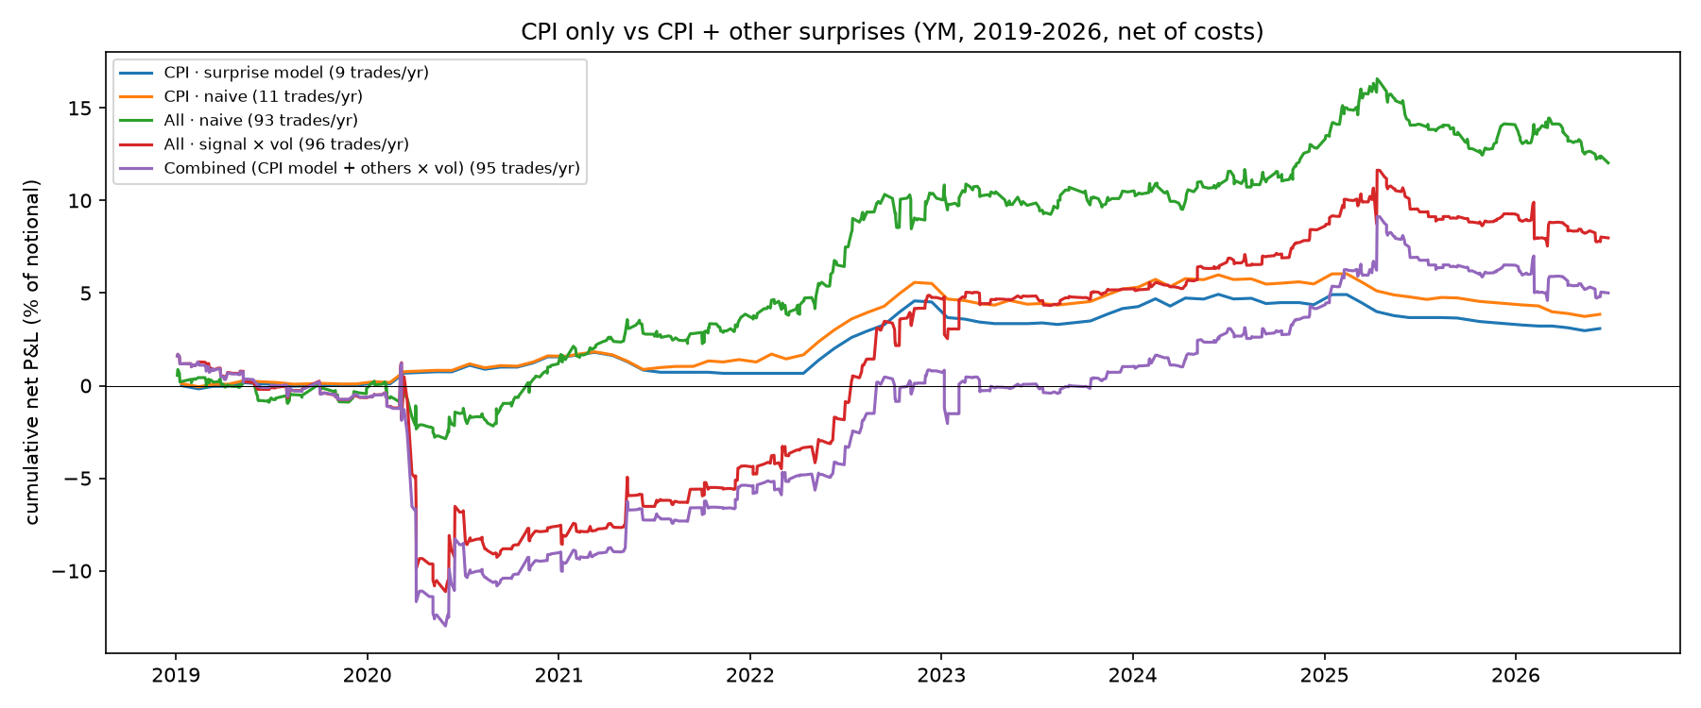
RQ5 · The multi-release books over time
Figure 23 · ES
Figure 24 · NQ
Reading
ES and NQ: the naive all-release book climbs steadily, biggest gains in 2022 but positive outside it (NQ +17.5%, ex-2022 Sharpe 0.44; ES +12.8%, 0.28)
Volatility sizing adds P&L but raises drawdowns to 12–14%
YM: +12.0%, ex-2022 Sharpe 0.40. ZN: every book falls almost linearly, paying the cost on each trade
Figure 25 · ZN
Figure 24b · YM
UC Berkeley Haas · MFE · BlackRock industry project
22
Notes:
Cumulative P&L of the CPI-only and multi-release books in each market. In the equity markets the simple naive book is the steadiest; volatility sizing adds return but much larger drawdowns. In ZN everything loses about the cost on every trade.

Slide 23
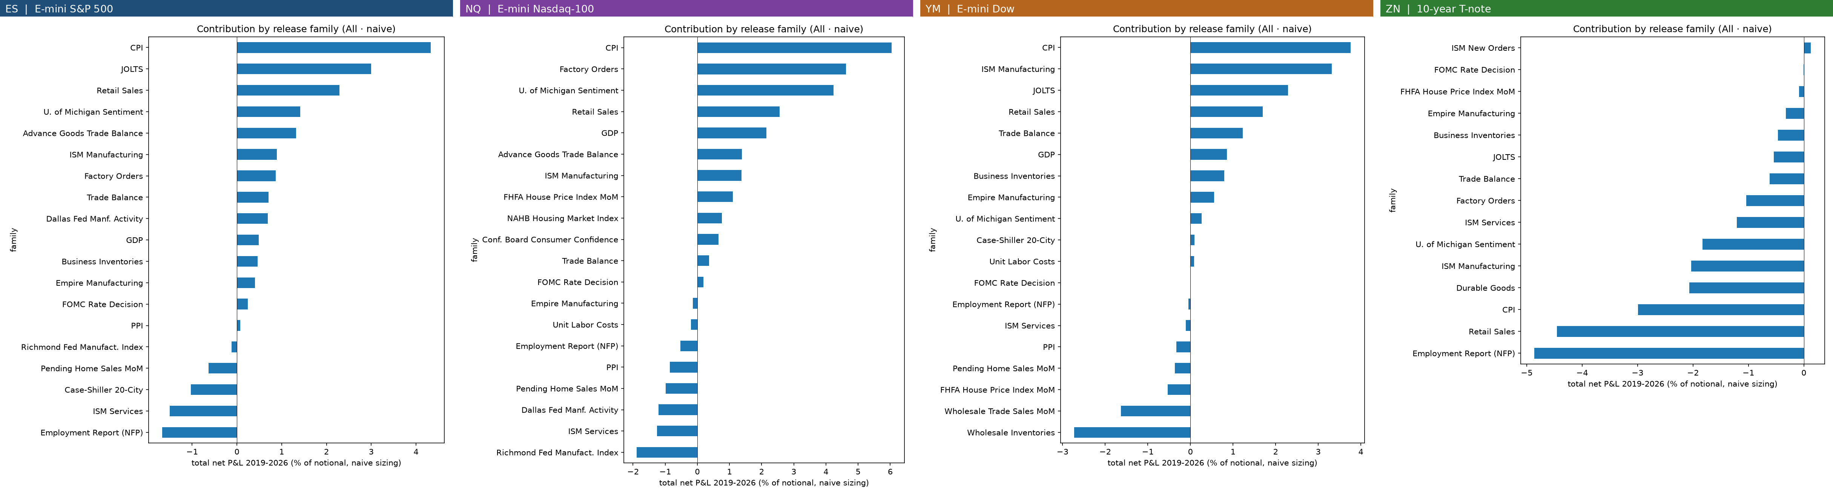
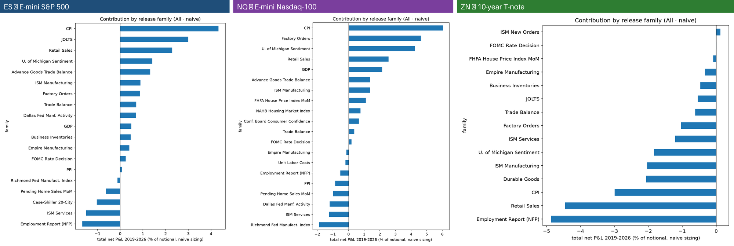
RQ5 · CPI leads; the rest is diversification across small edges
ES: CPI +4.3%, JOLTS +3.0%, Retail Sales +2.3% · NQ: CPI +6.0%, Factory Orders +4.6%, U. Michigan +4.2% · YM: CPI +3.8%, ISM Manufacturing +3.3%, JOLTS +2.3% · ES and NQ lose on the Employment Report and ISM Services · ZN: every major family loses about the cost on each trade
UC Berkeley Haas · MFE · BlackRock industry project
23
Notes:
CPI is the largest contributor in both equity markets. Beyond CPI the ranking differs between ES and NQ, so the broad book should be read as diversification across many small, noisy edges. In ZN every family loses about the cost on each trade.

Slide 24
RQ6 · DTW adds no reliable directional information
Notebook 06: the team's DTW specification on the same releases, entry and costs
0.01 · 0.03 · 0.03 · 0.04
DTW rank IC with the 30-min return (ES · NQ · YM · ZN); useful signals show 0.05–0.10
Takeaways
ES and NQ: every combination lowers the surprise book's Sharpe
CPI-only results point in different directions in ES and NQ: noise
YM: the blend reaches 1.06 (P(not better) 0.06), not confirmed elsewhere
UC Berkeley Haas · MFE · BlackRock industry project
24
Notes:
DTW's rank information coefficient is essentially zero in every market. Adding it to the surprise lowers the Sharpe in every combination. The CPI-only comparisons favour different combinations in different markets and none is significant, so we treat them as noise.

Slide 25
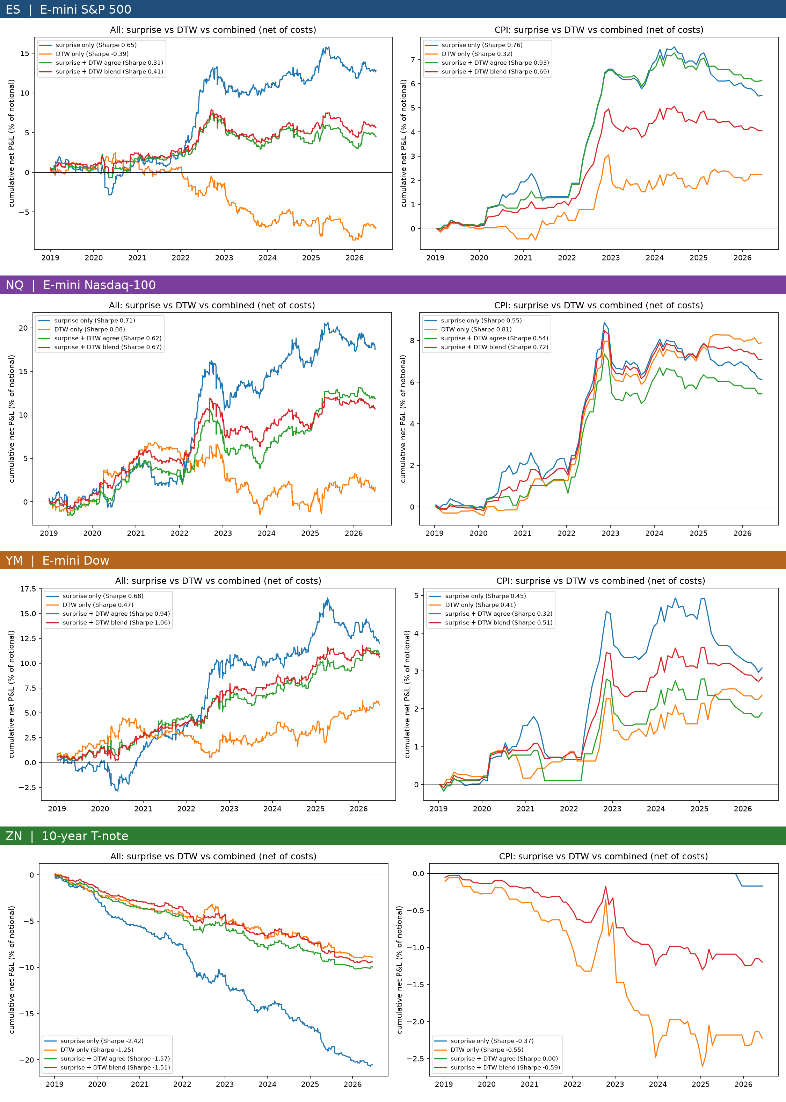
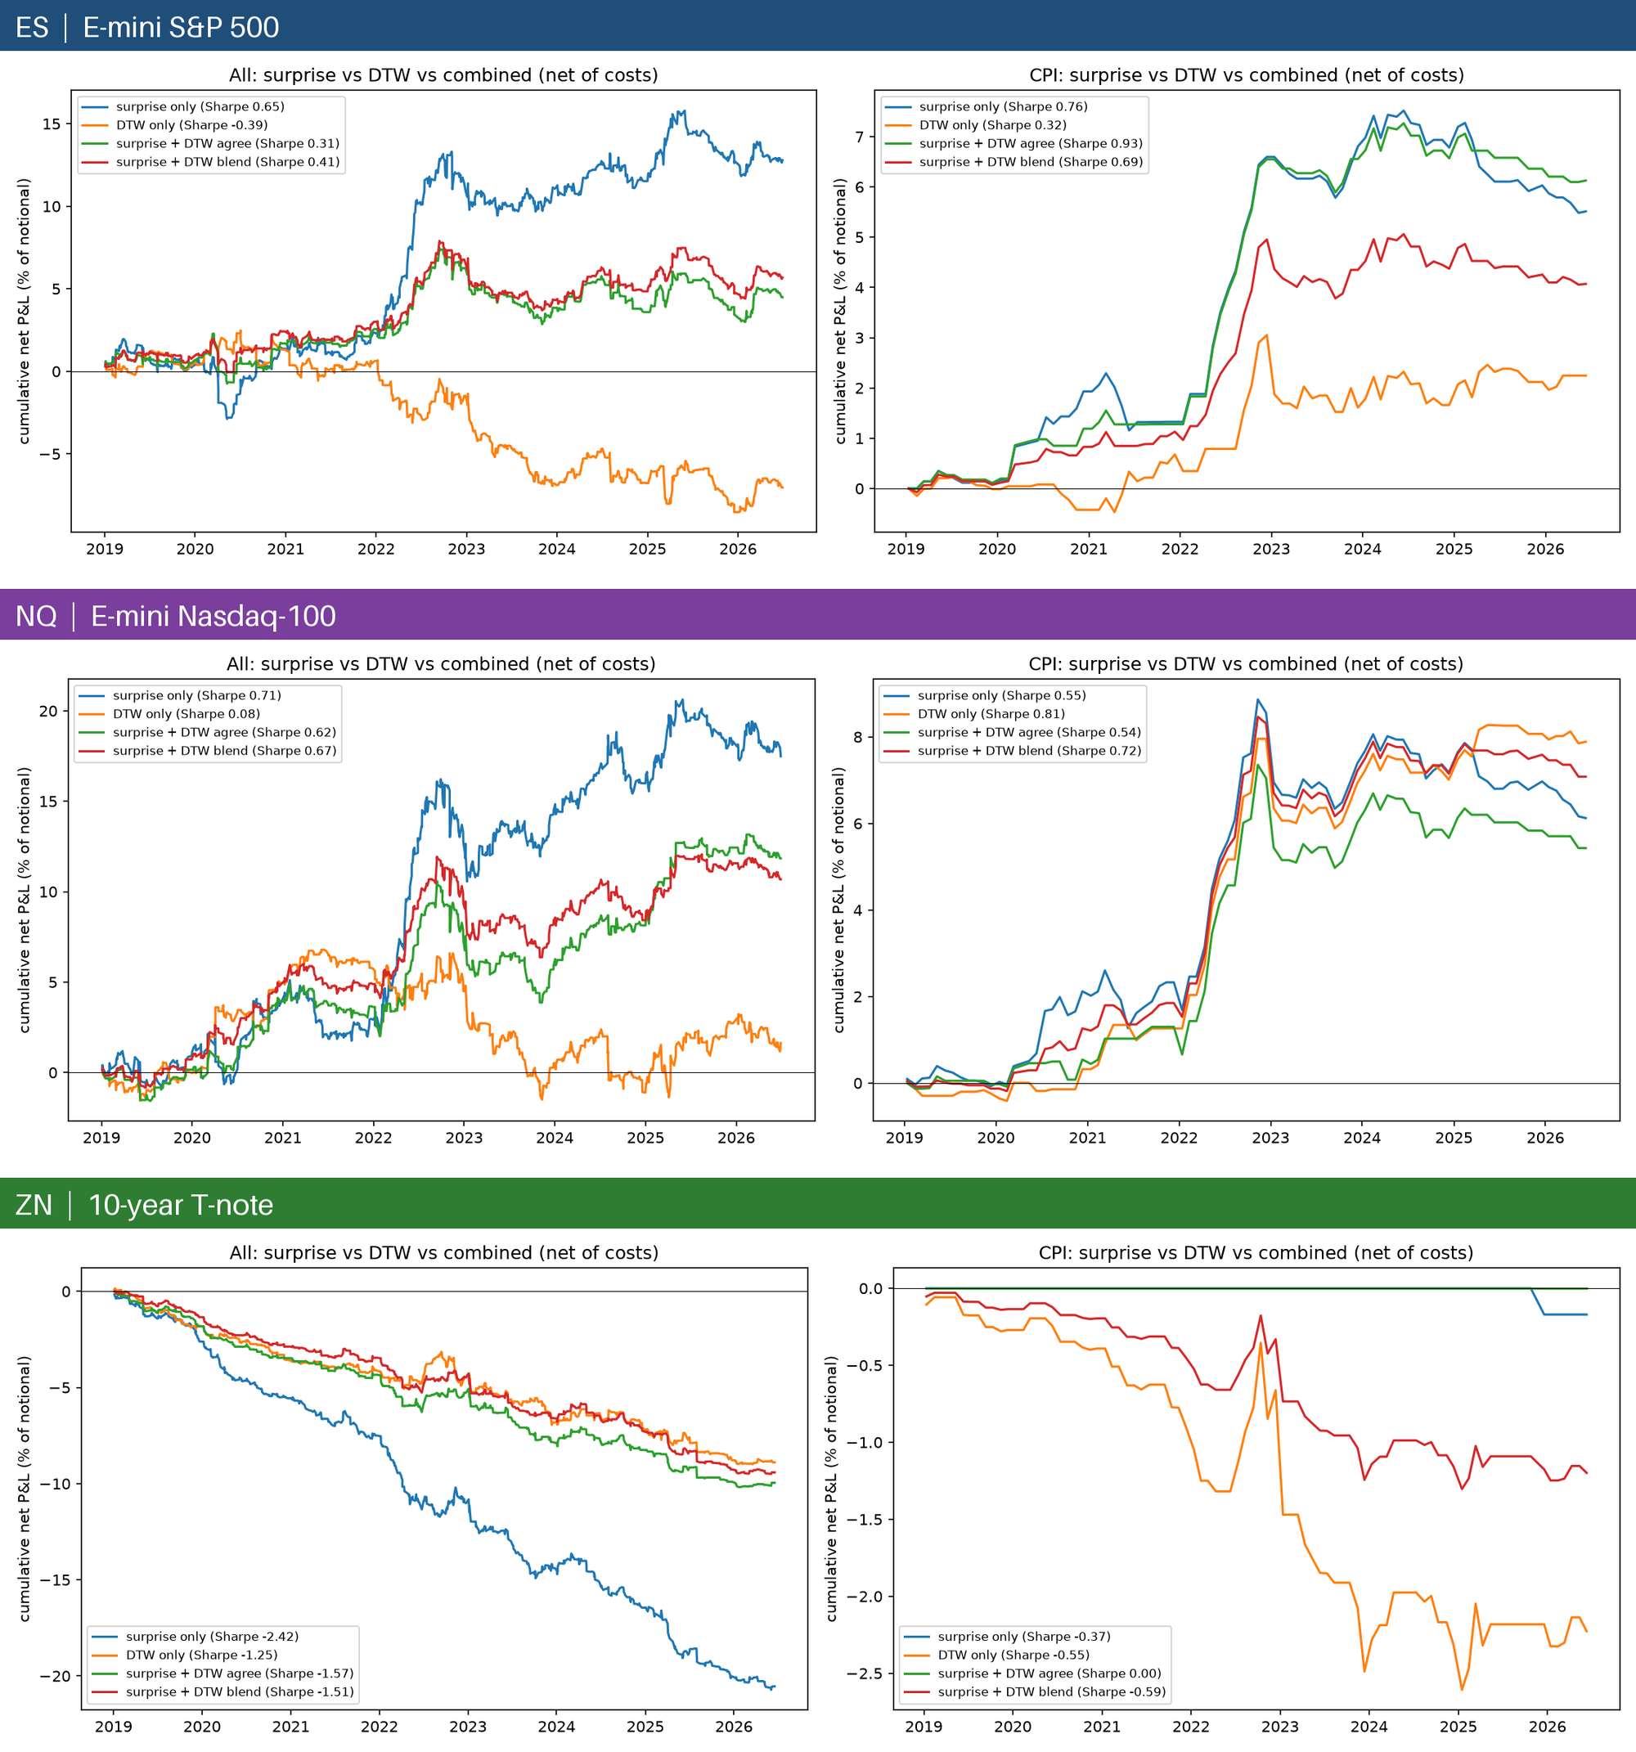
RQ6 · Surprise vs DTW over time
Figure 27 · ~10 releases (left panels) and CPI (right panels)
ES: surprise only rises in steps (mostly 2022); DTW only is flat until 2022, then falls to about −7%
NQ: DTW only rises in 2019–2022, then gives it all back from 2023, a pattern that does not persist
YM is the exception: agree and blend beat surprise only (0.94 and 1.06 vs 0.68)
CPI: the four lines move together; the differences are small and point in different directions in ES and NQ
ZN: every line falls almost linearly (the cost); the surprise line falls fastest because it trades most
UC Berkeley Haas · MFE · BlackRock industry project
25
Notes:
The time paths confirm the Sharpe comparison. DTW never adds a persistent edge; in NQ it looked promising for three years and then reversed.

Slide 26
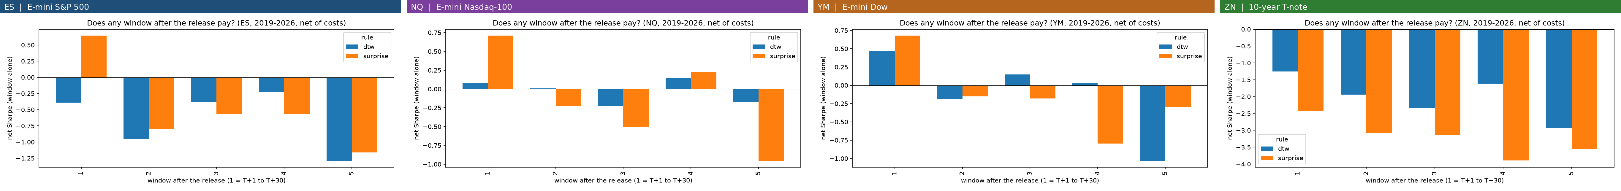
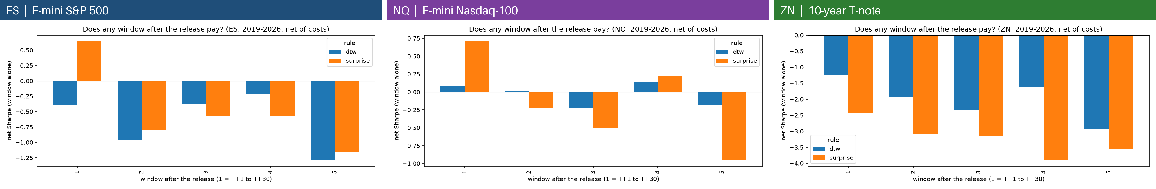
RQ6 · More windows add trades, not profit
Trades/yr, Sharpe | ES | NQ | YM
Surprise, window 1 only | 98, +0.65 | 97, +0.71 | 93, +0.68
Surprise W1 + DTW W2–5 | 348, −0.75 | 342, +0.27 | 329, 0.00
Surprise ladder (5 windows) | 490, −1.00 | 484, −0.29 | 463, −0.34
DTW ladder (5 windows) | 314, −1.23 | 309, −0.07 | 298, −0.23
Peer DTW slide (ES) | 185, +0.61 | — | —
Five windows after each release (peer structure)
Surprise rank IC: 0.14 in window 1 (ES), ≈ 0 in windows 2–5
The ceiling is ~100 trades a year per market at one trade per release
The right way to trade more is more markets with a drift, not more windows
UC Berkeley Haas · MFE · BlackRock industry project
26
Notes:
Copying the peer's five-window ladder takes the trade count well above 185, but every extra window loses money in ES and dilutes the edge in NQ. The surprise's information is used up in the first 30 minutes.

Slide 27
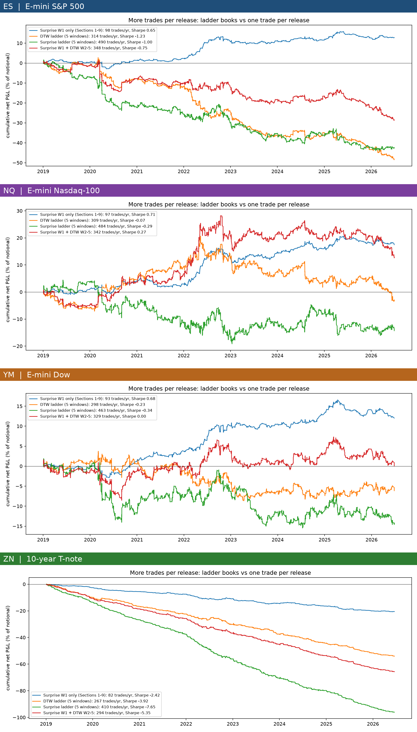
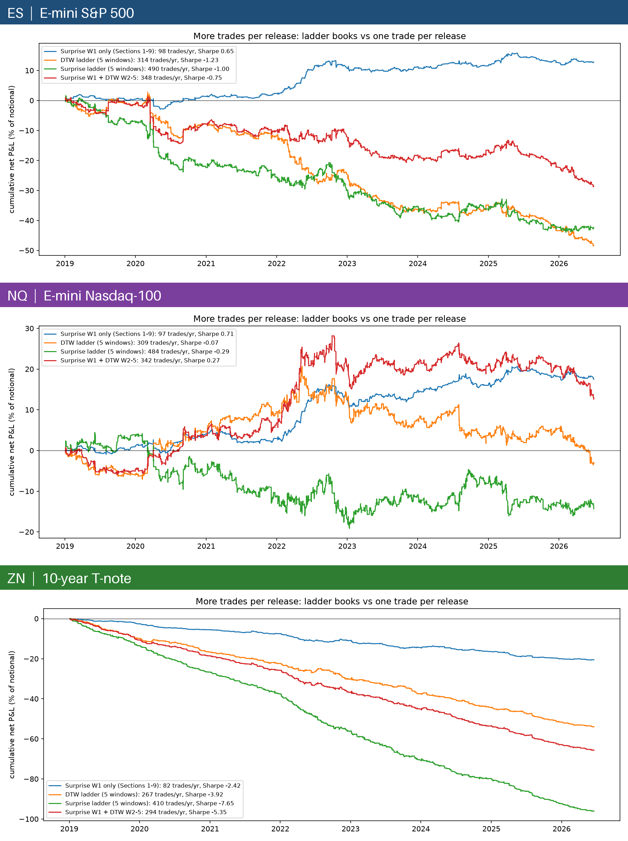
RQ6 · Ladder books: turnover and cost, not profit
+12.8%
−29% to −48%
ES window 1 only: the only ES book that ends positive
ES ladder books over 2019–2026
Figure 29 · three ladder books vs window 1 only
ES: each extra window adds about 1–2 bps of cost with no edge
NQ: cost below 1 bp, so 'surprise W1 + DTW W2–5' ends +12.9%, still below window 1 alone (+17.5%) with a drawdown three times larger
YM: window 1 alone +12.0%, ladder books −14% to 0%. ZN: the ladder books lose 54% to 96% of notional
More windows per release add turnover and cost, not profit
UC Berkeley Haas · MFE · BlackRock industry project
27
Notes:
Cumulative P&L of the ladder books. In ES every book with extra windows falls steadily; in NQ, with its low cost, one ladder book survives but is worse than trading window one alone; in ZN they collapse.

Slide 28
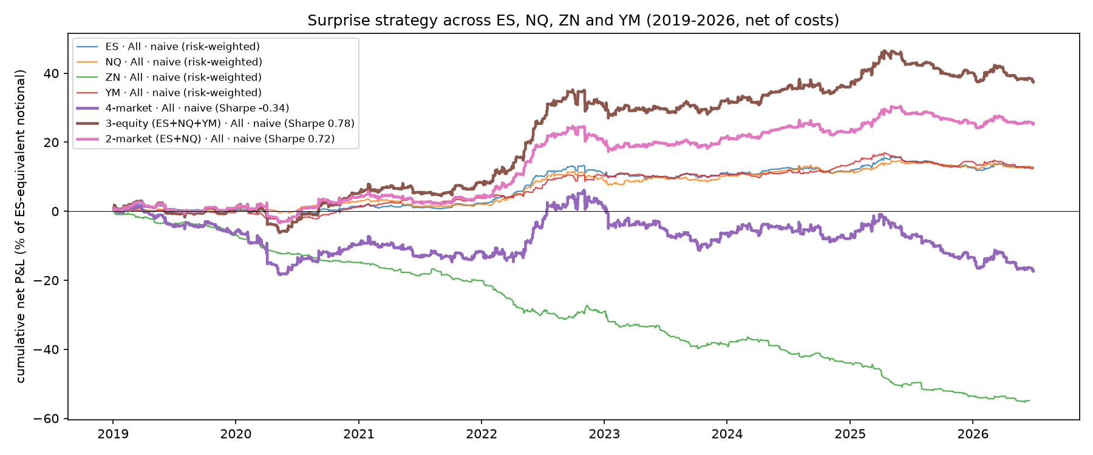
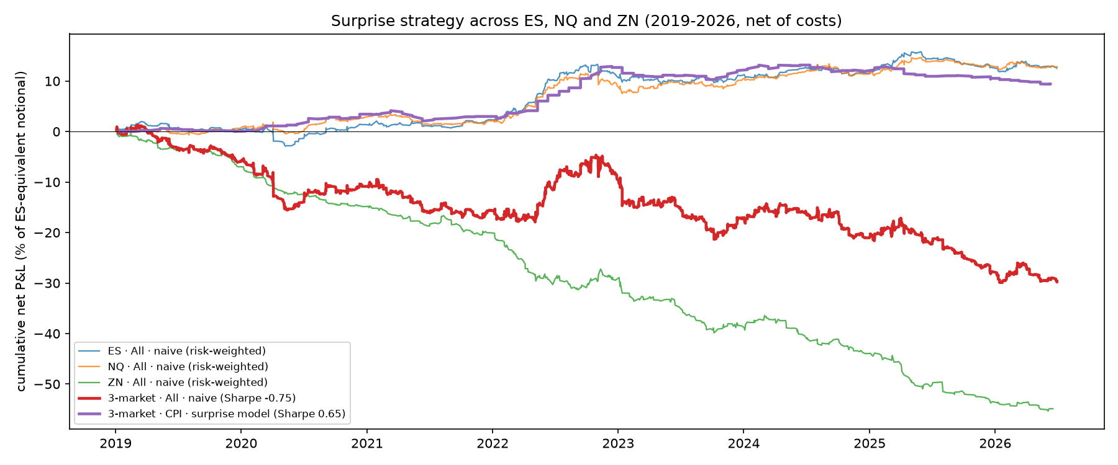
RQ7 · ES + NQ + YM combine well; ZN destroys the portfolio
Notebooks 07 and 07b: equal-risk weights from history only (ES 1.00, NQ 0.71, YM 1.02, ZN 2.67)
288
0.78
trades a year, ES + NQ + YM (195 for ES + NQ)
net Sharpe (1.10 at ¼ tick); ES + NQ 0.72
+38%
−0.34
total net P&L, 2019–26
Sharpe with ZN added (4 markets)
YM diversifies: its book correlates 0.66 with ES and 0.43 with NQ. ZN has no drift and gets the largest risk weight.
UC Berkeley Haas · MFE · BlackRock industry project
28
Notes:
Combining ES and NQ gives about 195 trades a year, a Sharpe of 0.72 and 25 percent total return, above the peer strategy's trade count with a higher Sharpe. Adding ZN turns the portfolio negative: it has no edge and, being low-volatility, receives the largest risk weight.

Slide 29
RQ7 · The team's four workstreams at equal costs
Notebooks 08 and 08b: each person's own trades re-priced on the same window (2019–2026) and Sharpe method
Takeaways
300+ trade-a-year DTW books are positive only at ¼ tick
Surprise-based books survive realistic costs
Reza ES+NQ+YM: highest Sharpe at ¼ tick (1.10) and highest total return at every cost
Jack's rebuild (310 tr/yr, 0.16) is an approximation, not his slide
UC Berkeley Haas · MFE · BlackRock industry project
29
Notes:
Once costs and the window are equal, the surprise-based books are the most robust. The high-turnover DTW strategies are positive only at a quarter tick per side. Aaryen's executable classifier has a similar Sharpe at our cost but far fewer trades and a much smaller total return. Our rebuild of Jack's strategy does not reproduce his slide, so it is an approximation.

Slide 30
RQ7 · Surprise vs the team's DTW book, on identical terms
combined/surprise_dtw_book.py: Jack Duncan's data, test years 2021–2026, costs and metrics · Sharpe at ¼ tick per side
Same terms
Shared: Jack's cleaned bars, contract specs, session grid, buy-and-hold, metrics and equal-risk combined book
Test years 2021–2026; validation 2018–2020
Different by design: one 30-min window at T+1 (vs a five-window ladder); walk-forward refit each year from 2013
Book | ES | NQ | ZN | All 3 | ES+NQ | ES trades
DTW book (Jack, 5 windows) | 0.21 | 0.41 | −0.85 | −0.19 | – | 1,443
Surprise, top-10 releases | 1.09 | 0.75 | −0.16 | 0.84 | 1.00 | 527
CPI surprise model | 0.51 | 0.46 | 0.17 | 0.47 | 0.49 | 62
Surprise + DTW agree | 0.37 | 0.48 | 0.12 | 0.45 | 0.48 | 271
CPI + DTW agree | 0.74 | 0.58 | 0.48 | 0.72 | 0.68 | 44
DTW only (Reza, 1 window) | −0.26 | −0.28 | 0.19 | −0.23 | −0.32 | 356
The surprise direction beats the DTW book in both equity markets and in the combined book, with about a third of the trades
ZN fails at any real cost in both workstreams: one tick is large next to its 30-minute moves
UC Berkeley Haas · MFE · BlackRock industry project
30
Notes:
This comparison runs my surprise books inside Jack's combined folder, on his cleaned data, his test years, his cost levels and his metric definitions, so the rows are directly comparable. At a quarter tick per side, the simple surprise book on the top ten releases has a Sharpe of 1.09 on ES and 0.75 on NQ, against 0.21 and 0.41 for the DTW book, with about a third of the trades. On ZN neither approach survives costs. Adding DTW to the surprise, either as a filter or on its own, does not improve the result in the test years. The CPI plus DTW row looks good but rests on about seven trades a year.

Slide 31
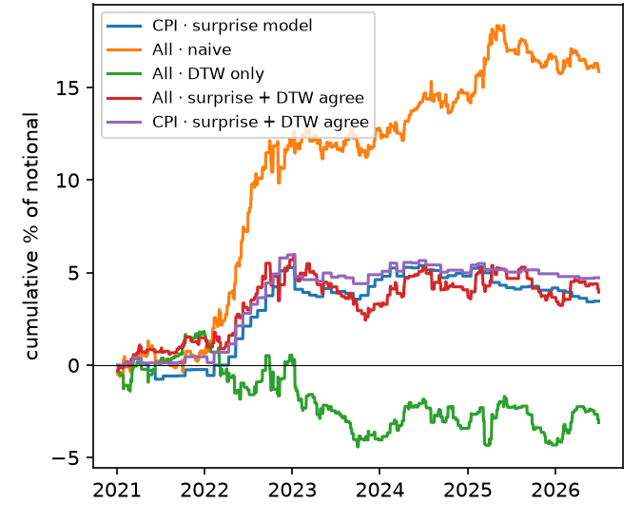
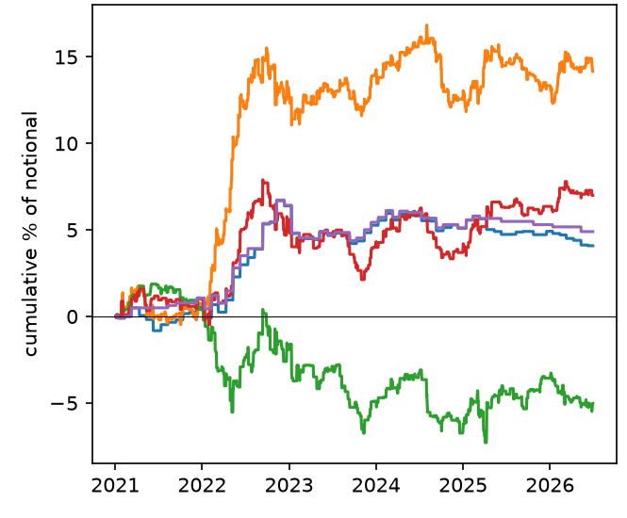
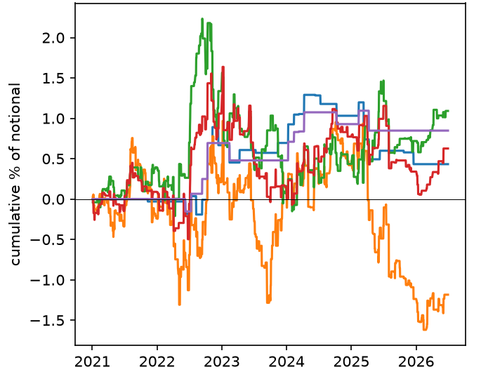
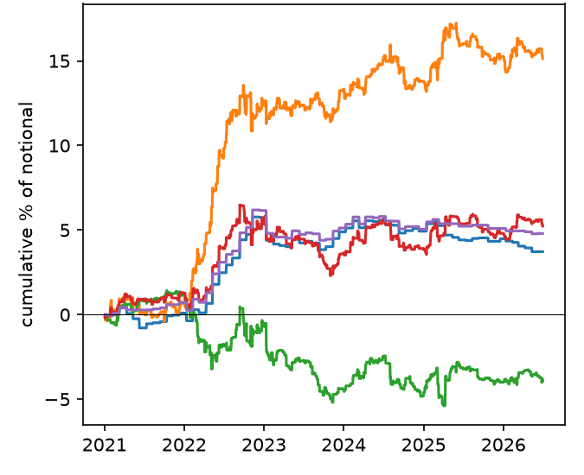
Adding DTW and its effect on the results
ES · E-mini S&P 500
NQ · E-mini Nasdaq-100
ZN · 10-year T-note
ES + NQ · equal risk
CPI surprise model
Surprise, top-10 releases
DTW only
Surprise + DTW agree
CPI + DTW agree
Cumulative % of notional, ¼ tick per side, test years 2021–2026 (combined/surprise_dtw_book.py)
Sharpe, ¼ tick | ES 18–20 | ES 21–26 | NQ 18–20 | NQ 21–26
Surprise, top-10 releases | 1.04 | 1.09 | 0.86 | 0.75
DTW only | 0.57 | −0.26 | 0.78 | −0.28
Surprise + DTW agree | 1.46 | 0.37 | 1.21 | 0.48
Effect of adding DTW
On its own (green), DTW loses in ES and NQ in 2021–2026 after working in 2018–2020: the same sign flip Jack found in dtw_dir
As a filter on the surprise (red), it halves the trades and cuts the Sharpe from 1.09 to 0.37 (ES) and 0.75 to 0.48 (NQ)
ZN: nothing survives costs; the surprise book (orange) ends negative
Most of the surprise book's gain came in 2022
Validation 2018–2020 vs test 2021–2026, both walk-forward out of sample.
UC Berkeley Haas · MFE · BlackRock industry project
31
Notes:
This slide shows what adding DTW does to the results in each market. The orange line is the plain surprise book; it climbs in ES, NQ and the ES plus NQ book, most of it in 2022. The green line is DTW on its own: it worked in the validation years but lost money in the test years in both equity markets, the same sign flip Jack found in his own DTW factor. The red line keeps a surprise trade only when DTW agrees: it trades about half as often and ends well below the plain surprise book. On ZN nothing survives costs. So adding DTW, as a signal or as a filter, does not improve the surprise strategy out of sample. Caveats: much of the gain is from 2022, and the constants were chosen while looking at these years.

Slide 32
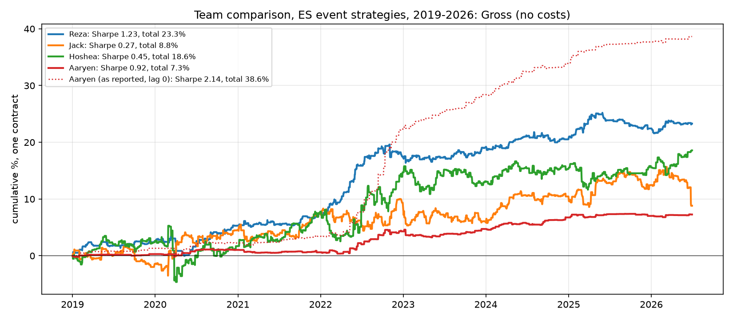
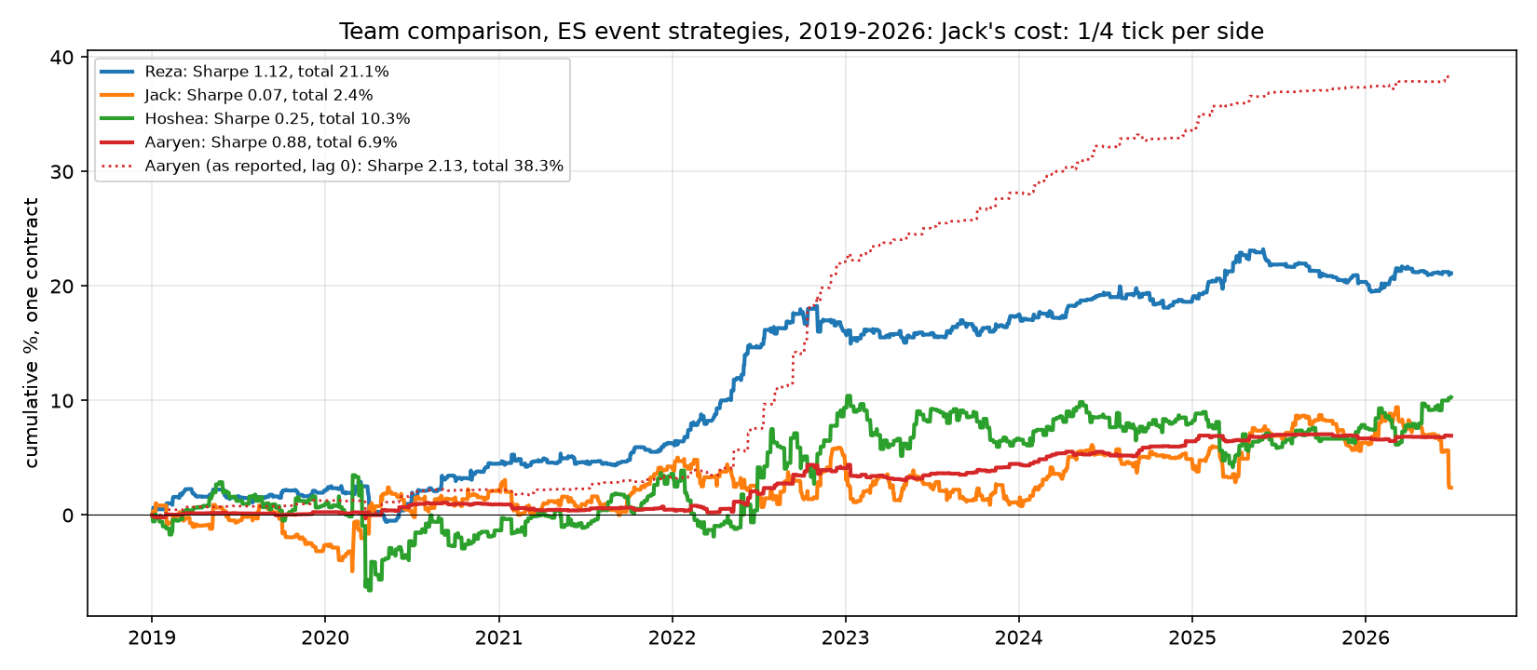
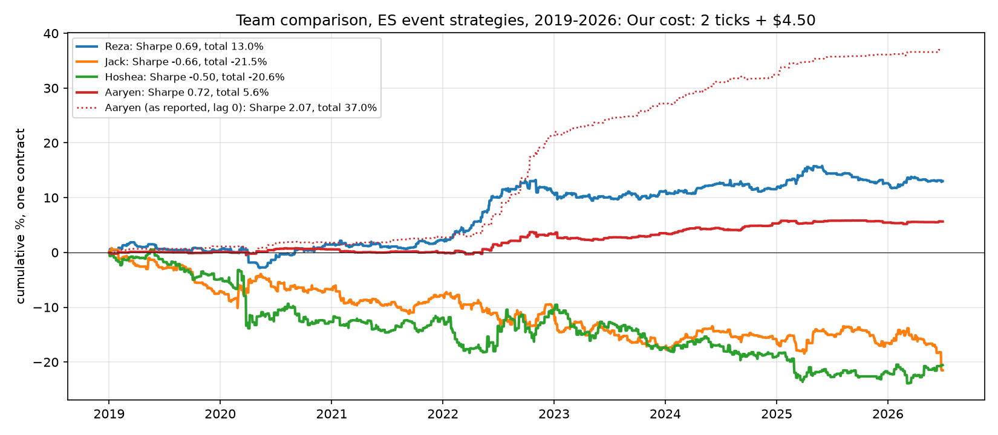
RQ7 · All four workstreams, three cost levels
Figure 33 · Gross (no costs)
Figure 34 · Jack's cost: ¼ tick per side
Figure 35 · Our cost: 2 ticks + $4.50
Sharpe / total | Gross | ¼ tick | 2 ticks+$4.50
Reza (ES all) | 1.23 / 23.3% | 1.12 / 21.1% | 0.69 / 13.0%
Reza (ES+NQ+YM) | 1.17 / 56.9% | 1.09 / 53.2% | 0.78 / 37.8%
Jack (rebuild) | 0.27 / 8.8% | 0.07 / 2.4% | −0.66 / −21.5%
Hoshea | 0.45 / 18.6% | 0.25 / 10.3% | −0.50 / −20.6%
Aaryen (exec.) | 0.92 / 7.3% | 0.88 / 6.9% | 0.72 / 5.6%
Aaryen (reported) | 2.14 / 38.6% | 2.13 / 38.3% | 2.07 / 37.0%
Only the surprise books stay positive at our cost; the DTW books fall to about −20%.
UC Berkeley Haas · MFE · BlackRock industry project
32
Notes:
One headline book per person, at three cost levels. Only the surprise-based books keep a positive return at realistic costs; the high-turnover DTW books need very low costs.

Slide 33
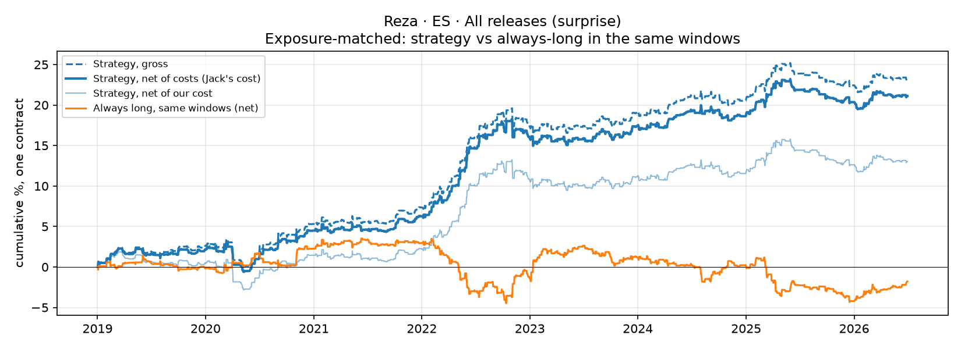
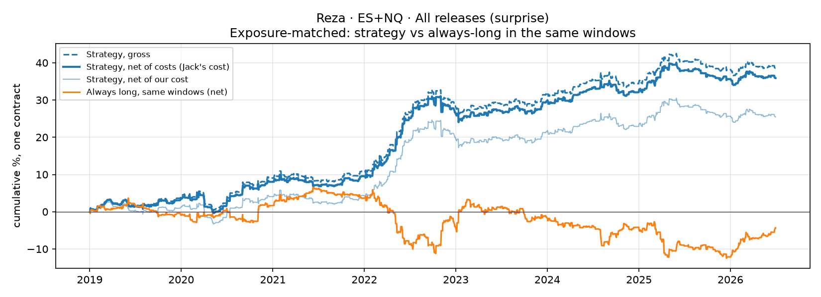
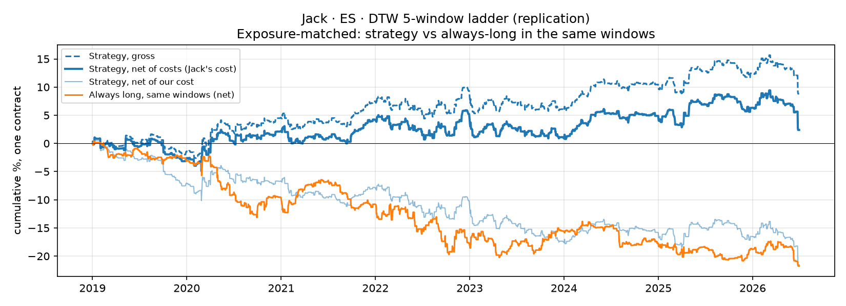
RQ7 · Each workstream in the peer slide format (1/2)
Figure 36 · Reza, ES all releases
Figure 37 · Reza, ES + NQ all releases
Figure 38 · Jack, DTW ladder (rebuild)
¼ tick per side | Reza ES | Reza ES+NQ | Reza ES+NQ+YM | Jack (rebuild)
Total % | 21.1 | 35.9 | 53.2 | 2.4
Daily Sharpe | 1.12 | 1.06 | 1.09 | 0.07
Max drawdown | −3.7% | −7.0% | −8.3% | −7.0%
Trades / yr | 98 | 195 | 288 | 315
Always long, same windows | −1.8% | −4.3% | −9.8% | −21.7%
Jack's own slide (his data, 2018–26): 185 trades/yr, Sharpe 0.61, 18.6%. Our rebuild is an approximation.
UC Berkeley Haas · MFE · BlackRock industry project
33
Notes:
The same slide format the DTW team uses, applied to each workstream. The ES plus NQ surprise book reaches 36 percent at the peer's cost with twice the trade count of ES alone.

Slide 34
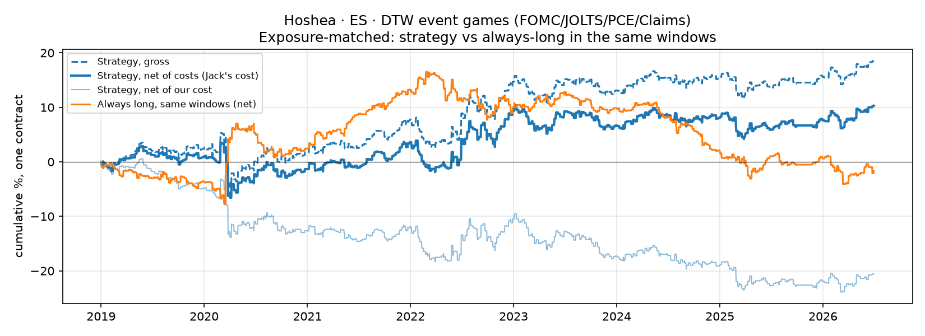
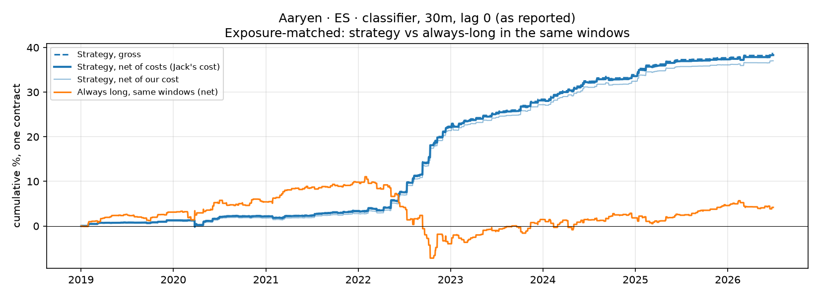
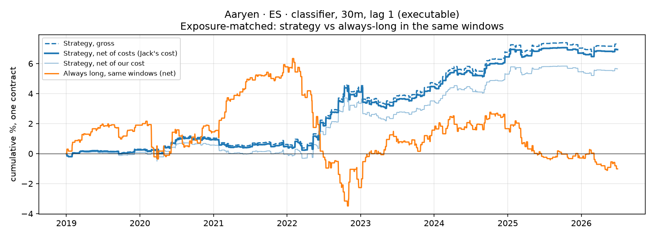
RQ7 · Each workstream in the peer slide format (2/2)
Figure 39 · Hoshea, DTW event games
Figure 40 · Aaryen, classifier, as reported (entry at pre-release price)
Figure 41 · Aaryen, classifier, executable (entry 1 min later)
¼ tick per side | Hoshea | Aaryen reported | Aaryen exec.
Total % | 10.3 | 38.3 | 6.9
Daily Sharpe | 0.25 | 2.13 | 0.88
Max drawdown | −10.1% | −1.5% | −1.4%
Trades / yr | 372 | 55 | 55
Always long, same windows | −1.7% | +4.2% | −1.0%
Same positions, entry one minute apart: 38.3% → 6.9%. ~80% of the reported profit is the first-minute jump.
UC Berkeley Haas · MFE · BlackRock industry project
34
Notes:
Hoshea's DTW factor is positive only at very low costs because it trades over 370 times a year. Aaryen's classifier looks exceptional when it enters at the pre-release price; with an executable entry it is a solid but much smaller result.

Slide 35
The decisive assumption: when you enter
Aaryen's 30-minute classifier, identical positions, entry moved by one minute
2.1 → 0.9
Sharpe: entry at the pre-release price vs one minute after the release
38.6% → 7.3%
Gross total return: ~80% of the reported profit is the first-minute jump
Report every strategy with an executable entry and at two cost levels. These choices change Sharpe ratios more than any model choice.
UC Berkeley Haas · MFE · BlackRock industry project
35
Notes:
Entry timing explains the largest difference in the team's reported numbers. Entering at the price before the release captures the jump, which no real strategy can do. Moving the entry by one minute removes about 80 percent of the classifier's profit. Jack's own rebuild found the same.

Slide 36
Discussion: why equities and not bonds?
1
Interpretation takes time
2
Liquidity returns gradually
A CPI print maps into yields almost mechanically; for equities investors must also judge growth, margins and risk premia. NQ (long duration) drifts most; YM behaves like a slightly smaller ES.
Order books thin out at the release and refill over minutes: part of the drift is price discovery.
3
Bonds move first
4
Cost relative to move
Treasury futures price rate news directly and fastest; by T+1 the move is complete.
ZN: 3 bps cost vs 10 bps average CPI drift, 0.8 bps predictable. ES/NQ/YM: 1.7 / 0.7 / 1.0 bps vs 18–26 bps.
UC Berkeley Haas · MFE · BlackRock industry project
36
Notes:
Four explanations fit the evidence. Equities need more interpretation than bonds, liquidity returns over minutes, Treasury futures are the first mover for rate news, and ZN's cost is large relative to its post-release moves.

Slide 37
Final comparison of the three model families
Model family | Best result (net, 2019–2026) | Verdict
Surprise only | CPI ≈1.0 (ES, NQ, YM); 10 releases 0.65 (ES), 0.71 (NQ), 0.68 (YM); ES+NQ+YM 0.78 at 288 trades/yr | Recommended
Surprise + State | CPI 0.77 (ES), 0.75 (NQ), 0.83 (YM) | Worse out of sample; use state for risk sizing
Surprise + Pattern (DTW) | 0.31–0.41 (ES), 0.62–0.67 (NQ), 0.94–1.06 (YM, n.s.) | Worse in ES and NQ; unconfirmed gain in YM
Five-window ladder | −0.75 to −1.23 (ES) | Adds only losing trades
Any ZN strategy | −0.3 to −2.4 | Not tradeable at realistic costs
Only the macro surprise in the first 30 minutes after a release, in equity-index futures, gives a robust, tradeable directional edge.
UC Berkeley Haas · MFE · BlackRock industry project
37
Notes:
Across the three model families and three markets, only the macro surprise in equity-index futures survives. State and DTW both lower out-of-sample performance, more windows add losing trades, and ZN is not tradeable.

Slide 38
Recommendations
1
Trade rule
2
Two-leg book
Enter at the close of the first post-release minute, exit at T+30; sign of the family surprise; no DTW, no extra windows
CPI core leg (surprise model or signal × vol) + multi-release naive leg on ES, NQ and YM (~290 trades/yr)
3
Risk, not direction
4
Clean universe
Scale position size by expected move (20-day vol, drawdown); stops in units of expected move
Drop families with no real surprise (FOMC, IORB); fix one CPI definition; skip |z| < 0.5
5
Regime scaling
6
Execution & monitoring
Raise exposure when macro data drive policy expectations (e.g. CPI–2y yield correlation)
Paper-trade 3–6 months; limit orders; rolling IC and Sharpe with pre-set stop rules
UC Berkeley Haas · MFE · BlackRock industry project
38
Notes:
Six recommendations, from the trade rule to governance. The most important caveat is execution: the ES multi-release book loses most of its edge above 4 ticks, so paper trading with real fills comes before capital.

Slide 39
Future work
Fixed CPI definition
Pre-register one definition and a |z| threshold; test on 2026+ hold-out
Order-book execution
Level-2 data to measure fills; entries at 10–60 seconds
Live paper trading
Machine-readable release feed; measure latency and slippage
More equity markets
RTY, Euro Stoxx 50, Nikkei around US releases (YM done: it works)
Short-rate markets
2-year Treasury (ZT), SOFR futures: is there a drift?
Volatility forecasting
State and DTW dispersion for sizing, stops, options
Richer surprises
Revisions, forecast dispersion, market-implied expectations
Longer sample
Back to 2000 across monetary-policy regimes
UC Berkeley Haas · MFE · BlackRock industry project
39
Notes:
Eight directions, detailed in the report: a fixed CPI definition, realistic execution, live paper trading, more equity markets, short-rate markets, volatility forecasting, richer surprise information and a longer sample.

Slide 40
Thank you
Benjamin Steel (BlackRock) proposed the research question and supervised the project.
Ian Kaufman and Chris Pohalski (UC Berkeley Haas, MFE program) coordinated the partnership with BlackRock and the project meetings.
Jack Duncan, Hoshea Zeng and Aaryen Mehta for the DTW strategies, release screening and surprise classification credited throughout.
Code, notebooks, results, papers and the full report: github.com/rezazamani2329/BlackRock-Project-State-Dependent-Intraday-Response-of-S-P-500-Futures-to-Macroeconomic-Surprises · team code: github.com/jack-duncan/blackrock-intraday
Student industry project. Views are the authors' own and do not represent BlackRock or UC Berkeley. Not investment advice.
UC Berkeley Haas
Notes:
Thank the supervisor, the program coordinators and the teammates. Questions.

