Slide 1
BlackRock industry project · UC Berkeley Haas MFE
Team Results: Macro Surprises and DTW on Equal Terms
Four workstreams, four futures markets (ES, NQ, YM, ZN), one set of data, entry rules and costs
Team: Jack Duncan, Hoshea Zeng, Aaryen Mehta, Reza Zamani (UC Berkeley MFE)
Supervisor: Benjamin Steel, BlackRock
Sources: notebooks 08 and 08b (sections 9–10) · combined/surprise_dtw_book · combined/team_book

Slide 2
What this deck covers
Team comparison at equal costs
slides 4–6
A
Notebook 08, sections 9–10: each person's own book re-priced on one window (2019–2026) and one Sharpe method, at three cost levels
Surprise and surprise + DTW books
slides 7–8
B
combined/surprise_dtw_book: the macro-surprise strategies run on the combined DTW book's data, years, costs and metrics
Team book
slides 9–12
C
combined/team_book: all four workstreams on the same terms, on every market where they exist, combined into team portfolios
Slide 13: conclusions
UC Berkeley Haas · MFE · BlackRock industry project
2
Notes:
Three parts. First, the equal-cost comparison from notebook 08. Second, the surprise and surprise plus DTW books run inside the combined folder on Jack's terms. Third, the team book, which puts all four workstreams on the same terms and combines them.

Slide 3
Four workstreams, one set of rules
Strategy | Built by | Direction from | Markets | Trades / yr (ES)
Macro-surprise book | Reza | consensus surprise, top-10 releases + CPI | ES · NQ · YM · ZN | ~96
CPI surprise model | Reza | predicted CPI move, if above cost | ES · NQ · YM · ZN | ~11
DTW ladder book | Jack | DTW price-path analogues, 5 windows | ES · NQ · YM · ZN | ~310
DTW event-game book | Hoshea | DTW factor on Claims, JOLTS, PCE | ES | ~370
Machine-learning classifier | Aaryen | walk-forward classifier, 30 min | ES | ~54
The same terms for everyone
Jack's cleaned 1-minute bars, roll jumps removed
Entry only after the release is public (T+1)
Costs: gross, ¼ tick, ½ tick per side, and 2 ticks + $4.50
Walk-forward; validation 2018–20, test 2021–26
Metrics: daily bps, Sharpe over 252 days, max drawdown
Each person's own positions are kept; only returns, costs and scoring are recomputed. Hoshea's and Aaryen's work exists on ES only. YM (E-mini Dow) was added after the ES and NQ results were known.
UC Berkeley Haas · MFE · BlackRock industry project
3
Notes:
Five strategies from four people. Only the macro-surprise, CPI and DTW ladder books exist on all three markets. Everything is rescored on the same bars, entry, costs and metrics, so the rows are comparable.

Slide 4
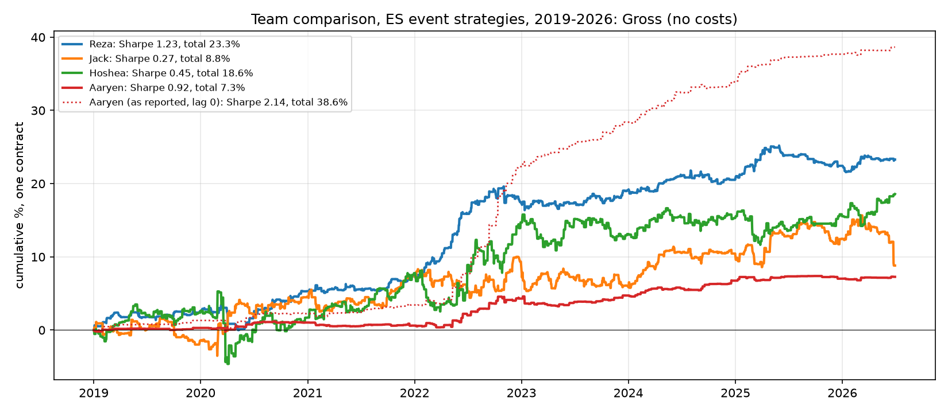
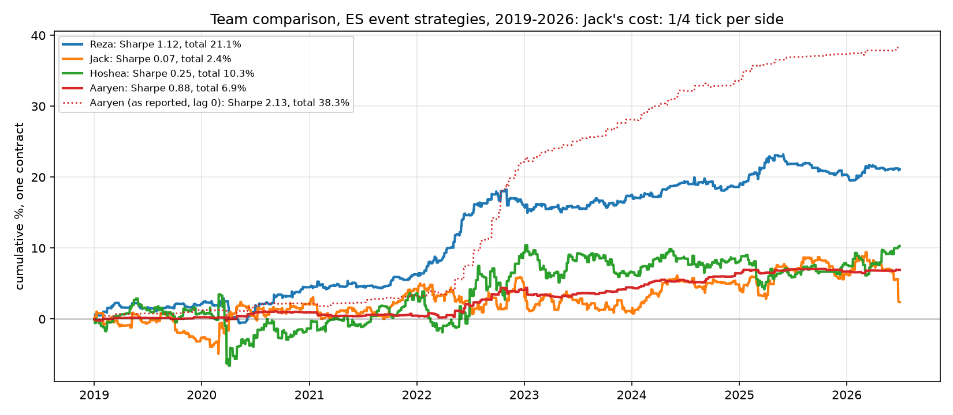
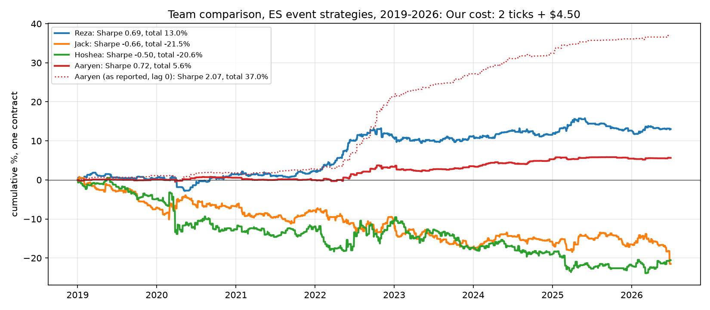
NOTEBOOK 08 · SECTION 10 · 2019–2026
A · Four workstreams at three cost levels
Gross (no costs)
¼ tick per side (Jack's cost)
2 ticks + $4.50 (our cost)
Sharpe / total | Gross | ¼ tick | 2 ticks + $4.50
Reza (ES, all releases) | 1.23 / 23.3% | 1.12 / 21.1% | 0.69 / 13.0%
Jack (rebuild) | 0.27 / 8.8% | 0.07 / 2.4% | −0.66 / −21.5%
Hoshea | 0.45 / 18.6% | 0.25 / 10.3% | −0.50 / −20.6%
Aaryen (executable) | 0.92 / 7.3% | 0.88 / 6.9% | 0.72 / 5.6%
Aaryen (as reported) | 2.14 / 38.6% | 2.13 / 38.3% | 2.07 / 37.0%
Only the surprise and classifier books keep a positive return at our cost.
UC Berkeley Haas · MFE · BlackRock industry project
4
Notes:
Section 10 of notebook 08. One headline book per person on the same window and Sharpe method, at three cost levels. The high-turnover DTW books turn from positive to about minus 20 percent as the cost rises. Aaryen's as-reported line includes the first-minute jump, which cannot be traded.

Slide 5
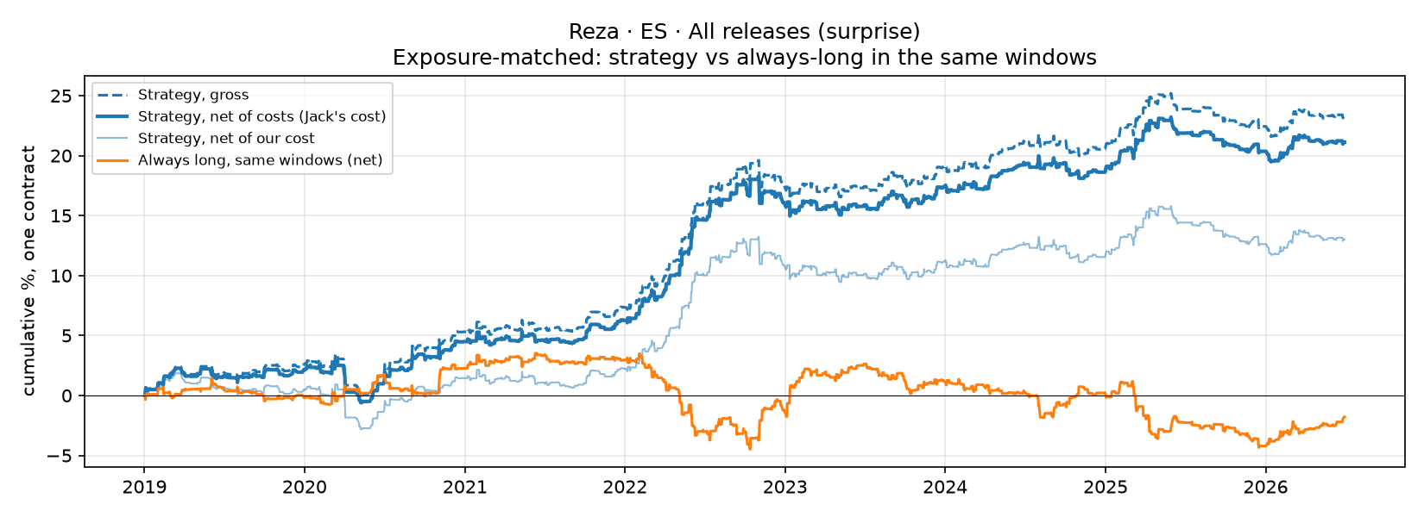
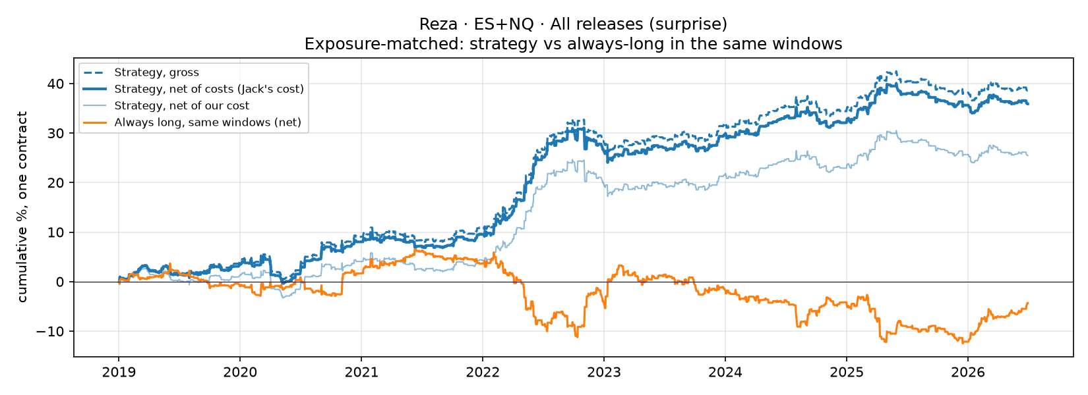
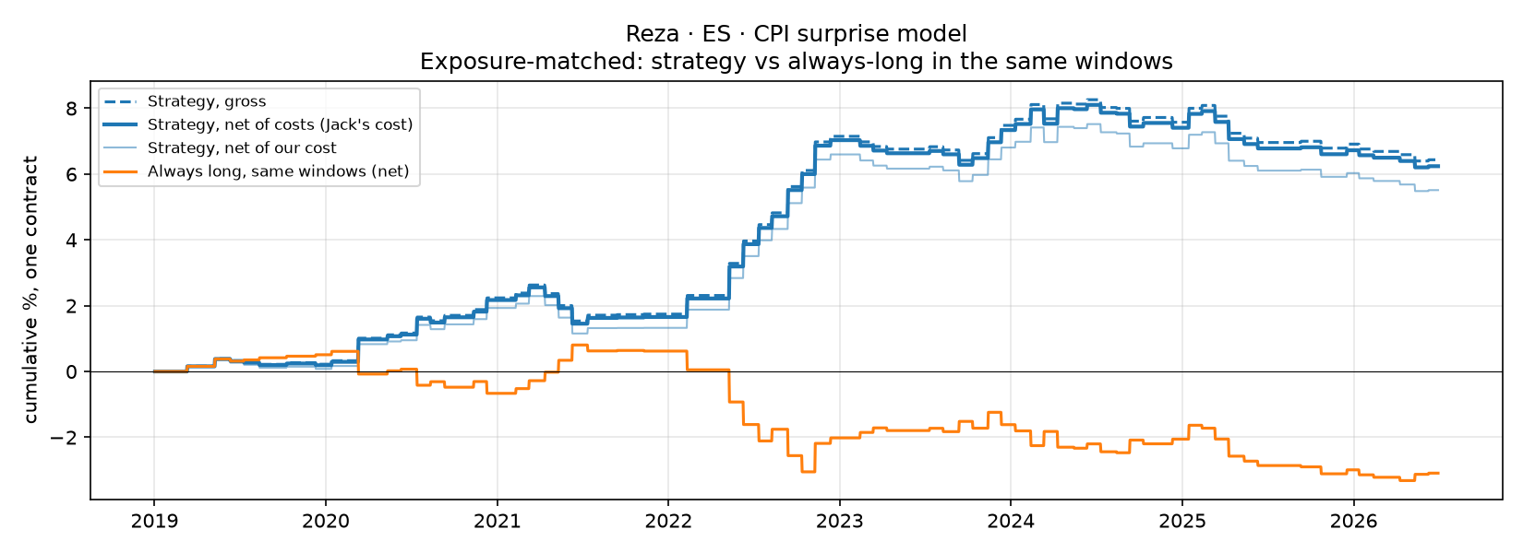
NOTEBOOK 08 · SECTION 9 · ¼ TICK PER SIDE · 2019–2026
A · Each workstream in the peer slide format (1/2)
Reza · ES · all releases (surprise)
Reza · ES + NQ · all releases (surprise)
Reza · ES · CPI surprise model
¼ tick per side | ES all | ES + NQ | ES CPI
Total % | 21.1 | 35.9 | 6.2
Sharpe | 1.12 | 1.06 | 0.84
Max drawdown | −3.7% | −7.0% | −1.9%
Trades / yr | 98 | 195 | 9
Always long, same windows | −1.8% | −4.3% | −3.1%
Solid: net; dashed: gross; orange: always long in the same windows.
UC Berkeley Haas · MFE · BlackRock industry project
5
Notes:
Section 9 shows each book in the format the DTW team used for their own slides: the strategy net and gross against being always long in exactly the same windows. The surprise books make money while always-long in the same windows loses, so the profit comes from direction, not from being in the market.

Slide 6
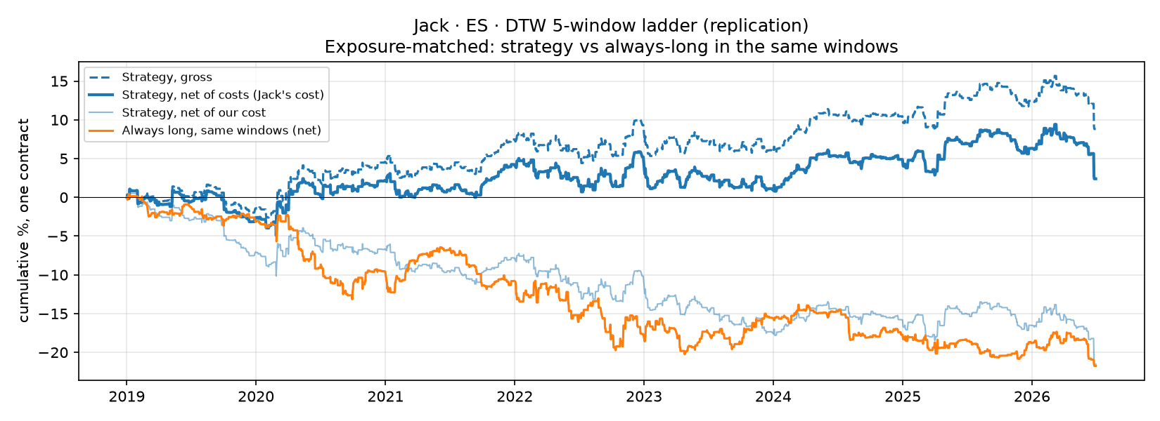
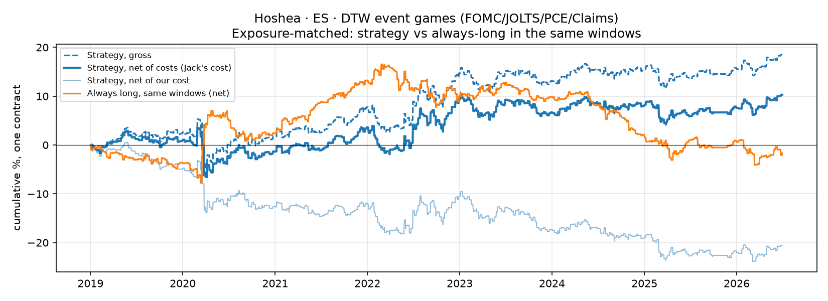
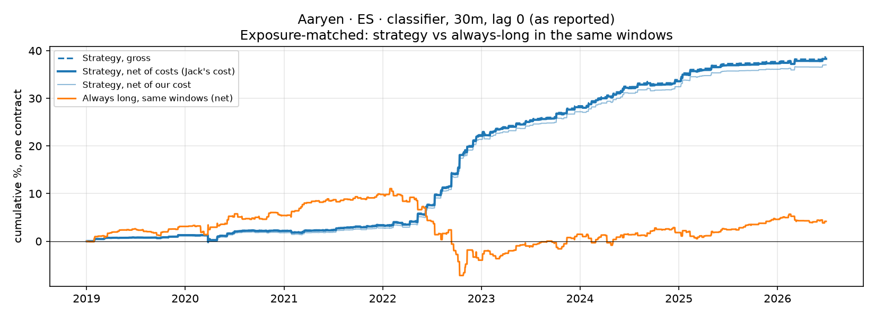
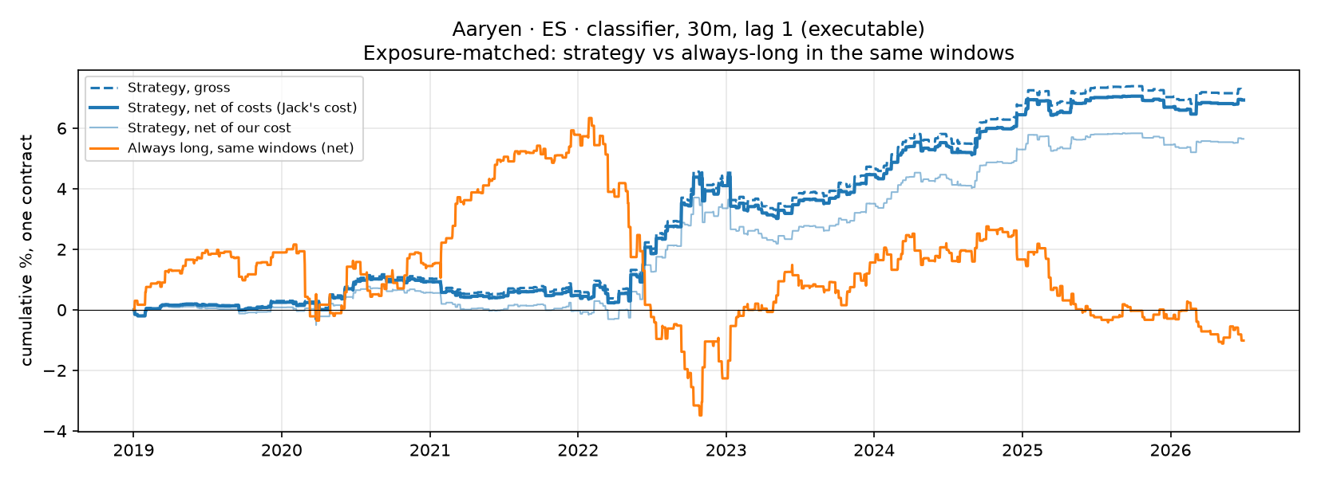
NOTEBOOK 08 · SECTION 9 · ¼ TICK PER SIDE · 2019–2026
A · Each workstream in the peer slide format (2/2)
Jack · DTW ladder (rebuild): +2.4%, Sharpe 0.07, 315 trades/yr
Hoshea · DTW event games: +10.3%, Sharpe 0.25, 372 trades/yr
Aaryen · classifier, as reported: +38.3%, Sharpe 2.13 (not tradeable)
Aaryen · classifier, executable: +6.9%, Sharpe 0.88, 55 trades/yr
UC Berkeley Haas · MFE · BlackRock industry project
6
Notes:
The other three workstreams in the same format. The DTW books trade over 300 times a year with a small edge per trade. Aaryen's classifier looks exceptional when it enters at the price before the release; with the same positions entered one minute later it is a solid but much smaller result.

Slide 7
B · Surprise books on the combined book's terms
combined/surprise_dtw_book · Sharpe at ¼ tick per side · test years 2021–2026
Same terms as the DTW book
Jack's cleaned bars, costs, session grid, metrics and equal-risk combined book
Walk-forward from 2013; validation 2018–20, test 2021–26
One 30-min window at T+1 (the DTW book uses five)
Five books: two surprise-only, one DTW-only, two surprise + DTW
Book | ES | NQ | ZN | ES+NQ+ZN | ES+NQ | YM | ES+NQ+YM
DTW ladder book (Jack, current) | 0.64 | 0.11 | −0.97 | 0.40 | 0.54 | −0.39 | 0.27
Surprise, top-10 releases | 1.09 | 0.75 | −0.16 | 0.84 | 1.00 | 1.06 | 1.08
CPI surprise model | 0.51 | 0.46 | 0.17 | 0.47 | 0.49 | 0.39 | 0.47
Surprise + DTW agree | 0.37 | 0.48 | 0.12 | 0.45 | 0.48 | 1.04 | 0.74
CPI + DTW agree | 0.74 | 0.58 | 0.48 | 0.72 | 0.68 | 0.41 | 0.63
DTW only (one window) | −0.26 | −0.28 | 0.19 | −0.23 | −0.32 | 0.44 | −0.09
The surprise direction beats the DTW book on all three equity indices with about a third of the trades; ZN fails at any real cost
DTW row: Jack's current book (commit ac384c3); YM run through the same code (DTW_EXTRA=YM), where it loses (−0.39)
UC Berkeley Haas · MFE · BlackRock industry project
7
Notes:
This notebook runs the surprise books inside the combined folder on Jack's data, years, costs and metrics. The plain surprise book on the top ten releases has the best Sharpe in the equity markets. Adding DTW, either as a filter or on its own, does not improve the test-year result. Jack has since improved his DTW book to 0.64 on ES, which is closer, but the surprise book is still ahead on ES and clearly on NQ.

Slide 8
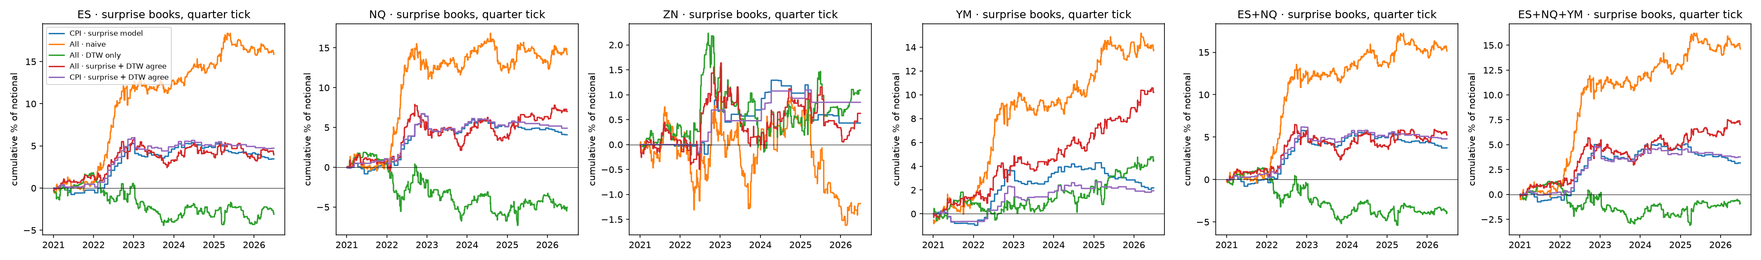
COMBINED/SURPRISE_DTW_BOOK · CUMULATIVE P&L · ¼ TICK · 2021–2026
B · Adding DTW and its effect on the results
Sharpe, ¼ tick | ES 2018–20 | ES 2021–26 | NQ 2018–20 | NQ 2021–26 | YM 2018–20 | YM 2021–26
Surprise, top-10 releases | 1.04 | 1.09 | 0.86 | 0.75 | 1.27 | 1.06
DTW only | 0.57 | −0.26 | 0.78 | −0.28 | 0.40 | 0.44
Surprise + DTW agree | 1.46 | 0.37 | 1.21 | 0.48 | 0.63 | 1.04
What this means
The surprise book is positive in both periods
In ES and NQ, DTW's direction worked in 2018–20 and reversed after 2021, the same flip Jack found in dtw_dir
So the DTW filter looked best in validation and worst in test; on YM it neither helps nor hurts in test (1.04 vs 1.06)
Most of the surprise book's gain came in 2022
UC Berkeley Haas · MFE · BlackRock industry project
8
Notes:
The chart shows the five books in each market and in the ES plus NQ book. Orange is the plain surprise book. Green, DTW on its own, lost in the equity markets in the test years after working in validation. Requiring DTW to agree halves the trades and lowers the Sharpe. On ZN nothing survives costs.

Slide 9
COMBINED/TEAM_BOOK
C · Team book: coverage and overlap
Strategy | ES | NQ | YM | ZN
Macro-surprise book | ✓ | ✓ | ✓ | ✓
CPI surprise model | ✓ | ✓ | ✓ | ✓
DTW ladder book | ✓ | ✓ | ✓ | ✓
DTW event-game book | ✓ | – | – | –
Machine-learning classifier | ✓ | – | – | –
Correlation of daily P&L, 2021–26 | value
Surprise ES vs surprise NQ (same releases) | 0.68
Surprise ES vs surprise YM (same releases) | 0.85
DTW ladder ES vs DTW ladder NQ | 0.15
Classifier vs surprise ES | 0.27
Classifier vs surprise ZN | 0.31
DTW event games vs every other book | −0.04 to 0.05
Surprise vs DTW ladder (any market) | −0.07 to 0.16
Hoshea's and Aaryen's work exists on ES only; the team portfolios use every book on every market where it exists.
Across people the books barely move together: they trade different releases and windows, which is what makes a team portfolio worth building.
UC Berkeley Haas · MFE · BlackRock industry project
9
Notes:
Only the surprise and DTW ladder books exist on all three markets. The correlations between different people's books are close to zero; the only high one is the same surprise strategy on ES and NQ, because the same releases move both equity markets.

Slide 10
C · Each strategy on each market
Sharpe, test years 2021–2026 · “–” = strategy not available on that market
Strategy | ES ¼ tick | NQ ¼ tick | ZN ¼ tick | YM ¼ tick | ES 2t+$4.5 | NQ 2t+$4.5 | ZN 2t+$4.5 | YM 2t+$4.5 | ES 2018–20
Macro-surprise book | 1.09 | 0.75 | −0.16 | 1.06 | 0.74 | 0.64 | −1.51 | 0.82 | 1.04
CPI surprise model | 0.51 | 0.46 | 0.17 | 0.39 | 0.61 | 0.45 | −0.43 | 0.29 | 1.27
DTW ladder book (Jack) | 0.64 | 0.11 | −0.97 | −0.39 | 0.10 | −0.04 | −5.03 | −0.74 | 0.59
DTW event-game book | 0.42 | – | – | – | −0.29 | – | – | – | 0.26
Machine-learning classifier | 0.95 | – | – | – | 0.81 | – | – | – | 0.38
Buy and hold (no costs) | 0.69 | 0.58 | −0.69 | 0.67 | – | – | – | – | 0.80
At ¼ tick the macro-surprise book leads on ES, NQ and YM; at a realistic cost the surprise book and the classifier hold up, the high-turnover DTW books do not
ZN loses after costs in every strategy; the DTW ladder loses on YM even before costs (run with Jack's exact code)
UC Berkeley Haas · MFE · BlackRock industry project
10
Notes:
This is the main results table. Columns one to three are at a quarter tick, four to six at our realistic cost of two ticks plus 4.50 dollars. The surprise book is the strongest in the equity markets, the classifier is the most cost-robust on ES, and nothing works on ZN after costs.

Slide 11
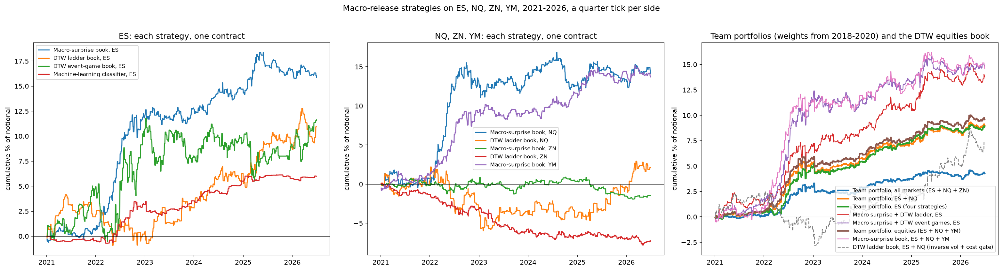
COMBINED/TEAM_BOOK · SECTION 8 · CUMULATIVE P&L · ¼ TICK · 2021–2026
C · The strategies and the team portfolios over time
ES
Surprise book climbs most, largely in 2022
Classifier: small but steady
NQ, ZN and YM
Surprise NQ and YM climb with ES
ZN books drift down: the cost on every trade
Team portfolios
ES, ES + NQ and ES + NQ + YM: steady, small drawdowns
Adding ZN (blue) lowers the whole book
UC Berkeley Haas · MFE · BlackRock industry project
11
Notes:
Left: each ES strategy. Middle: NQ and ZN. Right: the equal-risk team portfolios with weights from 2018 to 2020. The ES and ES plus NQ team books are smoother than any single strategy; adding ZN pulls the all-markets book down.

Slide 12
C · Team portfolios
Equal risk, weights from 2018–2020 only · test years 2021–2026 · return, vol and drawdown at ¼ tick
Portfolio | Gross | ¼ tick | ½ tick | 2t + $4.50 | Return | Vol | Max DD | Trades/yr
Team, equities (ES + NQ + YM) | 1.48 | 1.35 | 1.22 | 0.85 | +9.6% | 1.3% | −1.1% | 1,131
Team, ES + NQ | 1.45 | 1.31 | 1.17 | 0.78 | +9.0% | 1.3% | −1.1% | 1,043
Team, ES (four strategies) | 1.55 | 1.39 | 1.22 | 0.76 | +8.9% | 1.2% | −1.0% | 739
Team, all markets | 1.35 | 0.83 | 0.30 | −1.09 | +4.3% | 1.0% | −1.1% | 1,562
Surprise + DTW event games (ES) | 1.32 | 1.14 | 0.96 | 0.46 | +14.8% | 2.4% | −2.2% | 465
Surprise + DTW ladder (ES) | 1.31 | 1.16 | 1.01 | 0.59 | +13.8% | 2.2% | −2.0% | 315
Macro-surprise book alone (ES) | 1.18 | 1.09 | 0.99 | 0.74 | +15.9% | 2.7% | −2.6% | 96
Macro-surprise book (ES + NQ + YM) | 1.13 | 1.07 | 1.01 | 0.82 | +14.6% | 2.6% | −2.4% | 280
ES buy and hold | 0.69 | – | – | – | +62.4% | 16.9% | −31.1% | –
At ¼ tick, combining helps
The ES team book reaches 1.39 and the equity book (ES + NQ + YM) 1.35, above the best single book (1.09) with half its volatility and drawdowns near −1%.
At a realistic cost, the equity book holds up best
At 2 ticks + $4.50 the ES + NQ + YM team book keeps 0.85, ahead of the surprise book alone (0.74 on ES); the DTW books trade 300+ times a year, and adding ZN turns the book negative.
UC Berkeley Haas · MFE · BlackRock industry project
12
Notes:
The team portfolios weight each book by its risk, using only the validation years. At a quarter tick the ES and ES plus NQ team books reach a Sharpe of about 1.1 with drawdowns under 1.5 percent. At our realistic cost the high-turnover DTW books drag them below the surprise book alone, and adding ZN turns the all-markets book negative.

Slide 13
Conclusions
The macro-surprise direction is the strongest single signal in equities
1
ES 1.09, NQ 0.75 and YM 1.06 at ¼ tick; positive in both validation and test years
DTW works for sizing, not direction
2
Its direction flips between 2018–20 and 2021–26 in ES and NQ, and on YM the DTW book loses (−0.39)
The four workstreams are almost uncorrelated
3
Team portfolios reach 1.39 (ES) and 1.35 (ES + NQ + YM) at ¼ tick with half the risk
Execution cost decides the result
4
At 2 ticks + $4.50 the surprise book, the classifier and the equity team book (0.85) stay positive; ZN fails everywhere
Caveats: Hoshea's setting was chosen on the full sample; the test years have been examined several times; much of the gain comes from 2022; YM was added after the ES and NQ results were known.
UC Berkeley Haas · MFE · BlackRock industry project
13
Notes:
Four conclusions. The surprise direction is the strongest signal in the equity markets. DTW is useful for sizing but its direction is not stable. The four workstreams are nearly uncorrelated, so combining them lowers risk. And execution cost decides whether any of this is tradeable.

Slide 14
Thank you
Questions and discussion
Team code and results: github.com/jack-duncan/blackrock-intraday · Reza's study and papers: github.com/rezazamani2329/BlackRock-Project-State-Dependent-Intraday-Response-of-S-P-500-Futures-to-Macroeconomic-Surprises

