Slide 1


Asset Pricing with Deep Learning
Replication, Extensions and Uncertainty
Architecture, rolling performance and economic regimes
Reza Zamani, Hrafnhildur Lif Jonsdottir
Paraj Goyal and Elouan Bahri
Professor: Ali Kakhbod
Group 7 · October 2026
Notes:
Combined presentation. Slides 1–10 summarize the two previous decks. Slides 11–39 cover Codes 08–12, including sampling uncertainty. Source images come from the user-supplied replication deck.

Slide 2
Presentation overview
The original paper
Economic pricing restrictions, hidden macro states and adversarial instruments.
Our replication
Published benchmarks, local model rankings and validation checks.
New results from Codes 08–12
Architecture, rolling windows, regimes, combinations and uncertainty.
Original paper and replication
2

Slide 3
The original paper’s research question
Estimate a pricing kernel
Learn the stochastic discount factor that prices assets consistently with no arbitrage.
Use a richer information set
Firm characteristics and macroeconomic history allow risk exposures to vary over time.
Separate pricing from return prediction
An economic moment objective guides the network toward pricing-relevant information.
Original paper
3
Notes:
Chen, Pelger and Zhu, Deep Learning in Asset Pricing, arXiv:1904.00745v6, https://arxiv.org/pdf/1904.00745. Published results use Table I.

Slide 4
How the model learns asset prices
1. Summarize the economic environment
LSTM networks read macroeconomic history and create hidden states for the pricing and adversarial branches.
2. Build the pricing portfolio
A feedforward network combines firm characteristics with the pricing states to assign stock weights and construct the SDF.
3. Challenge and improve the model
The adversary finds instruments that reveal large pricing errors. The pricing network learns to reduce those errors.
Original paper
4
Notes:
Chen, Pelger and Zhu, Deep Learning in Asset Pricing, arXiv:1904.00745v6, https://arxiv.org/pdf/1904.00745. Published results use Table I. The SDF branch combines macroeconomic states with firm characteristics to produce portfolio weights. The instrument branch has its own macro encoder and conditional network. The branches optimize opposing sides of the conditional pricing-moment objective.

Slide 5
The original model architecture
Component | Input and role | Output
Macro SDF encoder | 178 macro series, LSTM | 4 states
Pricing-weight network | 46 characteristics + states | Two layers of 64 units
Macro instrument encoder | 178 macro series, LSTM | 32 states
Conditional network | Characteristics + states | 8 bounded instruments
The pricing objective links the SDF network and the adversarial instruments.
Original paper
5
Notes:
Chen, Pelger and Zhu, Deep Learning in Asset Pricing, arXiv:1904.00745v6, https://arxiv.org/pdf/1904.00745. Published results use Table I. Corrected the earlier slides: 46 firm characteristics, 64 hidden units, and 0.95 dropout retention (0.05 dropout probability).

Slide 6
Data and chronological evaluation
Sample | Period | Months
Training | 1967–1986 | 240
Validation | 1987–1991 | 60
Test | 1992–2016 | 300
46 firm characteristics and 178 macroeconomic inputs
Fit on training months and select checkpoints using validation months.
Original paper and replication
6
Notes:
Chen, Pelger and Zhu, Deep Learning in Asset Pricing, arXiv:1904.00745v6, https://arxiv.org/pdf/1904.00745. Published results use Table I. Local split calendar verified against saved factor files.

Slide 7
The paper’s published results
Model | Train | Validation | Test
LS | 1.800 | 0.580 | 0.420
EN | 1.370 | 1.150 | 0.500
FFN | 0.450 | 0.420 | 0.440
GAN | 2.680 | 1.430 | 0.750
GAN has the highest published monthly Sharpe in every split.
Original paper
7
Notes:
Chen, Pelger and Zhu, Deep Learning in Asset Pricing, arXiv:1904.00745v6, https://arxiv.org/pdf/1904.00745. Published results use Table I. All numbers on this slide are monthly Table I Sharpe ratios. Annualized values multiply by square root of 12.

Slide 8
Replication versus the original paper
GAN stays first, while FFN and EN exchange test-period ranks.
Our previous replication
8
Notes:
Chen, Pelger and Zhu, Deep Learning in Asset Pricing, arXiv:1904.00745v6, https://arxiv.org/pdf/1904.00745. Published results use Table I. Local values recomputed with population standard deviation for consistency. This changes the earlier presentation’s GAN test 0.611 to 0.612 after rounding. Source results/rolling_oos_reduced_schedule/tables/all_models_vs_paper_monthly_sharpe.csv.

Slide 9
Replication validation and common signals
Check | Our result | Reference
FF-3 test Sharpe | 0.196 | Paper 0.190
FF-5 test Sharpe | 0.223 | Paper 0.220
GAN test correlation | 0.800 | Authors’ monthly GAN
Leading characteristics | ST_REV, SUV, r12_2 | Same top three
These checks support the replication’s economic similarity to the original.
Our previous replication
9
Notes:
Sources: previous replication deck slides 11, 14, 15. results/tables/gan_official_sdf_comparison.csv. Fama–French benchmark values retain the earlier deck’s displayed convention.

Slide 10
Questions left by the previous presentations
Architecture
Would causal attention change the learned macro representation?
Time variation
Does one full-test Sharpe hide changes in relative performance?
Economic conditions
Do recession and volatility groups explain where the models differ?
Motivation for the new work
10
Notes:
Source: second presentation suggested improvements and first presentation potential extensions. We correct the scope: current rolling work evaluates fixed models and does not implement expanding-window refits.

Slide 11
What Codes 08–12 add
Code | Analysis | Question
08 | LSTM versus Transformer | Which encoder works at a common budget?
09 | 36/60-month rolling evaluation | When does performance change?
10 | Recession and volatility regimes | Where do return and risk differ?
11 | Consolidation and combinations | How do the comparisons fit together?
012 | Bootstrap uncertainty | How precisely do we estimate performance gaps?
The new contribution is a linked evaluation of architecture and economic conditions.
New results
11
Notes:
Saved replication and extension returns. New models use nine seeds, a shortened 16/4/48 schedule, four optimizer passes, and validation checkpoint selection. Code 012 subsequently assesses return-sample uncertainty with a paired block bootstrap. Codes 09–11 evaluate saved models without retraining.

Slide 12
The completed experiment uses shorter training
Setting | Audited author setup | Our completed run
Stage 1 / 2 / 3 epochs | 256 / 64 / 1024 | 16 / 4 / 48
Optimizer passes | 4 | 4
Checkpoint warm-up | 64 epochs | 4 epochs
Seeds per architecture | 9 | 9
Training framework | TensorFlow author code | PyTorch port
All 18 new models completed in 12.9 minutes. Full training remains a separate test.
Code 08
12
Notes:
Saved replication and extension returns. New models use nine seeds, a shortened 16/4/48 schedule, four optimizer passes, and validation checkpoint selection. Code 012 subsequently assesses return-sample uncertainty with a paired block bootstrap. Codes 09–11 evaluate saved models without retraining. Author training repository commit 6c26b9dad01e76b214ab8f5566c42a29e99677c9, https://github.com/LouisChen1992/Deep_Learning_Asset_Pricing. Schedule is from audited executable configuration, not a claim that every source detail matches.

Slide 13
LSTM and Transformer encoder comparison
Choice | LSTM | Transformer
Sequence processing | Recurrent state | Causal self-attention
SDF / instrument states | 4 / 32 | 4 / 32
Transformer specification | Not applicable | 2 layers, 4 heads, width 32
Economic objective | Shared | Shared
Training seeds and schedule | Shared | Shared
The comparison replaces both macro encoders and keeps the output dimensions.
Code 08
13
Notes:
Saved replication and extension returns. New models use nine seeds, a shortened 16/4/48 schedule, four optimizer passes, and validation checkpoint selection. Code 012 subsequently assesses return-sample uncertainty with a paired block bootstrap. Codes 09–11 evaluate saved models without retraining. Source configuration in results/paper_matched_reduced_schedule/manifest.json.

Slide 14
Train, validation and test comparison
The new LSTM exceeds Transformer in all three splits under the reduced budget.
Code 08 and Code 11
14
Notes:
Chen, Pelger and Zhu, Deep Learning in Asset Pricing, arXiv:1904.00745v6, https://arxiv.org/pdf/1904.00745. Published results use Table I. Source results/rolling_oos_reduced_schedule/tables/all_models_vs_paper_monthly_sharpe.csv. Original paper and Code 07 use different estimation procedures from the matched new pair.

Slide 15
Full-test Sharpe across the five portfolios
Author GAN 0.750, replication 0.612, extension LSTM 0.459, Transformer 0.304.
Code 11
15
Notes:
Saved replication and extension returns. New models use nine seeds, a shortened 16/4/48 schedule, four optimizer passes, and validation checkpoint selection. Code 012 subsequently assesses return-sample uncertainty with a paired block bootstrap. Codes 09–11 evaluate saved models without retraining. Sources: published GAN 0.75; supplied author series 0.749920; results/consolidated_comparison/tables/official_extended_test_returns.csv. The blend is exploratory.

Slide 16
Return and risk explain the architecture gap
Portfolio | Mean monthly | Annual volatility | Max drawdown
Paper GAN | 0.78% | 3.61% | -7.02%
Replicated GAN | 0.70% | 3.96% | -6.51%
Extension LSTM | 0.51% | 3.87% | -11.14%
Transformer | 0.42% | 4.82% | -15.35%
Equal-weight blend | 0.47% | 3.50% | -6.57%
Transformer combines a lower mean return with greater volatility than new LSTM.
Code 08 and Code 11
16
Notes:
Saved replication and extension returns. New models use nine seeds, a shortened 16/4/48 schedule, four optimizer passes, and validation checkpoint selection. Code 012 subsequently assesses return-sample uncertainty with a paired block bootstrap. Codes 09–11 evaluate saved models without retraining. Source recomputed risks from aligned saved test returns. Trading costs omitted. Drawdown includes initial wealth of 1.

Slide 17
Initialization sensitivity across nine seeds
Ensemble Sharpe uses averaged raw weights, rather than the mean member Sharpe.
Code 08
17
Notes:
Saved replication and extension returns. New models use nine seeds, a shortened 16/4/48 schedule, four optimizer passes, and validation checkpoint selection. Code 012 subsequently assesses return-sample uncertainty with a paired block bootstrap. Codes 09–11 evaluate saved models without retraining. Source results/paper_matched_reduced_schedule/tables/member_performance.csv. Same-numbered seeds are descriptive pairs, not identical random draws. Seed dispersion shares one market history.

Slide 18
Rolling evaluation uses fixed saved models
Definition | 36 months | 60 months
Complete windows | 265 | 241
First endpoint | December 1994 | December 1996
Last endpoint | December 2016 | December 2016
Statistic | Annualized rolling Sharpe | Annualized rolling Sharpe
Each window reuses earlier returns. Longer windows smooth short episodes.
This experiment evaluates fixed models. It does not refit an expanding-window model.
Code 09
18
Notes:
Saved replication and extension returns. New models use nine seeds, a shortened 16/4/48 schedule, four optimizer passes, and validation checkpoint selection. Code 012 subsequently assesses return-sample uncertainty with a paired block bootstrap. Codes 09–11 evaluate saved models without retraining. Complete windows: 265 for 36 months and 241 for 60 months. Annualized Sharpe equals monthly mean / monthly population std multiplied by sqrt(12).

Slide 19
36-month rolling Sharpe
Transformer beats new LSTM in 36.6% of complete windows.
Code 09 and Code 11
19
Notes:
Saved replication and extension returns. New models use nine seeds, a shortened 16/4/48 schedule, four optimizer passes, and validation checkpoint selection. Code 012 subsequently assesses return-sample uncertainty with a paired block bootstrap. Codes 09–11 evaluate saved models without retraining. Authors monthly series verified to match published rounded split Sharpes. Source results/consolidated_comparison/tables/official_extended_rolling_series.csv. Every monthly value retained. Sparse year labels are displayed on the category axis.

Slide 20
60-month rolling Sharpe
Transformer beats new LSTM in 19.9% of complete windows.
Code 09 and Code 11
20
Notes:
Saved replication and extension returns. New models use nine seeds, a shortened 16/4/48 schedule, four optimizer passes, and validation checkpoint selection. Code 012 subsequently assesses return-sample uncertainty with a paired block bootstrap. Codes 09–11 evaluate saved models without retraining. Authors monthly series verified to match published rounded split Sharpes. Source results/consolidated_comparison/tables/official_extended_rolling_series.csv. Every monthly value retained. Sparse year labels are displayed on the category axis.

Slide 21
Mean rolling Sharpe comparison
Portfolio | 36-month mean | 60-month mean
Paper GAN | 3.638 | 3.199
Replicated GAN | 2.890 | 2.504
Extension LSTM | 1.992 | 1.795
Transformer | 1.467 | 1.228
Equal-weight blend | 2.166 | 1.871
LSTM has the higher average, while the 36-month Transformer median is slightly higher.
Code 09 and Code 11
21
Notes:
Saved replication and extension returns. New models use nine seeds, a shortened 16/4/48 schedule, four optimizer passes, and validation checkpoint selection. Code 012 subsequently assesses return-sample uncertainty with a paired block bootstrap. Codes 09–11 evaluate saved models without retraining. Source results/consolidated_comparison/tables/official_extended_rolling_summary.csv. Means of overlapping rolling ratios are not full-period Sharpe ratios.

Slide 22
Economic regime definitions and sample sizes
Regime family | Definition | Test months
Business cycle | NBER expansion / recession | 274 / 26
Market volatility | High / low previous-12-month volatility | 123 / 177
The volatility cutoff comes from the training sample. Recession dates are retrospective.
These are separate partitions. Recession estimates depend on only 26 months.
Code 10
22
Notes:
Saved replication and extension returns. New models use nine seeds, a shortened 16/4/48 schedule, four optimizer passes, and validation checkpoint selection. Code 012 subsequently assesses return-sample uncertainty with a paired block bootstrap. Codes 09–11 evaluate saved models without retraining. Source results/regime_analysis/tables/monthly_regime_labels.csv. https://fred.stlouisfed.org/series/USREC. Fama–French market returns define lagged volatility with training median threshold 0.039783.

Slide 23
Business-cycle Sharpe comparison
New LSTM outperforms Transformer in both groups. Code 07 exceeds authors GAN in recession.
Code 10 and Code 11
23
Notes:
Saved replication and extension returns. New models use nine seeds, a shortened 16/4/48 schedule, four optimizer passes, and validation checkpoint selection. Code 012 subsequently assesses return-sample uncertainty with a paired block bootstrap. Codes 09–11 evaluate saved models without retraining. Source results/consolidated_comparison/tables/official_extended_regime_comparison.csv. Author GAN regime statistics are newly computed from the supplied monthly series, not published regime table entries.

Slide 24
Market-volatility Sharpe comparison
New LSTM and Transformer are closest in low-volatility months.
Code 10 and Code 11
24
Notes:
Saved replication and extension returns. New models use nine seeds, a shortened 16/4/48 schedule, four optimizer passes, and validation checkpoint selection. Code 012 subsequently assesses return-sample uncertainty with a paired block bootstrap. Codes 09–11 evaluate saved models without retraining. Source results/consolidated_comparison/tables/official_extended_regime_comparison.csv. Author GAN regime statistics are newly computed from the supplied monthly series, not published regime table entries.

Slide 25
Conditional months and rolling endpoints
Analysis | Returns used | Question
Conditional regime Sharpe | Only labeled months | How does performance differ within the state?
Rolling by endpoint regime | All returns in each trailing window | What trailing performance do we observe in that state?
A 36-month recession-ending window can include many expansion months.
The two measures can rank the models differently because they use different returns.
Code 11
25
Notes:
Saved replication and extension returns. New models use nine seeds, a shortened 16/4/48 schedule, four optimizer passes, and validation checkpoint selection. Code 012 subsequently assesses return-sample uncertainty with a paired block bootstrap. Codes 09–11 evaluate saved models without retraining. Endpoint labels group completed trailing statistics. A recession-ending window may contain expansion months. No regime switching rule is implemented.

Slide 26
36-month rolling performance by endpoint regime
In recession-ending windows, Transformer 1.409 slightly exceeds new LSTM 1.383.
Code 11
26
Notes:
Saved replication and extension returns. New models use nine seeds, a shortened 16/4/48 schedule, four optimizer passes, and validation checkpoint selection. Code 012 subsequently assesses return-sample uncertainty with a paired block bootstrap. Codes 09–11 evaluate saved models without retraining. Source results/consolidated_comparison/tables/official_extended_endpoint_regimes.csv. These are mean annualized trailing Sharpes classified by end-month state. They are not Sharpe ratios of regime-only returns. Window observations overlap.

Slide 27
60-month rolling performance by endpoint regime
In recession-ending windows, new LSTM 1.893 exceeds Transformer 1.775.
Code 11
27
Notes:
Saved replication and extension returns. New models use nine seeds, a shortened 16/4/48 schedule, four optimizer passes, and validation checkpoint selection. Code 012 subsequently assesses return-sample uncertainty with a paired block bootstrap. Codes 09–11 evaluate saved models without retraining. Source results/consolidated_comparison/tables/official_extended_endpoint_regimes.csv. These are mean annualized trailing Sharpes classified by end-month state. They are not Sharpe ratios of regime-only returns. Window observations overlap.

Slide 28
The equal-weight architecture combination
Portfolio | Train | Validation | Test
LSTM | 1.308 | 0.750 | 0.459
Transformer | 1.049 | 0.589 | 0.304
50/50 blend | 1.414 | 0.915 | 0.463
Test correlation between architectures is 0.292. Averaging lowers volatility.
Blend test Sharpe improves only slightly: 0.463 versus LSTM 0.459.
Code 11
28
Notes:
Saved replication and extension returns. New models use nine seeds, a shortened 16/4/48 schedule, four optimizer passes, and validation checkpoint selection. Code 012 subsequently assesses return-sample uncertainty with a paired block bootstrap. Codes 09–11 evaluate saved models without retraining. Source results/consolidated_comparison/tables/architecture_blend_split_comparison.csv. Blend returns equal 0.5*LSTM+0.5*Transformer, without additional gross renormalization. Added after prior test review. Weights are fixed and not optimized.

Slide 29
Sampling uncertainty in saved portfolio returns
A paired comparison
Resample the same months for every portfolio, so each draw preserves the return pairing.
Contiguous blocks
Use 10,000 draws and compare 6-, 12- and 24-month blocks to assess dependence sensitivity.
The question
Does a positive observed Sharpe gap remain distinguishable from zero under the bootstrap assumptions?
Uncertainty concerns the return sample, conditional on the saved models.
Code 012
29
Notes:
Source: results/bootstrap_uncertainty/tables/. Code 012 uses 300 aligned monthly excess returns, January 1992–December 2016, population standard deviation, 10,000 paired circular-block draws, 6/12/24-month blocks. Primary full-test block length is 12. Intervals condition on fixed saved models and the existing history. No models are retrained. The circular bootstrap samples contiguous return blocks with identical indices for every portfolio. Pointwise intervals concern one comparison. Simultaneous intervals use the maximum absolute centered bootstrap error across ten pairs for each block length.

Slide 30
Full-test model Sharpe and confidence intervals
Portfolio | Monthly Sharpe | 95% basic interval
Paper GAN | 0.750 | [0.442, 0.973]
Replicated GAN | 0.612 | [0.380, 0.783]
Extension LSTM | 0.459 | [0.244, 0.626]
Transformer | 0.304 | [0.146, 0.439]
Equal-weight blend | 0.463 | [0.265, 0.612]
Individual interval overlap does not answer the paired-difference question.
Code 012
30
Notes:
Source: results/bootstrap_uncertainty/tables/. Code 012 uses 300 aligned monthly excess returns, January 1992–December 2016, population standard deviation, 10,000 paired circular-block draws, 6/12/24-month blocks. Primary full-test block length is 12. Intervals condition on fixed saved models and the existing history. model_sharpe_confidence_intervals.csv. Paper GAN means the supplied author return series, not confidence intervals published in the paper. Intervals are pointwise 95% basic intervals.

Slide 31
Paired Sharpe differences and uncertainty
A minus B | Difference | 95% basic | 95% simultaneous
Paper GAN minus Replicated GAN | 0.138 | [-0.037, 0.256] | [-0.148, 0.425]
Extension LSTM minus Transformer | 0.155 | [-0.049, 0.365] | [-0.132, 0.441]
Extension LSTM minus Equal-weight blend | -0.004 | [-0.132, 0.119] | [-0.290, 0.283]
A positive point estimate can coexist with an interval containing zero.
LSTM minus Transformer is 0.155, with basic interval spanning zero.
Code 012
31
Notes:
Source: results/bootstrap_uncertainty/tables/. Code 012 uses 300 aligned monthly excess returns, January 1992–December 2016, population standard deviation, 10,000 paired circular-block draws, 6/12/24-month blocks. Primary full-test block length is 12. Intervals condition on fixed saved models and the existing history. paired_sharpe_difference_intervals.csv. Difference is A minus B. Pointwise basic intervals and simultaneous intervals adjust for different families. Simultaneous family contains all ten pairs among the five portfolios.

Slide 32
Interval methods can change the conclusion
A minus B | Basic | Percentile | Simultaneous
Paper GAN minus Replicated GAN | Unresolved | A higher | Unresolved
Extension LSTM minus Transformer | Unresolved | Unresolved | Unresolved
Extension LSTM minus Equal-weight blend | Unresolved | Unresolved | Unresolved
“A higher” means the entire interval lies above zero. “Unresolved” means it contains zero.
The paper-versus-replication gap is sensitive to the interval method.
Code 012
32
Notes:
Source: results/bootstrap_uncertainty/tables/. Code 012 uses 300 aligned monthly excess returns, January 1992–December 2016, population standard deviation, 10,000 paired circular-block draws, 6/12/24-month blocks. Primary full-test block length is 12. Intervals condition on fixed saved models and the existing history. interval_method_comparison.csv. Status labels correspond to the 12-month block choice. Basic intervals reflect the bootstrap error distribution around the observed estimate. Percentile intervals use raw bootstrap quantiles. Simultaneous intervals control the ten-comparison family under the bootstrap approximation. Method disagreement limits robustness.

Slide 33
Block-length sensitivity of architecture uncertainty
Both paired basic intervals contain zero at all three block lengths.
Code 012
33
Notes:
Source: results/bootstrap_uncertainty/tables/. Code 012 uses 300 aligned monthly excess returns, January 1992–December 2016, population standard deviation, 10,000 paired circular-block draws, 6/12/24-month blocks. Primary full-test block length is 12. Intervals condition on fixed saved models and the existing history. paired_sharpe_difference_intervals.csv. Values are pointwise basic interval widths in monthly Sharpe units. The observed difference is fixed because all methods reuse the same return history. Blocks are sensitivity choices, not independent tests.

Slide 34
Rolling uncertainty changes the interpretation
Rolling window | LSTM point estimate higher | Basic interval favors LSTM | Unresolved
36 months 265 windows | 168 / 265 | 39 | 226
60 months 241 windows | 193 / 241 | 45 | 196
No window has a basic interval favoring Transformer. Most windows remain unresolved.
Overlapping window counts describe the history, rather than independent evidence.
Code 012
34
Notes:
Source: results/bootstrap_uncertainty/tables/. Code 012 uses 300 aligned monthly excess returns, January 1992–December 2016, population standard deviation, 10,000 paired circular-block draws, 6/12/24-month blocks. Primary full-test block length is 12. Intervals condition on fixed saved models and the existing history. rolling_comparison_counts.csv. All complete windows use 2,000 draws and 6-month blocks. Figure counts refer to LSTM minus Transformer using pointwise basic intervals. Simultaneous tables adjust ten pairs within each window, not across time. Overlapping windows are dependent.

Slide 35
Additional comparisons among our own models
Local portfolio | Test Sharpe monthly | 36-month mean annualized | Recession Sharpe monthly
Replicated GAN | 0.612 | 2.890 | 0.455
Feedforward | 0.570 | 2.620 | 0.570
Equal-weight blend | 0.463 | 2.166 | 0.076
Extension LSTM | 0.459 | 1.992 | 0.264
Elastic Net | 0.412 | 2.074 | 0.254
Linear | 0.406 | 1.740 | 0.404
Transformer | 0.304 | 1.467 | -0.071
The paper benchmark remains in earlier comparisons. This adds seven local portfolios.
Code 012
35
Notes:
Source: results/bootstrap_uncertainty/tables/. Code 012 uses 300 aligned monthly excess returns, January 1992–December 2016, population standard deviation, 10,000 paired circular-block draws, 6/12/24-month blocks. Primary full-test block length is 12. Intervals condition on fixed saved models and the existing history. Additional sources: results/bootstrap_uncertainty/local_only/tables/overall_performance.csv, rolling_summary.csv, regime_comparison.csv, paired_intervals.csv. Monthly full-test and recession-only Sharpes differ from mean annualized rolling Sharpe. Local simultaneous intervals recalibrate all 21 local pairs. Regime entries are point estimates with no regime-specific confidence intervals. Recession contains only 26 months.

Slide 36
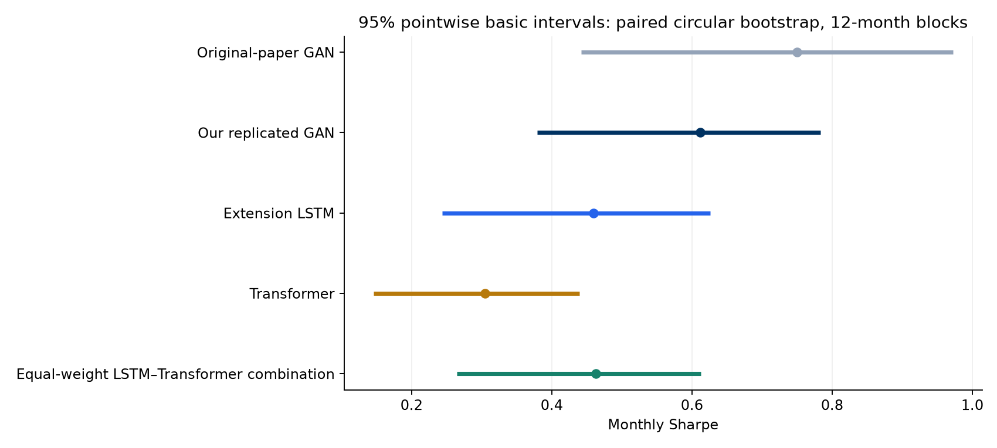
Code 012: model Sharpe confidence intervals
Monthly test Sharpe, with 95% basic intervals using 12-month blocks.
Figures from Code 012
36
Notes:
Source: results/bootstrap_uncertainty/tables/. Code 012 uses 300 aligned monthly excess returns, January 1992–December 2016, population standard deviation, 10,000 paired circular-block draws, 6/12/24-month blocks. Primary full-test block length is 12. Intervals condition on fixed saved models and the existing history. Figure copied unchanged from results/bootstrap_uncertainty/figures/model_sharpe_intervals.png. Interpret with the preceding method and results tables.

Slide 37
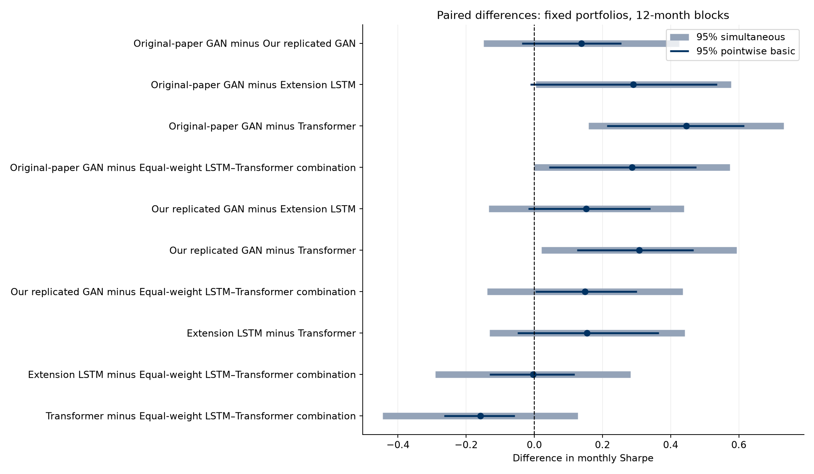
Code 012: uncertainty in paired differences
Paired monthly Sharpe gaps. Pointwise and simultaneous intervals answer different questions.
Figures from Code 012
37
Notes:
Source: results/bootstrap_uncertainty/tables/. Code 012 uses 300 aligned monthly excess returns, January 1992–December 2016, population standard deviation, 10,000 paired circular-block draws, 6/12/24-month blocks. Primary full-test block length is 12. Intervals condition on fixed saved models and the existing history. Figure copied unchanged from results/bootstrap_uncertainty/figures/paired_difference_intervals.png. Interpret with the preceding method and results tables.

Slide 38

Code 012: local models across economic regimes
Conditional monthly Sharpe. These regime estimates do not include confidence intervals.
Figures from Code 012
38
Notes:
Source: results/bootstrap_uncertainty/tables/. Code 012 uses 300 aligned monthly excess returns, January 1992–December 2016, population standard deviation, 10,000 paired circular-block draws, 6/12/24-month blocks. Primary full-test block length is 12. Intervals condition on fixed saved models and the existing history. Figure copied unchanged from results/bootstrap_uncertainty/local_only/figures/local_regime_comparison.png. Interpret with the preceding method and results tables.

Slide 39
Contributions and remaining research questions
What we add
A common-budget encoder comparison, rolling and regime evaluation, a fixed combination, and paired uncertainty.
What the evidence supports
LSTM has higher observed test Sharpe. Bootstrap intervals leave its advantage over Transformer unresolved.
What remains open
Full author-schedule GPU training, a new holdout, transaction costs and uncertainty across training runs.
The extensions explain performance differences and the limits of those conclusions.
Codes 08–12
39
Notes:
Saved replication and extension returns. New models use nine seeds, a shortened 16/4/48 schedule, four optimizer passes, and validation checkpoint selection. Code 012 subsequently assesses return-sample uncertainty with a paired block bootstrap. Codes 09–11 evaluate saved models without retraining. Code 012 does not establish equivalence from an interval containing zero. Fixed equal-weight combination was considered after test inspection. Recession labels are retrospective. No transaction costs, genuinely unseen holdout, retraining uncertainty, or real-time vintage correction is included.

