Slide 1


Asset Pricing with Deep Learning
Replication and Extensions
Architecture, rolling performance and economic regimes
Reza Zamani, Hrafnhildur Lif Jonsdottir
Paraj Goyal and Elouan Bahri
Professor: Ali Kakhbod
Group 7 · October 2026
Notes:
Asset Pricing with Deep Learning: Replication and Extensions. Eight sections: main paper, replication, Transformer, rolling windows, regime change, uncertainty, combination, summary. Source photograph and logo retained from the earlier presentation.

Slide 2
Presentation overview
1. Main paper
2. Replication
3. Transformer
4. Rolling windows
5. Regime change
6. Uncertainty
7. Combination
8. Summary
Eight parts
2
Notes:
Four extension sections: Transformer, rolling windows, regime change, and uncertainty. The combination section compares results jointly before the summary.

Slide 3
Main paper: model architecture and data
Goal: learn a stochastic discount factor through conditional pricing moments.
Component | Input and role | Output
Macro SDF encoder | 178 macro series, LSTM | 4 states
Pricing-weight network | 46 characteristics + states | Two layers of 64 units
Macro instrument encoder | 178 macro series, LSTM | 32 states
Conditional network | Characteristics + states | 8 bounded instruments
Train 1967–1986. Validation 1987–1991. Test 1992–2016.
Part 1. Main paper
3
Notes:
Chen, Pelger and Zhu, Deep Learning in Asset Pricing, arXiv:1904.00745v6, https://arxiv.org/pdf/1904.00745. Published results use Table I. Corrected the earlier slides: 46 firm characteristics, 64 hidden units, and 0.95 dropout retention (0.05 dropout probability).

Slide 4
Main paper: published results
Model | Train | Validation | Test
LS | 1.800 | 0.580 | 0.420
EN | 1.370 | 1.150 | 0.500
FFN | 0.450 | 0.420 | 0.440
GAN | 2.680 | 1.430 | 0.750
GAN has the highest published monthly Sharpe in every split.
Part 1. Main paper
4
Notes:
Chen, Pelger and Zhu, Deep Learning in Asset Pricing, arXiv:1904.00745v6, https://arxiv.org/pdf/1904.00745. Published results use Table I. All numbers on this slide are monthly Table I Sharpe ratios. Annualized values multiply by square root of 12.

Slide 5
Replication: comparison with the main paper
GAN stays first, while FFN and EN exchange test-period ranks.
Part 2. Replication
5
Notes:
Chen, Pelger and Zhu, Deep Learning in Asset Pricing, arXiv:1904.00745v6, https://arxiv.org/pdf/1904.00745. Published results use Table I. Local values recomputed with population standard deviation for consistency. This changes the earlier presentation’s GAN test 0.611 to 0.612 after rounding. Source results/rolling_oos_reduced_schedule/tables/all_models_vs_paper_monthly_sharpe.csv.

Slide 6
Replication: validation and common signals
Check | Our result | Reference
FF-3 test Sharpe | 0.196 | Paper 0.190
FF-5 test Sharpe | 0.223 | Paper 0.220
GAN test correlation | 0.800 | Authors’ monthly GAN
Leading characteristics | ST_REV, SUV, r12_2 | Same top three
These checks support the replication’s economic similarity to the original.
Part 2. Replication
6
Notes:
Sources: previous replication deck slides 11, 14, 15. results/tables/gan_official_sdf_comparison.csv. Fama–French benchmark values retain the earlier deck’s displayed convention.

Slide 7
Part 3
Transformer
Extension 1. Does causal attention improve on LSTM under a common training budget?
Part 3. Transformer
7
Notes:
Section 3: Transformer. Extension 1. Does causal attention improve on LSTM under a common training budget?

Slide 8
Transformer: the common training budget
Setting | Audited author setup | Our completed run
Stage 1 / 2 / 3 epochs | 256 / 64 / 1024 | 16 / 4 / 48
Optimizer passes | 4 | 4
Checkpoint warm-up | 64 epochs | 4 epochs
Seeds per architecture | 9 | 9
Training framework | TensorFlow author code | PyTorch port
All 18 new models completed in 12.9 minutes. Full training remains a separate test.
Part 3. Transformer
8
Notes:
Saved replication and extension returns. New models use nine seeds, a shortened 16/4/48 schedule, four optimizer passes, and validation checkpoint selection. Code 012 subsequently assesses return-sample uncertainty with a paired block bootstrap. Codes 09–11 evaluate saved models without retraining. Author training repository commit 6c26b9dad01e76b214ab8f5566c42a29e99677c9, https://github.com/LouisChen1992/Deep_Learning_Asset_Pricing. Schedule is from audited executable configuration, not a claim that every source detail matches.

Slide 9
Transformer: encoder structure
Choice | LSTM | Transformer
Sequence processing | Recurrent state | Causal self-attention
SDF / instrument states | 4 / 32 | 4 / 32
Transformer specification | Not applicable | 2 layers, 4 heads, width 32
Economic objective | Shared | Shared
Training seeds and schedule | Shared | Shared
The comparison replaces both macro encoders and keeps the output dimensions.
Part 3. Transformer
9
Notes:
Saved replication and extension returns. New models use nine seeds, a shortened 16/4/48 schedule, four optimizer passes, and validation checkpoint selection. Code 012 subsequently assesses return-sample uncertainty with a paired block bootstrap. Codes 09–11 evaluate saved models without retraining. Source configuration in results/paper_matched_reduced_schedule/manifest.json.

Slide 10
Transformer: train, validation and test results
The new LSTM exceeds Transformer in all three splits under the reduced budget.
Part 3. Transformer
10
Notes:
Chen, Pelger and Zhu, Deep Learning in Asset Pricing, arXiv:1904.00745v6, https://arxiv.org/pdf/1904.00745. Published results use Table I. Source results/rolling_oos_reduced_schedule/tables/all_models_vs_paper_monthly_sharpe.csv. Original paper and Code 07 use different estimation procedures from the matched new pair.

Slide 11
Transformer: return and risk comparison
Portfolio | Mean monthly | Annual volatility | Max drawdown
Paper GAN | 0.78% | 3.61% | -7.02%
Replicated GAN | 0.70% | 3.96% | -6.51%
Extension LSTM | 0.51% | 3.87% | -11.14%
Transformer | 0.42% | 4.82% | -15.35%
Equal-weight blend | 0.47% | 3.50% | -6.57%
Transformer combines a lower mean return with greater volatility than new LSTM.
Part 3. Transformer
11
Notes:
Saved replication and extension returns. New models use nine seeds, a shortened 16/4/48 schedule, four optimizer passes, and validation checkpoint selection. Code 012 subsequently assesses return-sample uncertainty with a paired block bootstrap. Codes 09–11 evaluate saved models without retraining. Source recomputed risks from aligned saved test returns. Trading costs omitted. Drawdown includes initial wealth of 1.

Slide 12
Transformer: sensitivity across nine seeds
Ensemble Sharpe uses averaged raw weights, rather than the mean member Sharpe.
Part 3. Transformer
12
Notes:
Saved replication and extension returns. New models use nine seeds, a shortened 16/4/48 schedule, four optimizer passes, and validation checkpoint selection. Code 012 subsequently assesses return-sample uncertainty with a paired block bootstrap. Codes 09–11 evaluate saved models without retraining. Source results/paper_matched_reduced_schedule/tables/member_performance.csv. Same-numbered seeds are descriptive pairs, not identical random draws. Seed dispersion shares one market history.

Slide 13
Part 4
Rolling windows
Extension 2. How does the performance of fixed saved models change over time?
Part 4. Rolling windows
13
Notes:
Section 4: Rolling windows. Extension 2. How does the performance of fixed saved models change over time?

Slide 14
Rolling: evaluation method
Definition | 36 months | 60 months
Complete windows | 265 | 241
First endpoint | December 1994 | December 1996
Last endpoint | December 2016 | December 2016
Statistic | Annualized rolling Sharpe | Annualized rolling Sharpe
Each window reuses earlier returns. Longer windows smooth short episodes.
This experiment evaluates fixed models. It does not refit an expanding-window model.
Part 4. Rolling windows
14
Notes:
Saved replication and extension returns. New models use nine seeds, a shortened 16/4/48 schedule, four optimizer passes, and validation checkpoint selection. Code 012 subsequently assesses return-sample uncertainty with a paired block bootstrap. Codes 09–11 evaluate saved models without retraining. Complete windows: 265 for 36 months and 241 for 60 months. Annualized Sharpe equals monthly mean / monthly population std multiplied by sqrt(12).

Slide 15
Rolling: 36-month Sharpe
Transformer beats new LSTM in 36.6% of complete windows.
Part 4. Rolling windows
15
Notes:
Saved replication and extension returns. New models use nine seeds, a shortened 16/4/48 schedule, four optimizer passes, and validation checkpoint selection. Code 012 subsequently assesses return-sample uncertainty with a paired block bootstrap. Codes 09–11 evaluate saved models without retraining. Authors monthly series verified to match published rounded split Sharpes. Source results/consolidated_comparison/tables/official_extended_rolling_series.csv. Every monthly value retained. Sparse year labels are displayed on the category axis.

Slide 16
Rolling: 60-month Sharpe
Transformer beats new LSTM in 19.9% of complete windows.
Part 4. Rolling windows
16
Notes:
Saved replication and extension returns. New models use nine seeds, a shortened 16/4/48 schedule, four optimizer passes, and validation checkpoint selection. Code 012 subsequently assesses return-sample uncertainty with a paired block bootstrap. Codes 09–11 evaluate saved models without retraining. Authors monthly series verified to match published rounded split Sharpes. Source results/consolidated_comparison/tables/official_extended_rolling_series.csv. Every monthly value retained. Sparse year labels are displayed on the category axis.

Slide 17
Rolling: comparison across window lengths
Portfolio | 36-month mean | 60-month mean
Paper GAN | 3.638 | 3.199
Replicated GAN | 2.890 | 2.504
Extension LSTM | 1.992 | 1.795
Transformer | 1.467 | 1.228
Equal-weight blend | 2.166 | 1.871
LSTM has the higher average, while the 36-month Transformer median is slightly higher.
Part 4. Rolling windows
17
Notes:
Saved replication and extension returns. New models use nine seeds, a shortened 16/4/48 schedule, four optimizer passes, and validation checkpoint selection. Code 012 subsequently assesses return-sample uncertainty with a paired block bootstrap. Codes 09–11 evaluate saved models without retraining. Source results/consolidated_comparison/tables/official_extended_rolling_summary.csv. Means of overlapping rolling ratios are not full-period Sharpe ratios.

Slide 18
Part 5
Regime change
Extension 3. Where do model results differ across business-cycle and volatility regimes?
Part 5. Regime change
18
Notes:
Section 5: Regime change. Extension 3. Where do model results differ across business-cycle and volatility regimes?

Slide 19
Regimes: definitions and sample sizes
Regime family | Definition | Test months
Business cycle | NBER expansion / recession | 274 / 26
Market volatility | High / low previous-12-month volatility | 123 / 177
The volatility cutoff comes from the training sample. Recession dates are retrospective.
These are separate partitions. Recession estimates depend on only 26 months.
Part 5. Regime change
19
Notes:
Saved replication and extension returns. New models use nine seeds, a shortened 16/4/48 schedule, four optimizer passes, and validation checkpoint selection. Code 012 subsequently assesses return-sample uncertainty with a paired block bootstrap. Codes 09–11 evaluate saved models without retraining. Source results/regime_analysis/tables/monthly_regime_labels.csv. https://fred.stlouisfed.org/series/USREC. Fama–French market returns define lagged volatility with training median threshold 0.039783.

Slide 20
Regimes: business-cycle comparison
New LSTM outperforms Transformer in both groups. Code 07 exceeds authors GAN in recession.
Part 5. Regime change
20
Notes:
Saved replication and extension returns. New models use nine seeds, a shortened 16/4/48 schedule, four optimizer passes, and validation checkpoint selection. Code 012 subsequently assesses return-sample uncertainty with a paired block bootstrap. Codes 09–11 evaluate saved models without retraining. Source results/consolidated_comparison/tables/official_extended_regime_comparison.csv. Author GAN regime statistics are newly computed from the supplied monthly series, not published regime table entries.

Slide 21
Regimes: market-volatility comparison
New LSTM and Transformer are closest in low-volatility months.
Part 5. Regime change
21
Notes:
Saved replication and extension returns. New models use nine seeds, a shortened 16/4/48 schedule, four optimizer passes, and validation checkpoint selection. Code 012 subsequently assesses return-sample uncertainty with a paired block bootstrap. Codes 09–11 evaluate saved models without retraining. Source results/consolidated_comparison/tables/official_extended_regime_comparison.csv. Author GAN regime statistics are newly computed from the supplied monthly series, not published regime table entries.

Slide 22

Regimes: comparison among our models
Conditional monthly Sharpe. These regime estimates do not include confidence intervals.
Part 5. Regime change
22
Notes:
Source: results/bootstrap_uncertainty/tables/. Code 012 uses 300 aligned monthly excess returns, January 1992–December 2016, population standard deviation, 10,000 paired circular-block draws, 6/12/24-month blocks. Primary full-test block length is 12. Intervals condition on fixed saved models and the existing history. Figure copied unchanged from results/bootstrap_uncertainty/local_only/figures/local_regime_comparison.png. Interpret with the preceding method and results tables.

Slide 23
Part 6
Uncertainty
Extension 4. How precisely do we estimate the differences in Sharpe ratios?
Part 6. Uncertainty
23
Notes:
Section 6: Uncertainty. Extension 4. How precisely do we estimate the differences in Sharpe ratios?

Slide 24
Uncertainty: paired block-bootstrap method
A paired comparison
Resample the same months for every portfolio, so each draw preserves the return pairing.
Contiguous blocks
Use 10,000 draws and compare 6-, 12- and 24-month blocks to assess dependence sensitivity.
The question
Does a positive observed Sharpe gap remain distinguishable from zero under the bootstrap assumptions?
Uncertainty concerns the return sample, conditional on the saved models.
Part 6. Uncertainty
24
Notes:
Source: results/bootstrap_uncertainty/tables/. Code 012 uses 300 aligned monthly excess returns, January 1992–December 2016, population standard deviation, 10,000 paired circular-block draws, 6/12/24-month blocks. Primary full-test block length is 12. Intervals condition on fixed saved models and the existing history. No models are retrained. The circular bootstrap samples contiguous return blocks with identical indices for every portfolio. Pointwise intervals concern one comparison. Simultaneous intervals use the maximum absolute centered bootstrap error across ten pairs for each block length.

Slide 25
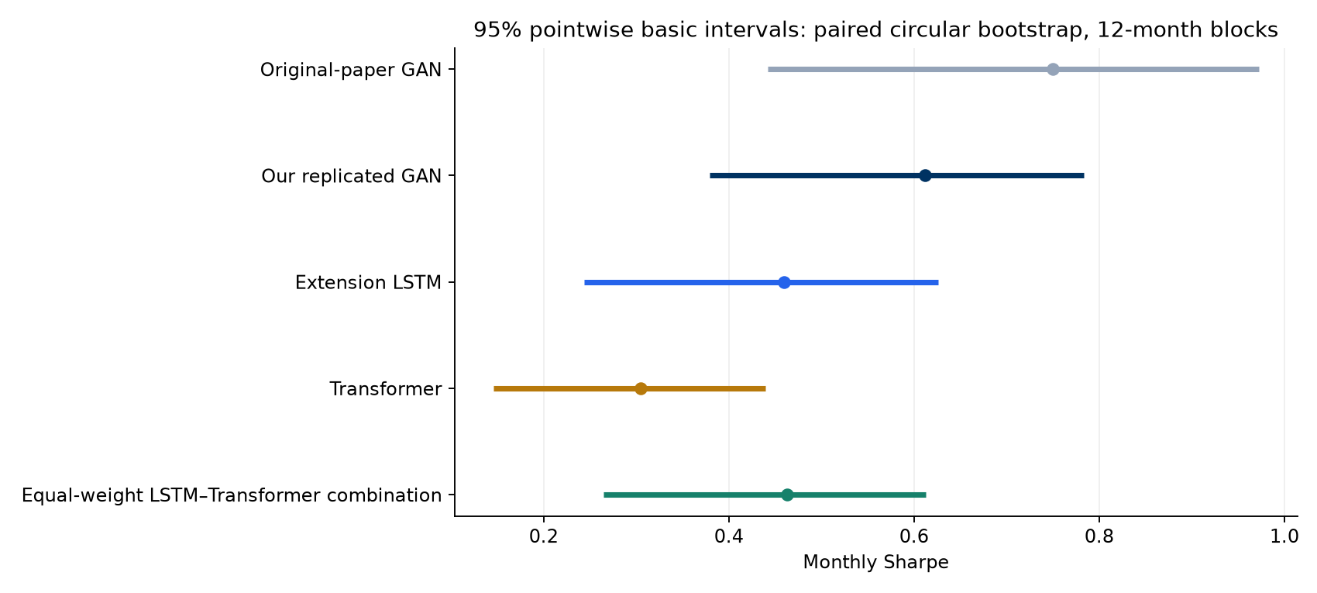
Uncertainty: model Sharpe intervals
Monthly test Sharpe, with 95% basic intervals using 12-month blocks.
Part 6. Uncertainty
25
Notes:
Source: results/bootstrap_uncertainty/tables/. Code 012 uses 300 aligned monthly excess returns, January 1992–December 2016, population standard deviation, 10,000 paired circular-block draws, 6/12/24-month blocks. Primary full-test block length is 12. Intervals condition on fixed saved models and the existing history. Figure copied unchanged from results/bootstrap_uncertainty/figures/model_sharpe_intervals.png. Interpret with the preceding method and results tables.

Slide 26
Uncertainty: paired Sharpe differences
A minus B | Difference | 95% basic | 95% simultaneous
Paper GAN minus Replicated GAN | 0.138 | [-0.037, 0.256] | [-0.148, 0.425]
Extension LSTM minus Transformer | 0.155 | [-0.049, 0.365] | [-0.132, 0.441]
Extension LSTM minus Equal-weight blend | -0.004 | [-0.132, 0.119] | [-0.290, 0.283]
A positive point estimate can coexist with an interval containing zero.
LSTM minus Transformer is 0.155, with basic interval spanning zero.
Part 6. Uncertainty
26
Notes:
Source: results/bootstrap_uncertainty/tables/. Code 012 uses 300 aligned monthly excess returns, January 1992–December 2016, population standard deviation, 10,000 paired circular-block draws, 6/12/24-month blocks. Primary full-test block length is 12. Intervals condition on fixed saved models and the existing history. paired_sharpe_difference_intervals.csv. Difference is A minus B. Pointwise basic intervals and simultaneous intervals adjust for different families. Simultaneous family contains all ten pairs among the five portfolios.

Slide 27
Uncertainty: interval-method comparison
A minus B | Basic | Percentile | Simultaneous
Paper GAN minus Replicated GAN | Unresolved | A higher | Unresolved
Extension LSTM minus Transformer | Unresolved | Unresolved | Unresolved
Extension LSTM minus Equal-weight blend | Unresolved | Unresolved | Unresolved
“A higher” means the entire interval lies above zero. “Unresolved” means it contains zero.
The paper-versus-replication gap is sensitive to the interval method.
Part 6. Uncertainty
27
Notes:
Source: results/bootstrap_uncertainty/tables/. Code 012 uses 300 aligned monthly excess returns, January 1992–December 2016, population standard deviation, 10,000 paired circular-block draws, 6/12/24-month blocks. Primary full-test block length is 12. Intervals condition on fixed saved models and the existing history. interval_method_comparison.csv. Status labels correspond to the 12-month block choice. Basic intervals reflect the bootstrap error distribution around the observed estimate. Percentile intervals use raw bootstrap quantiles. Simultaneous intervals control the ten-comparison family under the bootstrap approximation. Method disagreement limits robustness.

Slide 28
Uncertainty: block-length sensitivity
Both paired basic intervals contain zero at all three block lengths.
Part 6. Uncertainty
28
Notes:
Source: results/bootstrap_uncertainty/tables/. Code 012 uses 300 aligned monthly excess returns, January 1992–December 2016, population standard deviation, 10,000 paired circular-block draws, 6/12/24-month blocks. Primary full-test block length is 12. Intervals condition on fixed saved models and the existing history. paired_sharpe_difference_intervals.csv. Values are pointwise basic interval widths in monthly Sharpe units. The observed difference is fixed because all methods reuse the same return history. Blocks are sensitivity choices, not independent tests.

Slide 29
Uncertainty: rolling-window results
Rolling window | LSTM point estimate higher | Basic interval favors LSTM | Unresolved
36 months 265 windows | 168 / 265 | 39 | 226
60 months 241 windows | 193 / 241 | 45 | 196
No window has a basic interval favoring Transformer. Most windows remain unresolved.
Overlapping window counts describe the history, rather than independent evidence.
Part 6. Uncertainty
29
Notes:
Source: results/bootstrap_uncertainty/tables/. Code 012 uses 300 aligned monthly excess returns, January 1992–December 2016, population standard deviation, 10,000 paired circular-block draws, 6/12/24-month blocks. Primary full-test block length is 12. Intervals condition on fixed saved models and the existing history. rolling_comparison_counts.csv. All complete windows use 2,000 draws and 6-month blocks. Figure counts refer to LSTM minus Transformer using pointwise basic intervals. Simultaneous tables adjust ten pairs within each window, not across time. Overlapping windows are dependent.

Slide 30
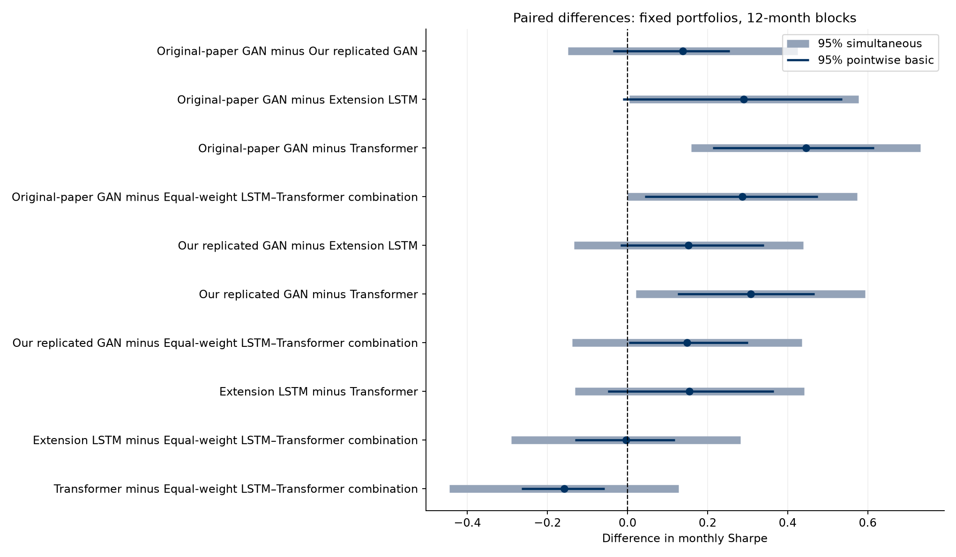
Uncertainty: all ten paired comparisons
Paired monthly Sharpe gaps. Pointwise and simultaneous intervals answer different questions.
Part 6. Uncertainty
30
Notes:
Source: results/bootstrap_uncertainty/tables/. Code 012 uses 300 aligned monthly excess returns, January 1992–December 2016, population standard deviation, 10,000 paired circular-block draws, 6/12/24-month blocks. Primary full-test block length is 12. Intervals condition on fixed saved models and the existing history. Figure copied unchanged from results/bootstrap_uncertainty/figures/paired_difference_intervals.png. Interpret with the preceding method and results tables.

Slide 31
Part 7
Combination
Joint comparisons across architectures, rolling windows, economic regimes, and the fixed portfolio combination.
Part 7. Combination
31
Notes:
Section 7: Combination. Joint comparisons across architectures, rolling windows, economic regimes, and the fixed portfolio combination.

Slide 32
Combination: equal-weight architecture portfolio
Portfolio | Train | Validation | Test
LSTM | 1.308 | 0.750 | 0.459
Transformer | 1.049 | 0.589 | 0.304
50/50 blend | 1.414 | 0.915 | 0.463
Test correlation between architectures is 0.292. Averaging lowers volatility.
Blend test Sharpe improves only slightly: 0.463 versus LSTM 0.459.
Part 7. Combination
32
Notes:
Saved replication and extension returns. New models use nine seeds, a shortened 16/4/48 schedule, four optimizer passes, and validation checkpoint selection. Code 012 subsequently assesses return-sample uncertainty with a paired block bootstrap. Codes 09–11 evaluate saved models without retraining. Source results/consolidated_comparison/tables/architecture_blend_split_comparison.csv. Blend returns equal 0.5*LSTM+0.5*Transformer, without additional gross renormalization. Added after prior test review. Weights are fixed and not optimized.

Slide 33
Combination: conditional months and rolling endpoints
Analysis | Returns used | Question
Conditional regime Sharpe | Only labeled months | How does performance differ within the state?
Rolling by endpoint regime | All returns in each trailing window | What trailing performance do we observe in that state?
A 36-month recession-ending window can include many expansion months.
The two measures can rank the models differently because they use different returns.
Part 7. Combination
33
Notes:
Saved replication and extension returns. New models use nine seeds, a shortened 16/4/48 schedule, four optimizer passes, and validation checkpoint selection. Code 012 subsequently assesses return-sample uncertainty with a paired block bootstrap. Codes 09–11 evaluate saved models without retraining. Endpoint labels group completed trailing statistics. A recession-ending window may contain expansion months. No regime switching rule is implemented.

Slide 34
Combination: 36-month rolling results by regime
In recession-ending windows, Transformer 1.409 slightly exceeds new LSTM 1.383.
Part 7. Combination
34
Notes:
Saved replication and extension returns. New models use nine seeds, a shortened 16/4/48 schedule, four optimizer passes, and validation checkpoint selection. Code 012 subsequently assesses return-sample uncertainty with a paired block bootstrap. Codes 09–11 evaluate saved models without retraining. Source results/consolidated_comparison/tables/official_extended_endpoint_regimes.csv. These are mean annualized trailing Sharpes classified by end-month state. They are not Sharpe ratios of regime-only returns. Window observations overlap.

Slide 35
Combination: 60-month rolling results by regime
In recession-ending windows, new LSTM 1.893 exceeds Transformer 1.775.
Part 7. Combination
35
Notes:
Saved replication and extension returns. New models use nine seeds, a shortened 16/4/48 schedule, four optimizer passes, and validation checkpoint selection. Code 012 subsequently assesses return-sample uncertainty with a paired block bootstrap. Codes 09–11 evaluate saved models without retraining. Source results/consolidated_comparison/tables/official_extended_endpoint_regimes.csv. These are mean annualized trailing Sharpes classified by end-month state. They are not Sharpe ratios of regime-only returns. Window observations overlap.

Slide 36
Combination: overall portfolio comparison
Author GAN 0.750, replication 0.612, extension LSTM 0.459, Transformer 0.304.
Part 7. Combination
36
Notes:
Saved replication and extension returns. New models use nine seeds, a shortened 16/4/48 schedule, four optimizer passes, and validation checkpoint selection. Code 012 subsequently assesses return-sample uncertainty with a paired block bootstrap. Codes 09–11 evaluate saved models without retraining. Sources: published GAN 0.75; supplied author series 0.749920; results/consolidated_comparison/tables/official_extended_test_returns.csv. The blend is exploratory.

Slide 37
Combination: overall, rolling and recession results
Local portfolio | Test Sharpe monthly | 36-month mean annualized | Recession Sharpe monthly
Replicated GAN | 0.612 | 2.890 | 0.455
Feedforward | 0.570 | 2.620 | 0.570
Equal-weight blend | 0.463 | 2.166 | 0.076
Extension LSTM | 0.459 | 1.992 | 0.264
Elastic Net | 0.412 | 2.074 | 0.254
Linear | 0.406 | 1.740 | 0.404
Transformer | 0.304 | 1.467 | -0.071
The paper benchmark remains in earlier comparisons. This adds seven local portfolios.
Part 7. Combination
37
Notes:
Source: results/bootstrap_uncertainty/tables/. Code 012 uses 300 aligned monthly excess returns, January 1992–December 2016, population standard deviation, 10,000 paired circular-block draws, 6/12/24-month blocks. Primary full-test block length is 12. Intervals condition on fixed saved models and the existing history. Additional sources: results/bootstrap_uncertainty/local_only/tables/overall_performance.csv, rolling_summary.csv, regime_comparison.csv, paired_intervals.csv. Monthly full-test and recession-only Sharpes differ from mean annualized rolling Sharpe. Local simultaneous intervals recalibrate all 21 local pairs. Regime entries are point estimates with no regime-specific confidence intervals. Recession contains only 26 months.

Slide 38
Summary: findings and next steps
What we add
A common-budget encoder comparison, rolling and regime evaluation, a fixed combination, and paired uncertainty.
What the evidence supports
LSTM has higher observed test Sharpe. Bootstrap intervals leave its advantage over Transformer unresolved.
What remains open
Full author-schedule GPU training, a new holdout, transaction costs and uncertainty across training runs.
The extensions explain performance differences and the limits of those conclusions.
Part 8. Summary
38
Notes:
Saved replication and extension returns. New models use nine seeds, a shortened 16/4/48 schedule, four optimizer passes, and validation checkpoint selection. Code 012 subsequently assesses return-sample uncertainty with a paired block bootstrap. Codes 09–11 evaluate saved models without retraining. Code 012 does not establish equivalence from an interval containing zero. Fixed equal-weight combination was considered after test inspection. Recession labels are retrospective. No transaction costs, genuinely unseen holdout, retraining uncertainty, or real-time vintage correction is included.

