Slide 1


Deep Learning in Asset Pricing
Replication and Model Comparisons
Transformer, rolling windows, regimes and portfolio combinations
Reza Zamani, Hrafnhildur Lif Jonsdottir
Paraj Goyal and Elouan Bahri
Professor: Ali Kakhbod
Group 7 · October 2026
Notes:
Suggested speaking time: 15 seconds.
Introduce the asset-pricing question and the team. This talk distinguishes the published paper, our historical replication and the matched extension experiment.
Source notes preserved:
Asset Pricing with Deep Learning: Replication and Extensions. Eight sections: main paper, replication, Transformer, rolling windows, regime change, uncertainty, combination, summary. Source photograph and logo retained from the earlier presentation.

Slide 2
Presentation overview
1. Main paper
2. Replication
3. Transformer
4. Rolling windows
5. Regime change
6. Uncertainty
7. Combination
8. Summary
15-minute presentation
2
Notes:
Suggested speaking time: 25 seconds.
Give the eight-part roadmap. Four extensions cover Transformer, rolling performance, economic regimes and uncertainty. The final comparison combines these perspectives.
Source notes preserved:
Four extension sections: Transformer, rolling windows, regime change, and uncertainty. The combination section compares results jointly before the summary.

Slide 3
Main paper: model architecture and data
Goal: learn a stochastic discount factor through conditional pricing moments.
Component | Input and role | Output
Macro SDF encoder | 178 macro series, LSTM | 4 states
Pricing-weight network | 46 characteristics + states | Two layers of 64 units
Macro instrument encoder | 178 macro series, LSTM | 32 states
Conditional network | Characteristics + states | 8 bounded instruments
Train 1967–1986. Validation 1987–1991. Test 1992–2016.
Part 1. Main paper
3
Notes:
Suggested speaking time: 50 seconds.
Explain that the pricing network learns a stochastic discount factor and the adversary searches for pricing errors. LSTM summarizes macroeconomic history. State the train, validation and test dates.
Source notes preserved:
Chen, Pelger and Zhu, Deep Learning in Asset Pricing, arXiv:1904.00745v6, https://arxiv.org/pdf/1904.00745. Published results use Table I. Corrected the earlier slides: 46 firm characteristics, 64 hidden units, and 0.95 dropout retention (0.05 dropout probability).

Slide 4
Main paper: published results
Model | Train | Validation | Test
LS | 1.800 | 0.580 | 0.420
EN | 1.370 | 1.150 | 0.500
FFN | 0.450 | 0.420 | 0.440
GAN | 2.680 | 1.430 | 0.750
GAN has the highest published monthly Sharpe in every split.
Part 1. Main paper
4
Notes:
Suggested speaking time: 40 seconds.
State the published monthly test Sharpe of 0.750. Published results are the reference, with the model and data definitions shown here.
Source notes preserved:
Chen, Pelger and Zhu, Deep Learning in Asset Pricing, arXiv:1904.00745v6, https://arxiv.org/pdf/1904.00745. Published results use Table I. All numbers on this slide are monthly Table I Sharpe ratios. Annualized values multiply by square root of 12.

Slide 5
Replication: comparison with the main paper
GAN stays first, while FFN and EN exchange test-period ranks.
Part 2. Replication
5
Notes:
Suggested speaking time: 45 seconds.
Our replicated GAN reaches monthly test Sharpe 0.612. Distinguish this historical replication from the later extension implementation. The gap from 0.750 does not isolate one implementation choice.
Source notes preserved:
Chen, Pelger and Zhu, Deep Learning in Asset Pricing, arXiv:1904.00745v6, https://arxiv.org/pdf/1904.00745. Published results use Table I. Local values recomputed with population standard deviation for consistency. This changes the earlier presentation’s GAN test 0.611 to 0.612 after rounding. Source results/rolling_oos_reduced_schedule/tables/all_models_vs_paper_monthly_sharpe.csv.

Slide 6
Replication: validation and common signals
Check | Our result | Reference
FF-3 test Sharpe | 0.196 | Paper 0.190
FF-5 test Sharpe | 0.223 | Paper 0.220
GAN test correlation | 0.800 | Authors’ monthly GAN
Leading characteristics | ST_REV, SUV, r12_2 | Same top three
These checks support the replication’s economic similarity to the original.
Part 2. Replication
6
Notes:
Suggested speaking time: 35 seconds.
Summarize validation and common signals. Explain why reproduction checks matter before interpreting architectural extensions.
Source notes preserved:
Sources: previous replication deck slides 11, 14, 15. results/tables/gan_official_sdf_comparison.csv. Fama–French benchmark values retain the earlier deck’s displayed convention.

Slide 7
Transformer: the common training budget
Setting | Audited author setup | Our completed run
Stage 1 / 2 / 3 epochs | 256 / 64 / 1024 | 16 / 4 / 48
Optimizer passes | 4 | 4
Checkpoint warm-up | 64 epochs | 4 epochs
Seeds per architecture | 9 | 9
Training framework | TensorFlow author code | PyTorch port
All 18 new models completed in 12.9 minutes. Full training remains a separate test.
Part 3. Transformer
7
Notes:
Suggested speaking time: 50 seconds.
Extension 1: replace the macro sequence encoder with causal attention. Both new architectures use nine seeds and the same reduced training budget and checkpoint rule. This is shorter than the author schedule.
Source notes preserved:
Saved replication and extension returns. New models use nine seeds, a shortened 16/4/48 schedule, four optimizer passes, and validation checkpoint selection. Code 012 subsequently assesses return-sample uncertainty with a paired block bootstrap. Codes 09–11 evaluate saved models without retraining. Author training repository commit 6c26b9dad01e76b214ab8f5566c42a29e99677c9, https://github.com/LouisChen1992/Deep_Learning_Asset_Pricing. Schedule is from audited executable configuration, not a claim that every source detail matches.

Slide 8
Transformer: train, validation and test results
The new LSTM exceeds Transformer in all three splits under the reduced budget.
Part 3. Transformer
8
Notes:
Suggested speaking time: 60 seconds.
Compare train, validation and test on the same schedule. Monthly test Sharpe is 0.459 for extension LSTM and 0.304 for Transformer. A newer architecture does not guarantee improvement.
Source notes preserved:
Chen, Pelger and Zhu, Deep Learning in Asset Pricing, arXiv:1904.00745v6, https://arxiv.org/pdf/1904.00745. Published results use Table I. Source results/rolling_oos_reduced_schedule/tables/all_models_vs_paper_monthly_sharpe.csv. Original paper and Code 07 use different estimation procedures from the matched new pair.

Slide 9
Rolling: evaluation method
Definition | 36 months | 60 months
Complete windows | 265 | 241
First endpoint | December 1994 | December 1996
Last endpoint | December 2016 | December 2016
Statistic | Annualized rolling Sharpe | Annualized rolling Sharpe
Each window reuses earlier returns. Longer windows smooth short episodes.
This experiment evaluates fixed models. It does not refit an expanding-window model.
Part 4. Rolling windows
9
Notes:
Suggested speaking time: 30 seconds.
Extension 2: evaluate the saved portfolios using 36- and 60-month rolling Sharpe. This does not refit models. Rolling chart values are annualized.
Source notes preserved:
Saved replication and extension returns. New models use nine seeds, a shortened 16/4/48 schedule, four optimizer passes, and validation checkpoint selection. Code 012 subsequently assesses return-sample uncertainty with a paired block bootstrap. Codes 09–11 evaluate saved models without retraining. Complete windows: 265 for 36 months and 241 for 60 months. Annualized Sharpe equals monthly mean / monthly population std multiplied by sqrt(12).

Slide 10
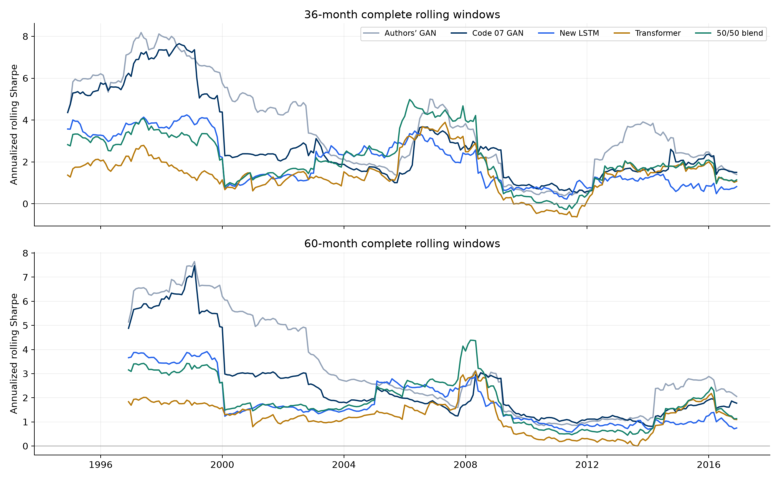
Rolling: 36- and 60-month Sharpe
Both window lengths show changes in relative performance.
Part 4. Rolling windows
10
Notes:
Suggested speaking time: 55 seconds. Source: results/readme/figures/rolling_sharpe.png from README. Both panels show annualized Sharpe for fixed saved portfolios, using complete 36- and 60-month rolling windows. Authors GAN corresponds to the original-paper portfolio, Code 07 GAN to our replicated GAN, New LSTM to extension LSTM, and 50/50 blend to the equal-weight LSTM–Transformer return combination. Explain how longer windows smooth fluctuations. These are evaluations of fixed models, with no rolling retraining. Overlapping windows do not provide independent evidence.

Slide 11
Rolling: comparison across window lengths
Portfolio | 36-month mean | 60-month mean
Paper GAN | 3.638 | 3.199
Replicated GAN | 2.890 | 2.504
Extension LSTM | 1.992 | 1.795
Transformer | 1.467 | 1.228
Equal-weight blend | 2.166 | 1.871
LSTM has the higher average, while the 36-month Transformer median is slightly higher.
Part 4. Rolling windows
11
Notes:
Suggested speaking time: 35 seconds.
Compare both window lengths. A mean of rolling annualized Sharpes differs from the full-test monthly Sharpe. Keep those quantities separate.
Source notes preserved:
Saved replication and extension returns. New models use nine seeds, a shortened 16/4/48 schedule, four optimizer passes, and validation checkpoint selection. Code 012 subsequently assesses return-sample uncertainty with a paired block bootstrap. Codes 09–11 evaluate saved models without retraining. Source results/consolidated_comparison/tables/official_extended_rolling_summary.csv. Means of overlapping rolling ratios are not full-period Sharpe ratios.

Slide 12
Regimes: definitions and sample sizes
Regime family | Definition | Test months
Business cycle | NBER expansion / recession | 274 / 26
Market volatility | High / low previous-12-month volatility | 123 / 177
The volatility cutoff comes from the training sample. Recession dates are retrospective.
These are separate partitions. Recession estimates depend on only 26 months.
Part 5. Regime change
12
Notes:
Suggested speaking time: 40 seconds.
Extension 3: define NBER expansion/recession and past-volatility regimes. The test includes only 26 recession months, so regime estimates have limited precision.
Source notes preserved:
Saved replication and extension returns. New models use nine seeds, a shortened 16/4/48 schedule, four optimizer passes, and validation checkpoint selection. Code 012 subsequently assesses return-sample uncertainty with a paired block bootstrap. Codes 09–11 evaluate saved models without retraining. Source results/regime_analysis/tables/monthly_regime_labels.csv. https://fred.stlouisfed.org/series/USREC. Fama–French market returns define lagged volatility with training median threshold 0.039783.

Slide 13

Regimes: comparison among our models
Conditional monthly Sharpe. These regime estimates do not include confidence intervals.
Part 5. Regime change
13
Notes:
Suggested speaking time: 55 seconds.
Use the Code 012 figure to compare all local portfolios by regime. Highlight the variation in rankings and treat the recession results as descriptive point estimates.
Source notes preserved:
Source: results/bootstrap_uncertainty/tables/. Code 012 uses 300 aligned monthly excess returns, January 1992–December 2016, population standard deviation, 10,000 paired circular-block draws, 6/12/24-month blocks. Primary full-test block length is 12. Intervals condition on fixed saved models and the existing history. Figure copied unchanged from results/bootstrap_uncertainty/local_only/figures/local_regime_comparison.png. Interpret with the preceding method and results tables.

Slide 14
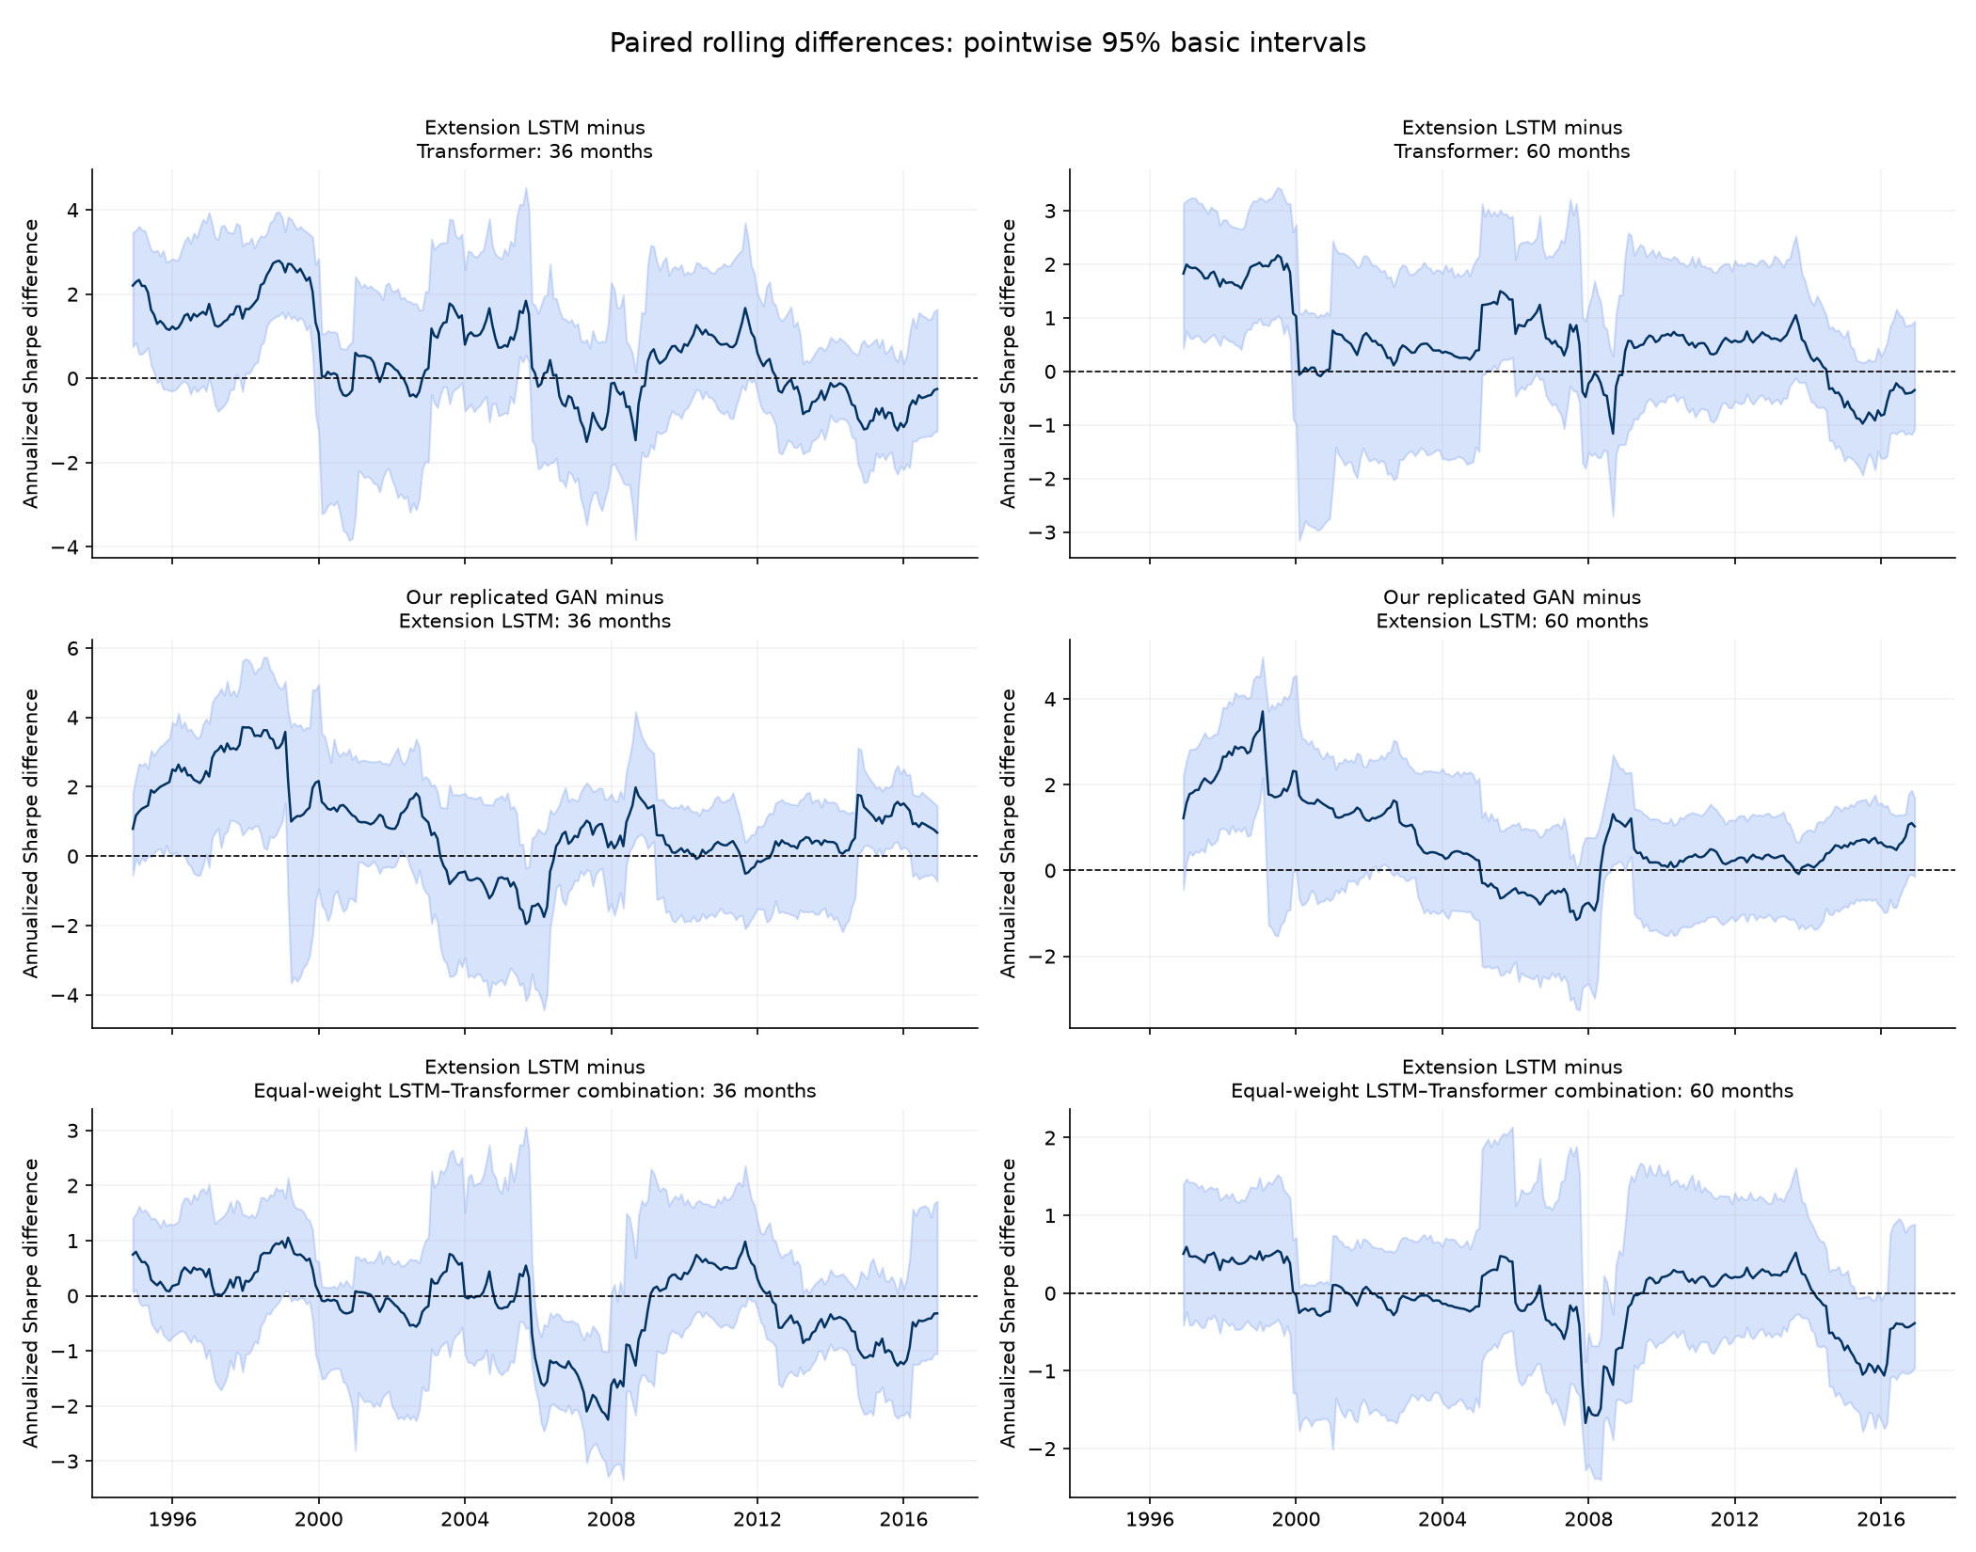
Uncertainty: rolling Sharpe differences
36- and 60-month windows
Line: observed annualized Sharpe gap.
Band: pointwise 95% basic interval.
Bands often cross zero. Many rankings remain unresolved.
Part 6. Uncertainty
14
Notes:
Suggested speaking time: 35 seconds.
Source: results/bootstrap_uncertainty/figures/rolling_difference_uncertainty.png, the exact original README figure from Code 012. Paired circular block bootstrap with 10,000 draws and 12-month blocks, conditional on saved models. Top row compares extension LSTM minus Transformer, middle replicated GAN minus extension LSTM, bottom extension LSTM minus equal-weight combination. Columns show 36 and 60 months. Dashed zero means equal Sharpe. Intervals crossing zero leave that window unresolved. Intervals are pointwise, with no simultaneous adjustment across dates. Overlapping windows do not provide independent evidence. Explain the full-test paired intervals on slide 16 separately.

Slide 15
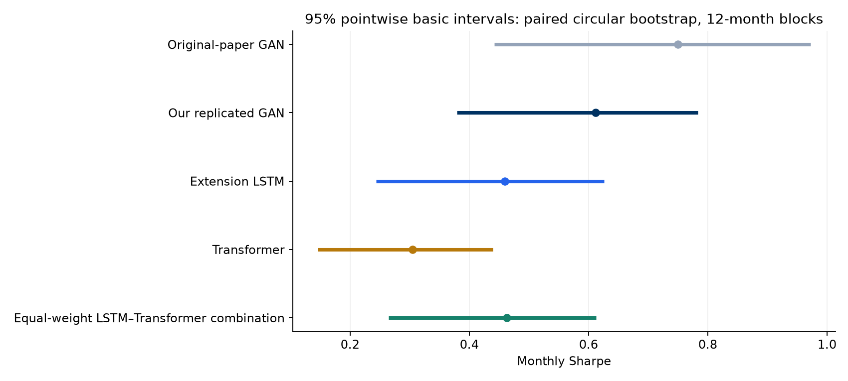
Uncertainty: model Sharpe intervals
Monthly test Sharpe, with 95% basic intervals using 12-month blocks.
Part 6. Uncertainty
15
Notes:
Suggested speaking time: 50 seconds.
Use the Code 012 intervals to separate observed ranking from precision. Show the paper benchmark and replication alongside the matched architecture comparison.
Source notes preserved:
Source: results/bootstrap_uncertainty/tables/. Code 012 uses 300 aligned monthly excess returns, January 1992–December 2016, population standard deviation, 10,000 paired circular-block draws, 6/12/24-month blocks. Primary full-test block length is 12. Intervals condition on fixed saved models and the existing history. Figure copied unchanged from results/bootstrap_uncertainty/figures/model_sharpe_intervals.png. Interpret with the preceding method and results tables.

Slide 16
Uncertainty: paired Sharpe differences
A minus B | Difference | 95% basic | 95% simultaneous
Paper GAN minus Replicated GAN | 0.138 | [-0.037, 0.256] | [-0.148, 0.425]
Extension LSTM minus Transformer | 0.155 | [-0.049, 0.365] | [-0.132, 0.441]
Extension LSTM minus Equal-weight blend | -0.004 | [-0.132, 0.119] | [-0.290, 0.283]
A positive point estimate can coexist with an interval containing zero.
LSTM minus Transformer is 0.155, with basic interval spanning zero.
Part 6. Uncertainty
16
Notes:
Suggested speaking time: 55 seconds.
The LSTM minus Transformer point gap is 0.155 monthly Sharpe. Its basic 95% interval includes zero. Simultaneous comparisons also leave that ranking unresolved. This does not prove equivalence.
Source notes preserved:
Source: results/bootstrap_uncertainty/tables/. Code 012 uses 300 aligned monthly excess returns, January 1992–December 2016, population standard deviation, 10,000 paired circular-block draws, 6/12/24-month blocks. Primary full-test block length is 12. Intervals condition on fixed saved models and the existing history. paired_sharpe_difference_intervals.csv. Difference is A minus B. Pointwise basic intervals and simultaneous intervals adjust for different families. Simultaneous family contains all ten pairs among the five portfolios.

Slide 17
Combination: equal-weight architecture portfolio
Portfolio | Train | Validation | Test
LSTM | 1.308 | 0.750 | 0.459
Transformer | 1.049 | 0.589 | 0.304
50/50 blend | 1.414 | 0.915 | 0.463
Test correlation between architectures is 0.292. Averaging lowers volatility.
Blend test Sharpe improves only slightly: 0.463 versus LSTM 0.459.
Part 7. Combination
17
Notes:
Suggested speaking time: 40 seconds.
The fixed 50/50 average combines saved LSTM and Transformer portfolio returns. Its test Sharpe is 0.463 versus LSTM 0.459. This exploratory combination was constructed after inspecting test outcomes.
Source notes preserved:
Saved replication and extension returns. New models use nine seeds, a shortened 16/4/48 schedule, four optimizer passes, and validation checkpoint selection. Code 012 subsequently assesses return-sample uncertainty with a paired block bootstrap. Codes 09–11 evaluate saved models without retraining. Source results/consolidated_comparison/tables/architecture_blend_split_comparison.csv. Blend returns equal 0.5*LSTM+0.5*Transformer, without additional gross renormalization. Added after prior test review. Weights are fixed and not optimized.

Slide 18
Combination: 36-month rolling results by regime
In recession-ending windows, Transformer 1.409 slightly exceeds new LSTM 1.383.
Part 7. Combination
18
Notes:
Suggested speaking time: 45 seconds.
Combine rolling evaluation with regimes labeled at the endpoint. A recession-ending 36-month window includes earlier expansion months. These annualized values answer a different question from conditional monthly regime Sharpe.
Source notes preserved:
Saved replication and extension returns. New models use nine seeds, a shortened 16/4/48 schedule, four optimizer passes, and validation checkpoint selection. Code 012 subsequently assesses return-sample uncertainty with a paired block bootstrap. Codes 09–11 evaluate saved models without retraining. Source results/consolidated_comparison/tables/official_extended_endpoint_regimes.csv. These are mean annualized trailing Sharpes classified by end-month state. They are not Sharpe ratios of regime-only returns. Window observations overlap.

Slide 19
Combination: overall, rolling and recession results
Local portfolio | Test Sharpe monthly | 36-month mean annualized | Recession Sharpe monthly
Replicated GAN | 0.612 | 2.890 | 0.455
Feedforward | 0.570 | 2.620 | 0.570
Equal-weight blend | 0.463 | 2.166 | 0.076
Extension LSTM | 0.459 | 1.992 | 0.264
Elastic Net | 0.412 | 2.074 | 0.254
Linear | 0.406 | 1.740 | 0.404
Transformer | 0.304 | 1.467 | -0.071
The paper benchmark remains in earlier comparisons. This adds seven local portfolios.
Part 7. Combination
19
Notes:
Suggested speaking time: 50 seconds.
Compare all seven local portfolios across overall, rolling and recession metrics. Read the column units explicitly. Historical replication models and the matched new architecture experiment have different implementations.
Source notes preserved:
Source: results/bootstrap_uncertainty/tables/. Code 012 uses 300 aligned monthly excess returns, January 1992–December 2016, population standard deviation, 10,000 paired circular-block draws, 6/12/24-month blocks. Primary full-test block length is 12. Intervals condition on fixed saved models and the existing history. Additional sources: results/bootstrap_uncertainty/local_only/tables/overall_performance.csv, rolling_summary.csv, regime_comparison.csv, paired_intervals.csv. Monthly full-test and recession-only Sharpes differ from mean annualized rolling Sharpe. Local simultaneous intervals recalibrate all 21 local pairs. Regime entries are point estimates with no regime-specific confidence intervals. Recession contains only 26 months.

Slide 20
Summary: findings and next steps
What we add
A common-budget encoder comparison, rolling and regime evaluation, a fixed combination, and paired uncertainty.
What the evidence supports
LSTM has higher observed test Sharpe. Bootstrap intervals leave its advantage over Transformer unresolved.
What remains open
Full author-schedule GPU training, a new holdout, transaction costs and uncertainty across training runs.
The extensions explain performance differences and the limits of those conclusions.
Part 8. Summary
20
Notes:
Suggested speaking time: 90 seconds.
Close with the contribution: matched architecture comparison plus rolling, regime and bootstrap evaluation, with an illustrative portfolio combination. LSTM leads the Transformer in point estimates, but intervals leave the gap unresolved. Full author-schedule GPU runs, a new holdout and trading costs remain future work.
Source notes preserved:
Saved replication and extension returns. New models use nine seeds, a shortened 16/4/48 schedule, four optimizer passes, and validation checkpoint selection. Code 012 subsequently assesses return-sample uncertainty with a paired block bootstrap. Codes 09–11 evaluate saved models without retraining. Code 012 does not establish equivalence from an interval containing zero. Fixed equal-weight combination was considered after test inspection. Recession labels are retrospective. No transaction costs, genuinely unseen holdout, retraining uncertainty, or real-time vintage correction is included.

