Slide 1


Deep Learning in Asset Pricing
Research question: can model changes improve asset-pricing performance?
Replication and Model Comparisons
Transformer, rolling windows, regimes and portfolio combinations
Reza Zamani, Hrafnhildur Lif Jonsdottir
Paraj Goyal and Elouan Bahri
Professor: Ali Kakhbod
Group 7 · October 2026
Notes:
Suggested speaking time: 15 seconds.
Introduce the asset-pricing question and the team. This talk distinguishes the published paper, our historical replication and the matched extension experiment.
Source notes preserved:
Asset Pricing with Deep Learning: Replication and Extensions. Eight sections: main paper, replication, Transformer, rolling windows, regime change, uncertainty, combination, summary. Source photograph and logo retained from the earlier presentation.
Presenter points:
1. Research question: can model changes improve asset-pricing performance?

Slide 2
Presentation overview
1. Main paper
2. Replication
3. Transformer
4. Rolling windows
5. Regime change
6. Uncertainty
7. Combination
8. Summary
Establish the published paper and replication benchmarks.
Evaluate four extensions, then compare combined results.
15-minute presentation
2
Notes:
Suggested speaking time: 25 seconds.
Give the eight-part roadmap. Four extensions cover Transformer, rolling performance, economic regimes and uncertainty. The final comparison combines these perspectives.
Source notes preserved:
Four extension sections: Transformer, rolling windows, regime change, and uncertainty. The combination section compares results jointly before the summary.
Presenter points:
1. Establish the published paper and replication benchmarks.
2. Evaluate four extensions, then compare combined results.

Slide 3
Main paper: model architecture and data
Goal: learn a stochastic discount factor through conditional pricing moments.
Component | Input and role | Output
Macro SDF encoder | 178 macro series, LSTM | 4 states
Pricing-weight network | 46 characteristics + states | Two layers of 64 units
Macro instrument encoder | 178 macro series, LSTM | 32 states
Conditional network | Characteristics + states | 8 bounded instruments
The SDF network minimizes pricing errors, while an adversary exposes remaining errors.
Train 1967–86, validate 1987–91, and test 1992–2016.
Part 1. Main paper
3
Notes:
Suggested speaking time: 50 seconds.
Explain that the pricing network learns a stochastic discount factor and the adversary searches for pricing errors. LSTM summarizes macroeconomic history. State the train, validation and test dates.
Source notes preserved:
Chen, Pelger and Zhu, Deep Learning in Asset Pricing, arXiv:1904.00745v6, https://arxiv.org/pdf/1904.00745. Published results use Table I. Corrected the earlier slides: 46 firm characteristics, 64 hidden units, and 0.95 dropout retention (0.05 dropout probability).
Presenter points:
1. The SDF network minimizes pricing errors, while an adversary exposes remaining errors.
2. Train 1967–86, validate 1987–91, and test 1992–2016.

Slide 4
Main paper: published results
Model | Train | Validation | Test
LS | 1.800 | 0.580 | 0.420
EN | 1.370 | 1.150 | 0.500
FFN | 0.450 | 0.420 | 0.440
GAN | 2.680 | 1.430 | 0.750
GAN has the highest published monthly Sharpe in every split.
Use these results as the reference benchmark for our replication and extensions.
Part 1. Main paper
4
Notes:
Suggested speaking time: 40 seconds.
State the published monthly test Sharpe of 0.750. Published results are the reference, with the model and data definitions shown here.
Source notes preserved:
Chen, Pelger and Zhu, Deep Learning in Asset Pricing, arXiv:1904.00745v6, https://arxiv.org/pdf/1904.00745. Published results use Table I. All numbers on this slide are monthly Table I Sharpe ratios. Annualized values multiply by square root of 12.
Presenter points:
1. GAN has the highest published monthly Sharpe in every split.
2. Use these results as the reference benchmark for our replication and extensions.

Slide 5
Replication: comparison with the main paper
Our GAN test Sharpe is 0.612, compared with the paper’s 0.750.
Similar rankings support replication, but do not imply exact numerical reproduction.
Part 2. Replication
5
Notes:
Suggested speaking time: 45 seconds.
Our replicated GAN reaches monthly test Sharpe 0.612. Distinguish this historical replication from the later extension implementation. The gap from 0.750 does not isolate one implementation choice.
Source notes preserved:
Chen, Pelger and Zhu, Deep Learning in Asset Pricing, arXiv:1904.00745v6, https://arxiv.org/pdf/1904.00745. Published results use Table I. Local values recomputed with population standard deviation for consistency. This changes the earlier presentation’s GAN test 0.611 to 0.612 after rounding. Source results/rolling_oos_reduced_schedule/tables/all_models_vs_paper_monthly_sharpe.csv.
Presenter points:
1. Our GAN test Sharpe is 0.612, compared with the paper’s 0.750.
2. Similar rankings support replication, but do not imply exact numerical reproduction.

Slide 6
Replication: validation and common signals
Check | Our result | Reference
FF-3 test Sharpe | 0.196 | Paper 0.190
FF-5 test Sharpe | 0.223 | Paper 0.220
GAN test correlation | 0.800 | Authors’ monthly GAN
Leading characteristics | ST_REV, SUV, r12_2 | Same top three
Factor Sharpe, return correlation and leading characteristics show economic similarity.
Implementation differences can still affect the replication gap.
Part 2. Replication
6
Notes:
Suggested speaking time: 35 seconds.
Summarize validation and common signals. Explain why reproduction checks matter before interpreting architectural extensions.
Source notes preserved:
Sources: previous replication deck slides 11, 14, 15. results/tables/gan_official_sdf_comparison.csv. Fama–French benchmark values retain the earlier deck’s displayed convention.
Presenter points:
1. Factor Sharpe, return correlation and leading characteristics show economic similarity.
2. Implementation differences can still affect the replication gap.

Slide 7
Transformer: the common training budget
Setting | Audited author setup | Our completed run
Stage 1 / 2 / 3 epochs | 256 / 64 / 1024 | 16 / 4 / 48
Optimizer passes | 4 | 4
Checkpoint warm-up | 64 epochs | 4 epochs
Seeds per architecture | 9 | 9
Training framework | TensorFlow author code | PyTorch port
Causal attention replaces both macro LSTM encoders.
Both architectures use nine seeds and the same reduced training schedule.
Part 3. Transformer
7
Notes:
Suggested speaking time: 50 seconds.
Extension 1: replace the macro sequence encoder with causal attention. Both new architectures use nine seeds and the same reduced training budget and checkpoint rule. This is shorter than the author schedule.
Source notes preserved:
Saved replication and extension returns. New models use nine seeds, a shortened 16/4/48 schedule, four optimizer passes, and validation checkpoint selection. Code 012 subsequently assesses return-sample uncertainty with a paired block bootstrap. Codes 09–11 evaluate saved models without retraining. Author training repository commit 6c26b9dad01e76b214ab8f5566c42a29e99677c9, https://github.com/LouisChen1992/Deep_Learning_Asset_Pricing. Schedule is from audited executable configuration, not a claim that every source detail matches.
Presenter points:
1. Causal attention replaces both macro LSTM encoders.
2. Both architectures use nine seeds and the same reduced training schedule.

Slide 8
Transformer: train, validation and test results
Extension LSTM leads Transformer: test monthly Sharpe is 0.459 versus 0.304.
This comparison holds under our reduced budget, not the full author schedule.
Part 3. Transformer
8
Notes:
Suggested speaking time: 60 seconds.
Compare train, validation and test on the same schedule. Monthly test Sharpe is 0.459 for extension LSTM and 0.304 for Transformer. A newer architecture does not guarantee improvement.
Source notes preserved:
Chen, Pelger and Zhu, Deep Learning in Asset Pricing, arXiv:1904.00745v6, https://arxiv.org/pdf/1904.00745. Published results use Table I. Source results/rolling_oos_reduced_schedule/tables/all_models_vs_paper_monthly_sharpe.csv. Original paper and Code 07 use different estimation procedures from the matched new pair.
Presenter points:
1. Extension LSTM leads Transformer: test monthly Sharpe is 0.459 versus 0.304.
2. This comparison holds under our reduced budget, not the full author schedule.

Slide 9
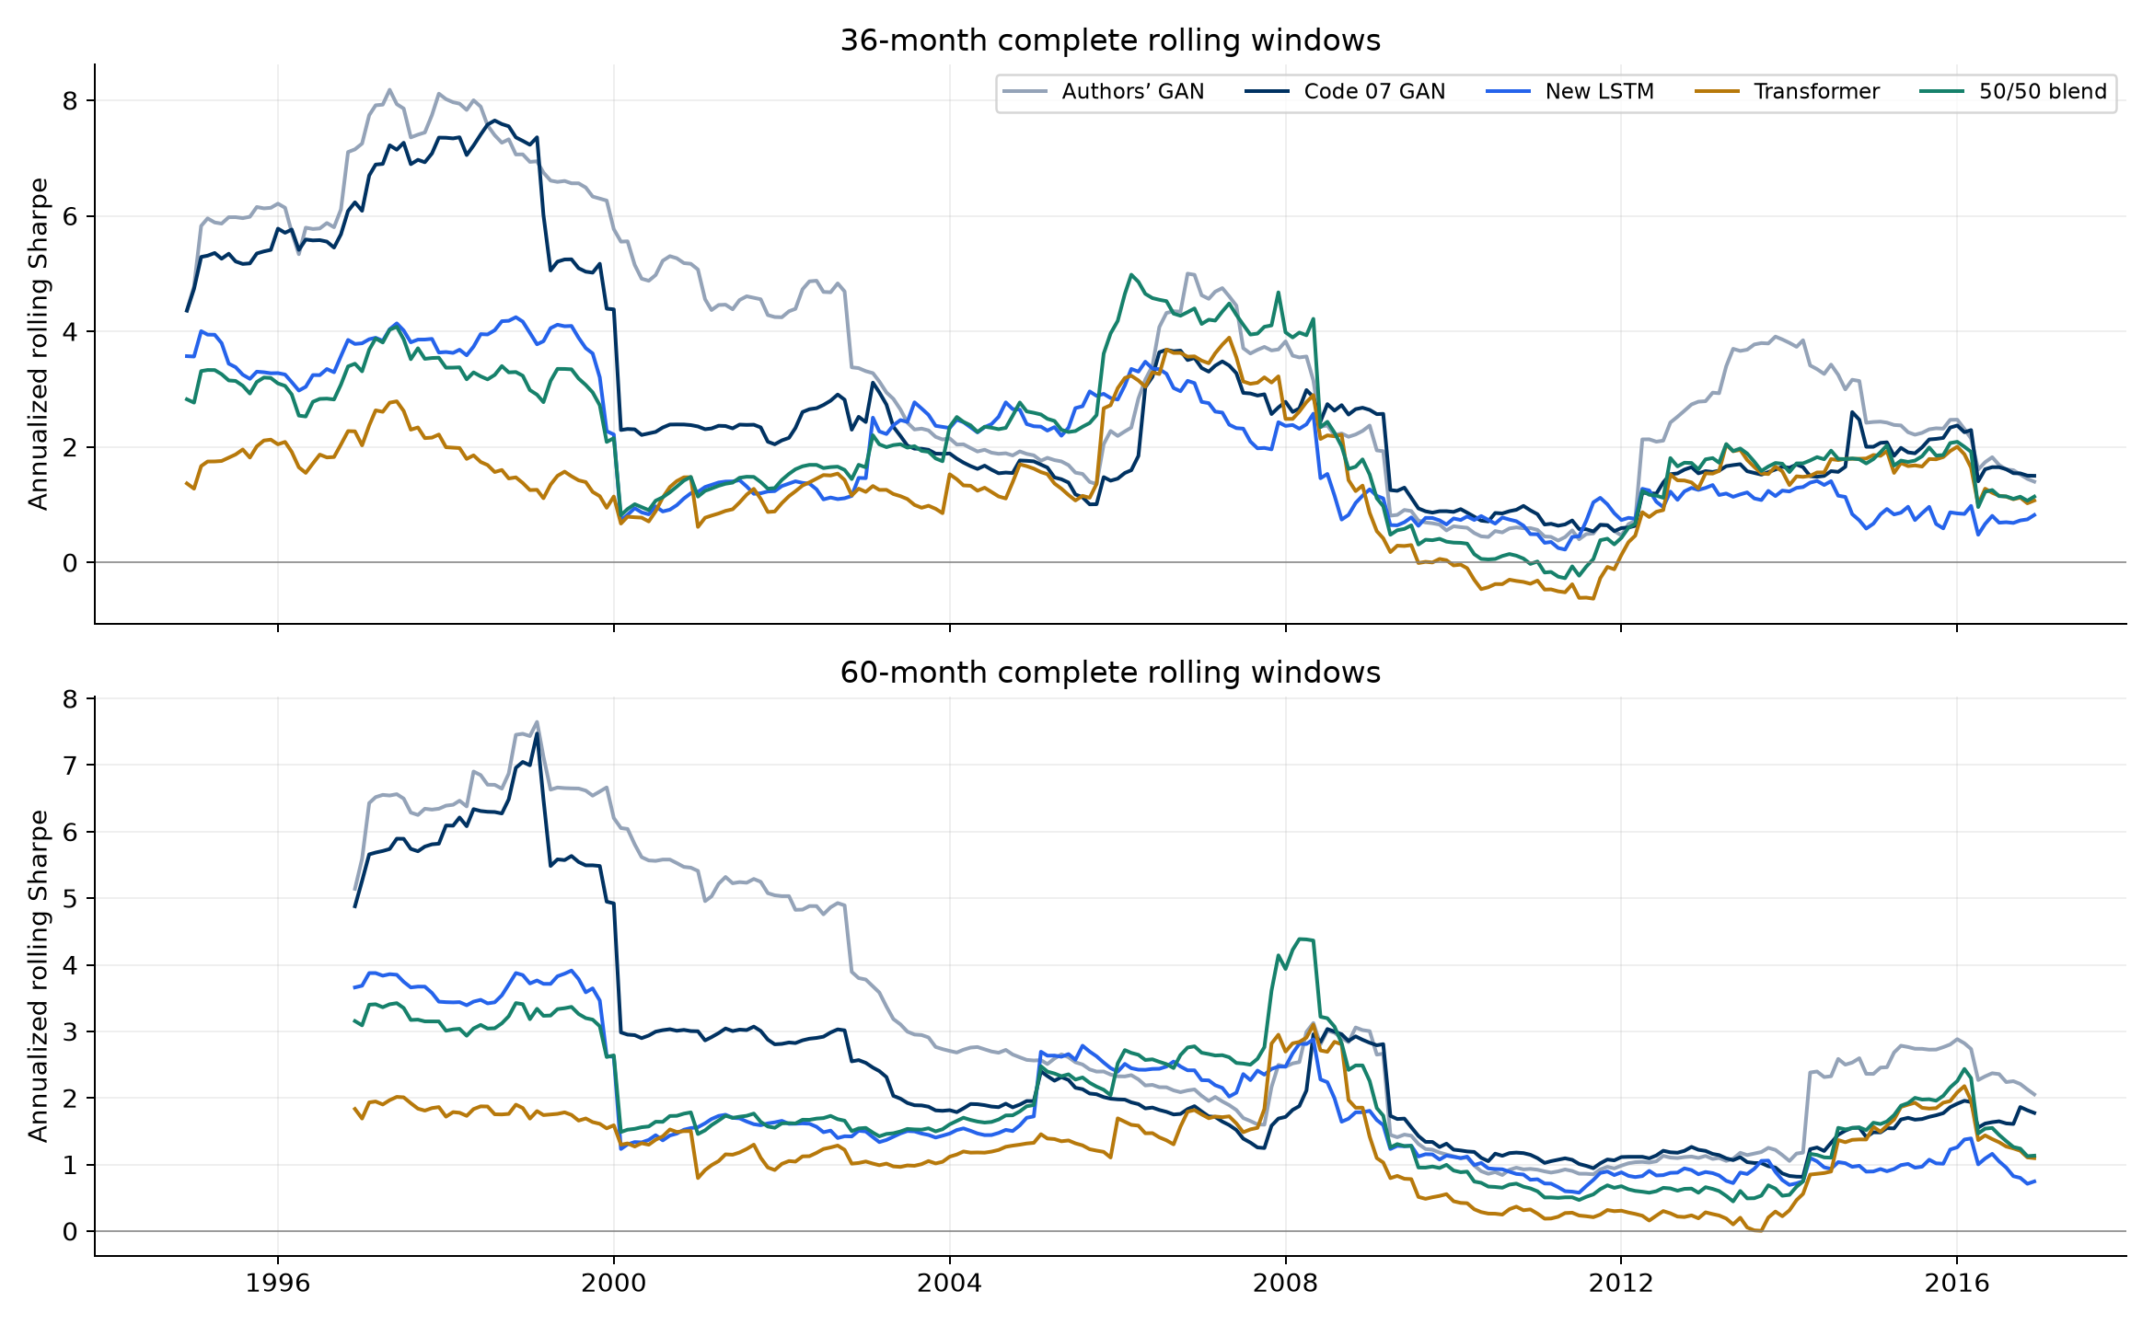
Rolling: 36- and 60-month Sharpe
Curves show annualized Sharpe over the previous 36 or 60 months.
Longer windows smooth fluctuations. These fixed models are not retrained.
Part 4. Rolling windows
9
Notes:
Suggested speaking time: 55 seconds. Source: results/readme/figures/rolling_sharpe.png from README. Both panels show annualized Sharpe for fixed saved portfolios, using complete 36- and 60-month rolling windows. Authors GAN corresponds to the original-paper portfolio, Code 07 GAN to our replicated GAN, New LSTM to extension LSTM, and 50/50 blend to the equal-weight LSTM–Transformer return combination. Explain how longer windows smooth fluctuations. These are evaluations of fixed models, with no rolling retraining. Overlapping windows do not provide independent evidence.
Presenter points:
1. Curves show annualized Sharpe over the previous 36 or 60 months.
2. Longer windows smooth fluctuations. These fixed models are not retrained.

Slide 10
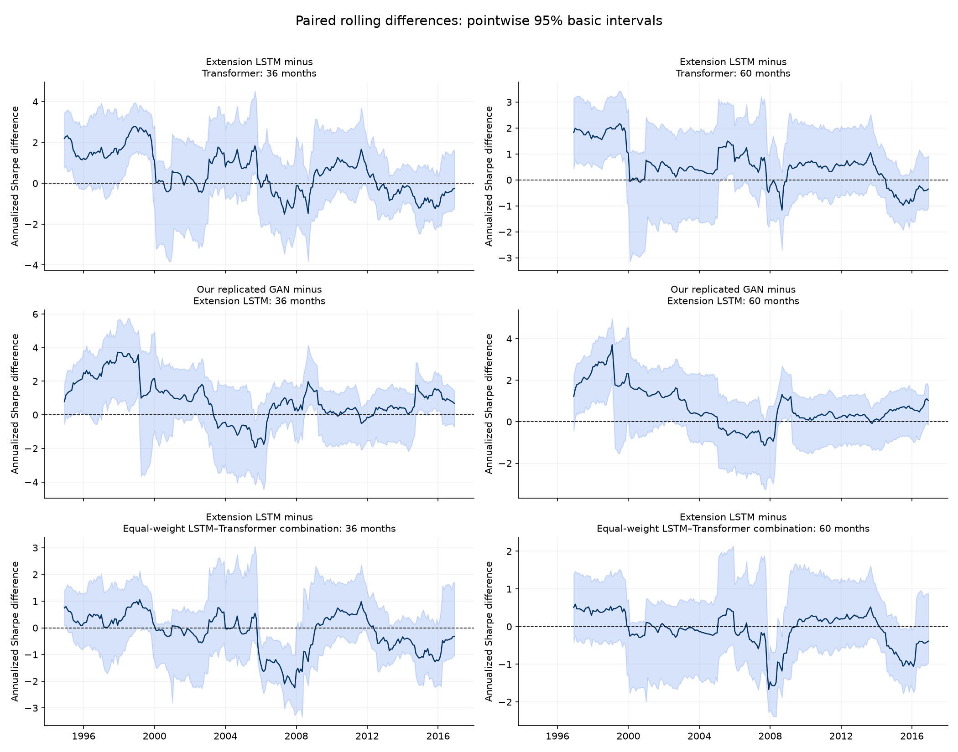
Rolling: paired Sharpe differences
36- and 60-month windows
Line: observed annualized Sharpe gap.
Band: pointwise 95% basic interval.
Line: observed paired Sharpe gap. Shading: pointwise 95% basic interval.
A band crossing zero leaves that window’s ranking unresolved.
Part 4. Rolling windows
10
Notes:
Suggested speaking time: 35 seconds. Source: results/bootstrap_uncertainty/figures/rolling_difference_uncertainty.png. Annualized paired rolling differences, pointwise 95% basic intervals, six-month blocks and 2,000 paired draws. Top: LSTM minus Transformer. Middle: replication minus extension LSTM. Bottom: LSTM minus equal-weight combination. Overlapping windows are dependent. A band containing zero leaves that window unresolved.
Presenter points:
1. Line: observed paired Sharpe gap. Shading: pointwise 95% basic interval.
2. A band crossing zero leaves that window’s ranking unresolved.

Slide 11
Regimes: definitions and sample sizes
Regime family | Definition | Test months
Business cycle | NBER expansion / recession | 274 / 26
Market volatility | High / low previous-12-month volatility | 123 / 177
The volatility cutoff comes from the training sample. Recession dates are retrospective.
Business-cycle and volatility regimes classify different economic conditions.
Only 26 recession months limit precision. NBER labels are retrospective.
Part 5. Regime change
11
Notes:
Suggested speaking time: 40 seconds.
Extension 3: define NBER expansion/recession and past-volatility regimes. The test includes only 26 recession months, so regime estimates have limited precision.
Source notes preserved:
Saved replication and extension returns. New models use nine seeds, a shortened 16/4/48 schedule, four optimizer passes, and validation checkpoint selection. Code 012 subsequently assesses return-sample uncertainty with a paired block bootstrap. Codes 09–11 evaluate saved models without retraining. Source results/regime_analysis/tables/monthly_regime_labels.csv. https://fred.stlouisfed.org/series/USREC. Fama–French market returns define lagged volatility with training median threshold 0.039783.
Presenter points:
1. Business-cycle and volatility regimes classify different economic conditions.
2. Only 26 recession months limit precision. NBER labels are retrospective.

Slide 12

Regimes: comparison among our models
Bars show monthly Sharpe using only months in each regime.
Feedforward leads recession Sharpe at 0.570, while Transformer has -0.071.
Part 5. Regime change
12
Notes:
Suggested speaking time: 55 seconds.
Use the Code 012 figure to compare all local portfolios by regime. Highlight the variation in rankings and treat the recession results as descriptive point estimates.
Source notes preserved:
Source: results/bootstrap_uncertainty/tables/. Code 012 uses 300 aligned monthly excess returns, January 1992–December 2016, population standard deviation, 10,000 paired circular-block draws, 6/12/24-month blocks. Primary full-test block length is 12. Intervals condition on fixed saved models and the existing history. Figure copied unchanged from results/bootstrap_uncertainty/local_only/figures/local_regime_comparison.png. Interpret with the preceding method and results tables.
Presenter points:
1. Bars show monthly Sharpe using only months in each regime.
2. Feedforward leads recession Sharpe at 0.570, while Transformer has -0.071.

Slide 13
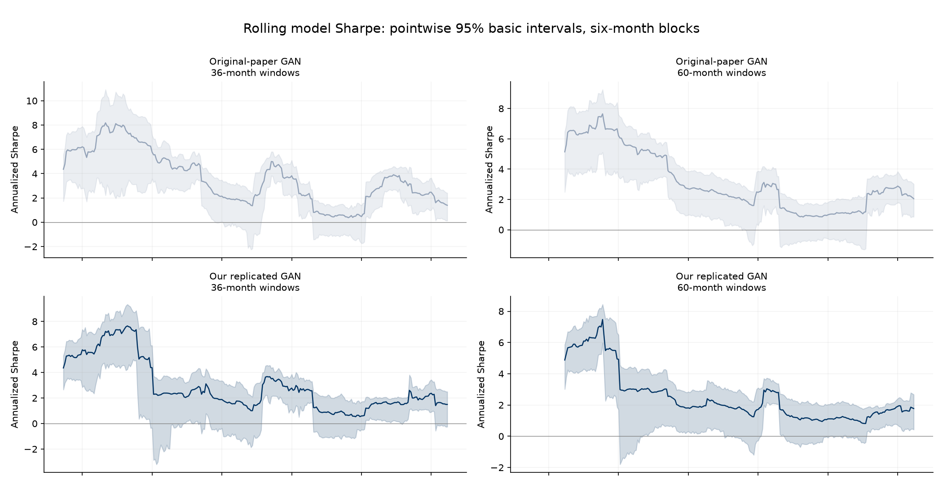
Uncertainty: paper and replication
Lines show annualized rolling Sharpe for the paper and replicated GAN.
Some bands cross zero, leaving positive Sharpe unresolved in those windows.
Part 6. Uncertainty
13
Notes:
Suggested speaking time: 35 seconds. Source: results/bootstrap_uncertainty/figures/rolling_model_uncertainty.png, Code 012. Original-paper GAN and our replicated GAN, both window lengths. The original figure is split across slides 13 and 14 without omitting any model panel. Curves show annualized rolling model Sharpe, bands pointwise 95% basic intervals with six-month blocks. These are marginal model intervals. Their overlap does not establish uncertainty in paired differences. The paired-difference figure on slide 10 uses six-month blocks. Both analyses condition on saved models. Overlapping windows are not independent observations.
Presenter points:
1. Lines show annualized rolling Sharpe for the paper and replicated GAN.
2. Some bands cross zero, leaving positive Sharpe unresolved in those windows.

Slide 14
Uncertainty: extension models
Separate confidence bands show sampling uncertainty for each extension model.
Several bands cross zero. Use the paired comparison on slide 15 to assess model gaps.
Part 6. Uncertainty
14
Notes:
Suggested speaking time: 50 seconds. Source: results/bootstrap_uncertainty/figures/rolling_model_uncertainty.png, Code 012. Extension LSTM, Transformer and equal-weight combination, both window lengths. The original figure is split across slides 13 and 14 without omitting any model panel. Curves show annualized rolling model Sharpe, bands pointwise 95% basic intervals with six-month blocks. These are marginal model intervals. Their overlap does not establish uncertainty in paired differences. The paired-difference figure on slide 10 uses six-month blocks. Both analyses condition on saved models. Overlapping windows are not independent observations.
Presenter points:
1. Separate confidence bands show sampling uncertainty for each extension model.
2. Several bands cross zero. Use the paired comparison on slide 15 to assess model gaps.

Slide 15
Uncertainty: paired Sharpe differences
A minus B | Difference | 95% basic | 95% simultaneous
Paper GAN minus Replicated GAN | 0.138 | [-0.037, 0.256] | [-0.148, 0.425]
Extension LSTM minus Transformer | 0.155 | [-0.049, 0.365] | [-0.132, 0.441]
Extension LSTM minus Equal-weight blend | -0.004 | [-0.132, 0.119] | [-0.290, 0.283]
A positive point estimate can coexist with an interval containing zero.
LSTM exceeds Transformer by 0.155 monthly Sharpe, but both intervals include zero.
The observed advantage remains statistically unresolved. This does not prove equality.
Part 6. Uncertainty
15
Notes:
Suggested speaking time: 55 seconds.
The LSTM minus Transformer point gap is 0.155 monthly Sharpe. Its basic 95% interval includes zero. Simultaneous comparisons also leave that ranking unresolved. This does not prove equivalence.
Source notes preserved:
Source: results/bootstrap_uncertainty/tables/. Code 012 uses 300 aligned monthly excess returns, January 1992–December 2016, population standard deviation, 10,000 paired circular-block draws, 6/12/24-month blocks. Primary full-test block length is 12. Intervals condition on fixed saved models and the existing history. paired_sharpe_difference_intervals.csv. Difference is A minus B. Pointwise basic intervals and simultaneous intervals adjust for different families. Simultaneous family contains all ten pairs among the five portfolios.
Presenter points:
1. LSTM exceeds Transformer by 0.155 monthly Sharpe, but both intervals include zero.
2. The observed advantage remains statistically unresolved. This does not prove equality.

Slide 16
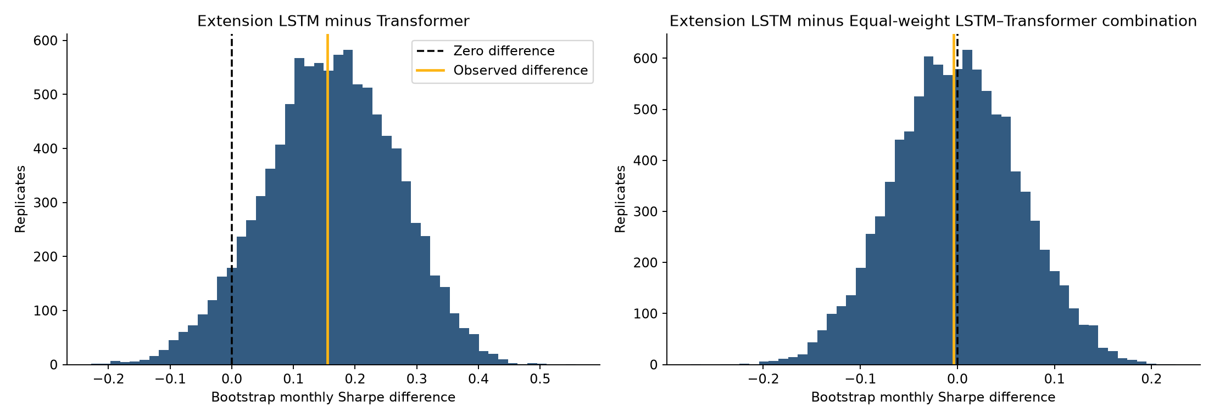
Uncertainty: bootstrap Sharpe differences
Bars count 10,000 draws. Gold marks the observed gap, black marks zero.
Both paired 95% basic intervals include zero, despite different point estimates.
Part 6. Uncertainty
16
Notes:
Suggested speaking time: 30 seconds. Source: results/bootstrap_uncertainty/figures/bootstrap_difference_distributions.png, Code 012. These are 10,000 paired circular bootstrap draws using 12-month blocks over the full 300-month test sample. X axis is a monthly Sharpe difference and y axis counts bootstrap replicates. Dashed black indicates zero and gold the observed gap. The LSTM minus Transformer point gap is 0.155, with 95% basic interval [-0.049,0.365]. The LSTM minus combination gap is -0.004, interval [-0.132,0.119]. These distributions are conditional on saved models and are not posterior probabilities or null-test distributions. Both paired basic intervals include zero.
Presenter points:
1. Bars count 10,000 draws. Gold marks the observed gap, black marks zero.
2. Both paired 95% basic intervals include zero, despite different point estimates.

Slide 17
Combination: equal-weight architecture portfolio
Portfolio | Train | Validation | Test
LSTM | 1.308 | 0.750 | 0.459
Transformer | 1.049 | 0.589 | 0.304
50/50 blend | 1.414 | 0.915 | 0.463
Test correlation between architectures is 0.292. Averaging lowers volatility.
Averaging saved LSTM and Transformer returns lowers volatility.
Test Sharpe rises only from 0.459 to 0.463. The combination is exploratory.
Part 7. Combination
17
Notes:
Suggested speaking time: 40 seconds.
The fixed 50/50 average combines saved LSTM and Transformer portfolio returns. Its test Sharpe is 0.463 versus LSTM 0.459. This exploratory combination was constructed after inspecting test outcomes.
Source notes preserved:
Saved replication and extension returns. New models use nine seeds, a shortened 16/4/48 schedule, four optimizer passes, and validation checkpoint selection. Code 012 subsequently assesses return-sample uncertainty with a paired block bootstrap. Codes 09–11 evaluate saved models without retraining. Source results/consolidated_comparison/tables/architecture_blend_split_comparison.csv. Blend returns equal 0.5*LSTM+0.5*Transformer, without additional gross renormalization. Added after prior test review. Weights are fixed and not optimized.
Presenter points:
1. Averaging saved LSTM and Transformer returns lowers volatility.
2. Test Sharpe rises only from 0.459 to 0.463. The combination is exploratory.

Slide 18
Combination: 36-month rolling results by regime
Bars group rolling windows by the economic regime at their endpoint.
A recession-ending window includes expansion months, unlike conditional regime Sharpe.
Part 7. Combination
18
Notes:
Suggested speaking time: 45 seconds.
Combine rolling evaluation with regimes labeled at the endpoint. A recession-ending 36-month window includes earlier expansion months. These annualized values answer a different question from conditional monthly regime Sharpe.
Source notes preserved:
Saved replication and extension returns. New models use nine seeds, a shortened 16/4/48 schedule, four optimizer passes, and validation checkpoint selection. Code 012 subsequently assesses return-sample uncertainty with a paired block bootstrap. Codes 09–11 evaluate saved models without retraining. Source results/consolidated_comparison/tables/official_extended_endpoint_regimes.csv. These are mean annualized trailing Sharpes classified by end-month state. They are not Sharpe ratios of regime-only returns. Window observations overlap.
Presenter points:
1. Bars group rolling windows by the economic regime at their endpoint.
2. A recession-ending window includes expansion months, unlike conditional regime Sharpe.

Slide 19
Combination: overall, rolling and recession results
Local portfolio | Test Sharpe monthly | 36-month mean annualized | Recession Sharpe monthly
Replicated GAN | 0.612 | 2.890 | 0.455
Feedforward | 0.570 | 2.620 | 0.570
Equal-weight blend | 0.463 | 2.166 | 0.076
Extension LSTM | 0.459 | 1.992 | 0.264
Elastic Net | 0.412 | 2.074 | 0.254
Linear | 0.406 | 1.740 | 0.404
Transformer | 0.304 | 1.467 | -0.071
Overall, rolling and recession columns answer different questions and use different units.
Replication leads local test Sharpe at 0.612. Feedforward leads recessions at 0.570.
Part 7. Combination
19
Notes:
Suggested speaking time: 50 seconds.
Compare all seven local portfolios across overall, rolling and recession metrics. Read the column units explicitly. Historical replication models and the matched new architecture experiment have different implementations.
Source notes preserved:
Source: results/bootstrap_uncertainty/tables/. Code 012 uses 300 aligned monthly excess returns, January 1992–December 2016, population standard deviation, 10,000 paired circular-block draws, 6/12/24-month blocks. Primary full-test block length is 12. Intervals condition on fixed saved models and the existing history. Additional sources: results/bootstrap_uncertainty/local_only/tables/overall_performance.csv, rolling_summary.csv, regime_comparison.csv, paired_intervals.csv. Monthly full-test and recession-only Sharpes differ from mean annualized rolling Sharpe. Local simultaneous intervals recalibrate all 21 local pairs. Regime entries are point estimates with no regime-specific confidence intervals. Recession contains only 26 months.
Presenter points:
1. Overall, rolling and recession columns answer different questions and use different units.
2. Replication leads local test Sharpe at 0.612. Feedforward leads recessions at 0.570.

Slide 20
Summary: findings and next steps
What we add
A common-budget encoder comparison, rolling and regime evaluation, a fixed combination, and paired uncertainty.
What the evidence supports
LSTM has higher observed test Sharpe. Bootstrap intervals leave its advantage over Transformer unresolved.
What remains open
Full author-schedule GPU training, a new holdout, transaction costs and uncertainty across training runs.
Our contribution combines architecture, rolling, regime and uncertainty evaluation.
Higher point estimates still need uncertainty checks and a new holdout.
Part 8. Summary
20
Notes:
Suggested speaking time: 90 seconds.
Close with the contribution: matched architecture comparison plus rolling, regime and bootstrap evaluation, with an illustrative portfolio combination. LSTM leads the Transformer in point estimates, but intervals leave the gap unresolved. Full author-schedule GPU runs, a new holdout and trading costs remain future work.
Source notes preserved:
Saved replication and extension returns. New models use nine seeds, a shortened 16/4/48 schedule, four optimizer passes, and validation checkpoint selection. Code 012 subsequently assesses return-sample uncertainty with a paired block bootstrap. Codes 09–11 evaluate saved models without retraining. Code 012 does not establish equivalence from an interval containing zero. Fixed equal-weight combination was considered after test inspection. Recession labels are retrospective. No transaction costs, genuinely unseen holdout, retraining uncertainty, or real-time vintage correction is included.
Presenter points:
1. Our contribution combines architecture, rolling, regime and uncertainty evaluation.
2. Higher point estimates still need uncertainty checks and a new holdout.

