Slide 1
Crowded Carry in G10 FX and Crypto
Crash risk in FX and crypto carry trades
STUDENTS
PROFESSOR
Reza Zamani · Paraj Goyal
Amir Kermani
Currency Markets (MFE 230GB) · Final project · October 2026
Notes:
[about 0:20]
• Good morning. Our project asks one question: do carry trades crash when they are crowded?
• We test it in two markets with the same economics: G10 currencies and crypto.
• Strategy A is carry in seven G10 currencies against the US dollar, with a crowding filter built from CFTC data.
• Strategy C is funding carry in twelve crypto perpetual futures on Binance, including the coins that collapsed, Terra and FTX Token.

Slide 2
Carry pays because it crashes
Same economic mechanism, two very different markets
• Carry: borrow the low-yield asset, hold the high-yield one.
• UIP says this earns nothing; in the data it earns a premium, with rare large crashes.
• Crashes are worst when the trade is crowded and everyone unwinds at once (Brunnermeier, Nagel & Pedersen 2008).
Hypotheses, fixed before testing:
• A: carry earns a premium; crowded months are followed by weaker carry; it loses in volatility spikes.
• C: funding carry earns a premium with little BTC exposure; its crashes are coin-specific.
A: G10 FX
C: Crypto
Carry signal
3-month rate differential
Perpetual funding rate
Crowding data
CFTC speculator positions
Funding = leveraged demand
Universe
7 currencies vs USD
12 coins (listed below)
Frequency
Monthly, 1999–2026
Weekly, 2020–2026
Currencies: Japanese yen (JPY), euro (EUR), British pound (GBP), Swiss franc (CHF), Canadian dollar (CAD), Australian dollar (AUD) and New Zealand dollar (NZD), each against the US dollar.
Coins: Bitcoin (BTC), Ethereum (ETH), BNB, XRP, Cardano (ADA), Dogecoin (DOGE), Solana (SOL), Litecoin (LTC), Chainlink (LINK), Avalanche (AVAX), Terra (LUNA) and FTX Token (FTT).
Notes:
[about 1:00]
• Carry means borrowing in a low-yield asset and holding a high-yield one.
• Uncovered interest parity says this should earn nothing, but in the data it earns a premium.
• The catch is crash risk: carry goes up the stairs and down the elevator.
• Brunnermeier, Nagel and Pedersen show crashes are worst when speculators are crowded into the trade.
• In FX the yield is the interest-rate differential, and we measure crowding with CFTC speculator positions.
• Our FX universe is the yen, euro, British pound, Swiss franc, Canadian dollar, Australian dollar and New Zealand dollar, all against the US dollar.
• In crypto the yield is the perpetual funding rate, which also measures leveraged demand.
• Our coins are Bitcoin, Ethereum, BNB, XRP, Cardano, Dogecoin, Solana, Litecoin, Chainlink, Avalanche, Terra and FTX Token.
• We wrote the hypotheses and all parameters down before running any backtest.

Slide 3
Data and methodology
Public data; a research design chosen to keep the tests honest
Data | Source | Coverage
FX spot, 7 currencies | FRED (Fed H.10) | 1999–2026
3-month rates | OECD via FRED | 1999–2026
Speculator positions | CFTC Commitments of Traders | 1986–2026
Crypto price, volume, funding | Binance public archive | 2020–2026
Carry factor (validation) | Lustig–Roussanov–Verdelhan | 1983–2021
• All parameters were fixed before the first backtest.
• The out-of-sample period starts in 2011 for A and in 2024 for C.
• Costs are 3 bp per unit traded in FX and 5 bp in crypto.
• There is no look-ahead: weights set at t earn the return of t+1, and CFTC data are used only after their Friday release.
• There is no survivorship bias, because Terra (LUNA) and FTX Token (FTT) stay in the sample.
• Robustness grids are reported, but they were never used for tuning.
Data fix: before Aug 2000 CFTC lists the same currency futures under 'International Monetary Market'. Matching both names extended positioning back to 1986.
Notes:
[about 0:50]
• All data are public: FRED for FX and rates, CFTC for positions, Binance for crypto.
• One data fix worth mentioning: before 2000 the CFTC lists currency futures under a different exchange name; matching both names gave us positioning back to 1986.
• Every parameter was fixed in advance, and our out-of-sample period starts in 2011 for FX and in 2024 for crypto.
• Returns are net of costs, there is no look-ahead, and we keep the two coins that died, Terra (LUNA) and FTX Token (FTT).

Slide 4
Strategy A: crowding-filtered G10 carry
Yen, euro, pound, Swiss franc, Canadian, Australian and New Zealand dollar vs USD, monthly
1
Carry portfolio
33
At each month-end we buy the 2 highest-rate currencies and sell the 2 lowest, with equal weights and no net dollar bet.
crowded months out of 328, 1999–2026
2
Crowding signal
Each currency's CFTC net speculative position over open interest is z-scored over 36 months.
Who we usually hold
• Long: New Zealand dollar (94% of months) and Australian dollar (75%).
• Short: Swiss franc (99%), Japanese yen (52%) and euro (40%).
3
Portfolio crowding
It is the average z of the long leg minus the average z of the short leg.
4
Filter
If crowding is above 1, all positions are cut to half for the next month.
Notes:
[about 1:00]
• Each month we rank the seven currencies by their three-month interest rate.
• We buy the two highest and sell the two lowest, so the portfolio has no net dollar bet.
• In practice we are almost always long the New Zealand and Australian dollars and short the Swiss franc, often with the yen or the euro.
• For crowding we take speculators' net futures position and z-score it over 36 months.
• Crowding is high when speculators are unusually long what we hold and short what we sell.
• When this score is above one standard deviation, we halve the position, which happened in 33 months.

Slide 5
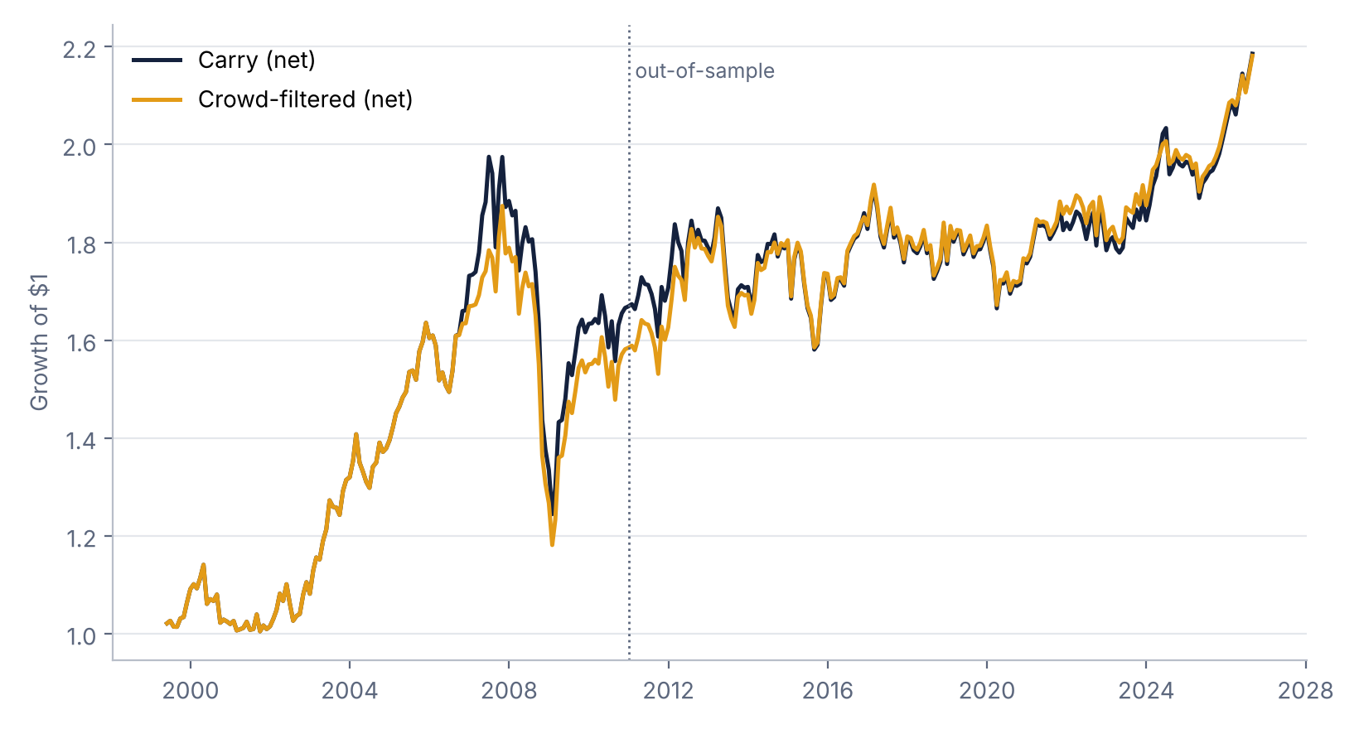
Crowding filter helps out of sample, not in 2008
0.27 → 0.32
Out-of-sample Sharpe, net: carry vs crowd-filtered (2011–2026)
0.30% vs 0.02%
Next-month carry after non-crowded vs crowded months
0.82
Correlation with the academic LRV carry factor (1999–2021)
Full sample, net: Sharpe 0.37 carry, 0.38 filtered; max drawdown -37% either way.
Notes:
[about 1:20]
• Plain carry earns about 3.3% a year after costs, a net Sharpe of 0.37.
• Our carry has a 0.82 correlation with the published Lustig–Roussanov–Verdelhan factor, which validates the code and data.
• After crowded months, next-month carry averages only 0.02% versus 0.30% otherwise, with more negative skew.
• Out of sample the filter lifts the Sharpe from 0.27 to 0.32, and every variant in our robustness grid also beats 0.27.
• But it did not avoid 2008: the crash started from a non-crowded reading, so the max drawdown is -37% either way.
• One caveat is that there are only 33 crowded months, so the effect is not precisely estimated.

Slide 6
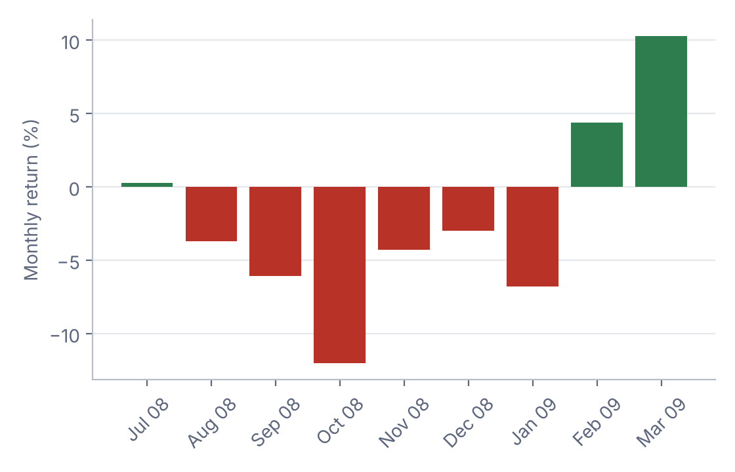
Strategy A loses when volatility spikes
Monthly net carry on risk factors, Newey-West t-stats, 1999–2021
The 2008 carry crash: -20.5% (Jul 2008 – Mar 2009)
-1.55
0.35
Beta to equity-volatility changes (t = -3.7)
Beta to the dollar factor (t = 4.1)
0.25%
0.18
Monthly alpha (t = 1.7): not significant
R² of the two-factor model
Worst months: Oct 2008, Aug 2007, May 2000, Jan 2009, and the Jan 2015 Swiss franc de-peg.
Notes:
[about 0:50]
• To see when it loses, we regress monthly carry on the dollar factor and on equity-volatility shocks.
• The volatility beta is -1.55 with a t-stat of -3.7: carry loses when volatility jumps.
• Once we control for these factors the alpha is not significant, so carry is pay for risk, not a free lunch.
• From July 2008 to March 2009 the strategy lost 20.5% as the funding currencies, the Japanese yen and the Swiss franc, rallied against the Australian and New Zealand dollars.

Slide 7
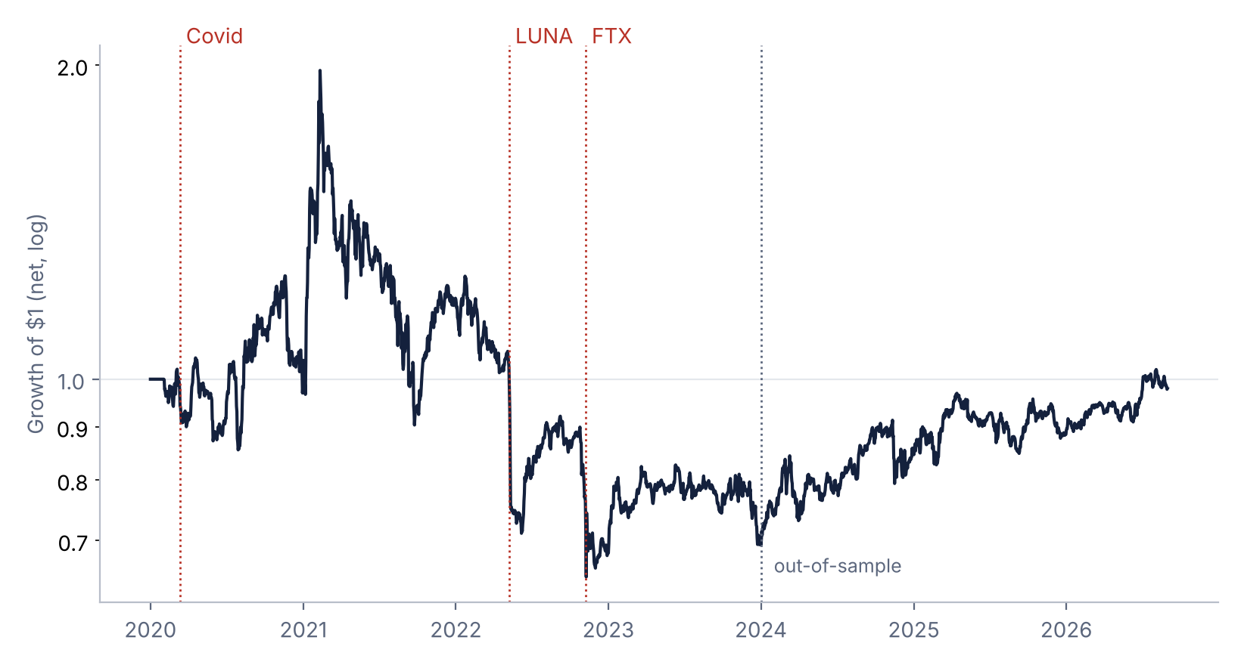
Strategy C: crypto funding carry
Binance perpetuals on BTC, ETH, BNB, XRP, ADA, DOGE, SOL, LTC, LINK, AVAX, LUNA, FTT; weekly, 2020–2026
• Funding is paid every 8 hours, and positive funding means longs pay shorts.
• Each Sunday we short the third of coins with the highest 7-day funding and buy the lowest third.
• The book is dollar-neutral and pays 5 bp per trade.
0.14
0.81
Net Sharpe, full
Net Sharpe, 2024–26
-27%
Worst week: LUNA collapse, May 2022
Notes:
[about 1:20]
• Crypto perpetual futures have their own interest rate, the funding rate, paid every 8 hours between longs and shorts.
• High funding means many leveraged longs, so it is both a carry signal and a crowding signal.
• Each Sunday we short the third of coins with the highest funding and buy the third with the lowest.
• The twelve coins are Bitcoin, Ethereum, BNB, XRP, Cardano, Dogecoin, Solana, Litecoin, Chainlink, Avalanche, Terra and FTX Token.
• We keep Terra (LUNA) and FTX Token (FTT), which both collapsed in 2022, to avoid survivorship bias.
• Net Sharpe is 0.14 over the full sample: -0.07 in 2020 to 2023 and 0.81 since 2024.
• The worst week was the Terra (LUNA) collapse in May 2022, -27.3%: traders were shorting Terra, its funding turned negative, and so our rule held it long.

Slide 8
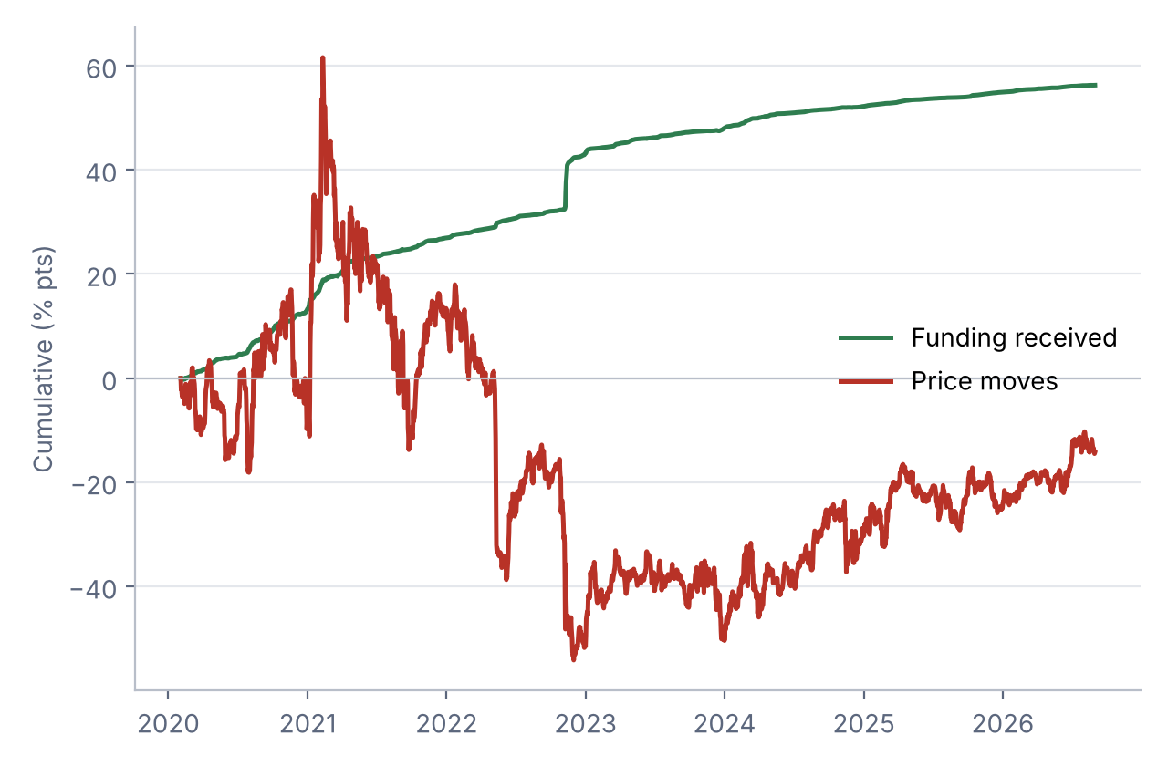
Funding is earned, but price moves dominate
Where the return comes from, and what drives the losses
% per year | Funding | Price | Net
Full | +8.5 | -2.2 | +4.1
In-sample | +12.3 | -12.5 | -2.5
Out-of-sample | +3.1 | +13.0 | +13.9
Takeaways
• Funding income is steady at about 8.5% a year, but price moves decide the result.
• The strategy has no market exposure, since its beta to Bitcoin is -0.02.
• Its losses come from single coins: Terra lost 87 points, XRP 58 and Dogecoin 43.
• Our pre-set risk control lowered the Sharpe from 0.14 to -0.16, so it did not help.
• Deeply negative funding signals crowded shorts, not a cheap coin.
Total P&L by coin, % pts: Solana +102, BNB +51, Avalanche +36; Terra -87, XRP -58, Dogecoin -43, FTX Token -13.
Notes:
[about 1:10]
• We split the return into funding and price. Funding adds about 8.5% a year, steadily.
• But price moves dominate: in 2020 to 2023 the coins we shorted, like Dogecoin and XRP, kept rallying and wiped out the funding.
• Since 2024 most of the gain came from price, so we read the strong out-of-sample number with caution.
• The beta to Bitcoin is about zero, so the strategy has no market exposure.
• Its losses come from single coins: Terra alone cost 87 percentage points, XRP 58 and Dogecoin 43, while Solana and BNB were the biggest winners.
• A risk control we fixed in advance made things worse and lowered the Sharpe to -0.16: the cap halved exposure and the filter missed the timing of Terra's collapse.
• Our takeaway is that crypto carry crashes in the mirror image of FX: it ends up long whatever traders short hardest.

Slide 9
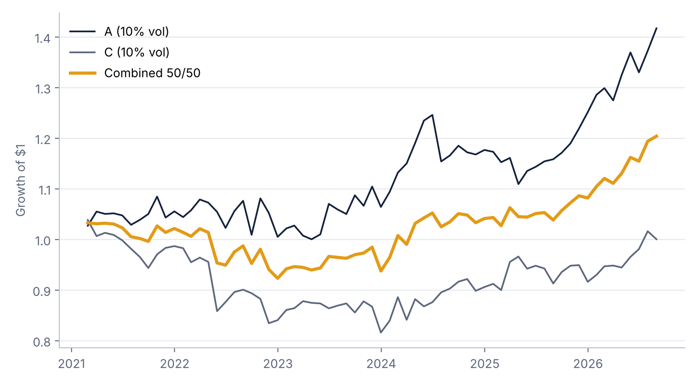
Combining FX and crypto carry
Each scaled to 10% vol with lagged volatility, 50/50, 2021–2026
0.11
Correlation between A and C, monthly, 2021–2026
Takeaways
• FX carry and crypto carry are almost uncorrelated, so they crash at different times.
• The 50/50 mix has 7.0% volatility, compared with about 9% for each strategy alone.
• Its worst month is -5.9%, smaller than for FX (-7.4%) or crypto (-10.2%).
• The mix does not beat FX alone on Sharpe (0.51 vs 0.71), because crypto carry was weak in this window.
 | Sharpe | Vol (%) | Max DD (%) | Worst month (%)
A | 0.71 | 9.4 | -11 | -7.4
C | 0.05 | 9.3 | -21 | -10.2
Combined 50/50 | 0.51 | 7.0 | -11 | -5.9
Notes:
[about 0:50]
• Finally, we scale both strategies to 10% volatility and combine them 50/50.
• Their correlation is only 0.11: FX and crypto carry crash at different times.
• The mix has 7.0% volatility and a Sharpe of 0.51, and its worst month, -5.9%, is smaller than either part's.
• It does not beat FX alone on Sharpe, because crypto carry was weak in this window.
• Our takeaway is that the benefit of combining them is lower risk, not a higher return.

Slide 10
Conclusions and limitations
What we found
Limitations
• FX carry reproduces the academic factor (corr 0.82) and is exposed to volatility shocks.
• Crowding predicts weaker carry, and the filter modestly improves the out-of-sample Sharpe.
• Crypto funding carry is market-neutral, but its crashes are coin-specific: it ends up long what traders short hardest.
• FX and crypto carry are nearly uncorrelated (0.11).
• The crypto history is short (2020–2026) and covers only 12 coins.
• There are only 33 crowded FX months, and the 2008 crash was not flagged.
• The crypto results depend on the lookback and the rebalancing frequency.
• Costs are simple estimates, and we ignore funding-rate caps, borrow limits and exchange risk.
Notes:
[about 1:00]
• To conclude: in both markets carry looks like compensation for crash risk.
• In FX, crowding measured from CFTC positions is a cheap and modestly useful warning sign.
• In crypto, sorting on funding alone exposes you to single-coin collapses like Terra and FTX Token.
• Because the two crash at different times, they diversify each other.
• The main limitations are a short crypto sample, few crowded FX months, and simple cost estimates.
• Thank you, we are happy to take questions.

