Slide 1
Crowded Carry
Crash risk in FX and crypto carry trades
Reza Zamani · [partner]
MFE 230GB Currency Markets · Final project · October 8, 2026
Notes:
Person 1 opens. One sentence: we test whether carry trades crash when they are crowded, in G10 FX and in crypto.

Slide 2
Carry pays because it crashes
Person 1
Same economic mechanism, two very different markets
• High-yield assets earn a premium over low-yield ones.
• The premium is compensation for crash risk: when many investors hold the same trade, forced unwinding produces sudden losses (Brunnermeier, Nagel & Pedersen 2008).
• Hypothesis: crowding is measurable, and crowded carry should crash more.
A: G10 FX
C: Crypto
Carry signal
3-month rate differential
Perpetual funding rate
Crowding data
CFTC speculator positions
Funding = leveraged demand
Universe
7 currencies vs USD
12 coins incl. LUNA, FTT
Frequency
Monthly
Weekly rebalance, daily P&L
Notes:
Explain why both are carry: an FX forward earns the rate differential; a short perpetual earns the funding rate.

Slide 3
Strategy A: crowding-filtered G10 carry
Person 1
JPY, EUR, GBP, CHF, CAD, AUD, NZD vs USD, monthly, 1999–2026
1
Carry portfolio
1986
Each month-end: long the 2 highest-rate currencies, short the 2 lowest. Equal weights, dollar-neutral, 3 bp costs.
CFTC positioning history (after fixing the pre-2000 CME exchange name)
2
Crowding signal (alternative data)
CFTC net speculative position / open interest, 36-month z-score, used only after the Friday release.
33
3
Portfolio crowding
Average z of the long leg minus average z of the short leg.
crowded months out of 328
4
Filter
Crowding > 1: cut positions to half. All parameters fixed before testing; out-of-sample from 2011.
Notes:
Mention the data issue we fixed: before Aug 2000 CME currency futures are reported as 'International Monetary Market'.

Slide 4
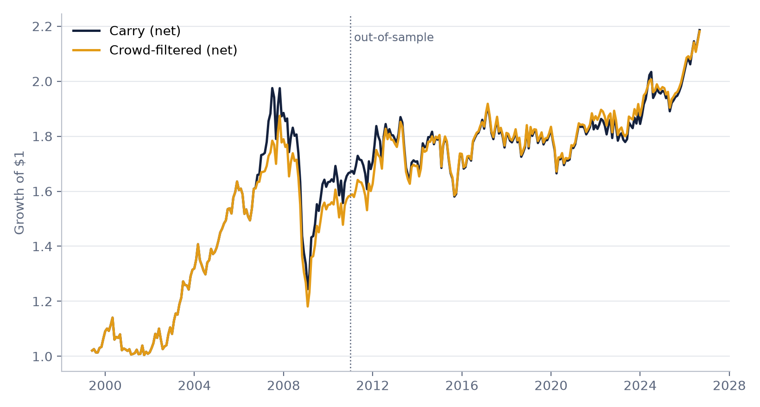
Crowding filter helps out of sample, not in 2008
Person 1
0.27 → 0.32
Out-of-sample Sharpe, net: carry vs crowd-filtered (2011–2026)
0.30% vs 0.02%
Next-month carry after non-crowded vs crowded months
-37%
Max drawdown either way: the 2008 crash began from a non-crowded reading
Notes:
Full-sample net Sharpe 0.37 vs 0.38. The filter roughly doubles turnover.

Slide 5
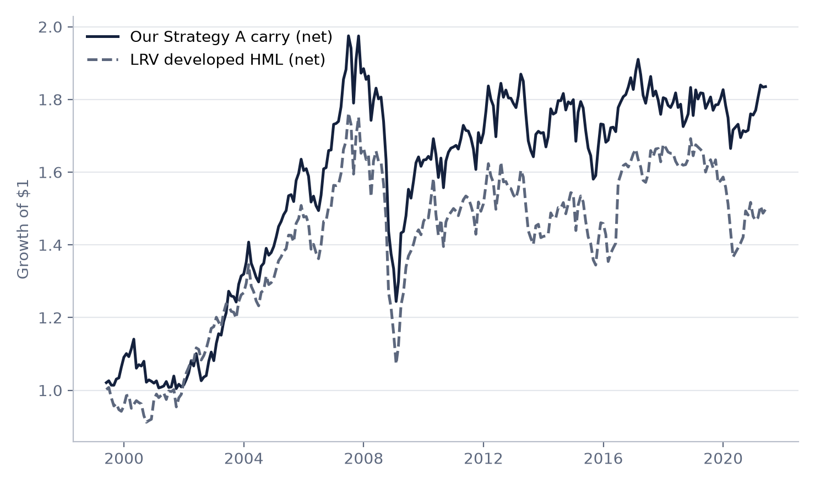
Our carry matches the academic carry factor
Person 1
Strategy A vs Lustig–Roussanov–Verdelhan developed HML, net, 1999–2021
0.82
Monthly correlation with LRV developed HML
Net, 1999–2021 | Ours | LRV
Ann. mean (%) | 3.2 | 2.3
Ann. vol (%) | 9.5 | 10.0
Sharpe | 0.34 | 0.23
Max drawdown (%) | -37 | -39
Notes:
Course file CurrencyPortfolios.xls. This validates our data pipeline and code.

Slide 6
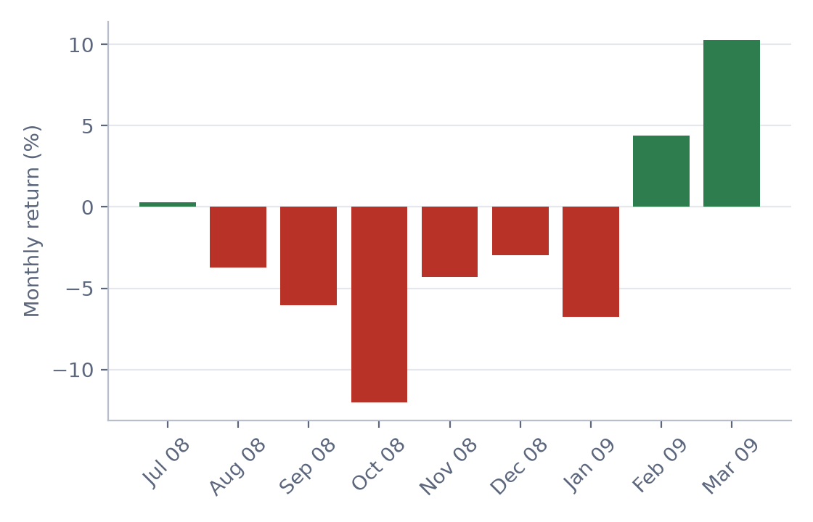
Strategy A loses when volatility spikes
Person 1
Monthly net carry regressed on risk factors, Newey-West t-stats
The 2008 carry crash: -20.5% (Jul 2008 – Mar 2009)
-1.55
0.35
Beta to equity-volatility changes (t = -3.7)
Beta to the dollar factor (t = 4.1)
0.25%
0.18
Monthly alpha (t = 1.7): not significant
R² of the two-factor model
Worst months: Oct 2008, Aug 2007, May 2000, Jan 2009, and the Jan 2015 Swiss franc de-peg.
Notes:
The textbook carry-crash exposure: funding currencies (JPY, CHF) rally when volatility jumps.

Slide 7
Strategy C: crypto funding carry
Person 2
12 Binance USDT perpetuals, 2020–2026; USDC as a sanity check only
1
Signal
≈ 12–15%
Trailing 7-day average funding rate, data up to the day before.
Average annual funding on BTC, ETH, XRP, LTC, LINK: the crypto 'interest rate'
2
Portfolio
Each Sunday: short the top third, long the bottom third by funding. Equal weights, dollar-neutral, 5 bp costs.
2022-11-14
3
P&L
Side × price return − side × funding paid. A short receives positive funding.
FTT's last traded day; the archive shows a frozen price afterwards, which we exclude
4
No survivorship bias
LUNA and FTT included; a coin trades only on days with a price and volume > 0.
Notes:
Funding is paid every 8 hours between longs and shorts and keeps the perpetual close to spot. High funding = crowded leveraged longs.

Slide 8
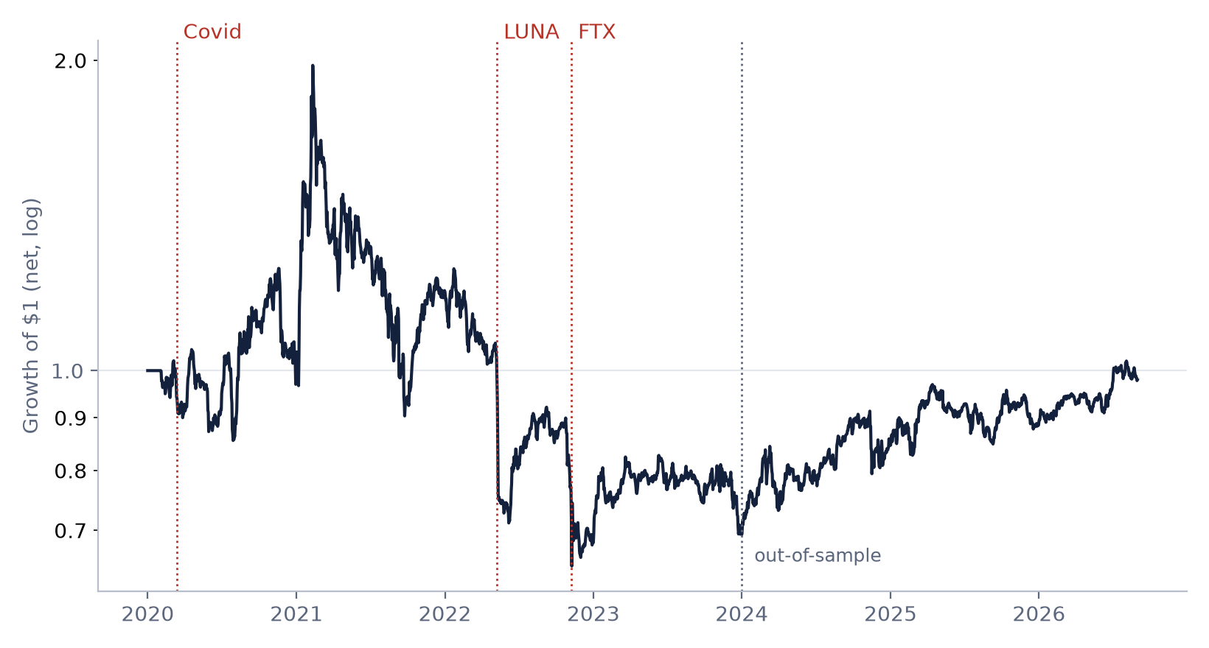
Crypto carry: weak in-sample, strong since 2024
Person 2
0.14
Full-sample net Sharpe (4.1% a year, 30% vol)
0.81
Out-of-sample net Sharpe, 2024–2026
-27%
Worst week (LUNA, May 2022): the strategy was long LUNA
Notes:
LUNA's funding had turned negative as traders shorted it, so the rule held it long into the collapse. FTX week: -11.6%.

Slide 9
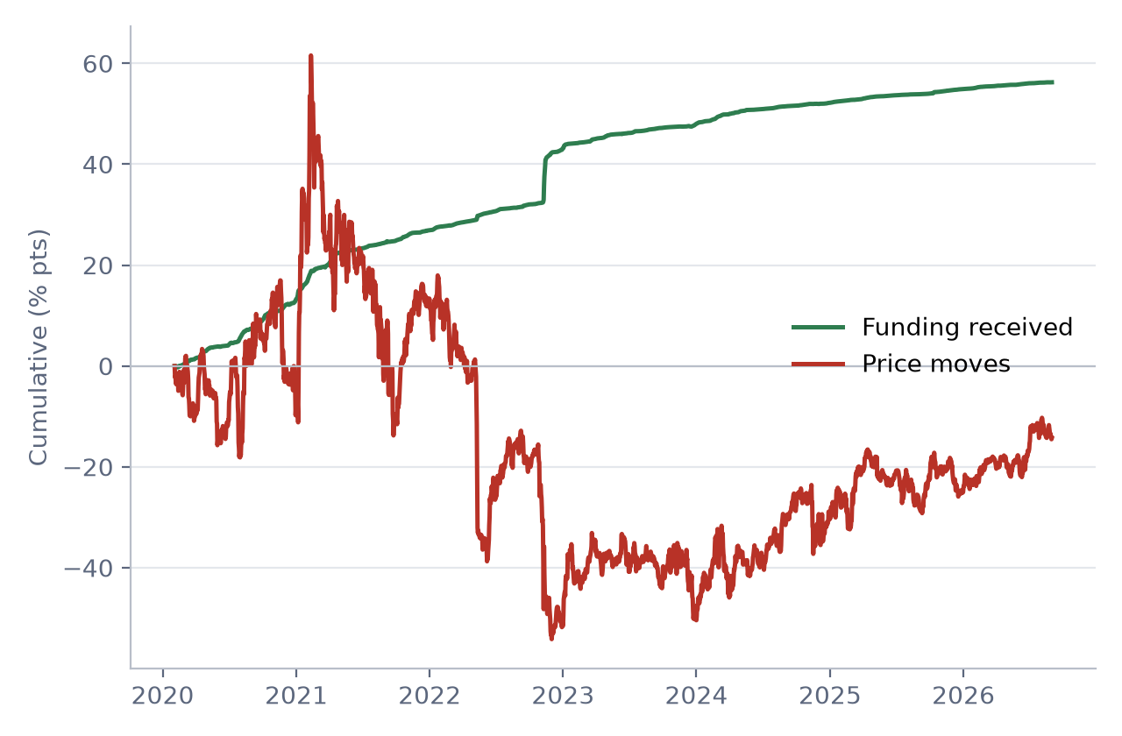
Funding is earned, but price moves dominate
Person 2
Return decomposition and robustness
% per year | Funding | Price | Net
Full | +8.5 | -2.2 | +4.1
In-sample | +12.3 | -12.5 | -2.5
Out-of-sample | +3.1 | +13.0 | +13.9
Lookback × rebalance | Sharpe net | Sharpe OOS
3 days, daily | 0.68 | 0.41
3 days, weekly | 0.49 | 1.29
7 days, daily | 0.56 | 0.92
7 days, weekly (base) | 0.14 | 0.81
30 days, daily | 0.28 | 0.83
30 days, weekly | 0.07 | 0.42
Notes:
Shorter signals do better even after costs: funding information decays within days. We report the pre-specified 7-day weekly case as the main result and do not switch after seeing results.

Slide 10
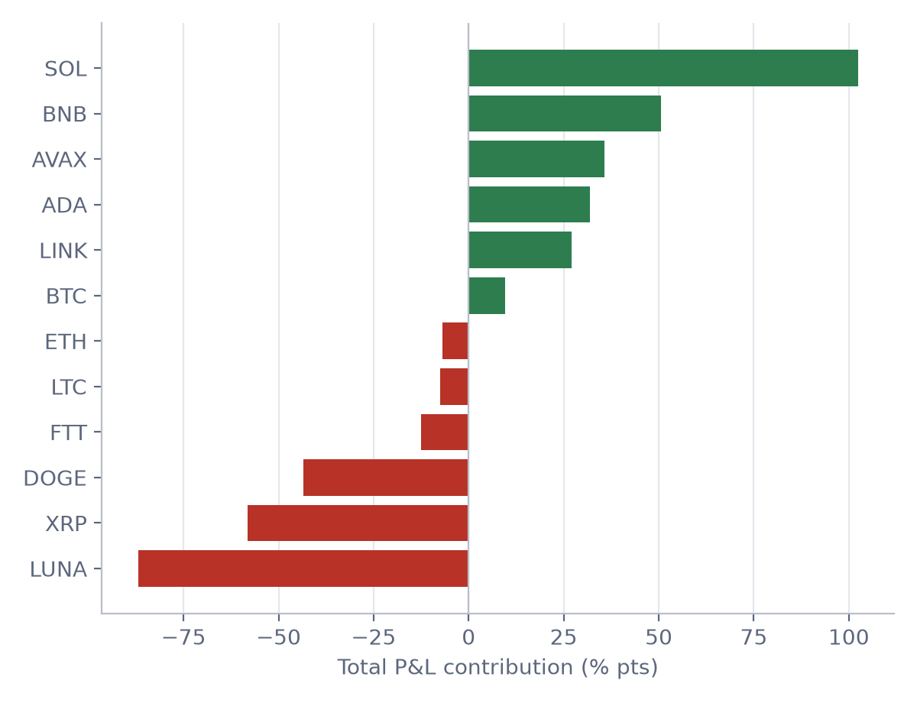
A pre-specified risk control did not help
Person 2
Cap each coin at 1/6 of a leg; no longs with funding below −50% a year
Net | Base | Controlled
Sharpe, full | 0.14 | -0.16
Sharpe, out-of-sample | 0.81 | 0.74
Max drawdown (%) | -67 | -43
LUNA week (%) | -27.3 | -18.9
• The cap mostly halves exposure (3–4 coins per leg).
• LUNA's funding crossed −50% mid-week, after the Sunday rebalance.
• The filter blocked the biggest winners, BNB and SOL.
• Lesson: deeply negative funding means crowded shorts, not distress.
Notes:
Losses are concentrated: LUNA -87, XRP -58, DOGE -44 percentage points. Beta to BTC is about zero (t = -0.75).

Slide 11
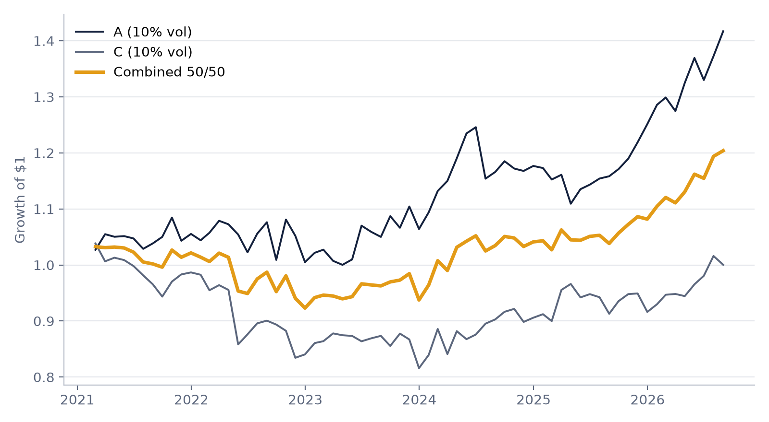
Combining FX and crypto carry
Person 2
Each scaled to 10% vol with lagged volatility, 50/50, 2021–2026
0.11
Correlation between A and C
 | Sharpe | Vol (%) | MaxDD (%)
A | 0.71 | 9.4 | -11
C | 0.05 | 9.3 | -21
Combined 50/50 | 0.51 | 7.0 | -11
Notes:
The two carry trades crash at different times, so the combination is much smoother; Strategy C was weak in this window, so the combination does not beat A on Sharpe.

Slide 12
Conclusions and limitations
Both
What we found
Limitations
• FX carry reproduces the academic factor (corr 0.82) and is exposed to volatility shocks.
• Crowding predicts weaker carry and modestly improves the out-of-sample Sharpe.
• Crypto funding carry is market-neutral, but its crashes are coin-specific: it ends up long what traders short hardest.
• FX and crypto carry are nearly uncorrelated (0.11).
• Short crypto history (2020–2026) and only 12 coins.
• Few crowded FX months (33); the 2008 crash was not flagged.
• Crypto results depend on lookback and rebalancing frequency.
• Costs are simple estimates; no funding-rate caps, borrow limits or exchange risk.
Notes:
Close with the main message: carry is compensation for crash risk, and crowding is measurable in both markets.

