Slide 1
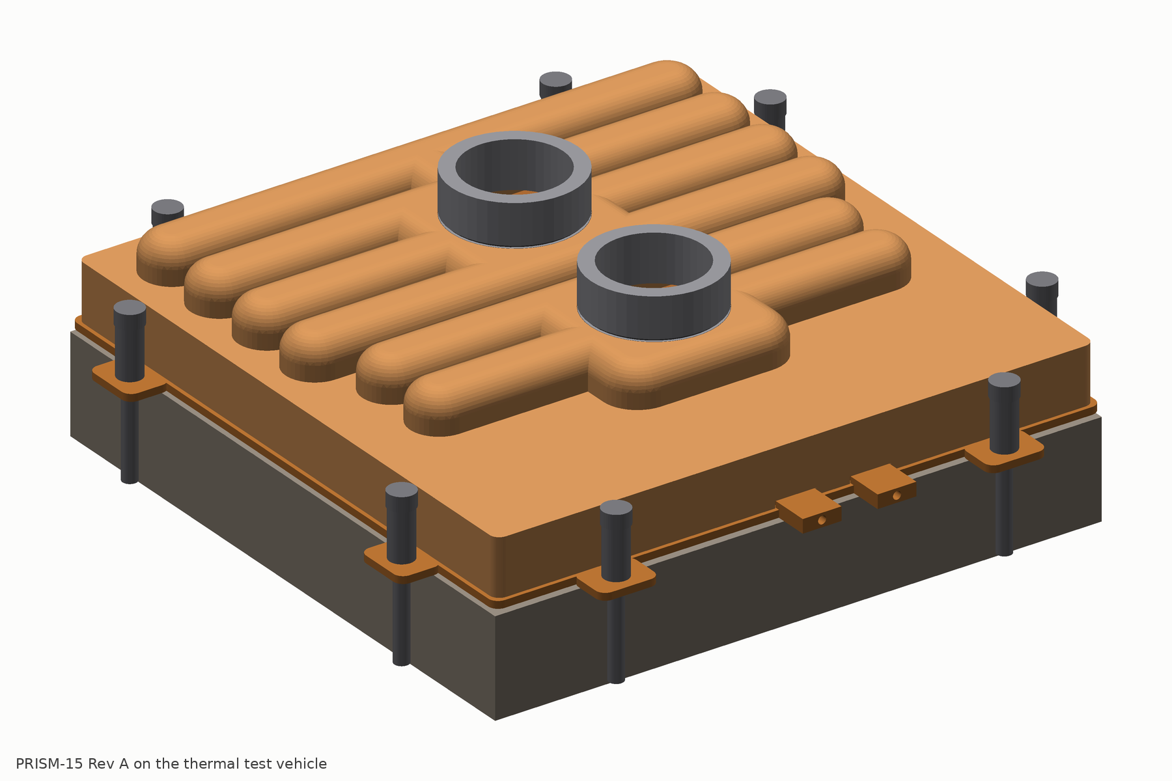
PRISM-15 Rev A
DESIGN REVIEW · 16 OCTOBER 2026
A copper cold plate designed to beat the CoolIT 15 kW benchmark at its own operating point
Architecture, dimensioned design, parametric CAD, predicted datasheet, manufacturing route and programme. Every performance number is a model prediction: no hardware exists yet.
1
Notes:
This deck is the design review for PRISM-15 Rev A. The brief was to set CoolIT’s 15 kW cold plate as the benchmark and design a conventionally manufacturable plate that beats it. Everything shown is a model prediction until the first coupons and plates are tested.

Slide 2
Beat CoolIT’s 15 kW plate at its own published point
THE BRIEF
15 kW
18 LPM
34.4 K
44.2 K
four ceramic heaters, about 117 cm²
PG25 water-glycol at 45 °C inlet
average case-to-inlet rise, standard paste
hottest of 24 thermocouples on 3 plates
What CoolIT did not publish
The rules we set ourselves
Pressure drop, heated area, paste identity, height, mass. We reconstructed them from the brief’s photographs and a calibrated model: about 120 cm², about 22 kPa, a skived split-flow copper core.
Conventional manufacturing, no printing. Same paste class and the same eight-thermocouple layout. Two test vehicles (117 and 100 cm²). Pressure drop at three boundaries. Five plates, three re-mounts, an independent repeat.
2
Notes:
CoolIT’s brief reports exactly one operating point and three numbers. Everything else about their plate is reconstructed, and we say so wherever a CoolIT-like number appears.

Slide 3
Lower on every thermal metric, one third of the pressure drop, higher in price
THE VERDICT, PREDICTED
At 15 kW, 18 LPM PG25, 45 °C inlet, 117 cm² | CoolIT 15 kW | PRISM-15 Rev A | Verdict
Average case-to-inlet, same paste class | 34.4 K measured | 31.0 K | win, P ≈ 0.8
Maximum case-to-inlet, same paste class | 44.2 K measured | 38.7 K | win, P ≈ 0.9
Average / maximum on a phase-change pad | ≈ 32.5 / 40.3 K est. | 29.0 / 34.8 K | win
Plate pressure drop, 20 mm ports | ≈ 22 kPa reconstructed | 7.6 kPa | win
Load at 85 °C case, paste / pad | 12.9 / 14.8 kW | 15.7 / 18.4 kW | win
Inlet allowed at 15 kW, paste / pad | 40.8 / 44.7 °C | 46.3 / 50.2 °C | win
Height at the headers / mass | ≈ 22–28 mm / 1.2–1.6 kg est. | 20.8 mm / 1.3 kg | parity to win
Factory cost per plate at 100k per year | ≈ US$126 | US$165 | loss, +31 %
PRISM values are model predictions, ±25 % per term until tested. Probabilities include programme factors. Full scorecard: design report section 0.
3
Notes:
Three of CoolIT’s numbers are measured; everything in the CoolIT column marked estimated or reconstructed is ours. PRISM’s advantage is largest on the maximum, which is what limits a chip, and on pressure drop, which is what limits a rack.

Slide 4
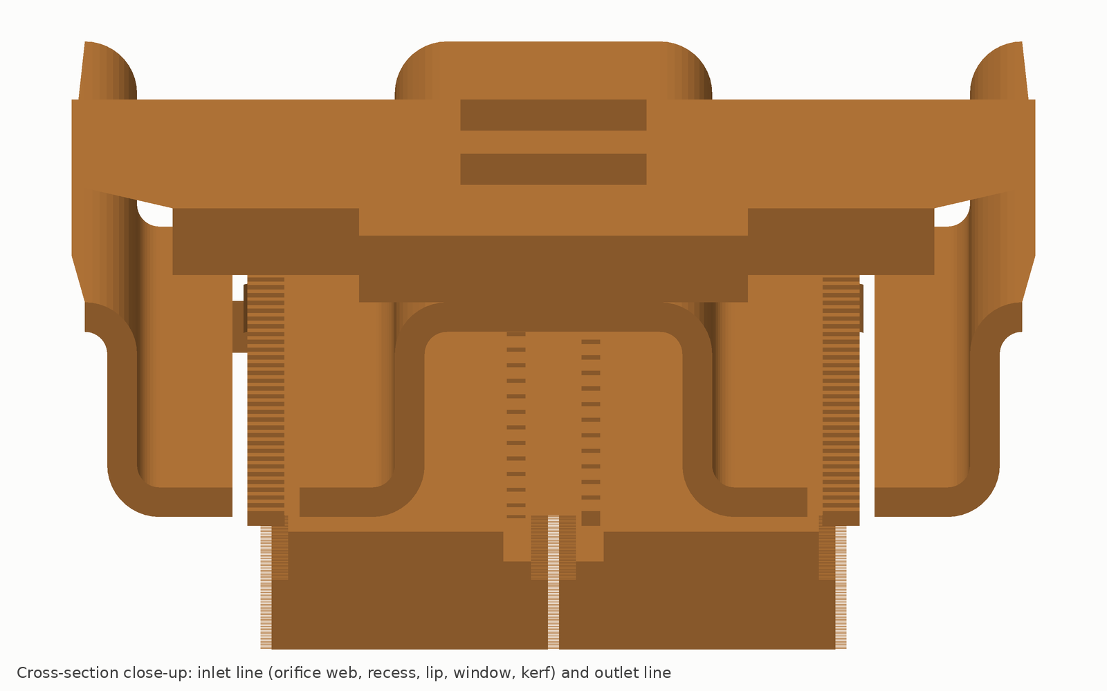
Every parcel of coolant travels 7.7 mm, not 54
THE MECHANISM
1. Fifteen metered lines
A separate 0.4 mm web of 756 graded orifices feeds each line through a recess onto a grate lip. Flow is uniform within ±2.2 % at every flow, because meter and plenum both scale with velocity squared.
2. Short cells, fine fins
0.15 mm fins at 0.15 mm gaps, 2.0 mm tall, kerfed at each line. Each segment starts at inlet temperature; fins are sized for heat transfer and fouling, not for pressure drop.
3. Tied fin tips
Every fin tip is brazed to the grate. The 0.85 mm base sees pressure only between ties 0.3 mm apart, so it carries 1 MPa with zero bow and holds a pad or liquid metal at its rated resistance.
Section from the CAD assembly across the lines at y = 10 mm. Split-flow plates send coolant 54 mm along coarse 0.2 mm fins; the far edge runs on coolant already 12.7 K warmer.
4
Notes:
The three rules do most of the work. The flow length is the lever on the caloric term, the fine fins on the convection term, and the ties on the base term and on the interface.

Slide 5
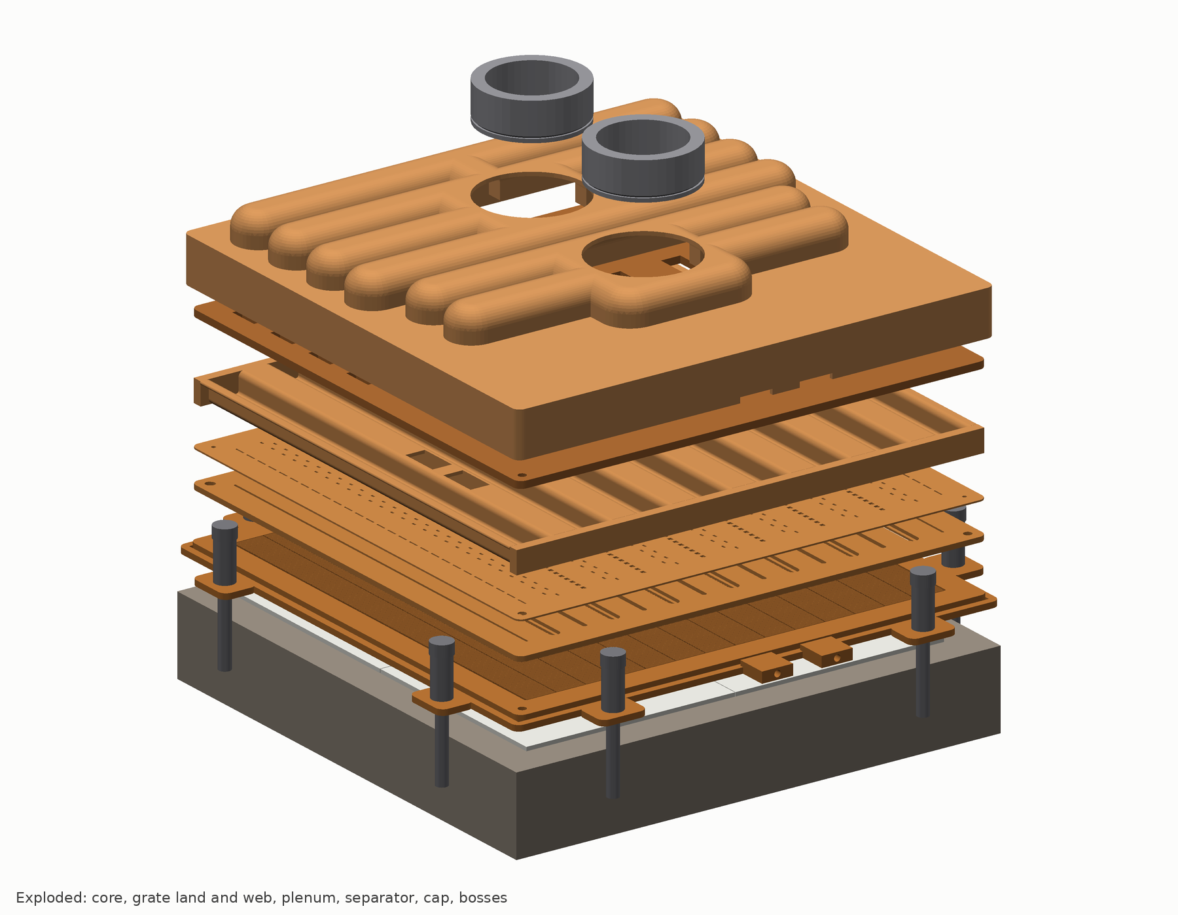
Fourteen copper parts, one vacuum braze cycle, one external seam
THE STACK
Layer, top down | What it is | z, mm
Port bosses | 2 × 20 mm bore, machined OFE, piloted in cap pockets; 50 µm guard cup under the inlet dome | 19.8–29.5
Cap | drawn 1.0 mm OFE; 2 inlet + 4 outlet arches 10 × 7.7, 2 cross domes with a spine, skirt lapped to the rim | 12.1–20.8
Separator | 1.8 mm plate; 14 inlet and 32 outlet windows 5 × 8 | 10.3–12.1
Plenum | one 0.8 mm sheet folded into 15 channels 6.9 × 5.0 mm; 2 end frames; 14 bleed holes | 4.5–10.3
Meter web | 0.40 mm strip, 756 laser-pierced orifices, graded | 4.1–4.5
Land plate | 1.30 mm; 15 windows, 7 recesses with lips; brazed to every fin tip | 2.8–4.1
Core | 125 × 125 skived OFE: 360 fins, 15 kerfs, 0.85 mm base, rim, 8 ears, 2 tap bosses | 0–2.8
Height 20.8 mm at the arches, 29.5 mm at the bosses · plate mass 1.15 kg (CAD) · only the skirt-to-rim lap can leak outward
5
Notes:
Every part is a stamping, a fold, a draw, a laser blank or a skived block. The stack goes into one fixture on two alumina pins and comes out of the furnace as a plate.

Slide 6
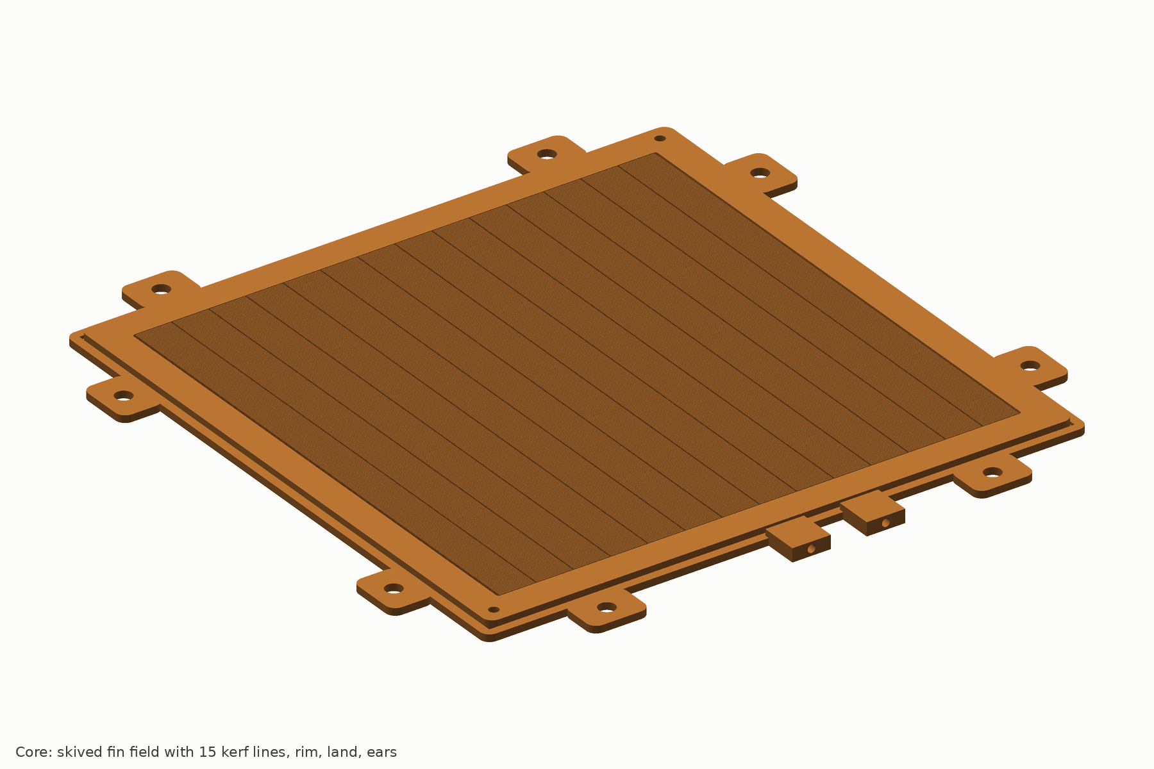
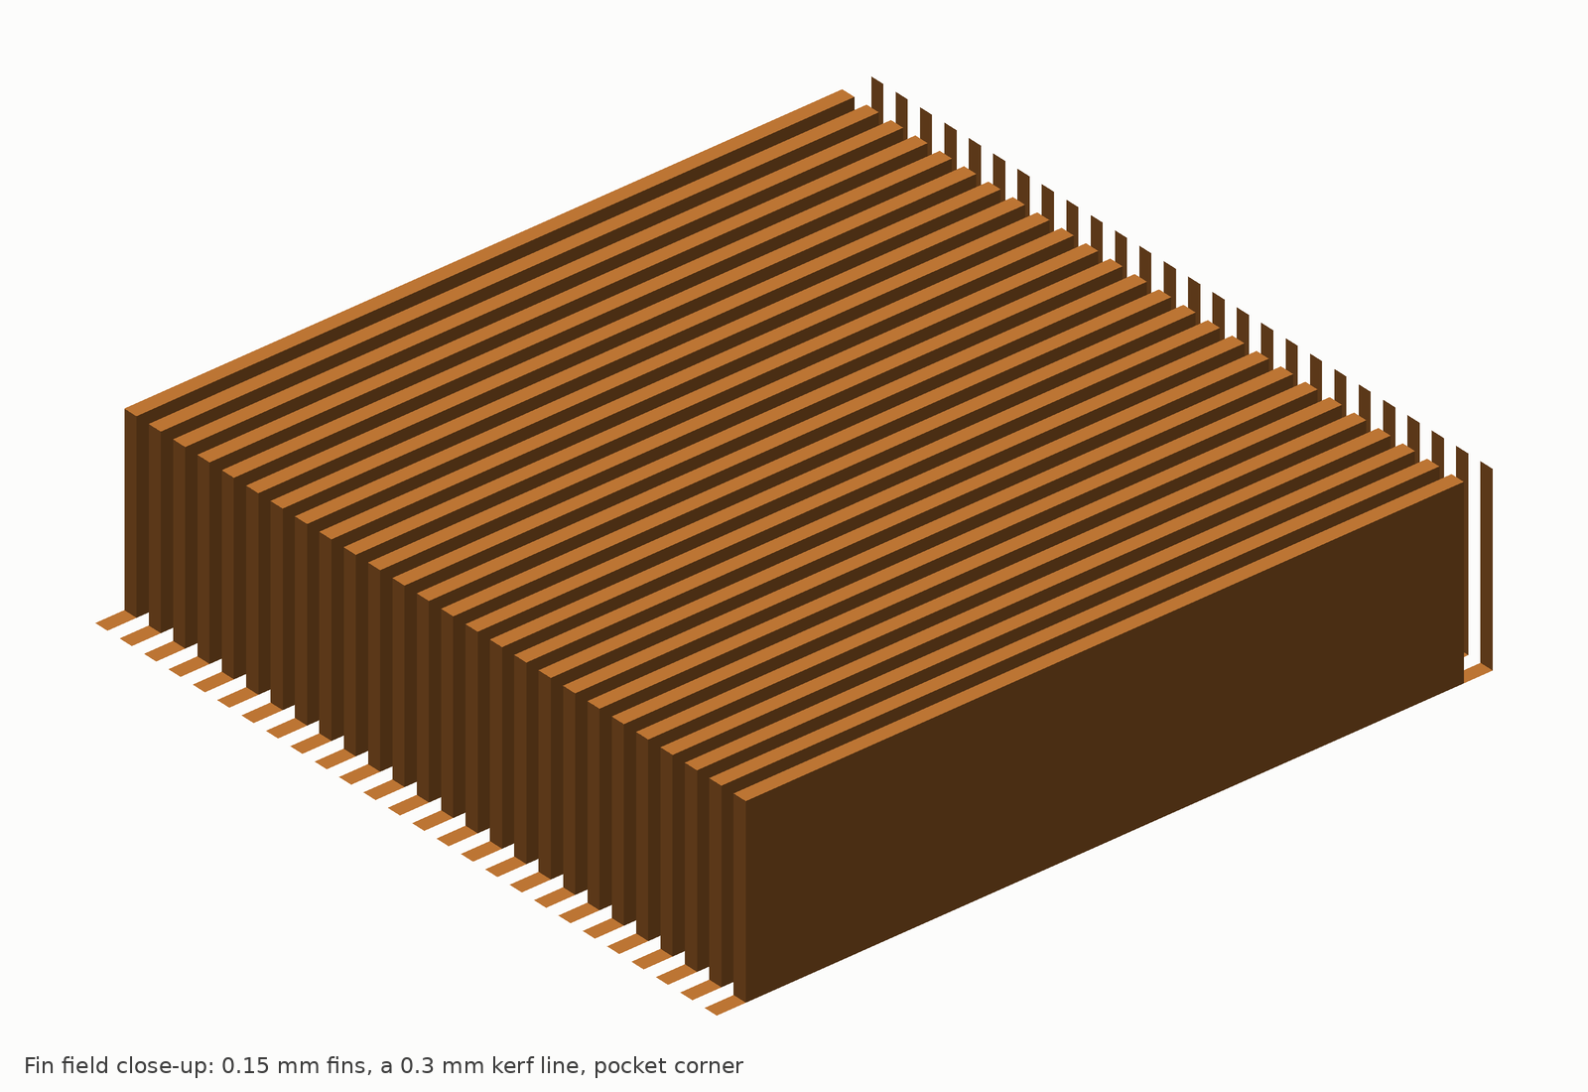
A skived field the ties let us run at 0.85 mm
LAYER 1 · CORE
Feature | Value | Tolerance
Material | OFE copper C10100, 4.3 mm H02 blank | O₂ ≤ 5 ppm
Fin field | 108 × 108; 360 fins 0.15 thick, 0.15 gap, 2.0 tall | t ±0.02, pitch ±0.005
Kerfs | 15 lines at 7.7143 pitch, 0.30 wide, gang-sawn in potted fins | w +0.05/−0, x ±0.03
Base under the field | 0.85 (0.80 min), fly-cut after braze, ultrasonic gauge | ±0.05; 1.0 fallback
Tip plane | fins and rim coplanar at z 2.80 for the braze | flat ≤ 0.020
Die face | flatness 0.02 over the field, Ra 0.8, concave 0–10 µm only | parallel 0.03
Rim, land, ears | rim 121.4 carries the grate and the cap skirt; land z 1.5; 8 ears, holes 4.5 | ±0.05 / ±0.1
Instrumentation | 2 tap bosses read fin-field dP for the fouling signature | 1.0 mm holes
Base term 2.79 K at 0.85 mm; 2.63 K at 0.80; 3.29 K at the 1.0 mm fallback. The thin base is gated on experiment E1 proving that one unbonded land strip can be seen at proof.
6
Notes:
Skiving at 0.15 by 0.15 by 2.0 mm in copper is at the edge of current capability, which is why the first-article plan starts with a six-blank skiving trial.

Slide 7
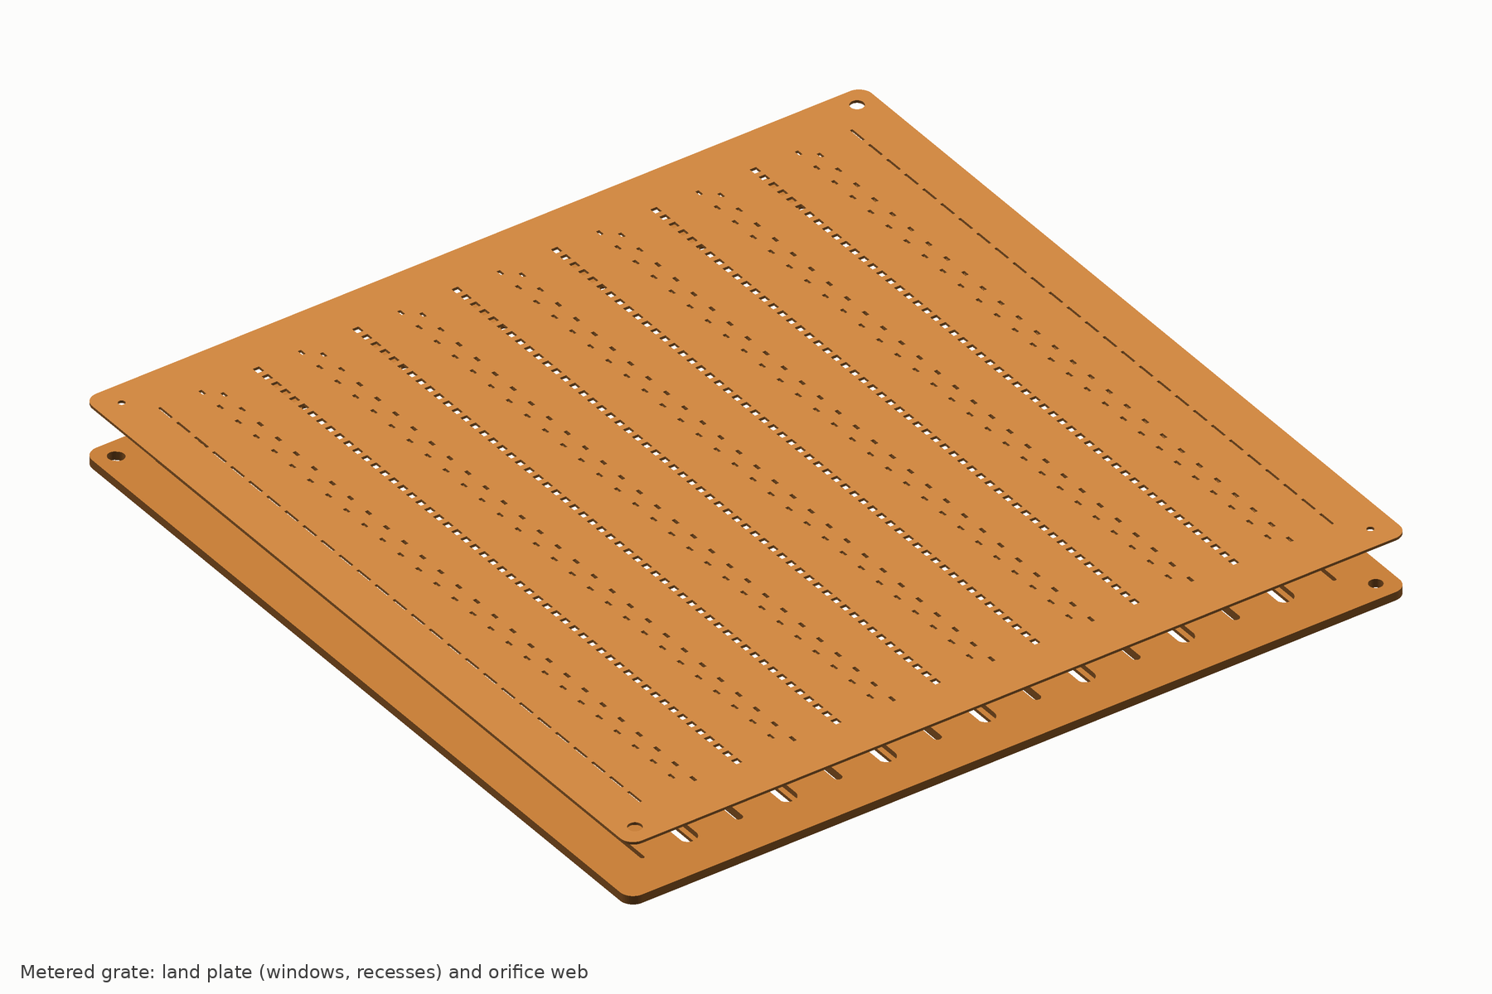
Two laminations: the lands that tie, the web that meters
LAYER 2 · GRATE
Land plate, 1.30 mm
A 1.2 mm window over every kerf; a 2.7 × 0.8 mm recess on the seven inlet lines so the jet lands on a 0.75 mm lip, never on a fin. Continuous lands brazed to the fin tips over at least 70 % of their length. Laser-scribed capillary-break grooves keep filler out of the windows.
Meter web, 0.40 mm
378 inlet orifices, 0.50 × 0.99–1.12 mm in five size steps, alternating ±1.0 mm off the line; 378 outlet-row holes that balance the two segments beside each line. 2.31 kPa at 1.54 m/s; discharge coefficient 0.72 assumed, measured on coupons in E2. Laser-pierced, electropolished, 100 % backlit vision.
The web is the only part that changes between packages: a new zoning is a laser file and two to three weeks, not a die.
±2.2 %
1.06
per-orifice flow, 9 to 36 LPM
segment max/min at 18 LPM
7
Notes:
The grate is two laminations because the recess must open toward the web. Putting the orifices 1.3 mm above the braze plane makes the meter immune to braze fillets.

Slide 8
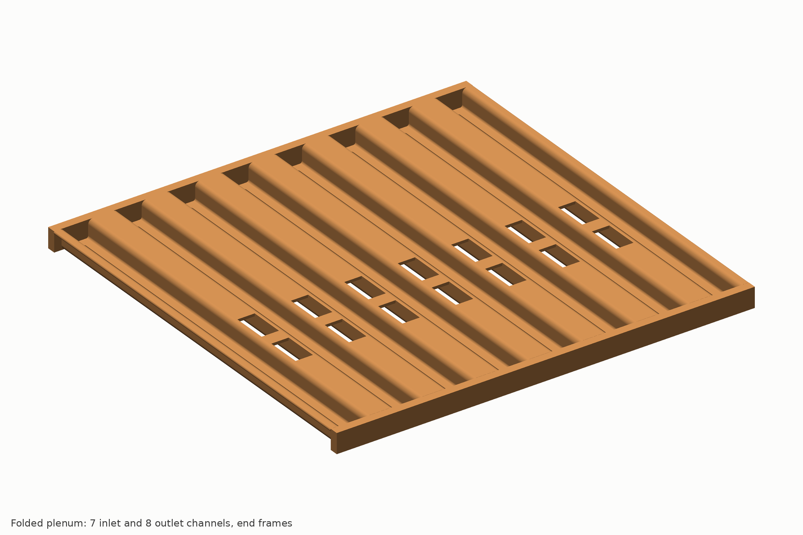
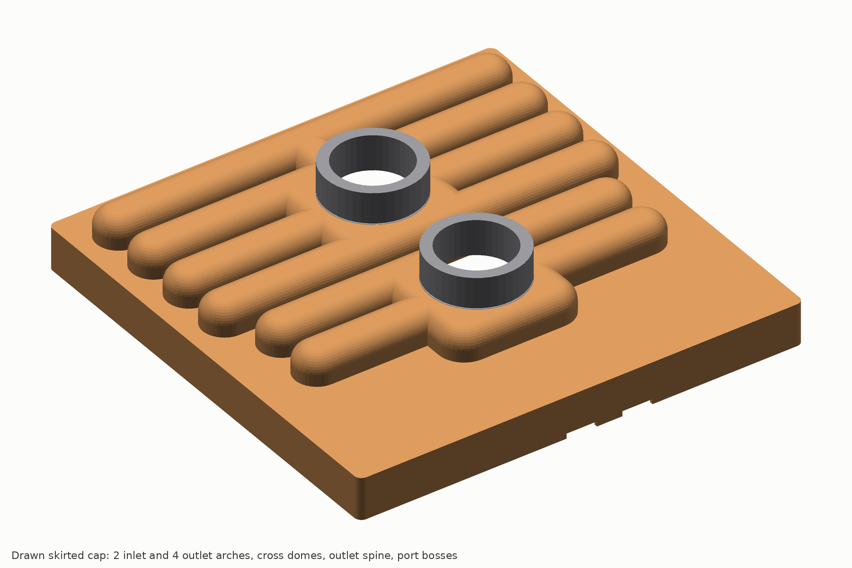
Folded, stamped and drawn: no forging, no machined manifold
LAYERS 3 TO 5 · PLENUM, SEPARATOR, CAP
Plenum: one 0.8 mm sheet
Folded into 16 walls and 15 channels of 6.9 × 5.0 mm at 7.7143 mm pitch, held by two slotted end frames. Inlet channels take coolant through ceiling windows; 14 bleed holes leave no stagnant corner. Velocity at or below 0.65 m/s.
Separator: 1.8 mm plate
14 inlet windows at y −21 and −7, 32 outlet windows at +7, +21, +35 and +49, all 5 × 8 mm; 0.46 kPa. A 0.6 mm 316L option saves 106 g.
Cap: drawn 1.0 mm, skirted
Two inlet and four outlet arches, 10 × 7.7 mm internal at 14 mm pitch (the widest a 1.0 mm sheet can form with a brazeable valley), 35 mm cross domes under the 20 mm bosses, and a skirt drawn to 121.5 / 123.4 that laps 1.3 mm onto the rim. That lap, with one silver ring, is the plate’s only external seam. Bar height 20.8 mm.
8
Notes:
The verification round found that stamped laminations could not be made at these web widths and that a forged header bar cost height, mass and money the physics did not need.

Slide 9
Flow length follows heat flux, and a new package is a laser file
ZONING
Local heat flux | Cell length | Where
above 250 W/cm² | 5 to 6 mm | compute dies
100 to 250 W/cm² | 6 to 8 mm | the 15 kW test plate: 7.7 mm
50 to 100 W/cm² | 8 to 12 mm | memory stacks
below 50 W/cm² | 12 mm | lid margins, slot-end bleeds only
Why length, not just flow
The two-dimensional cell model shows the average case temperature falling with cell length at every flux while the case ripple is flat between 5 and 8 mm. Grading length turned the architecture’s one conceded loss on uniform low-flux lids into parity.
GPU example shipped with the package
Four 26 × 33 mm dies at 350 W/cm² plus 16 HBM stacks on a 110 × 120 mm field: 17 lines, 5.5 mm over the dies and 11 mm over memory; the die block takes about 88 % of the flow and no memory stack sits downstream of a die.
Core, grate land plate, plenum and cap tooling are common across packages; only the 0.4 mm meter web and the pedestal cut change.
9
Notes:
This is the commercial point of the metered grate. A split-flow plate needs a new skiving program and often a new manifold for every package; here a zoning change is an artwork file.

Slide 10
The numbers a sales sheet would carry, with their spread
PREDICTED DATASHEET
15 kW, 45 °C PG25 inlet, 117 cm², OCP format | Phase-change pad | Paste | Liquid metal, Tier 2
R″ average / maximum at 18 LPM (cm²·K/W) | 0.228 / 0.272 | 0.243 / 0.303 | 0.188 / 0.225
Rise, average / maximum at 18 LPM (K) | 29.2 / 34.9 | 31.1 / 38.8 | 24.1 / 28.9
Rise at the 15 LPM rated flow (K) | 30.9 / 37.1 | 32.9 / 41.0 | 25.8 / 31.1
Inlet allowed at 15 kW, 85 °C maximum case (°C) | 50.1 | 46.2 | 52.3, return-limited
Capacity at 85 °C case, 45 °C inlet, 1.2 LPM/kW (kW) | 18.4 | 15.7 | 19.5 rated (25.4 thermal)
Plate dP at 15 / 18 / 22.5 / 36 LPM, 20 mm bore (kPa) | 5.5 / 7.6 / 11.4 / 27.5 | same | same
P10 / P50 / P90 of the average at 18 LPM (K) | 26.7 / 29.3 / 32.4 | 27.9 / 31.2 / 35.4 | 22.2 / 24.2 / 26.4
P10 / P50 / P90 of the maximum at 18 LPM (K) | 32.3 / 35.2 / 38.6 | 35.6 / 39.3 / 43.7 | 26.9 / 29.2 / 31.8
Term budget at the benchmark with paste: coolant 7.5 K, interface 9.0 K, base 2.8 K, convection 10.9 K, two-dimensional penalty 0.9 K. CoolIT’s measured 34.4 K decomposes as 6.3, 9.0, 6.6 and 12.6 K on the same model: PRISM gives back 3.8 K of base and 1.7 K of convection and pays 1.2 K more in the coolant.
10
Notes:
The pad is the recommended interface and the decision metric at gate G2 is the pad average at 18 LPM. Even the P90 paste average, 35.4 K, is close to CoolIT’s measured 34.4.

Slide 11
The maximum wins at every flow; the plate drop is a third of the reconstruction
FLOW SWEEP AND PRESSURE DROP
Case-to-inlet rise at 15 kW, K
Pressure drop, PG25 at 45 °C, kPa
LPM | Pad avg / max | Paste avg / max | CoolIT-like paste
7.5 | 41.9 / 50.5 | 43.8 / 54.4 | 43.5 / 62.1
11.25 | 34.5 / 41.5 | 36.4 / 45.4 | 38.4 / 51.9
15 | 30.9 / 37.1 | 32.9 / 41.0 | 35.7 / 46.8
18 | 29.2 / 34.9 | 31.1 / 38.8 | 34.4 / 44.2 measured
22.5 | 27.4 / 32.7 | 29.4 / 36.6 | 33.0 / 41.5
LPM | Plate, 20 mm ports | With barbs | With UQD08 pair | CoolIT-like
7.5 | 1.7 | 2.2 | 4.6 to 6.3 | 7.8
15 | 5.5 | 7.6 | 17 to 24 | 19.1
18 | 7.6 | 10.6 | 25 to 34 | 24.6
27 | 16.0 | 22.7 | 54 to 76 | 44.4
36 | 27.5 | 39.5 | 95 to 134 | 69.3
The average crosses at about 0.5 LPM/kW: below that the split-flow plate’s short caloric path wins on the average. The maximum never crosses.
81 % of the plate drop is inertial. The meter takes 2.3 kPa, the fins 1.1, the ports 1.6. Quick-disconnects dominate any tray loop, which is why we publish three boundaries.
CoolIT-like columns are our calibrated split-flow model, measured only at 18 LPM (34.4 / 44.2 K). External claim: at or below 10 kPa at 18 LPM and 30 kPa at 36 LPM with 20 mm ports.
11
Notes:
Below 0.75 LPM per kW the 15 kW outlet exceeds 65 °C and the OCP sweep is run at reduced power. The pressure-drop test is the cheapest and first measurement.

Slide 12
Rated by velocity, proven by pressure, gated on one defect
MARGINS
Pressure ratings
Velocity caps set the rating
Working pressure 1.03 MPa (150 psi), 100 % proof at 1.55 MPa, design burst at or above 3.1 MPa, sample burst at or above 4.5 MPa. Highest stress at design burst: 29.8 MPa in the plenum wall against a 40 MPa allowable for annealed copper. The 12 kN pressure load on the fin field is carried by the ties and never reaches the clamp.
Meter orifices 1.54 m/s at 18 LPM, capped at 2.0 m/s, reached at 23.4 LPM: that cap, not thermal capacity, sets the 19.5 kW rating. Ports 0.95 m/s, arches 0.93, plenum 0.62, fin tops at or below 0.5 (E2 pass criterion), fin channels 0.20 m/s at Reynolds 44.
The governing defect
Uniformity and bow
One unbonded land strip between kerfs stays leak-tight at working pressure but collapses at 1.8 to 2.6 MPa, below design burst. At proof it bulges about 2 µm, which the 1 µm confocal scan sees; at a 1.0 mm base it bulged 0.6 µm and was invisible. The 0.85 mm base is gated on experiment E1 showing per-strip detection; the fallback costs 0.7 K.
Along-plenum max/min 1.06, line 1.03, segment 1.06 to 1.09; the weakest segment runs 0.4 K hot against a 1.5 K allowance. Under the 2 kN test clamp the plate bows 23 µm concave and the hot base bows 19 µm convex: they cancel, and the die face is cut 0 to 10 µm concave so corners never lift hot.
12
Notes:
The defect story is the honest centre of the structural case. A tied plate is only as good as its worst land strip.

Slide 13
One furnace cycle, sixteen critical characteristics, every plate tested
MANUFACTURING
1
2
3
4
Skive the core from a 4.3 mm OFE blank
Pot, gang-saw 15 kerfs, plane the tip plane to ±20 µm
Mill and groove the land plate; laser and electropolish the web
Fold the plenum, laser the separator, draw the cap
5
6
7
8
Stack on 2 pins with etched BAg-8 foils; vacuum braze 795 °C, 60 per load
Helium leak test dry; infrared flow screen
Fly-cut the die face to 0.85 mm with in-line ultrasonic gauge
Flush, proof with bulge scan, dP at 3 flows, bake, N₂ pack
Braze fixture FIX-15
Inspection that finds the real failures
Graphite platens, four TZM tie rods and eight TZM leaf springs turn the copper stack’s extra 0.137 mm of thermal growth into 1,250 N at 795 °C: 0.08 MPa on the stack, insensitive to shim error. 9.5 kg per fixture, 60 per furnace load, 300 cycles of life. Dead weight would have been 128 kg per plate.
100 % on every plate: fin thickness and pitch by vision, tip plane by laser scan, all 756 orifices by backlit vision, base thickness by ultrasonics, helium leak at 10⁻⁶ mbar·L/s, cleanliness to ISO 16232, proof with a 1 µm confocal bulge map, dP within ±10 %, infrared flow screen. By lot: CT of 1 in 200, sections of 1 in 1,000, burst 1 in 2,000.
13
Notes:
The routing is ordered so that helium testing happens before any wet step and the infrared screen before the fly-cut coats the die face.

Slide 14
A third more per plate, parity per kilowatt, and a silver-free route to close the gap
COST
Factory cost line, US$ per plate | 100k / yr | 10k / yr
Copper, 1.52 kg of blanks and strip | 22.1 | 25.5
Skiving, kerfing, planing, fly-cut | 28.9 | 70.4
Grate, plenum, separator, cap, bosses | 18.5 | 51.5
Silver filler, 5.7 g BAg-8 preforms | 14.7 | 20.6
Vacuum braze and fixtures | 17.6 | 38.7
Taps, guard, stubs, hardware, frame, tooling | 24.3 | 42.3
Test: flush, helium, proof and scan, dP, IR, bake | 11.8 | 28.3
Factory cost, P50 (direct ÷ yield × 1.12) | 165 | 388
P10 / P90 | 156 / 175 | 361 / 427
US$165
US$126
PRISM-15 Rev A at 100k per year
like-sized split-flow plate, estimate
US$142
US$8.9
route C2, Cu-Sn belt braze, decided at G1
per kW of pad capacity, vs US$8.5 incumbent
Capital per 100k-per-year line at the contract manufacturer: US$5.6 to 8.0 M, of which 1.4 to 1.6 vacuum furnaces are US$2.4 to 3.2 M and the test cell US$1.0 to 1.6 M. Copper at US$14.6/kg and silver at US$65/oz, hedged 6 to 12 months. Yield 93.5 % mature; per-SKU tooling is limited to the laser-pierced meter web.
14
Notes:
Cost is the one metric the plate loses outright. The silver filler and the 100 % test regime are most of the premium.

Slide 15
The clamp bears on the cap, never on the ears or the ties
MOUNTING AND INTEGRATION
Retention budget
Load frame and screw kits
Interface | Pressure | Force N | Kit
Test vehicle, 4 × 54 mm AlN heaters, pad condition | 25 psi | 2,011 | DIE-TTV
Hard-mode vehicle, 4 × 50 mm copper blocks | 25 psi | 1,724 | DIE-TTV
Lidded 100 cm² package, pad or liquid metal | 7 to 13 psi | 480 / 880 | SPR-60 / 110
Bare-die block, 16.6 to 33 cm² | 0.15–0.35 MPa | 480 / 880 | SPR-60 / 110
The 1.5 mm annealed ears would see 47 to 195 MPa against a 40 MPa allowable, so an 85 g stainless frame bears on two flat cap lands over the plenum end frames. Eight dia-4 captive shoulder screws with preset springs: 480 N (SPR-60) or 880 N (SPR-110) per plate on a lidded package, 2,011 N on the test vehicle. Clamp repeatability 4 to 5 %.
Variants in the same tooling
HBM pedestal 0 to 0.40 mm cut in the same fly-cut for bare-die packages; a PRISM-G envelope of 127 × 137 mm with 17 zoned lines at 1.03 to 1.15 kg; four test vehicles from the 4 kW single-die point to 400 W/cm² and 30 kW.
1,151 g
1,307 g
1,400 g
plate, CAD solids
lane sum with stubs, screws, backplate
SKU limit; budget 1,240
Mass is 67 g over the 1,240 g budget on the cap lane’s basis and 92 g under the 1,400 g limit with the frame; a 0.6 mm 316L separator (−106 g) recovers it. A thinner cap sheet is ruled out by draw thinning at the arch ends. Decision at G1.
15
Notes:
Nothing in the clamp path touches the fin ties: the load goes from the cap lands down the plenum end frames into the solid rim.

Slide 16
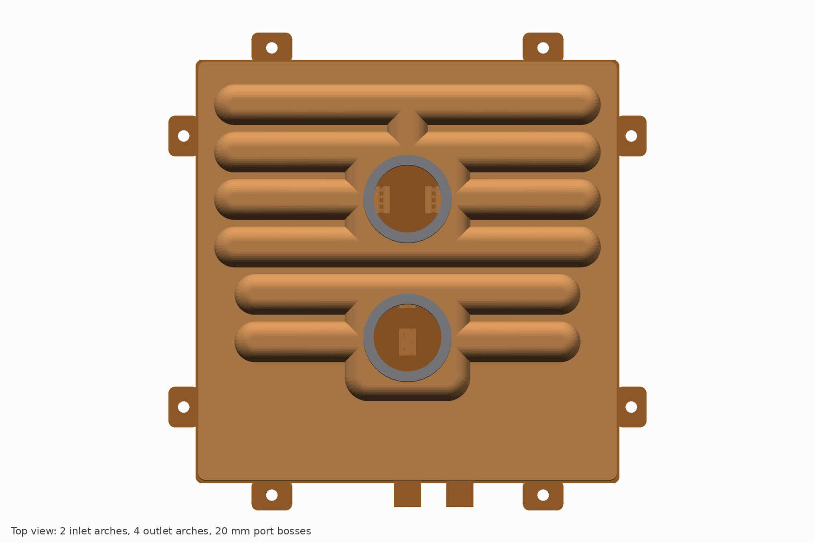
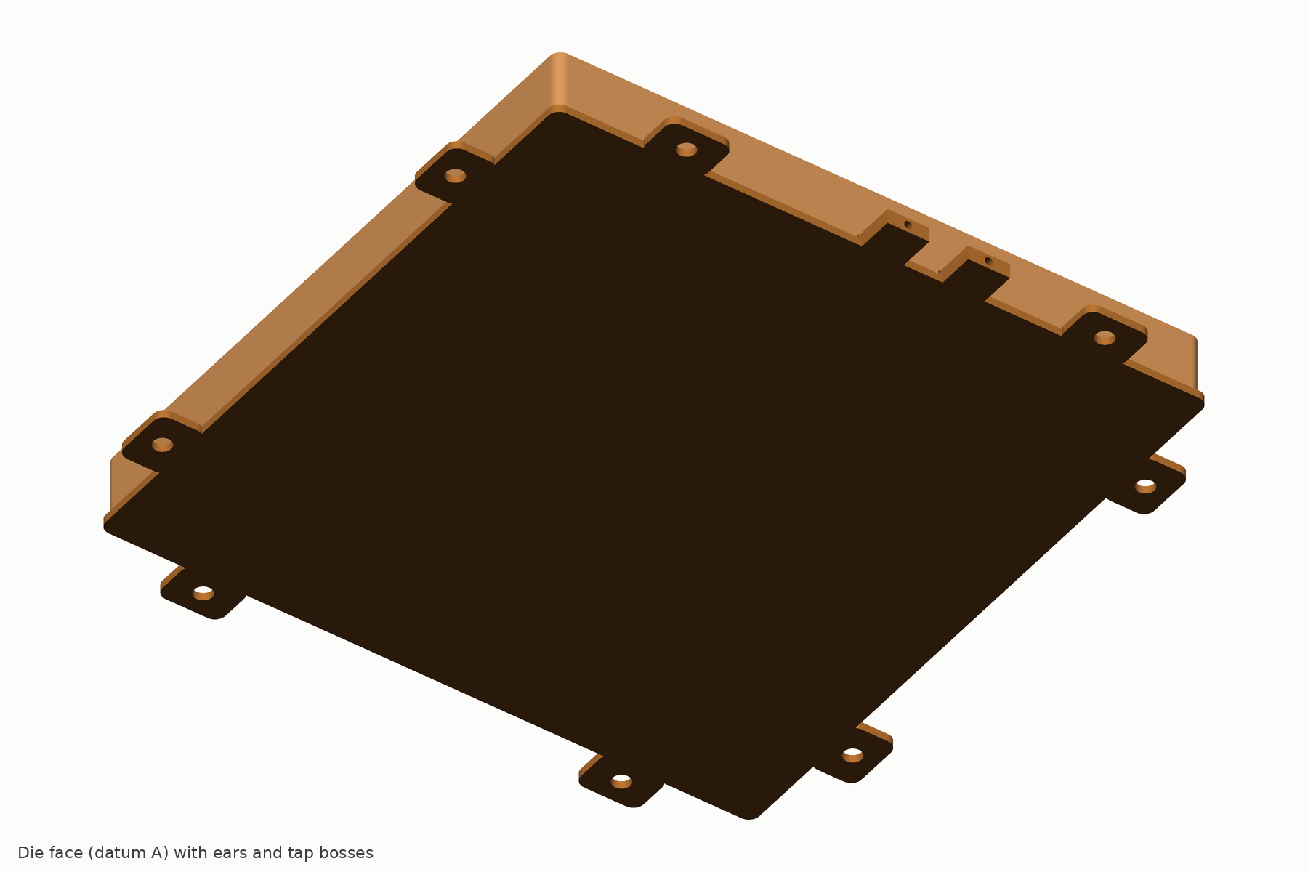
Fourteen real solids from one parameter file, checked for interference
CAD PACKAGE
Check | Result
Solid validity | 14 of 14 valid single bodies
Interference, 20 pairs incl. cap vs every part inside its skirt | zero volume on all
Height at arch crowns / bosses | 20.8 mm / 29.5 mm
Plate mass from solid volumes (no stubs, frame or backplate) | 1,151 g
Fins, kerfs, orifices modelled | 360, 15, 756
Delivered: STEP AP214 per part and the full assembly, STL meshes, developed flat pattern of the plenum, orifice artworks and separator pattern as DXF, orthographic SVG views, dimension tables per part, render set, and the CadQuery source that regenerates all of it from design/params.json.
Known simplifications: saw run-out ramp, capillary-break scribes, orifice corner radii, draw thinning, the stub seats and the guard’s corrugations are not modelled. The cap is regenerated from the cap lane’s values; the frame and screws follow the mechanical lane.
16
Notes:
Because every part is built from the one parameter file, a change decided at gate G1 regenerates the parts, the assembly check, the drawings and the mass table in minutes.

Slide 17
Eight concessions, stated before anyone else finds them
WHAT IT DOES NOT WIN
Concession | Size | Why it stands
Price per plate | US$165 vs about 126 | fine skiving, two-lamination grate, silver, 100 % test; parity per kW; US$142 on route C2
No field record | none | first hardware month 3; 22-plate endurance months 5 to 11
Fouling life at equal filtration | 0.15 mm gaps | ships with a mandatory 33 µm absolute tray filter; dose claim only until E4
Average on a 100 cm² footprint, paste | parity | the fin-field advantage shrinks with small heaters; both vehicles are tested
Average at or below 0.5 LPM/kW | loss | the split-flow plate’s short caloric path wins on the average at low flow
CoolIT’s 4 kW single-die point | loss with the drop-in core | the meter pays 2.3 kPa and the field is oversized for a 50 × 50 mm die
350 W/cm² at 85 °C case | about 98 °C (88 °C gated grade) | a bare-die Tier 3 problem; still about 16 K better than a split-flow model
Thermal buffering of power steps | up to 1 K more rise in 100 ms | 40 % less copper over the die; the absolute peak is still 3 to 6 K lower
The recommended public claim (decision D1) excludes the 4 kW point, the low-flow average and the 100 cm² average, and is released only after gate G2 measurement.
17
Notes:
A claim of beats on every metric would be false and would be shown false by the first independent lab.

Slide 18
The braze, the benchmark and the patents are the three that matter
RISKS
# | Risk | Likelihood / impact | Early warning | Fallback
R1 | Tie braze voids or wicking; per-strip detection fails at the 0.85 mm base | medium / critical | E1 at month 3 | routes B, C, D; base 1.0 mm (+0.7 K)
R8 | IP: CoolIT Split-Flow family, TW I606224, Microfabrica | high / US timing | FTO opinion, month 4 | non-US first; US from September 2028; indemnity insurance
R4 | Benchmark ambiguity used against us (footprint, case, thermocouple bias) | high / credibility | reviewers | two vehicles, R″ per area, purchased plates, standing offer to test any CoolIT plate
R3 | CFD shows fin-top velocity above 0.5 m/s under the jets | medium / erosion, IP | CFD at month 2 | wider lip, lower orifice velocity
R12 | Micro-channel lids displace lidded plates at NVIDIA | medium–high / rank A2 | customer signals | D7 lid-insert study; G2 pivot decision
R9 | Cost above US$175 at 100k per year | medium / channel | RFQs, month 1 | route C2; per-SKU tooling limited to the web
R5 | OCP’s recommended interface material is a paste | medium / average margin | read §5.2, month 1 | lead with maximum, uniformity, dP, capacity
R10 | Test-vehicle heaters crack at 150 W/cm² | medium / schedule | commissioning, months 3–4 | copper-block cartridge vehicles
Fourteen risks in the register (architecture 13.1). Probability of a decisive pad result at month 12: 0.43; the dominant failure mode is a one-to-three-month slip at E1 or at test-vehicle commissioning, not a thermal miss.
18
Notes:
The kerf is a weak design-around of CoolIT’s Split-Flow patents, which run to September 2028 in the US. The programme therefore builds and sells outside the US first.

Slide 19
What a competitor has to copy, and how each piece is protected
INNOVATION REGISTER
FILE, NARROW
FILE, NARROW
FILE, NARROW
Tied, kerfed skived field under a stepped grate
Inertial meter off the braze plane, graded to the plenum
Jets on a grate lip, doubled outlet header, outlet orifice row
Every fin tip brazed to the lands; a 0.85 mm base that carries 1 MPa with zero bow.
Uniformity that does not change with flow; orifices that braze can never reach.
No erosion on fins, no Microfabrica exposure; segment imbalance 1.36 to 1.06 at no height cost.
DEFENSIVE PUBLICATION
TRADE SECRET
TRADE SECRET
Flux-graded flow length
Tie-braze recipe and per-strip detection
Artwork-per-SKU zoning tool
5 to 6 mm over dies, 12 mm over margins; partly anticipated, so published rather than filed.
Capillary-break grooves, masked lands, the differential-expansion fixture, the confocal bulge map.
A new package is a laser file in two to three weeks; the solver that grades 756 orifices stays in-house.
KNOW-HOW
PUBLISH VIA OCP
DEFENSIVE PUBLICATION
Folded plenum and drawn skirted cap
Fin-field dP taps and the filtration ladder
Transparent test method
Fifteen channels from one sheet; one external seam instead of four to six.
A fouling signature read at the fins; 50 µm guard in the boss plus a 33 µm tray cartridge.
Two vehicles, three dP boundaries, independent repeat; cleared against the NVIDIA heater-vehicle patent first.
Three stretch items beyond Rev A: chevron-staggered lines (about −1.3 K on the maximum), viscous self-balancing for zoned SKUs, a 0.60 mm base with thermographic tie verification. Time to copy after disclosure: 12 to 24 months.
19
Notes:
The patent filing covers the combination: ties, kerfs, stepped grate and graded meter. Everything that would have to be disclosed to be patented but is unenforceable offshore stays a trade secret.

Slide 20
AI accelerators first, SiC power conversion second, storage drives never
APPLICATIONS
Rank | Application | Variant | Entry
A1 | Hyperscaler custom ASICs (TPU, Trainium, Maia, MTIA class) | PRISM-15 or PRISM-G zoned, R+ with tray filter | samples M12–15, volume 2029
A2 | NVIDIA reference designs | PRISM-G; micro-channel-lid insert | via NVIDIA thermal engineering, 2029–30
A3 | 15–30 kW modules, Kyber-class blades, wafer-scale tiles | PRISM-15, -15-HF, -W | 2028–29
A4 | CPU, NVSwitch, co-packaged optics | PRISM-S | rack kits only
P1 | 800 VDC rectifier and solid-state-transformer SiC modules | PRISM-DC direct-substrate cooler | demonstrator M9–12, volume 2028+
P2 | 800 VDC shelf plates | keyed-orifice plate | rack kits only
P3 | SiC traction | PRISM-A | licence 2028, vehicles 2030–31
Why AI data centres first
The plate is sized and tested for the 15 kW class and scales to the GPU envelope on the same tooling. Buyers who control package, tray and loop can adopt the tray filter and the R+ grade.
SiC converters: a 27 % smaller junction swing
On a 1200 V SiC half-bridge with a sintered substrate the PRISM-DC core cuts the junction-to-coolant rise from 31.4 to 22.8 K per 400 W switch: 1.38× the loss per cm² of SiC, or four to five times the power-cycling life. Under a gap pad the advantage vanishes.
“SSD converters”
Read as SiC converters. Solid-state transformers and DC breakers fit; storage drives at 1 to 2 W/cm² gain nothing from this core.
20
Notes:
The A1 socket is contested: Group-A houses already ship liquid products for TPU and Trainium. The pitch to a hyperscaler is the zoned plate, the tray filter and the data pack together.

Slide 21
Twelve months to a public OCP-format result, gated five times
PROGRAMME
Months | Work | Gate and kill criterion
0–1 | RFQs, long-lead furnace and skiver orders, OCP §5.2 and PG25 guidelines read, FTO claim pulls, CBP ruling request | –
1–3 | E0 purchased plates; E1 braze coupon matrix; E2 water table and single-cell CFD; design freeze preparation | G1, month 3: Rev A freeze. Join route, base 0.8 vs 1.0, C2 go/no-go. Kill if no route passes E1 by month 5
3–6 | Build A, 12 plates; test-vehicle commissioning; fouling test starts; FTO opinion at month 4; 5 plates × 3 re-mounts, paste and pad | G2, month 6: pad ≤ 31 / ≤ 36 K and paste ≤ 33 K, else re-scope the claim or pivot; one letter of intent
6–9 | Build B, 20 plates on production-intent dies; endurance on 22 plates; independent laboratory | G3, month 9: independent repeat within ±1.5 K
9–12 | OCP-format report; R+ and liquid-metal stretch data | G4, month 11–12: public at OCP Global Summit 2027
12–18 | 300–500-plate pilot at the contract manufacturer; PPAP; samples to two hyperscaler programmes | G5, month 18: qualified product; volume 2029
US$8.4–10.7 M
US$2.3 M
0.43
0.68
12 months with 15–20 % contingency; 18 FTE
first tranche, to gate G1 at month 3
probability of a decisive pad result at month 12
pad average, maximum and dP all winning
21
Notes:
The gates are written so that the first US$2.3 million buys the answer to the only question that can sink the plate.

Slide 22
Seven decisions for the line manager
DECISIONS REQUESTED
# | Decision | Recommendation
D1 | Public claim | Scoped claim, after G2: beats CoolIT like-for-like on average and maximum case temperature, uniformity, capacity and inlet headroom; maximum lower at every flow; dP below any credible reconstruction; costs more, ships with a filter, no field record. No claim on the 4 kW point or the low-flow and 100 cm² averages
D2 | Channel and moat | Build and supply through a non-Group-A contract manufacturer to hyperscalers and to NVIDIA via its thermal engineering team; no licence to Group-A houses
D3 | Budget and gating | Tranches: US$2.3 M to G1 at month 3, the rest on a G1 pass; full scope US$8.4–10.7 M
D4 | Rev A stack | Vacuum BAg braze as baseline (US$165); silver-free Cu-Sn belt route (US$142) decided at G1 on E1 coupons
D5 | US launch and site | No US offers, sales or evaluation units before the FTO opinion; no US sale before 10 September 2028 unless it clears; Vietnam or Mexico build first; Taiwan only after TW I606224 is charted
D6 | Filtration | Tray cartridge mandatory and supplied, 150 cm² and 33 µm absolute; the product is “mechanically drop-in, ships with a tray filter kit”
D7 | Hedges | US$0.4–0.6 M micro-channel-lid insert design study plus a two-phase watching brief
22
Notes:
D1 and D5 are the two that protect the company: an honest claim that survives an independent lab, and no US exposure before counsel has read CoolIT’s claims.

Slide 23
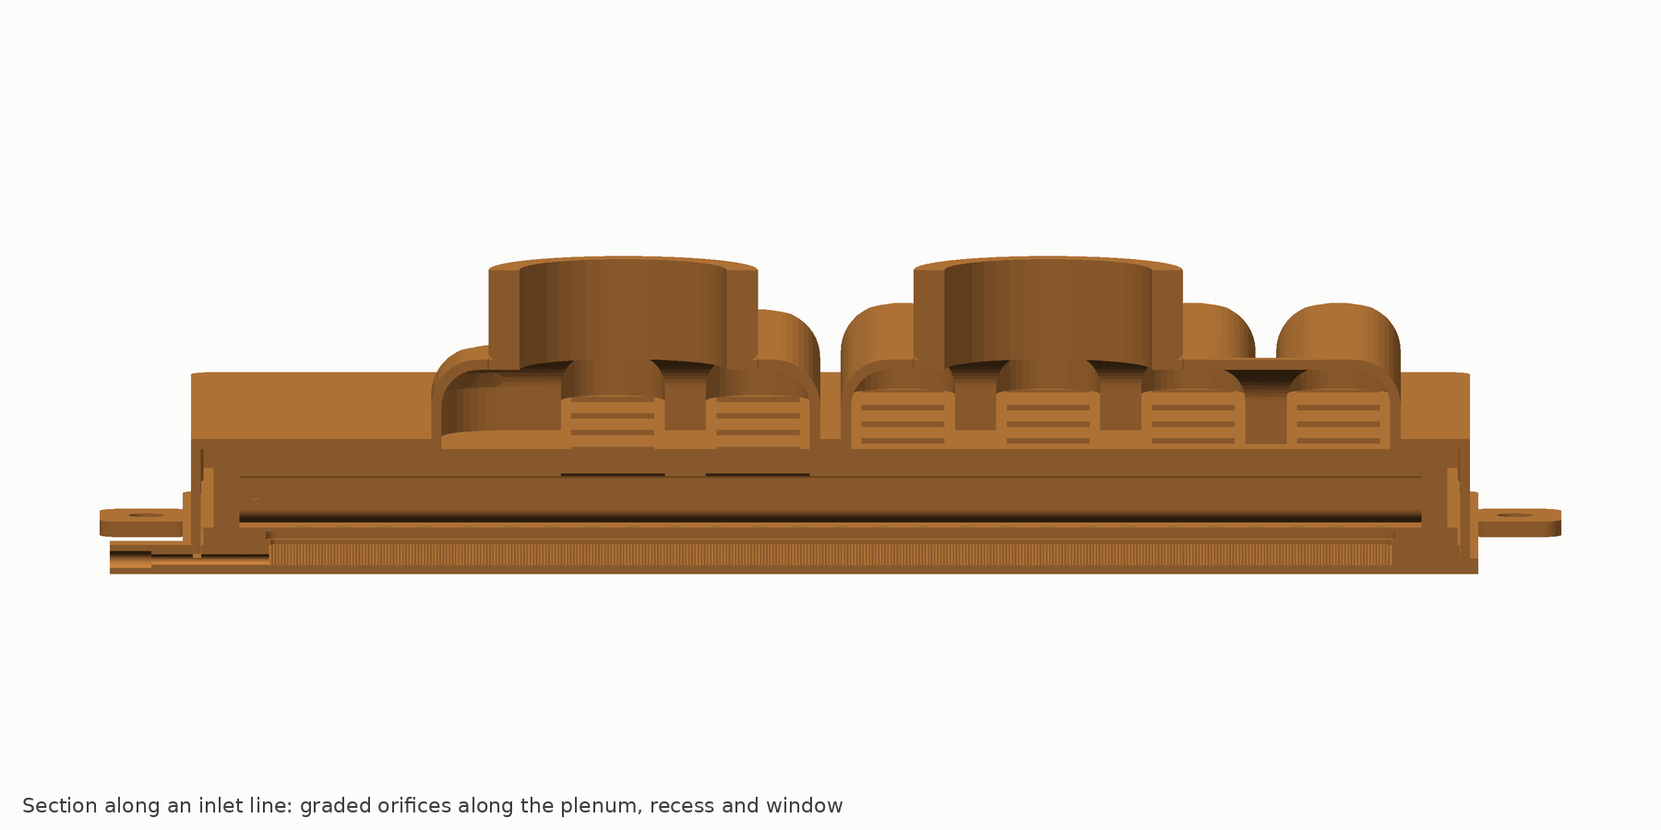
Replace the predictions with measurements
THE NEXT NINETY DAYS
Buy two or three incumbent plates and a CoolIT 4 kW-class plate; establish rig repeatability at or below 1 K (E0).
Run the 24-coupon tie-braze matrix across routes, fixture pressures and base thicknesses; prove per-strip detection (E1).
Water-table and single-cell CFD: segment max/min at or below 1.15, fin-top velocity at or below 0.5 m/s (E2).
Close the inter-lane items: 2.0 mm pins, 4.5 mm ear holes, the guard variant, the cap draw trial, the 316L separator for mass.
Gate G1 at month 3: freeze Rev A, release the fold tool, draw dies and slotting head, order Build A.
Deliverables in hand today: architecture of record, eight design-definition documents, parametric CAD with STEP, STL and DXF, predicted datasheet, manufacturing package, this deck, the design report and the explainer video.
23
Notes:
If the braze coupons pass and the water table confirms the segment balance, every number in this deck is on track to be measured by month 6 and repeated independently by month 9.

