Slide 1

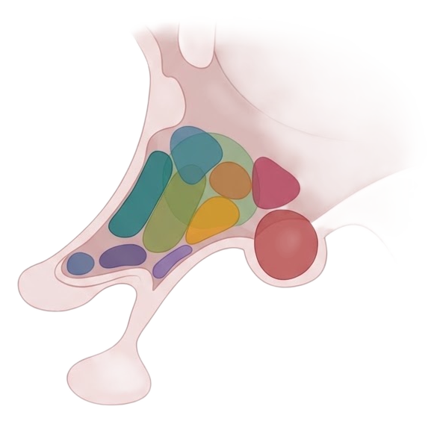
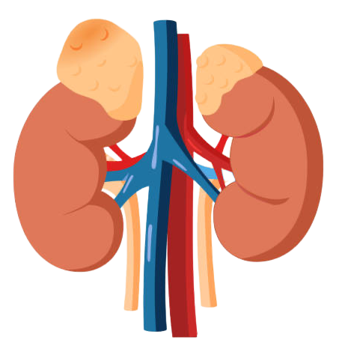
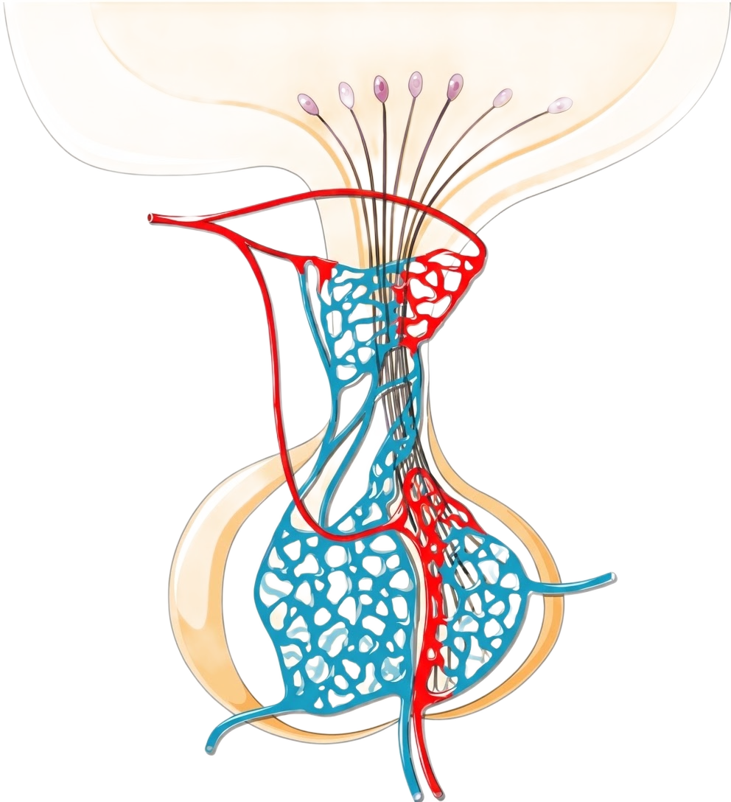

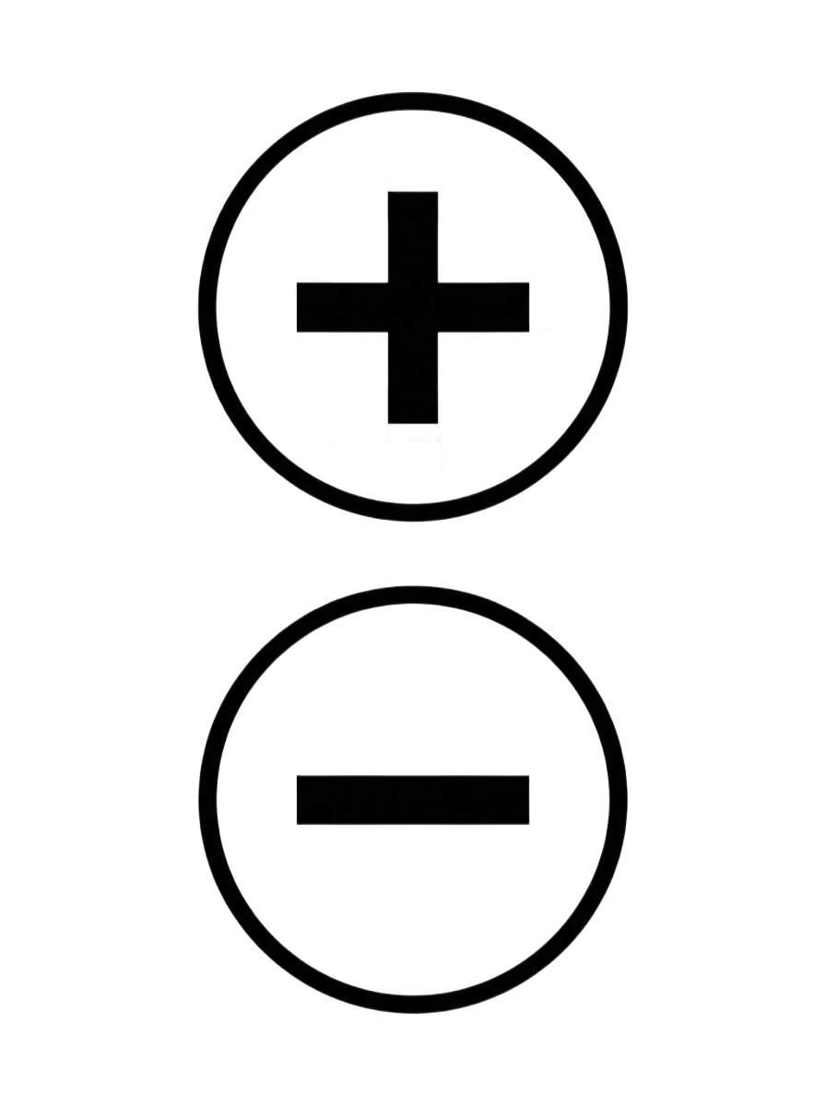
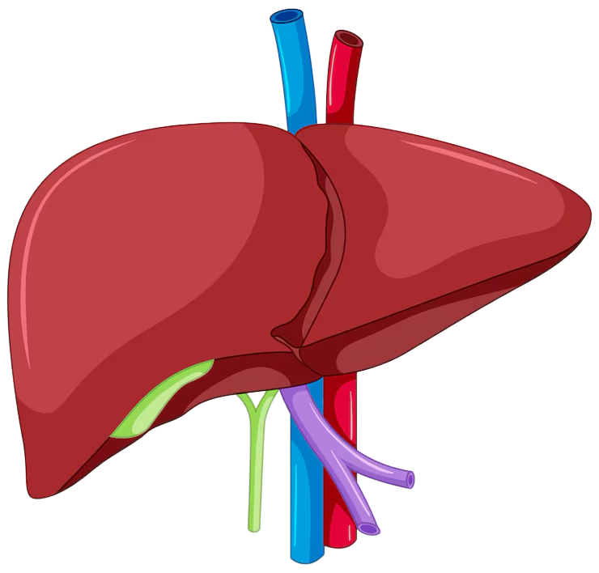
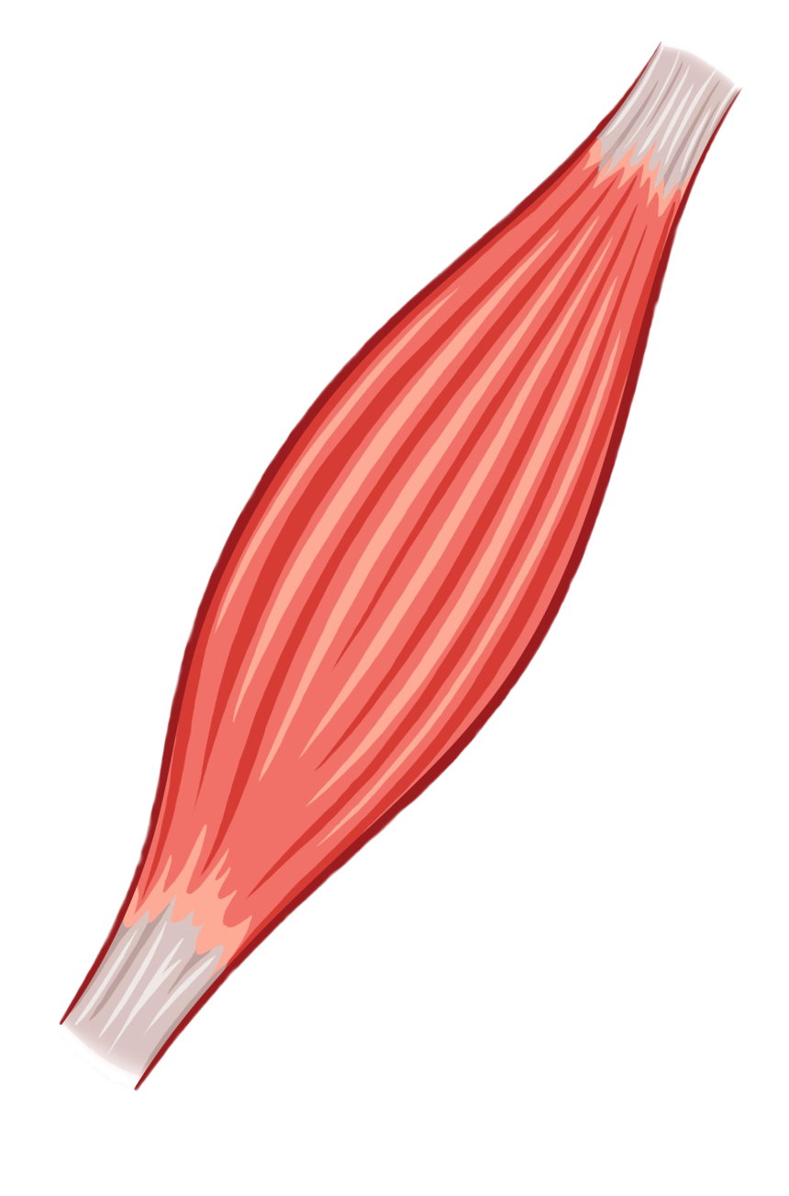

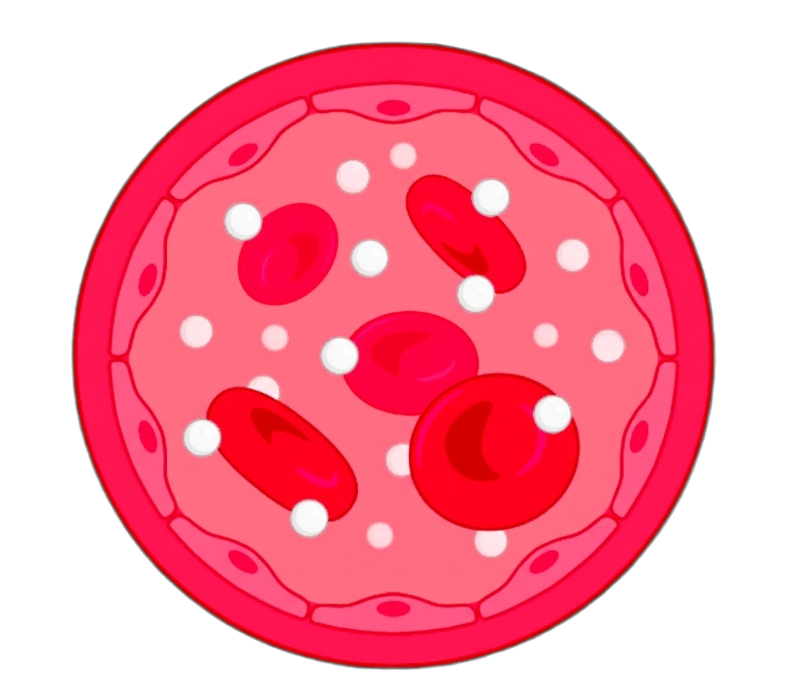

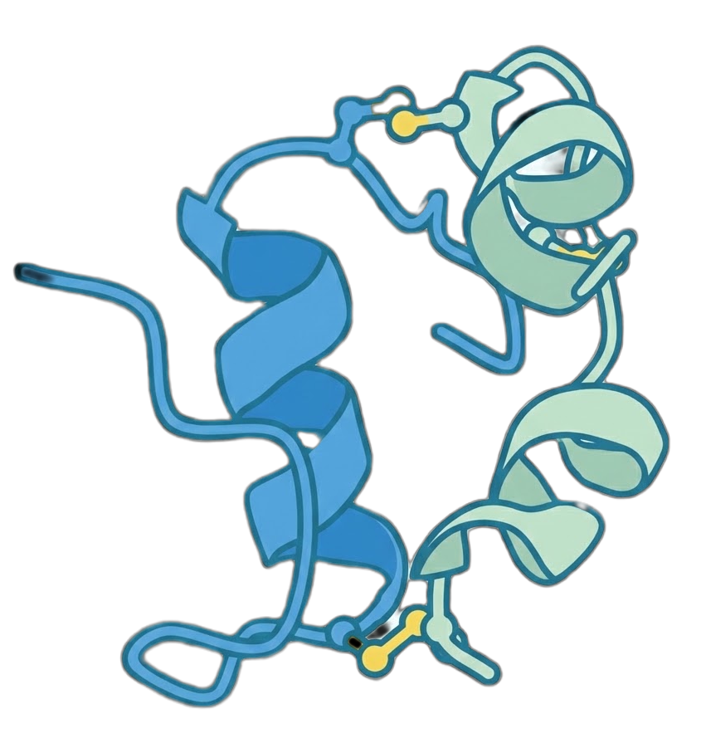
Layer 1: Psychosocial Stress
Layer 2: HPA Axis Mediator
Psychosocial Stress (UKB Score)
ACTH
CRH
Adrenal gland
Pituitary gland
Hypothalamus
Layer 3: Metabolic Outcomes
Cortisol
Secretion
Facilitated Disposal
HGP (Production)
Liver
Muscle/Adipose
Glucose in Blood
Insulin-mediated HGP Suppression
Pancreas
Insulin

Slide 2
