Slide 1
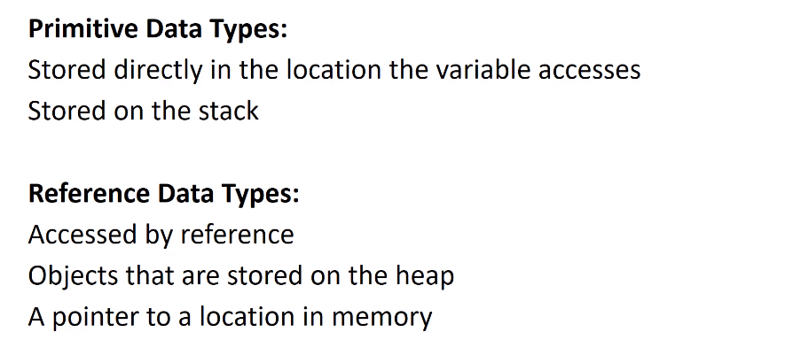
Primitive Data Types Vs. Reference Types

Slide 2
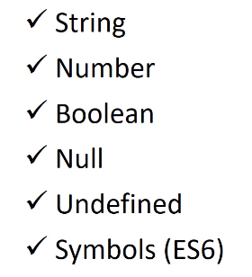
Primitive Data Types

Slide 3
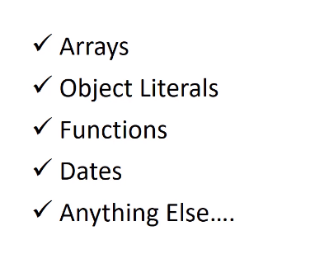
Reference Data Types

Slide 4
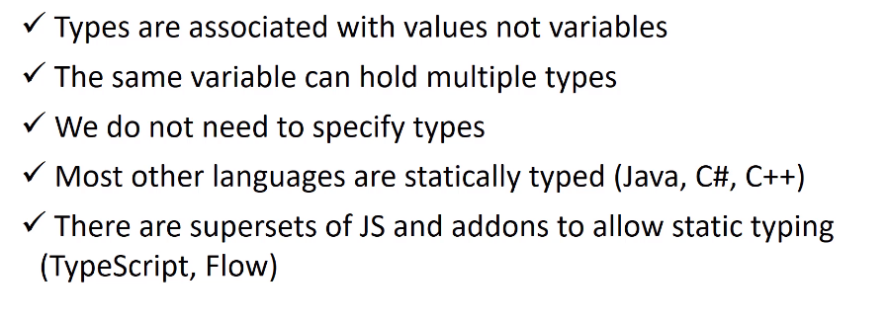
Dynamically Typed Language

Slide 5
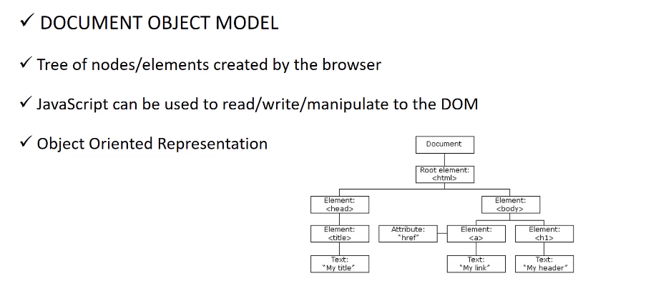
What is The DOM

