Slide 1
CSCI 4711 Software Engineering Spring 2023 Final Project Presentation
Room Management System
James Wilt
Ian Roberson
Charles Smith

Slide 2
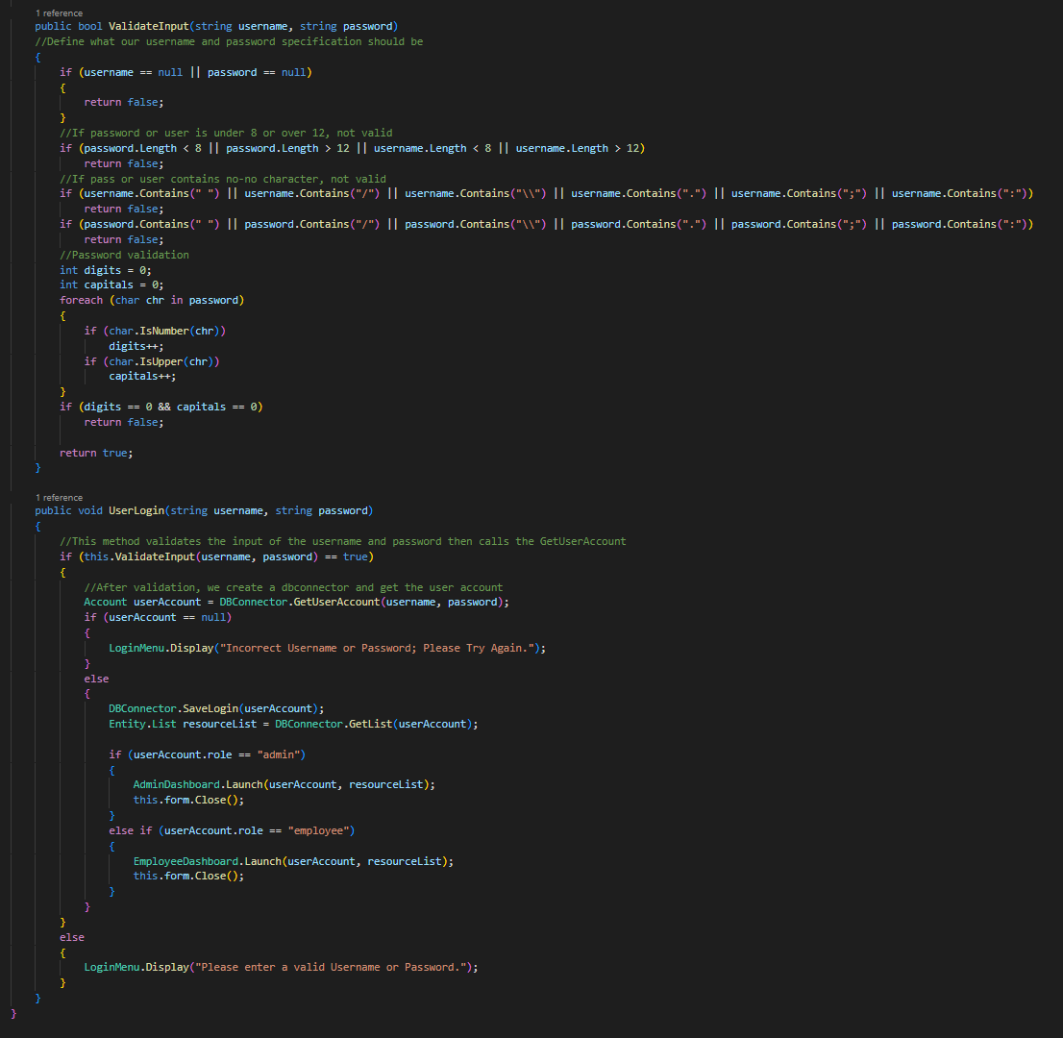
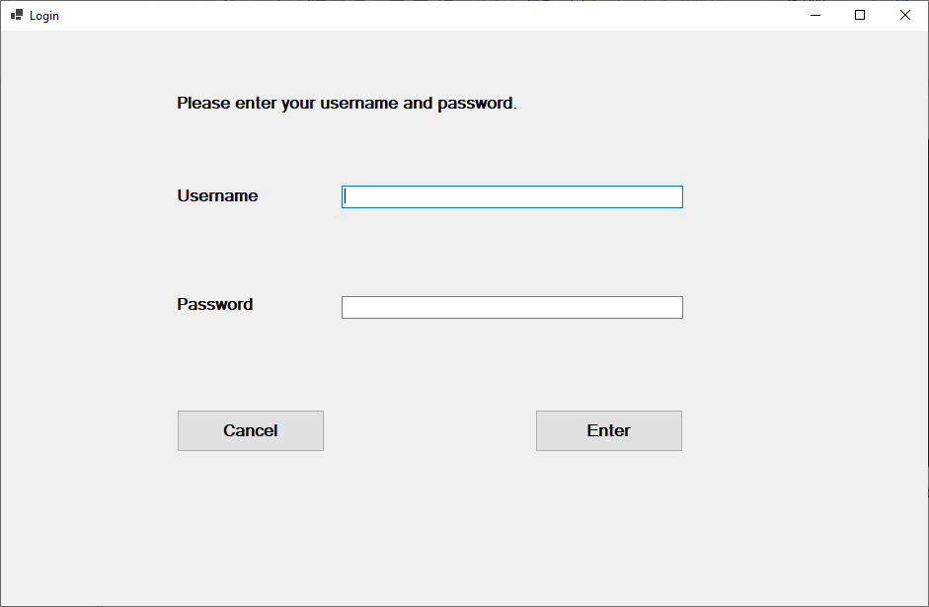
Accomplishments – Requirements
Program written in C# (.Net 6, 7 compatible)
Secured storage of credentials in the database, and all user input is validated on Login attempt.
All Login/Logout operations stored in the Database.
All classes fall into one of the 3 subsystem categories and directly map to Entity, Boundary or Control objects.
Above: Login screen UI
Above: LoginController code for UserLogin/ InputValidation

Slide 3
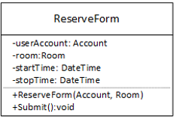
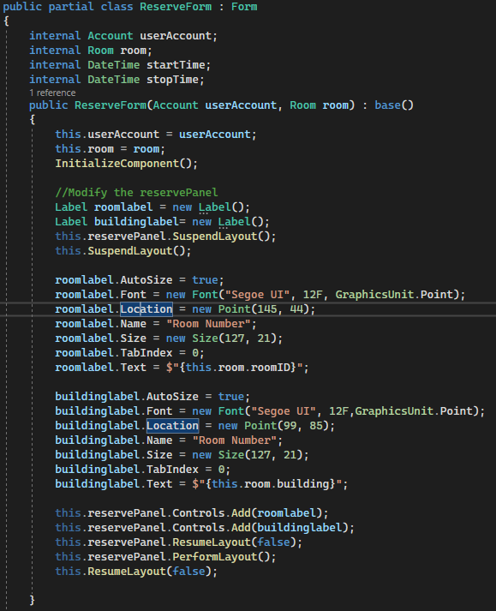
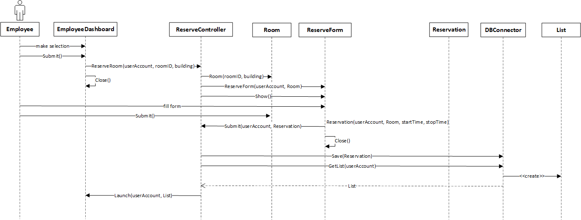
Accomplishments – Design
Left: ReserveForm Class diagram
Below: ReserveForm Class
All Sequence Diagrams directly translated into unique classes and methods.
Maximum re-use of objects in memory, where applicable, Entity Objects were used to facilitate values needed for method calls.
Classes modeled effectively to allow for inheritance and interfacing of common methods.
Above: ReserveRoom Sequence Diagram

