Slide 1
CSCI 4711 Software Engineering Spring 2023 Initial Project Presentation
Room Management System
James Wilt, Charles Smith, Ian Roberson

Slide 2
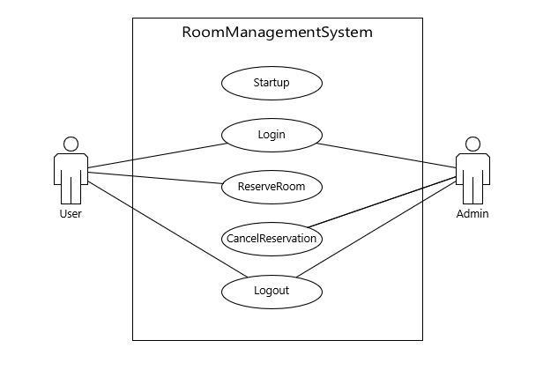
Use Case Diagram

Slide 3
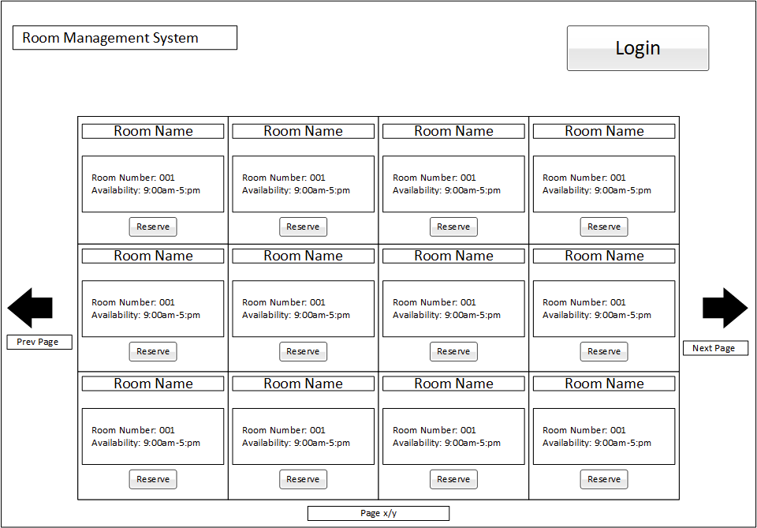
Startup
Notes: If user is not logged in, reserve button functions as a login button
If the user is already logged in, then the login button becomes a logout button

Slide 4
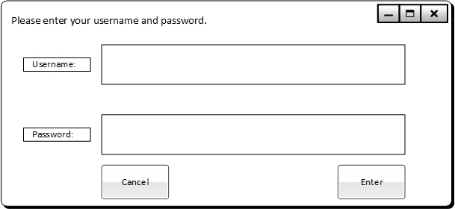
Login
John Smith
**********

Slide 5
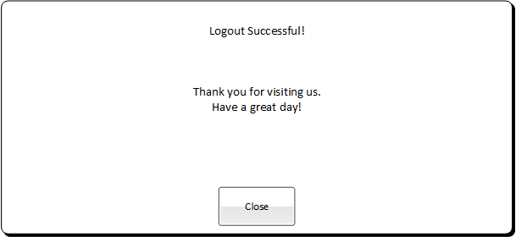
Logout

Slide 6
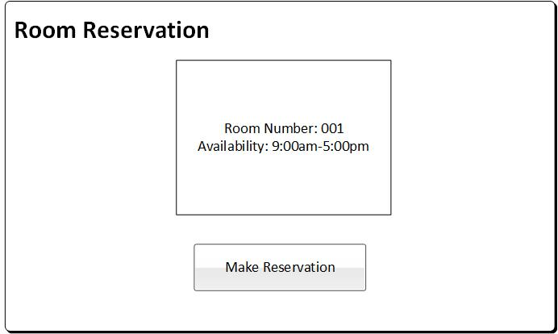
ReserveRoom
User must be logged in as Guest to view this page.

Slide 7
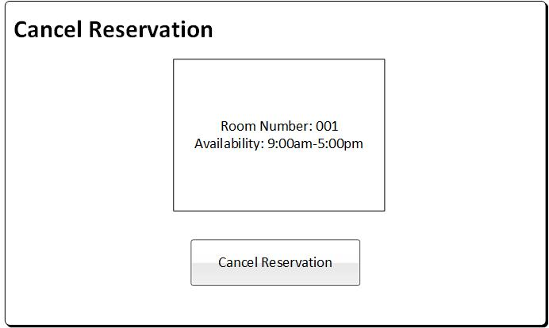
CancelReservation
User must be logged in as Admin to view this page.

Slide 8
Conclusion
Light-weight and effective solution for a Room Management System
Compact UI design enables a simple and concise user experience, without compromising security.
Pre-fetching of all rooms at startup allows for registered users to start reserving rooms immediately.
System allows for administrators to quickly cancel reservations.
Perfect for small to moderate sized buildings.

