Slide 1
CSCI 4711 Software Engineering Spring 2023 Initial Project Presentation
Room Management System
James Wilt, Charles Smith, Ian Roberson

Slide 2
Use Case Diagram

Slide 3
Startup

Slide 4
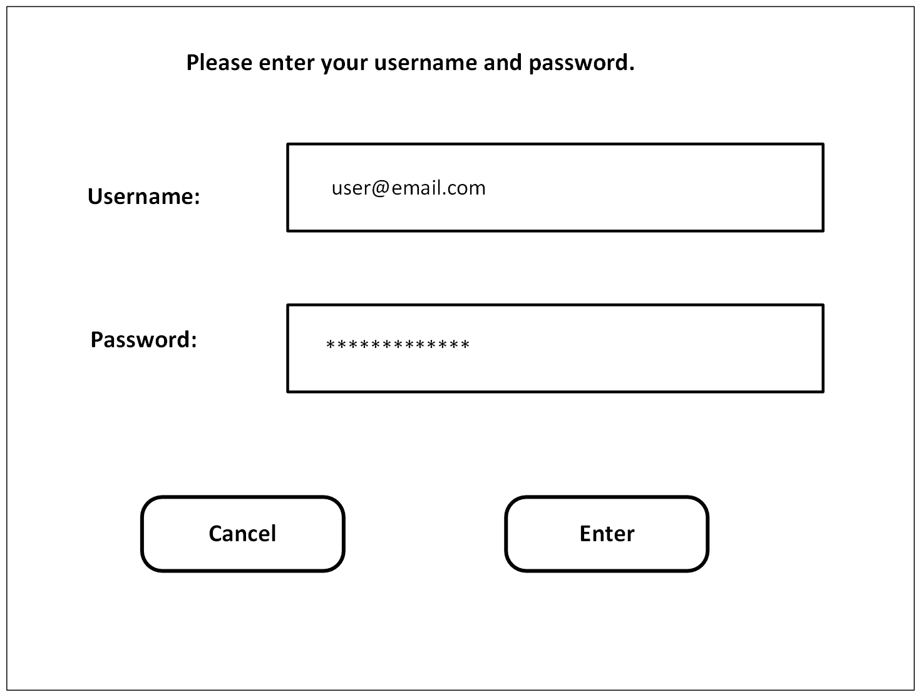
Login

Slide 5
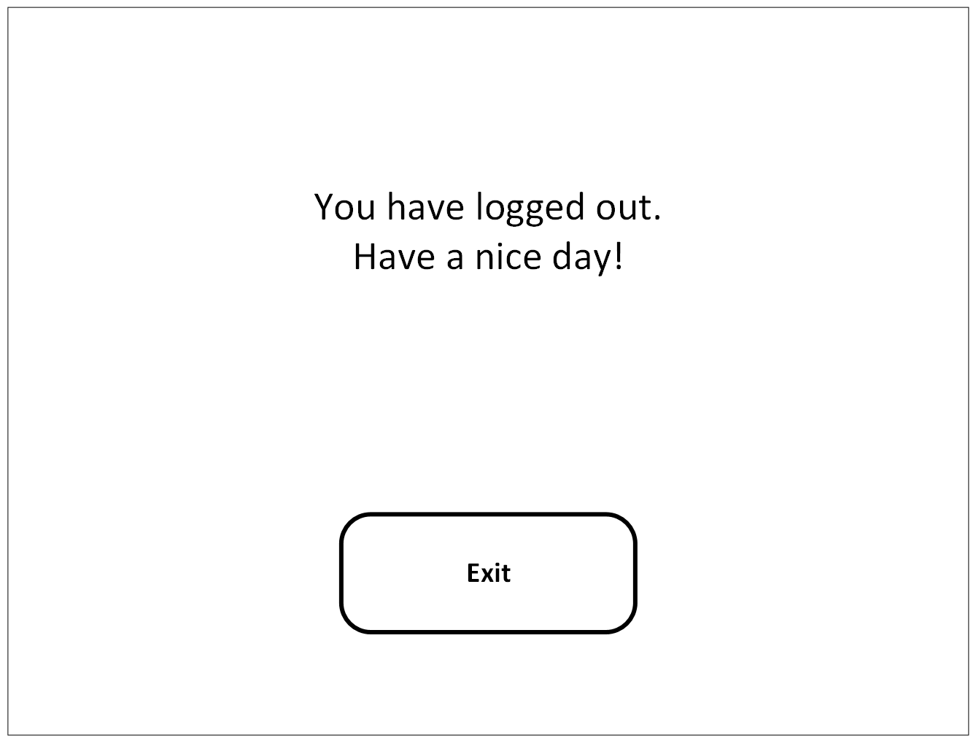
Logout

Slide 6
ReserveRoom

Slide 7
CancelReservation

Slide 8
Conclusion
Effective Solution for a Room Management system
Compact UI design enables a simple yet effective user experience, while not compromising security.
Rendering of all rooms at startup allows for users to start reserving rooms immediately. Minimal wait time makes for maximum user experience.
System allows for administrators to quickly cancel reservations.
????

