Slide 1
Final Project
Do chocolate candies have a higher average win percent than non-chocolate candies?
Prepared by
Rezoan Ishteaque Hossain
IS 381
May 17, 2026
Method used
Public FiveThirtyEight candy dataset
Response variable: winpercent
Main explanatory variable: chocolate
Test: one-sided Welch two-sample t-test
Rezoan Ishteaque Hossain • IS 381

Slide 2
Overview of the Data
The data comes from the FiveThirtyEight candy dataset.
The cases are individual candies, and there are 85 candy types in the dataset.
This is an observational study because the data was already collected.
Research question: Do chocolate candies have a higher average win percent than non-chocolate candies?
Dependent variable
winpercent — numerical; shows the win percent for each candy.
Independent variables
chocolate — categorical (0 = no, 1 = yes) fruity — categorical (0 = no, 1 = yes)
Why this matters
This analysis shows whether chocolate is associated with stronger candy ratings.
Rezoan Ishteaque Hossain • IS 381

Slide 3
Summary Statistics
Group | n | Mean | Median | SD | Min | Max
Non-chocolate | 48 | 42.14 | 41.65 | 10.22 | 22.45 | 67.04
Chocolate | 37 | 60.92 | 60.80 | 12.81 | 34.72 | 84.18
Key finding
Chocolate candies have a much higher average win percent. Mean winpercent: 60.92 vs. 42.14
What the table suggests
The higher mean and median for chocolate candies suggest they tend to perform better in this dataset.
Rezoan Ishteaque Hossain • IS 381

Slide 4
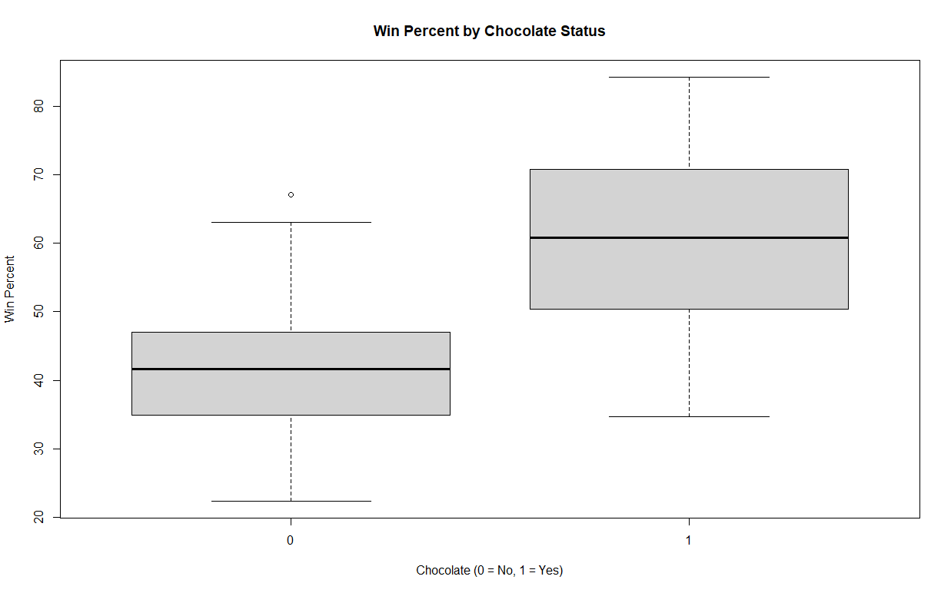
Visualization 1: Boxplot
What it shows
The center of the chocolate group is clearly higher than the center of the non-chocolate group.
Interpretation
Chocolate candies generally have higher win percent values than non-chocolate candies.
Rezoan Ishteaque Hossain • IS 381

Slide 5
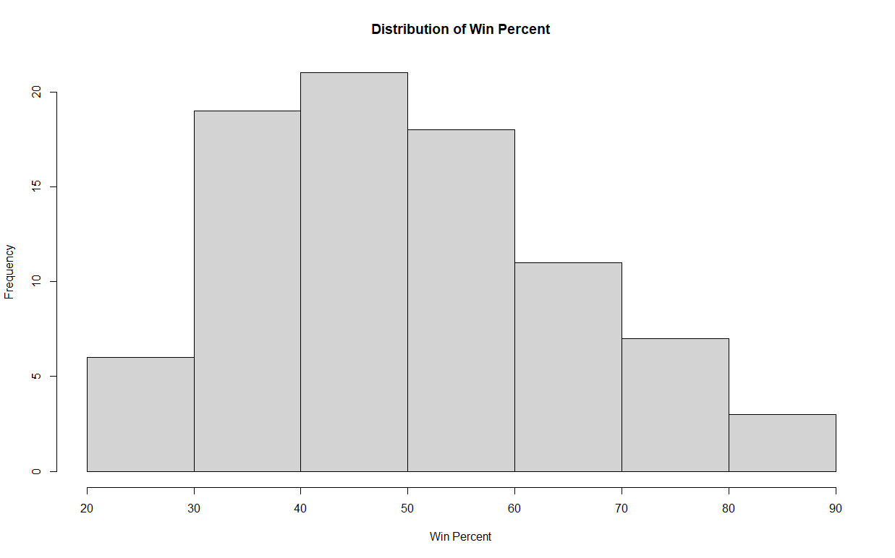
Visualization 2: Histogram
Overall distribution
Most candies are grouped in the middle range of win percent.
Takeaway
There are fewer candies at the very low and very high ends.
Rezoan Ishteaque Hossain • IS 381

Slide 6
Statistical Output
Hypotheses
H0: The mean win percent is the same for chocolate and non-chocolate candies. H1: Chocolate candies have a higher mean win percent.
Sample means
Chocolate: 60.92 Non-chocolate: 42.14
Welch two-sample t-test results
t = 7.3031
df = 67.539
p-value = 2.082e-10
95% lower confidence bound = 14.49
Decision
Because the p-value is far below 0.05, reject the null hypothesis.
Interpretation
There is very strong statistical evidence that chocolate candies have a higher average win percent.
Rezoan Ishteaque Hossain • IS 381

Slide 7
Conclusion
Answer to the research question
Yes. Based on the summary statistics, the graphs, and the one-sided Welch t-test, chocolate candies have a higher average win percent in this dataset.
Why this matters
This project shows that one candy characteristic, chocolate, is associated with stronger overall candy ratings.
Limitations
This dataset includes 85 candies only, and the study is observational. It shows association, not causation.
Final takeaway
Overall, chocolate candies tend to perform better than non-chocolate candies in terms of win percent.
Rezoan Ishteaque Hossain • IS 381

