Slide 1
Network Programming
K Hari Babu
Department of Computer Science & Information Systems

Slide 2
Outline

Slide 3
Outline
Threads
Overview
Creation
Termination
Join
Detach
Thread synchronization
Mutexes
Condition variables
Server Design
Multi Process Concurrency
Preforking models
Prethreading models
Single Process Concurrency
Signal driven I/O
epoll()
Concurrency in UDP

Slide 4
Pthreads
T1: ch 26

Slide 5
Threads
A thread is a line of execution.
A single process can contain multiple threads.
The threads in a process can execute concurrently. On a multiprocessor system, multiple threads can execute parallel.
Problems with multiple processes in an application
Exchange of information among processes requires IPC mechanism.
All threads in a process share process’s data segments (all global variables) , and heap apart from text segment. Stack is individual to each thread.
But synchronization mechanisms are required to control access.
Process creation with fork() is relatively expensive (even with copy-on-write).
Thread creation is 10 times faster. No page-table duplication. No memory duplication.

Slide 6
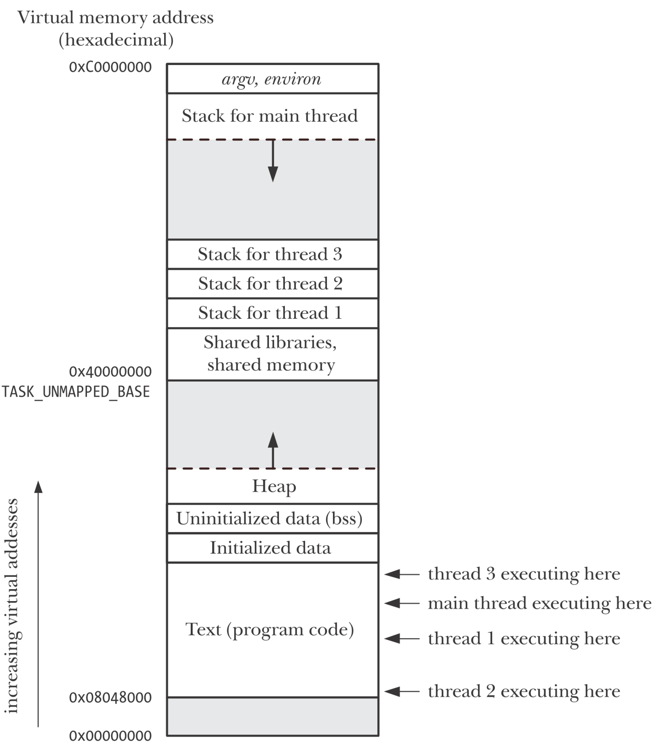
Separate stack for each thread
Multiple threads run
concurrently

Slide 7

Threads
Threads share
heap, data, text segments, global variables, file descriptors, CWD, user, group ids, signal handlers, signal dispositions
Individual
stack, registers, program counters, errno, signal mask, priority
errno is local to each thread.
Normally sys calls return -1 on error and set errno. But Pthread API calls return 0 on success and >0 on failure. They do not set errno.
errno is set when a sys call is directly called within a thread.
Compiling pthread applications.
The program is linked with the libpthread library.

Slide 8
Pthreads API
Thread Management
creation, detach, join, exit
POSIX requires all threads are created as joinable threads
Thread Synchronization
join
mutex (i.e. semapore with value of 1)
semaphore
condition variables

Slide 9

Thread Creation
When a program is started by exec, a single thread is created, called the initial thread or main thread. Additional threads are created by pthread_create.
start: this is the function, the thread will start executing.
thread: this is the thread id, filled by kernel.
attr: normally NULL.
Each thread has numerous attributes: its priority, its initial stack size, whether it should be a daemon thread or not etc.
When a thread is created, we can specify these attributes by initializing a pthread_attr_t variable that overrides the default.
arg: argument to the function.

Slide 10
Joining with Terminated Thread
We can wait for a given thread to terminate by calling pthread_join.
pthread_create is similar to fork, and pthread_join is similar to waitpid.
If retval is a non NULL pointer, then it receives status of a thread specified by pthread_exit().
A thread can call join on any thread in the process. No parent-child relationship in threads.
A non-detatched thread must be joined by some thread, otherwise it will lead to zombie thread. Resources will be held up in the kernel.

Slide 11


Detaching a Thread
By default a thread is joinable. If we do not join, kernel will store the status of the thread.
If we do not care about the status of the thread, then we can detach the thread.
System will automatically cleanup when the thread terminates.
Detaching a thread doesn’t make it immune to exit() in another thread or a return in the main thread.
pthread_detach() simply controls what happens after a thread terminates, not how or when it terminates.
A thread can detach itself.

Slide 12


More Pthread Functions
pthread_self Function
Each thread has an ID that identifies it within a given process. The thread ID is returned by pthread_create().
A thread fetches this value for itself using pthread_self().
pthread_exit Function
The retval argument specifies the return value for the thread.
Calling pthread_exit() is equivalent to performing a return in the thread’s start function.
If the main thread calls pthread_exit() instead of calling exit() or performing a return , then the other threads continue to execute.

Slide 13
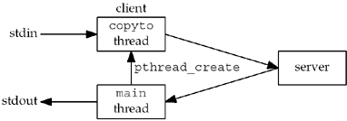
Batch Mode Client Using Threads
Client uses two threads
Main thread: data transfer from socket to stdout
copyto thread: data transfer from stdin to socket.

Slide 14
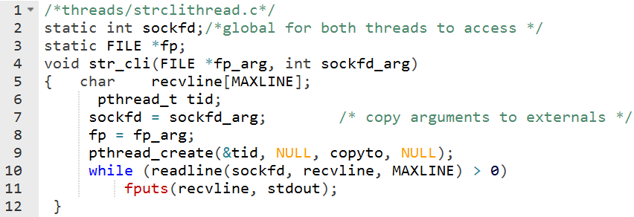
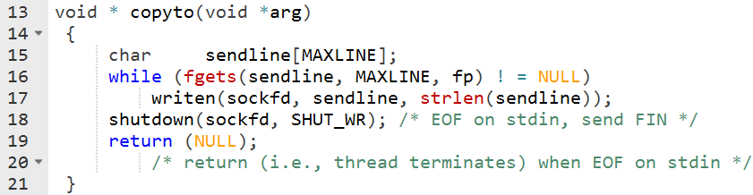
Batch Mode Client Using Threads

Slide 15
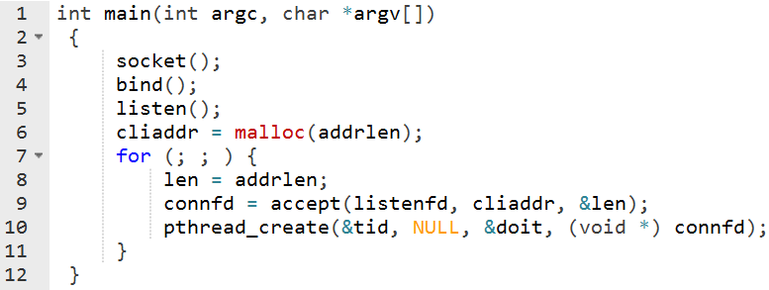
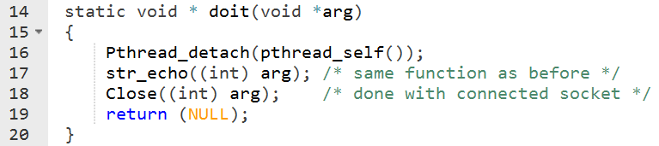
TCP Echo Server Using Threads
Server creates a new thread every time it accepts a new connection through accept().

Slide 16
Passing Arguments to New Threads
Problem with the code in the previous slide:
According to ANSI, connfd can’t be casted to void*. It is not guaranteed to work on all systems.
Passing address of connfd also not going to work. Because two threads may end up working on the same connfd value.
Each time we call accept, we first call malloc() and allocate space for an integer variable, the connected descriptor.
This gives each thread its own copy of the connected descriptor.
The thread fetches the value of the connected descriptor and then calls free to release the memory.

Slide 17
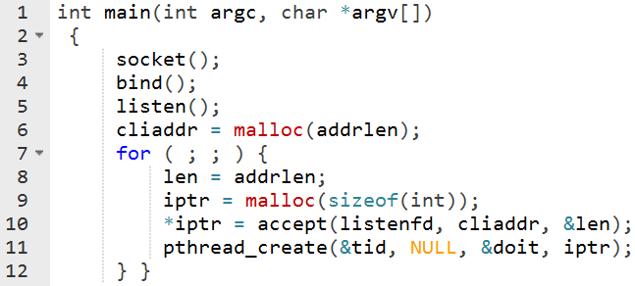
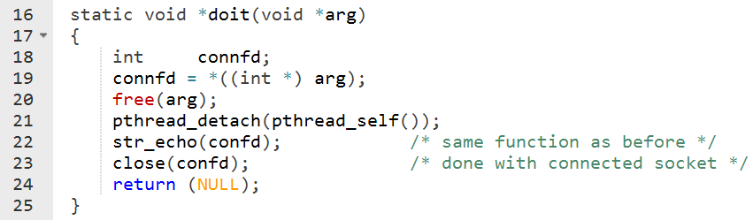
Passing Arguments to New Threads

Slide 18
Protecting Accesses to Shared Variables: Mutexes
The term critical section refers to a section of code that accesses a shared resource and whose execution should be atomic.
Its execution should not be interrupted by another thread that simultaneously accesses the same shared resource.
Pthreads provide mutexes for protecting critical section.
Each mutex has two states: locked, unlocked.
At most one thread may hold lock on a mutex.
When a thread locks a mutex, it becomes the owner of that mutex. Only the mutex owner can unlock the mutex.

Slide 19
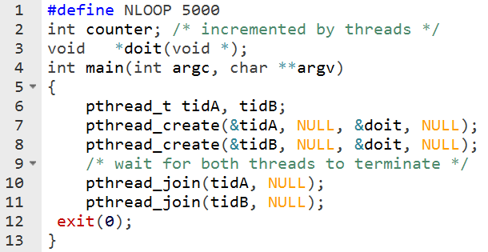
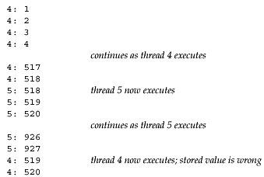
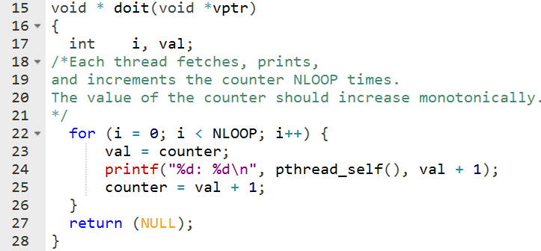
Critical Section Problem

Slide 20
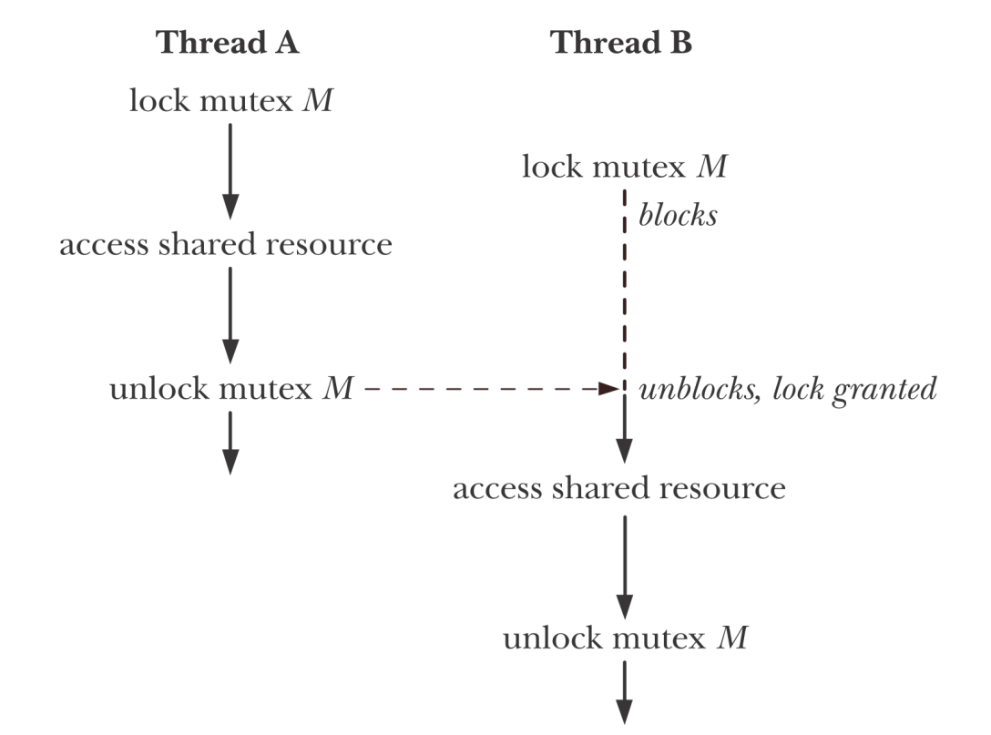
Using Mutex
Each thread employs the following protocol for accessing a resource:
lock the mutex for the shared resource;
access the shared resource; and
unlock the mutex.

Slide 21

Using Mutex
A mutex is a variable of the type pthread_mutex_t. Mutex must always be initialized.
For a statically allocated mutex
The pthread_mutex_trylock() function is the same as pthread_mutex_lock(), except that if the mutex is currently locked, pthread_mutex_trylock() fails, returning the error EBUSY.

Slide 22
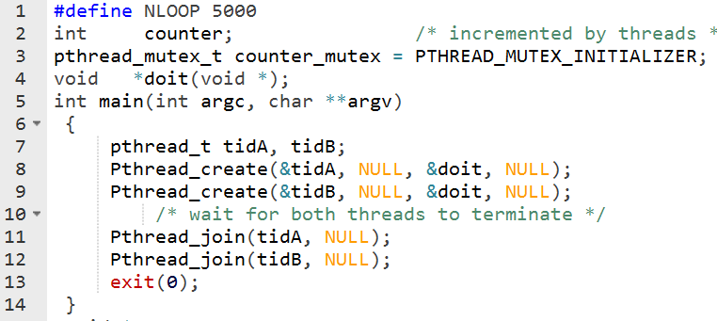
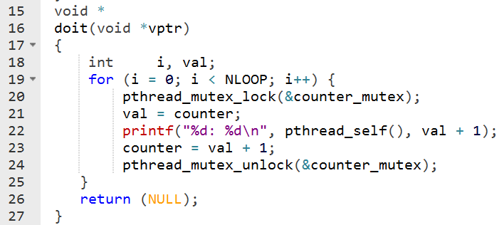
Using Mutexes

Slide 23
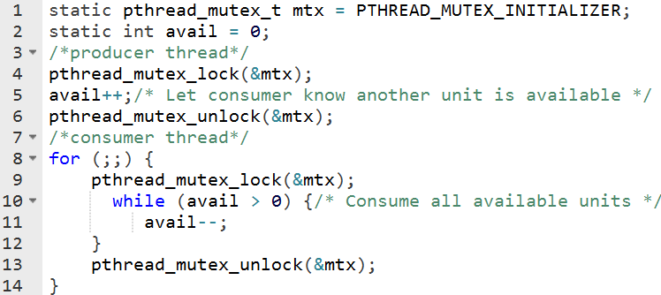
Condition Variables
A mutex is fine to prevent simultaneous access to a shared variable, but we need something else to let us go to sleep waiting for some condition to occur.
The above code works, but it wastes CPU time, because the consumer thread continually loops, checking the state of the variable avail. A condition variable remedies this problem.

Slide 24
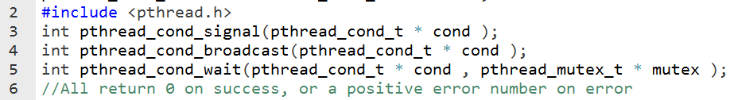
Condition Variables
Condition variable allows a thread to sleep (wait) until another thread notifies (signals) it that it must do something.
A condition variable is always used in conjunction with a mutex.
The mutex provides mutual exclusion for accessing the shared variable, while the condition variable is used to signal changes in the variable’s state.
Broadcast wakes up all blocked threads. Each will go through the code. Used when there is different tasks done for a particular condition.

Slide 25
Using Condition Variables
Why mutex is associated with condition variable?
The thread locks the mutex in preparation for checking the state of the shared variable.
The state of the shared variable is checked.
If the shared variable is not in the desired state, then the thread must unlock the mutex (so that other threads can access the shared variable) before it goes to sleep on the condition variable.
Done atomically
When the thread is reawakened because the condition variable has been signaled, the mutex must once more be locked, since, typically, the thread then immediately accesses the shared variable.
it is not possible for some other thread to acquire the mutex and signal the condition variable before the thread calling pthread_cond_wait() has blocked on the condition variable.

Slide 26
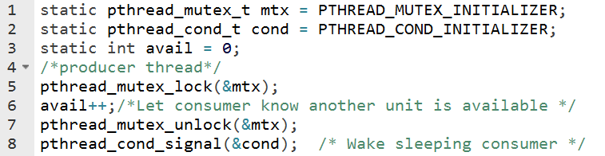
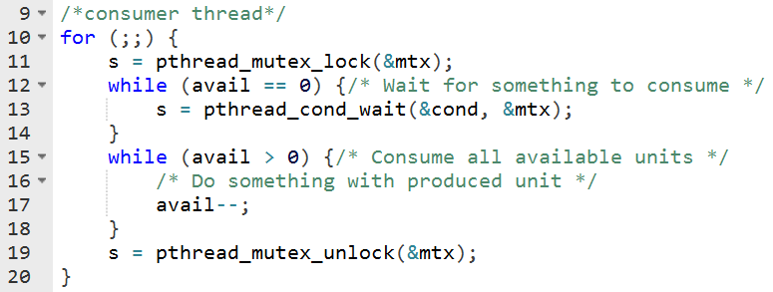
Using Condition Variables

Slide 27
Web client: Using threads

Slide 28
Threads: web client
The client establishes an HTTP connection with a Web server and fetches a home page.
On that page are often numerous references to other Web pages.
Instead of fetching these other pages serially, one at a time, the client can fetch more than one at the same time, using multiple connections, one per thread.

Slide 29
Threads: web client
We have designed a web client handling multiple simultaneous connections using non-blocking connect.
Now we will design using threads:
With threads, we can leave the sockets in their default blocking mode.
Create one thread per connection.
Each thread can block in its call to connect. Kernel will schedule threads that are ready.

Slide 30
Threads: web client
This program will read up to 20 files from a Web server.
We specify as command-line arguments
the maximum number of parallel connections,
the server's hostname, and
each of the filenames to fetch from the server.
It means
three simultaneous connection
server’s hostname
filename for the home page
the files to be read
T1: 26.6 & 26.9

Slide 31
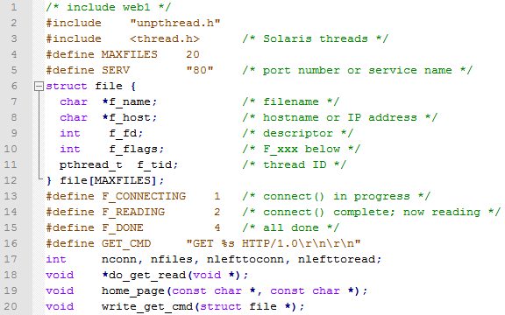
Header file

Slide 32
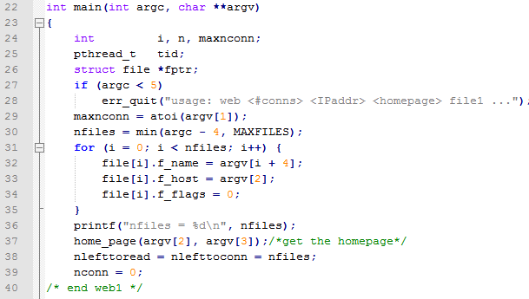
Main function
Initialize structures

Slide 33
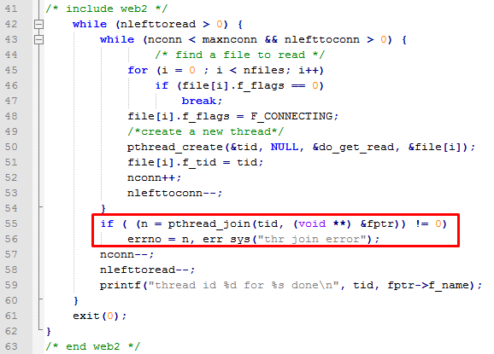
Main function
Create maximum of maxconn threads and wait for them to terminate.

Slide 34
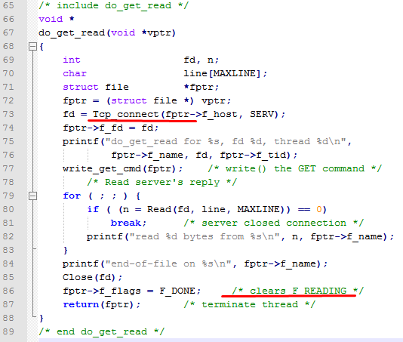
do_get_read function

Slide 35
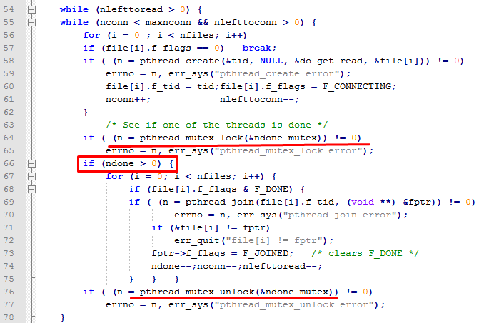
Polling for Available Threads

Slide 36
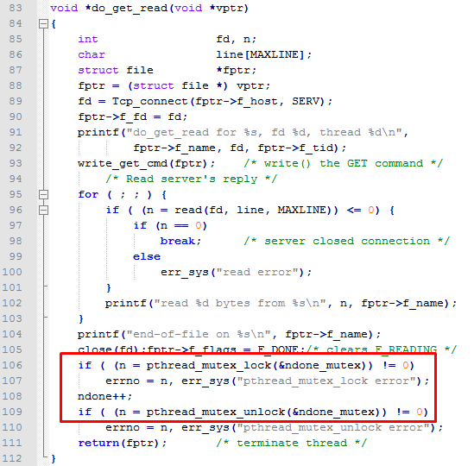
Polling for Available Threads

Slide 37
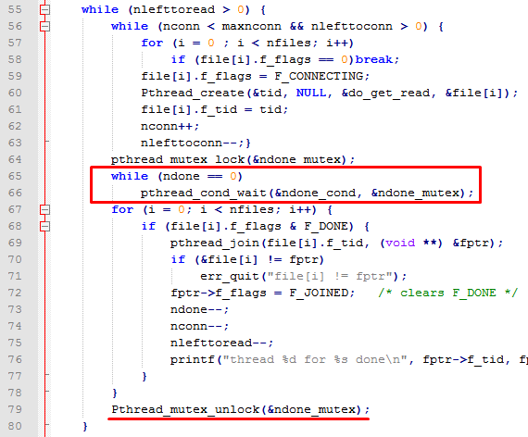
Using Condition Variables

Slide 38
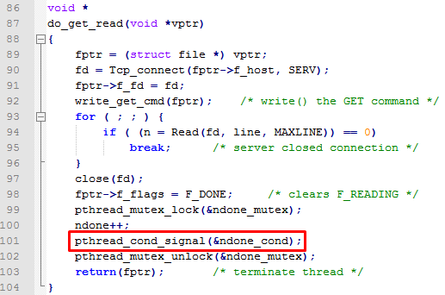
Using Condition Variables

Slide 39
Performance
Table shows the clock time required to fetch a Web server's home page, followed by nine image files from that server.
The RTT to the server is about 150 ms.
The home page size was 4,017 bytes and the average size of the 9 image files was 1,621 bytes.
TCP's segment size was 512 bytes.
Most of the improvement is obtained with three simultaneous connections.
# simultaneous connections | Clock time (seconds), non blocking | Clock time(secs) Threads
1 | 6.0 | 6.3
2 | 4.1 | 4.2
3 | 3.0 | 3.1
4 | 2.8 | 3.0
5 | 2.5 | 2.7
6 | 2.4 | 2.5
7 | 2.3 | 2.3
8 | 2.2 | 2.3
9 | 2.0 | 2.2

