Slide 1
Booking Funnel
High Level Design Document
Version 1.0.0.3
Created By :- Santhosh
Create Date :- 19/11/2014
Update Date :- 01/12/2014

Slide 2
Block Diagram – Booking Funnel
N
Apache Solr Indexing Server
New Booking Funnel Search Implementation(AutoComplete Feature) – Solr Integration
B2B
B2C
Call Center
REST Service
Existing Inventory Flow
APP SERVER (WCF/Middle Tier)
Partner Web Services
(Inventory Availability Validation of Products on Partner Sites)
MSSQL Tenant DB
(Inventory Availability Validation of Negotiated Products)

Slide 3
Block Diagram – Search & Index Flow
Admin Site
(Perform Location Creation & Updation)
MSMQ
B2B
B2C
Call Center
CRUD
Third Party Services
(Perform Location Creation & Updation)
Search
Search
Search
CRUD
Process Service
(Near Real Time Synchronization Between Apache Solr Cache & MSSQL DB)
Apache Solr Indexing Server
(Intelligent Location Information – each location item contains latitude/longitude)
CRUD
CRUD
CRUD
CRUD
CRUD
Batch Service
(One Time Flush and Recreate Spatial Index)
CRUD
Read
MSSQL DB
(Location Search)
Notes:
Search Location – All the location which includes City, Landmark, Airport & Products.
Location Graph – This is a Cartesian product of Search Location tables.

Slide 4
Data Model (Common Collection/ Tenant Specific) – Location Search Entity (Complete Universe/Location Data store)
LSName
LSLatitude
LSLongitude
TenantID
LSGeometry
SiteID
LocationSearch
LSSubType
LSID
ProductCode
LSType
Notes:
Business Rules
Location Search Key(LSID) – should be a unique key for each and every location search entity.
Location Name (LSName) – can be product name, landmark, city/area or airport. Based on the location type, any one of these columns will contain values.
Location Type(LSType) – can be one of these four values Hotel, Landmark, City/Area or Airport.
Location Sub Type(LSSubType) – can be specific/limited to “hotel” Location Type. It can be either Partner or Negotiated Product.
ProductCode– this id is unique for each and every Hotel. This id should be passed to the Partner API / Searched in the Tenant Database for Product Id.
Location City Center Distance(LSCityCenterDistance) – distance of the location from the city center.
Location Airport Distance(LSAirportDistance) – distance of the location from the nearest airport.
Tenant ID & Site ID – can be used in the search key to perform additional logic to restrict results based on individual tenant and micro site to support multi-tenant architecture.

Slide 5
Business Rules
Location Search Key(LSID) – should be a unique key for each and every location search entity.
Location Name (LSName) – can be product name, landmark, city/area or airport. Based on the location type, any one of these columns will contain values.
Location Type(LSType) – can be one of these four values Hotel, Landmark, City/Area or Airport.
Location Sub Type(LSSubType) – can be specific/limited to “hotel” Location Type. It can be either Partner or Negotiated Product.
ProductCode– this id is unique for each and every Hotel. This id should be passed to the Partner API / Searched in the Tenant Database for Product Id.
Tenant ID & Site ID – can be used in the search key to perform additional logic to restrict results based on individual tenant and micro site to support multi-tenant architecture.

Slide 6
Data Model – Apache Solr Index Creation for Common Collection Implementation
TenantID
LSLatitude
LSLongitude
SiteID
LSGeometry
LSID
LocationSearch
LSName
ProductCode
LSType
LSSubType

Slide 7
Data Model – Apache Solr Index Creation for Tenant Specific Collection Implementation
LSLatitude
LSLongitude
SiteID
LSGeometry
LSID
LocationSearch
LSName
ProductCode
LSType
LSSubType

Slide 8
NOSQL – Search Key/Value
Key
Value
(LocationGeometry,Distance)
Related Products
Related Landmarks
Related
Airports
Related City/Ares

Slide 9
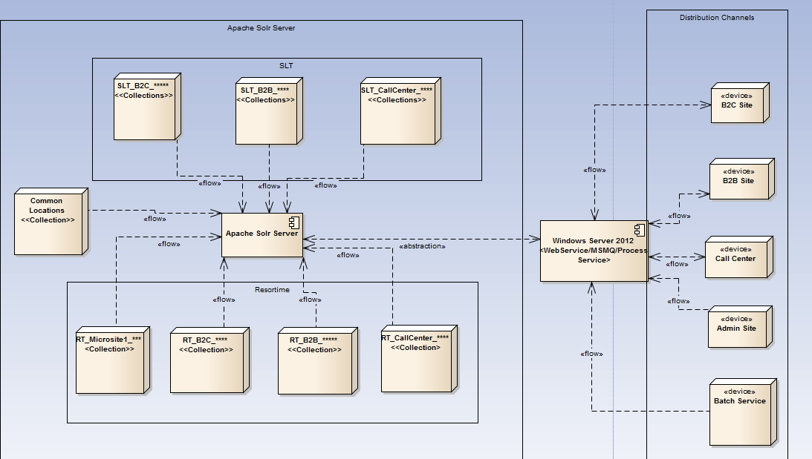
Apache Solr Collection Distribution in AWS Machine to support Multi Tenants and Micro site

Slide 10
Work Break Down Structure
RDMS related activities to generate table and necessary stored procedure as proposed in the ER diagram.
Obtain and populate the data in the database.
Create a tool to calculate the distance of each location from the nearest airport for already available products.
Create a tool to calculate the distance of each location from the city center for already available products.
Create a tool to obtain latitude and longitude of all the negotiated products.
Create a tool to obtain latitude and longitude of all the partner products.
PCM – Change to admin site to handle inserting latitude and longitude mandatory and choosing
nearest airport and nearest city center to obtain their corresponding distance.
8. Install Apache Solr and perform feasibility analysis.
9. Obtain Apache Solr API fro .NET and manipulate the API for its consistency.
10. Training time to explore Apache Solr.
11. Create a document schema in Apache Solr to handle Location Search Entity.

Slide 11
Work Break Down Structure
12. Create a service to populate the records from SQL Server to Apache Solr as proposed in the ER Diagram
(ETL process).
13. Create an Index in Apache Solr.
14. Modify search logic code in all distributed channels(call center, b2b, b2c, web service) for Auto complete.
15. Choose the optimal logic to bring auto complete logic.
16. Assign design team to incorporate design changes to Auto complete drop down as required.
17. Create a service to perform spatial search.( e.g. :- Input is a single location type and output is the list of location Search entity type).
18. Integrate the search with search results page.
19. Risk in handling multitenant architecture and also micro site architecture. Analyze on bringing up a stable design to support this feature.
20. Setup Apache Solr on AWS Environment and test the functionality on the same.
21. Unit Test Cases for QA to be provided and training needs to be provided.
22. Deployment document for build and release team to be provided.
23. Technical Specification Document to be create and delivered for the overall feature.
24. KT Session to be provided for the entire team on implementation of booking funnel Search.

Slide 12
Pseudocode to develop POC
A. Create and Populate the Search Location table to enrich the universal location data store.
Create a table named Location Search in metadata database which contains all Landmarks, Airport, City/Area across the globe with reference to the context of the application.
Data obtained from expedia and geonames.org serves as the input to Location Search Table.
This entity type can be stored in the metadata database for generic location types .
B. Create and Populate the Location Search table to have a complete details of all the products of the tenants grouped based on Site they own.
Create a table named Location Search in tenant database which contains all Products information.
This entity type can be stored in the tenant database for specific products based on tenant id and site id.
C. NoSQL – Populate the distributed cache using (A) and (B)
Create a batch service to prepare an index for Apache Solr.
One collection in Solr is created specific to Location Search table which was created and populated in metadata database(A).

Slide 13
Pseudocode to develop POC
3. Several collections are created in Solr, grouped by Tenant Id and Site Id. Each tenant ID and site Id group will contain products specific to that tenant and for a specific site (distributed channel). (B).
D. Auto populate drop down in Search Page in distributed channel.
Whenever a search is done in the search widget for a particular location. A normal search is performed
on both the common collections and tenant_site specific collections to pull down the matching records.
When an end user chooses a particular location from the auto complete drop down. The corresponding locations latitude, longitude and threshold distance is send to the tenant_site specific collection to obtain the list of location entities which falls within the search range using Apache Solr Server.
Apache Solr performs Breadth First Search and provides a list of product name that matches the criteria and provided to obtain Search results.

Slide 14
Pseudocode to develop POC
F. Updating/Enriching Location Entities
Whenever a new product is added to the system.
The location will be inserted into the SearchEntities table and a cross join is performed to identify its related locations.
G. Synchronize new/updated locations to NoSQL
A Batch process will sync the new data item to the couch and create a corresponding key/value pair.
It will also take into that all its related locations are updated with this new item in its graph to account for the search to
be consistent.

Slide 15
Technology Stack
Apache Solr 4.10.2
ASP. Net MVC Framework – WebApi REST
SQL Server 2012
MSMQ
Apache SolrCloud Zookeeper
Java Virtual Machine

Slide 16
Thank You!!!

