Slide 1
Booking Funnel
High Level Design Document
Version 1.0.0.2
Created By :- Santhosh
Create Date :- 19/11/2014
Update Date :- 29/12/2014

Slide 2
Block Diagram – Search & Index Flow
Admin Site
(Perform Location Creation & Updation)
Third Party Services
(Perform Location Creation & Updation)
B2B
B2C
Call Center
MSMQ
Process Service
(Near Real Time Synchronization Between NOSQL Cache & MSSQL DB)
NOSQL Distributed Cache
(Intelligent Location Information – each location item contains latitude/longitude)
Batch Service
(One Time Flush and Recreate Spatial Index)
MSSQL DB
(Location Search)
Notes:
Search Location – All the location which includes City, Landmark, Airport & Products.
Location Graph – This is a Cartesian product of Search Location tables.

Slide 3
Block Diagram – Inventory Availability Validation Flow
N
New Booking Funnel Search Implementation – Solr Integration
Get list of Hotel Id
NOSQL Distributed Cache
(contains Intelligent Location Data)
B2B
B2C
Call Center
Existing Inventory Flow
APP SERVER (WCF/Middle Tier)
Get list of Hotel Id
Partner Web Services (Inventory Availability Validation of Products on Partner Sites)
MSSQL Tenant DB
(Inventory Availability Validation of Negotiated Products)

Slide 4
Data Model – Location Search Entity (Complete Universe/Location Data store)
LSName
LSLatitude
LSLongitude
TenantID
LSCoordinates
SiteID
LocationSearch
LSSubType
ID
ProductCode
LSType
Notes:
Business Rules
Location Search Key(LSID) – should be a unique key for each and every location search entity.
Location Name (LSName) – can be product name, landmark, city/area or airport. Based on the location type, any one of these columns will contain values.
Location Type(LSType) – can be one of these four values Hotel, Landmark, City/Area or Airport.
Location Sub Type(LSSubType) – can be specific/limited to “hotel” Location Type. It can be either Partner or Negotiated Product.
ProductCode– this id is unique for each and every Hotel. This id should be passed to the Partner API / Searched in the Tenant Database for Product Id.
Location City Center Distance(LSCityCenterDistance) – distance of the location from the city center.
Location Airport Distance(LSAirportDistance) – distance of the location from the nearest airport.
Tenant ID & Site ID – can be used in the search key to perform additional logic to restrict results based on individual tenant and micro site to support multi-tenant architecture.

Slide 5
Business Rules
Location Search Key(ID) – should be a unique key for each and every location search entity.
Location Name (LSName) – can be product name, landmark, city/area or airport. Based on the location type, any one of these columns will contain values.
Location Type(LSType) – can be one of these four values Hotel, Landmark, City/Area or Airport.
Location Sub Type(LSSubType) – can be specific/limited to “hotel” Location Type. It can be either Partner or Negotiated Product.
ProductCode– this id is unique for each and every Hotel. This id should be passed to the Partner API / Searched in the Tenant Database for Product Id.
Tenant ID & Site ID – can be used in the search key to perform additional logic to restrict results based on individual tenant and micro site to support multi-tenant architecture.

Slide 6
NOSQL – Search Key/Value
Key
Value
(LocationGeometry,Distance)
Related Products
Related Landmarks
Related
Airports
Related City/Ares

Slide 7
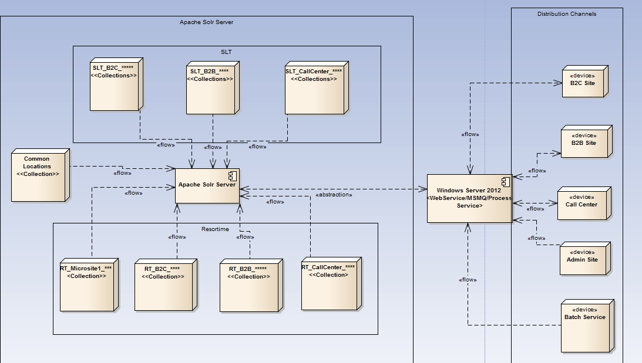
Apache Solr Collection Distribution in AWS Machine to support Multi Tenants and Micro site

Slide 8
Pseudocode to develop POC
A. Create and Populate the Search Location table to enrich the universal location data store (using EAN from Expedia).
Create a table named Location Search in metadata database which contains all Landmarks, Airport, City/Area across the globe with reference to the context of the application.
Data obtained from expedia serves as the input to Location Search Table.
This entity type can be stored in the metadata database for generic location types .
B. Create and Populate the Location Search table to have a complete details of all the products of the tenants grouped based on Site they own.
Create a table named Location Search in tenant database which contains all Products information.
This entity type can be stored in the tenant database for specific products based on tenant id and site id.
C. NoSQL – Populate the distributed cache using (A) and (B)
Create a batch service to prepare an index for Apache Solr which will be an one time activity and can be triggered based on need basis.
One collection in Solr is created specific to Location Search table which was created and populated in metadata database(A).

Slide 9
Pseudocode to develop POC
3. Several collections are created in Solr, grouped by Tenant Id and Site Id. Each tenant ID and site Id group will contain products specific to that tenant and for a specific site (distributed channel). (B).
D. NoSQL – Populate the distributed cache
Admin site will insert the new hotels and updated hotels and their corresponding hotels to MSMQ.
Create a process service which will read the updated and newly inserted hotel from the MSMQ and index the same in the Solr as well as sync the information to the database in near real time.
E. Auto populate drop down in Search Page in distributed channel.
Whenever a search is done in the search widget for a particular location. A normal search is performed
on both the common collections and tenant_site specific collections to pull down the matching records.
When an end user chooses a particular location from the auto complete drop down. The corresponding locations latitude, longitude and threshold distance is send to the tenant_site specific collection to obtain the list of location entities which falls within the search range using Apache Solr Server.
Apache Solr performs Breadth First Search and provides a list of product name that matches the criteria and provided to obtain Search results.

Slide 10
Pseudocode to develop POC
F. Consolidate Partner and Negotiated Hotels and show the categorization.
Perform logic to obtain the negotiated hotel and their corresponding the longitude and latitude and segregate the data in the database.
Perform logic to obtain the partner hotel and their corresponding the longitude and latitude and segregate the data in the database.

Slide 11
Proposed/Implemented RNS(Rezopia NoSql Service) System To Be Merged To Current Milestone:-
Appendix A – RNS Design – Logical and Dynamic View
http://172.29.91.19/xtpsaas/trunk/docs/Knowledge Repository/Santhosh/Enterprise Rezopia/R1/Sprint 1/RNS_1.0.0.0.rar
Extract the zip file.
It contains 2 folders, Design and Source Code.
Design contains architecture of RNS System
Source Code contains boiler plate code.

Slide 12
Q&A Session
Thank You!!!

