Slide 1
High Level Design CSV Upload Using MSMQ/Batch Service
AGENDA
Architecture Diagram
Database Schema
UI Design
Algorithm/Functional Logic
Advantages
Version 1.0.0.0
Prepared By – Santhosh
Dated – 23/5/2014

Slide 2
Excel uploaded for processing per day price. Message displayed to end user instantaneously stating ”The document has been submitted for processing and the notification will be send to the user once the document completes processing.”
I. Architecture
Media Folder
(File I/O)
Location to upload CSV
Admin Site CSV Per Day Price
Upload Screen
Upload
Location to download CSV
MSMQ
Place the file details in the queue along with user details to notify and correlation id.
Batch Service will process the file using the details from the queue and update the status in the database and purge the message after processing.
Move the processed document from Upload location to Download Location after processing through Batch Service.
Admin Site - CSV Upload Status Display & Download Processed File Screen
1. Batch Service To Process Uploaded CSV Document.
2. Notify the status to the user after processing the document.
3. Move the processed document from Upload location to Download Location.
4. Change the status from “Inprogress” to “Completed” to intimate the user in the admin site.
Table needs to be created to monitor the status of CSV processing logic.
When the document is uploaded for processing the status should be “Document Submitted For Processing”.
When the CSV is taken up for processing the batch service should update the status to “Document Inprogress”.
4. When the processing is completed, the processed file should be moved to download csv location and the location should be inserted in the database and the status should change to “Completed”
Batch Service
Server
DB
Batch Service processes and
Inserts records
into the database and updates
the status.
Status of the document can be viewed in the
Frontend and the download url should
be available for processed document in the frontend as well..

Slide 3
I a SYSTEM BLOCK DIAGRAM
Job Control System
Batch Service
File Server (File Upload/ File Download)
Database
Front End
1. User Interface To Upload/Download.
2. Monitor the various decision parameters of the Job.
MSMQ
SMTP

Slide 4
I b. DEPLOYMENT DIAGRAM IN CLOUD
BATCH SERVICE
QUEUE LAYER
BLOB LAYER
DATA BASE
BS1
BS2
METADATA DB
BS3
BS4
BS5
BLOB1
MSMQ1
TENANT DB
BLOB2
APP SERVER/
MIDDLE TIER
AS1
AS2
MSMQ2
BLOB3
TENANT ARCHIVE DB
MSMQ3
WS1
WS2
BLOB4
WS3
WS4
WEB SERVER LAYER/ FRONT END

Slide 5
II. Data Base Schema
Schema name – bu
1. Table name – BulkUploadTemplateType
TemplateTypeId – GUID
TemplateTypeName – nvarchar(250)
TemplateTypeFilePath – nvarchar(250)
TemplateTypeTotalProcessedCount – int
TemplateTypeTotalProcessedSize - int
TemplateTypeCreateDate – datetime
TemplateTypeCreatedContactId – GUID
TemplateTypeModifiedDate – datetime
TemplateTypeModifiedContactId – GUID

Slide 6
2. Table name – BulkUpload
BulkUploadId - GUID
TemplateTypeId – GUID
TemplateName – nvarchar(200)
TemplateFileDownloadPath – nvarchar(200)
TemplateSubmittedToBeProcessed – datetime
TemplateProcessingInitiated – datetime
TemplateProcessingCompleted – datetime
TemplatePriority – char(1) – Range ( E- Emergency,H – High, M – Medium, L – Low)
TemplateTotalRecordsToBeProcessed – int(5)
TemplateTotalRecordsProcessedSuccessfull – int(5)
TemplateTotalRecordsProcessedFailed – int(5)
TemplateScheduleProcessing – datetime
TemplateException – nvarchar(250)
TemplateProcessStatus – char(1) – Range(S-Submitted, I – Inprogress/Initiated, C – Successful/Completed, F - Failed)
TemplateNotificationStatus - char(1) - Range(S-Successful, F - Failure, NC - Not Configured)

Slide 7
3. Table name – QueueManager
MSMQID – GUID
MSMQName – varchar(20)
MSMQPath– nvarchar(250)
MSMQCredentials – nvarchar(250)
MSMQCurrentMessageCount – int(5)
MSMQFileUploadFolderPath – nvarchar(250)
MSMQFileDownloadFolderPath – nvarchar(250)
MSMQPriority – char(1) Range ( E- Emergency, H – High, M – Medium, L – Low)
MSMQBatchServiceSystemName – nvarchar(200)
MSMQTotalMessageProcessedCount – int(5)
MSMQCreatedDate – datetime
MSMQCreatedContactId – GUID
MSMQUpdatedDate – datetime
MSMQUpdatedContactId – GUID

Slide 8
III. UI Design
CSV Template Upload Page
Create Template Upload Page.
Create Template Type Page ( Need to be discussed, fine if seed data can be provided)
Modify Template Type Page.
Delete Template Type Page
Display Template Type Page
Create MSMQ Page ( Need to be discussed, fine if seed data can be provided)
Modify MSMQ Page
Delete MSMQ Page.
Display MSMQ Page.
Display Status and Information of Batch Service processing CSV.

Slide 9
IV. Algorithm/Functional Logic
User Story/Module 1 (Template Type) :-
Provision to upload the templates and store the templatetypename and file path in the database.
Perform Create, Read, Update and Delete operation on the templates.
Create the UI page to display the details as required.
Note :- Seed data can be provided unless this feature is incorporated
User Story/Module 2 (MSMQ) :-
Provision to store the msmq related data in the database.
Create MSMQ Data, Associate the path, Provide credentials, Associate system which is used to process
the msmq.
3. Perform Create, Read, Update and Delete operation on the msmq related data.
4. Create the UI page to display the details as required.
Note :- Seed data can be provided unless this feature is incorporated

Slide 10
User Story/Module 3 (Functional Logic To Upload, Process and Download Processed Documents) :-
User Story/SubModule 3.1 (Data Upload) :-
Upload the template from the front end and store it in the templatfile path and
store the associated data in the database.
Create an MSMQ and associate the system where batch service is configured to use the
MSMQ. Set priority to each MSMQ.
Upload the data using the corresponding template type.
A record will be inserted in the BulkUpload table with the “templatename, templatetypeid,
TemplateSubmittedToBeProcessed, TemplatePriority with one of the value ( E- Emergency,H – High,
M – Medium, L – Low), TemplateScheduleProcessing(if any),TemplateProcessStatus as S”.
5. A msmq message will be created in the MSMQ, which has less traffic and less amount of data to be processed
and the file will be placed in the corresponding MSMQ file upload folder path with the message body having
“BulkUploadId” and “UploadContactiD” which can be used for correlation.

Slide 11
User Story/SubModule 3.2 (Batch Service) :-
Batch Service from differenct machine can choose it’s corresponding queues from the MSMQ table.
Based on MSMQ priority, the priority queues and their files will be processed one a time.
The status of the processing document should be notified to the end user through user interface, thus when the
document is taken for processing, “TemplateProcessingInitiated” column will be updated with the datetime,
“TemplateProcessStatus” will update to Inprogress/Initiated,” TemplateTotalRecordsToBeProcessed “ will
update to the total number of rows that needs to be processed in the excel.
Once the document has completed processing, the document will be moved from msmq uploaded folder path to
msmq download folder path and the link will be updated in the database for file to be downloaded in the
“TemplateDownloadPath” column.
Notification will be triggered to the user informing him to login and download the processed file and verify
the status in excel using the “updatecontactid” in msmq message. “TemplateNotificationStatus“ will be
updated to S. If for any reason, notification failed due to SMTP, “TemplateNotificationStatus“ will be
updated to F or NC.
6. From the database front these columns will be updated, ” TemplateTotalRecordsSucceeded“ will update
to number of successful records processed, ” TemplateTotalRecordsFailed“ will update to number of failed
records, “TemplateProcessingCompleted” column will be updated with the datetime. The difference between the
time taken to “TemplateProcessingInitiated” and “TemplateProcessingCompleted” will give you
“DocumentProcessingTime”.
7. MSMQ message will be purged for that specific template after this process.

Slide 12
User Story/SubModule 3.3 (Batch Service Exception) :-
Incase of any exception in the Batch Service at the time of processing due to invalid template uploaded, etc
Corresponding failure message will be stored in the “TemplateException” column, “TemplateProcessStatus“ will
be updated to F. All the other columns whichever is applicable should be updated.
3. Notification will be triggered to the user informing him to login and download the processed file and verify
the status in excel using the “updatecontactid” in msmq message. “TemplateNotificationStatus“ will be
updated to S. If for any reason, notification failed due to SMTP, “TemplateNotificationStatus“ will be
updated to F or NC.
4. Uploaded File needs to be deleted from MSMQ Folder Path.
MSMQ message will be purged for that specific template after this process.
User Story/SubModule 3.4 (Download Processed Document) :-
1. The UI should be available to display the download location of the processed CSV Document from “TemplateFileDownloadPath “ in BulkUpload Table.
Note:- Each module is split, so that no dependency exists between other modules. However, based on developers understanding it can be split further.

Slide 13
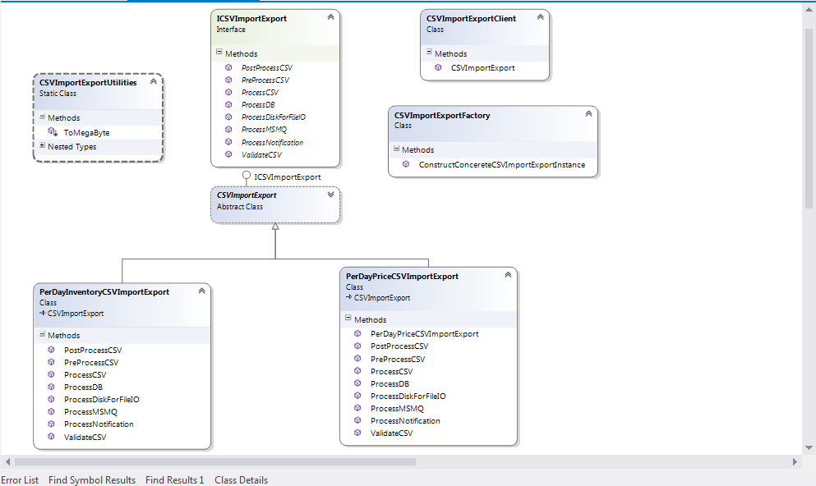
4. CLASS DIAGRAM

Slide 14
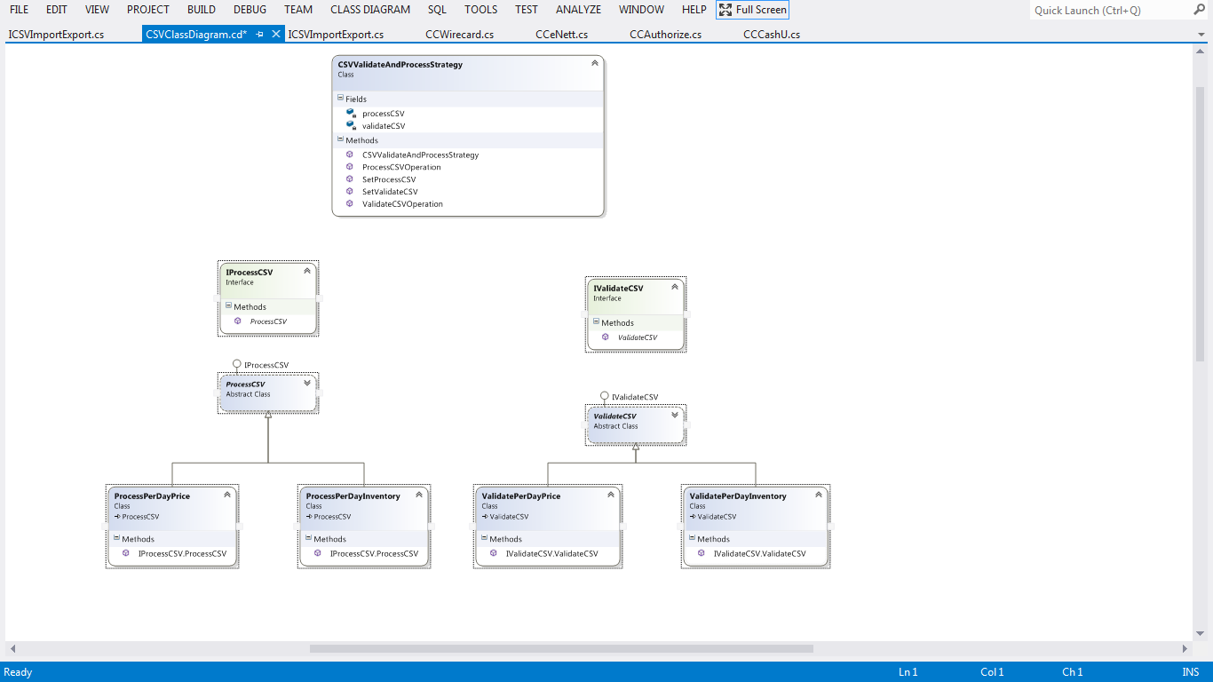

Slide 15
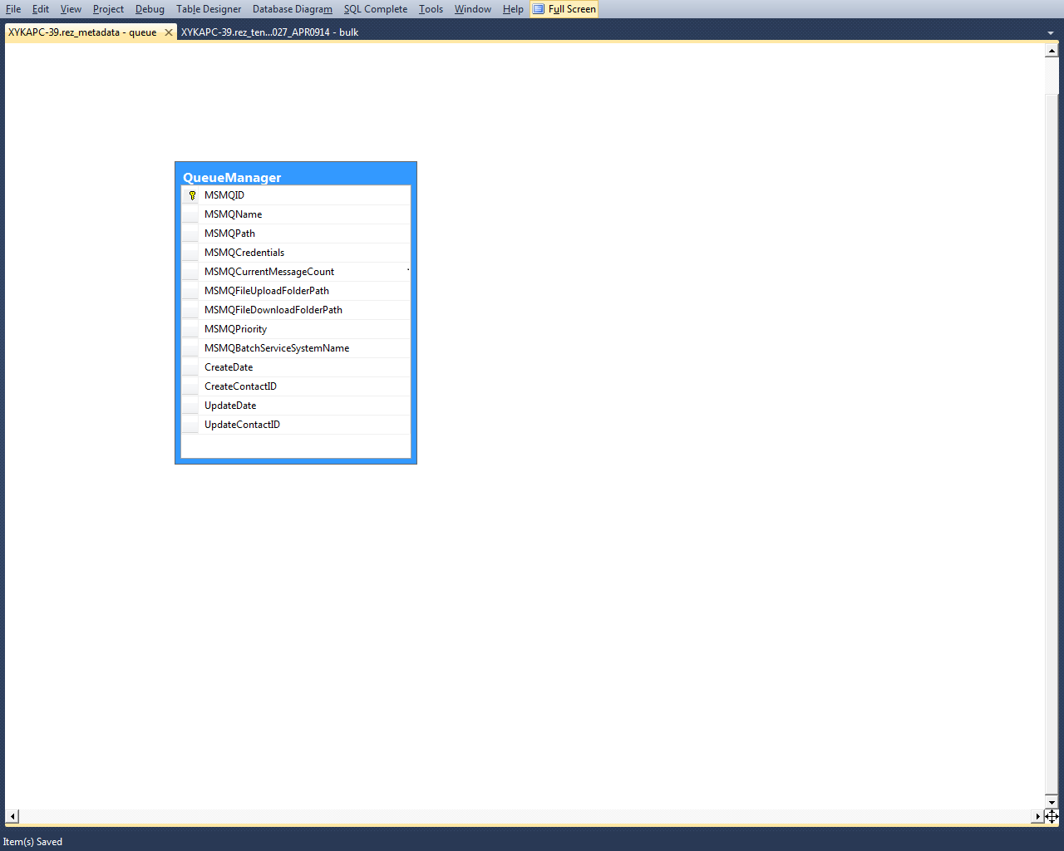
5. DB DIAGRAM OF METADATA DB

Slide 16
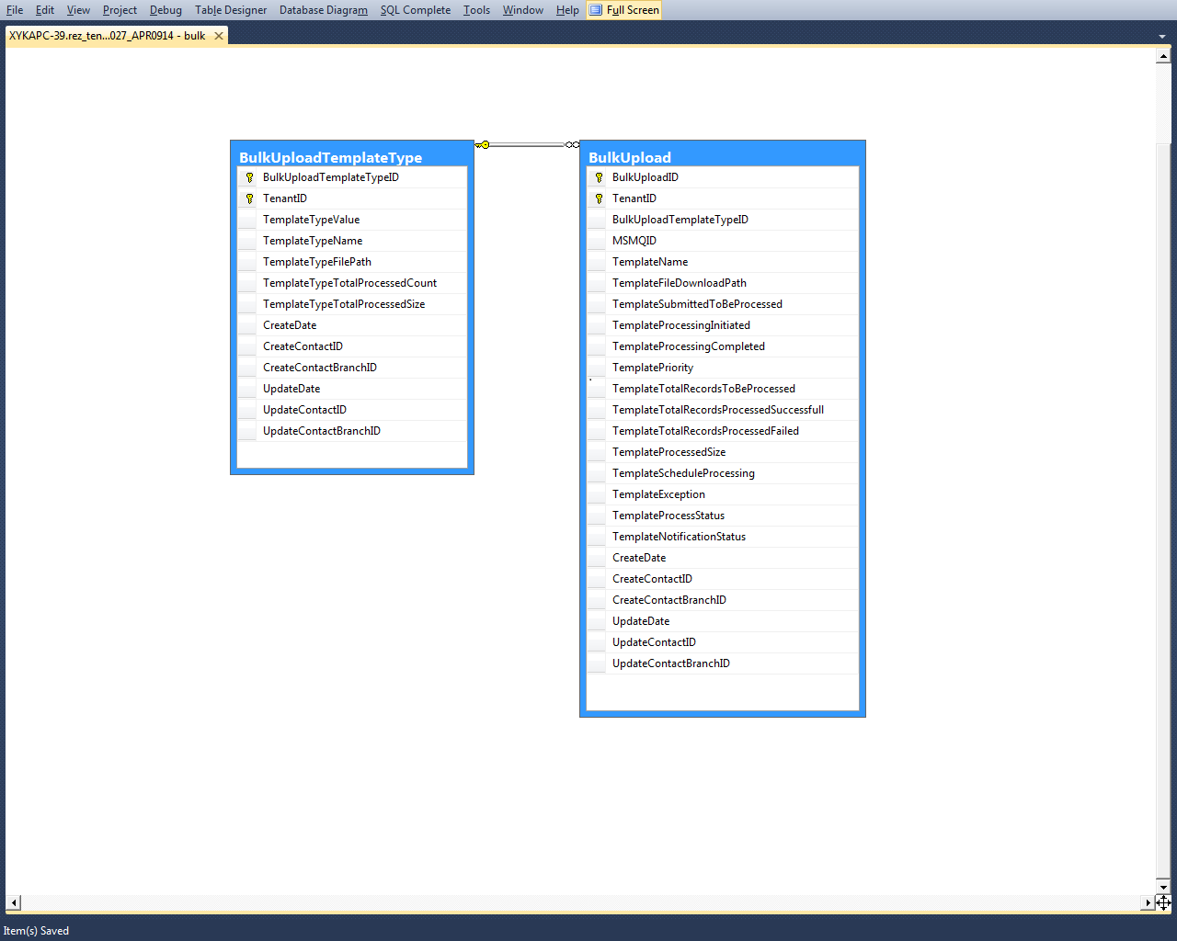
6. DB DIAGRAM OF TENANT DB

Slide 17
Advantages
Move CSV upload processing logic from front end to batch service.
Ability to span multiple msmq and assign separate batch service instance to process separate queues
leveraging the power of CPU and multiple process to process simultaneously.
Reduce processing time and increase productivity from the end user perspective.
Schedule uploaded document to process at specified time.
Provision to view the status of processing from the admin site.
Centralized repository for templates and processing logic.
Reduce maintenance time for upload and download.
Ability to get historical information for running loads using different time stored based on which
processing machine and queues can be increased in a fly.
9. Emergency queue available to process only emergency documents.
Thanks you !!!!

