Slide 1

Advanced Machine Learning
Enhancing Legal Document Summarization with LLM
- Md Rezuanul haque
- Xu Fan
17 May 2024

Slide 2

Problem Statement
Goal
Develop a Large Language Model (LLM) based system that generates concise, accurate summaries for law document.
Challenge
Involving not only extracting key information but also preserving the legal context and nuances crucial for understanding.
Our objective
Facilitate faster and more efficient review processes for legal professionals, enhancing accessibility to vital information.

Slide 3

Data
INPUTS:
Full-text legal documents from the Indian Supreme Court.
OUTPUS:
Abstractive summaries and Extractive summaries that are concise and maintain the essential legal context and nuances.
Source: IN-Abs : http://www.liiofindia.org/in/cases/cen/INSC/
Source: IN-Ext : http://www.liiofindia.org/in/cases/cen/INSC/

Slide 4


Evaluation protocol - Performance Metric
The model’s performance is evaluated using ROUGE scores (ROUGE-N and ROUGE-L).

Slide 5
Evaluation protocol – Dataset Splitting
The dataset is divided into training (80%), validation (10%), and testing (10%) sets. This distribution ensures robust training and reliable evaluation of the model's performance across unseen data.

Slide 6
Evaluation protocol - Model Comparison
Baseline Comparison: Our evaluation protocol includes comparing the performance of the LLM-based models against a simpler baseline model, such as one using TF-IDF for extractive summarization. This comparison helps illustrate the advancements and effectiveness of the LLM approach.
Statistical Methods: Also we used statistical tests approach to determine the significance of the results obtained from different models or different configurations of the same model.

Slide 7
Evaluation protocol - Hyperparameter Tuning
We implemented systematic adjustment of model parameters (like learning rate, batch size, number of epochs) based on performance on the validation set. This step ensures the model is neither underfitting nor overfitting and is crucial for optimizing model performance.

Slide 8
Designing the Abstractive Summarization Model
1. Model Selection:
Architecture: Choose a pre-trained Large Language Model (LLM) Bart-Large-CNN. This models are beneficial due to their deep understanding of context and advanced generative capabilities.
Pre-training: Utilize a model pre-trained on a diverse corpus that includes extensive legal or formal text to ensure it has prior exposure to complex language structures.

Slide 9
Designing the Abstractive Summarization Model
2. Fine-Tuning Approach:
Dataset: Use the IN-Abs dataset, which includes abstractive summaries, to fine-tune the model. This dataset will help the model learn the appropriate style and condensation required for legal summaries.
Training Details: Implement sequence-to-sequence training, where the full text documents are inputs, and the abstractive summaries are outputs. Pay attention to the maximum token length to ensure comprehensive processing without truncating important information.

Slide 10
Designing the Abstractive Summarization Model
3. Hyperparameter Optimization:
Experiment with different learning rates, batch sizes, and attention mechanisms to optimize performance.
Used validation loss to gauge overfitting and adjust the model's capacity or training duration accordingly.

Slide 11
Evaluation protocol – Abstractive Result Analysis
Evaluation Loss: The model achieved an average loss of 1.7132 on the evaluation dataset. This loss metric helps in understanding how well the model has learned to summarize the legal documents, with a lower loss indicating better performance.
ROUGE-1 Score: The ROUGE-1 score, which measures the overlap of unigrams between the generated summaries and the reference summaries, is 0.4719 (47.19%). This score suggests that nearly half of the words in the generated summaries accurately reflect the content of the reference summaries, highlighting the model's capability to identify key content elements.
ROUGE-2 Score: At 0.2301 (23.01%), the ROUGE-2 score is significantly lower than ROUGE-1, indicating challenges in capturing sequences of words. This score reflects the model's difficulty in maintaining phrase-level accuracy and coherence in the summaries.
ROUGE-L Score: The score for ROUGE-L, which assesses the longest common subsequence, stands at 0.3154 (31.54%). This score points to the model's moderate ability to preserve the structural and order integrity of the original content in the summaries.
ROUGE-Lsum Score: With a score of 0.4201 (42.01%), the ROUGE-Lsum metric shows an improvement over ROUGE-L, suggesting that when evaluating broader content similarities, the model performs better, though there is still room for enhancement in sequence fidelity.

Slide 12
Designing the Extractive Summarization Model
1. Methodology:
Baseline Model: Start with a simpler TF-IDF based model to establish a baseline. This method focuses on identifying key sentences based on their term frequency-inverse document frequency scores.
Advanced Techniques: Implement a supervised learning approach using models like BERT, which can understand the context better than basic frequency-based methods.

Slide 13
Designing the Extractive Summarization Model
2. Feature Engineering:
We used feature Engineering with TF-IDF based summarization approach. Also implemented cosine similarity metrics.

Slide 14
Designing the Extractive Summarization Model
3. Training and Evaluation:
Dataset: Used the IN-Ext dataset, which provides expert-generated extractive summaries. Train the model to predict the importance scores for each sentence, then select the top-ranked sentences as the summary.
Evaluation Metrics: Used ROUGE metrics to compare the extracted summaries against the reference summaries to measure the effectiveness of the extraction.

Slide 15

Comparison - Abstractive VS Extractive
Filename:
1954_M_25.txt
Abstractive Summary:
This appeal with special leave is directed against the judgment and order of the labour appellate tribunal of india in a dispute regarding the workers claim for bonus. In 1949 the selling rates for cloth and yarn were controlled by the government and were approximately 4 per cent.below those obtained in 1948. The basic wages were increased from the 1st december 1948 and the total wages paid were therefore higher than those in the previous year. There was moreover indiscipline amongst the workers and production suffered.
Extractive Summary:
the respondent thereupon appealed to the labour appellate tribunal which substantially agreed with the industrial court on questions of fact as well as the general position in law but imported considerations of social justice and treating this as a special case where social justice would demand that labour should have bonus for the year where for that very year capital had not only a reasonable return but much in excess of that allowed the appeal and directed the appellant to pay to the workmen bonus at the rate of annas 4 per rupee within six weeks of their decision.

Slide 16
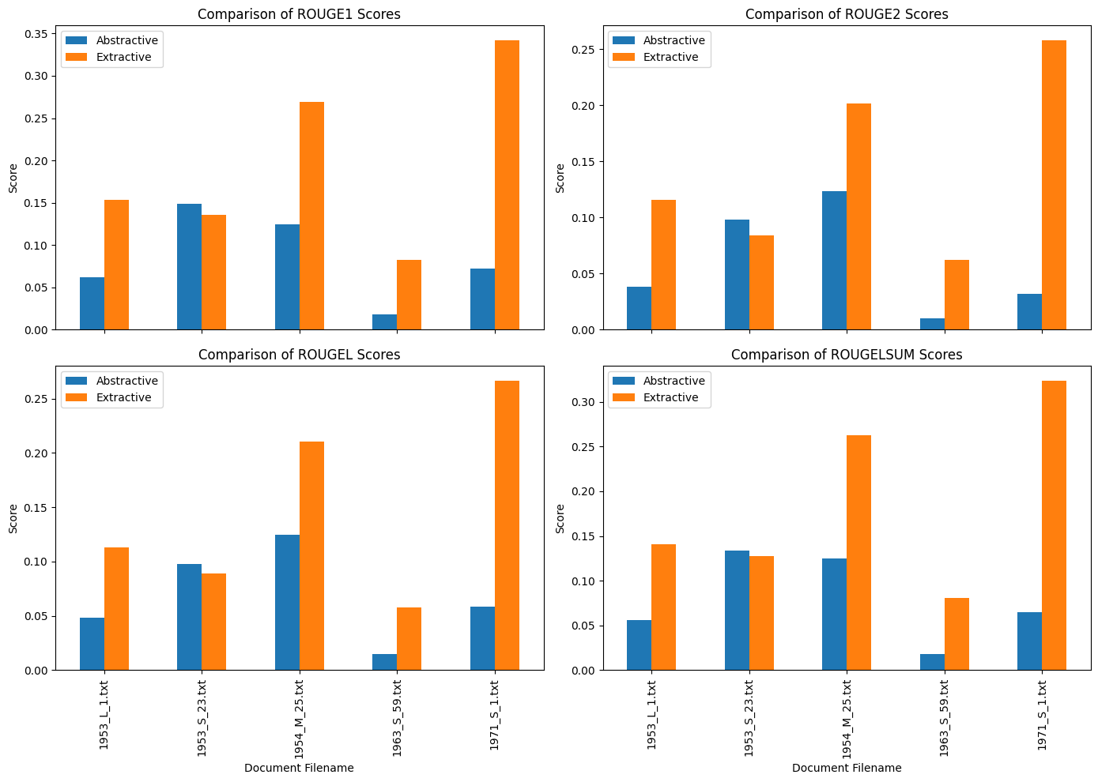
ROUGE Comparison – Abstractive VS Extractive

Slide 17
ROUGE Comparison – Abstractive VS Extractive
Key Insights from the Graph Data:
Consistent Performance: The extractive summarization method consistently registers higher scores across all metrics compared to the abstractive method. For instance, in the document "1971_S_1.txt," the extractive method scored a ROUGE-1 of 34.22%, significantly surpassing the abstractive method's 7.21%.
Performance Range: The highest performance for the abstractive method is noted in "1953_S_23.txt" with a ROUGE-1 score of 14.89%. The lowest performance is observed in "1963_S_59.txt" with a ROUGE-1 score of 1.84%. Despite its lowest scores, the extractive method still outperforms the abstractive method in all cases, highlighting its effectiveness.

Slide 18
Conclusion
Previous comparison data indicates that extractive summarization techniques are substantially more effective than abstractive methods in processing and summarizing legal documents. This effectiveness is evident across various metrics, suggesting that extractive methods are better at preserving the essential content and structure of legal texts. The comparative underperformance of abstractive methods underscores the need for further advancements in generative summarization technologies, particularly to enhance their capability in handling complex and specialized content typical of legal texts.

Slide 19

End
Thank you for your attention.
Now feel free to ask your question.

