Slide 1
Alumni website
Presented By :

Slide 2
Abstruct
Objective:
The objective of this application is to allow old
and new students of a university or college to
communicate with each other. This allows students to know about each other and their current activities.

Slide 3
Existing System
Many institutions, colleges and universities
maintain the information manually about
present and past students. This does not allow
efficient data management and retrieval process.
A student willing to get information about others
has to approach the college and obtain the
details. Often the information may not be
available and misleading.

Slide 4
Proposed System
The application allows students to register and then search the data based on different criteria. Also it has the benefit of having a centralized database and up to date information. A user can easily obtain information about other registered users.

Slide 5
Modules
Administration
Event
Alumni/Student
Page

Slide 6
Hardware and software
Technology : Laravel (PHP)
Web Technologies : Html, JavaScript, CSS
Web Server : Apache
Database : MySQL
Processor : Pentium RAM : 1GB

Slide 7
Page module
Admin can create edit various necessary pages here.
It includes :
Create a new Page
Edit an existing page
Delete a page

Slide 8
Administrator Module
The administrator is responsible for maintaining
information of students. When a student submits the registration form, administrator will complete the verification process and, if successful, the student details are added into the database. The administrator maintains the passwords of Event Manager and that of himself.

Slide 9
Event Module
This module maintains the information about various events that are conducted by various colleges and universities. Details of notifications are also maintained. The manager can add, delete, edit and view event details.

Slide 10
Alumni Module
The Alumni/Students can register themselves and after the approval from the administrator, they can logon into their account and can send mails, post queries, update their profiles and even search for other student details. one can view the event details and search for specific information. The module provides mail and query functionalities.

Slide 11
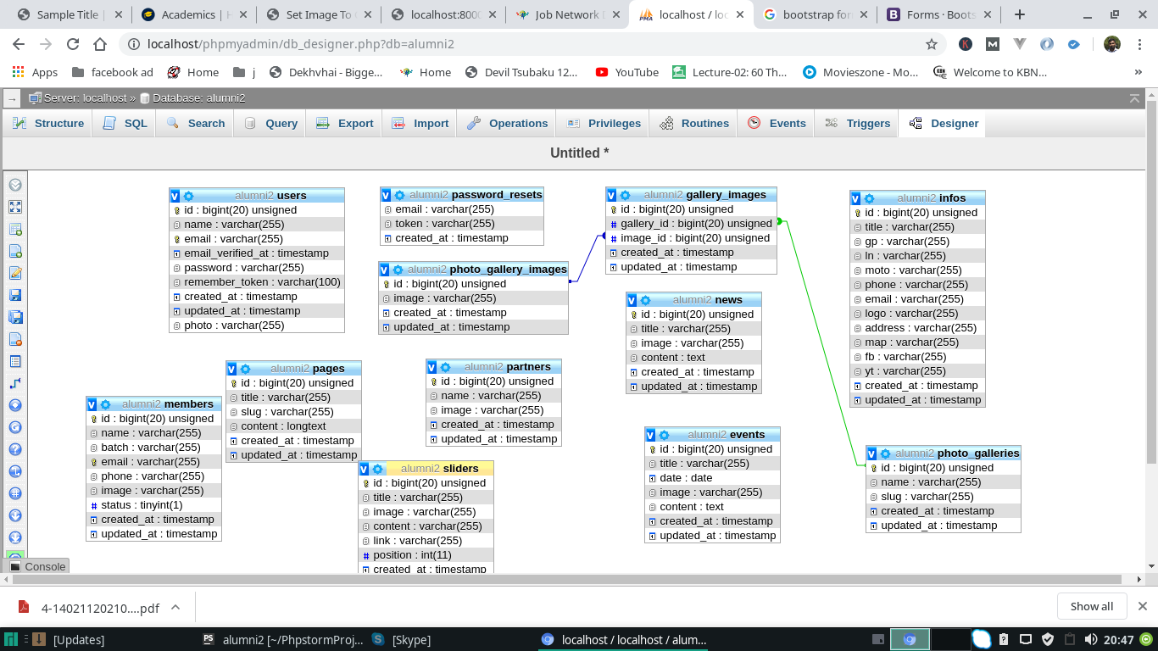
ER Diagram

Slide 12
Technologies Used
Laravel
Laravel is a free, open-source[3] PHP web framework, created by Taylor Otwell and intended for the development of web applications following the model–view–controller (MVC) architectural pattern and based on Symfony. Some of the features of Laravel are a modular packaging system with a dedicated dependency manager, different ways for accessing relational databases, utilities that aid in application deployment and maintenance, and its orientation toward syntactic sugar

Slide 13
Technologies Used
HTML
Hypertext Markup Language (HTML) is the standard markup language for creating web pages and web applications. With Cascading Style Sheets (CSS) and JavaScript, it forms a triad of cornerstone technologies for the World Wide Web.
Web browsers receive HTML documents from a web server or from local storage and render the documents into multimedia web pages. HTML describes the structure of a web page semantically and originally included cues for the appearance of the document.

Slide 14
Technologies Used
CSS
Cascading Style Sheets (CSS) is a style sheet language used for describing the presentation of a document written in a markup language like HTML. CSS is a cornerstone technology of the World Wide Web, alongside HTML and JavaScript.
CSS is designed to enable the separation of presentation and content, including layout, colors, and fonts This separation can improve content accessibility, provide more flexibility and control in the specification of presentation characteristics, enable multiple web pages to share formatting by specifying the relevant CSS in a separate .css file, and reduce complexity and repetition in the structural content.

Slide 15
Technologies Used
Javascript
JavaScript ,often abbreviated as JS, is a high-level, interpreted programming language that conforms to the ECMAScript specification. JavaScript has curly-bracket syntax, dynamic typing, prototype-based object-orientation, and first-class functions.
Alongside HTML and CSS, JavaScript is one of the core technologies of the World Wide Web. JavaScript enables interactive web pages and is an essential part of web applications. The vast majority of websites use it, and major web browsers have a dedicated JavaScript engine to execute it.

Slide 16
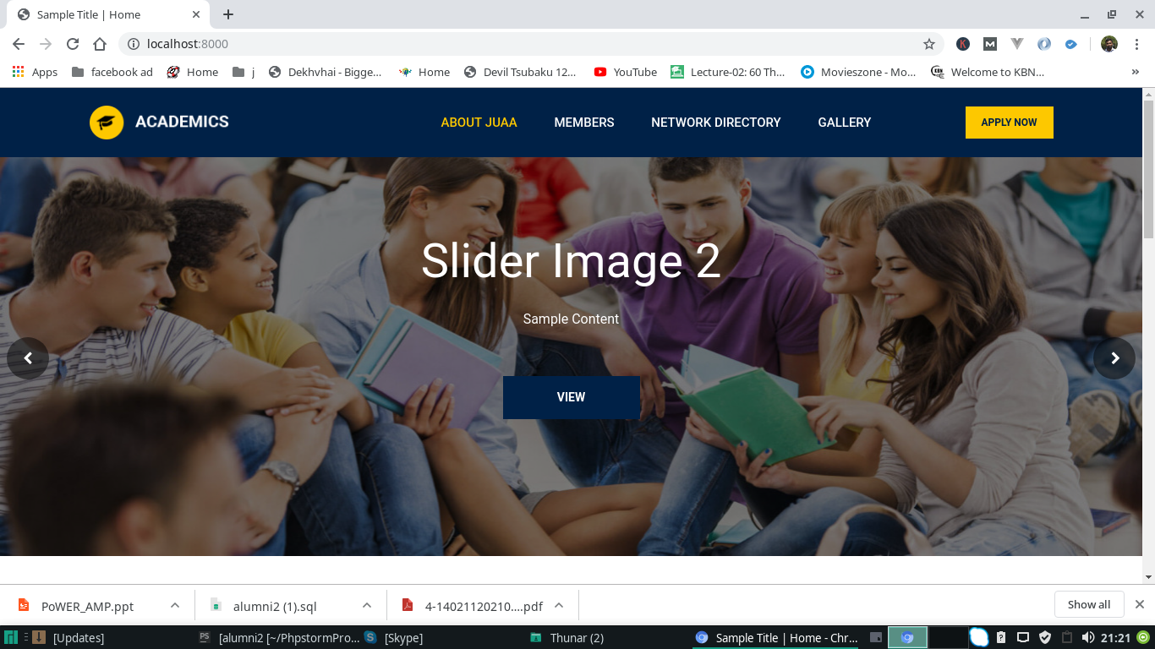
ScreenShot
Home Page

Slide 17
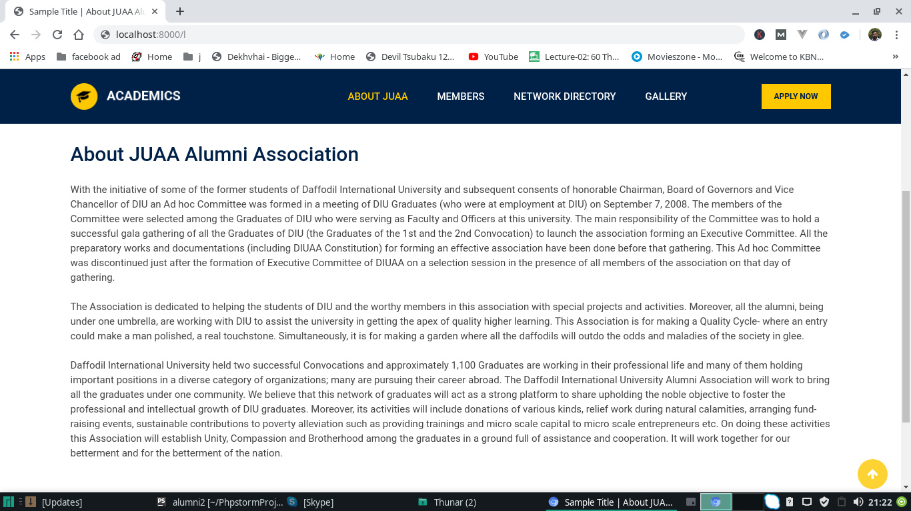
Screenshot
Specific Page

Slide 18
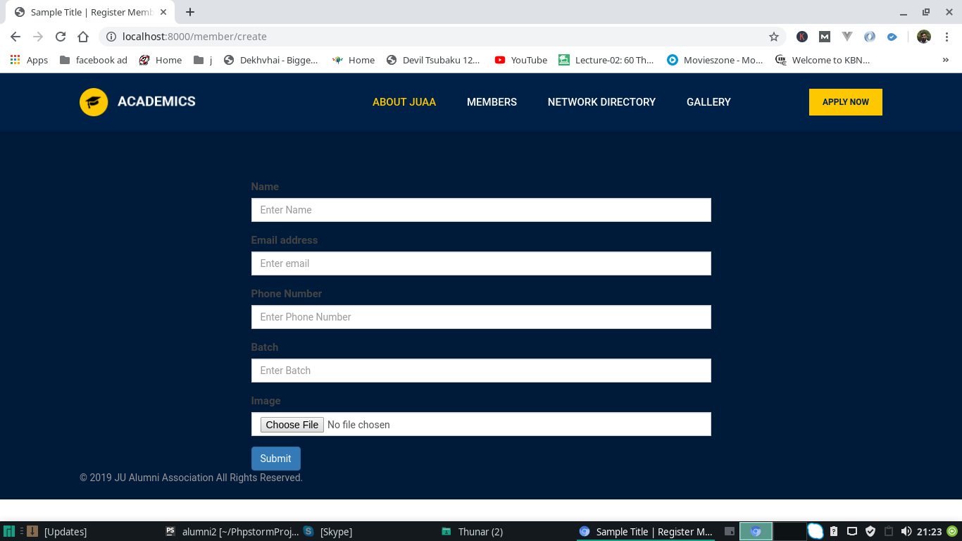
ScreenShot
Registration

Slide 19
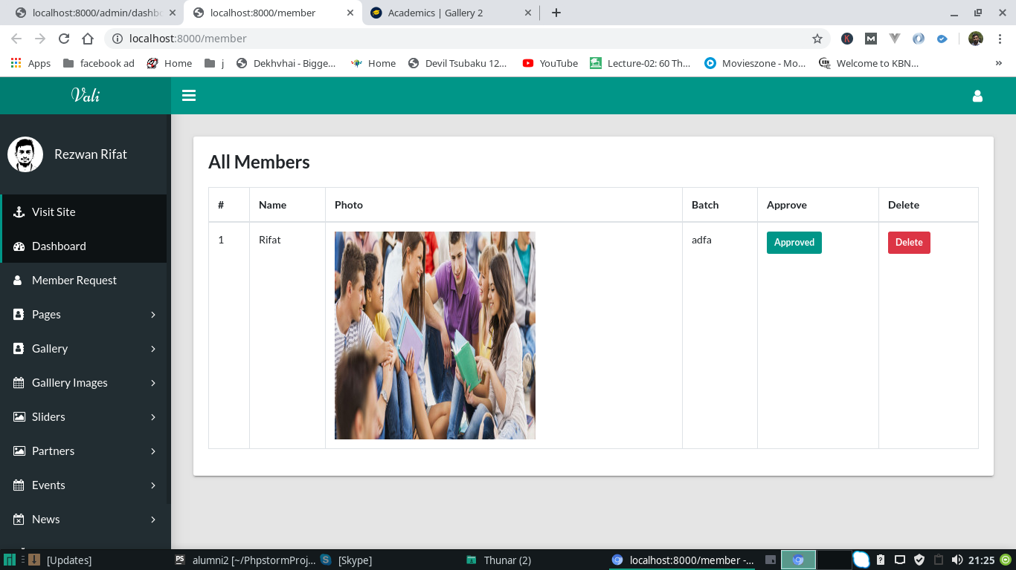
Screenshot
Dashboard

Slide 20


