Slide 1
ERP for College/School
Presented By:

Slide 2
Problem Definition
Student Attendance
Event
Book
Fee
Time Table
Result
Assignment

Slide 3
Objective
It is designed for better interaction between students, teachers, & management. This management software very gracefully handles all the requirements for easy school management.
The school management system being web based can be accessed from anywhere in the world, which enables the students, teachers, parents & the management be in touch with each other at all times.

Slide 4
Functional Requirements
Hardware:
• Processor
• Ram
• Hard disk
• Internet Connection
Software
• Operating system(Window, Linux ,Mac )
• Database Server
• Language(html)
• Compatible Browser

Slide 5
Functional Requirements
• School management system shall be network base.
• Admin shall login.
• Admin shall add new student, teacher, and class and modify them. Admin shall update school news.
• Admin shall access all the data about student related.
• Admin shall manage the school activity.
• Admin shall generate time table.
• Student shall login by his/her id.
• Student shall view study activity of his class
• Student shall see assignment online.
• Student shall view the news event of the school.

Slide 6
Functional Requirements
• Teacher shall login.
• Teacher shall assign assignments to this student.
• Teacher shall create event.
• Teacher shall take test online.
• Teacher shall mark attendance online.
• Teacher shall declare result online.

Slide 7
Functional Requirements
Permission
There is a ACL for access control.
Role and Permission is assigned dynamically.

Slide 8
Non-functional Requirements
• The system should be easy to use.
• The system should be available 24 hour.
• The system should response at the time
• System should provide specific information to specific user.
• The system should not fail.
• Right information is available to right student and teacher at right time.

Slide 9
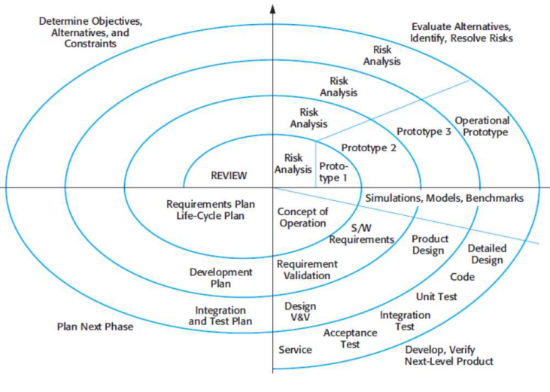
Software Engineering Model

Slide 10
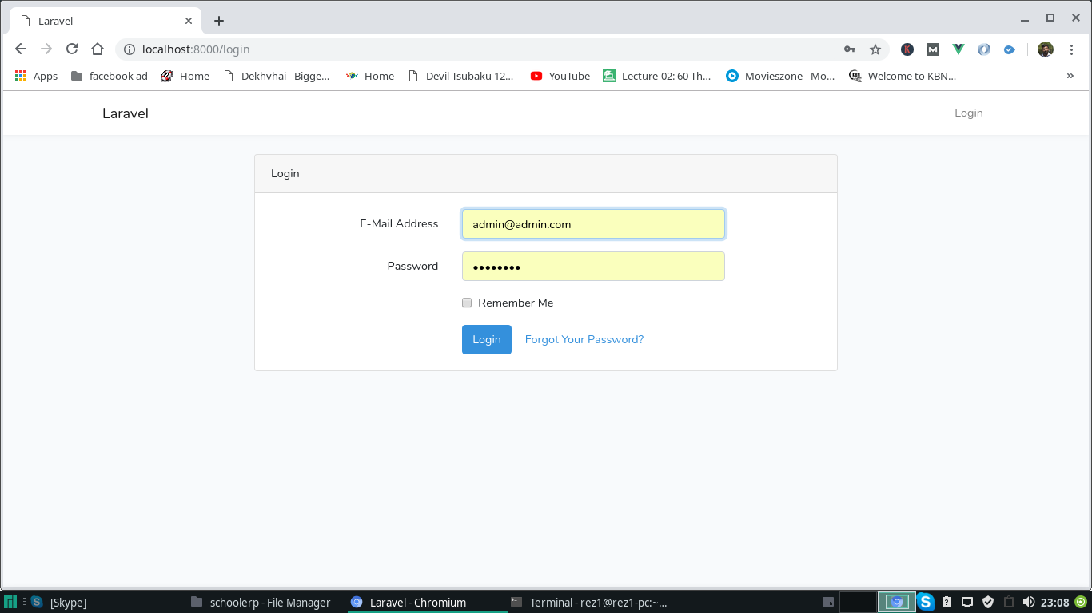
Interface Design - Login

Slide 11
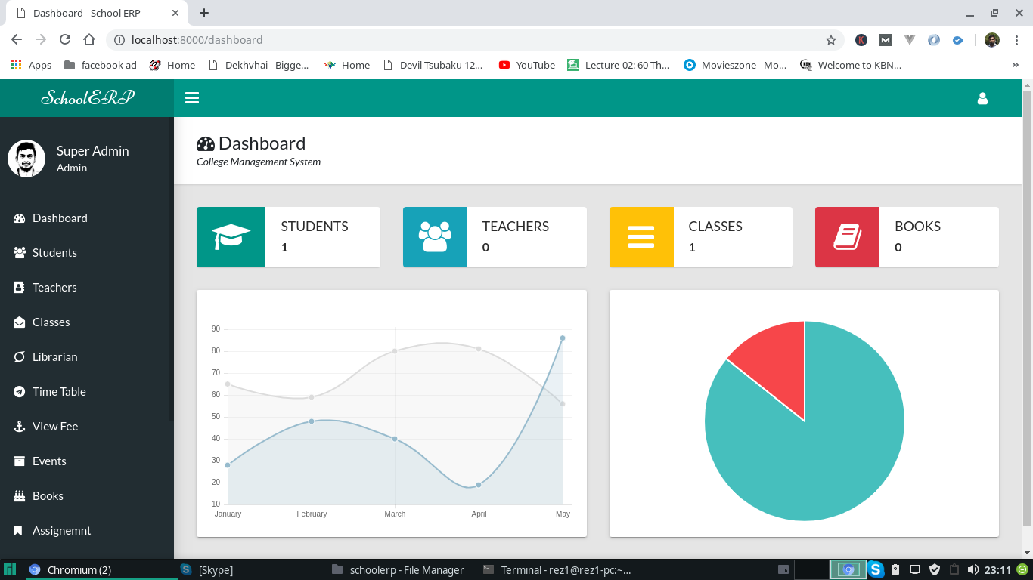
Interface Design
Dashboard

Slide 12
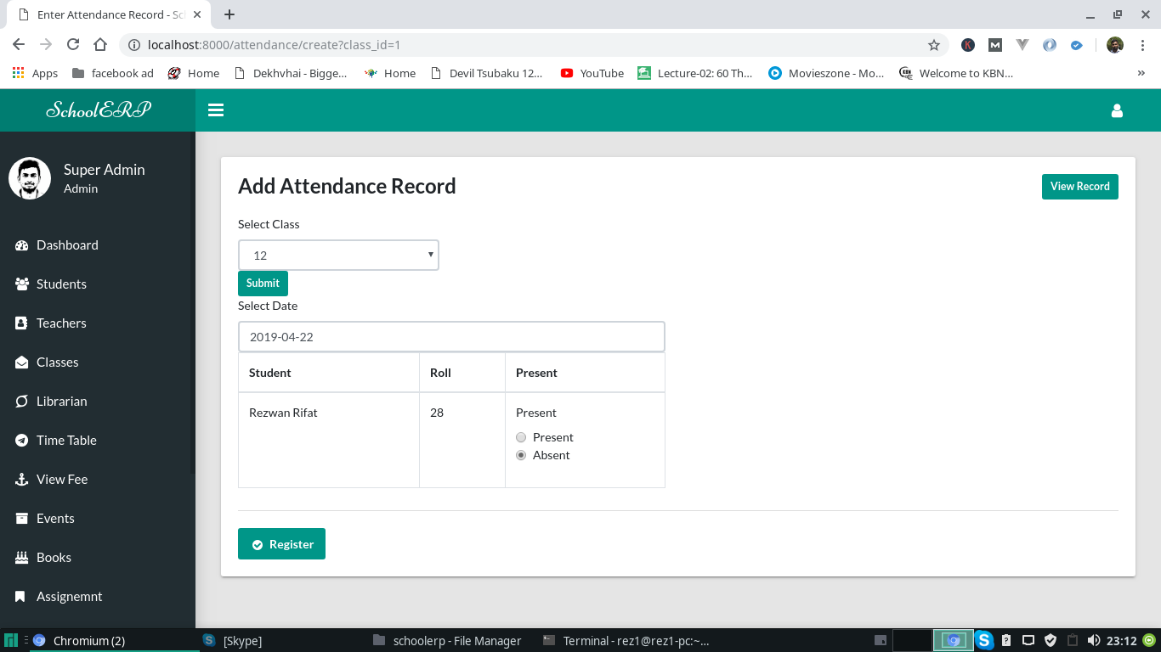
Interface Design
Attendance

Slide 13
Technology Used
Laravel (PHP MVC)
Jquery (Javascript)
HTML
CSS

Slide 14
Laravel MVC
MVC is a software architecture…that separates domain/application/business…logic from the rest of the user interface. It does this by separating the application into three parts: the model, the view, and the controller.

Slide 15
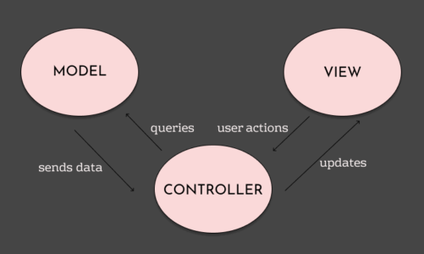
Laravel MVC

Slide 16
Front End Technologies
HTML
HTML stands for Hyper Text Markup Language
HTML is the standard markup language for Web pages
HTML elements are the building blocks of HTML pages
HTML elements are represented by <> tags

Slide 17
Front End Technologies
Javascript
JavaScript is the Programming Language for the Web
JavaScript can update and change both HTML and CSS
JavaScript can calculate, manipulate and validate data

Slide 18
Front End Technologies
CSS
CSS stands for Cascading Style Sheets
CSS describes how HTML elements are to be displayed

Slide 19
Feasibility Study
Effective communication between teachers , and students
Complete automation of all operations
Centrally stored information with zero redundancy
Frequent interaction with teachers
Reliable update on fee payment.
Tracking of homework assigned by teacher
Prior information about school events and holidays
Automated student attendance
Computerized management of marks and grades
Homework assignment to students and approval
Access to attendance, timetable, marks, grades and examination schedule
Prior information about school events and holidays

Slide 20
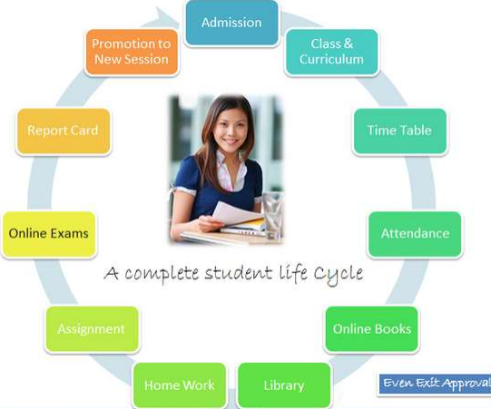
Benefits

Slide 21
Thank You

