Slide 1
Texture Mapping
Computer Graphics | CSE 404
Mohammad Imrul Jubair

Slide 2
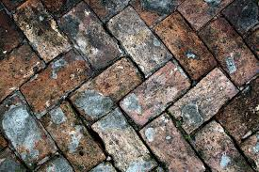
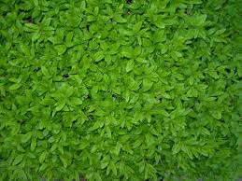
What is Texture ?
Texture:
The feel, appearance, or consistency of a surface or a substance.
…… The natural world is rich in texture: the surface of any visible object is textured at certain scale

Slide 3
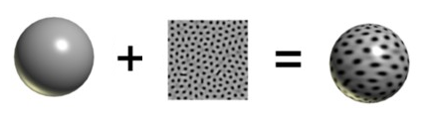
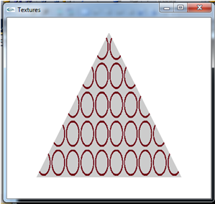


What is Texture Mapping in OpenGL?
Texture Mapping → Texture Wrapping
An object
An image
(jpg, bmp, etc. )
Texture Mapped

Slide 4
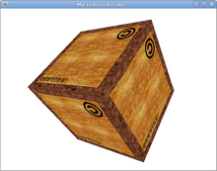
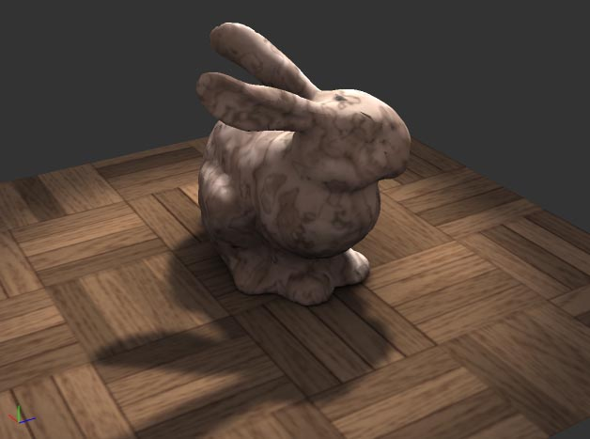
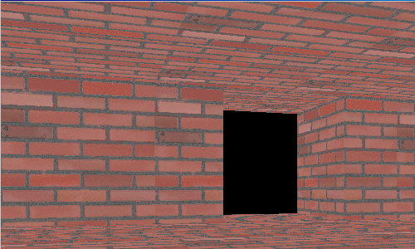
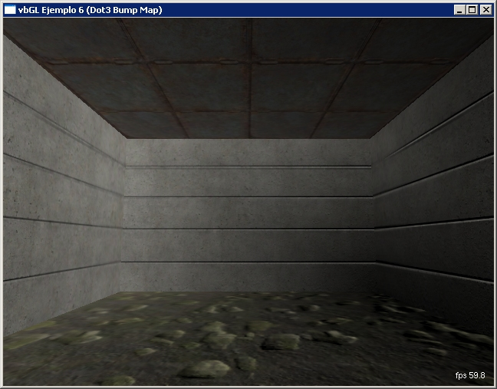
What is Texture Mapping in OpenGL?

Slide 5

Example
(-1, 1,0)
Quad
(1, 1,0)
100
100
Image
(0,0,0)
(-1, -1,0)
(1, -1,0)

Slide 6
Example
(-1, 1,0)
(1, 1,0)
100
100
we can put this image block as tiles on this Quad one by one
(-1, -1,0)
(1, -1,0)

Slide 7
Example
Y
(-1, 1,0)
axis for the Quad
(1, 1,0)
100
(0,0,0)
100
X
(-1, -1,0)
(1, -1,0)

Slide 8
Example
V
Y
axis for the Quad
100
(0,0,0)
100
X
(0,0)
axis for the Image
U

Slide 9
Example
(-1, 1,0)
(1, 1,0)
(0,0,0)
(U,V) = (0, 0)
(X,Y) = (-1, -1,0)
(1, -1,0)

Slide 10
Example
(-1, 1,0)
(1, 1,0)
(0, 3)
(0,0,0)
(0, 0)
(-1, -1,0)
(1, -1,0)

Slide 11
What is Texture Mapping in OpenGL?
(-1, 1,0)
(1, 1,0)
(0, 3)
(0,0,0)
(3, 0)
(0, 0)
(-1, -1,0)
(1, -1,0)

Slide 12
What is Texture Mapping in OpenGL?
(3, 3)
(-1, 1,0)
(1, 1,0)
(0, 3)
(3, 0)
(0, 0)
(-1, -1,0)
(1, -1,0)

Slide 13
Steps In Texture Mapping.
Step 1 : a) Loading Image
b) Image → OpenGL Texture (To make the image ready for wrapping an object)
Step 2: Mapping that ready texture on the object (Wrapping)

Slide 14

CODE ! ☹
CODES ! CODES!! CODES !!!
Exhausted?

Slide 15

Why So Serious ??? ☺
We don't have to know how it works; all we have to know is what it does

Slide 16
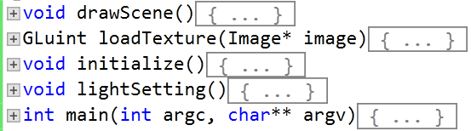
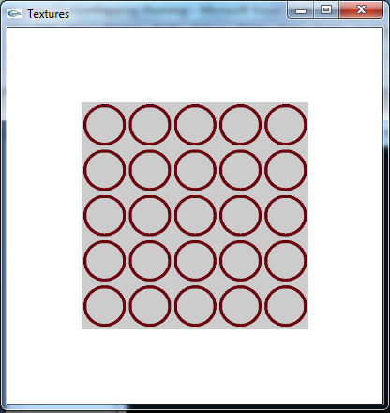
Lets Know - What It Does !

Slide 17
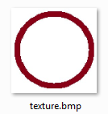
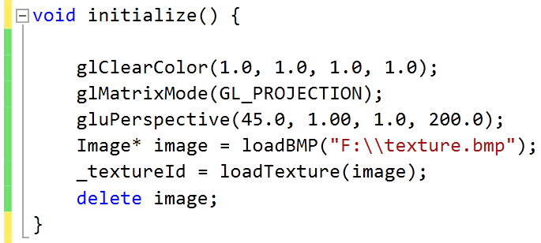
Step 1 : Image → OpenGL Texture

Slide 18
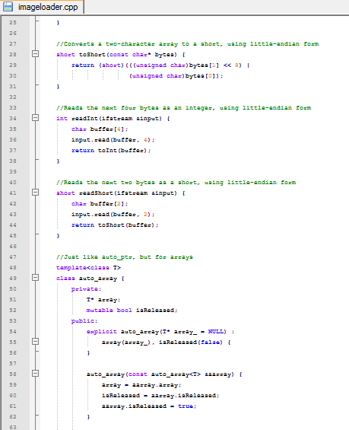
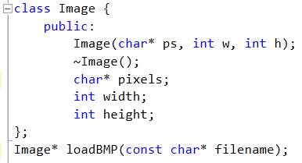
Step 1 : Image → OpenGL Texture
imageloader.cpp
imageloader.h
Detailed Codes

Slide 19

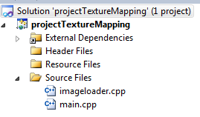
Step 1 : Image → OpenGL Texture
imageloader.cpp
imageloader.h
Detailed Codes

Slide 20
Step 1 : Image → OpenGL Texture

Slide 21
Step 1 : Image → OpenGL Texture
1
2
Now our Image is reading for wrapping an object!
3
What we have done here is actually -
We load the image
load the texture into OpenGL
then delete the Image object, since we don't need it any more.

Slide 22
Step 2 : Mapping the Texture on a Plane

Slide 23
Step 2 : Mapping the Texture on a Plane
void drawScene()
{
…….
glEnable(GL_TEXTURE_2D);
glBindTexture(GL_TEXTURE_2D, _textureId);
……
}

Slide 24
Step 2 : Mapping the Texture on a Plane
void drawScene()
{
…….
glEnable(GL_TEXTURE_2D);
glBindTexture(GL_TEXTURE_2D, _textureId);
……
glTexParameteri(GL_TEXTURE_2D, GL_TEXTURE_MIN_FILTER, GL_LINEAR);
glTexParameteri(GL_TEXTURE_2D, GL_TEXTURE_MAG_FILTER, GL_LINEAR);
}

Slide 25
Step 2 : Mapping the Texture on a Plane
glTexCoord2f(0.0, 0.0);
glVertex3f(-1.0, -1.0, 0.0);
glTexCoord2f(0.0, 5.0);
glVertex3f(-1.0, 1.0, 0.0);
glTexCoord2f(5.0, 5.0);
glVertex3f(1.0, 1.0, 0.0);
glTexCoord2f(5.0, 0.0);
glVertex3f(1.0, -1.0, 0.0);
void drawScene()
{
…….
glEnable(GL_TEXTURE_2D);
glBindTexture(GL_TEXTURE_2D, _textureId);
……
glTexParameteri(GL_TEXTURE_2D, GL_TEXTURE_MIN_FILTER, GL_LINEAR);
glTexParameteri(GL_TEXTURE_2D, GL_TEXTURE_MAG_FILTER, GL_LINEAR);
……..
glBegin(GL_QUADS);
glEnd();
……
}

Slide 26
Step 2 : Mapping the Texture on a Plane
glTexCoord2f(0.0, 0.0);
glVertex3f(-1.0, -1.0, 0.0);
glTexCoord2f(0.0, 5.0);
glVertex3f(-1.0, 1.0, 0.0);
glTexCoord2f(5.0, 5.0);
glVertex3f(1.0, 1.0, 0.0);
glTexCoord2f(5.0, 0.0);
glVertex3f(1.0, -1.0, 0.0);
(U, V)
(X,Y)
Y
V
X
U

Slide 27
Step 2 : Mapping the Texture on a Plane
glTexCoord2f(0.0, 0.0);
glVertex3f(-1.0, -1.0, 0.0);
glTexCoord2f(0.0, 5.0);
glVertex3f(-1.0, 1.0, 0.0);
glTexCoord2f(5.0, 5.0);
glVertex3f(1.0, 1.0, 0.0);
glTexCoord2f(5.0, 0.0);
glVertex3f(1.0, -1.0, 0.0);
→
(U,V) :(0, 0)
(X,Y) : (-1, -1,0)

Slide 28
Step 2 : Mapping the Texture on a Plane
glTexCoord2f(0.0, 0.0);
glVertex3f(-1.0, -1.0, 0.0);
glTexCoord2f(0.0, 5.0);
glVertex3f(-1.0, 1.0, 0.0);
glTexCoord2f(5.0, 5.0);
glVertex3f(1.0, 1.0, 0.0);
glTexCoord2f(5.0, 0.0);
glVertex3f(1.0, -1.0, 0.0);
(0, 5.0)
→
(-1, 1,0)
→
(0, 0)
(-1, -1,0)

Slide 29
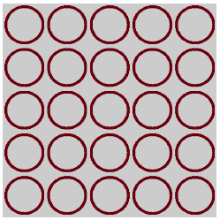
Step 2 : Mapping the Texture on a Plane
glTexCoord2f(0.0, 0.0);
glVertex3f(-1.0, -1.0, 0.0);
glTexCoord2f(0.0, 5.0);
glVertex3f(-1.0, 1.0, 0.0);
glTexCoord2f(5.0, 5.0);
glVertex3f(1.0, 1.0, 0.0);
glTexCoord2f(5.0, 0.0);
glVertex3f(1.0, -1.0, 0.0);
(0, 5)
(5, 5)
→
(-1, 1,0)
(1, 1,0)
→
→
→
(0, 0)
(5, 0)
(-1, -1,0)
(1, -1,0)

Slide 30
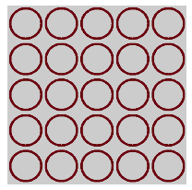
……Calculate your mapping first
glBegin(GL_QUADS);
glTexCoord2f(0.0, 0.0);
glVertex3f(-1.0, -1.0, 0.0);
glTexCoord2f(0.0, 5.0);
glVertex3f(-1.0, 1.0, 0.0);
glTexCoord2f(5.0, 5.0);
glVertex3f(1.0, 1.0, 0.0);
glTexCoord2f(5.0, 0.0);
glVertex3f(1.0, -1.0, 0.0);
glEnd();

Slide 31
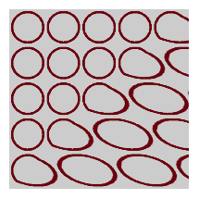
……Calculate your mapping first
glBegin(GL_QUADS);
glTexCoord2f(0.0, 0.0);
glVertex3f(-1.0, -1.0, 0.0);
glTexCoord2f(0.0, 5.0);
glVertex3f(-1.0, 1.0, 0.0);
glTexCoord2f(5.0, 5.0);
glVertex3f(1.0, 1.0, 0.0);
glTexCoord2f(3.0, 0.0);
glVertex3f(1.0, -1.0, 0.0);
glEnd();

Slide 32
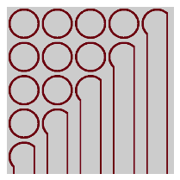
……Calculate your mapping first
glBegin(GL_QUADS);
glTexCoord2f(0.0, 0.0);
glVertex3f(-1.0, -1.0, 0.0);
glTexCoord2f(0.0, 5.0);
glVertex3f(-1.0, 1.0, 0.0);
glTexCoord2f(5.0, 5.0);
glVertex3f(1.0, 1.0, 0.0);
//glTexCoord2f(3.0, 0.0);
glVertex3f(1.0, -1.0, 0.0);
glEnd();

Slide 33
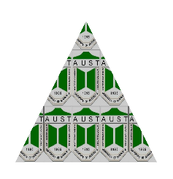

…….More
glBegin(GL_TRIANGLES);
glTexCoord2f(0.0, 0.0);
glVertex3f(-1.0, -1.0, 0.0);
glTexCoord2f(2.5, 2.5);
glVertex3f(0.0, 1.0, 0.0);
glTexCoord2f(5.0, 0.0);
glVertex3f(1.0, -1.0, 0.0);
glEnd();
U,V = (2.5, 2.5)
X,Y = (0.0, 1.0, 0.0)
U,V = (0.0, 0.0)
U,V = (5.0, 0.0)
X,Y = (-1.0, -1.0, 0.0)
X,Y = (1.0, -1.0, 0.0)

Slide 34
And At Last
glTexParameteri(GL_TEXTURE_2D, GL_TEXTURE_MIN_FILTER, ______________);
glTexParameteri(GL_TEXTURE_2D, GL_TEXTURE_MAG_FILTER, ______________);
pixel from Texture
pixel from Quad
GL_NEAREST (average of neighbor pixels)
GL_LINEAR (directly block)

