Slide 1
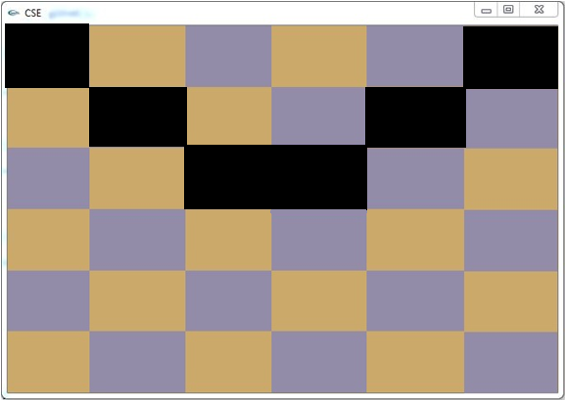
Can you do this ? (1)
Number of rectangles in columns and rows will be given. You’ve to write a code that generate the following thing. Here number of rectangles in rows and columns is 6.

Slide 2
Can you do this ? (2)
Can you scale the left triangle as like as the right triangle with respect to its middle point ?

Slide 3

Can you do this ? (3)
Can you do this ? Can you rotate that square with respect to z- axis and as well as to y-axis ? (clockwise)
Y
X
Z

