Slide 1
CSE 404 Computer Graphics (Lab)
Course Teacher : Mohammad Imrul Jubair

Slide 2
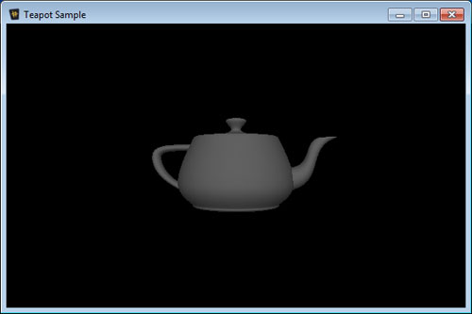
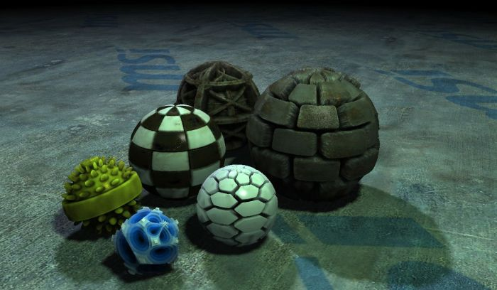
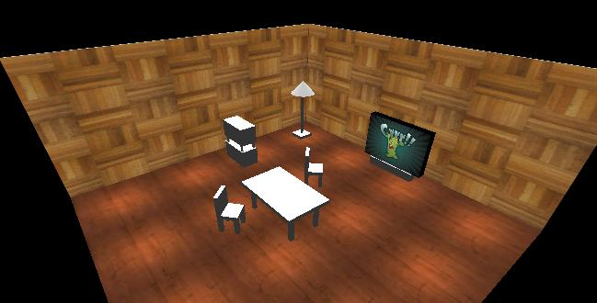
What is openGL ?
OpenGL is a low-level graphics library specification. It makes available to the programmer a small set of geometric primitives - points, lines, polygons, images, and bitmaps. OpenGL provides a set of commands that allow the specification of geometric objects in two or three dimensions, using the provided primitives, together with commands that control how these objects are rendered.

Slide 3


Lets configure openGL in our PC !
https://sites.google.com/site/imruljubair/teaching

Slide 4
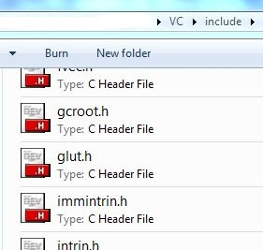
Lets configure openGL in our PC !

Slide 5
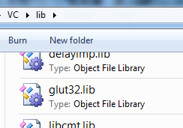
Lets configure openGL in our PC !

Slide 6
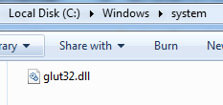
Lets configure openGL in our PC !

Slide 7
How to code?
Just create a new empty project …..
There are some built-in things for you, which makes coding easier ☺ !
Lets know about those.

Slide 8
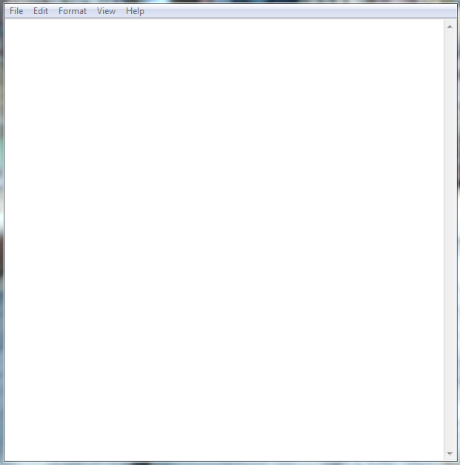

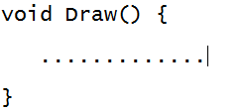
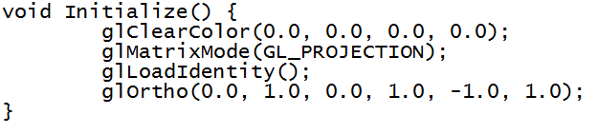
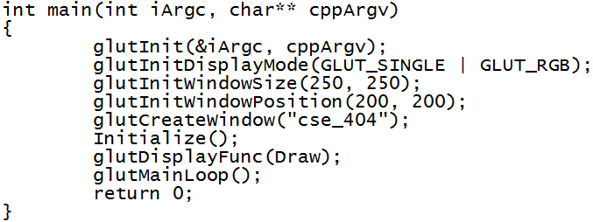
How to code?

Slide 9
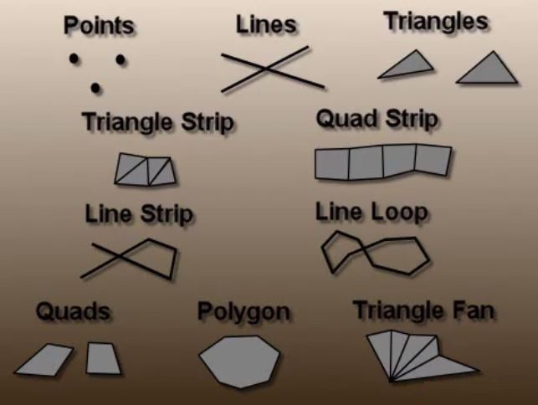
We’ll try to draw some basic objects

Slide 10
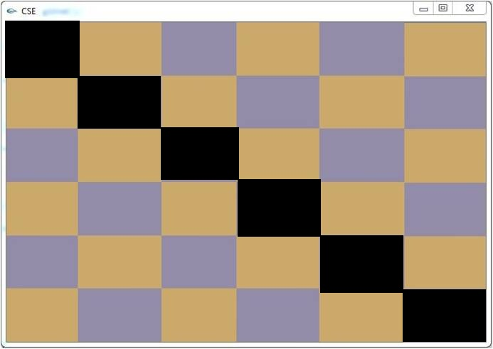
Can you do that ?
Number of rectangles in columns and rows (n) will be given. You’ve to write a code that generate the following thing. Here n=6. Note that, rectangles in diagonal positions must be colored black!

Slide 11
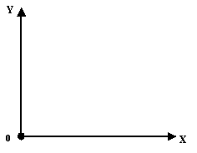
We can also play with our stuffs : TRANSFORMATION ☺
Translate :
(0.5,0.3)

Slide 12
We can also play with our stuffs : TRANSFORMATION ☺
Translate :
Suppose, we’ve translated it by (0.3, 0.3) –
0.5 + 0.3 = 0.8
0.3 + 0.3 = 0.6
(0.8,0.6)

Slide 13
We can also play with our stuffs : TRANSFORMATION ☺
Scale :
(x2, y2)
(x1, y1)
(x3, y3)

Slide 14
We can also play with our stuffs : TRANSFORMATION ☺
Scale :

Slide 15
We can also play with our stuffs : TRANSFORMATION ☺
Scale :

Slide 16
We can also play with our stuffs : TRANSFORMATION ☺
Scale :
(x2’, y2’)
(x1’, y1’)
(x3’, y3’)

Slide 17
We can also play with our stuffs : TRANSFORMATION ☺
Scale :
(x2’, y2’)
(x1’, y1’)
Suppose, we’ve scaled it by 30% with respect to origin–
x1 * 0.3 = x1’
y1 * 0.3 = y1’
……………..
(x3’, y3’)

Slide 18
We can also play with our stuffs : TRANSFORMATION ☺
Can you scale the left triangle as like as the right triangle with respect to its middle point ?

Slide 19
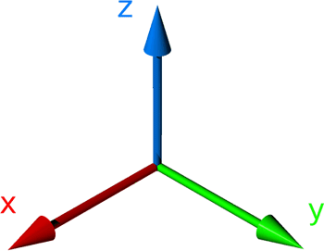
We can also play with our stuffs : TRANSFORMATION ☺
Rotate :

Slide 20
We can also play with our stuffs : TRANSFORMATION ☺
Rotate :

Slide 21
We can also play with our stuffs : TRANSFORMATION ☺
Rotate :

Slide 22
We can also play with our stuffs : TRANSFORMATION ☺
Rotate :
Suppose, we’ve rotated it by Ѳ degree with respect to X axis

Slide 23

We can also play with our stuffs : TRANSFORMATION ☺
Can you do this ? Can you rotate that square with respect to z- axis and as well as y-axis ? (clockwise)
Y
X
Z

