Slide 1

Bangladesh Army University of Science and Technology
Project Presentation
Project Name: BioSpark
Based On: Android (Java)
IDE: Android Studio
Database: Firebase
Submitted by:
Name : S. M. Rezwanul Haque Akib
Roll : 180201073
Batch : 8th
Level : 2
Term : II
Sec and Group: B Sec, G2
Dept. of CSE, BAUST.
Course Title: Software Development Project II
Course Code: CSE 2200
Supervised By: Md. Toukir Ahmed
Lecturer, Dept. of CSE.

Slide 2
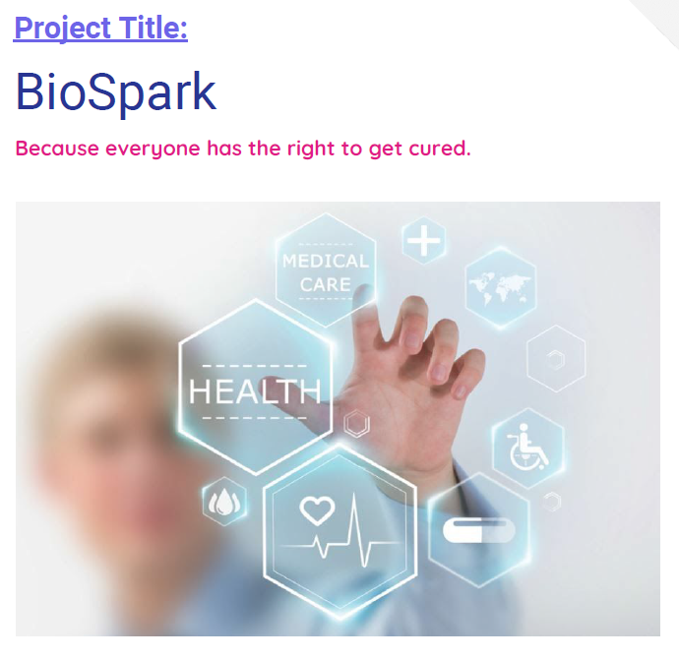
So, my project name as you can see is BioSpark which is a android application. It is a modern health heath which can be pretty helpful in time of emergency.
Because time plays a crucial role in these moments, I tried to put as much effort to make this app helpful in practical scenario.

Slide 3
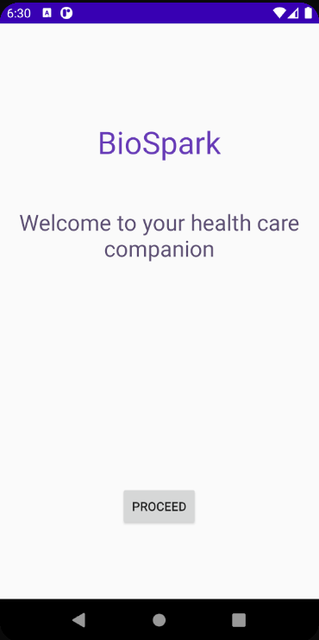
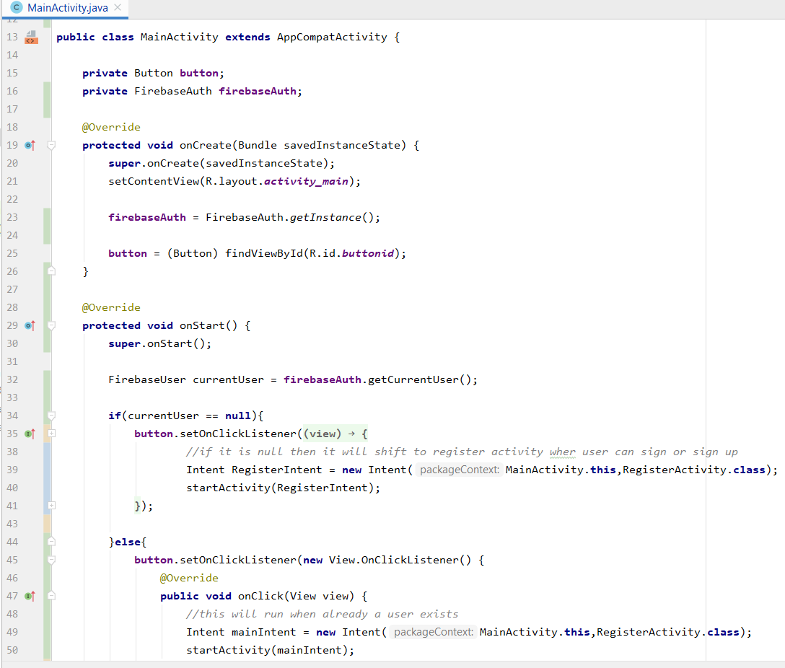
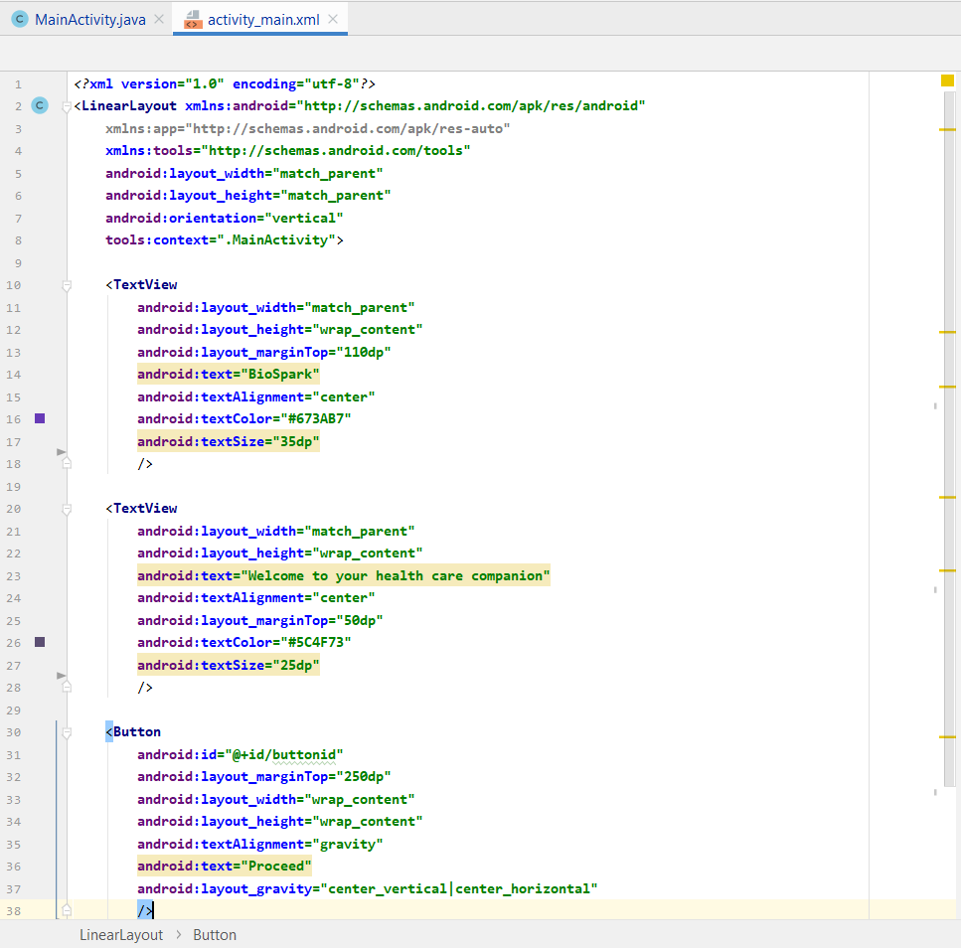
This is the main Intent(Page), the java code and the design section of the app. Here the app will proceed after pressing that proceed button on bottom.

Slide 4
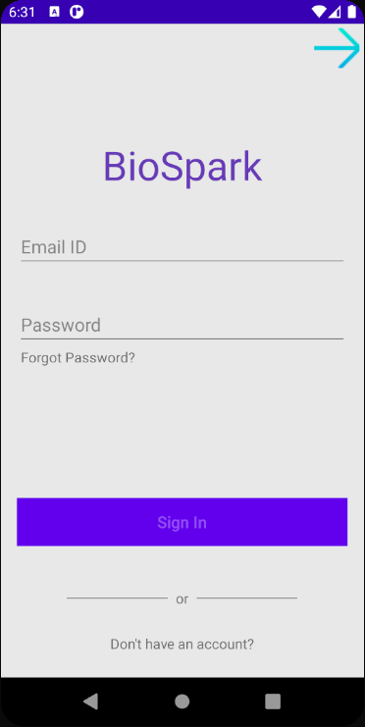
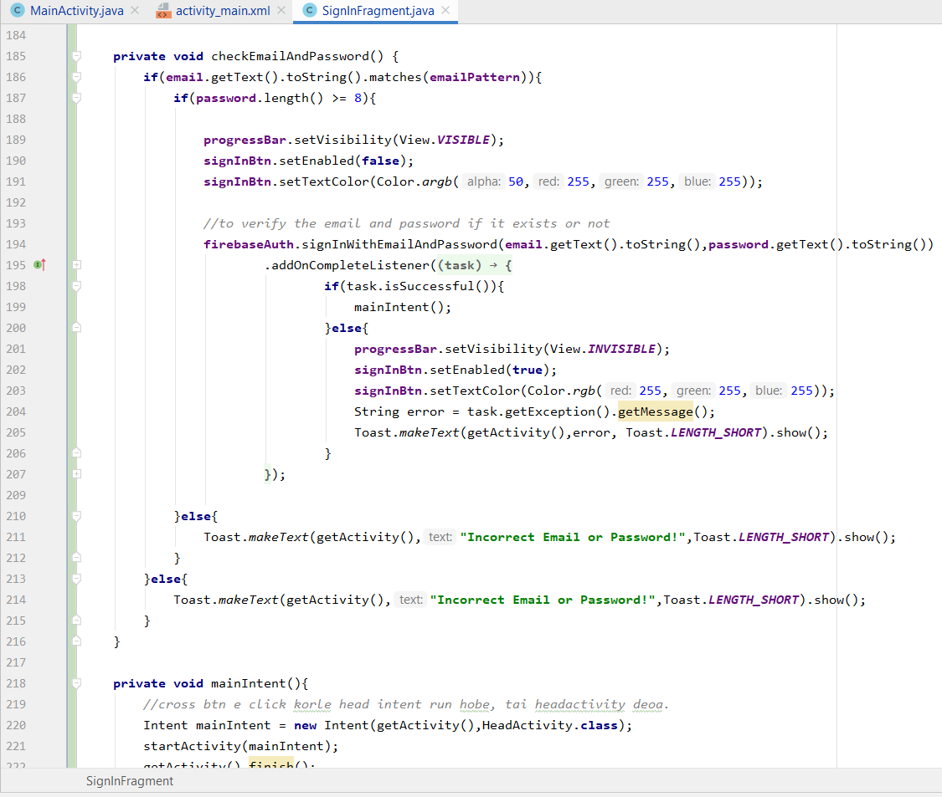
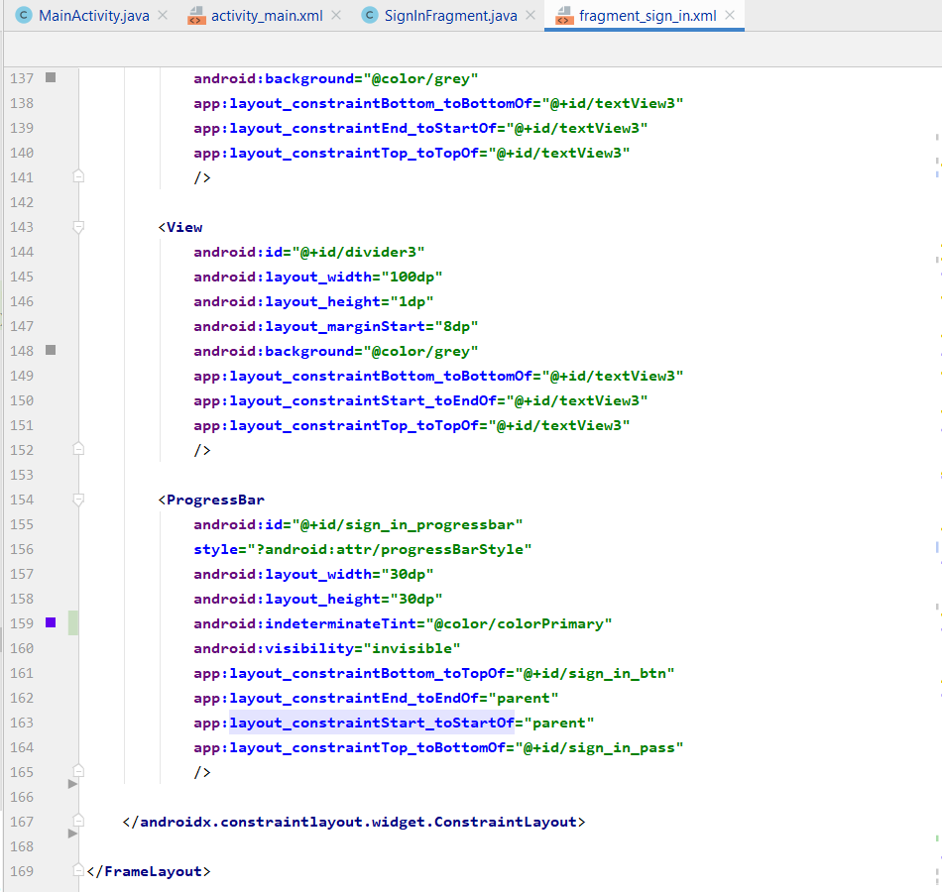
Here it is the sign in page. Initially the button has been disabled. But after putting the previously signed email and password. The button will become active to be pressable.

Slide 5
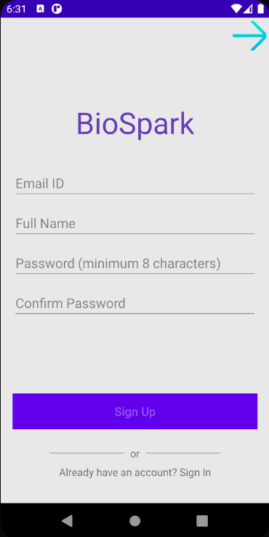
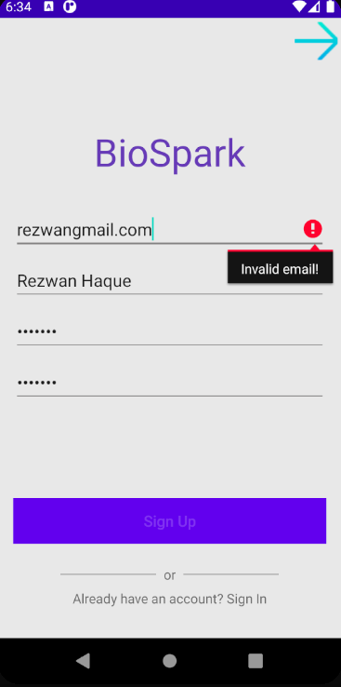
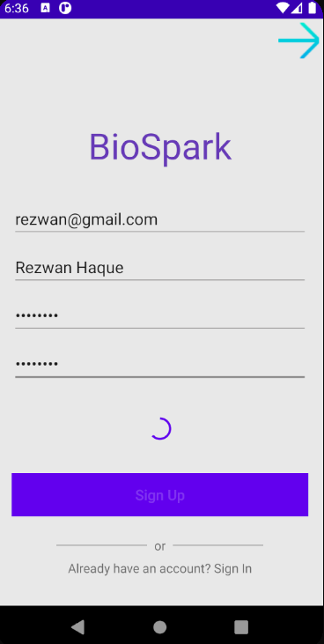

Slide 6
As you saw in the previous slide, a user cannot sign up using a invalid email format, or with any mismatched passwords or a password consisting of less than 8 characters. In either of the cases, it will show a error sign.
Here is the email format checker variable.

Slide 7
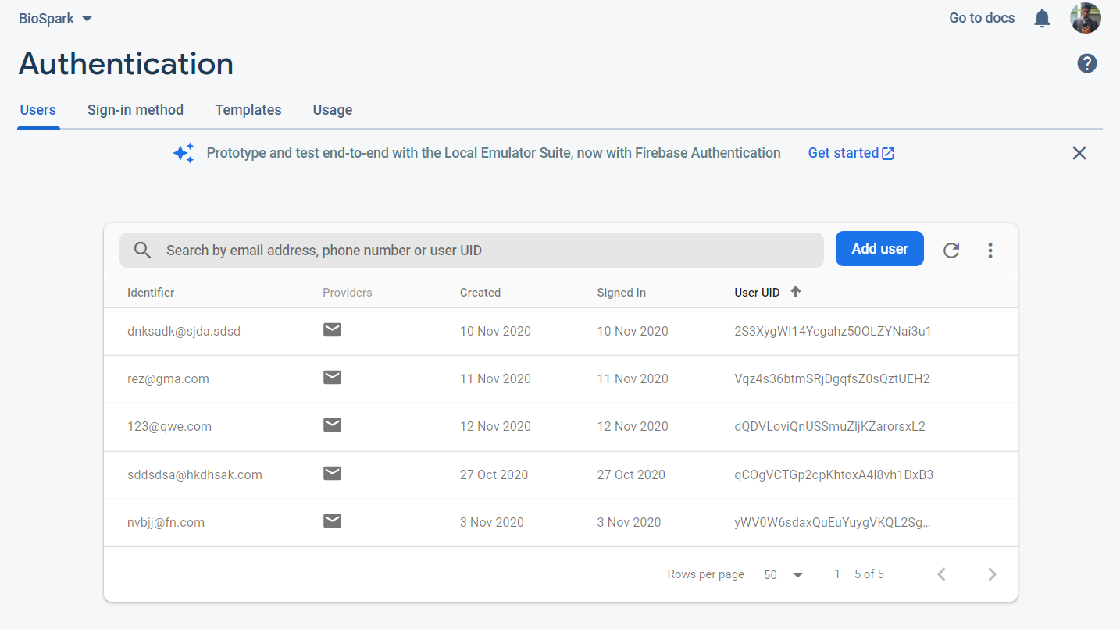
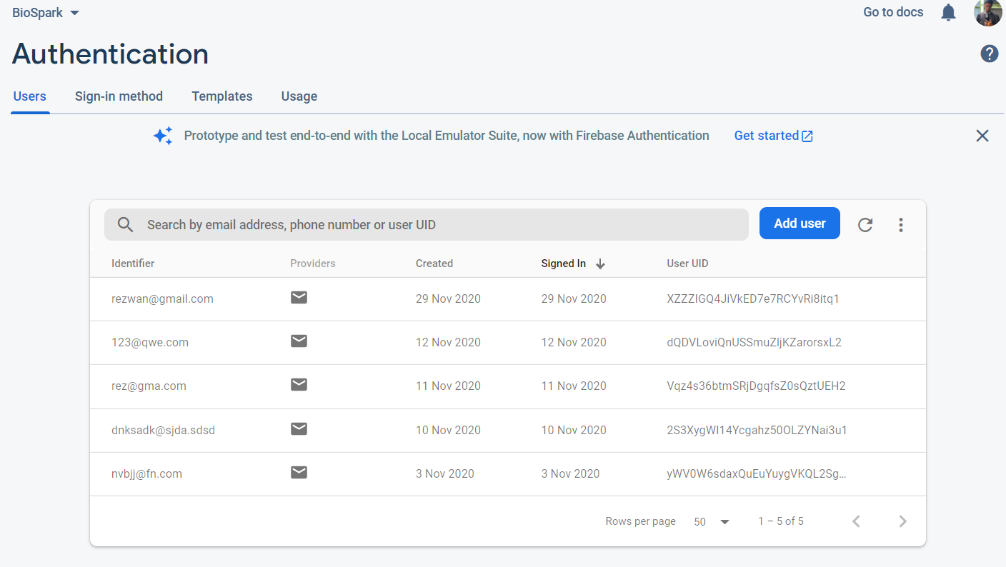
Before signing up
User registration system using firebase database.
After signing up

Slide 8
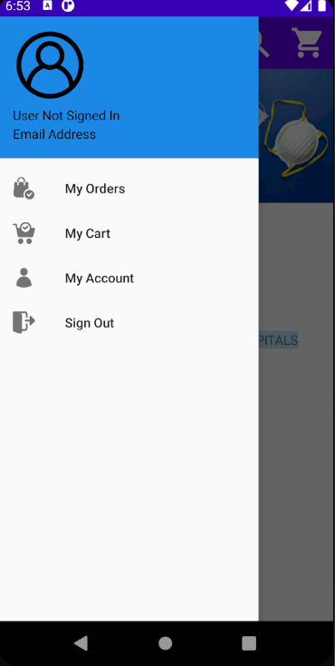
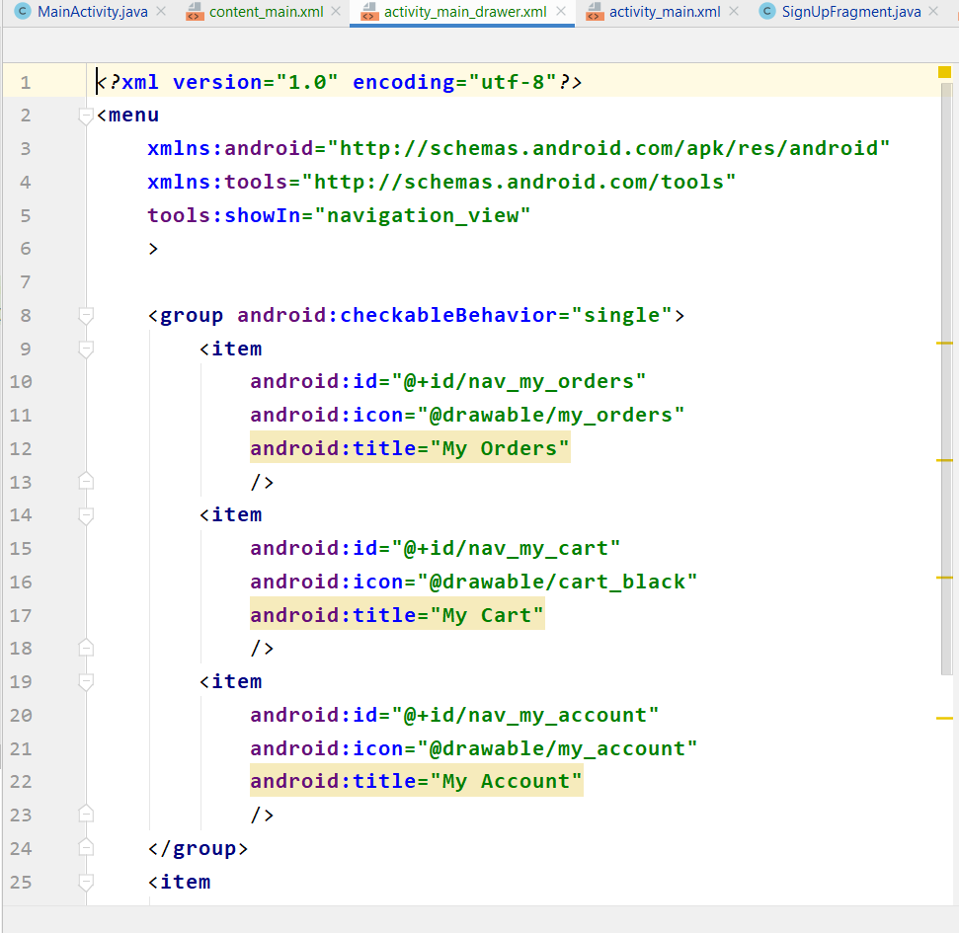
This is the DrayerLayout section. Where user will get various app control options.

Slide 9
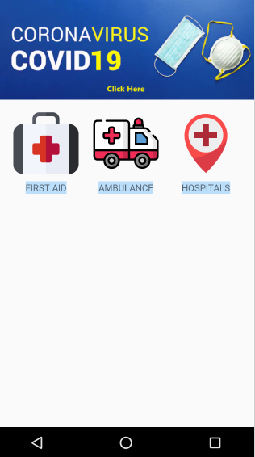
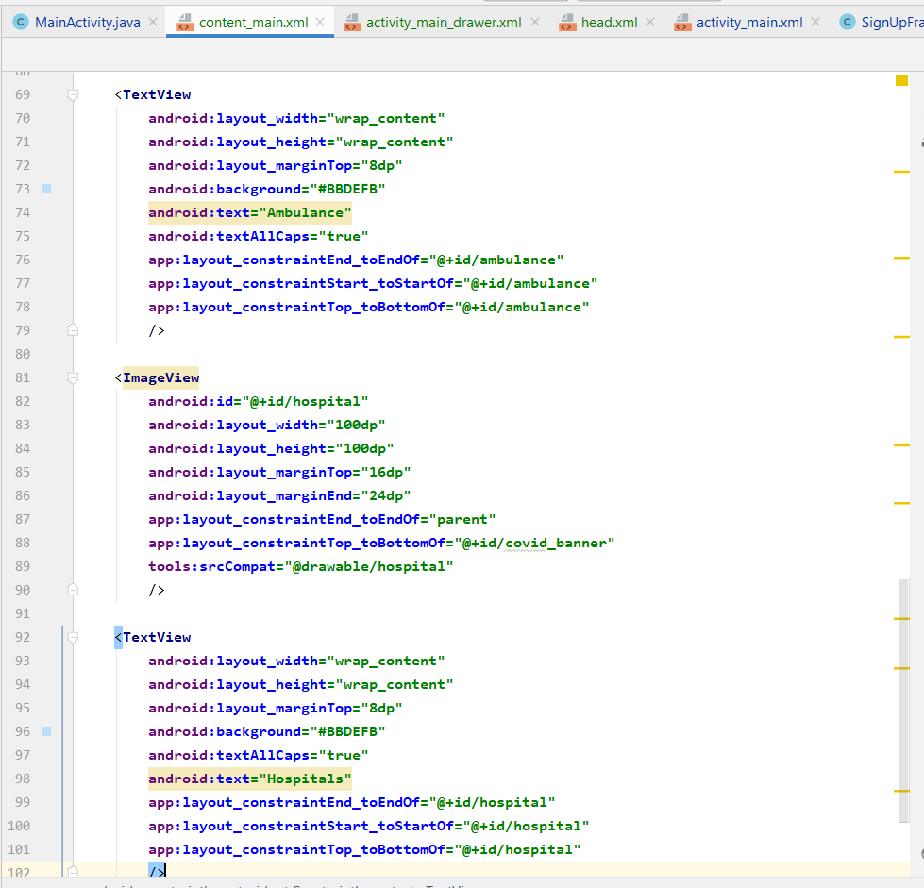
This is the content main page. Where there is there button which will give listings of “First Aid” items, Ambulance services name & contact and Hospital emergency hotline numbers.

Slide 10
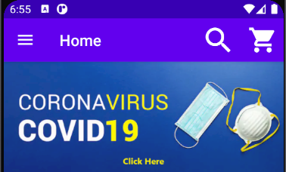
Here pressing the search icon will open the medicine directory.
Cart icon is for the items added to cart.
And in bottom of action bar, there is a banner related to Covid 19.
We are living in critical times. To keep track of that, I added this banner with link.

Slide 11
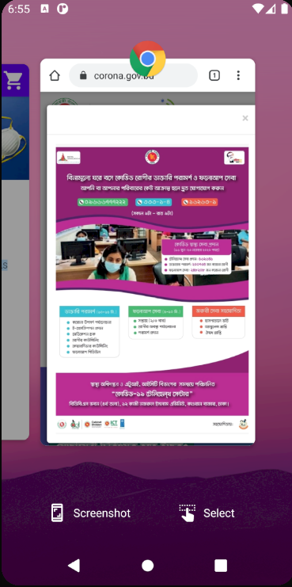
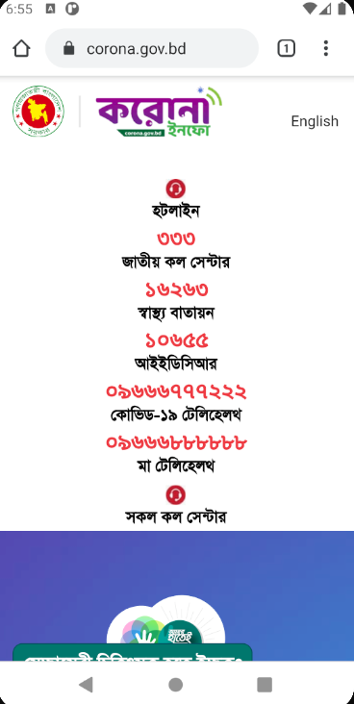
Clicking the banner will open the browser option and redirect to govt. official website of latest Covid-19 Updates.

Slide 12
Future Work:
A few work handy options is still missing like:
Medicine directory form live database
Cart system and
And a prescription upload option where user can upload his precription as a image and admin will be able to process that on his own.
I think the 3rd option will help the elders greatly as they will have take less hassle to get medicines.

Slide 13
Thank you. I hope that this app will help you in your time of need.
Github Link: https://github.com/rezwanakib/biosparktest

