Slide 1

FRANK @ LAM
Davide Morelli, University of Pisa
David Plans Casal, University of East Anglia
19 December 2005

Slide 2

What?
Frank is/will be an Open Source framework for evolutionary music composition

Slide 3
Aim
An extension of Todd and Werner’s Co-evolutionary approach to algorithmic composition/improvisation
Using Puredata framework and custom C external objects

Slide 4
Future Aim
To shift focus from current work on rhythmic/melodic co-evolution to frequency spectra
Depart from current MIDI model

Slide 5
Background
Biles (GenJam), Pachet (Continuator), Rowe (1993), ANN-based (Mozer, 1994), Impett (2001), Todd & Werner (Frankenstinian Methods,2001)
Notes:
Biles : old and clunky, fitness bottleneck, human critic
Pachet : Java, neuroevolutionary (maybe?), totally inaccessible and software-packaged, not OSS, not good.
Todd : coming from his earlier 1991 work (jordan networks) and 1999 then in ‘Musical Networks’, 2001
Impett : musical composition is modelled as a dynamic agent system consisting of interacting embodied behaviours. Autonomous agent behaviour (physical, virtual, emergent, or agreed beforehand)
Miranda : considers GA use for synthesis, Swarm (Impett, SwarmMIDI), calls it the ‘Engineering approach’ or when refering to Todd, the ‘Musicological’ approach. Impett : Creative approach.

Slide 6
Where Frank fits
Frank attempts to bridge ‘Musicological’ to ‘Creative’ approaches (Miranda)
Uses co-evolution theory and the concept of musical cultural history within a GA framework.

Slide 7
Current work
Todd’s critics implemented so far in Frank:
  Local transition preference
  Global transition preference (too cpu intensive)
  Surprise preference

Slide 8
Stage 1
Music space : MIDI world (argh)
Winning phenotype : best fitness
  Using source melody as mother
  Source melody will be live input

Slide 9
Stage 1 : Genes
Melody genes are expressed by four tables:
  chord_note
  octave
  passing_note
  played

Slide 10
Stage 1 : Results
Using a prevalence of local transition preference method (Todd 1rst method):
  After > 500 generations, result melody uses most used transition interval
  e.g. source melody: c d e d c d g c. winner: c d c d c d c d ....

Slide 11
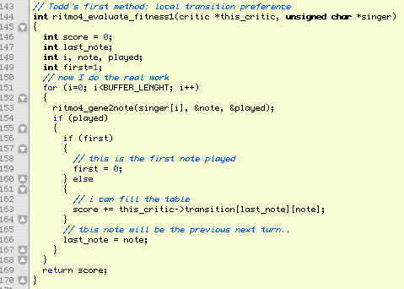

Slide 12
Stage 1 : Results
Using prevalence of surprise preference method:
  Semi-chaotic output which resembles source melody in shape but without context

Slide 13
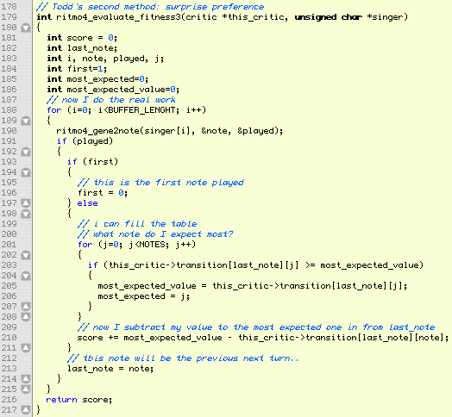

Slide 14
Stage 2
Using existing music as context
  Ligeti’s #10 piano etude (results : difficult to discern fitness right away)
  Jarrett/Gustavsen/Hancock material (chord recognition harder)
  Shostakovich’s #2 prelude in Am (results : simpler musical space, better overall reaction from critics)
    same melodic shape repeated (almost)
    simple tonal context

Slide 15
Stage 2
Current implementation
  Wonderful World of C Tunes
  Next step : diversity
    Live implementation
    Some mother preferences taken from live sampling
    Negation of silence : NOT ‘Continuator’

Slide 16
Stage 2
Need better, smarter critics
  Current fitness functions must be optimised

Slide 17
Stage 3 : seriously
Intervals are important, but Todd misses shape
  1) C D E D B C
  2) A E G F B C (shape)
  3) C D C D C D (local transition)
  4) E D B C D E (global transition)
1 and 2 are closer than 1 and 3 or 1 and 4

Slide 18
Stage 3
2d transition tables have no history (only remember -1)
  Will implement memory using +3d matrix plus GA
  May use Kohonen SOM to map musical melody space history

Slide 19
Stage 3
Form
  Single co-evolving GA creates no form
  Multiple-GA system may solve multiple gesture evolution
Need a Form Manager

Slide 20
Stage 4 : future
Transition from MIDI to Spectra
  Possible marriage of C externals and Ruby/GridFlow or Python (py/pyext)
  Probable use of Maxlib (Footils for Puredata)
  FFT tables from within 3d matrix as musical world
  Introduction of culture and agency (multiple GAs in agent-driven framework)
    (where ‘agent’ is Russel/Norvig extended reflex agent in Ruby puredata object transactions)

Slide 21
Stage 4 : future
Implementation and release of Frank
  (Already in CVS) Set of Puredata generic externals and libraries
  Set of documentation and open API (FLOSS project)
  C bindings for Ruby/Python (more approachable for students)
    Possible implementation of GridFlow-based API for teaching
    Inclusion in Puredata/Ruby ‘music programming’ course?
    SWIG interfaces

Slide 22


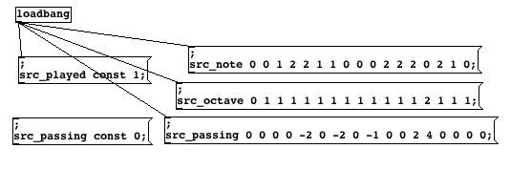
19 December 2005
my gene

