Slide 1

Analise Matricial Parte 1: Matrizes
Notacao e Conceitos Elementares
Prof. Ricardo Fabbri, Ph.D.
Março de 2012
Notes:
Good afternoon, Thank you all for being here. So I will be presenting my work on Multiview Differential Geometry in Application to Computer Vision.

Slide 2
Faça muitas perguntas
Somos todos humanos

Slide 3
Plano de Aula
Algebra de Matrizes Revisitada
  Matrizes Especiais
  Inversa de Matrizes
Notes:
In this presentation I'll first talk about the problem of 3D reconstruction and calibration, and how it can benefit from the use of curves.
I will give a tour of previous work on curves, then present some key theoretical results in the framework I developed with prof. Kimia. I will then present a practical system for curve reconstruction and camera calibration, and close with future work.

Slide 4
Algebra de Matrizes Revisitada

Slide 5
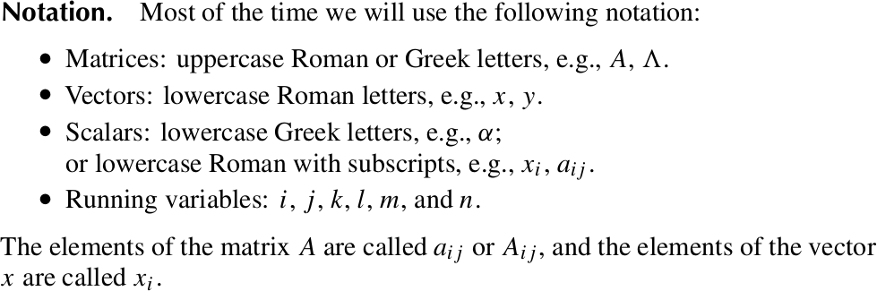
Notacao

Slide 6
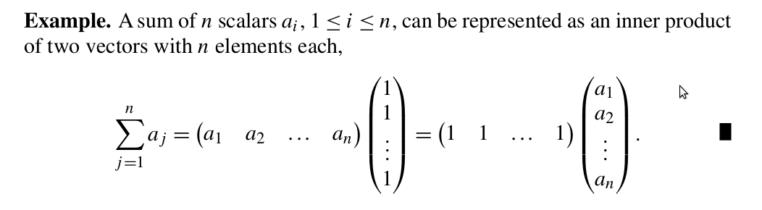


Operacoes

Slide 7
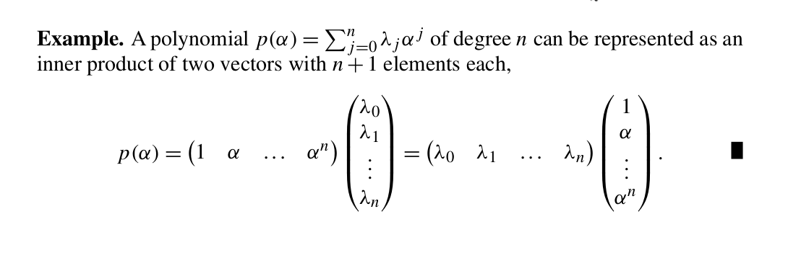

Slide 8
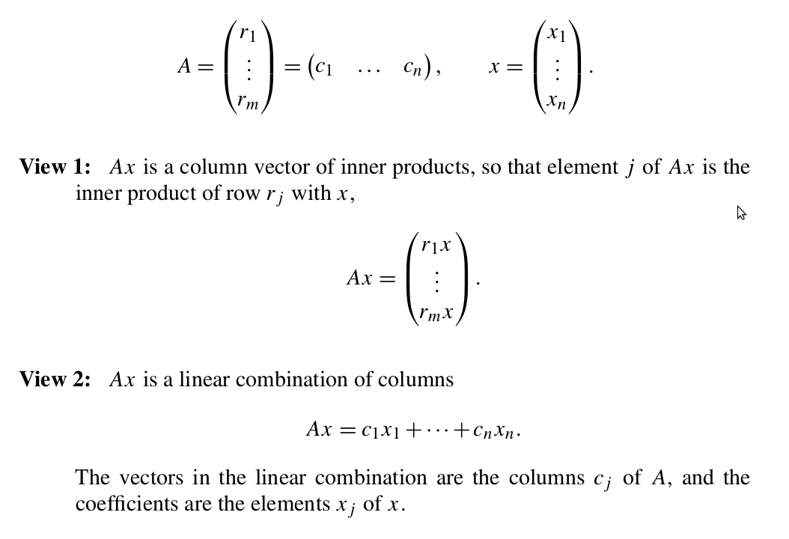

Slide 9
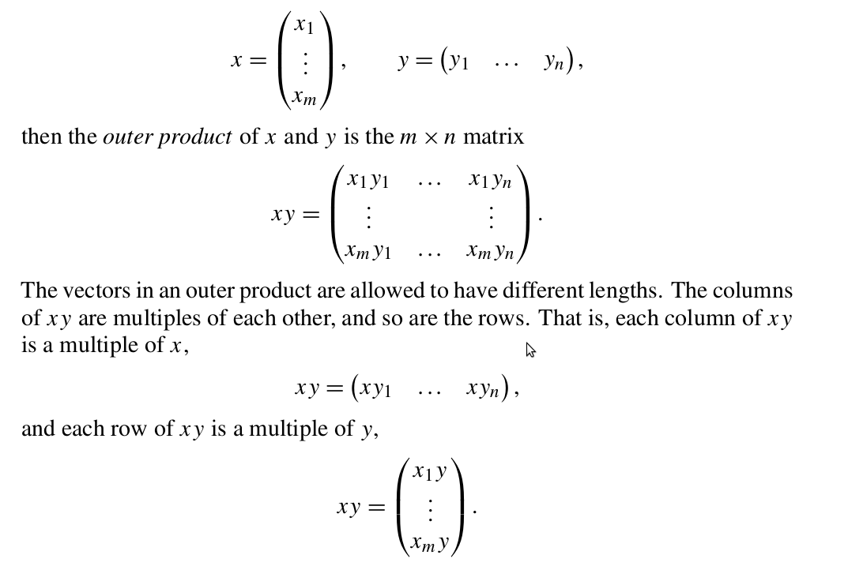

Slide 10
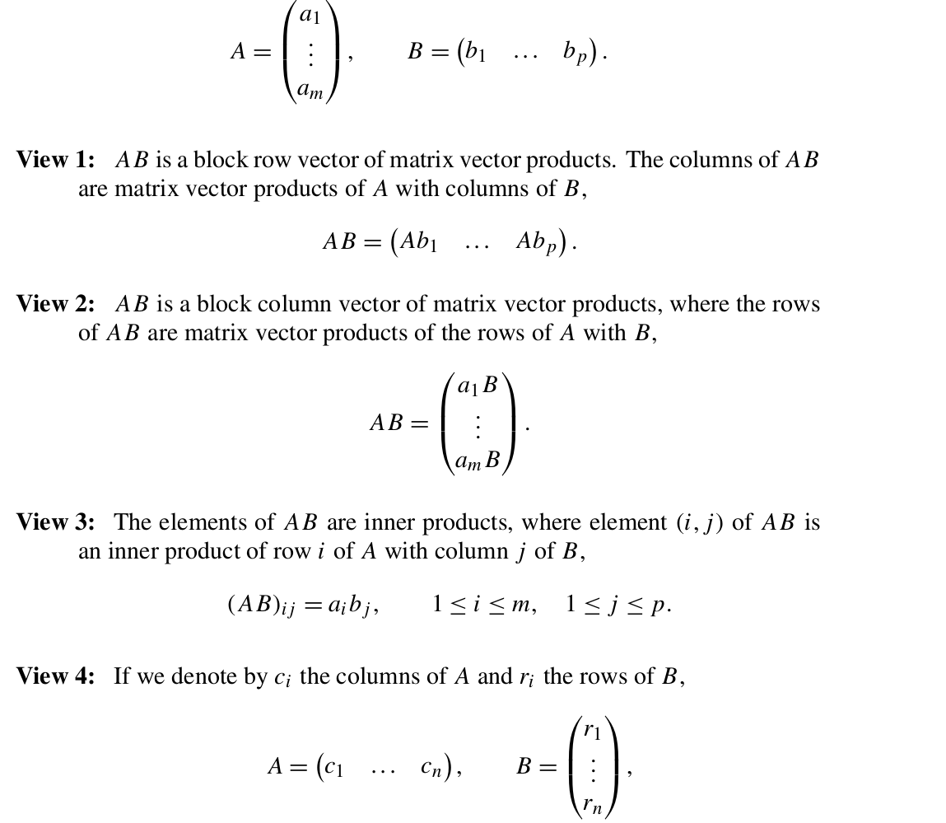

Slide 11
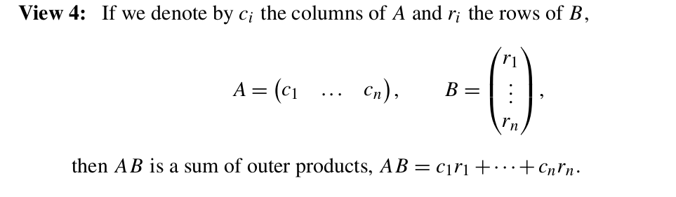

Slide 12
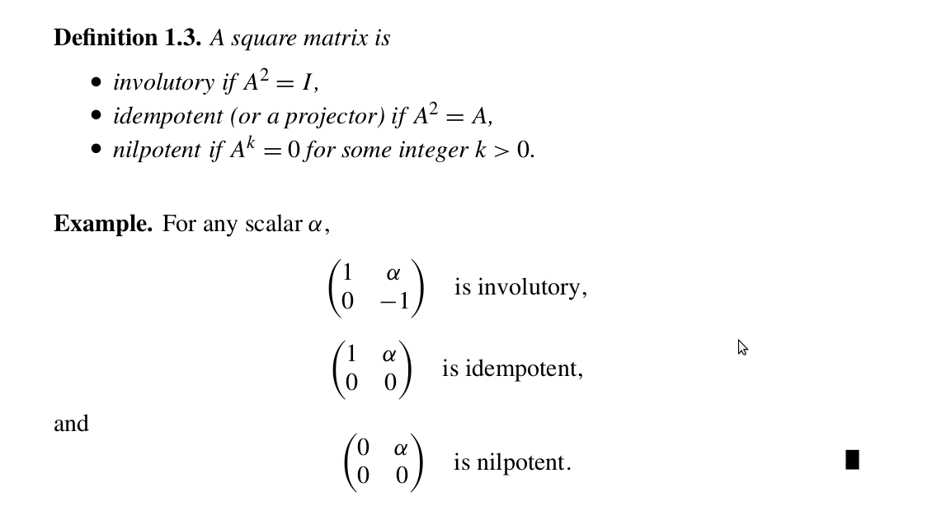

Slide 13
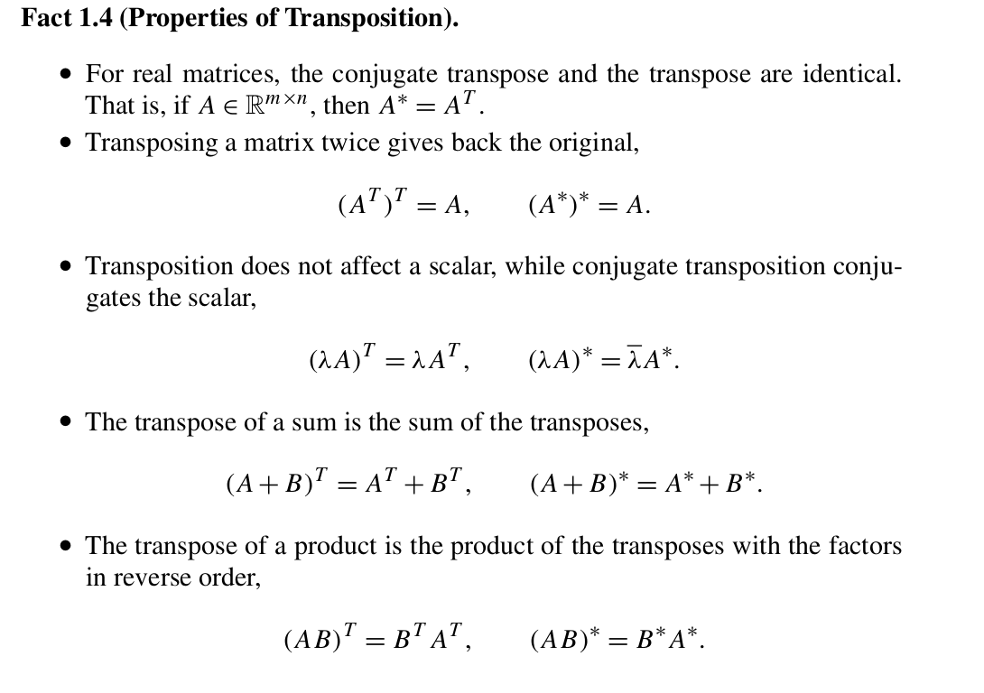

Slide 14
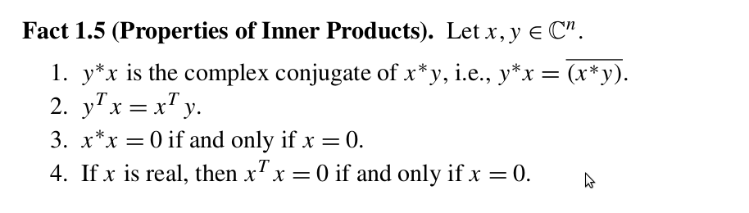

Slide 15
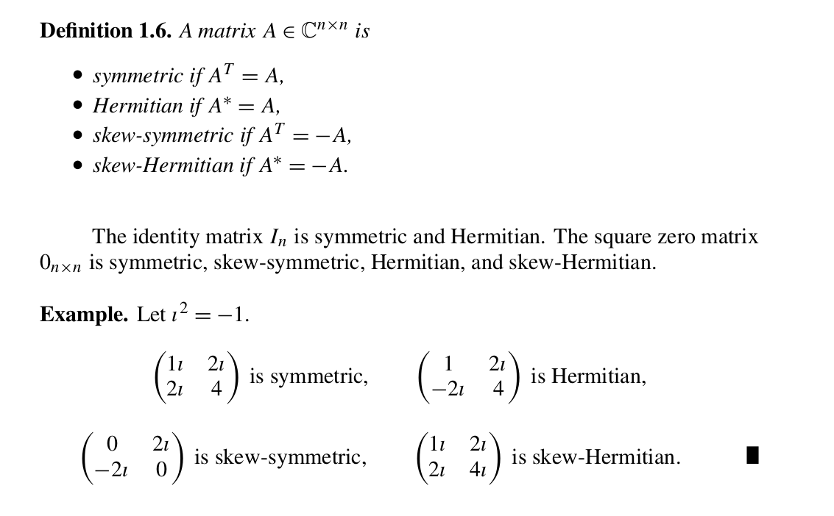

Slide 16
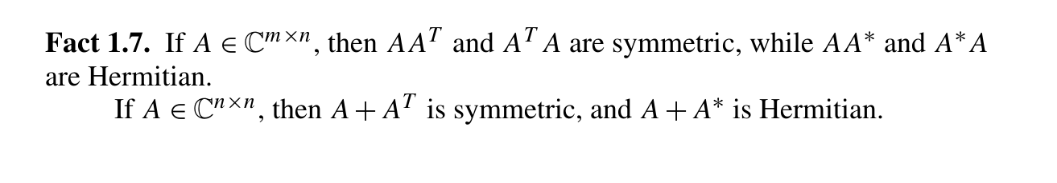

Slide 17
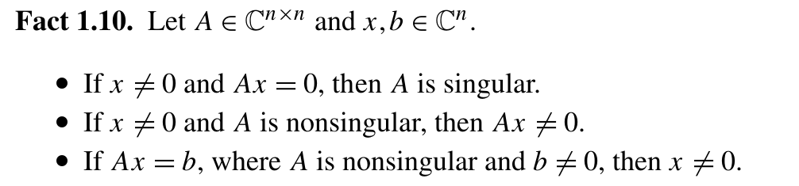

Slide 18
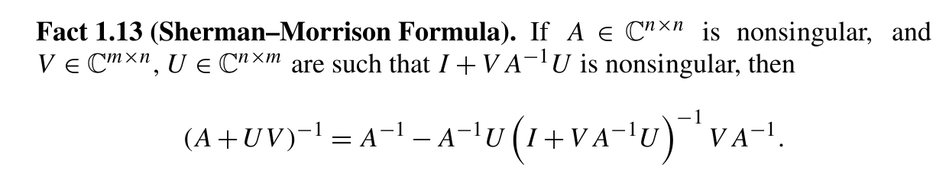

Slide 19
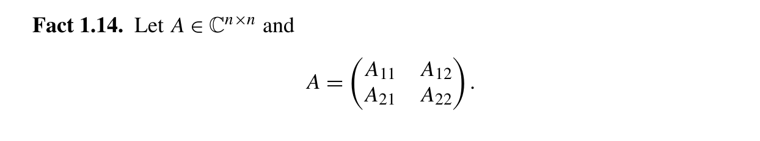
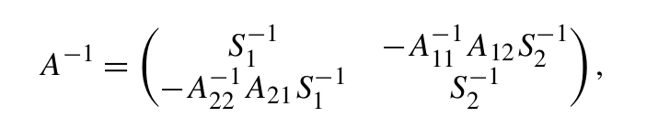
Schur complements

Slide 20
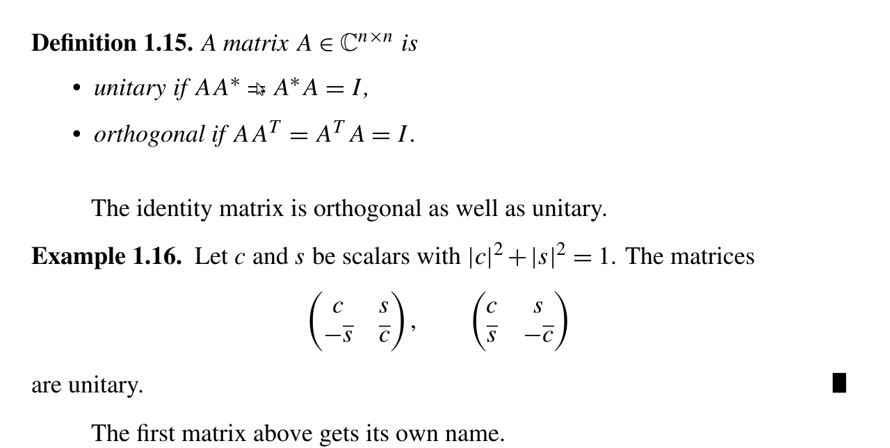

Slide 21
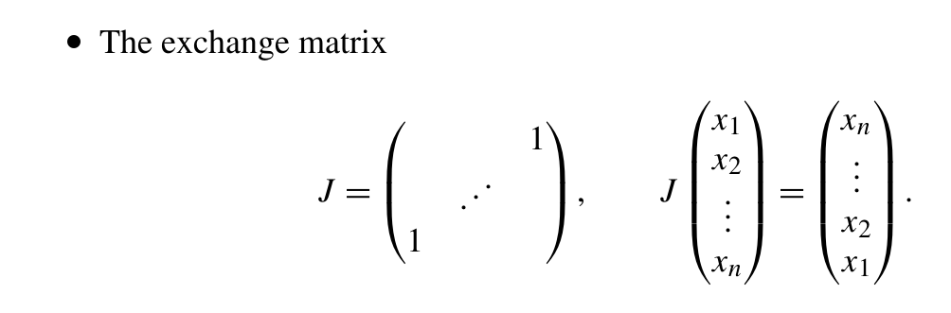
Permutation Matrices
Rows are Permutations of Identity's Rows

Slide 22
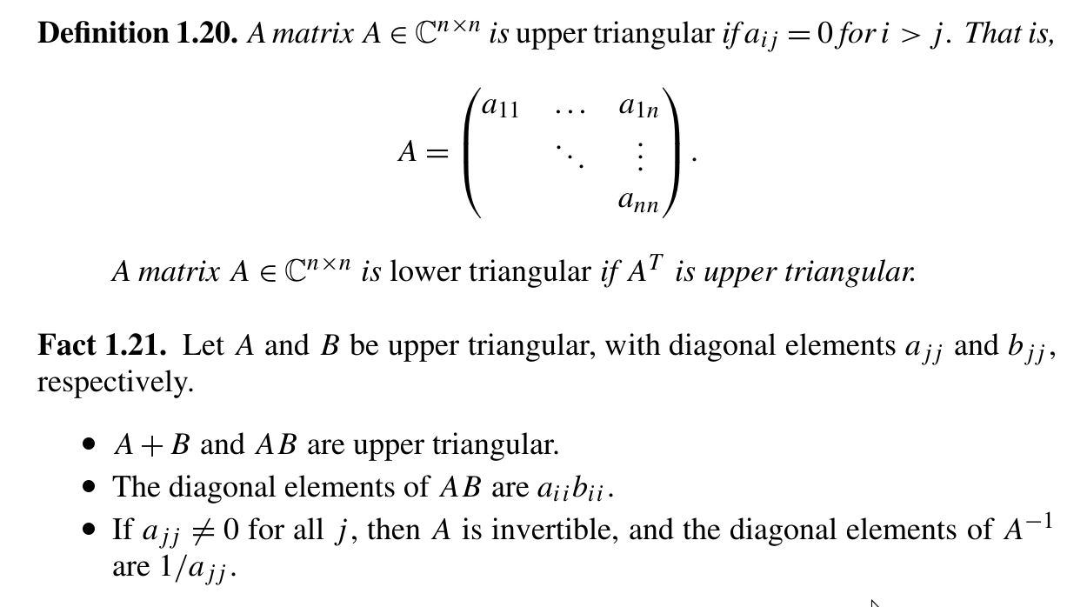

Slide 23
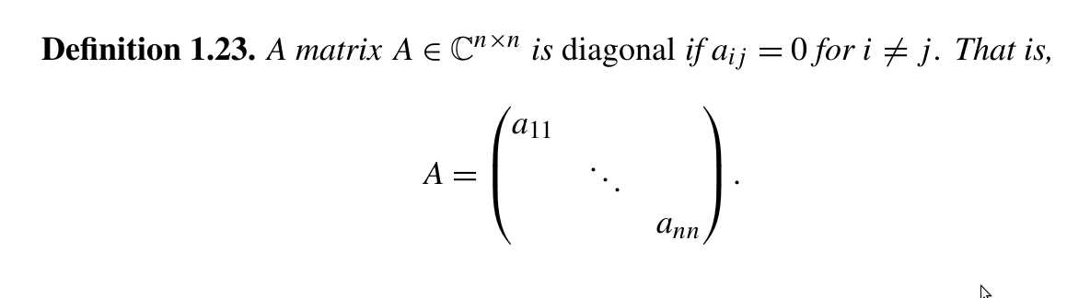
Matrizes Diagonais

Slide 24
Fim do Capitulo 1

