Slide 1
ENGN 2560
Progress Presentation
Combined Top-Down/Bottom-Up Segmentation
Firat Kalaycilar
firat@lems.brown.edu
Based on PAMI'08 Paper by Borenstein and Ullman

Slide 2
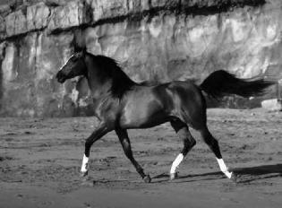

Problem
Figure-ground image segmentation
  The task of finding two sets of pixels:
    A set of figure (object) pixels
    A set of ground (background) pixels

Slide 3
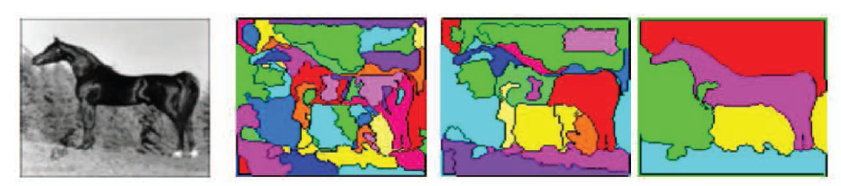
Bottom-Up Segmentation
Segmentation as a bottom-up process
  No stored object representation.
  Segment image into homogenous regions using some image based criteria.
Advantage: Informative about the exact object boundaries
Disadvantage: Over/Undersegmentation

Slide 4
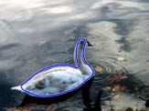
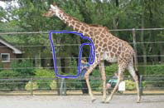
Top-Down Segmentation
Segmentation as a top-down process
  Stored object representations.
  Look for the object using prior knowledge about its possible appearance and shape.
Advantage: We know what we are looking for.
Disadvantage: Object representation cannot model the entire class perfectly.

Slide 5
Combined TD/BU Segmentation
Idea is to make use of the advantages of both approaches.
  TDS can produce a preliminary segmentation.
  BUS can refine it to obtain a better delineation of the object boundary.

Slide 6
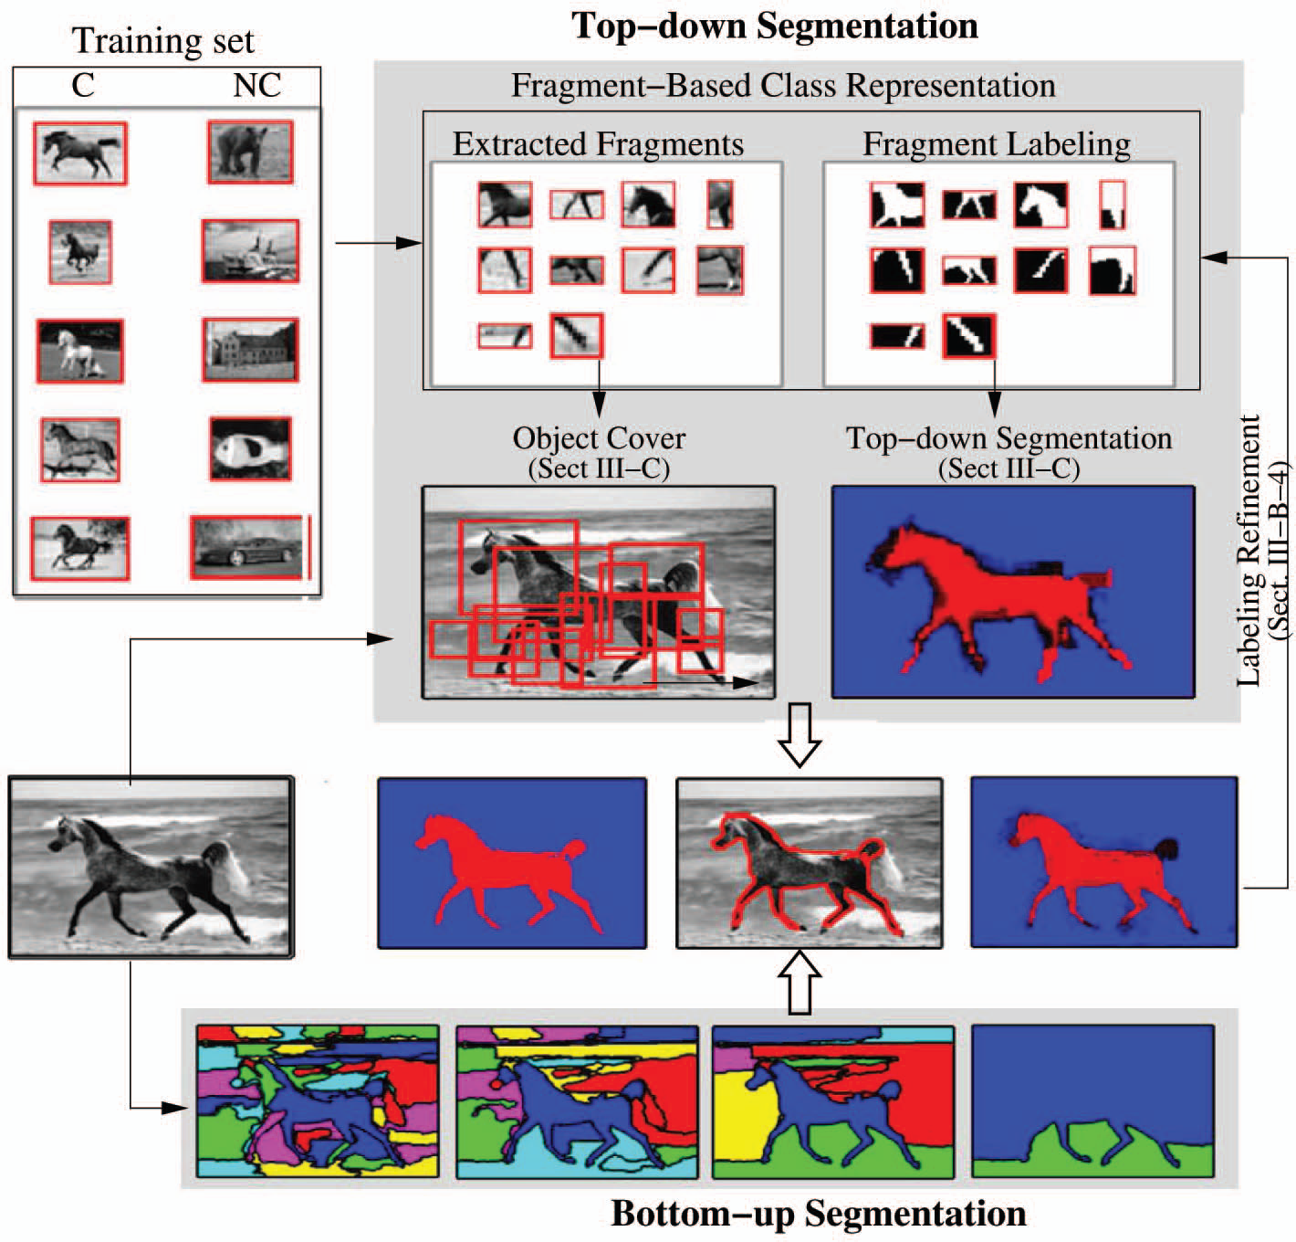
Combine TDS and BUS
Query image

Slide 7
Components
Fragment Bank Construction (Training)
Bottom-up segmentation (BUS)
Top-down segmentation (TDS)
Combining BUS and TDS (CSEG)

Slide 8

Fragment Bank Construction
Divide the dataset into two parts: Training and Test sets
In this stage, only use the training images.
For each training image
  Randomly extract N rectangular patches
  Extract N corresponding groundtruth patches using the groundtruth figure-ground segmentations of the training images.
  For every fragment, compute and record its normalized center.
0.1554 0.1711

Slide 9
Normalized Center
Fragment Center
(fx, fy)
(x0,y0)
RANDOM FRAGMENT
RANDOM FRAGMENT
BOUNDING BOX
BOUNDING BOX
IMAGE
(x1,y1)
(0,0)
Normalized Center
(nx, ny)
0 < nx, ny < 1
RANDOM FRAGMENT
BOUNDING BOX
(1,1)

Slide 10
Fragment Bank Construction
Make sure that each gray level patch and its corresponding groundtruth figure-ground segmentation satisfies the following criteria:
  0.7 <= Aspect ratio <= 1.43
  0.15 <= Relative area of the figure (white) <= 0.85
  1000 <= Width x Height <= 3000
We can reduce the number of fragments by eliminating them randomly
  For example; first I extracted 600 (20 frags/horse x 30 horses) fragments. Then I reduced the fragment bank size to 300.

Slide 11
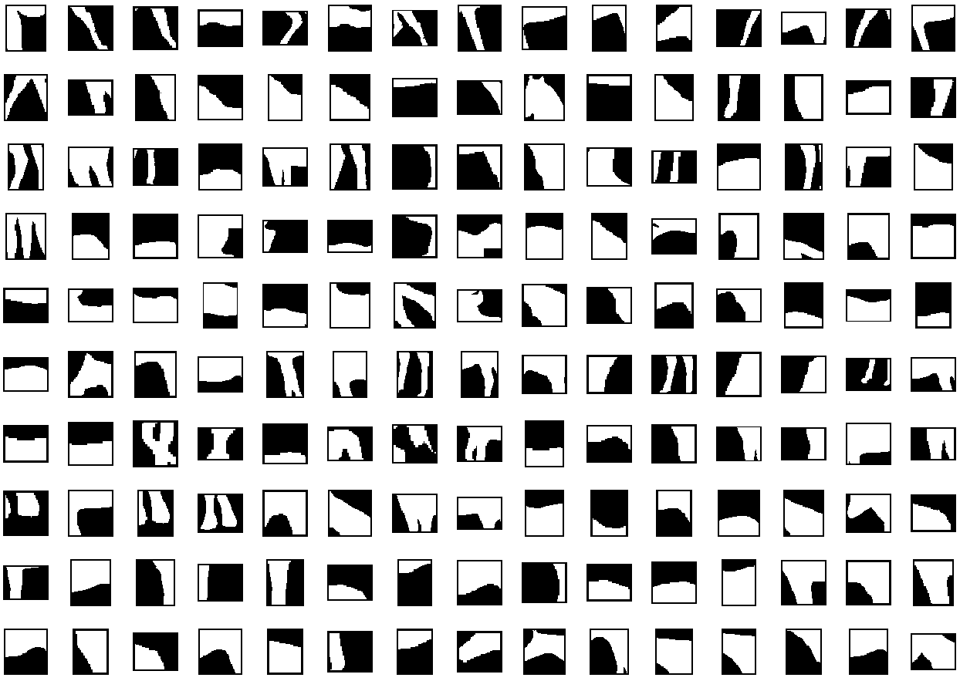

Slide 12
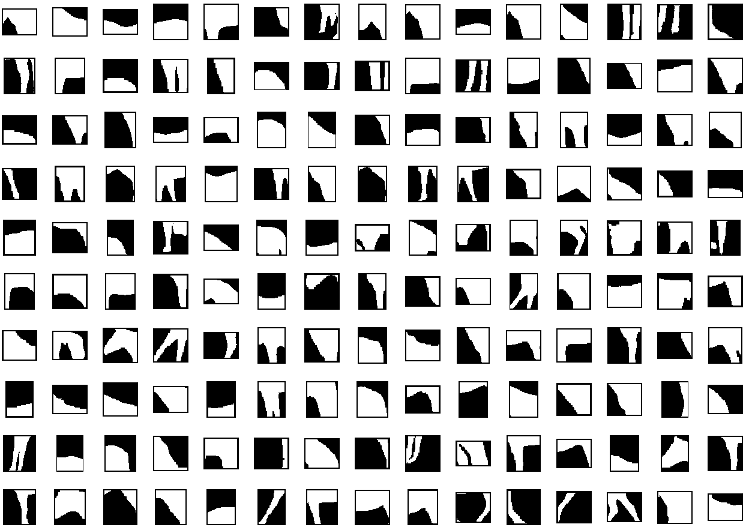

Slide 13
Bottom-up Segmentation
“Efficient Graph Based Image Segmentation” by Felzenszwalb and Huttenlocher, IJCV 2004
  Very fast
  Has only 3 parameters
  A hierarchical segmentation can be obtained by just varying the parameters.
Currently, I use flat segmentation.

Slide 14
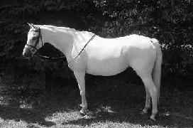






Slide 15
Top-down Segmentation
In this stage, only the test images are used.
For each test image
  For each fragment of the fragment bank
    Compute normalized cross correlation.
    Use non-maximum suppression to find the locations of high responses.
    Keep the locations having responses (R) greater than a threshold.
    Skip if there is no location left. Else continue.
    Normalize each location.
    Compute the squared distance (D) between the stored normalized center and the normalized location. (1 – D/2) is the spatial consistency score (SC).
    Compute the final score as
      FS = α x R + (1 – α) x SC
      0 <= α <= 1.
    Transfer the groundtruth figure-ground labeling of the fragment to the location yielding the highest FS.
  Select the pixels covered by sufficient amount of fragments as foreground.

Slide 16
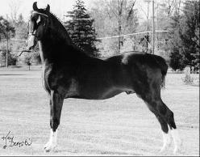
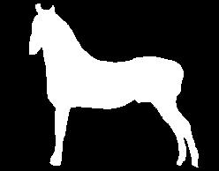
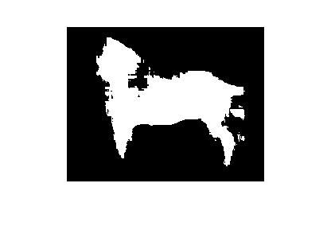
input
groundtruth
TDS output

Slide 17
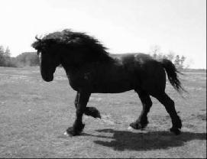
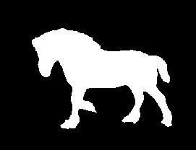
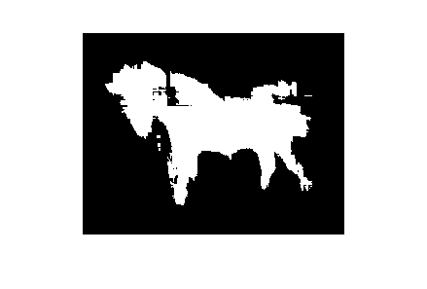
input
groundtruth
TDS output

Slide 18
Combining TDS and BUS
For each test image
  For each BU segment of the image
    Compute the ratio of the pixels detected as foreground at the end of TDS.
    If the ratio is greater than a threshold, label the entire BU segment as foreground.
    Otherwise, label the entire BU segment as background.

Slide 19
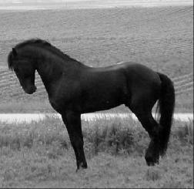

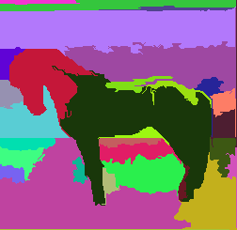
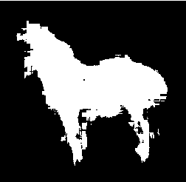
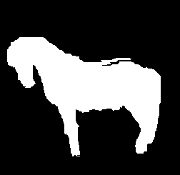
input
groundtruth
BUS output
TDS output
Combined output

Slide 20
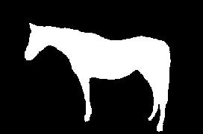
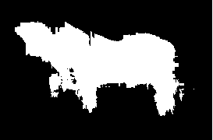
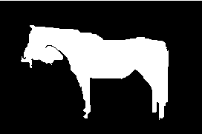
input
groundtruth
BUS output
TDS output
Combined output

Slide 21
Experimental Results
Weizmann Horse Dataset
  328 images in total
  Training: 30 images
  Test: 298 images
I generated a fragment bank for once using the criteria I explained before.
  300 fragments in total
I didn't evaluate the BUS, because it doesn't end up with a figure-ground segmentation.
I used BUS to generate 9 segmentations per test image. As we go from the 1st level to the 9th level, the number of segments decreases.

Slide 22

How to evaluate?
I used two measures as the authors did in their paper:
  Figure consistency
  Overall consistency
    {Total number of correctly classified foreground and background pixels} / {Total number of pixels}

Slide 23
Experimental Results
Top-down Segmentation
  There are two parameters:
    α: Weight representing the contributions of normalized cross correlation response and the spatial consistency of a fragment.
    τ: Normalized cross correlation response threshold
  Conducted experiments:
    α ϵ{0, 0.05, 0.10... 0.95, 1.00}
    τ ϵ{0, 0.05, 0.10... 0.95}
  According to the average figure consistency
    Best → α = 0.05, τ = 0.95, AFC = 55.68%
    Worst → α = 1.00, τ = 0.95, AFC = 3.79%
  According to the overall consistency
    Best → α = 0.15, τ = 0.90, OC = 85.62%
    Worst → α = 1.00, τ = 0.90, OC = 75.51%

Slide 24
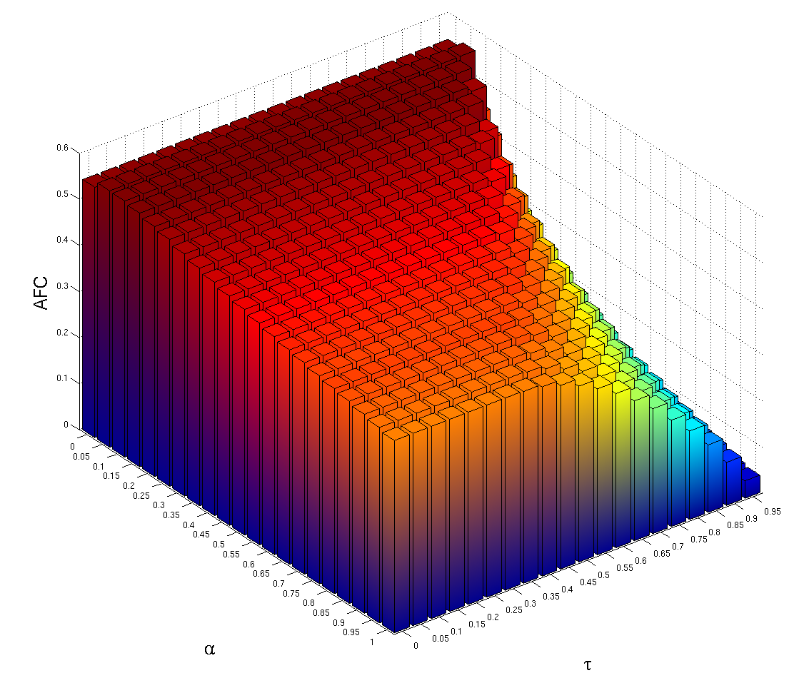

Slide 25
Experimental Results
Combined Segmentation (Using TDS with the highest AFC)
  There are two parameters:
    λ: BUS level
    θ: Threshold to label an entire BU segment as foreground
  Conducted experiments:
    λ: 1 – 9
    θ ϵ{0, 0.05, 0.10... 0.95}
  According to the average figure consistency
    Best: λ = 2, θ = 0.45, AFC = 63.64%
    Worst: λ = 9, θ = 0.95, AFC = 5.28%
  According to the overall consistency
    Best: λ = 2, θ = 0.55, OC = 88.79%
    Worst: λ = 9, θ = 0.05, OC = 30.41%

Slide 26
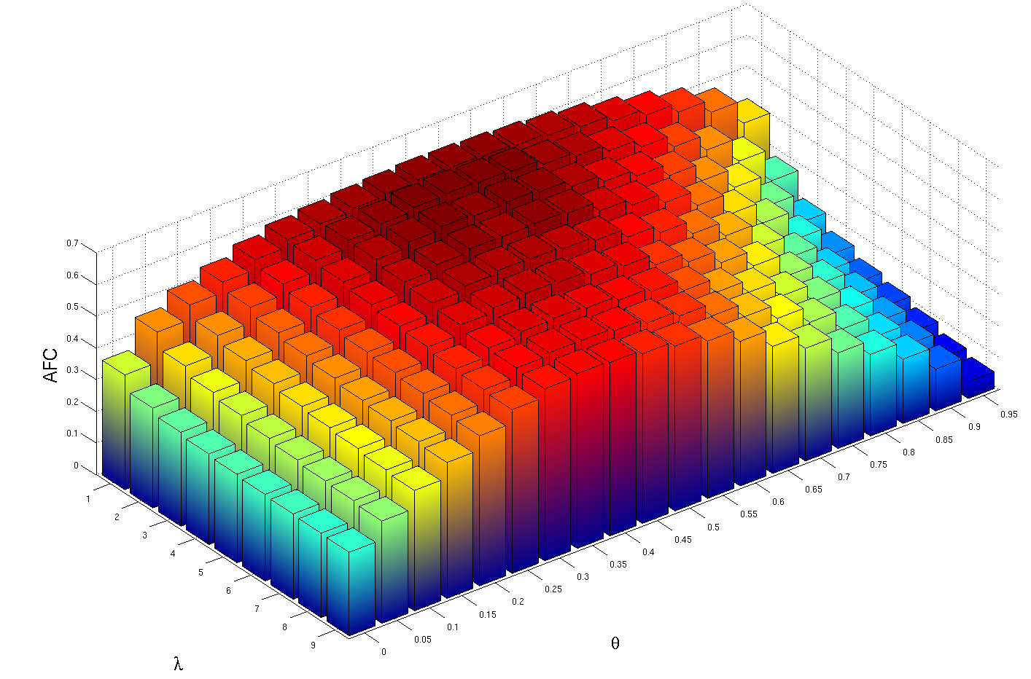

Slide 27
Experimental Results
Comparison of my results to the ones in the paper:
  Paper: TDS (AFC = 58%, OC = 84%)
  Mine: TDS (AFC = 55.68%, OC = 85.62%)
  Paper: Combined with Flat Segmentation
(AFC = 65%, OC = 85%)
  Mine: Combined with Flat Segmentation
(AFC = 63.64%, OC = 88.79%)

Slide 28
Conclusions
A simpler version of the TDS approach works comparably well as the one presented in the paper.
Combining the output of the BU and TD processes increases the segmentation accuracy as expected.

Slide 29
Plan
Apr 21 – Apr 27: Work on improving the TDS stage.
Apr 28 – May 4 : Work on using the entire segmentation hierarchy instead of using a fixed level in the BUS stage.
May 5 – May 11: Work on the components which still require improvements.
May 12 – May 21: Evaluate the system using different datasets.

