Slide 1
Two kinds of thought experiments
A thought experiment is necessary when you cannot do a real experiment. This usually is very useful to determine which are the logical consequences of a physical theory under extreme conditions that are not accessible through measurement instruments. Examples are the cat paradox of Schrödinger or the entanglement property of two electrons of opposite spin that when created at the same spatial point are then brought light years apart. But a weaker example of a thought experiment is one where it is not available the real experiment but nonetheless is available the computer experiment. This often happens since given a mathematical model of a physical system the simulation does not have any of the restrictions posed by the manufacturing of laboratory instruments necessary to probe the real physical system just modeled.
In the following we will worry about this second weak experiment.

Slide 2
The weak thought experiment
The weak thought experiment has been very useful to probe new mathematical structures like the Feynmann path integral. For example a way to realize the mathematical consequences of the path integral is to think as if you were doing a computer experiment.
The weak thought experiment that Feynmann proposed as a mental exercise has been later put in practice as a computer exercise. A pioneer in this transcription has been David. M. Ceperley in his [2] Review of Modern Physics 67, 279 (1995).
But a weak thought experiment can become very useful also when the experimental data are so indirect as in astrophysical observations. In these case the mathematical model itself can only be thought as a meaningful one, it can be solved by a computer experiment, and the results compared with the astrophysical observations.
In the following we will worry about a particular weak experiment to determine the thermodynamic and structural properties of a white dwarf.

Slide 3
What is a white dwarf
In the book [1] S. L. Shapiro and S. A. Teukolsky, Black Holes, White Dwarfs, and Neutron Stars. The Physics of Compact Objects (John Wiley & Sons Inc, New York, 1983) white dwarfs are described as dense remnants of stars, composed mainly of carbon and oxygen nuclei, which contain electrons, protons and neutrons and are supported against collapse induced by gravity by the electron degeneracy pressure due to Pauli exclusion principle. They remain white dwarfs till gravity overcomes electron degeneracy pressure, crushing electrons into protons to form neutrons through β+ decay.
Therefore the simplest model for the interior of a white dwarf is that of Jellium. This is a system of pointwise electrons immersed in a uniform neutralizing background. The density of the electron gas is so high that the Fermi temperature is much higher than the temperature of the star and the electron gas can be considered degenerate.
Chandrasekar model of a white dwarf equilibrium structure didn’t take into account the effects of general relativity. First Tolman, and later Oppenheimer and Volkoff proposed a way to treat the hydrodynamic equations for the equilibrium and stability of a star within the framework of general relativity. To solve the set of hydrodynamic equations one important ingredient is the equation of state of the plasma of the star.

Slide 4

The equation of state (eos)
The eos of an ideal and perfect plasma is a politrope
Where p is the pressure and we assume that the white dwarf is made up of a completely ionized plasma with ρ=μ_{e} m_{u} n with n the electrons number density, m_{u} the atomic mass unit, and μ_{e}=A/Z with Z the atomic number and A the mass number, so that for example for a Helium or Carbon white dwarf μ_{e}=2 and for an Iron white dwarf μ_{e}= 56/26.
In order to make some progress towards a more realistic equation of state it is necessary to drop the assumptions of an ideal and perfect electron gas. This has been accomplished with various mean field theories. Since for a white dwarf the Wigner-Seitz radius is small, 0.0003 < r_{s} =(4πn/3)^{-1/3}/a_{B}< 0.01, where a_{B} is Bohr radius, the corrections due to the Coulomb interaction will be small. The main effect of the electrostatic corrections is to give smaller radii and larger central densities compared with Chandrasekhar models of the same mass. As described in §2.4 of the book [1] a first electrostatic correction arises because the positive charges are not uniformly distributed in the gas but are concentrated in individual nuclei. A more accurate equation of state is needed for the strongly correlated plasma at high temperature and high density in the classical regime or at low temperature and low density in the quantum regime. Taking linearly into account charge screening in the electron-ion plasma a better approximation can be obtained from the Debye-Hückel theory in the classical regime or the Thomas-Fermi (and Thomas-Fermi-Dirac or Hartree-Fock) theory in the quantum regime. An even more accurate but non linear theory of screening is offered by Vlasov theory in the classical regime or Lindhard (also known as random phase approximation) theory in the quantum regime. Apart from these mean field theories, perturbative or integral equation approaches are also available.

Slide 5
The weak thought experiment
More progress towards an exact solution of the model of the plasma is otherwise possible employing numerical computer experiments like path integral Monte Carlo [2] at finite non zero temperature or diffusion Monte Carlo at zero temperature. In order to take into account the effects of general relativity in the equation of state to be used within the Tolman-Oppenheimer-Volkoff equilibrium it is then necessary to solve a path integral Monte Carlo experiment for an electron or an electron-ion plasma within general relativity.
We can then proceed following two distinct routes, either we treat the quantum particles as living in a classical
(non-quantum) spacetime or classical (non-quantum) particles living in a quantum spacetime [R. Fantoni, Many Body in General Relativity: A thermal equivalence principle, Quantum Rep. 8, 42 (2026)]. Here we propose to use the former route which we found to be the simplest of the two.
This welding of causality, inherent in general relativity, and casuality, inherent in the Monte Carlo method, is expected to offer an operative approach to the problem of (quantum) statistical gravity of many body liquids.
The melt between the superposition principle of quantum physics and the non linearity of general relativity is still under construction.
In the following we will solve a concrete computer experiment.

Slide 6
White dwarf thin atmosphere
The luminosity of a white dwarf is due to a thin radiating layer on the star surface (see chapter 4 of the book [1]). The mechanism of a white dwarf cooling is the primary bridge between our theoretical description of the star and observational data which rely on essentially two aspects: luminosity observations and time scale of the observed cooling.
We then propose to determine the properties of the electron plasma in this thin surface layer using the path integral Monte Carlo (PIMC) method [2] at low non zero temperature. In order to take into account the effects of general relativity we will use the 3+1 foliation of Arnowitt, Deser, and Misner (ADM) to build a density matrix from the stress-energy tensor through a path integral where on each imaginary timeslice one selects a constant time foil. This amounts to treat the quantum Coulomb plasma in the classical Schwarzschild spatial metric in a patch of subatomic dimensions just at the radius of the star of mass . We will neglect the gravitational potential energy of the plasma subject to the attraction of the star mass M but will include the “geometrical potential” w = −ℏ[ln √³g]/τ with τ the imaginary time step used in the discretization of the path integral.
We will determine the effect of the temperature, the quantum statistics, the charge neutrality of the patch, and the curvature of space due to the mass M, on the thermodynamic and structural properties of the star atmosphere.

Slide 7
Non relativistic quantum particles on a curved space
We may assume that the electrons dispersion relation is the one of non relativistic particles ϵ(p) = p²/2m. This is reasonable since the density of the electron-proton plasma in the thin surface layer is ρ ≈ 10³g/cm³ (see section 4.1 of the book [1]), much lower than the central densities, corresponding to r_{s} ≈ 0.2. Therefore p_{F}²/(mc)² ≈ 0.01 where m is the electron mass and p_{F} = h(3n/4π)^{1/3} is the polarized electrons Fermi momentum. The temperature of the surface layer falls in the range 10⁶K <∼T <∼10⁷K. We will consider a white dwarf with a radius R ≈ 700Km and a solar mass ≈ 2 × 10³⁰Kg, so the Schwarzschild radius is about R_{Sc} ≈ 3Km.
This allows to proceed without worrying about the formation of electron-positron pairs or of the employment of complications like the Fock ‘fifth parameter’ used by Feynmann.
In Ref. [3] [R. Fantoni, Path Integral Monte Carlo on a Sphere, Phys. Rev. B 114, 185409 (2026)] I used the Path Integral Monte Carlo (PIMC) method to study the thermodynamic and structural properties of a many body system. Here I will use the same method for the atmosphere of the white dwarf.

Slide 8

3N dimensional manifold where the N particles live
Schwarzschild solution of Einstein field equations in vacuum in imaginary time for a mass
For the N particles we introduce a metric tensor of the 3N dimensional manifold that results from taking N spatial foils of Schwarzschild metric at constant imaginary times
From now on we will use natural Planck units c=G=ħ=k_{B}=1 where c is the speed of light, ħ is the reduced Planck constant, G is the gravitational constant, and k_{B} is the Boltzmann constant.

Slide 9

The position representation of the matter density matrix
on constant imaginary time spatial foils of
Schwarzschild metric
The Bloch equation for the density matrix
In the small imaginary time τ limit the position representation of the density matrix is
where S is the action
with τK the kinetic action and τU the inter action of the N particles. At an imaginary time β=Mτ=1/T, with T the absolute temperature, we can expand in a path integral

Slide 10



The primitive action
The kinetic action is
where
The inter action is
where
is the Copson-Linet pair potential between two charges q₁ and q₂ on the Schwarzschild spatial foil. The following two limits hold
We may then introduce a Coulomb coupling constant Γ= βe²/a_{B}r_{s} , where e is the electron charge, such that for Γ>>1 the plasma will be strongly correlated.

Slide 11
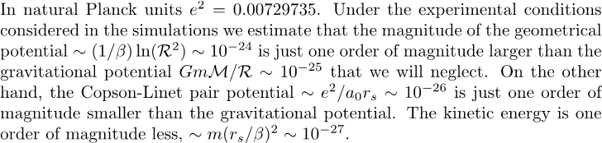
The geometrical potential
We will interpret the Jacobian of the elementary 3N dimensional volume of integration in the path integral as an external geometrical potential

Slide 12


The quantum statistics I
We will treat the electrons as polarized spin ½ Fermions. It is then necessary to antisymmetrize the density matrix
We may then introduce a de Broglie thermal wavelength with λ=1/2m. When the size, Λ, of the many body path R₀, R₁, R₂, …, R_{M} equals the interparticle spacing, n^{-1/3}, with n the proper particle number density, the permutations will have an effect on the measure of diagonal observables that requires R₀=R_{M}. This determines a degeneracy temperature
We may then introduce an adimensional parameter Θ=T/T_{D} such that for Θ << 1quantum statistics will be very important.

Slide 13
The quantum statistics II
Fermions properties cannot be calculated exactly with path integral Monte Carlo because of the Feynmann fermions sign problem
[D. M. Ceperley, Fermion Nodes, J. Stat. Phys. 63, 1237 (1991).]
[D. M. Ceperley, Path integral Monte Carlo methods for fermions, in Monte Carlo and Molecular Dynamics of Condensed Matter Systems, edited by K. Binder and G. Ciccotti (Editrice Compositori, Bologna, Italy, 1996).]
We then have to resort to an approximate calculation. The one we chose was the Restricted Path Integral (RPIMC) approximation with a ``free fermions restriction''.

Slide 14
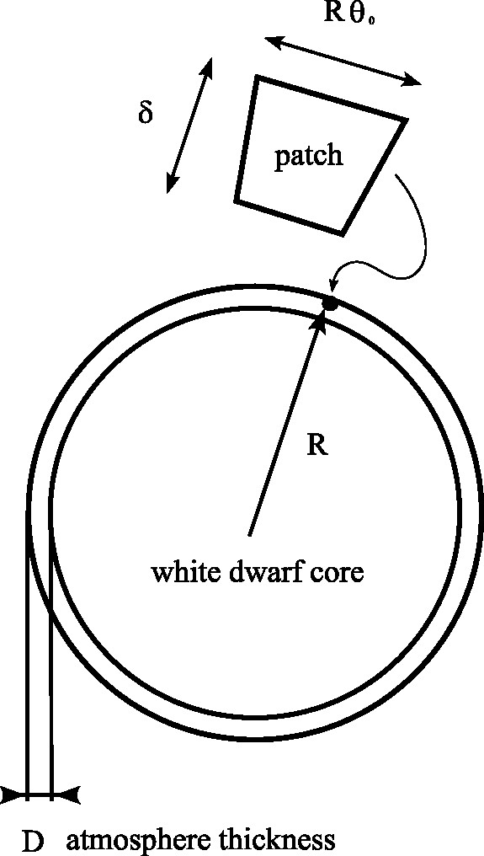
The patch
In the simulation we use
R ≈ 7 x 10⁷ cm ≈ R☉/1000
D ≈ R/100
δ ≈ Å/20
θ₀ ≈ φ₀ ≈ 10⁻¹⁷ rad
We use periodic boundary conditions on θ∈[- θ₀/2, θ₀/2] and φ∈[- φ₀/2, φ₀/2] of periodicities θ₀ and φ₀ and wall boundary conditions on r=R and r=R-δ.
We always use N=30 electrons within the patch which correspond to an electron number density in Planck units equal to
n ≈ 3 x 10⁷²
Corresponding to
r_{s} ≈ 0.06

Slide 15
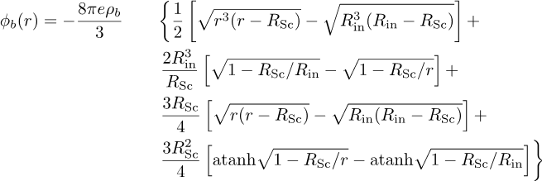
The charge neutrality
In order to take into account the positive ions component it is necessary to make the patch neutrally charged. The simplest way to achieve this is to imagine the electrons as immersed in a uniform neutralizing background of charge density ρ_{b} = -en. Then it is necessary to add to the pair Cpson potential the external potential
Where the surface r=R_{in}=R_{Sc} - δ/2 is grounded. The effect of the background is to increase both the kinetic and potential energy of the plasma.

Slide 16
The Black Hole limit
We can imagine to increase the mass of the star so that the Schwarzschild radius comes closer to the atmosphere.
This is case BH in Table I where the Schwarzschild radius
R_{Sc} ≈ /2 .
We see how the geometrical potential becomes more negative and the Copson potential and the kinetic energy are diminished.

Slide 17
Numerical results I

Slide 18
Numerical results II

Slide 19
Numerical results III

