Slide 1
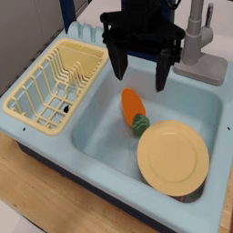
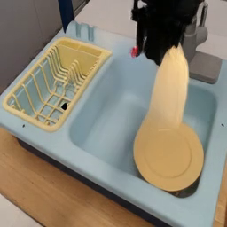
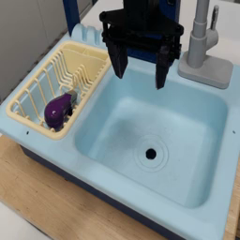
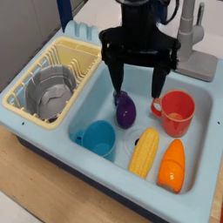
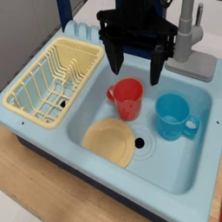
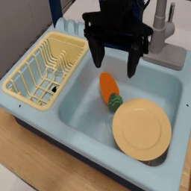
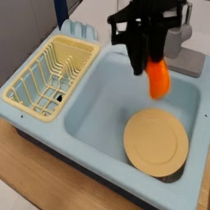

Filter
DROID-SLAM
Low-Consistency Videos
SEA-RAFT
High-Consistency Videos
Rollouts
generated by
World Model
$$S_{\text{r}}=w_{3}⋅\hat{s_{\text{3}}}+w_{p}⋅\hat{s_{\text{p}}}$$

Slide 2
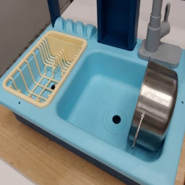
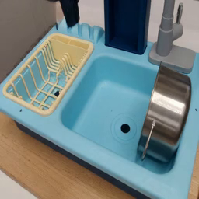
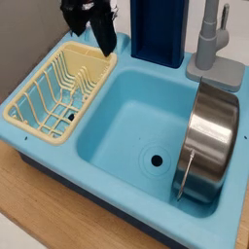
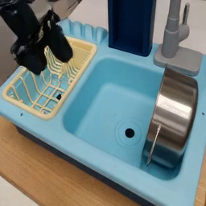
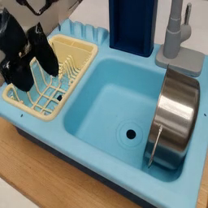
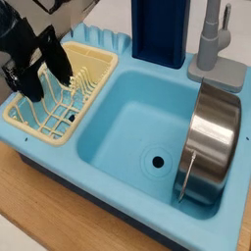
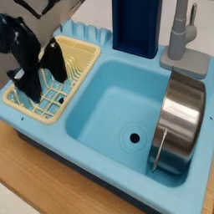
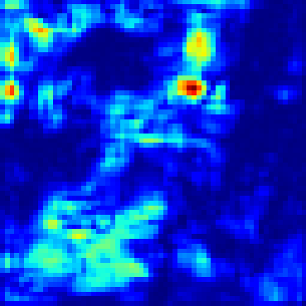


Frames from a single rollout
DROID-SLAM
$$j_{t}=\left|e_{t}−e_{t−1}\right|, t^{∗}=\arg{\max_{t}\left(j_{t}\right)}$$
$$M_{i}\left(u,v\right)=|δ_{i}\left(u,v\right)|_{2}$$

