Slide 1
The Finite-Field FFT
Lecture 10

Slide 2
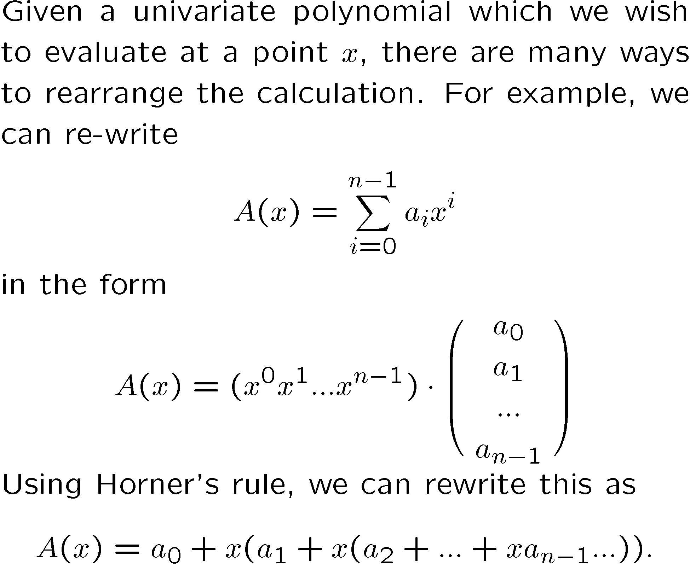
Intro

Slide 3
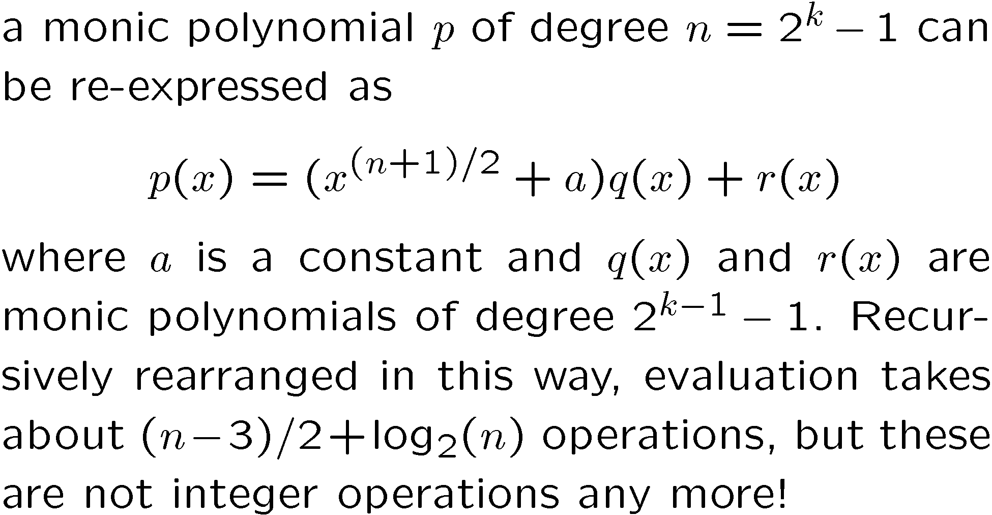
If we knew {a_{i}} ahead of time we could pre-process the coefficients

Slide 4
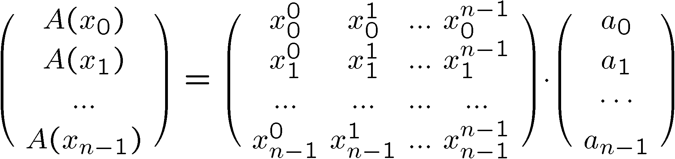
Simultaneous Evaluation at Many Points
If we keep the polynomial fixed, and evaluate at many points, we can do better, as we will see. For specificity in notation, let us evaluate A(x) at n given points, x₀ , ... , x_{n-1} .
Let us represent the problem as a matrix multiplication:
Is this perfectly clear?

Slide 5
Roots of Unity
It is especially convenient for subsequent operations to choose the points specially:
Definition:
ω_{n} is a primitive n^{th} root of unity in a computation structure (e.g. finite field), if ω_{n}^{n} = 1 but for no m such that 0 < m < n is ω_{n}^{m} = 1.
Examples:
In the finite field of the integers mod 41 ( { Z}₄₁ ), the element 3 is a primitive 8th root of unity.
In Z₃ the element 2 is a square-root of unity, since 2² = 4 ´ 1 mod 3.
Over the complex numbers, ω_{n} = e^{2 π i / n} .

Slide 6
Definition of Fourier Transform
Definition:
A Fourier Transform (FT) is a sequence of n points constituting the evaluation of a polynomial with coefficients { a₀ , ..., a_{n-1} } at the points { ω⁰ , ..., ω^{n-1} } where ω is a primitive n^{th} root of unity.
That is, the Fourier Transform can be thought of as the left hand side of the equation on the next slide.

Slide 7
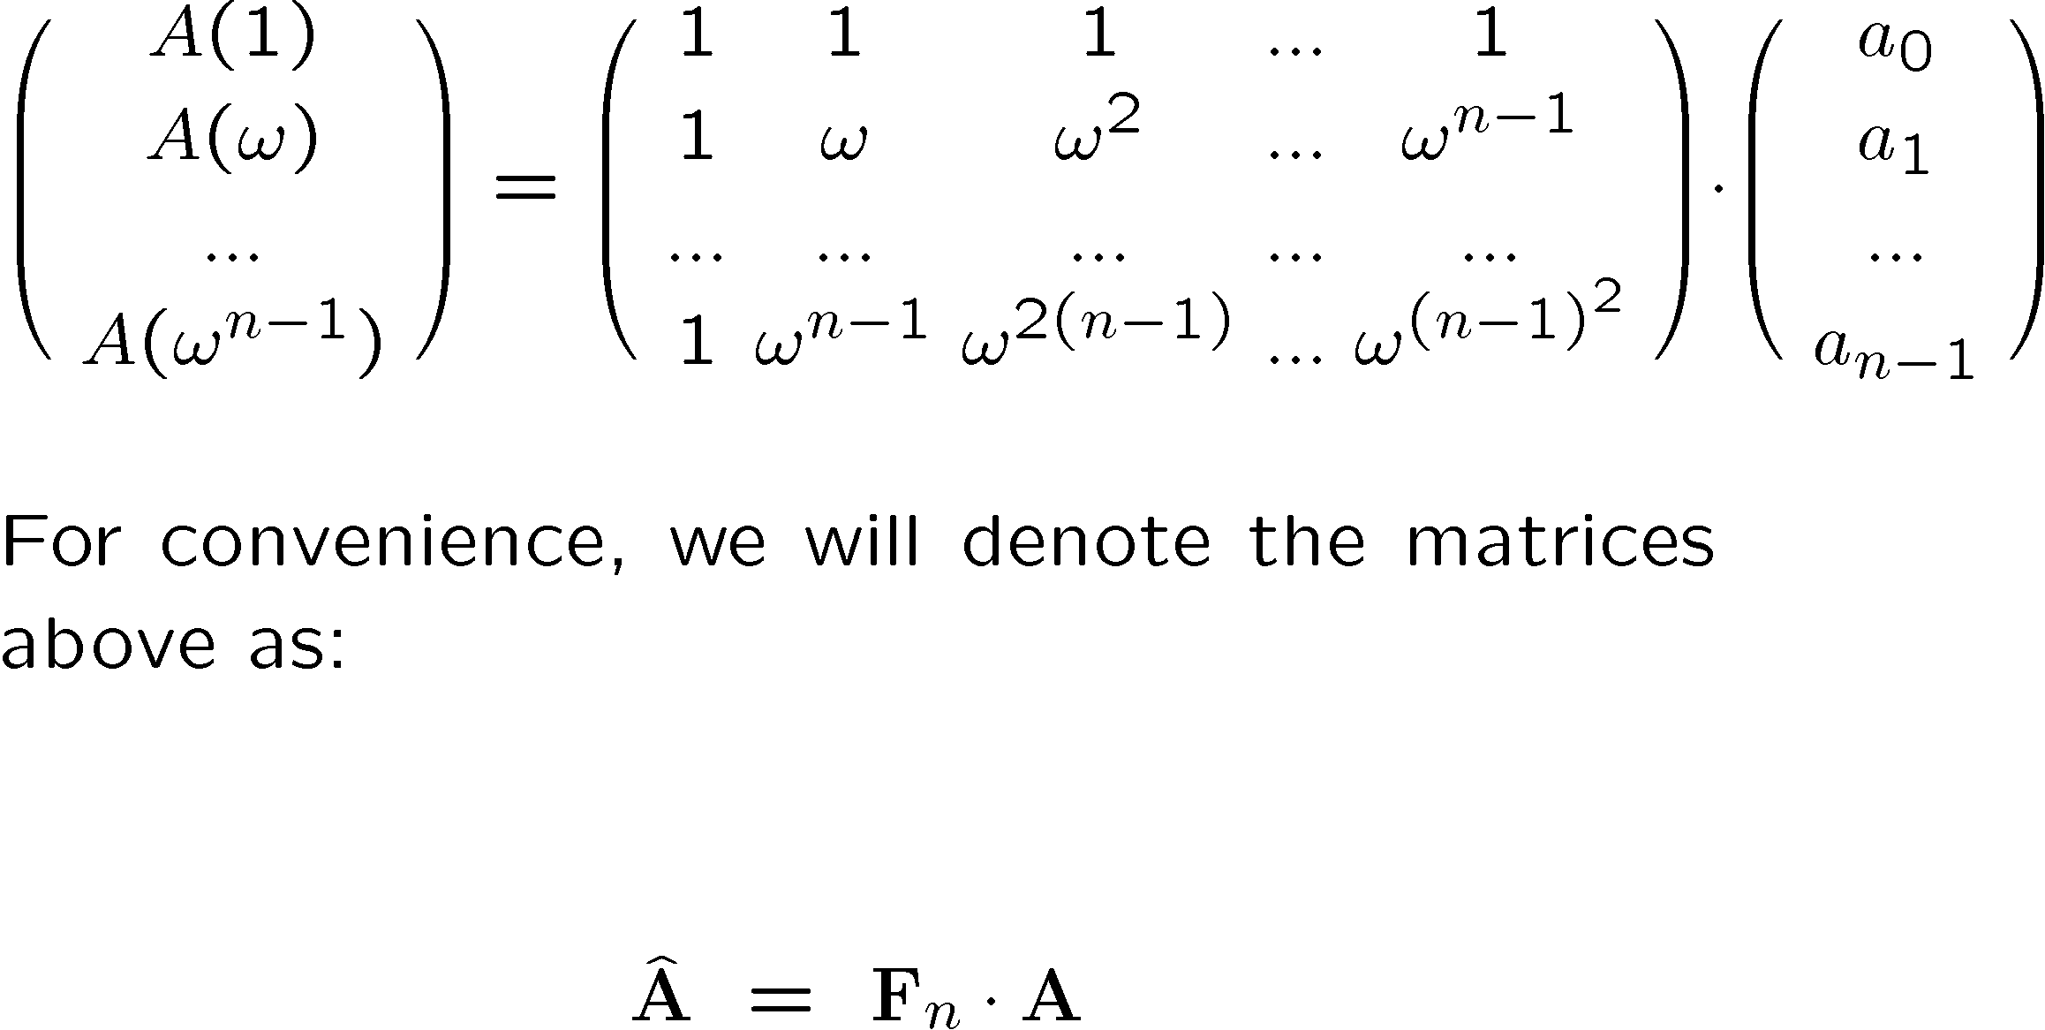
FT is “just” a matrix multiplication
for convenience we will denote it this way
stop here and understand this.

Slide 8
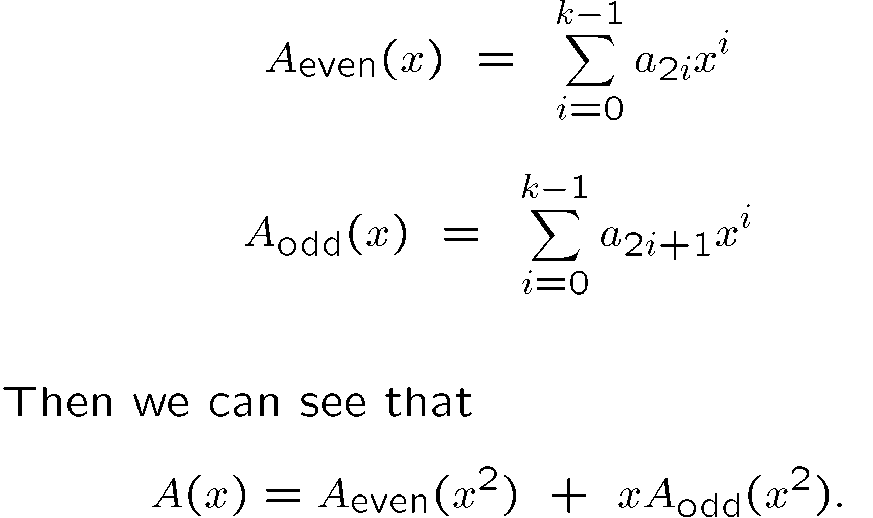
Computing
Let n be even = 2k.

Slide 9
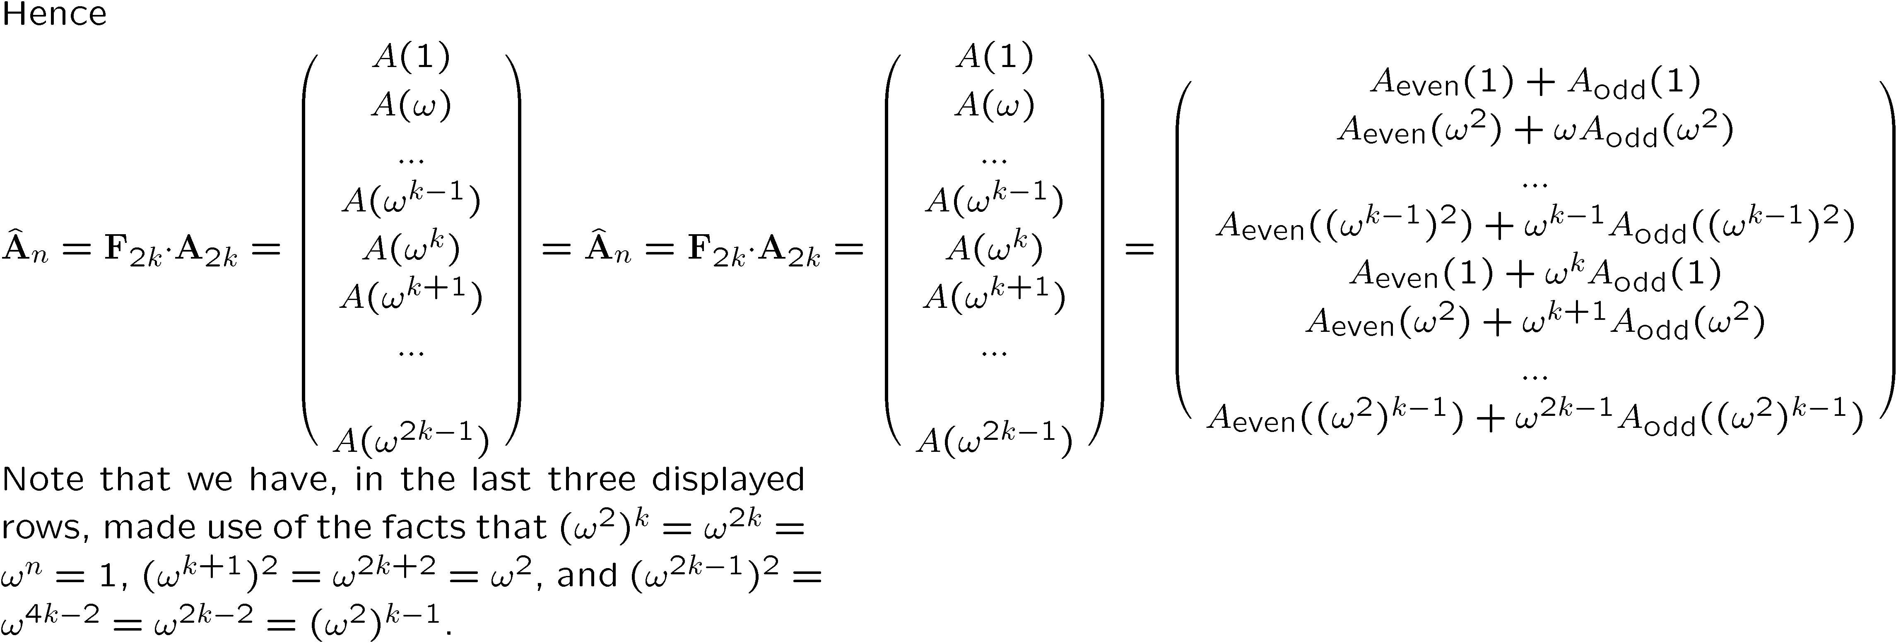
Computing

Slide 10
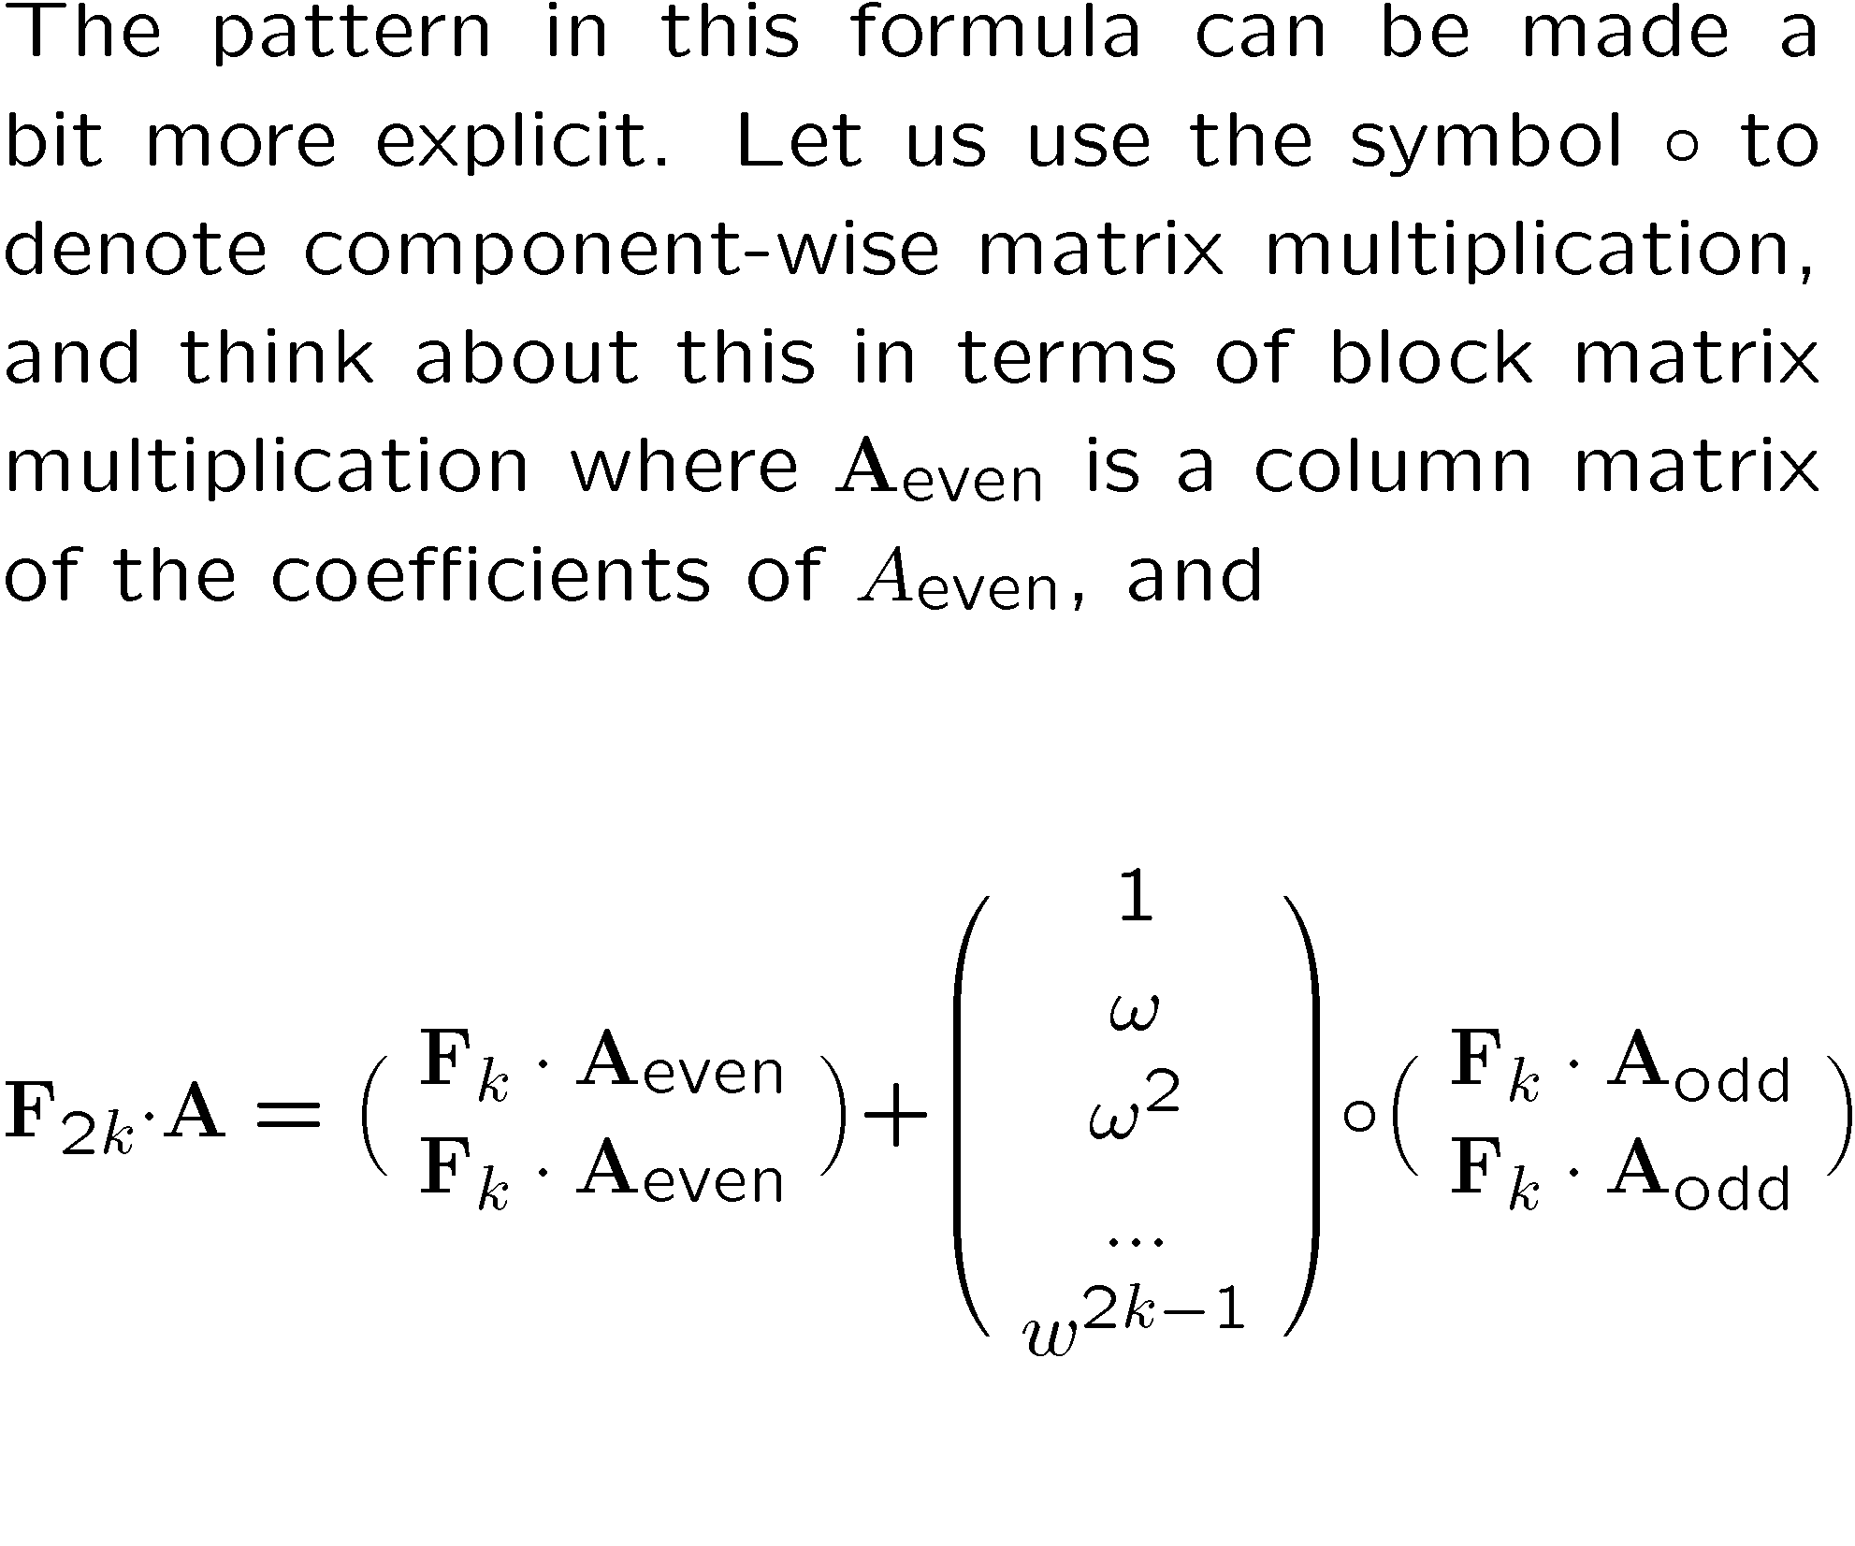
Computing
We have accomplished a 2k Fourier Transform with 2 size k Fourier Transforms plus some O(n) operations and powerings of ω (which can be precomputed).

Slide 11
How fast is this FFT?
A principal item of interest is the running time for the FFT. If the time to perform an FFT of size 2k is T(2k), then from our expression above,
T(2k)=2T(k)+O(k ).
Iterating this formula gives (where r=log₂ k):
T(2k)=2^{r} T(1) + O(rk)= O(n log n).
Thus this trick reduces the O(n²) algorithm (of n applications
of Horner's rule), to O(n log n) operations. This is a very good speedup, and was allegedly known by Gauss and others, until it was popularized by Cooley and Tukey.

Slide 12
We have to be able to invert the FFT = Interpolation!
That is, we are given a set of evaluation points (powers of a root of unity) and asked to provide a polynomial which assumes given values at those points.
The inverse of F_{n} is a matrix G_{n}
where the (i,j)^{th} element is ω_{n}^{-ij} /n,
where we have, somewhat unconventionally, numbered the rows and columns so that the 0,0 element is at the top left.

Slide 13
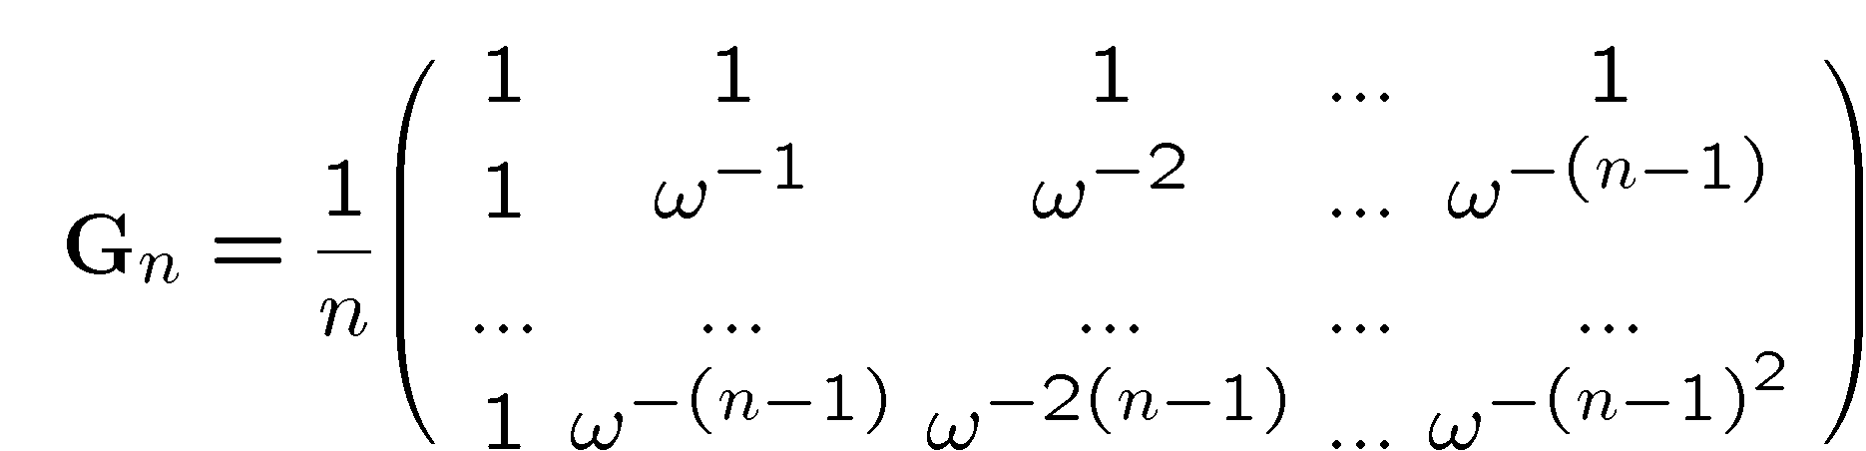
The Inverse of F_{n}
It looks rather like F_{n} with ω⁻¹ in place of ω, and with a 1/n out front. So whatever computation structure we have needs to allow us to compute 1/n, as well as have roots of unity we can use.

Slide 14
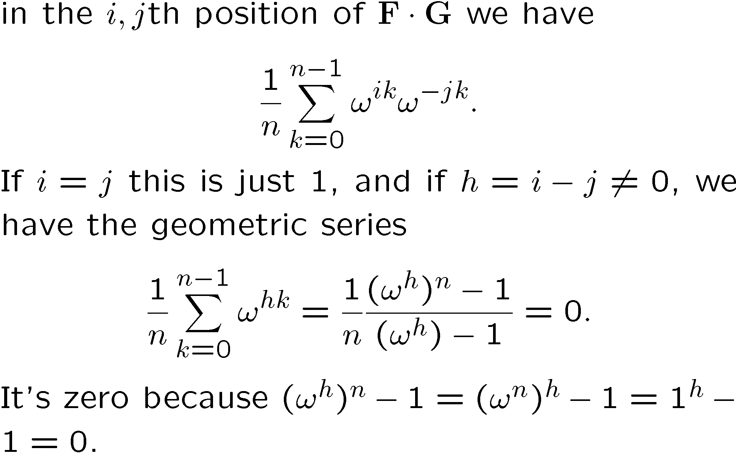
Proof that I = F_{n} G_{n}

Slide 15
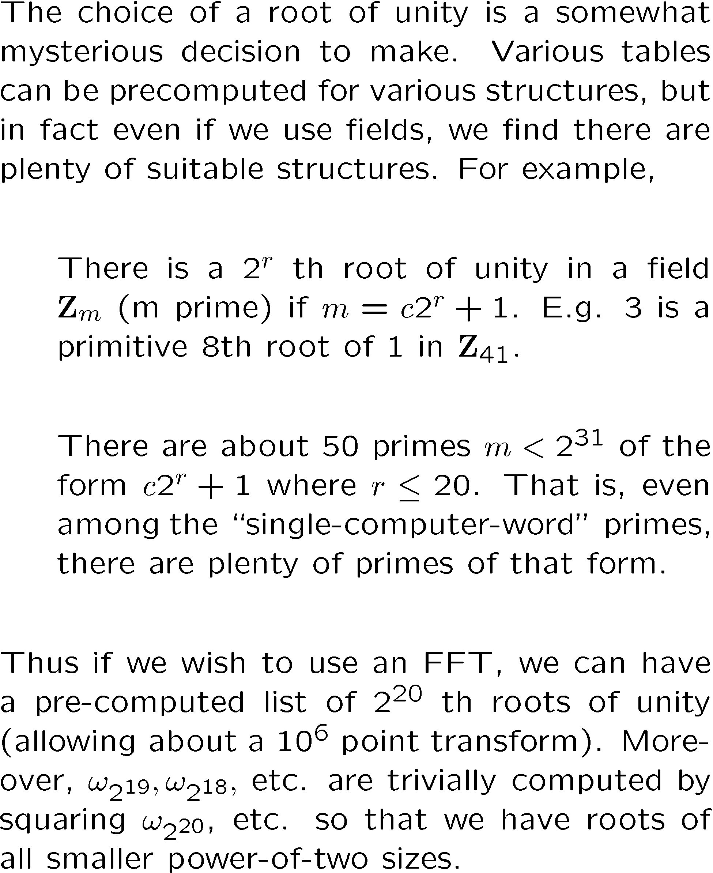
How hard is it to find primitive roots of unity? Not hard.

Slide 16
How many of these can we find?

Slide 17
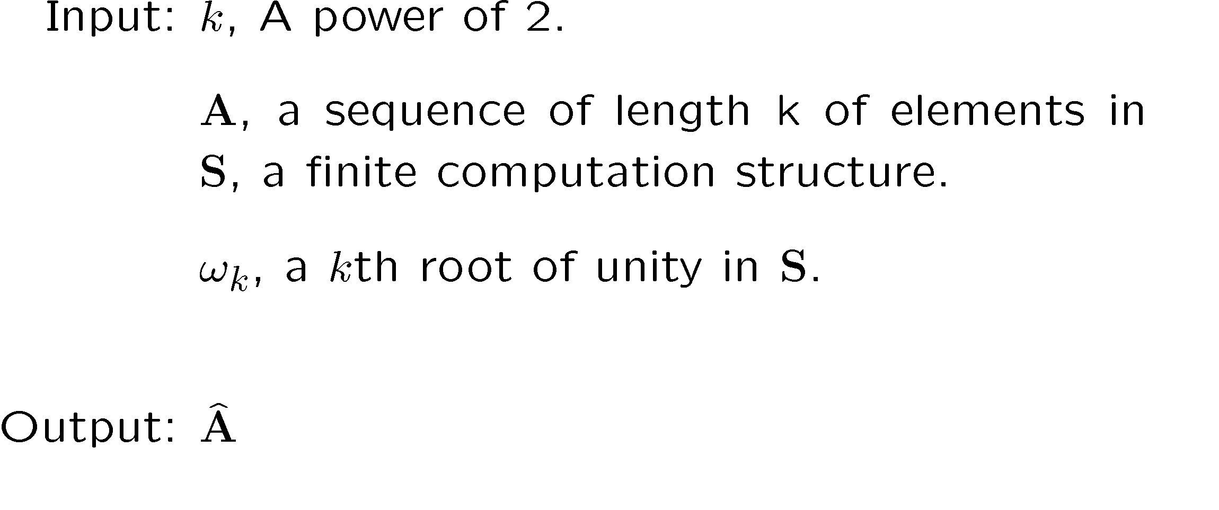
The algorithm, written simply, recursively

Slide 18
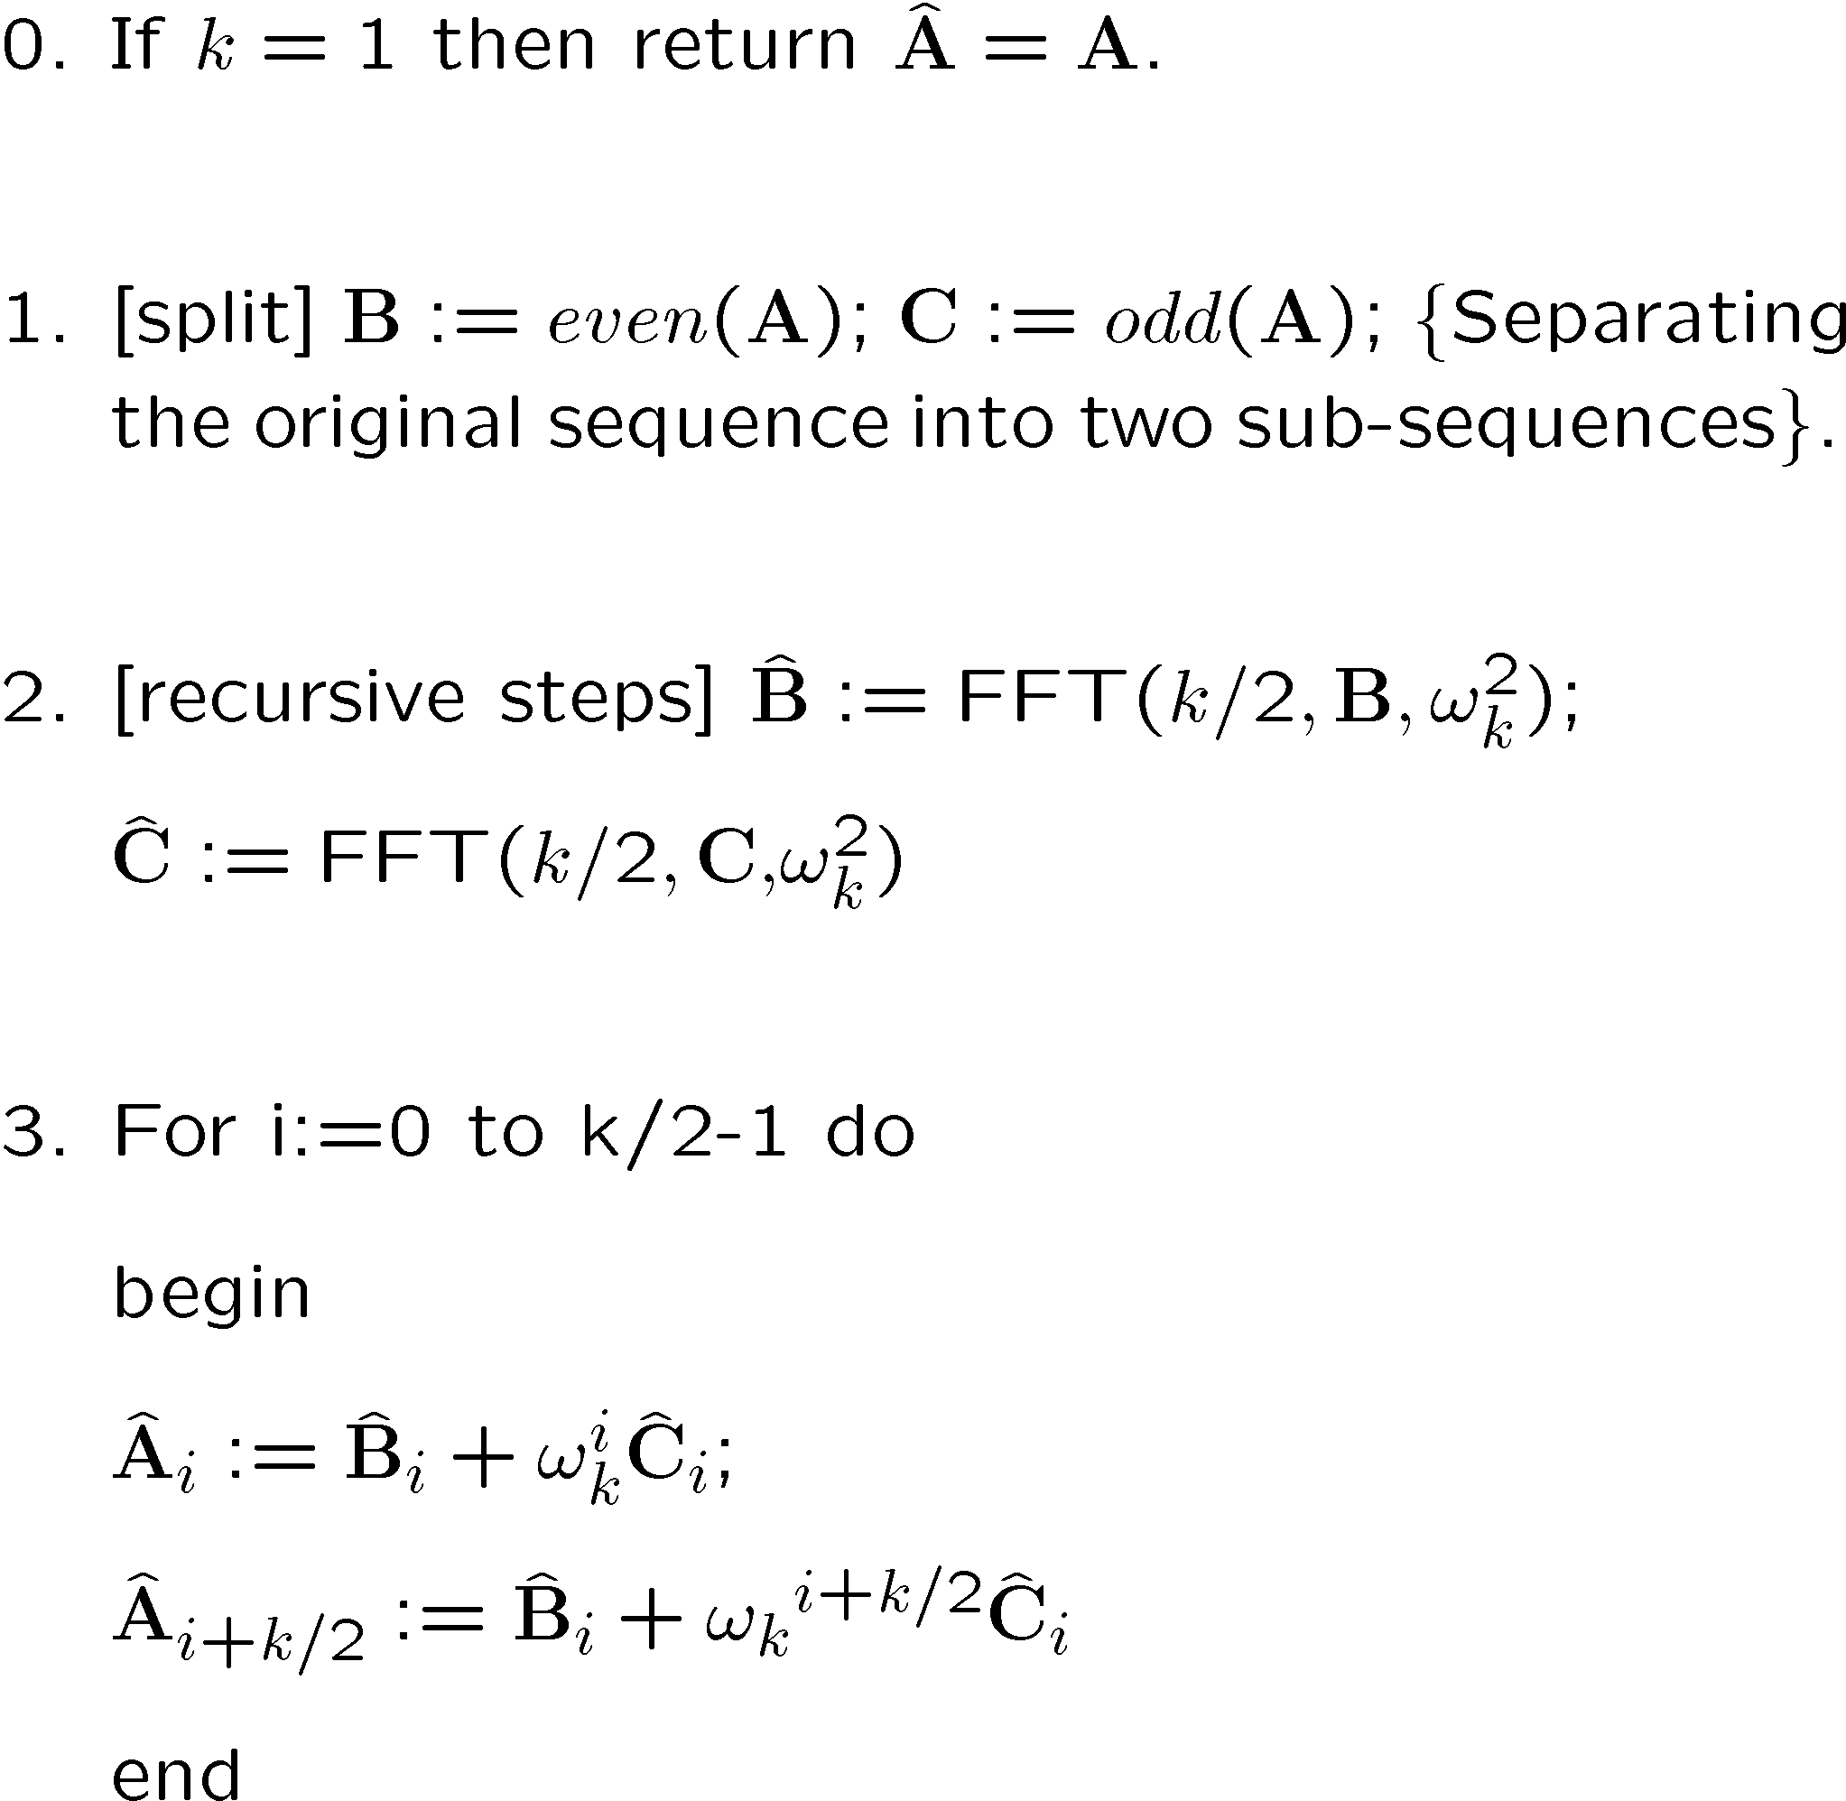
The insides:

Slide 19
Can the FFT be improved?
Basically, it continues to be a major industry to come up with improved designs, variations and implementations of the FFT.
http://www.fftw.org/
is the home page for the fastest FFT “in the West”.
Limitations that can be modified: power of 2, (vs power of 3 or product-of primes) in-place transforms, cache performance.

Slide 20
Since I usually badmouth asymptotic results, is this practical (e.g. for polynomials)?
Yes: Enough of the time that it has been implemented in a few systems.
No: It is not the default for any computer algebra system. Probably not fast enough for routinely-small routinely-sparse routinely many-variables. Coefficients must be bounded in some effective way.
Other techniques (e.g. Karatsuba) sometimes prevail.

Slide 21
Benchmark
One benchmark set up to favor FFTs suggest that computing f(x)² where f is a dense polynomial over a single-precision-size finite field, is best done by FFT only if deg(f)>96.
How favored?
(x+1)⁹⁶ has many “bignum” coefficients, so a real comparison might need 3 or 4 FFTs + CRA + bound computation.
For f(x) sparse, FFTs would do almost as much work, but the competition would not.

