Slide 1
Determinants
Lecture 11

Slide 2
Computing Determinants comes up frequently
Numerous calculations can be phrased as matrix determinant calculations
Eigenvalues
Resultants
Solution of linear systems
This doesn’t mean you SHOULD compute these by determinants necessarily...

Slide 3
Sparse Matrices
A numerical matrix of size n X m is sparse if it has k << mn non-zero terms.
A symbolic matrix could either be numerically sparse or could have many terms where each term is a sparse polynomial.
The most extreme sparse matrix in this second sense would be one in which each entry is a distinct term that combines with nothing else. e.g.

Slide 4
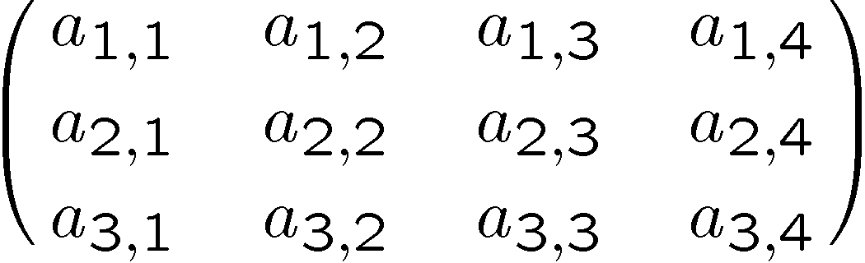
Sparse Matrices
A numerical matrix of size n X m is sparse if it has k << mn non-zero terms.
A symbolic matrix could either be numerically sparse or could have many terms where each term is a sparse polynomial.
The most extreme sparse matrix in this second sense would be one in which each entry is a distinct term that combines with nothing else. e.g. 3X4

Slide 5
How large is a sparse NxN determinant?
N! terms. Each term is size N.
For example, the generic 3x3 matrix has determinant a_{1,1}a_{2,2}a_{3,3}-a_{1,2}a_{2,1}a_{3,3}-a_{1,1}a_{2,3}a_{3,2}+a_{1,3}a_{2,1}a_{3,2}+a_{1,2}a_{2,3}a_{3,1}-a_{1,3}a_{2,2}a_{3,1}.
with, as expected, six terms

Slide 6
How large is a sparse NxN determinant?
and since we are using a computer to generate this, we can show you the 24 terms of the 4x4 determinant:
a_{1,1}a_{2,2}a_{3,3}a_{4,4}-a_{1,2}a_{2,1}a_{3,3}a_{4 ,4}-a_{1,1}a_{2,3}a_{3,2}a_{4,4}+a_{1,3}a_{2,1}a_{3,2}a_{4,4}+a_{1,2}a_{2,3}a_{3,1}a_{4,4}-a_{1,3}a_{2,2}a_{3,1} a_{4,4}-a_{1,1}a_{2,2}a_{3,4}a_{4,3}+a_{1,2}a_{2,1}a_{3,4}a_{4,3}+a_{1,1}a_{2,4}a_{3,2}a_{4,3}-a_{1,4}a_{2,1}a_{3,2}a_{4,3}-a_{1,2}a_{2,4}a_{3,1}a_{4,3}+a_{1,4}a_{2,2}a_{3,1}a_{4,3}+a_{1,1}a_{2,3}a_{3,4}a_{4,2}-a_{1,3}a_{2,1} a_{3,4}a_{4,2}-a_{1,1}a_{2,4}a_{3,3}a_{4,2}+a_{1,4}a_{2,1}a_{3,3}a_{4,2}+a_{1,3}a_{2,4}a_{3,1}a_{4,2}-a_{1,4}a_{2,3}a_{3,1}a_{4,2}-a_{1,2}a_{2,3}a_{3,4}a_{4,1}+a_{1,3}a_{2,2}a_{3,4}a_{4,1}+a_{1,2}a_{2,4}a_{3,3}a_{4,1}-a_{1,4} a_{2,2}a_{3,3}a_{4,1}-a_{1,3}a_{2,4}a_{3,2}a_{4,1}+a_{1,4}a_{2,3}a_{3,2}a_{4,1}
typeset kind of peculiarly, but not too bad.
This is actually a sum over all permutations of the indices X a coefficient which is the “sign” of the permutation
As happens with many facts about determinants, you should be able to prove that this determinant has N! terms a few different ways. Here’s another...

Slide 7
How large is a sparse NxN determinant?
Here are the 24 terms of the 4x4 determinant expanded in minors around the first row:
a_{1,1}(a_{2,2}(a_{3,3}a_{4,4}-a_{3,4}a_{4,3})-a_{2,3}(a_{3,2}a_{4,4}-a_{3,4}a_{4,2})+a_{2,4}(a_{3,2}a_{4,3}-a_{3,3}a_{4,2}))-a_{1,2}
(a_{2,1}(a_{3,3}a_{4,4}-a_{3,4}a_{4,3})-a_{2,3}(a_{3,1}a_{4,4}-a_{3,4}a_{4,1})+a_{2,4}(a_{3,1}a_{4,3}-a_{3,3}a_{4,1}))+a_{1,3}(a_{2,1}
(a_{3,2}a_{4,4}-a_{3,4}a_{4,2})-a_{2,2}(a_{3,1}a_{4,4}-a_{3,4}a_{4,1})+a_{2,4}(a_{3,1}a_{4,2}-a_{3,2}a_{4,1}))-a_{1,4}(a_{2,1}(a_{3,2}a_{4,3}-a_{3,3}a_{4,2})-a_{2,2}(a_{3,1}a_{4,3}-a_{3,3}a_{4,1})+a_{2,3}(a_{3,1}a_{4,2}-a_{3,2}a_{4,1}))
Which also gives us another proof there are N! terms.
Looking around for on-line summaries of the many useful and elementary properties of the determinant, I found this:
http://mathworld.wolfram.com/Determinant.html

Slide 8
N*N! vs O(1).
The size of any numerical (floating point) determinant of any size is a constant (one fp number).
Are there intermediate positions and complexities? How best to compute symbolic determinants? Note that SOME symbolic determinants will be small (even zero!)
One of my favorite papers is
M. Gentleman and S. Johnson,
Analysis of Algorithms, A Case Study: Determinants of Matrices with Polynomial Entries
ACM Transactions on Mathematical Software (TOMS)
Volume 2 , Issue 3 (September 1976)
[DOI] http://doi.acm.org/10.1145/355694.355696
gentleman.pdf

Slide 9
Two models
All elements distinct symbols (the model already discussed).
All elements are univariate polynomials dense to the same degree.

Slide 10
Two distinct algorithms: Gaussian elimination
The Gaussian elimination method, using exact division, is appropriate for computations over the integers; If we ignore pivoting, the algorithm consists of n -1 steps, indexed by a variable k running from 1 to n - 1. The k^{th} step involves the computation of an n -k +1 by n -k +1 matrix, which we shall call A^{(k+l)}; the entries will be denoted a_{ij}^{(k+1)} with k · i, j · n. The original matrix is identified with A⁽¹⁾.
For each k, the entry a_{ij}^{(k+1)} is computed by the formula
a_{ij}^{(k+1)} = (a_{kk}^{(k)} a_{ij}^{(k)} - a_{ik}^{(k)} a_{kj}^{(k)} )/a_{k-1,k-1}^{(k-1)}
for k +l · i, j · n, where A⁽⁰⁾ is taken to be 1. The division is always exact, so each a_{ij}^{k} is a polynomial and a_{nn}^{(n)} is the determinant of A^{(n)}

Slide 11
Cost of Gaussian elimination / I
An analysis of this algorithm shows that each a^{(k)} is a determinant (minor) of some k-by-k submatrix of the original matrix. Since we assumed all entries in the original matrix to be of the same size, we may expect that all elements in A ^{(k)}, for a given i, are the same size.

Slide 12
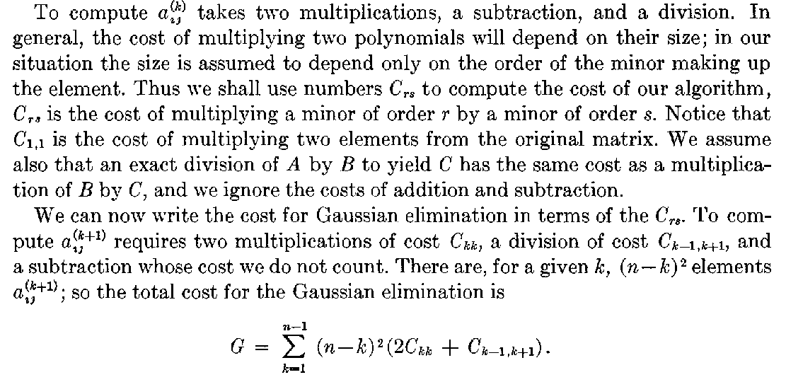
Cost of Gaussian elimination / II

Slide 13
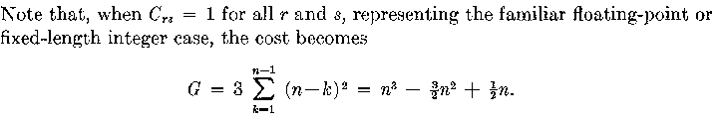
Cost of Gaussian elimination / II

Slide 14
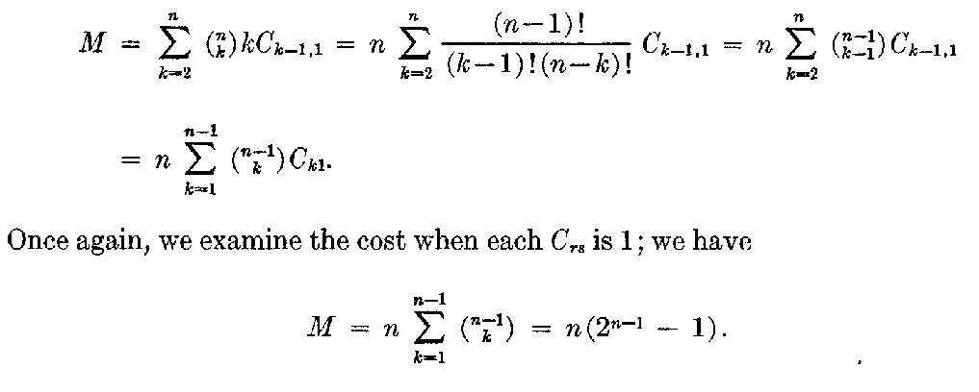
Cost of Expansion by Minors
this goes a long way toward explaining why numerical analysts don’t do this.

