Slide 1
Algebraic Simplification
Lecture 12

Slide 2
Simplification is fundamental to mathematics
Numerous calculations can be phrased as “simplify this command”
The notion, informally, is “find something equivalent but easier to comprehend or use.”
Note the two informal portions of this:
EQUIVALENT
EASIER

Slide 3
References
J. Moses: Simplification, a guide for the Perplexed, CACM Aug 1971.
B. Buchberger, R. Loos, Algebraic Simplification in Computer Algebra: Symbolic and Algebraic Computation, (ed: Buchberger, Collins, Loos). Springer-Verlag p11-43. (142 refs)

Slide 4
Trying to be rigorous, let T be a class of expressions
We could define this by some grammar, e.g.
E → n | v
d → 1|2|3|4|5|6|7|8|9 ;;nonzero digit
n → d | 0 | dn
E → E+E | E*E | E^E | E-E| E/E | (E) | Σ E ...
v → x | y | z ….
etc.

Slide 5
Define an equivalence relation on T, say ~
x+x ~ 2*x ;; functional equivalence
true ~ not(false) ;; logical constant equivalence
(consp a) ~ (equal a(cons (car a)(cdr a)))
etc etc etc

Slide 6
Define an ordering
R ≺ S if R is simpler than S.
For example, R is expressible in fewer symbols, or if it has the same number of symbols, is alphabetically lower.

Slide 7
Find an algorithm K
For every t in T, K(t) ~ t
that is, it maintains equivalence.
K(t) < t or K(t) = t
that is, running K either produces a simpler result or leaves t unchanged.

Slide 8
If you have a zero-equivalence algorithm Z
For every t in T, Z(t) returns true iff t~0
You can make a simplification algorithm if T allows for subtraction.
Enumerate all expressions e₁, e₂, ... in dictionary order up to t. The first one encountered such that Z(e_{i} –t) tells us that e_{i} is the simplest expression for t.
This is a really bad algorithm. In addition to the obvious inefficiency, consider that integers need not be simplest “themselves”. 2^20 vs 1048576. Which has fewer characters?

Slide 9
We’d prefer some kind of “canonicalization”
That is, K(t) has some kind of nice properties.
K(t)=0 if Z(t). That is, everything equivalent to zero simplifies to zero.
K(<polynomial>) is a polynomial in some standard form, e.g. expanded, terms sorted.
K(t) is usually small ... is a concise description of the expression t
(Maybe “smallest” ideal member)

Slide 10
We’d prefer some kind of valuation
That is, every expression in T can be evaluated at a point in n-space to get a real or complex number. Expressions equivalent to 0 will evaluate to 0.
Floating-point evaluation does not work perfectly: This may not be 0: 4 arctan(1)-π
Evaluation in a finite field has no roundoff BUT how does one evaluate sin(x), x 2 Z_{p}?
(W. Martin, G. Gonnet, Oldehoeft)

Slide 11
Sometimes simplest seems rather arbitrary
We generally agree that ∑^{k}_{i=1} f(i) – ∑^{k}_{j=1} f(j) = 0, assuming i, j do not occur “free” in f.
But what is the simplest form of the sum ∑^{k}_{i=1}f(i)? Do we use i, j, or some “simplest” index? And if both are simplest, why are they not identical?
The same problem occurs in integrals, functions (λ-bound parameters), logical statements 8 x ... etc.

Slide 12
Sometimes we encounter an attempt to formalize the notion: “Regular” simplifiers
Consider rational expressions whose components are not indeterminates, but algebraically independent objects.
Easy to detect 0.
Not necessarily canonical:
y:= sqrt(x^2-1).. leave this alone or transform to w*z = sqrt(x-1)*sqrt(x+1) ?
(e.g. in Macsyma, ratsimp, radcan commands)
(studied by Caviness, Brown, Moses, Fateman)

Slide 13
What basis to use for expressing as polynomial sub-parts?
A similar problem is....
y:= sqrt(e^{x}-1).. leave this alone or transform to w*z =
sqrt(e^{x/2}-1)*sqrt(e^{x/2}+1)?
Consider integration of sqrt(e^{x}-1)/sqrt(e^{x/2}-1), which is the same as integrating sqrt(e^{x/2}+1). The latter is integrated by Macsyma to
4 * sqrt(e^{x/2} + 1) - 2 * log(sqrt(e^{x/2} + 1) + 1) + 2 * log(sqrt(e^{x/2} + 1) - 1)

Slide 14
Leads to studies of various cases
Algebraic extensions, minimal polynomials (classical algebra)
Radical expressions and nested radical simplifications (R. Zippel, S. Landau, D. Kozen)
Differential field simplification can get even more complicated than we have shown,
e.g. exp(1/(x²-1)) / exp(1/(x-1)) . This requires partial fraction expansion of exponents. And then what about exp(1/(exp(x)-1))?

Slide 15
Simplification subject to side conditions
f := s⁶+3c²s⁴+3c⁴s²+c⁶ with s²+c² = 1. This should be reduced to 1, since it is (s²+c²)³. (think of sin²x +cos²x=1 with s=sin x c=cos x)
How to do this with
many side conditions
large expressions
deterministically, converging
expressions like f+s⁷ which could be either s⁷ + 1 or (-c⁶+3c⁴-3c²+1)s+1 which is arguably of lower complexity (if s c)

Slide 16
Rationalizing the denominator
2/sqrt(2) -> sqrt(2), but
1/(x ^{1/2}+z^{1/4} + y^{1/3} )
“simplifies” to
(((z^{1/4})³ + ( - y^{1/3} - sqrt(x))(z^{1/4})² + ((y^{1/3})² + 2sqrt(x)y^{1/3} + x)z^{1/4} - y - 3sqrt(x) (y^{1/3})² - 3xy^{1/3} - sqrt(x) x)
/
(z + ( - y^{1/3} - 4sqrt(x))y - 6x(y^{1/3})² - sqrt(x)xy^{1/3} - x²))
Notes:
$$ ((\left(\root 4 \of(z)\right)^(3)+\left(-\root 3 \of(y)-\sqrt(x)%
\right)\,\left(\root 4 \of(z)\right)^(2)+\left(\left(\root 3 \of(y)%
\right)^(2)+2\,\sqrt(x)\,\root 3 \of(y)+x\right)\,\root 4 \of(z)-y-3%
\,\sqrt(x)\,\left(\root 3 \of(y)\right)^(2)-3\,x\,\root 3 \of(y)-%
\sqrt(x)\,x)\over(z+\left(-\root 3 \of(y)-4\,\sqrt(x)\right)\,y-6\,x%
\,\left(\root 3 \of(y)\right)^(2)-4\,\sqrt(x)\,x\,\root 3 \of(y)-x^(%
2))) $$

Slide 17
Simplification subject to side conditions
Solved heuristically by division with remainder, substitutions
e.g. divide f by s²+c²-1:
f = g*(s²+c²-1)+h = g*0+h = h.
Solved definitively by Gröbner basis reduction
(more discussion later).

Slide 18
Still trying to be rigorous. Simplification is undecidable.
t~0 is undecidable for T defined by R1:
one variable x
constants for rationals and π
+, *, sin, abs and composition.
.. Daniel Richardson, "Some Unsolvable Problems Involving Elementary Functions of a Real Variable." J. Symbolic Logic 33, 514-520, 1968.
(We will go over a version of this, a reduction to Hilbert’s 10th problem. )

Slide 19
Still trying to be rigorous (cf. Brown’s REX)
Let Q be the rational numbers.
If B is a set of complex numbers and z is complex, we say that z is algebraically dependent on B if there is a polynomial
p(t)=a_{d}t^{d}+...+a₀ in Q[B][t] with a_{d} ≠ 0 and p(z)=0.
If S is a set of complex numbers, a transcendence basis for S is a subset B such that no number in B is algebraically dependent on the rest of B and such that every number in S is algebraically dependent on B.
The transcendence rank of a set S of complex numbers is the cardinality of a transcendence basis B for S. (It can be shown that all transcendence bases for S have the same cardinality.)

Slide 20
Simplification of subsets of R1 may be merely difficult
Schanuel’s conjecture: If z₁, ..., z_{n} are complex numbers which are linearly independent over Q then (z₁, ..., z_{n}, exp(z₁),...exp(z_{n})) has transcendence rank at least n.
It is generally believed that this conjecture is true, but that it would be extremely hard to prove. Even though this is known...
Lindemann’s thm: If z₁, ..., z_{n} are complex numbers which are linearly independent over Q then (exp(z₁),...exp(z_{n})) are algebraically independent.

Slide 21
What we don’t know
Note that we do not even know if e+π is rational. From Lindemann we know that exp(x), exp(x²), ... are algebraically independent, and so a polynomial in these forms can be put into a canonical form.
More material at D. Richardson’s web site
http://www.bath.ac.uk/~masdr/

Slide 22
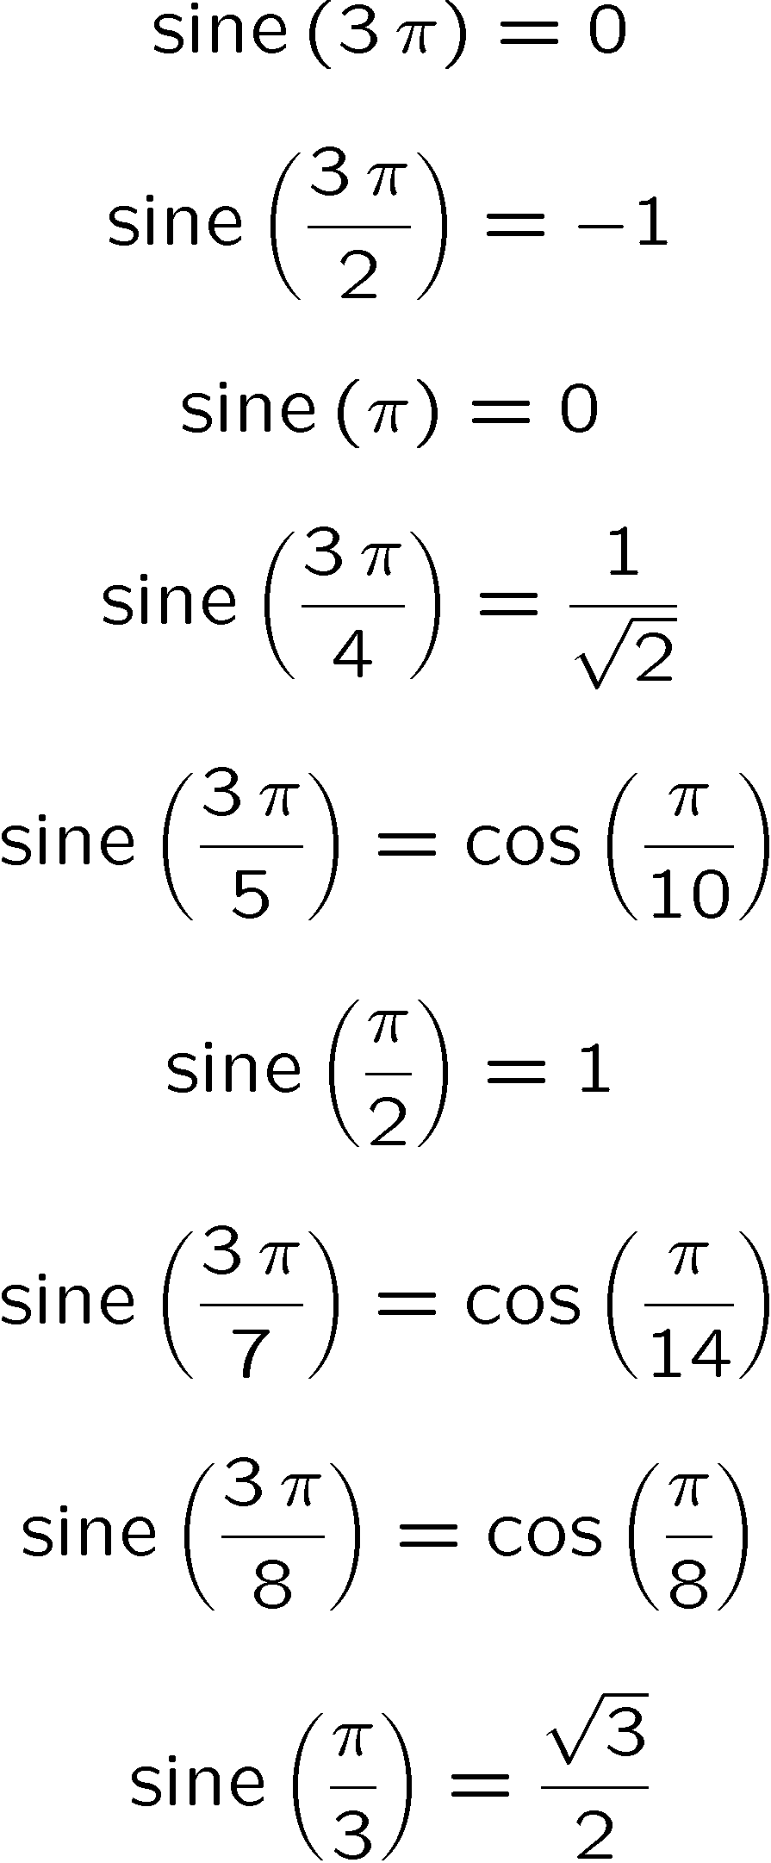
What about sin, cos?
Periodic real functions with algebraic relations
sin(π/12) = ¼ (sqrt(6)-sqrt(2))
etc

Slide 23
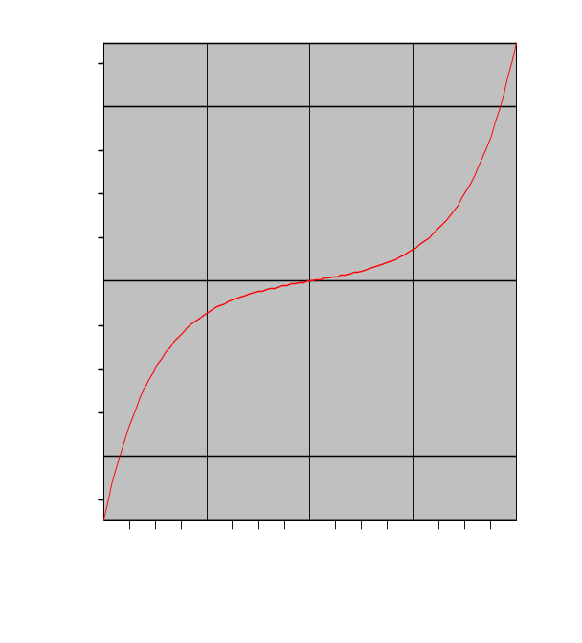
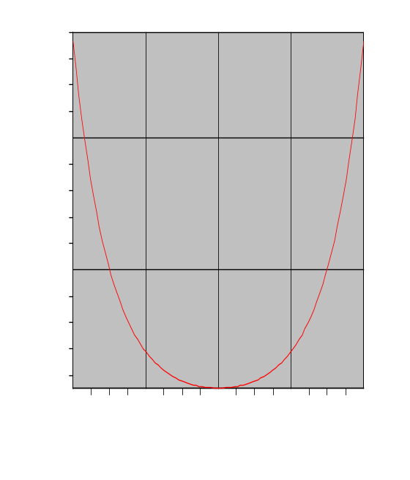
What about sin(complex)?
sin(a+b*i)= i cos(a)sinh(b)+sin(a)cosh(b)
etc
sinh(x) cosh(x)

Slide 24
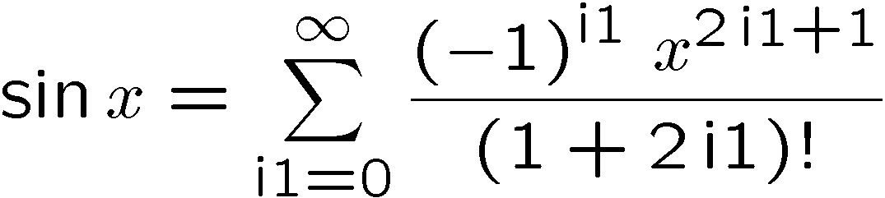
What about sin(something else)?
Consider sin series as a DEFINITION
implications for e.g. matrix calculations

Slide 25
What about arcsin, arccos
arcsin(¼ (sqrt(6)-sqrt(2))) = π/12
arcsin(sin(x)) is not x, necessarily
arcsin(sin(0)) = arcsin(0) = 0
arcsin(sin(π)) = arcsin(0) = 0
arctan(tan(4)) is not 4, but 4-π = .85842..

Slide 26
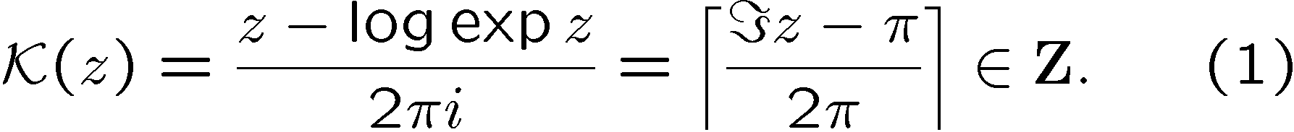
What about exponential and log?
Log(exp(x)) is not the same as x, but is x reduced modulo 2π i. Difference between log and Log? (principal value?)
Exp(log(x)) is x
One recent proposal (Corless) introduces the “unwinding number” K
log(1/x) = -log(x)-2π i K (-log(x))

Slide 27
What about other multi-branched identities?
arctan(x)+arctan(y)=arctan((x+y)/(1-xy)) +πK(arctan(x)+arctan(y))
However, not all functions have such a simple structure (The Lambert-W function)
z=w*exp(w) has solution w=lambert(z), whose branches do not differ by 2π i or any constant.

Slide 28
There are unhappy consequences like..
arctan(x)+arctan(y)=arctan((x+y)/(1-xy)) +πK(arctan(x)+arctan(y))
therefore arctan(x)-arctan(x) might reasonably be a set, namely {nπ | n 2 Z}. Where does this lead us??

Slide 29
Even if we nail down exponential and log what happens next?
Is sqrt(x) the same as exp( ½ log(x)) ? Probably not.
Is there a way around multiple values of algebraic numbers or functions?
let sqrt(x)  {y | y² = x}
thus sqrt(9) = {3, -3}
Or would it be better to say that sqrt(9) is “some root of” p(r) = r^2-9 = 0?

Slide 30
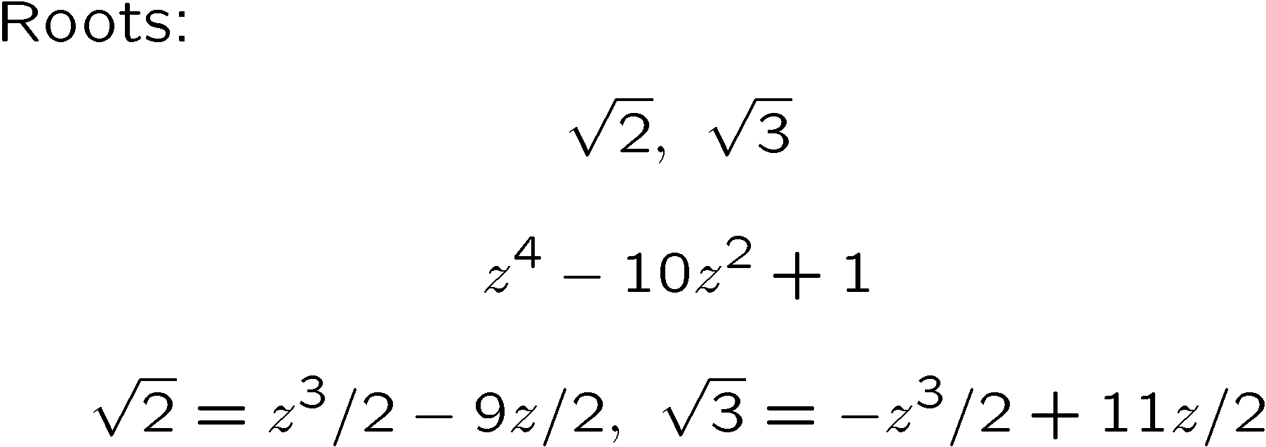
Radicals (surds): Finding a primitive element
Functions of sqrt(2), sqrt(3)...

Slide 31
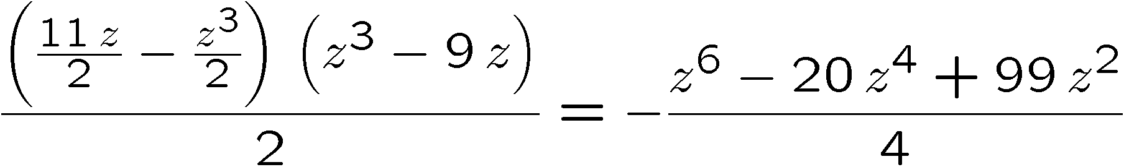
Using primitive element
sqrt(2)* sqrt(3) is
modulo the defining polynomial z⁴-10z+1 this is (z²-5)/2 .
Squaring again gives (z⁴-10z²+25)/4, which reduces to 6. So sqrt(2)*sqrt(3) is sqrt(6).
Tada.

Slide 32
Macsyma allow us to factor, this way..
(C1) factor(x²-3, z⁴-10*z²+1);
(D1) (( - z³ + 11z + 2x) * (z³ - 11 z + 2x)/4)
(C2) tellrat(z⁴-10*z²+1);
(D2) x²-3

Slide 33
This is really treating algebraic numbers as sets
Just about the only way to “get rid of” sqrt(s) is to square it and get s.
If we could distinguish the roots {r₁,r₂} such that r_{i}²=s, then r₁+r₂=0, also.
Any other transformation is algebraically dangerous, even if it is tempting.
Programs sometimes provide:
sqrt(x)*sqrt(y) vs. sqrt(x*y)
sqrt(x²) vs. x or abs(x) or sign(x)*x
However sqrt(1-z)*sqrt(1+z)=sqrt(1-z²) IS TRUE
How to prove this?? (Monodromy Thm)

Slide 34
Moses’ characterization of politics of simplification
Radical
Conservative
Liberal
New Left
catholic (= eclectic)
<discuss Moses’ CACM article>

Slide 35
Richardson’s undecidability problem
We start with the unsolvability of Hilbert’s 10 problem, proved by Matiyasevic in 1970.
Thm: There exists a set of polynomials over the integers P ={P(x₁, ....,x_{n})} such that over all P in P the predicate “there exists non-negative integers a₁, ...,a_{n} such that P(a₁,...,a_{n})=0” is recursively undecidable.”
(proof: see e.g. Martin Davis, AMM 1973,)

Slide 36
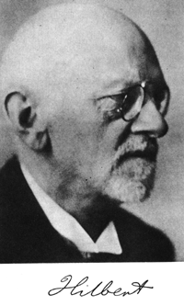
David Hilbert, 1900
http://aleph0.clarku.edu/~djoyce/hilbert/
“Hilbert's address of 1900 to the International Congress of Mathematicians in Paris is perhaps the most influential speech ever given to mathematicians, given by a mathematician, or given about mathematics. In it, Hilbert outlined 23 major mathematical problems to be studied in the coming century.”
I guess mathematicians should be given some leeway here...

Slide 37
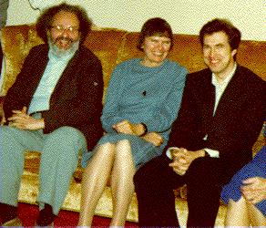
Martin Davis, Julia Robinson, Yuri Matiyasevich

Slide 38
Reductions we need:
Richardson requires only one variable x, Hilbert’s 10th problem requires n (3, perhaps?)
Richardson is talking about continuous everywhere defined functions, the Diophantine problem is INTEGERS.

Slide 39
From many vars to one
Notation, for f: R→R by f⁽⁰⁾(x) we mean x, and by f^{(i+1)}(x) we mean f(f^{(i)}(x) ) for all i¸ 0.
Lemma 1: Let h(x)=x sin(x) and g(x)=x sin(x³).
Then for any real a₁, ...,a_{n} and any 0 < ε < 1, 9 b such that 8 (1 · k· n), |h(g^{(k-1)}(b))-a_{k}| < ε

Slide 40
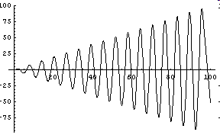
From many vars to one
Sketch of proof. (by induction).. Given any 2 numbers a₁ and a₂, there exists b>0 such that |h(b)-a₁|<ε and g(b)=a₂ Look at the graph of y=h(x):=x*sin(x). It goes arbitrarily close to any value of y arbitrarily many times.

Slide 41
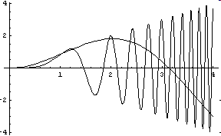
From many vars to one
Look at the graph of g(x) as well as h(x). We look closer ... Every time h(x), the slow moving curve, goes near some value, g(x) goes near it many more times.

Slide 42
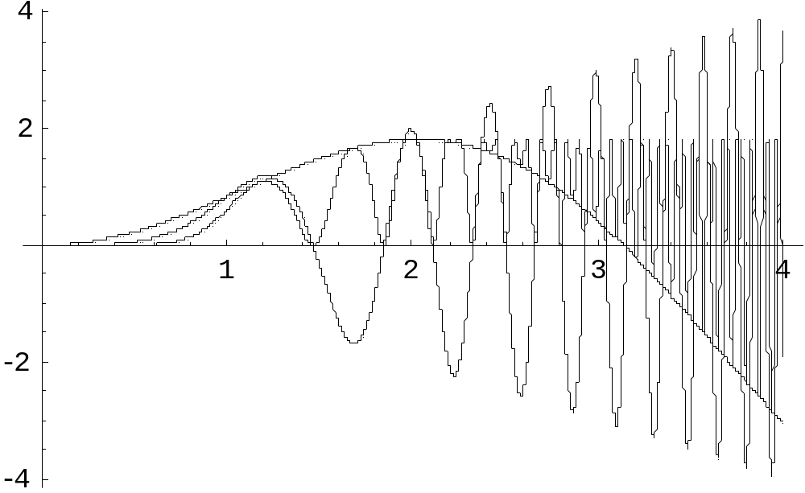
h(x), g(x), h(g(x))
All plotted together

Slide 43
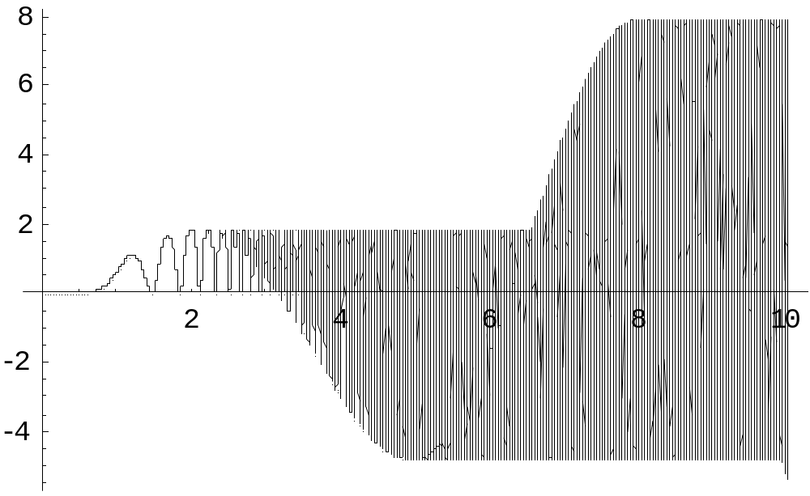
h(g(x)), alone, out to 10
Actually, the picture, at this resolution, should fill in completely after about 4.
The (Mathematica) plotting program shows “beats” at its sample rate.

Slide 44
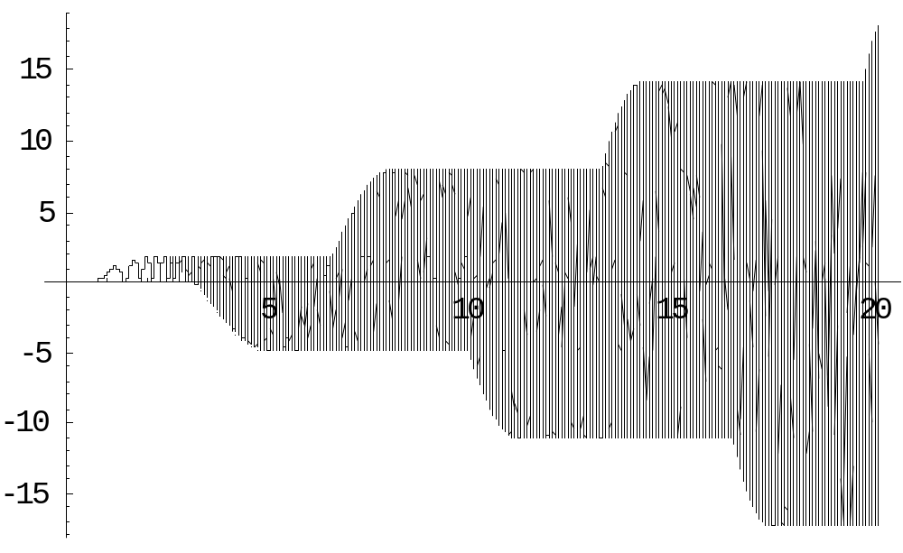
h(g(x)), alone, out to 20
Actually, the picture, at this resolution, should fill in completely after about 4.
The (Mathematica) plotting program shows “beats” at its sample rate.

Slide 45
Now suppose Lemma 1 is true for n.
That is, 9 b’ such that |h(b’)-a₂| < ε, |h(g(b’))-a₃| < ε ... |h(g^{(n-1)}(b’))-a₃| < ε . Hence 9 b>0 such that |h(b)-a₁|< ε and g(b) = b’. Therefore the result holds for n+1. QED
Why are we doing this? We wish to show that any finite collection of n real numbers can be encoded “close enough for any practical purpose” in one real number by using functions x*sin(x) and x*sin(x³). This is not the only way to do this, but Richardson wanted a simple encoding. Interleaving decimal digits would be another way, but messier. Henceforth we assume we can encode any set of reals b= {b₁,...,b_{n}} into a single real number.

Slide 46
Next step: dominating functions.
F(x₁,...,x_{n}) 2 R is dominated by G(x₁,...,x_{n}) 2 R if for all real x₁, ...,x_{n}
G (x₁,...,x_{n}) >1
For all real Δ₁, ...,Δ_{n} such that |Δ_{i}|<1, G(x₁,...,x_{n}) > F(x₁+Δ₁, ...,x_{n}+Δ_{n})
Lemma 2: For any F 2 R there is a dominating function G.
Proof (by induction on the number of operators in G).

Slide 47
Proof of Lemma 2: dominating functions.
Lemma 2: For any F 2 R there is a dominating function G.
Proof (by induction on the number of operators in G).
If F=f₁+f₂, let G=g₁²+g₂²+2.
If F= f₁*f₂, let G=(g₁²+2)*(g₂²+2).
If F=x , let G=x²+2.
If F=sin(x), let G=2.
If F = c, a constant, let G= c²+2

Slide 48
The theorem
Theorem: For each P 2 P there exists F 2 R such that (i) there exists an n-tuple of nonnegative integers A= (a₁, ...,a_{n}) such that P(A)=0 iff (ii) there exists an n-tuple of nonnegative real numbers B=(b₁, ...,b_{n}) such that F(B)<0.
(note: (i) is Hilbert’s 10th problem, undecidable)

Slide 49
How we do this.
We need to find only those real solutions of F which are integer solutions of P.
Note that sin²(π x_{i}) will be zero only if x_{i} is an integer. We can use this to force Richardson’s continuous x_{i} to happen to fall on integers a_{i}!

Slide 50
Proof, (i) → (ii)
Consider P 2 P, (i) →(ii): for 1 · i · n, let K_{i} be a dominating function for ∂/∂ x_{i} (P²). Note that for 1 · i · n, K_{i} 2 P.
Let
F(x₁,...,x_{n})=(n+1)²{P²(x₁,...,x_{n})+
∑_{1 · i · n}sin²(πx_{i})*K_{i}² (x₁,...,x_{n})} -1
Now suppose A=(a₁,...,a_{n}) is such that P(A)=0. Then F(A)=-1. So (i)→(ii).

Slide 51
Proof, continued (ii) → (i)
Still, let
F(x₁,...,x_{n})=(n+1)²{P²(x₁,...,x_{n})+
∑_{1 · i · n}sin²(πx_{i})*K_{i}² (x₁,...,x_{n})} -1
Now suppose B=(b₁,...,b_{n}), a vector of non-negative real numbers is such that F(B)<0. Choose a_{i} to be the smallest integer such that |a_{i}-b_{i}| · ½ . We will show that P^2(A)<1 which implies P(A)=0 since P assumes only integer values. F(B)<0 implies that...

Slide 52
Proof, continued (ii) → (i), F(b)<0
F(B)<0 means
(n+1)²{P²(B)+ ∑_{1 · i · n}sin²(πb_{i})*K_{i}² (B)} –1 <0
or
P²(B)+ ∑_{1 · i · n}sin²(πb_{i})*K_{i}² (B) <1/(n+1)²
Since each of the factors in the sum on the left is non-negative, we have that each of the summands is individually less than 1/(n+1)² which is itself < 1/(n+1). In particular, P²(B)+ <1/(n+1)² < 1/(n+1)
and also for each i, |sin(π b_{i})*K_{i}(B)| < 1/(n+1)

Slide 53
Proof, continued (ii) → (i)
By the n-dimensional mean value theorem of calculus,
P²(A) = P²(B)+ ∑_{1 · i · n} | a_{i}-b_{i}| ∂/∂ x_{i} P²(c₁,...,c_{n})
for some set of c_{i} where min(a_{i},b_{i}) · c_{i} · max(a_{i},b_{i}).
Since K_{i} is a dominating function for ∂/∂x_{i}P²(x₁,...,x_{n}) for each i,
P²(A) < P²(B)+ ∑_{1 · i · n} | a_{i}-b_{i}|K_{i}(B).
(Note that |c_{i} –b_{i}| · | a_{i}-b_{i}| < ½ . )

Slide 54
Proof, continued (ii) → (i)
We need to show that |a_{i}-b_{i}| < |sin(π b_{i})|... but recall that a_{i} is the smallest integer such that |a_{i}-b_{i}| · ½ . What do these functions look like?

Slide 55
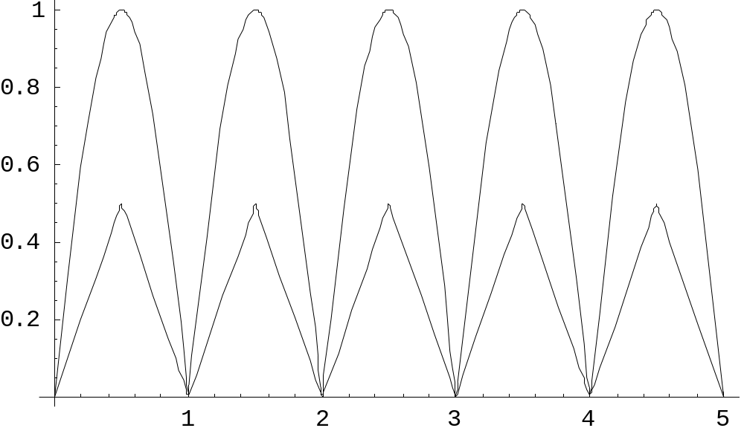
Proof, continued (ii) → (i)
plot[{|sin(πx)|, |x-ceiling(x-1/2)|}, x=0..5]

Slide 56
the home stretch.. substituting for |a_{i}-b_{i}|
P²(A) < P²(B)+ ∑_{1 · i · n} | sin(π b_{i})|K_{i}(B)
By previous results, each of the n+1
terms on the right is less than 1/(n+1),
so P(A) < 1.
So the predicate “there exists a real number β, the encoding of B such that G(β) =F(B)< 0” is recursively undecidable.
Now suppose G(x) 2 R, then so is |G(x)|-G(x) 2 R. We cannot tell if F(x) is zero if we cannot tell if G(x)<0. So we have proved Richardson’s result. QED (whew!)
More details in Caviness’ paper.

Slide 57
Does this matter?
Richardson’s theorem tells us that we can’t make certain statement about a computer algebra algorithms, e.g. “solves all integration problems” at least if the algorithm requires knowing if an expression from this class R is zero.
It doesn’t enter explicitly into our programs, since the difficulty of simplifying sub-classes of this, or “other” classes is computationally hard and/or ill-defined anyway, but we can often simplify effectively, regardless of this result.

