Slide 1
Symbolic Integration
Lecture 14

Slide 2
The problem of integration in finite terms
The Freshman Calculus Problem
The Artificial Intelligence Problem
The Algebraic (Rational Function) Problem (Tobey, Horowitz, Rothstein, Trager)
The Decision Problem (Liouville, Ritt, Rosenlicht, Risch, Cherry, Trager, Davenport, Bronstein, others)
The Computer Algebra System problem.
Extensions to definite integration, numerical integration, approximation by Taylor series, Laurent series, asymptotic series.

Slide 3
The Freshman Calculus Problem. Find the flaws.
Humans are intelligent
MIT students are especially intelligent humans.
Freshmen study integral calculus (this is in 1960’s before Advanced Placement).
Therefore solving calculus problems requires intelligence.
If a computer can solve calculus problems, then it is intelligent (An example of Artificial Intelligence).
To solve these problems, imitate a freshman student.
Future extensions: do the rest of math, and the rest of AI.

Slide 4
Freshman Calc → AI: James Slagle’s approach
AND-OR trees for evaluation of difficulty of a path (do we abandon this route or plow on?)
Game playing: could be any complex task.
or
or
and

Slide 5
Slagle’s program SAINT Symbolic Automatic INTegrator
ELINST: elementary instance expression pattern matching (in assembler).
Simplification program (in assembler).
Used lisp prefix expressions (* x (sin x))
First major lisp program (in Lisp 1.5).
Took about a minute per problem (about the same time as a student!) running uncompiled on an IBM 7090 (32k word x 36 bits/word).
Could not do rational function integration (out of space.)

Slide 6
The Algebraic (Rational Function) Problem
Many attempts to do this right, e.g. Theses of R.Tobey, E. Horowitz, and with extensions, M. Rothstein, B. Trager.
Main idea is to take a rational expression
q(x)/r(x), express it as a polynomial + “proper” fraction P+Q/R with deg(Q)<= deg(R).
Integrate P, a polynomial, trivially.
Expand Q/R in partial fractions.

Slide 7
Partial fractions “trivialized”
From Q/R Find all the complex roots of R,
a₀, ...,a_{n}.
Express Q/R as ∑ c_{i}/(x-a_{i}) which integrates to ∑ c_{i} log(x-a_{i}).
multiple roots are simple: c*(x-a)^{-n} → c/(1-n)*(x-a)^{1-n}
Can we always find {a_{i}}? Complex roots can be found numerically. Can we find c_{i}?
It turns out that we can expand the summation and solve everywhere... with a big problem..

Slide 8
an example of the general cubic...

Slide 9
What’s the problem?
If the denominator R= s₃x³+s₂x²+s₁x+s₀, then each of the roots a_{i} look like this:

Slide 10
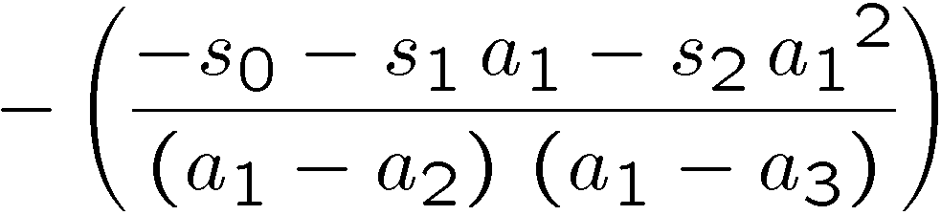
The answer is unmanageable even if we can compute it.
For the cubic, each c_{i} looks something like this
and so it is ugly. Often enough these expressions can be simplified, and so the task is to find a minimal algebraic extension in which the c_{i} can be expressed. We DON’T need to see the a_{i}, but can use facts like a₁a₂a₃ is the constant term of polynomial R; we have neat forms for all symmetric functions of roots.

Slide 11
For a general quartic, it gets worse.
For order 5 or more there is in general no formula “in radicals” for the roots. That is, we can’t expect to represent the a_{i} for symbolic polynomials without extra notation (Elliptic Fns (not radicals) will do).
We can find approximate numerical roots in C if the problem has a “numeric” denominator solely in Q[x], but all bets are off “symbolically”.
The solution is “RootSum(f(x),poly,x)” expressions where we have ∑ f(a_{i}) where {a_{i}} are the roots of the polynomial poly.

Slide 12
This trick works for numeric denominators too

Slide 13
Rothstein/Trager/Rioboo/Lazard (et al), find the c_{i} easier
Let B(x) be square free and of degree >= A(x),
then s (A/B)dx = c_{i} log(v_{i})
where c_{i}, are the distinct roots of the polynomial R(c)=Resultant(x,A(x)-cB’(x),B(x)) and v_{i}=gcd(A(x)-c_{i}B’(x),B(x)) for i = 1,...n.
We need Square-free computation and Resultant wrt x
(Good reference: Geddes/Czapor/Labahn)

Slide 14
Squarefree isn’t a problem
Let the problem be sA(x)/B(x)^{n} with deg(A)<=deg(B).
Since B itself is square free, its GCD with B’=dB/dx is 1. Thus we can compute c,e such that c*B+e*B’=1.
Now multiply through by A to get cAB+eB’A=A, and substitute in the original sA(x)/B(x)^{n} to get s(cAB+eB’A)/B(x)^{n} . Now dividing through we get
s cA/B^{n-1} + s eA* (B’/B^{n}) where the second term can be integrated by parts to lower the power of B^{n} in the denominator.
(reminder: s u dv = uv-s v du. Let u =eA, dv=B’/B^{n},
v=1/((1-n)B^{n-1}), du=(eA)’, so s v du comes out as <something>/B^{n-1}+ s <something>/B^{n-1} . Iterate until B^{n} = B¹ .)

Slide 15
Resultant isn’t a problem
Well, actually it is something we’d prefer not to do since it takes a while, but we have algorithms for it.
Conclusion: we can do rational function integration pretty well. But it took us into the mid-1980s to do it right.

Slide 16
The decision problem
Liouville [1809-1882] During the period (1833-1841) presented a theory of integration; proved elliptic integrals cannot have elementary expressions.
Various other writers advanced the subject in late 1800’s
J. Ritt (1948) Integration in Finite Terms Columbia Univ. Press
M. Rosenlicht (AMM. 1972) Integration in Finite Terms
R. Risch (1968,69) Solution to the problem of IFT [unreadable]
B. Trager, J. Davenport, M.Bronstein [implementation]

Slide 17
Risch’s result
Theorem: Let K be a differential field and f be from K . Then an elementary extension of the field K which has the same field of constants as K and contains an element g such that g’ = f exists if and only if there exist constants c₁..c_{n} from K and functions u₀,..,u_{n} from K such that
f= u₀’+ ∑_{i=1,...,n}c_{i}(u_{i}’/u_{i})
or
g=s fdx = u₀+ ∑ _{i=1..,n} c_{i} log(u_{i})
note: this allows additional logs in the answer, but that’s all. The structure of the integral is specified. And the notation g’ means “the derivative of g”.

Slide 18
What’s a Differential Field?
Equip a field with an additional operator D which satisfies identities parallel to the rules for differentiation of functions. These structures obviously include various fields of functions (e.g. the field of rational functions in one variable over the real field).
The goal is to provide a setting to answer concretely such questions as, "Does this function have an elementary antiderivative?”

Slide 19
Formally, start with a field F and a derivation map
Derivation is a map of F into itself
a  a’ such that
(a+b)’ = a’ + b’
(ab)’=a’b+ab’
CONSEQUENTLY. (I.E. these are not new axioms)
(a/b)’= (a’b-ab’)/b² if a,b, 2 F and b≠ 0
(a^{n})’ = na^{n-1}a’ for all integers n
1’ =0; the constants F are a subfield of F

Slide 20
Also
If a, b are in a differential field F with a being nonzero, we call a an exponential of b or b a logarithm of a if b’ = a’/a.
For algebraic extensions of F, there is a theorem that says that F is of characteristic zero and K is an algebraic extension field of F then the derivation on F can be extended uniquely to K.

Slide 21
We must also deal with algebraic pieces
Algebraic extensions z where p(z)=0 in F
Monomial extensions exp() and log(). Independent extensions are required e.g. log(x) and log(x²) don’t cut it since (log(x²))-(2log(x)) is a constant (perhaps 0)

Slide 22
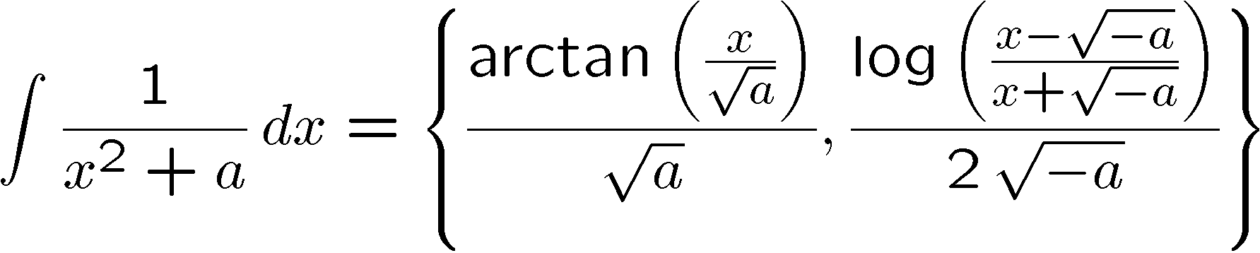
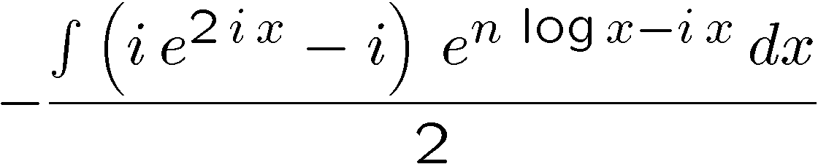
examples
sometimes we prefer arctan (if a<0 below), sometimes logs.
Risch converts s x^{n}sin x to exponentials
and then can’t do it..

Slide 23
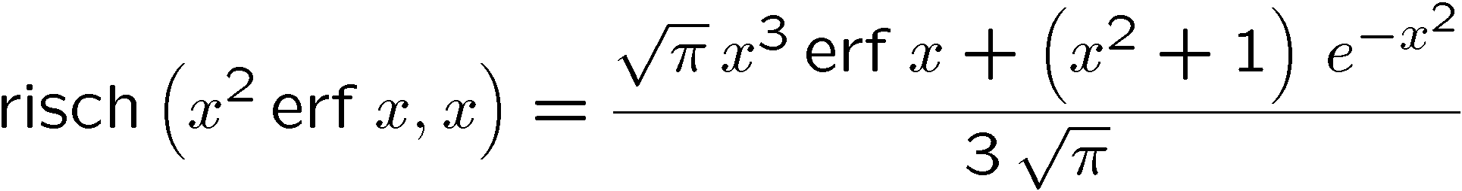
Extensions of the Risch algorithm
Allow certain functions beyond log, exp such that the form of the integral still holds. For example, erf(x) = (2/π)s₀^{x} exp(-t²)dt has the appropriate structure.

Slide 24
The Risch Algorithm: two steps back.
There is a fallacy in claiming the Risch "algorithm" is an algorithm at all: it depends, for solution of subproblems, on heuristics to tell if certain expressions are equivalent to zero.
We know from Richardson’s work that the zero-equivalence problem over a class of expressions much smaller than that of interest for integration is recursively unsolvable.
But that is not the problem with most implementations of the Risch algorithm. They mostly have not been programmed completely, because, even assuming you can solve the zero-equivalence problem, the procedure is hard to program.

Slide 25
The Risch Algorithm: answers are not ncessarily what you expect
It is not nearly as useful as you might think, because it returns algebraic antiderivatives whose validity may be on a set of measure zero. Work by D. Jeffrey A. Rich (among others) on removing gratuitous discontinuities, is helpful.
The Risch algorithm may also, in the vast majority of problems, simply say, after an impressive pause, nope. can't do it. There is no reasonable complexity analysis for the process, which is probably why certain authors ignore it.

Slide 26
The Risch Algorithm: answering wrong problem
Also, most people are interested in definite, not indefinite integrals, at least once they've finished with Freshman calculus.
And in cases where approximate solutions are easily obtained for the corresponding definite integral, the Risch algorithm may grind on for a long while and then say there is no closed form. Or if there is a closed form, if it is to be ultimately evaluated numerically, the closed form may be less useful than the quadrature formula!

Slide 27
Nevertheless, the Risch Algorithm fascinates us
The theory of algebraic integration, and its corresponding history is interesting.
The “solution” to calculus problems can probably be presented this way.
It’s a good advertising slogan.
The definite integration problem is also a classic in the applied mathematics literature:
It would seem that vast tables (20,000 entries) could be replaced with a computer program. (Actually Risch alg. is almost irrelevant here)

Slide 28
It also eludes us.
It is in some sense at the pinnacle of CAS algorithms: it uses more mechanisms of a computer algebra system than nearly any other program.
  Rational function manipulation (GCD, partial fractions, factoring)
  Simplification in a differential field (algebraic, exponential/log, complex extensions)
  Solving certain ODEs
  J. Moses, J. Davenport, B. Trager, D. Lazard, R. Rioboo, A. Norman, G. Cherry, M. Bronstein,

Slide 29
Go over examples of Risch in Moses’ paper
Detailed understanding of Risch’s original presentation is a challenge.

Slide 30
How should one write an integration program? (Moses)
Quick solution to easy problems
A collection of methods and transformations
Radical methods
(less known, table lookup)
consider approximate or numerical approaches
  expand integrand in Taylor series, orthogonal polynomials, Fourier series, or asymptotic series or even approximate as rational functions.
  (for rational functions), approximate the roots of the denominator and do partial fraction expansion.
  do the whole task by quadrature (a well-studied area) treating the integrand as a “black box” capable only of returning a value at a point. [difficulties with infinite range or nasty behaviors.]

Slide 31
Losing numerically
Try integrating x*sin(x) between 0 and 5000.
Numerically, it’s tough unless you guess that it is periodic (certainly possible, but somewhat of a leap of faith if you just have a “black box integrand”).
Symbolically it is –5000 cos (5000)+sin(5000)
Mathematica gives -774.31 (symbolic → number) vs NIntegrate -- -210450)

Slide 32
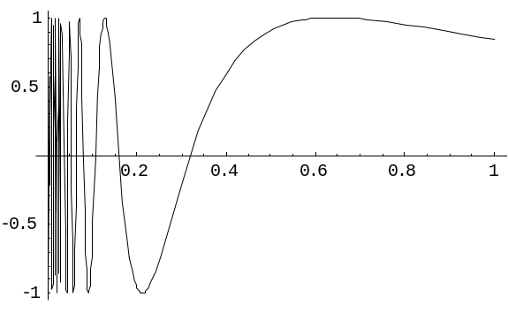
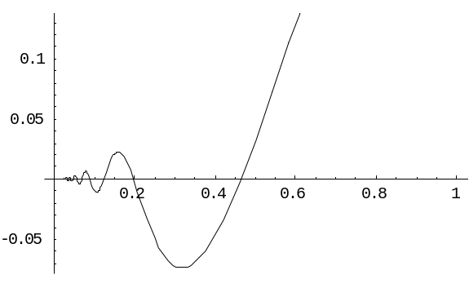
Harder: Losing numerically, rapid oscillation..
Or sin(1/x) between ε and 1.
integral is -CI[x⁻¹] + x sin[x⁻¹]
CI is “cosine integral”= ∫^{x} cos(t)/t dt, lesser known but still tabulated function.

Slide 33
Harder: integrating through singularity
Examples… take the difference or quotient of functions whose singularities cancel, or which have integrable singularities.

Slide 34
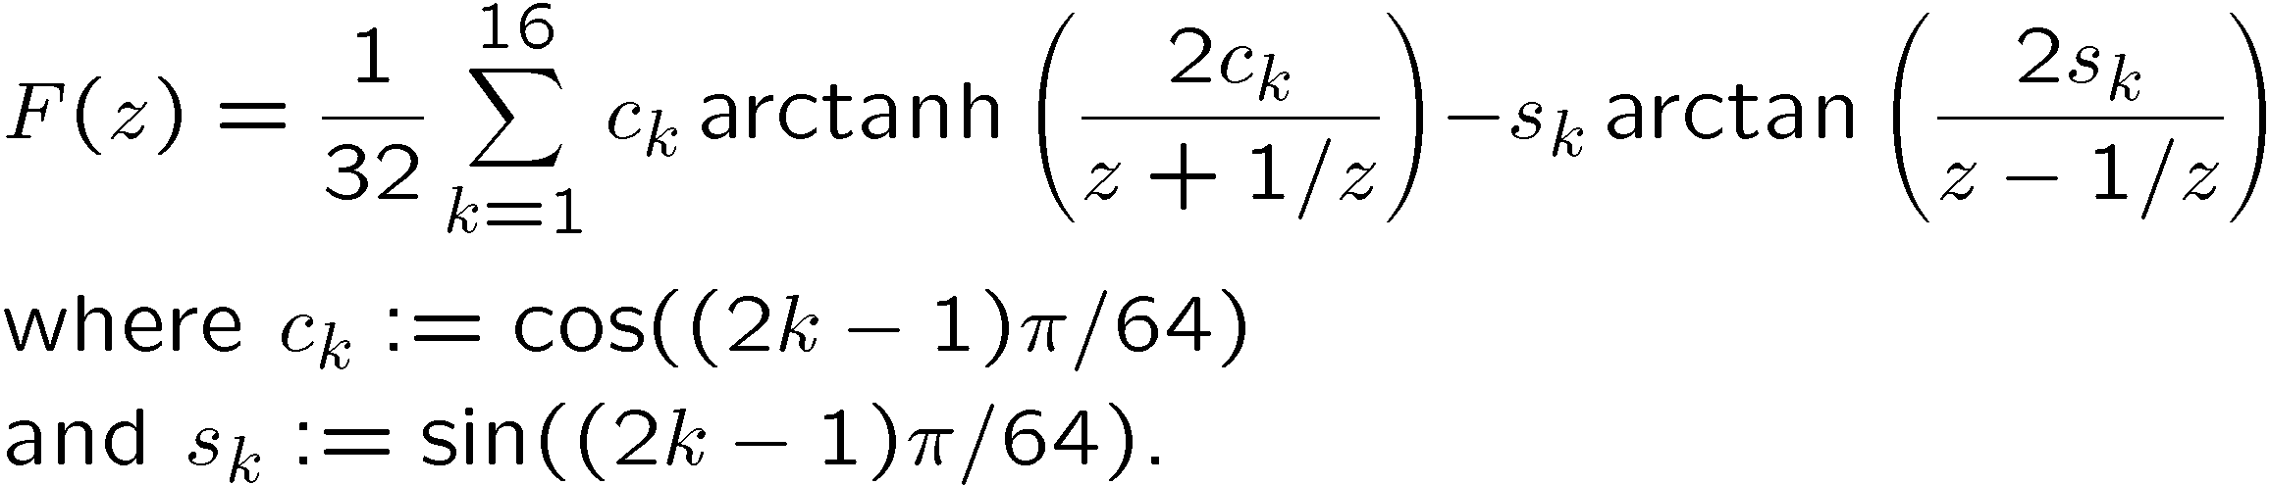
Losing symbolically
Sometimes, as mentioned earlier, the answer is possible but ugly. Consider this expression suggested by W. Kahan.. s1/(z⁶⁴+1) dz integrated to
Computer algebra systems get forms that are worse than this (try them!) and often contribute other monstrosities more easily integrated numerically

