Slide 1
System Issues: Constructing a Computer Algebra System
Lecture 16

Slide 2
Outline
1. Why do it?
CS /fun /it can be done.
Math/AI/Theology
Profit
2. General design goals
3. Strategies
4. The front end
5. Data
6. Algorithms

Slide 3
CS/fun
Interest in building a system that can apply algorithmic mathematics. Enjoy algorithm development and generalization. With computers we can manipulate symbols not only numbers.
but there are other goals
  We will pursue this digression for a few slides.

Slide 4
Other Goals, different, maybe more ambitious: build a system that...
"knows" mathematics
is a repository for all mathematics
can discover proofs (automated reasoning)
can discover new mathematics
invent interesting conjectures
is an artificial intelligence (knows physics etc also!)

Slide 5
Sample version of the formalist / constructivist / mathematics theology
The goals of the QED project
http://www.rbjones.com/rbjpub/logic/qedres00.htm
to help mathematicians cope with the explosion in mathematical knowledge
to help development of highly complex IT systems by facilitating the use of formal techniques
to help in mathematical education
to provide a cultural monument to “the fundamental reality of truth”
to help preserve mathematics from corruption
to help reduce the “noise level” of published mathematics
to help make mathematics more coherent
to add to the body of explicitly formulated mathematics
to help improve the low level of self-consciousness in mathematics (?)

Slide 6
Reflection
http://tunes.org/Review/Reflection.html
discuss programs in the programming language.
Easily done in some languages, impossible in others.
Symbolic computing (especially in lisp, where data and programs can be made of the same “stuff”) provides some opportunities not available in the usual CS curriculum.
end of digression.

Slide 7
Can you get rich building a CAS?
What is the market?
  Fans of higher math?
  Engineers, Scientists?
  Wall St. Analysts?
  Freshman Calculus students?
  Dentists? (no.)
How many people will pay how much for this facility?
Find a “killer app”. Probably education.
Find people to gush about it (Steve Jobs? NYTimes?)

Slide 8
A few computer algebra systems
Maple, Mathematica, Macsyma, Maxima, Derive, Reduce, Axiom, NTL, Cocoa, GiNaC, Cathode, GAP, Fermat, Form, Macaulay, Pari, Singular, Yacas, Jacal, Mupad ..
In one sense it has become easier to build systems because many people have sufficient resources (one PC will do it) to attempt the task.
In another sense it has become harder: there are systems with 1000 person-years’ “head start”.
A list of most of them at http://symbolicnet.org

Slide 9
Shared Goals (well, not always)
Generality (wide domain of discourse)
Correctness, Robustness, orthogonality
Ease of use (batch, interactive, web)
Speed
Portability (Linux, UNIXes, Windows, Mac)
Conforming to standards
Communication with other systems (OpenMath, MathML/XML, MP, RPC, OLE, Java beans)
Ease of growth
Parallel/distributed possibility

Slide 10
Strategies: Three traditional ways to focus attention on the task at hand
Mathematics is neat
  commutative algebra is neat
  group theory is neat
  number theory is neat
Physics is neat
Computers are neat

Slide 11
Mathematics is neat
And computer programming is simple. Written by math types. Sometimes rather broad focus, e.g. Computational group theory; sometimes very specific: computations modulo 251. Sometimes very efficient, sometimes lacking in robustness or usability.

Slide 12
Physics is neat
Written by physicists.
  Everything is best done by physicists, who can cut through the nonsense of math and CS. Hence initially naive with respect to both math and CS. ''Let's do tensors''.
  Sometimes pushes state of the art since there is (or has been) money for physics.

Slide 13
Computers are neat, math is simple.
Written by CS types. Treat math as a programming language problem, or a data structure problem.
Often mathematically unsophisticated. Sometimes grows in mathematical maturity as CS types perceive gaps and re-engineer.

Slide 14
CS types are not necessarily sophisticated
Greenspun's Tenth Rule of Programming: "Any sufficiently complicated C or Fortran program contains an ad-hoc, informally-specified bug-ridden slow implementation of half of Common Lisp."
i.e. complex systems implemented in low-level languages cannot avoid reinventing and/or reimplementing (maybe poorly on both counts) the facilities built into higher-level languages.

Slide 15
Strategies: the 2 language approach
Build an interpreter/compiler for the user language which looks like math.
  algebraic operations (+ * / )
  Built-in functions (sin cos)
  declarative style definitions
  algebraic domains, geometric domains
  Commands (solve, integrate, factor)
but also should allow simple programming:
  imperative style program definitions
  Pattern-replacement rules
The implementation language should be different and concentrate on data representation,
  efficiency, portability, implementation of the user language as well as most algorithms.
Simple algorithms in the user language are possible.
(Macsyma: Macsyma+ Lisp
Mathematica: Mathematica + C
Most lisps: lisp + baby lisp + C + assembler)

Slide 16
Strategies: the library approach
There is no user language. The implementation language, which is C++ or Java, is a library. GiNaC for example.
Typically the first major “follow-on” effort is to provide a user-level front end, e.g. in Python or Java or Tcl or... thereby making the claim “we are only building a library” debatable. The library view therefore is really just deferring controversial decisions briefly.

Slide 17
Strategies: the one language. Design a new one
Plan: The user language is sufficient, with an appropriate compiler, to write the whole system.
The “any decent compiler” fallacy.
What should the target for the compiler be?
Often C is used as a “machine-independent assembly language.”
Some systems used Fortran that way (SAC-1,2)
Axiom: The compiler Aldor for the Axiom language produced alternatively Lisp or C. In theory, no programs should be written in lisp or C directly.
More discussion under “front end”.

Slide 18
Implementation Language design issues
A person or team who invents a language must consider the costs of maintaining that implementation. In at least a few prominent cases, the inventor has little or no experience in languages and makes a muddle of it. Understanding SICP (Abelson/Sussman) would help, in my view.
Examples: Macsyma (but that was 1968!), Mathematica, Maple. Even Matlab.

Slide 19
A common approach
An interpreter/byte-code + compiler or interface to C
Tcl/TK, Reduce-CSL, Macsyma-CLISP, Mathematica
Here's how it works:
A small program is written in C or other "simple" language.
(simple = simple statements in C are converted to
code with relatively easily-predicted execution time. Often a substitute for assembler).
This program is sometimes called a kernel.

Slide 20
What’s in the kernel?
The kernel includes…
All the material that is necessary to raise the discourse to a reasonable level:
  bignums,
  storage allocation,
  maybe polynomial arithmetic.
an interpreter for a byte-code language.
I/O and some OS dependent items
  Web interface
  Security
  Efficient.. Numerics? Graphics? Database?

Slide 21
What is byte code?
a design for a kind of simplified machine whose operations are just what the application needs, rather than the usual mix of assembly language.
a framework (perhaps with stack management, storage management, security constraints) for this "virtual machine".
its operation: a virtual machine evaluator or interpreter goes through these byte codes and calls subroutines in the kernel (or some other mechanism like threaded code) for execution.

Slide 22
Pros/Cons of byte code
Advantages
  usually much more compact than assembler. Important for cache memory.
  usually portable across different architectures
  could be intermediate code for further compilation steps (JIT).
  could be used as a basis for distributing small patches.
Disadvantages
  Slower, usually.
  VM design may restrict computation. e.g. Java VM can't do Lisp easily.

Slide 23
Mixing byte code and ordinary binary code
CSL approach: (Codemist Standard Language)
  While OptimizeMore do
    {Load the whole system and run for a while as byte-code, profiling.
    Compile and reload the parts that seem to be bottlenecks}
  Used for implementing Reduce with a modest size memory.
  Same data structures
CLISP (implementation of Common Lisp)

Slide 24
Why is slow code sometimes OK?
It is usually acceptable to do infrequent parts of the computation at a slower speed. Even 100 times slower maybe acceptable. Trade off: size of code, fast turn-around (no need to run a compiler on it), ease of debugging. {cf. Matlab.. overhead to call invert(M)..}
Lisp usually has interpreter and compiler both, with fast turn around for compiling:
some Lisp systems always compile (and type check) before running (CMUCL), optional with Allegro CL.

Slide 25
Traditional strategy for numeric code
If you provide an opportunity to segment off numeric-data intensive operations into separate routines, you can also finesse efficiency.
  plotting z=f(x,y) on a grid of 100x100 points requires computing f 10000 times.
  integrating f(x) numerically from 0 to 1 may require computing f at many points.
  Compiling f may be plausible even if done at run time.
  Call to numeric library if appropriate: same speed as if called from C or Fortran. The time to check that an n £ n array consists entirely of double-floats is O(n²). If you are doing an O(n³) operation, the check is negligible. Or you may just have a package that assumes numerics. (Matlab, special packages e.g. for dense arrays, in Mathematica, Maple, Macsyma)

Slide 26
digression on Reduce
Reduce is written in a dialect called RLISP, which is an infix kind of lisp. e.g. this makes syntactic sense:
a := list(1, 2, 3); → (setq a (list 1 2 3))
car a + car b ; → (+ (car a)(car b))
There are two modes, algebraic and symbolic (not the clearest names...)
RLISP is implementable in common lisp, CSL, PSL, Scheme ...

Slide 27
digression on SMP, pre-Mathematica
(Brief biased history of SMP written by a group led by Stephen Wolfram when at Caltech:)
SW decided that Macsyma was too slow and he could do much better by writing in C. He got together with some colleagues and wrote SMP. A legal hassle with Caltech made SW more cautious the next time he wrote a program.
SMP was fatally flawed in several ways, but one was the unreliability of the underlying storage mechanism. (Neither GC nor reference count.)

Slide 28
digression on Mathematica
Redid everything to produce Mathematica, which consists of some code written in a customized version of C (actually may be something like Objective C, with some kind of automatic reference counting.) and the user-language for Mathematica. For Version 4, the code for the kernel consists of about 650,000 lines of C and 30,000 lines of Mathematica.
In the Mathematica 4 kernel the breakdown of different parts of the code is roughly as follows:
  language and system: 30%;
  numerical computation: 25%;
  algebraic computation: 25%;
  graphics and kernel output: 20%.
Stats for version 5.2? Presumably much larger.

Slide 29
The front-end problem
Input: how do we convey commands
  factor
  solve
How do we convey mathematical data
  w 2 [-1,1]
  H is a Hilbert space
  z is a complex number {clearly a lie. z is a letter!}
  Introduce new notation?
Output:
  “scientific visualization”
  Publication quality display

Slide 30
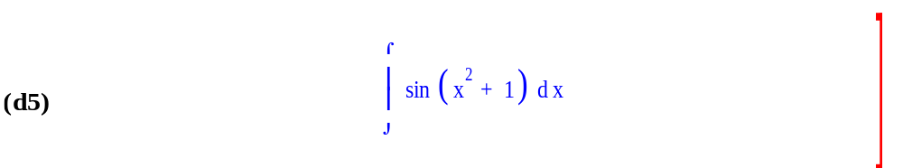
History of CAS Output
First generation: line-display: integral(sin(x^2+1),x)
Second generation: “glass teletype” with typeset display like this (Charybdis, 1966)
/
[ 2
(D5) I SIN(x + 1) dx
]
/
Third generation: typeset

Slide 31
How important is that fancy display?
The answer to that problem is..
((sqrt(%pi) * (((sqrt(2) * %i - sqrt(2)) * sin(1) + ( - sqrt(2) * %i - sqrt(2)) * cos(1))
* erf((((sqrt(2) * %i + sqrt(2)) * x)/2))
+ ((sqrt(2) * %i + sqrt(2)) * sin(1) + (sqrt(2) - sqrt(2) * %i) * cos(1))
* erf((((sqrt(2) * %i - sqrt(2)) * x)/2))))/8)

Slide 32
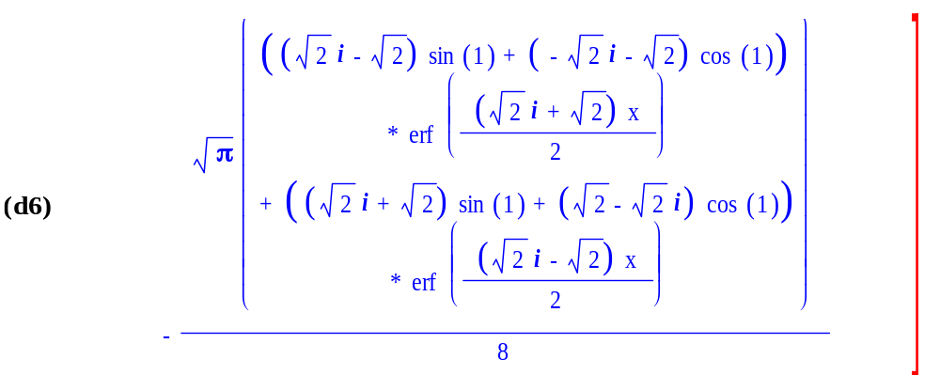
Or displayed in a fancy way (from Macsyma)

Slide 33
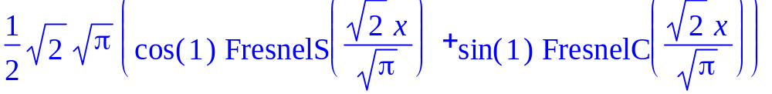
Also Maple and TeX...

Slide 34
Typesetting is now easily solved at the demo-ware level. A few serious problems remain..
Easy to hack together TeX and display
BUT
Serious solutions must address very large multi-line formulas, interactivity (selecting subexpressions)
The spreadsheet idea
Renaming
Detailed control (macsyma demo 1/e^{x} or e^{-x} or …)
MathML/XML.
  output your formula to a browser and hope for the best

Slide 35
Our example in MathML (generated by Maple)
"<math xmlns='http://www.w3.org/1998/Math/MathML'> <semantics><mrow xref='id33'><mrow><mrow><mfrac xref='id1'><mn>1</mn><mn>2</mn></mfrac><mo>&InvisibleTimes;</mo><mrow xref='id3'><msqrt><mn xref='id2'>2</mn></msqrt></mrow></mrow><mo>&InvisibleTimes;</mo><mrow xref='id5'><msqrt><mn xref='id4'>&pi;</mn></msqrt></mrow></mrow><mo>&InvisibleTimes;</mo><mfenced><mrow xref='id32'><mrow xref='id18'><mrow xref='id8'><mi xref='id6'>cos</mi><mo>&ApplyFunction;</mo><mfenced><mn xref='id7'>1</mn></mfenced></mrow><mo>&InvisibleTimes;</mo><mrow xref='id17'><mi>S</mi><mo>&ApplyFunction;</mo><mfenced><mrow xref='id16'><mfrac><mrow xref='id13'><mrow xref='id11'><msqrt><mn xref='id10'>2</mn></msqrt></mrow><mo>&InvisibleTimes;</mo><mi xref='id12'>x</mi></mrow><mrow xref='id15'><msqrt><mn xref='id14'>&pi;</mn></msqrt></mrow></mfrac></mrow></mfenced></mrow></mrow><mo>+</mo><mrow xref='id31'><mrow xref='id21'><mi xref='id19'>sin</mi><mo>&ApplyFunction;</mo><mfenced><mn xref='id20'>1</mn></mfenced></mrow><mo>&InvisibleTimes;</mo><mrow xref='id30'><mi>C</mi><mo>&ApplyFunction;</mo><mfenced><mrow xref='id29'><mfrac><mrow xref='id26'><mrow xref='id24'><msqrt><mn xref='id23'>2</mn></msqrt></mrow><mo>&InvisibleTimes;</mo><mi xref='id25'>x</mi></mrow><mrow xref='id28'><msqrt><mn xref='id27'>&pi;</mn></msqrt></mrow></mfrac></mrow></mfenced></mrow></mrow></mrow></mfenced></mrow><annotation-xml encoding='MathML-Content'><apply id='id33'><times/><cn id='id1' type='rational'>1<sep/>2</cn><apply id='id3'><root/><cn id='id2' type='integer'>2</cn></apply><apply id='id5'><root/><pi id='id4'/></apply><apply id='id32'><plus/><apply id='id18'><times/><apply id='id8'><cos id='id6'/><cn id='id7' type='integer'>1</cn></apply><apply id='id17'><csymbol id='id9'

Slide 36
Our example in MathML (generated by Maple) continued
definitionURL='http://www.maplesoft.com/MathML/FresnelS'>FresnelS</csymbol><apply id='id16'><divide/><apply id='id13'><times/><apply id='id11'><root/><cn id='id10' type='integer'>2</cn></apply><ci id='id12'>x</ci></apply><apply id='id15'><root/><pi id='id14'/></apply></apply></apply></apply><apply id='id31'><times/><apply id='id21'><sin id='id19'/><cn id='id20' type='integer'>1</cn></apply><apply id='id30'><csymbol id='id22' definitionURL='http://www.maplesoft.com/MathML/FresnelC'>FresnelC</csymbol><apply id='id29'><divide/><apply id='id26'><times/><apply id='id24'><root/><cn id='id23' type='integer'>2</cn></apply><ci id='id25'>x</ci></apply><apply id='id28'><root/><pi id='id27'/></apply></apply></apply></apply></apply></apply></annotation-xml><annotation encoding='Maple'>1/2*2^(1/2)*Pi^(1/2)*(cos(1)*FresnelS(2^(1/2)/Pi^(1/2)*x)+sin(1)*FresnelC(2^(1/2)/Pi^(1/2)*x))</annotation></semantics></math>"

Slide 37
MathML as a standard could make everyone’s output work with everyone’s display
That’s the thought, anyway.
Extensions for presentation and content
OpenMath.org

Slide 38
Front-end important for flash: graphics too
Mathematica's introduction in the mid 1980s made the case clear that marketing was important for CAS. And a lot of the marketing required fancy displays on the computers then coming on the market: NeXt and the new Macintosh.
For the front end on Windows, Mac, Unix (X), significant amount of specialized code is needed to support each different type of user interface environment.
The front end for Mathematica (v4) contains ``about 600,000 lines of system-independent C source code, of which roughly 150,000 lines are concerned with expression formatting. Then there are between 50,000 and 100,000 lines of specific code customized for each user interface environment. ''

Slide 39
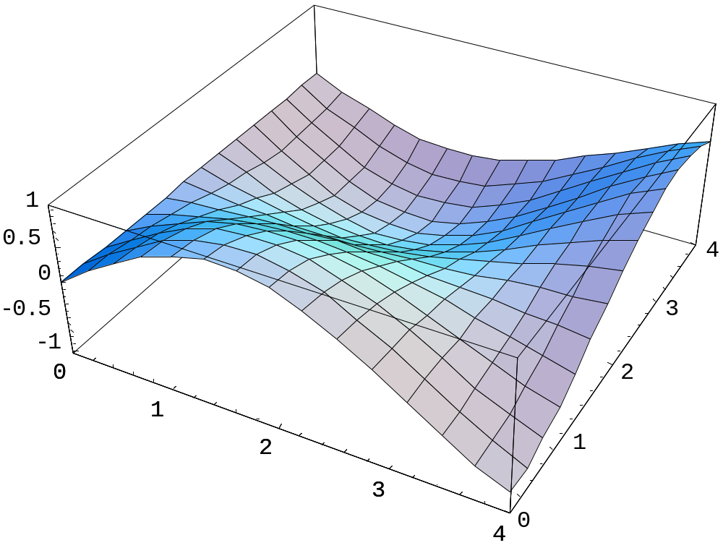
Mathematica Sin[x]*Cos[y]

Slide 40
Macsyma sin(x)*cos(y)

Slide 41
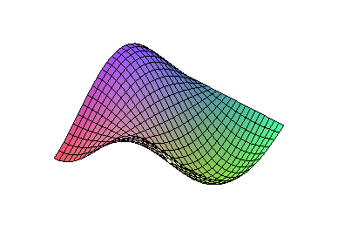
Maple, ditto (no “options”)

Slide 42
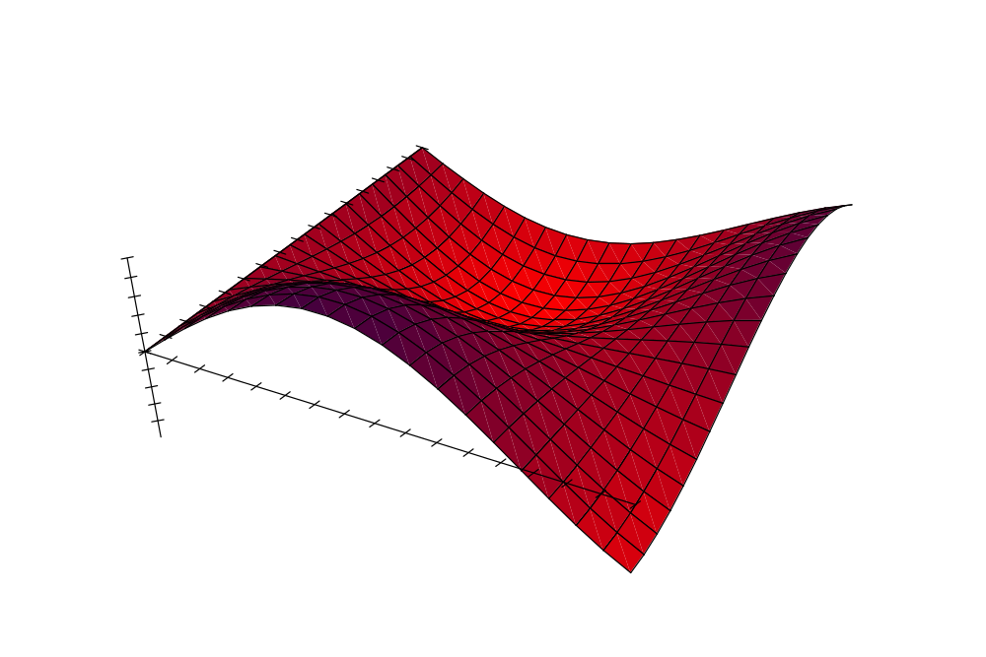
Mupad

Slide 43
Other systems (e.g. Reduce, open-source Maxima)
Maxima uses utilities like Gnuplot in an attempt to be mostly portable. Hence:
  Usually less “integrated” into the system.
  Portable solutions don’t take advantage of the special features of the interfaces... e.g. X window simulator on Microsoft Windows?

Slide 44
The Notebook “paradigm” input + output
commands interspersed with displays
text and pictures interspersed
typeset displays
command-line editing
outlining (suppression of detail)
save/restore/execute
where do edited commands go? (not in-place)

Slide 45
Digression: Correctness (words from MMA book)
''The standards of correctness for Mathematica are certainly much higher than for typical mathematical proofs. But just as long proofs will inevitably contain errors that go undetected for many years, so also a complex software system such as Mathematica will contain errors that go undetected even after millions of people have used it. Nevertheless, particularly after all the testing that has been done on it, the probability that you will actually discover an error in Mathematica in the course of your work is extremely low. Doubtless there will be times when Mathematica does things you do not expect. But you should realize that the probabilities are such that it is vastly more likely that there is something wrong with your input to Mathematica or your understanding of what is happening than with the internal code of the Mathematica system itself. If you do believe that you have found a genuine error in Mathematica, then you should contact Wolfram Research at the addresses given in the front of this book so that the error can be corrected in future versions.''

Slide 46
Coming up:
Numeric Data and Algorithms in CAS
Numeric, symbolic
Some Sources:
http://cs.berkeley.edu/~fateman/papers/
  mac82.pdf mma.review.pdf (reviews by RJF of macsyma and mathematica)
www.math.unm.edu/~wester (detailed comparisons of CAS and various other links)
http://krum.rz.uni-mannheim.de/cabench/diractiv.html (another benchmark collection)

