Slide 1
Closed Forms for Summations
Lecture 19

Slide 2
Two categories (maybe 3) of Summations
Indefinite summation:
  Σ_{1 · i · n} f(i); f not dependent on n
  f dependent on n
  -- finite difference calculus has a long history: initial work done by Newton, Euler, Bernoulli, Boole.
  Definite summation (particular solutions): Zeilberger, Gosper, Ramanujan, etal
  The Book A=B by Petkovsek, Wilf, Zeilberger)
  Online at http://www.cis.upenn.edu/~wilf/AeqB.html

Slide 3
Indefinite summation parallels to integration
integration of polynomials
integration of rational functions
difference operator Δ parallels the derivative
Σ and s are similar
But not similar enough for some purposes!

Slide 4
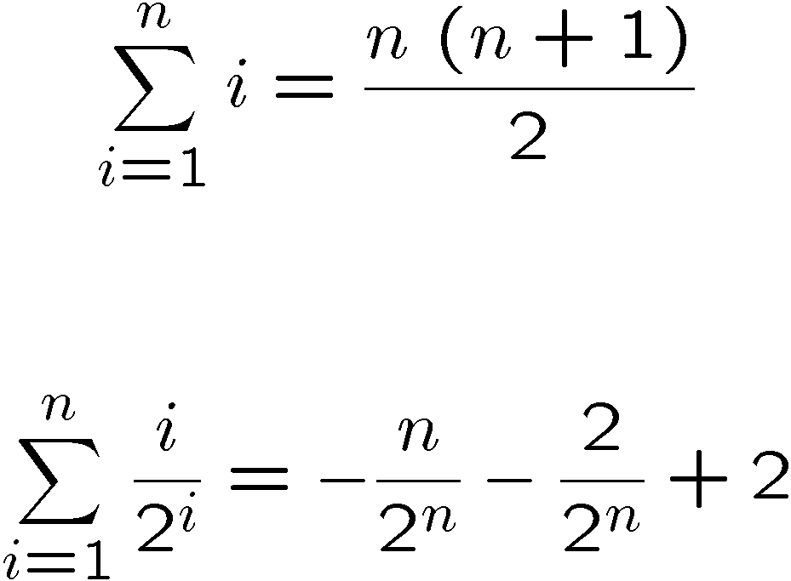
Some simple examples (Macsyma, in this case)

Slide 5
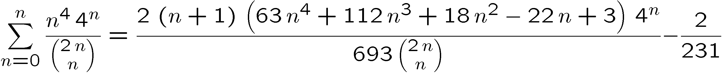
A more elaborate example

Slide 6
Start simply
if we need g(n) = ∑_{i=a}^{n} f(i) we approach by
finding the indefinite summation
h(x) = ∑_{i=0}^{x-1} f(i)
Then we can find the definite summation from a to n:
g(n) = h(n+1) – h(a).
Sidestepping any issues of singularities.
Note that this means sum from a to b + sum from b+1 to c = sum from a to c, even if a<b<c is false..
Δ h(x) is defined by h(x+1)-h(x), is f(x)

Slide 7
Also
Δ⁻¹ f(x) = h(x), and as a reminder, note that
h(x) = ∑ _{i=0}^{x-1} f(i)
Note parallel: we can obtain an expression for the summation by anti-differencing; compare to integration by anti-differentiation.

Slide 8
Simple Properties of Δ
Unique up to addition of functions whose first difference is zero
  Constants, since h(x):=C means h(x+1)-h(x)= 0
  functions with period 1, e.g. h(x):=sin (π x)

Slide 9
It is also convenient to define shift operator, E
E f(x) := f(x+1)
hence
  Δ f(x) = Ef(x)-f(x)

Slide 10
Δ(f¢g)=Eg¢Δf+fΔg
Proof that Δ(f¢g)=EgΔf+fΔg
Expand the right side,
g(x+1)*(f(x+1)-f(x))+f(x)*(g(x+1)-g(x))
.. Multiply out..
g(x+1)*f(x+1)-g(x+1)*f(x)+f(x)*g(x+1)-f(x)*g(x)
.. The underlined terms cancel, leaving
f(x+1)*g(x+1)-f(x)*g(x),
Which is Δ (f(x)¢ g(x)).
QED

Slide 11
Δ(1/g)=Δ g / (g E g)
Proof that Δ(1/g)=Δ g / (g E g)
Expand the right side,
1/g(x+1)-1/(g(x), combine over common denominator:
(g(x+1)-g(x))/(g(x)*g(x+1))
Which corresponds to
g / (g E g)
QED

Slide 12
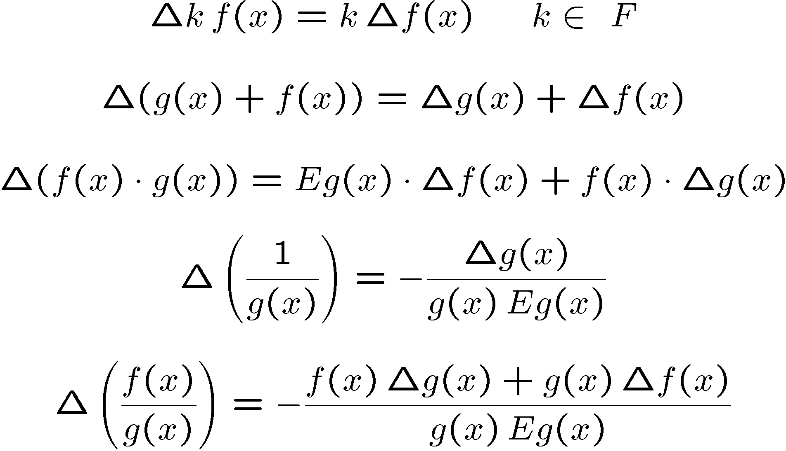
Summary of properties of Δ

Slide 13
Occasionally useful property
The chain rule
Δ f(g(x)) = Δ f(x)
where Δ f(x) = f(x+h)-f(x)
x
g(x)
1
Δ g(x)
x
h

Slide 14
Proof..
The chain rule
Δ f(g(x)) = Δ f(x)
f(g(x+1))-f(g(x)) on left
f(g(x)+Δ g(x))-f(g(x)) on right =
f(g(x)+g(x+1)-g(x))-f(g(x))… QED
x
g(x)
1
Δ g(x)

Slide 15
The simplest non-trivial form to sum is a polynomial
A(x) = ∑ a_{i} x^{i}
The analogy to differential calculus is to integrate, term by term:
  easy since Dx^{n} = nx^{n-1}.
Differences of powers are not so concise:
Δ(x^{n}) = (x+1)^{n}-x^{n} = ∑(binomial(n,i) x^{i},i=0..n-1)… has n-1 terms.
INSTEAD consider factorial functions, defined by
[x]_{n} = x(x-1)(x-2)....(x-n+1).

Slide 16
What is the difference of a factorial function?
Δ [x]_{n} =n[x]_{n-1}
Proof:
[x]_{n} = E [x]_{n} – [x]_{n} .
E[x]_{n} = (x+1)x(x-1)(x-2).... (x-n+2)
[x]_{n} = x(x-1)(x-2)....(x-n+2)(x-n+1).
All the terms in red are the same, and one can factor them out. they are [x]_{n-1}. The remaining factor is simply (x+1)-(x-n+1) = n.
The product is n[x]_{n-1} . QED

Slide 17
To sum a polynomial of degree d, convert it to factorial form:
one way is to set up a table by which we expand d factorial functions [x]₁+x, [x]₂= x²-x, etc, solve for powers of x, e.g. x²= [x]₂-[x]₁, and we can substitute into any polynomial, collect [] terms and provide the result.
Another is to use Newton’s divided difference interpolation formula , which as a special case gives:
f(x)=sum([x]_{i}/i! Δ^{i} f(0)) where we mean by Δf(0), is Δf(x) where x=0. We define higher differences in the obvious way: (Δ²f(0) = Δ (Δ(f(0)) = Δ (f(1)-f(0)) = Δ(f(2)-f(1)-(f(1)-f(0))= f(2)-2f(1)+f(0). ) This is almost always written in a table.

Slide 18
Divided difference table for f= 3*x^3-2*x+1
x | f(x) | Δ f(x) | Δ²f(x) | Δ³f(x)
0 | 1 | 1 | 18 | 18
1 | 2 | 19 | 36
2 | 21 | 55
3 | 76

Slide 19
Divided difference table for f= 3*x^3-2*x+1
x | f(x) | Δ f(x) | Δ²f(x) | Δ³f(x)
0 | 1 | 1 | 18 | 18
1 | 2 | 19 | 36
2 | 21 | 55
3 | 76
Δ⁻¹ f =sum([x]_{i}/i! Δ^{i} f(0))=1*[x]₁+ 1/2*[x]₂ +18/3!*[x]₃ +18/4!*[x]₄ .

Slide 20
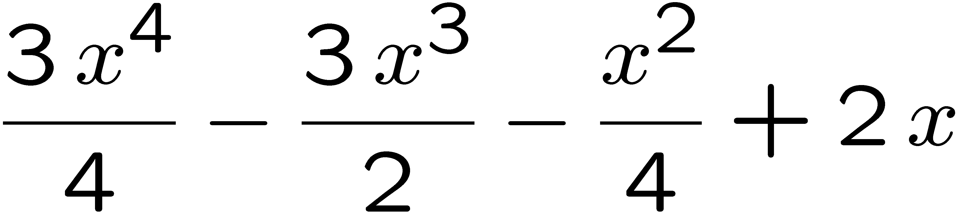
Converting BACK to conventional polynomial form can be done by expanding [x]_{i} and combining terms
Total is 1*x
+1/2* x*(x-1)
+18/3!* x*(x-1)*(x-2)
+18/4!* x*(x-1)*(x-2)*(x-3) =

Slide 21
Sums of rational functions
Define factorial operators on functions...
[f(x)]_{k} = f(x) ¢ f(x-1) ¢ ... ¢ f(x-k+1) for k >0
extend the operator by noticing
[f(x)]_{k} = [f(x)]_{r}¢ [f(x-r)]_{k-r}
Define [f(x)]₀ to be 1 and use the previous line as an identity. Then for k=0 we get
[f(x)]_{-r} = 1/[f(x+r)]_{r}

Slide 22
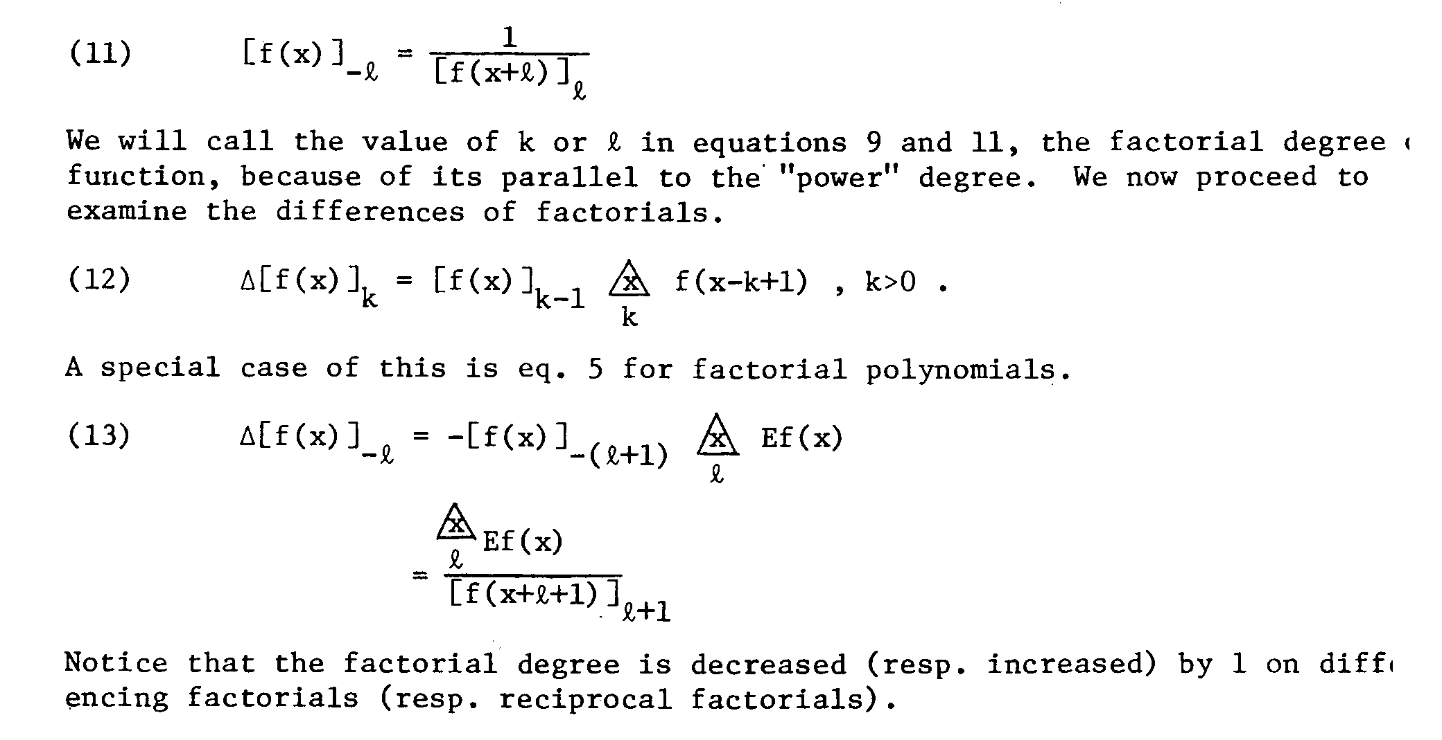
Differences of factorials
R. Moenck, Macsyma Users’ Conf. 1977

Slide 23
What does this mean for summation (Δ⁻¹)?
If we can get rational expressions so they look like the RHS of that equation, we can find their summation, namely [f(x)]_{-l}

Slide 24
We need to use Shift Free Decomposition to go further.
Given a product of functions, we can decompose it into a product of factorial functions.
Let S=a ¢ b ¢ c where a,b,c are mutually relatively prime and Ea=b. Then shift S:
ES = (Ea)¢(Eb)¢(Ec) = b ¢ Eb ¢ Ec
GCD(S,ES) = b
So we can divide out b and a from S and express
S=[b]₂¢ c .

Slide 25
If we apply this observation repeatedly, we can get S to be shift free
S=[s₁]₁ ¢ [s₂]₂ ¢ ... ¢ [s_{k}]_{k} where the individual s_{k} are shift-free.
Analogous to partial fraction decomposition in the differential calculus Hermite integration process, we can form a shift-free partial fraction for some rational function we wish to sum. That is,
A(x)/S(x) = ∑ (A_{i}/[s_{i}]_{i}), i=1..k
and a “complete” decomposition
A(x)/S(x) = ∑ ∑(A_{ij}/[s_{i}]_{j}), i=1..k,j=1..i

Slide 26
Shift-1 independence is not enough. We need to show S(x) is k-shift-free
Compute resultant of S(x) and S(x+k) with respect to k. If there is an integer k>1 shift, then fill in the terms for numerator and denominator. e.g. if S = x*(x+3), change it to
[x+3]₄ and multiply numerator by (x+1)(x+2).

Slide 27
Summation by parts
Similar to Hermite integration using
Δ⁻¹(u¢ Δ v) = u ¢ v - Δ ⁻¹(Ev ¢ Δ u)
can be used to reduce denominators of the form [x_{i}]_{j} to [x_{i}]₁
EVENTUALLY... one gets a rational function plus an indefinite summation of terms with shift-free denominators of factorial degree 1.

Slide 28
The transcendental part
Define ψ_{m}(x)= D^{m}(logΓ(x+1)), m>0 where n!=Γ(n+1) is the well-known gamma function
ψ_{m}(x)=
D^{m}(Δ logΓ(x+1))=
D^{m}(log(Γ(x+2)/Γ(x+1)))=
D^{m} log(x+1) =
D^{m-1}(1/(x+1)) =
((-1)^{m-1}¢ (m-1)!¢(x+1)^{-m}.

Slide 29
The sum of a negative power of x+1 finishes the task
Δ⁻¹(x+1)^{-m} = (-1)^{m-1}/(m-1)! ψ_{m}(x)
The ψ_{m} functions are known as polygamma functions and serve a role similar to logs in Hermite integration.
Rational summation is pretty much solved, though people still look for fast ways of doing some of the steps (shift-free decomposition).

Slide 30
This is not the end of the story: what about more elaborate summands?
Gosper’s algorithm looks at ∑ a_{i} = Δ⁻¹a_{i} by seeking a “telescoping function” f(n).
Let a_{n} = Δ g(n) = g(n+1)-g(n)
then suppose g(n)=f(n)*a_{n}.
We have to solve the functional equation
C(n)=a_{n+1}/a_{n} = (f(n)+1)/f(n+1)
Only the ratio of 2 terms is used (easily computed). If C(n) is rational in n, then this is called hypergeometric summation.

Slide 31
Restrictions/ Extensions
Note that the terms a_{n} can be far more general than rational; the requirement is on the RATIO: a_{n+1}/a_{n} is rational.
Gosper’s work is the basis for a decision procedure, widely used in computer algebra systems.
Excellent reference: A=B, by Petkovsec, Wilf, Zeilberger

