Slide 1
Algebraic Algorithms: CS 282
Spring, 2002
Lecture 1

Slide 2
The subject: “Symbolic Computation”
Computer algebra systems (CAS) and their supporting algorithms for performing symbolic mathematical manipulation.
Math surprises: Can you program, or make constructive, various more-or-less well-known symbolic computations?
Computer Science tasks: Can you build a mathematical intelligence? Or at least a skilled assistant?

Slide 3
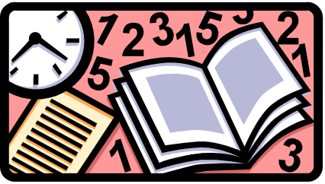
An aside on your non-constructive education
In freshman calculus you learned to integrate rational functions. You could integrate 1/x and 1/(x-a) into logarithms, and you used partial fractions. Unless you’ve recently taken (or taught) this course, you’ve forgotten the details.

Slide 4
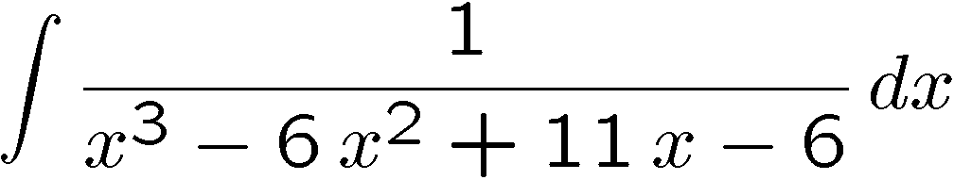
Here’s an integration problem

Slide 5
Fortunately you can factor the denominator this way by guesswork

Slide 6
And then do the partial fraction expansion

Slide 7
And then integrate each term…

Slide 8
Non-constructive parts
Do you really know an algorithm to factor the denominator into linear and quadratic factors?
Can you do this one, say…
And if it does not factor (it need not, you know… what do you do then?)

Slide 9
If the denominator doesn’t factor
And it gets worse … there is no guarantee that you can even express the roots of irreducible higher degree polynomials in radicals.

Slide 10
Moral of this story
You probably never knew how to integrate rational functions. Only some rational functions.
Writing a program to (say) factor or integrate uses ideas you may have never seen before.
End of aside

Slide 11
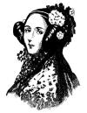
Some History: Ancient
Ada Augusta, 1844 foresaw prospect of non-numeric computation using Babbage’s machines. Just encode symbols as numbers, and operations as arithmetic.

Slide 12



Some History: Less Ancient
Philosophers/Mathematicians, e.g. G. Frege, but best known:B. Russell, A.N. Whitehead (Principia Mathematica 1910-1913)

Slide 13


Some History: No, you can’t do it all…
Godel, Turing

Slide 14




Some History: New optimism?
1958-60 first inklings .. automatic differentiation, tree representations, Lisp,
Minsky ->Slagle, (1961), Moses(1966); Is it AI?

Slide 15
Computer Algebra Systems : threads
Three trends emerged in the 1960s:
  AI / later…expert systems
  Mathematics e.g. Berlekamp [factoring] , Liouville-> Risch [integration], computational group theory
  Algorithms / Computer Science e.g. Knuth/Brown/Collins [polynomial GCD]

Slide 16
Some Historical Systems
Early to mid 1960's - big growth period, considerable optimism in programming languages, as well as in computer algebra…
- Mathlab, Symbolic Mathematical Laboratory,
Formac, Formula Algol, PM, ALPAK, Reduce; Special purpose systems,
optimism about conquering all of math by coming up with the right programming formalism, and accumulating “facts”.

Slide 17
Mathematics’ flirting with computing..
Constructive algorithmic algebra was fashionable in the early 20th century (early editions of van der Waerden's classic "Modern Algebra“ book), but existence proofs became more popular. Too bad. I think the tide is turning towards constructive approaches.

Slide 18
Some theory/algorithm breakthroughs
1967-68 algorithms: Polynomial GCD,
Berlekamp’s polynomial Factoring,
Risch Integration "near algorithm",
Knuth’s Art of Computer Programming
1967 - Daniel Richardson: interesting zero-equivalence results.

Slide 19
Some well-known systems
Computers got comparatively cheaper, so systems get more ambitious, more available (1968-78)
  SAC-1 Altran, Macsyma, Scratchpad.
  Mathlab 68, MuSimp/MuMath, SMP, Automath, others.
Further development; new entrants of 1980's
  Maple, Mathematica (1988), Derive, Axiom, Theorist, Milo,
Consolidation: 1990s improving existing systems,
  new experimental systems (theorem proving, niche math)

Slide 20
Some support systems
Common Lisp gets standardized.
Scheme gets standardized too.
C++ popularized as “the answer”
Portability (UNIX™? Linux, Windows, Apple)
Java
HTML, XML and Browsers

Slide 21
The Marketing Blitz and shakeout
Mathematica, NeXT, Apple, graphics.
Maple comes out from under a rock.
IBM/Scratchpad goes public as Axiom under NAG sponsorship, then is killed. (2001)
MuPad at Univ of Paderborn, is free, then sold.
Macsyma goes into hiding, parts come out free.
Openmath and MathML put “Math on the Web”.
Connections.
  Links from Matlab to Maple,
  Scientific Workplace to Maple or Mathematica.
The arrival of network agents for problem solving.
  Calc101, Tilu, TheIntegrator, Ganith, …

Slide 22
Are there really differences in systems?
What we see today in systems:
  Mathematica essentially takes the view that mathematics is a collection of rules with a procedure for pattern matching; and that a system needs neat graphics for Marketing.
  Axiom takes the view that a computer algebra system is an implementation of Modern Algebra
  Almost everyone concedes that good algorithms and data structures are necessary for effective, efficient computation; sometimes Math takes a back seat.

Slide 23
Next time
What do these CAS and the many systems we haven’t explicitly mentioned, have in common?
Algebraic systems
  Objects
  Operations
  Properties? Axioms?
  Extensions to a base system (programming? Declarations?)
  Underlying all of this: efficient representations

