Slide 1
Basic Domains of Interest used in Computer Algebra Systems
Lecture 2

Slide 2
We can compute with any finitely representable objects, at least in principle
Objects from any algebraic system, and even some ad-hoc mixtures
With any algorithms
  All steps specified precisely
  Terminating
Some processes are not-necessarily terminating. E.g. L’hôpital’s rule … use termination heuristics: time/space limits, losing some credibility for results ☹
But we tend to concentrate on domains that occur in applied math, physical sciences, etc.

Slide 3
The Usual Operations
Integer and Rational:
  Ring and Field operations +- * exact quotient, remainder
GCD, factoring of integers
Approximation via rootfinding
Polynomial operations
  Ring, Field, GCD, factor
  Truncated power series
  Solution of polynomial systems
Matrix operations (add determinant, resultant, eigenvalues, etc.)

Slide 4
More Operations
Sorting (e.g. of monomials)
Union (collections)
Tests for zero
Extraction of parts (polynomial degree, constant coefficient, leading coefficient)
Conversion to different forms (“expand”, express algebraic function in a minimal extension, “simplify”)

Slide 5
Yet More Operations
Differentiate
Integrate
Limit
Prove
Find region in which (in)equalities hold
Confirm (as: steps in a proof)
Expand in series

Slide 6
Yet More Operations
Plot
plot3d(exp(-x^2-y^2)*x,x,-2,2,y,-1.5,2.5)

Slide 7
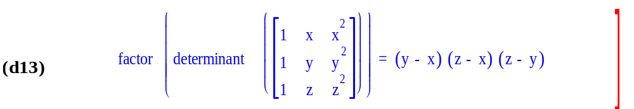
Yet More Operations
Typesetting

Slide 8
Integer representations, operations
The ring operations +*-
Euclidean Domain: quotient & remainder, GCD
UFD : factorization

Slide 9
Unfortunately computers don’t do these operations directly
Addition modulo 2³¹-1 is rarely what we need.
How do we do arbitrary precision integer arithmetic? (If we could do this, we could build the rationals, and via intervals or some other construction, we could make reals)

Slide 10
Is it hard to do arbitrary integer (bignum) arithmetic?
In spite of your knowledge of this subject, there are subtleties, especially in long division!
You must choose fast algorithms (moderate size) or asymptotically optimal algorithms (large size): what’s your target?

Slide 11
Who cares about integer arithmetic?
You need fast long arithmetic to compute billions of digits of π e.g. DH Bailey's home page
You need fast moderate-length arithmetic to play integer-factoring games.
Arguably, there are sensitive geometric predicates that require very high precision (floats).
You need all lengths to build a computer algebra system: without it your system tells lies.
Every Common Lisp has bignums built in.

Slide 12
Some ideas just for representing integers
Integers are sequences of characters, 0..9.
Integers are sequences of words modulo 10⁹ which is the largest power of 10 less than 2³¹.
Integers are sequences of hexadecimal digits.
Integers are sequences of 32-bit words.
Integers are sequences of 64-bit double-floats (with 8 bits wasted).
Sequences are linked lists
Sequences are vectors
Sequences are stored in sequential disk locations

Slide 13
Yet more ideas
Integers are sequences of 64-bit double-floats (with 8 bits used to position the bits)
e.g. 2⁻³⁰⁰+2³⁰⁰ takes 2 words
Integers are stored in redundant form a+b+…
Integer are stored modulo set of different primes
Integers are stored in p-adic form as a sequence of x mod p, x mod p², …

Slide 14
To be continued..
Integers and more.

