Slide 1
Loose Ends: Evaluation, Mathematical Types, DLMF, Syntax and OCR
Lecture 20

Slide 2
Outline
Evaluation (ref neweval.pdf)
Mathematical Type Systems, esp Axiom
Syntax Extension, esp Macsyma
Nat’l Inst. of Stds and Tech: DLMF
OCR

Slide 3
Evaluation and names
Too many contexts for a symbol like “x”
Programming: int x=43. ...
Programming: bound variable (lambda(x) (+ x 1))
Programming declared name: double_float x; [methods]
Symbolic: sin(2*x)=2*sin(x)*cos(x) .. for all x
Symbolic: Solve x²-1=0 for x
Symbolic: Let F[x] be a polynomial domain consisting of the field F extended by the indeterminate x
Symbolic/logical: assume x is real
Symbolic bound variable: Sum(r_{x},x=1..1)
Type-symbolic class name x

Slide 4
Disambiguating a symbol’s interpretation
Lisp has x, ‘x, also “x”
Maple has x, uneval, evalf evalhf
Mathematica has x, Hold[x], HoldAll[], HoldFirst[]
No way of doing this naturally.

Slide 5
Evaluation and operators
a+b simplifying to a+b.
a+a simplifying to 2*a
a+b+c simplifying to c+7 (if a=4, b=3)
Application of functions vs. simplification
sin(π) simplifies to 0?
sin(3) vs sin(3.0)?

Slide 6
Evaluation and depth
x:=y+1
y:=z+1
what is x? z+2?
evaluate 0,1,2, until stops changing?

Slide 7
Algebraic Type Systems
Axiom
Mupad
ModeReduce (gone)
Gauss / Maple
Format/ Macsyma

Slide 8
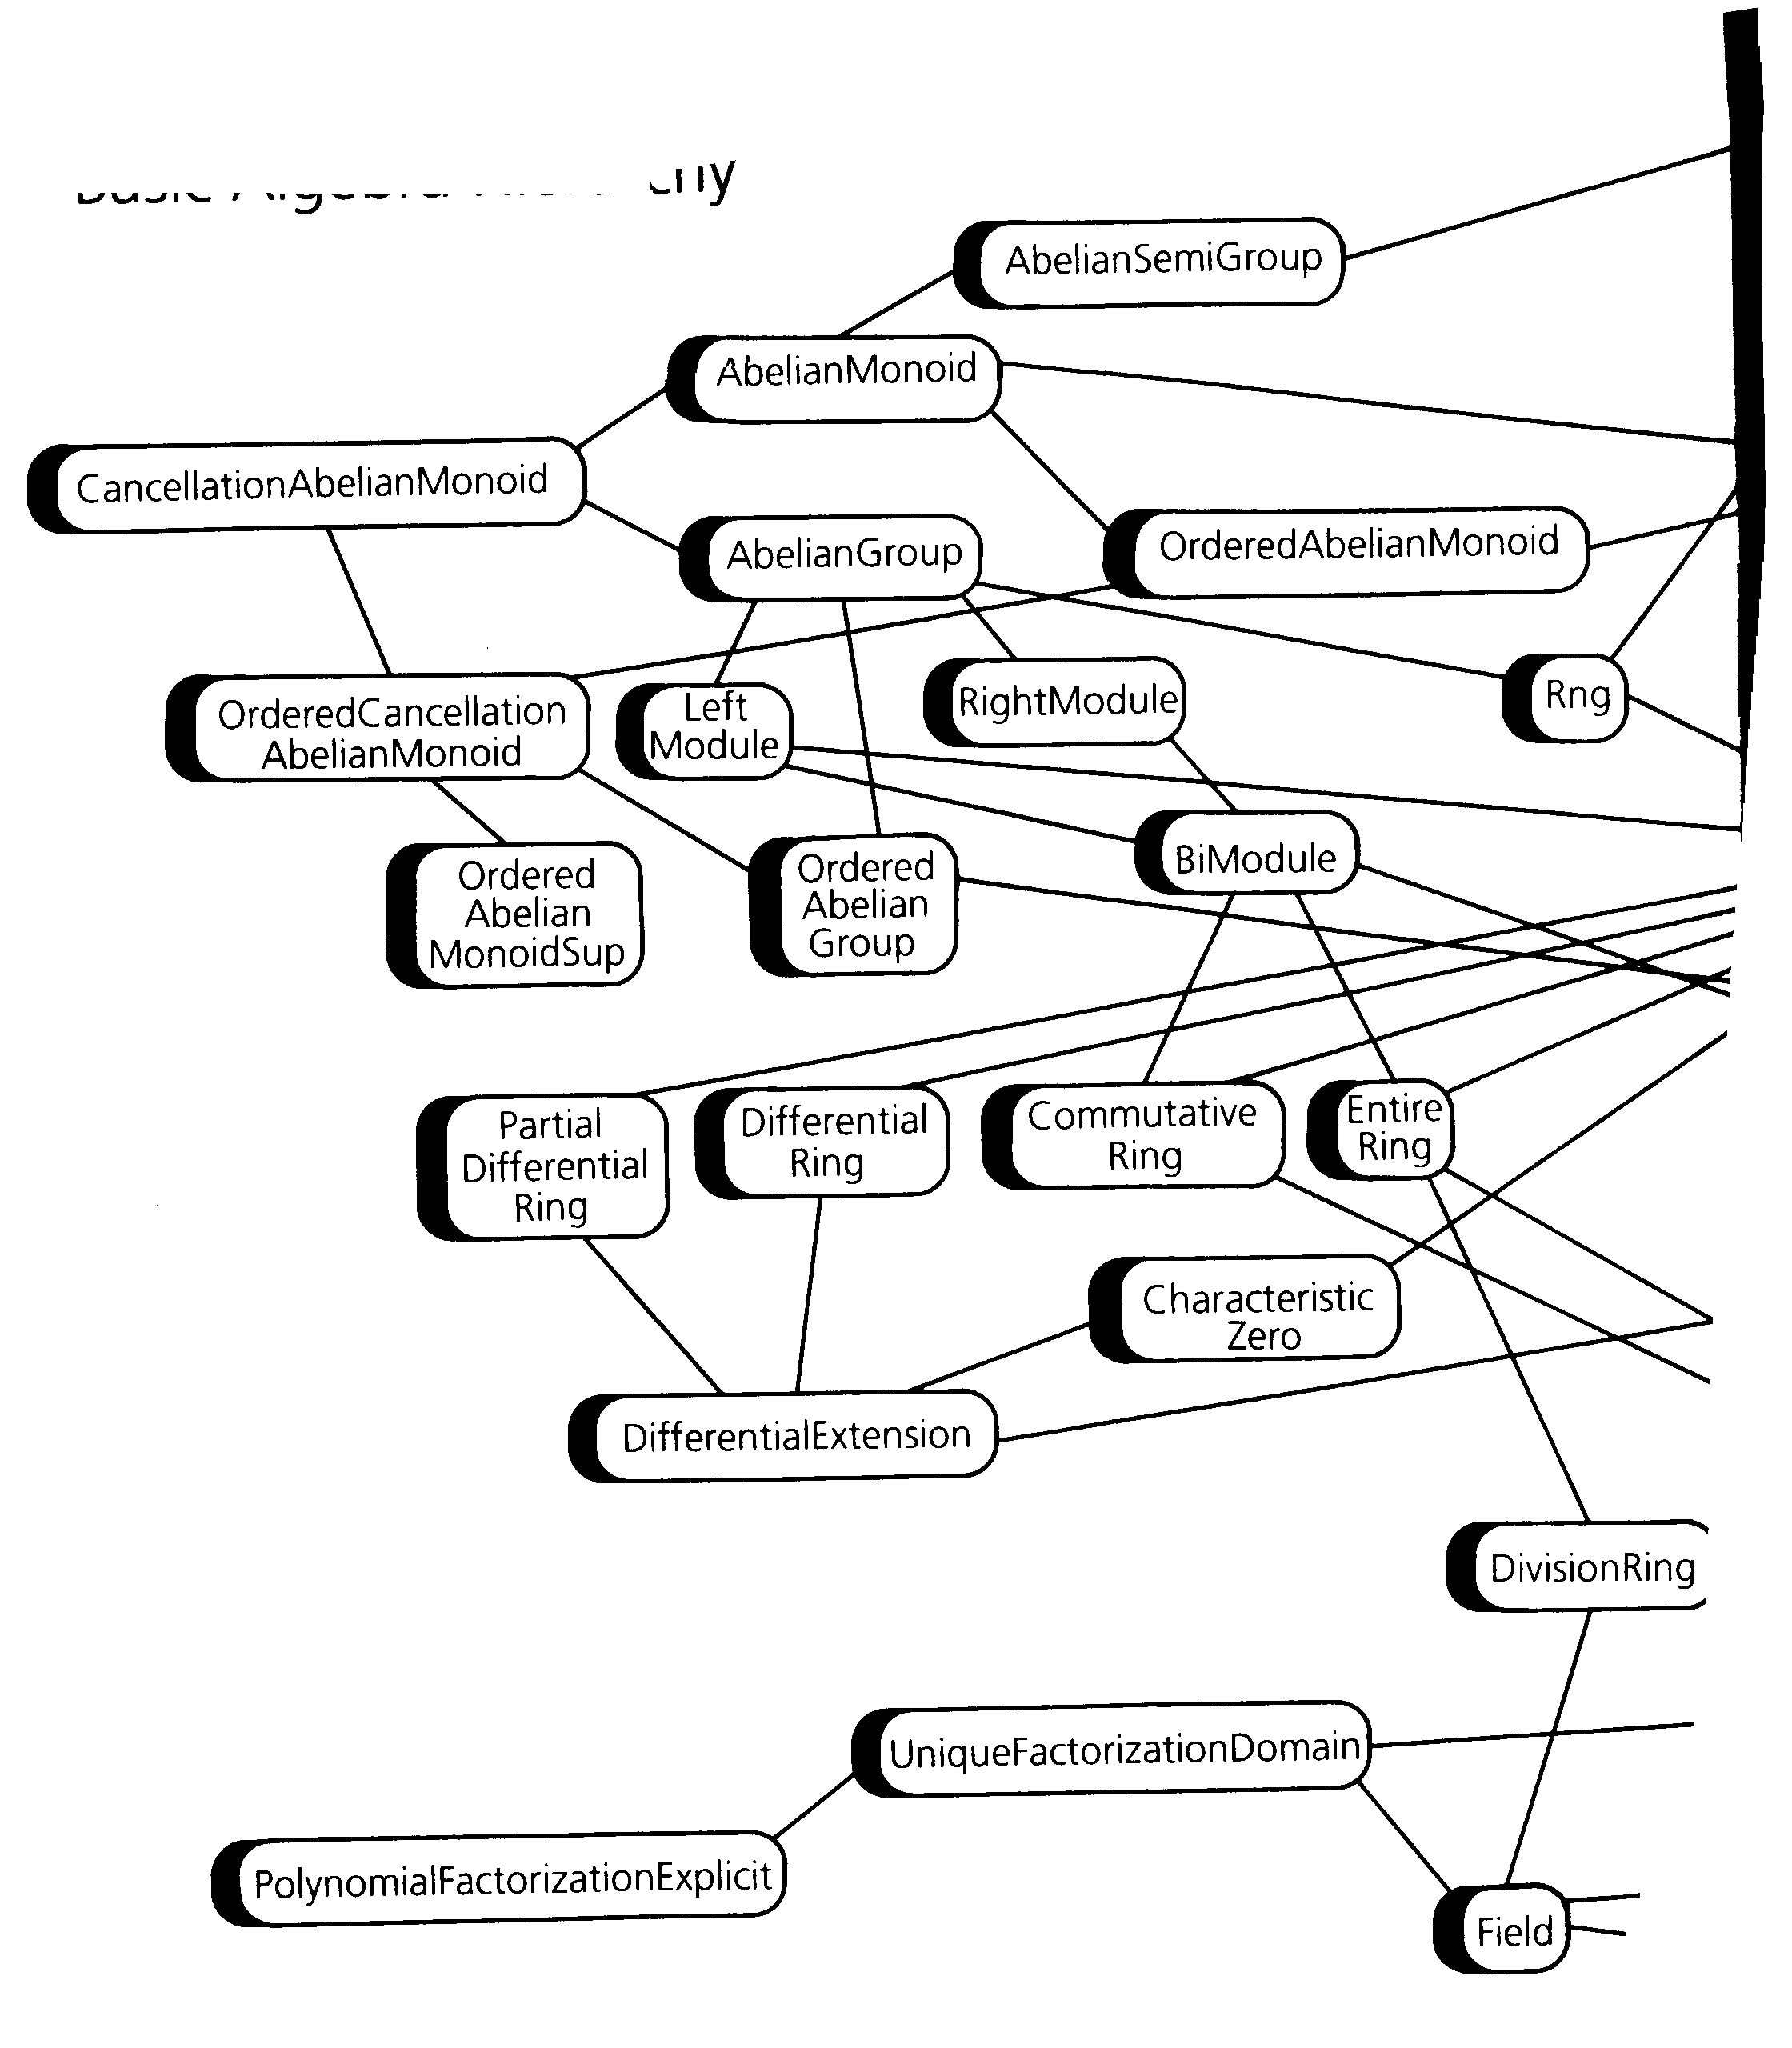
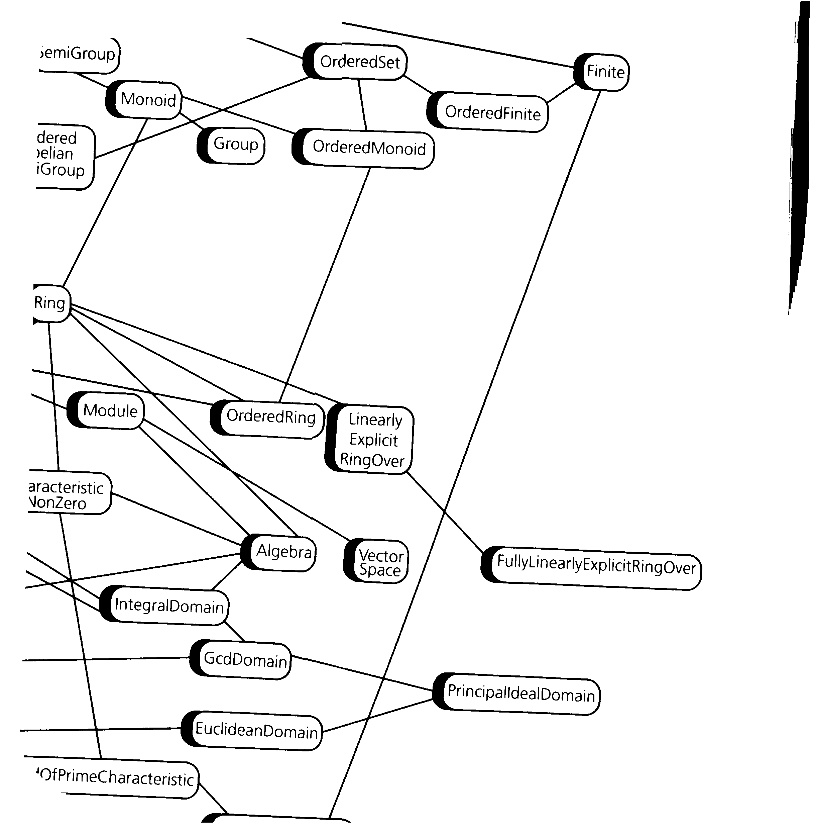
The most thorough example is Axiom
Basic Algebraic Hierarchy (scanned in 2 pieces)

Slide 9
How does this work
Answers come out with tags like type:DistributedMultivariatePolynomial([x,y], Fraction Integer)
and occasionally the user must assert domains like DMP([x,y],FRAC INT)
More complicated items are “easily” constructed..

Slide 10
Axiom Categories and Domains
Categories define algebraic properties. Protect programs from doing meaningless operations, and allow all meaningful ones.
name, e.g. Ring
operations, e.g. “+”, “*” “-”
other categories that it extends (inherits from)
Domains (of computation) denote classes of objects: Integer, Float, Polynomial(Integer), Matrix(Float)

Slide 11
Arguably Axiom allowed experts to define very general algebraic notions
And programs to go along with them.
But to specify programs you need data structures too, and these are categories.
Here is what Axiom provides..

Slide 12
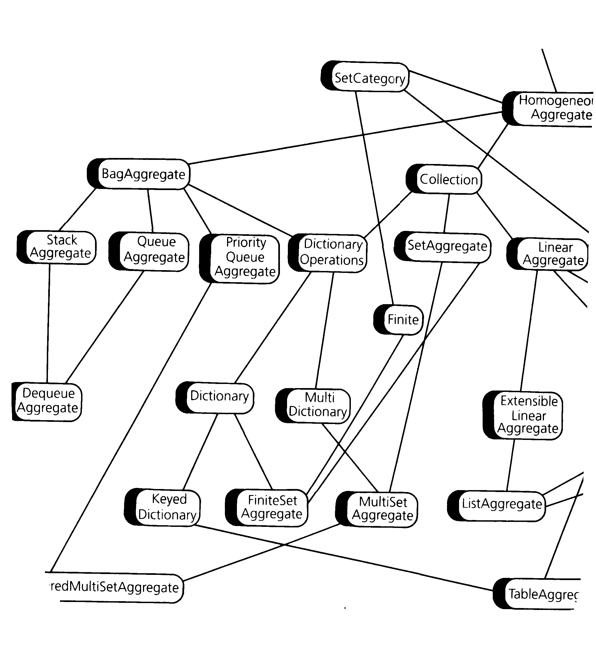
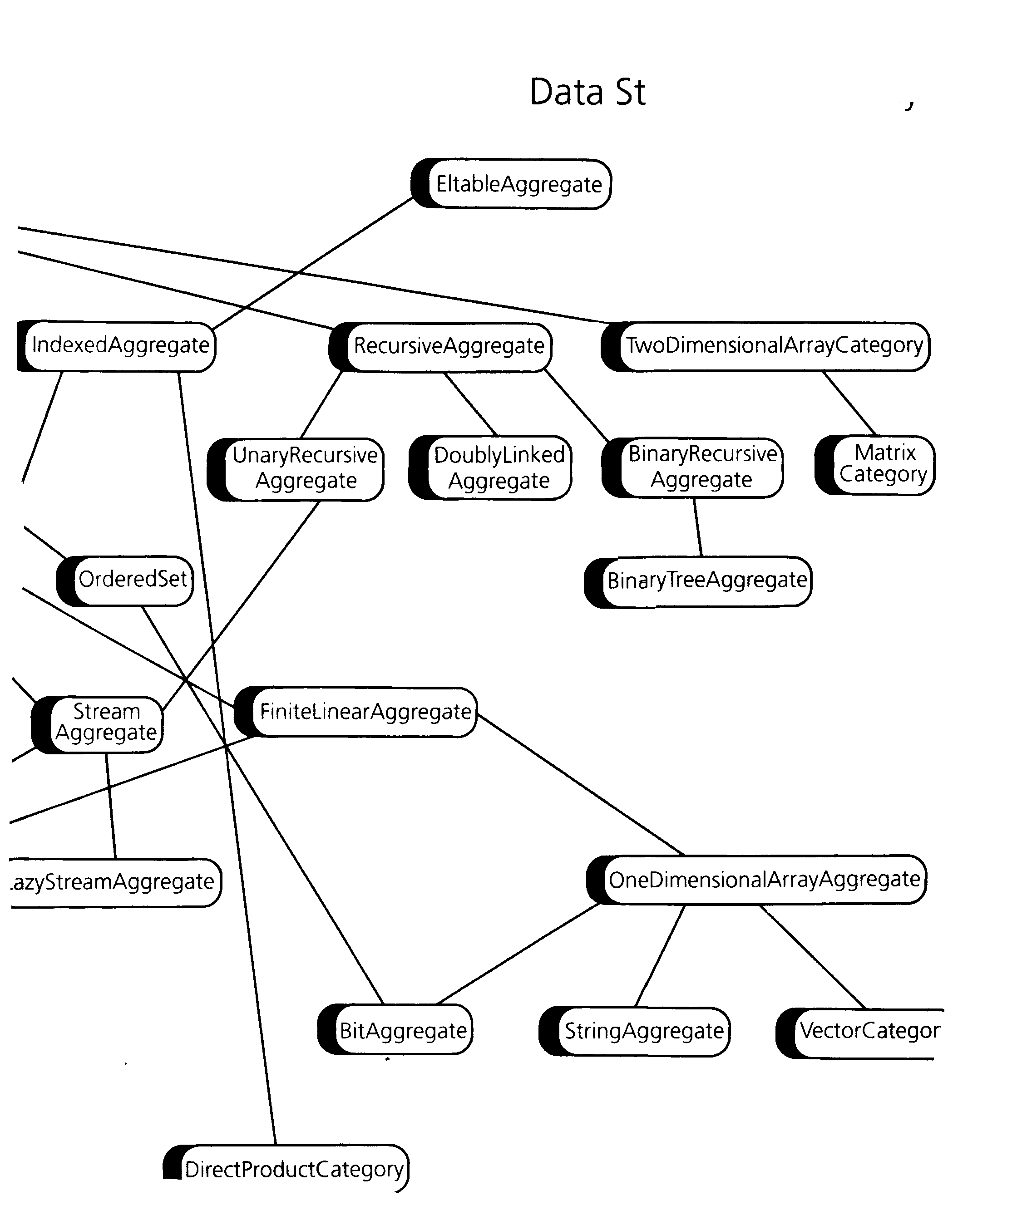
(from endpapers of Axiom reference...)
Data Structure Hierarchy

Slide 13
How far can we push this?
By allowing objects of type file, stream, color, point, ... there is not much that is excluded. It just isn’t especially convenient to program for the novice. Nor is it especially compact or fast – although there is nothing to prevent it from being compiled to good code.
Why did NAG drop Axiom (late 2001)? Perhaps
  Not strategic: can use numerical NAG from Maple
  Not profitable
  Misunderstanding of the market?

