Slide 1
Basic Extensions for Computer Algebra System Domains
Lecture 2c

Slide 2
Preview: Extensions
if x is an indeterminate, and
if D is a domain, we can talk about D[x], polynomials in x with coefficients in D
or D(x) ratios of polys in x.
Or D[[x]] : (truncated) power series in x over D.
Or Matrices over D.

Slide 3
Beware of notation
A particular polynomial expression might be referred to as p(x), which notation is also used to denote a function or mapping p:D₁→D₂ or a function application if x is not an indeterminate but a element in a field as p(3). Confused? The notation is unfortunate. Not confused? You are probably used to it.

Slide 4
Aside 2.1: canonical forms vs. mathematical equivalence
Mathematically, we don’t distinguish between two equivalent elements in Z(x), say 1/(x+1) and (x-1)/(x²-1).
Computationally these can be distinguished, and generally they must be distinguished. Often we must compute a canonical form for an expression by finding a particular “simplest” form in an equivalence class.

Slide 5
Aside 2.2: Simplification is almost everything in this business..
Trivial reduction. All computational problems in computer algebra can be reduced to simplification:
simplify (ProblemStatement) to CanonicalSolution

Slide 6
Aside 2.3: Computer representation and canonical forms
A computer might distinguish between two strings “abc” and “abc” if they are stored in different locations in memory. Or might not.
Usually it is advantageous to store an object only once in memory, but not always. (Should we store 43 just once? How about 3.141592654 ? How about ax²+bx+c?)

Slide 7
Back to extensions
if r is a root of an irreducible polynomial p, that is, p(r)=0, we will also talk about a ring or field extended by r: Q[r]. E.g. p(r)=r²+1=0 means r = p(-1) or i, and we have just constructed the complex rationals Q[r].
Z[i] is called “Gaussian integers" The set of elements a+bi, with a, b, integers.
Q[i] would allow rational a, b. (remember rationalizing denominators?)
Given such a field, you can extend it again.
IF you want to represent Q extended by sqrt(2),
and then THAT extended by sqrt(3), you can do so. Don't extend it again by sqrt(6). (why?)

Slide 8
More on extensions
In nice cases (primitive element), algebraic
arithmetic can be done by "reducing" modulo r. This is accomplished by dividing by p(r) and discarding the remainder: if E = a+b*p(r) then E´ a
You may need reminders of shortcuts. e.g. remainder of p(x) / (x-a) is the same as substituting a for x in p.
(other terms we will use on occasion: Euclidean domains, unique factorization domains, ideals, differential fields, algebraic curves. We’ll motivate them when needed)

Slide 9
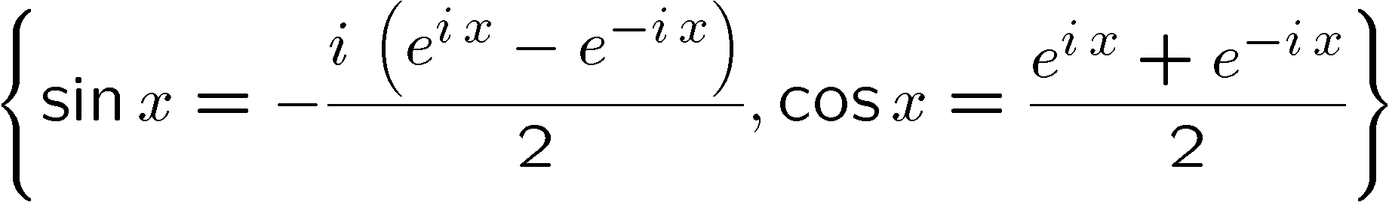
Other extensions
Differential fields have what amounts to log() and exp() extensions.
And an operation of differentiation such that
D(exp(x)) = exp(x), D(log(x)) =1/x.
Exp and log can be nested, and you can make trig functions:

Slide 10
There’s more… Other kinds of symbolic computation
Whole careers have been made out of other kinds of symbolic computation:
theorem proving, string manipulation, group representations, geometric computation, type theory/programming language representations, etc.
(J. Symbolic Computation publishes broadly…)
We will not probably not get to any of these areas in this course, although I could be swayed by student interest… also projects involving these topics are generally appropriate.

