Slide 1
Operations, representations
Lecture 3

Slide 2
Recall that we can compute with any finitely representable objects, at least in principle
Objects from any algebraic system, and even some ad-hoc mixtures
With any algorithms
  All steps specified precisely
  Terminating
Some processes are not-necessarily terminating. E.g. L’hôpital’s rule … use termination heuristics: time/space limits, losing some credibility for results ☹

Slide 3
The Usual Operations
Integer and Rational:
  Ring and Field operations +- * exact quotient, remainder
GCD, factoring of integers
Approximation via root-finding
Polynomial operations
  Ring, Field, GCD, factor
  Truncated power series
  Solution of polynomial systems
Matrix operations (add determinant, resultant, eigenvalues, etc.)

Slide 4
More Operations
Sorting (e.g. of monomials)
Union (collections of objects)
Tests for zero
Extraction of parts (polynomial degree, constant coefficient, leading coefficient)
Conversion to different forms (“expand”, express algebraic function in a minimal extension, “simplify” )

Slide 5
Yet More Operations
Differentiate
Integrate
Limit
Prove
Find region in which (in)equalities hold
Confirm (as: steps in a proof)

Slide 6
Yet More Operations
Plot
plot3d(exp(-x^2-y^2)*x,x,-2,2,y,-1.5,2.5)

Slide 7
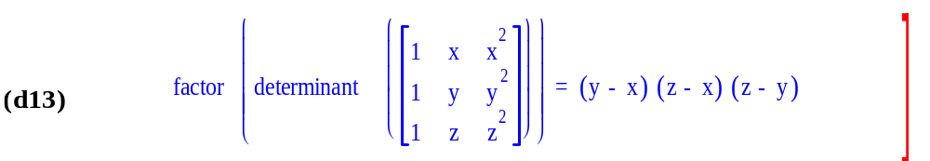
Yet More Operations
Typesetting

Slide 8
Integer representations, operations
The ring operations +*-
Euclidean Domain: quotient & remainder, GCD
UFD : factorization

Slide 9
Unfortunately computers don’t do these operations directly
Addition modulo 2³¹-1 is rarely what we need.
How do we do arbitrary precision integer arithmetic? (If we could do this, we could build the rationals, and via intervals or some other construction, we could make reals)

Slide 10
Is it hard to do arbitrary integer (bignum) arithmetic?
In spite of your belief that you are familiar with this subject, there are subtleties. Famous examples: factorization; even in long division!
You must choose fast algorithms (moderate size) or asymptotically optimal algorithms (large size): what’s your target?
You need fast arithmetic to compute billions of digits of π e.g. GMP or DH Bailey's home page
Arguably, there are sensitive geometric predicates that require very high precision.

Slide 11
Who cares about integer arithmetic?
You need to be able to compute with all lengths of numbers to build a computer algebra system: without it your system lies. [SMP used floats; e.g. represented 1/3 by 0.3333333..4. ]
Every Common Lisp has bignum arithmetic built in, some import GMP.

Slide 12
Some ideas just for representing integers
Integers are sequences of characters, 0..9.
Integers are sequences of words modulo 10⁹ which is the largest power of 10 less than 2³¹. [Maple!]
Integers are sequences of hexadecimal digits.
Integers are sequences of 32-bit words storing 16 bits.
Integers are sequences of 32-bit words.
Integers are sequences of 64-bit double-floats (with 8 bits wasted).
Sequences are linked lists
Sequences are vectors
Sequences are stored in sequential disk locations
Sign-magnitude representations possible too.

Slide 13
Yet more ideas
Integers are sequences of 64-bit double-floats (with 8 bits used to position the bits)
e.g. 2⁻³⁰⁰+2³⁰⁰ takes 2 words
Integers are stored in redundant form a+b+…
Integers are stored in p-adic form as a sequence of x mod p, x mod p², …

Slide 14
Addition in each of these representations
The fastest is the p-adic one, since all the arithmetic can be done without carry, in parallel.
Not usually used because
You can’t tell for sure if a number is +, -
Parallelism is almost always irrelevant ☹
If you must see the answer converted to decimal, the conversion is O(n²)
Conversion to decimal may be very common if your application is a bignum calculator.

Slide 15
Multiplication
Extremely well-studied.
The usual method takes O(n²),
Karatsuba style O(n^{1.585})
or FFT style O(n log n).
These will be studied in the context of multiplying polynomials.
Note that 345 can be mapped to p(x)=3x²+4x+5 where p(10) is 345.
Except for the “carry”, the operation is the same.

Slide 16
Integer Division
This is too tedious to present in a lecture.
Techniques for guessing the next big digit (bigit) of a quotient within +1 are available, Knuth’s Art of Computer Programming vol 2 has details.
For exact division (not div+remainder) consider Newton iteration as an alternative
FFT / fast multiplication helps

Slide 17
GCD
Euclid’s algorithm for integers is O(n² log n) but is hard to beat in practice, though see analysis of HGCD (Yap) for an O(n log² n) algorithm..
HGCD is portrayed as a winner for polynomials, but only by complexity analysts who (I suspect, in this case) assume that certain costs are constant when they grow exponentially, and/or subproblems, even small ones, can be done in O(n log n) time when n² is “faster”

Slide 18
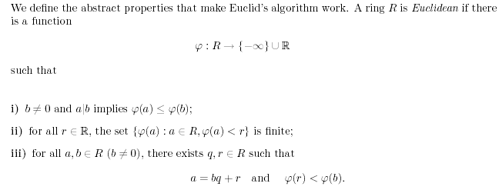
Reminder… A Ring R is Euclidean
If there is a function ψ

Slide 19
Shows the tendency to obfuscate…
What Rings do we use, and what is ψ?
For integers, absolute value ψ
For polynomials in x, degree in x ψ

Slide 20
Where next?
We could spend a semester on integer arithmetic, but this does not accomplish any higher goals of CAS
We proceed to polynomials, typically with integer coefficients or finite field coeffs.

