Slide 1
Polynomial Division, Remainder,GCD
Lecture 7

Slide 2
Division with remainder, integers
p divided by s to yield quotient q and remainder r: 100 divided by 3
p = s*q + r
100 = 3*33 + 1
by some measure r is less than s: 0<r<s

Slide 3
Division with remainder, polynomials
p(x) divided by s(x) to yield quotient q(x) and remainder r(x):
p = s*q + r
by some measure (degree in x, usually) r<s
notice there is an asymmetry if we have several variables..

Slide 4
Example (this is typeset from Macsyma)
quotient, remainder

Slide 5
Long division: In detail
x²
+ 2x
+1
x+1
) x³+3x²+3x+1
x³+ x²
2x²+3x
2x²+2x
x+1
x+1
0

Slide 6
That was lucky: Divisible AND we could represent quotient and remainder over Z[x].
Consider this minor variation -- the divisor is not monic (coefficient 1) : 2x+1 instead of x+1. This calculation needs Q[x] to allow us to do the division...

Slide 7
Long division: In detail
1/2x²
+ 5/4x
+7/8
2x+1
) x³+ 3x²+ 3x +1
x³+ 1/2x²
5/2x²+3x
5/2x²+5/4x
7/4x+1
7/4x+7/8
1/8

Slide 8
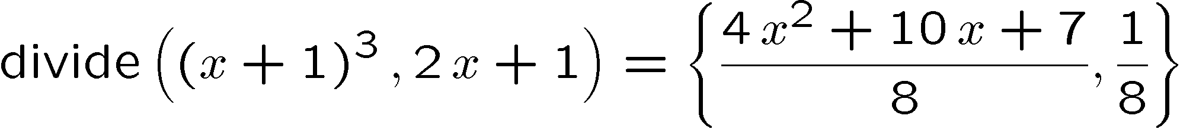
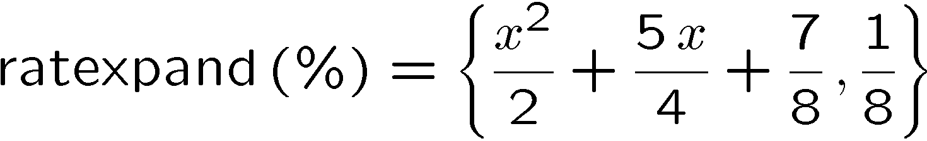
Macsyma writes it out this way

Slide 9
In general that denominator gets nasty:
5^4 is 625.

Slide 10
Symbols (other indeterminates) are worse

Slide 11
Pseudo-remainder.. Pre-multiplying by power of leading coefficient... a³
note: we are doing arithmetic in Z[a,b][x] not Q(a,b)[x].

Slide 12
Order of variables matters too.
Consider x²+y² divided by x+y, main variable x.
Quotient is x-y, remainder 2y² . That is,
x²+y² = (x-y)(x+y) + 2y² .
Now consider main variable y
Quotient is y-x, remainder 2x² . That is,
x²+y² = (-x+y)(x+y) + 2x² .

Slide 13
Some activitives (Gröbner Basis reduction) divide by several polynomials
P divided by s₁, s₂, ... to produce
P= q₁s₁+1₂s₂+... (not necessarily unique)

Slide 14
Euclid’s algorithm (generalized to polynomials): Polynomial remainder sequence
P₁, P₂ input polynomials
P₃ is remainder of divide(P₁,P₂)
.... P_{n} is remainder of divide(P_{n-2},P_{n-1})
If P_{n} is zero, the GCD is P_{n-1}
At least, an associate of the GCD. It could have some extraneous factor (remember the a³?)

Slide 15
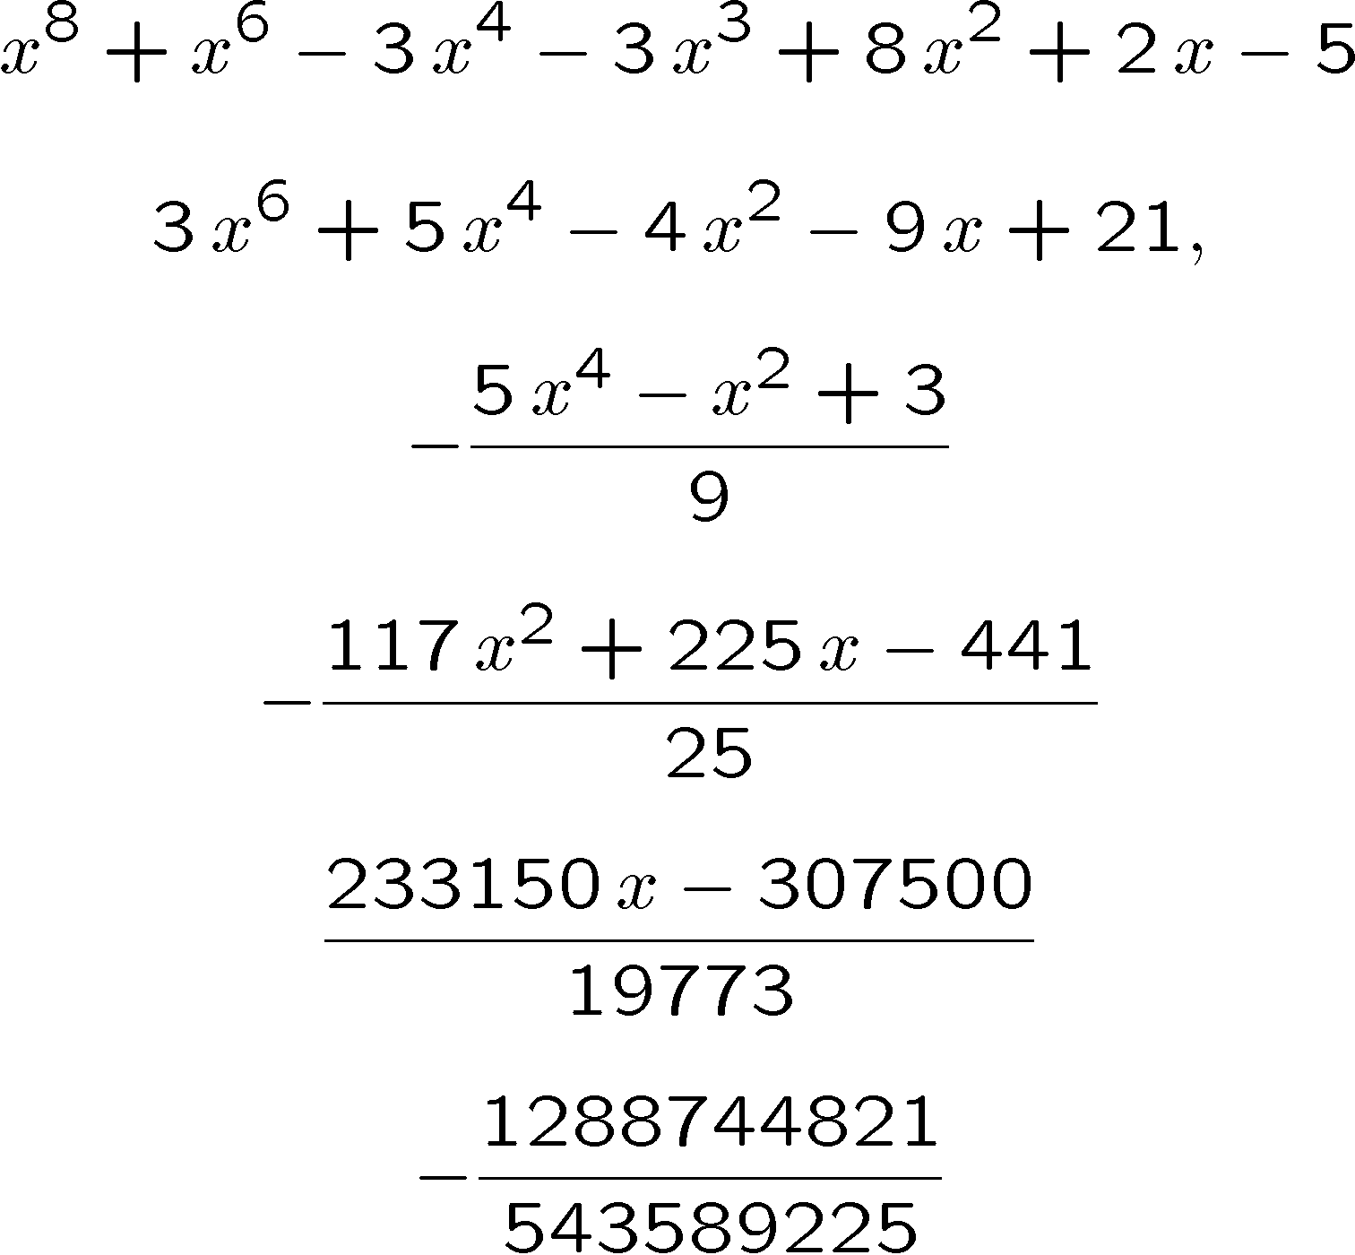
How bad could this be? (Knuth, vol 2 4.6.1)
Euclid’s alg. over Q

Slide 16
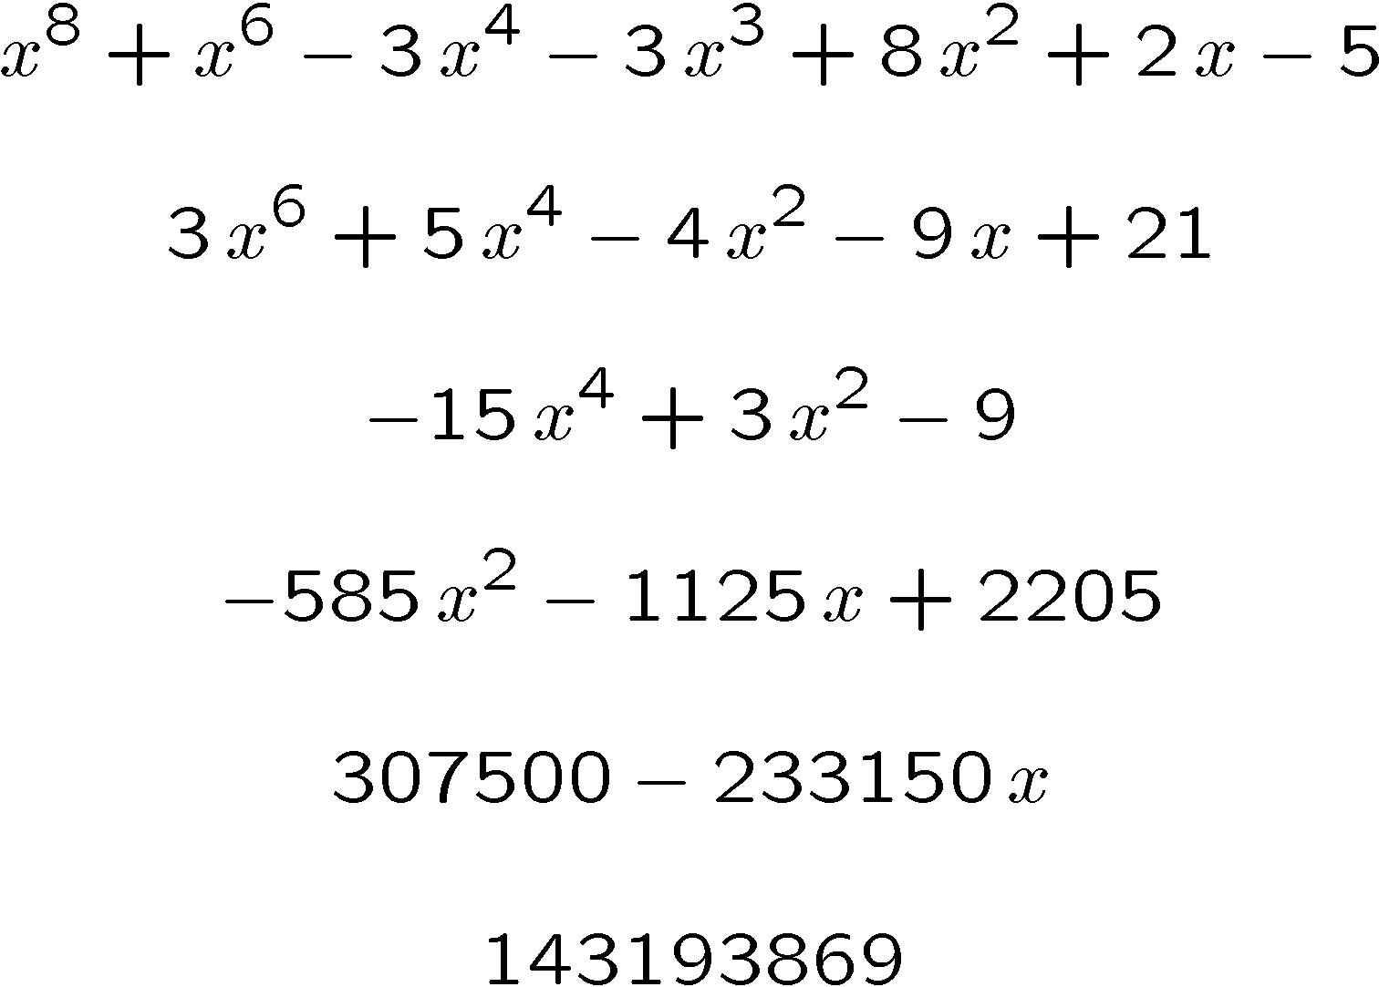
Making the denominators disappear by premultiplication....
Euclid’s alg. over Z, using pseudoremainders

Slide 17
Compute the content of each polynomial
1
1
1/9
9/25
50/ 19773
1288744821/ 543589225
Euclid’s alg. over Q. Each coefficient is reduced... not much help.

Slide 18
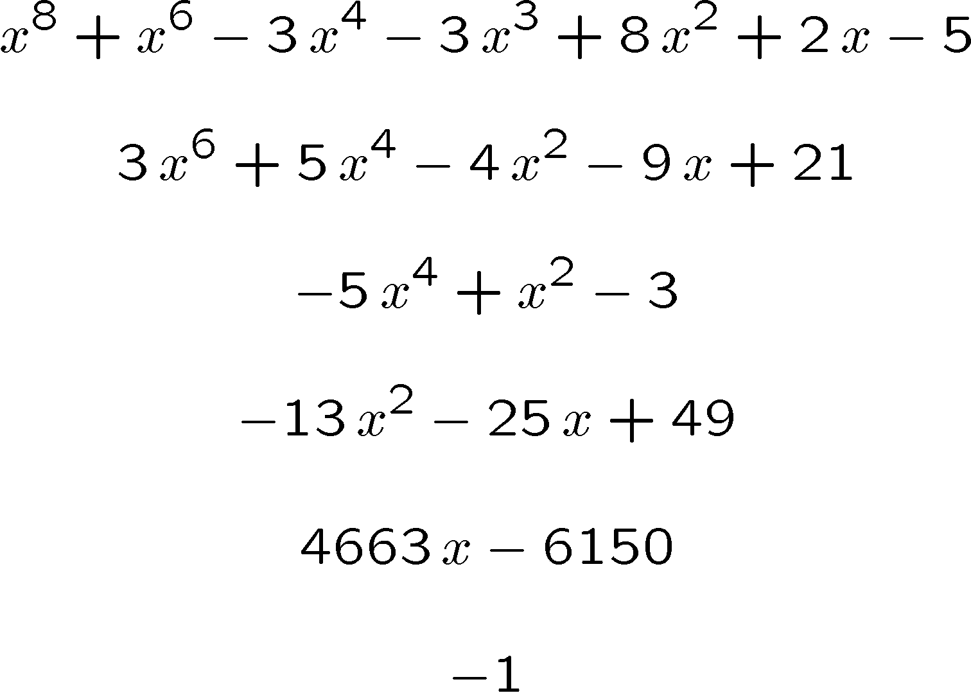
Better but costlier, divide by the content
Euclid’s alg. over Q, content removed: primitive PRS

Slide 19
Some Alternatives
Do computations over Q, but make each polynomial MONIC, eg. p₂= x⁶+5/3x⁴+...
(this does not gain much, if anything. recall that in general the leading coefficient will be a polynomial. Carrying around 1/(a³+b³) is bad news.
Do computations in a finite field (in which case there is no coefficient growth, but the answer may be bogus)

Slide 20
Sample calculation mod 13 drops some coefficients!
x⁸+x⁶-3x⁴-3x³-5x²+2x-5
3x⁶+5x⁴-4x²+4x-5
-2x⁴+3x²+4
6x-5 was 585x² ... but 585|13
5x-2
0
... bad result suggests 5x-2 is the gcd, but 5x-2 is not a factor of p₁ or p₂

Slide 21
This modular approach is actually better than this...
In reality, the choice of 13 is easily avoidable, and there are plenty of “lucky” primes which will tell us the GCD is 1
e.g. prime 3571 gives,
X⁸+x⁶-3x⁴-3x³-5x²+2x-5
3x⁶+5x⁴-4x²+4x-5
x⁴+714x²+1429
281x²-9x+589 or x²+826x+1095
x+1152
376647 or 1 if monic.

Slide 22
Another Alternative: the subresultant PRS
Do computations where a (guaranteed) divisor not much smaller than the content can be removed at each stage (subresultant PRS)
In our example, the subresultant’s last 2 lines are
  9326x-12300
  260708 (actually the subres PRS is usually better; our example was an abnormal remainder sequence)

Slide 23
The newest thought: Heuristic GCD, the idea is to evaluate
In our example,
p₁(1234567)=5396563761321934654715861185575219389243022352699
p₂(1234567)=10622071959634010638660619508311948074
the integer GCD is 1
Can we conclude that if the GCD is h(x), that h(1234567)=1 ?

Slide 24
The GCD papers, selected, online in /readings. Recent “reviews”
M. Monagan, A. Wittkopf:
On the design and implementation of Brown's Algorithm (GCD) over the integers and number fields. Proc. ISSAC 2000 p 225-233
http://portal.acm.org/citation.cfm?doid=345542.345639
or the class directory, monagan.pdf
P. Liao, R. Fateman:
Evaluation of the heuristic polynomial GCD Proc ISSAC 1995 p 240-247
http://doi.acm.org/10.1145/220346.220376
or this directory, liao.pdf

Slide 25
The GCD papers, selected, online in /readings. Classics.
G.E. Collins:
Subresultants and reduced polynomial remainder sequences
JACM Jan 1967
http://doi.acm.org/10.1145/321371.321381
or this directory, collins.pdf
W.S Brown:
The Subresultant PRS algorithm
ACM TOMS 1978
brown.pdf

Slide 26
The GCD papers, selected, online in /readings. The sparse GCDs
J. Moses and D.Y.Y. Yun
The EZ GCD algorithm
1973 Proc. SYMSAC
moses-yun.pdf
R. Zippel: SPMOD in Zippel’s text. Or PhD

Slide 27
The GCD papers, selected, online in /readings. The sparse GCDs
E. Kaltofen:
Greatest common divisors of polynomials given by straight-line programs
JACM 1988.
http://doi.acm.org/10.1145/42267.45069
kaltofen.pdf

