Slide 1
Hensel Interpolation
Lecture 9

Slide 2
Recall our typical mapping from GCD
GCD(F(x,y,z),G(x,y,z))
H(x,y,z)
H_{p}(x,y,z)
GCD(F_{p}(x,y,z),G_{p}(x,y,z))
GCD(F_{p}(x,0,0),G_{p}(x,0,0))
H_{p}(x,0,0)

Slide 3
Start in the lower right corner of this diagram with some image of a factorization
c(x)*h(x)=f(x) mod p
... we have c mod p, h mod p. (and f mod p)
... we want to know c and h over Z [x], in fact, over Z[x,y,z,...] as many variables as are necessary.
note that here c(x) is the cofactor of f, (c=f/h), and h is the gcd(f,g).
ALSO we’ll sometimes need to trump up these --otherwise in general --false assumptions..
f(x) and h(x) are monic [leading coeff 1]
f(x) and h(x) are “square-free”. That is, f(x)=k²(x)*... is forbidden.

Slide 4
Aside..
Removing squared factors takes some effort, but not as much as factoring generally, so this is a good move if the problem is to find factors. Compared to taking a GCD, it is not such a clear win, but still, it must be done.
Making the input monic by separating the content and primitive part, then dividing (in a finite field) by the leading coefficient; we must replace these factors, perhaps at considerable cost (the leading coefficient may be a polynomial in other variables!)

Slide 5
Recall p-adic notation
If p and N are integers, then the p-adic representation of N is
(a₀, a₁, ..., a_{m}) where for i = 1, ...,m = we have
(–p+1)/2≤ai<(p-1)/2 or here we will use.. 0≤a_{i}<p
N = a₀p⁰ + a₁p¹ + ... + a_{m}p^{m}
For instance, the 3-adic representation of the integer 65 is (2,0,1,2).= 2+0*3+1*3²+2*3³ = 2+9+54 = 65

Slide 6
p-adic notation for polynomials
We can extend this notion to polynomials. If p(x) and q(x) are polynomials (in x), then the p-adic representation of q is (a₁, a₂, ..., a_{m}) where for i=1, ..., m-1, a_{i} is in an integer, a_{m} is a nonzero integer and
q(x) = a₀p(x)⁰ + a₁p(x)¹ + ... +a_{m}p(x)^{m}
For instance the (x-1)-adic representation of x³ is (1,3,3,1) = 1+ 3*(x-1)+3(x-1)²+1*(x-1)³ = 1+3x-3+3x²-6x+3+x³-3x²+3x-1 = x³

Slide 7
Hensel Algorithms
Start with a p-adic approximate and compute ever more accurate versions. When we get a high enough approximation p^{r} we hope (or prove) it will be good over the integers.
The original linear Hensel Construction lifts a factorization
from mod p^{i} to mod p^{i+1} at the i^{th} step
while the quadratic construction due to Zassenhaus lifts a factorization from mod (p²)^{i} to mod (p²)^{i+1}
That is, twice as many terms instead of one more term. Nevertheless, the linear version may require so much less computation at each step that it may be the algorithm of choice in lifting to a given power of a modulus.

Slide 8
Starting up.. Algorithm
Let u(x) be a monic polynomial . (As previously noted, this assumption is, in general, unwarranted. Since overcoming it makes the algorithm messy, we ignore it.)
in Z[x] and assume v₁(x) ¢ w₁(x) = u(x) mod p and GCD (v₁,w₁) = 1 mod p where p is a prime.
The algorithm computes a sequence of pairs of polynomials
{(v_{i},w_{i})} such that
v_{i}(x) ¢ w_{i}(x) = u(x) mod p^{i}

Slide 9
Step I
Compute by means of the Extended Euclidean Algorithm
generalized to polynomials, two polynomials a(x) and b(x) in Z_{p}[x] such that
(i) deg(a) < deg(w₁)
deg(b) < deg(v₁)
(a(x)v₁ + b(x)w₁ = 1) mod p

Slide 10
Step II
Now suppose we are given (v_{i}, w_{i}) and we wish to compute (v_{i+1},w_{i+1}). Compute a polynomial c_{i} such that
(p^{i}c_{i}(x) = v_{i}(x)w_{i}(x) - u(x)) mod p^{i+1}
How hard is this? a multiply, subtraction, and division with remainder

Slide 11
Step III
Compute (by polynomial division of a(x)c_{i}(x) by w₁(x)) the quotient q_{i}(x) and remainder a_{i}(x) such that
a(x)c_{i}(x) = q_{i}(x)w₁(x) + a_{i}(x) mod p
and set
b_{i}(x) := (b(x)c_{i}(x) + q_{i}(x)v₁(x)) mod p
Observe that deg(a_{i})<deg(w₁), deg(b_{i})<deg(v_{i})
and mod p,
a_{i}v₁ + b_{i}w₁ = (a ¢ c_{i} - w₁q_{i})v₁+ (b ¢ c_{i} + v₁q_{i})w₁
= c_{i}(a ¢ v₁ + b ¢ w₁ )
= c_{i}

Slide 12
Step III- observation
{so in Z[x] , (or Z_{p2}[x] )
a_{i}v₁ + b_{i}w₁ = c_{i} + p ¢ d_{i}(x) for some d_{i}(x) in Z[x]

Slide 13
Step IV
Set
v_{i+1}(x) := v_{i}(x)-p^{i}b_{i}(x) mod p^{i+1}
w_{i+1}(x) := w_{i}(x)-p^{i}a_{i}(x) mod p^{i+1}
Observe that, over the integers
v_{i+1}(x)w_{i+1}(x) = v_{i}(x)w_{i}(x)- p^{i}[a_{i}(x)v_{i}(x)+b_{i}(x)w_{i}(x)] + p^{2i} ¢ a_{i}(x)b_{i}(x)
= u(x) + p^{i} ¢ c_{i}(x) - p^{i}[c_{i}(x) +p ¢ d_{i}(x)] + p^{2i} ¢ a_{i}(x)b_{i}(x)
= u(x) - p^{i+1}[d_{i}(x)-p^{i-1} ¢ a_{i}(x)b_{i}(x)
that is,
v_{i+1}(x)w_{i+1}(x) = u(x) mod p^{i+1} (QED)

Slide 14
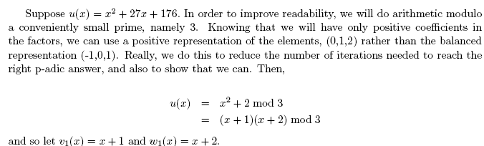
An Example (see online notes “Hensel.pdf”)

Slide 15
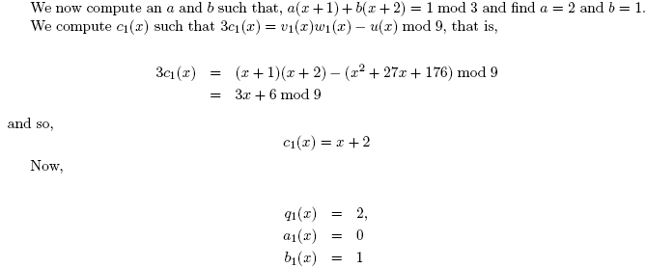
Continuing…

Slide 16
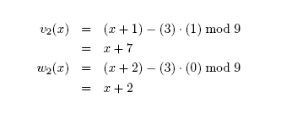
Result Modulo 9

Slide 17
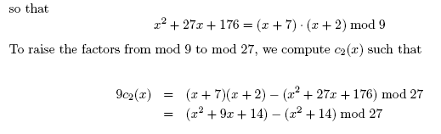
We must go further, to mod 3^3

Slide 18
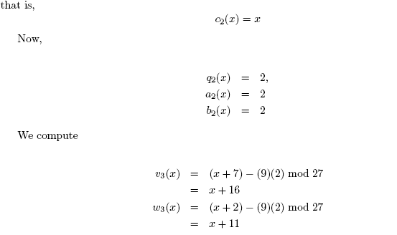
Here are the steps

Slide 19
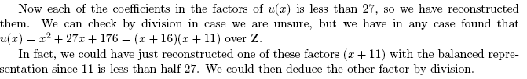
Check (x+16)*(x+11)
end

