Slide 1
Automatic Differentiation
Lecture 18b

Slide 2
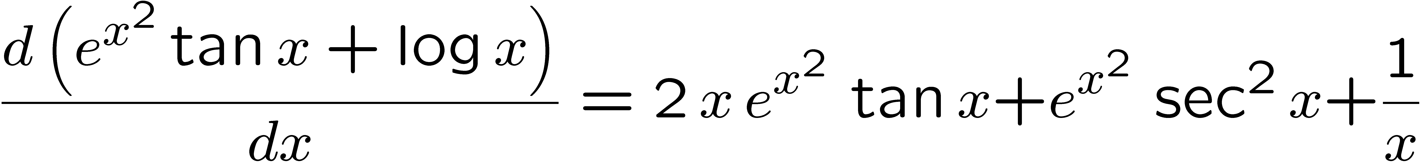
What is “Automatic Differentiation”
We want to compute both f(x), f’(x), given a program for f(x):=exp(x^2)*tan(x)+log(x).
We could do this via…

Slide 3
But this is too much work.
All we really want is a way to compute, for a specific numeric value of x, f(x), and f’(x). Say the value is x=2.0. We could evaluate those two expressions, or we could evaluate a taylor series for f around the point 2.0, whose coefficients would give us f(2) and f’(2)/2!
Or we could do something cleverer.

Slide 4
ADOL, ADOL-C, Fortran (77, 90) or C “program differentiation”
Rewrite (via a compiler?) a more-or-less arbitrary Fortran program that computes f(c) into a program that computes ⟨f(c), f’(c)⟩ for a real value c.
How to do this?
Two ways, “forward” and “reverse”

Slide 5
Forward automatic differentiation
In the program to compute f(c) make these substitutions:
  Where we see the expression x, replace it with ⟨c,1⟩
    the rule d(u) = 1 if u=x.
  Where we see a constant, e.g. 43, use ⟨43,0⟩
    the rule d(u)=0 if u does not depend on x
  Where we see an operation ⟨a,b⟩ +⟨r,s⟩ use ⟨a+r,b+s⟩
    the rule d(u+v) = du+dv
  Where we see an operation ⟨a,b⟩ *⟨r,s⟩ use ⟨a*r,b*r+a*s⟩
    the rule d(u*v)= u*dv+v*du
  Where we see cos(⟨r,s⟩) use ⟨cos(r),-sin(r)*s⟩
    the rule d(cos(u))=-sin(u)du
  Etc.

Slide 6
Two ways to do forward AD
Rewrite the program so that every variable is now TWO variables, var and var_{x}, the extra var_{x} is the derivative.
Leave the “program” alone and overlay the meaning of all the operations like +, *, cos, with generalizations on pairs ⟨α, β⟩

Slide 7
Does this work “hands off”? (Either method..)
Mostly, but not entirely.
Some constructions are not differentiable. Floor, Ceiling, decision points.
Some constructions don’t exist in normal fortran (etc.) e.g. “get the derivative” needed for use by
  Newton iteration: z_{i+1} := z_{i}- f(z_{i})/f’(z_{i})
Is it still useful? Apparently enough to build up a minor industry in enhanced compilers. see www.autodiff.org for comprehensive references
If the programs start in Lisp, the transformations are clean and short. See www.cs.berkeley.edu/~fateman/papers/overload-AD.pdf

Slide 8
Where is this useful?
A number of numerical methods benefit from having derivatives conveniently available: minimization, root-finding, ODE solving.
Generalized to F(x,y,z), and partial derivatives of order 2, 3, (or more?)

Slide 9
What about reverse differentiation?
The reverse mode computes derivatives of dependent variables with respect to intermediate variables and propagates from one statement to the previous statement according to the chain rule.
Thus, the reverse mode requires a “reversal” of the program execution, or alternatively, a stacking of intermediate values for later access.

Slide 10
Reverse..
Given independent vars x = {x₁, x₂, …}
And dependent vars y = {y₁(x), y₂(x) …}, and also temporary vars…
(read grey stuff upward…)
A=f(x1,x2)
B=g(A,x3) … we know d/dx1 of B is dG/d1 * dA/dx1
R=A+B … we know d/dx1 of R is dA/dx1+dB/dx1, what are they?

Slide 11
Which is better?
Hybrid methods have been advocated to take advantage of both approaches. Reverse has a major time advantage for many vars; it has the disadvantage of non-linear memory use– depends on program flow, loops iterations must be stacked.
Numerous conferences on this subject.
Lots of tools, substantial cleverness.

