Slide 1
Microsoft Tenné Creating with purpose, empowering movie achievement
Rebecca Frost-Brewer

Slide 2
Summary
Descriptive analysis of data from IMDb, The Movie Database, and Box Office Mojo reveal trends for Microsoft to use in determining what movies to make
For successful, sustained gross earnings over time, Tenné should produce Adventure and Action
For immediately successful gross earnings, Tenné should produce Sci-Fi, Animation, Adventure, Fantasy, or Action movies
Create Sci-Fi movies.

Slide 3

Outline
Business Problem
Data & Methods
Results
Conclusions
Next Steps

Slide 4
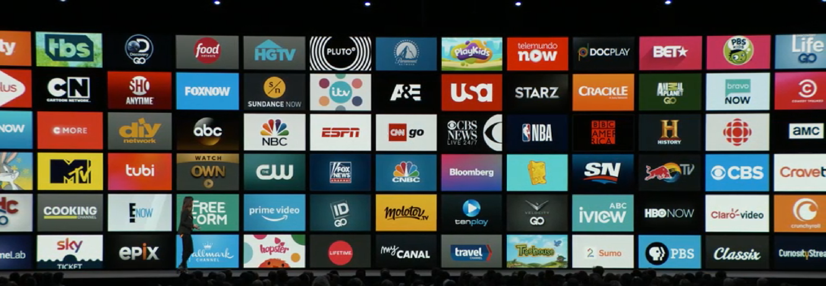
Business Problem
Determine what kind of movies to make

Slide 5
Data & methods
The data for this analysis have come from:
The Movie Database (movie title, audience rating)
IMDb (movie title, release year, genres, and audience rating)
Box Office Mojo (movie title, gross earnings)
The data span the years from 2010 to 2018
The target variables are release year, gross earnings, genres, and audience ratings.

Slide 6
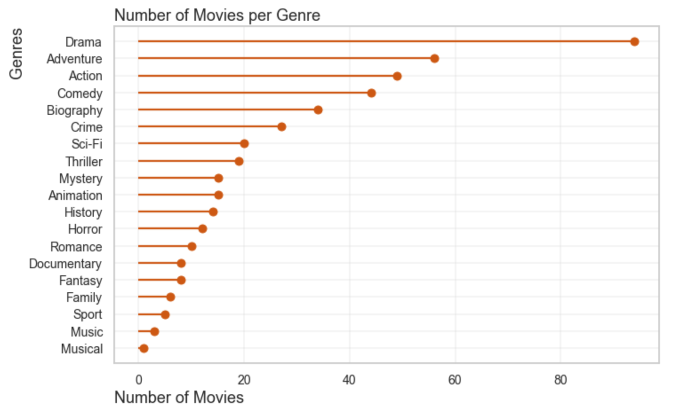
results
The top three genres by number of movies created:
Drama (94)
Adventure (56)
Action (49)

Slide 7
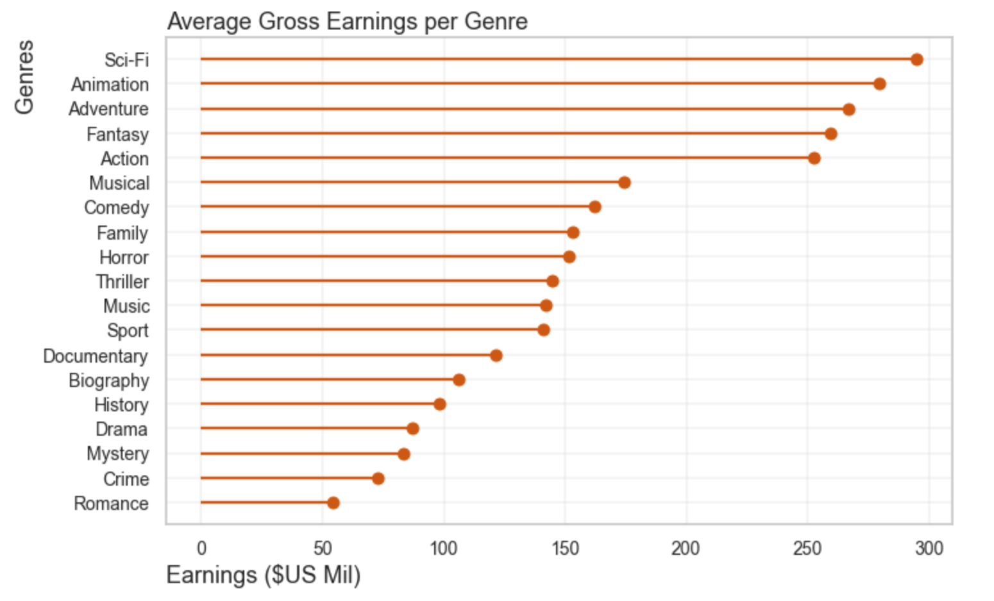
results
The top five genres by average gross earnings per movie:
Sci-Fi ($291mil)
Animation ($278mil)
Adventure ($267mil)
Fantasy ($259mil)
Action ($253mil)

Slide 8
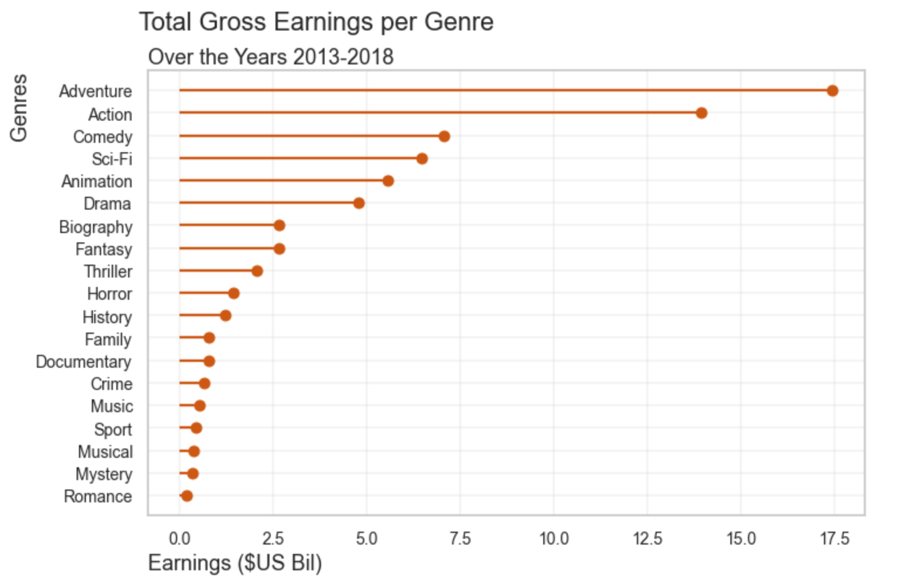
Results
Top genres by total gross earnings over 2013-2018
Adventure ($17.4bil)
Action ($13.9bil)
Comedy ($7.0bil)
Sci-Fi ($6.4bil)
Animation ($5.5bil)

Slide 9
conclusions
For successful, sustained gross earnings over time, Tenné should produce Adventure and Action.
For immediately successful gross earnings, Tenné should produce movies that are Sci-Fi, Animation, Adventure, Fantasy, or Action
Create Sci-Fi movies
Next Steps
Analyze more recent data
Analyze streaming data
Analyze demographics of movie-makers and movie-watchers

