Slide 1
Microsoft Tenné Creating with purpose, empowering movie achievement
Rebecca Frost-Brewer

Slide 2
Summary
Descriptive analysis of data from IMDb, The Movie Database, and Box Office Mojo reveal trends for Microsoft to use in determining what movies to make
For successful gross earnings, Tenné should produce Sci-Fi, Adventure, and Action movies
For successful audience ratings, Tenné should produce Musical, Sci-Fi, and Animation movies.
Create Sci-Fi movies

Slide 3

Outline
Business Problem
Data & Methods
Results
Conclusions
Next Steps

Slide 4
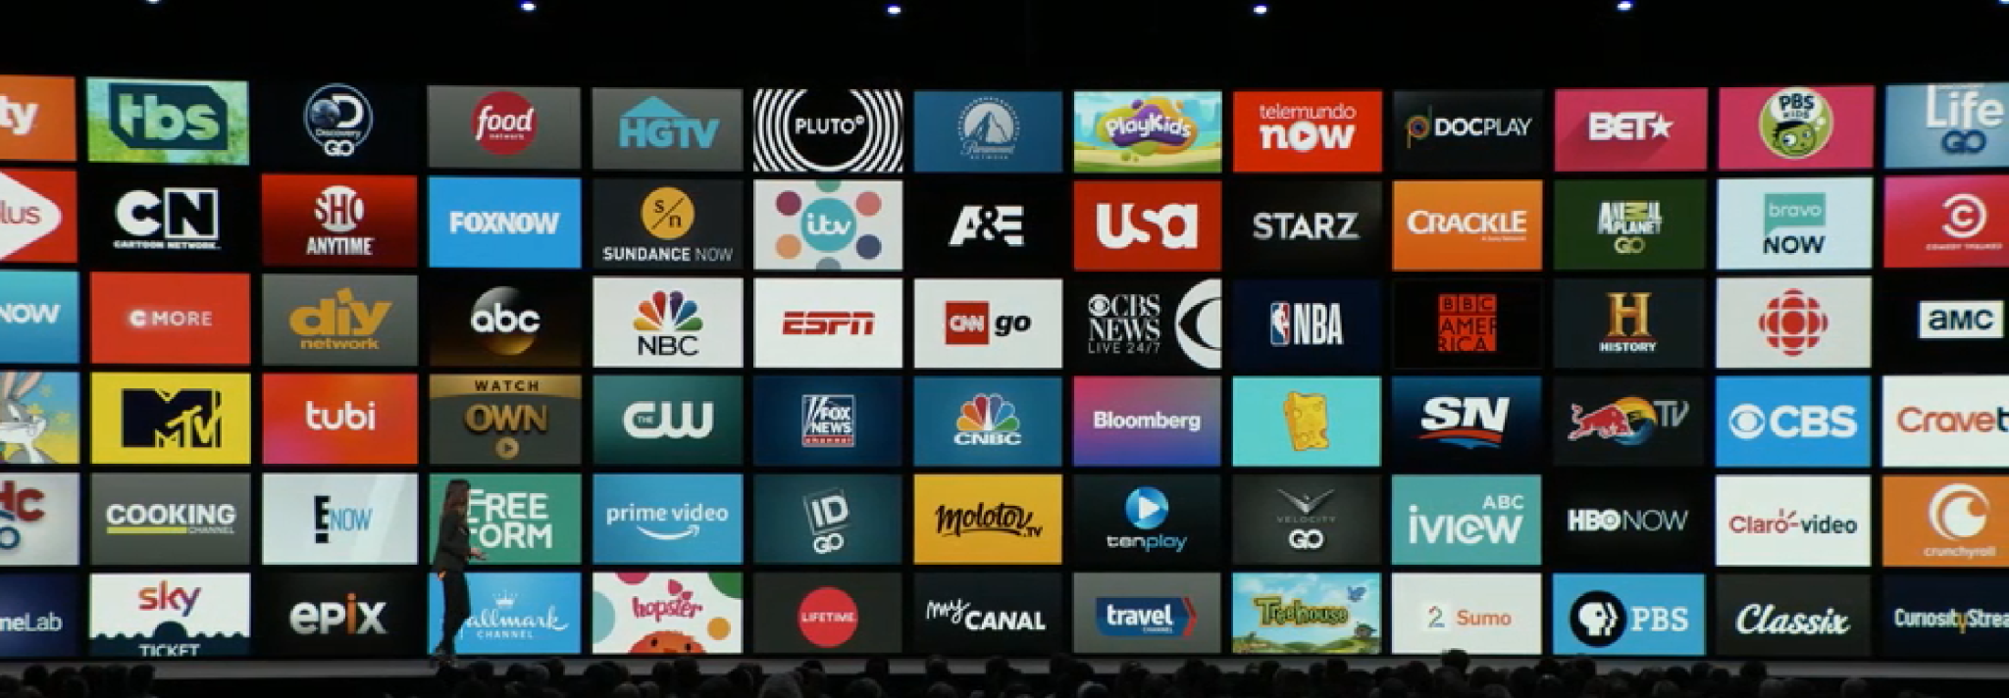
Business Problem
Determine what kind of movies to make

Slide 5
Data & methods
The data for this analysis have come from:
The Movie Database (movie title, audience rating)
IMDb (movie title, release year, genres, and audience rating)
Box Office Mojo (movie title, gross earnings)
The data span the years from 2010 to 2018
The target variables are release year, gross earnings, genres, and audience ratings.

Slide 6
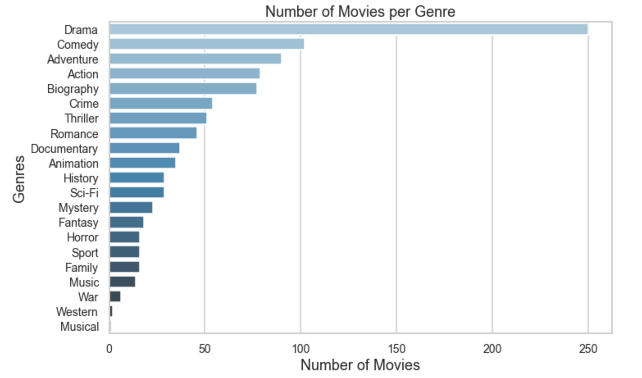
results
The top three genres by number of movies created:
Drama (250)
Comedy (102)
Adventure (90)

Slide 7
results
Genre | Count of Movies | Average Rating
Musical | 16 | 7.7
Sci-Fi | 33 | 7.6
Animation | 44 | 7.52
Mystery | 28 | 7.51
Adventure | 104 | 7.51
Documentary | 41 | 7.49
Biography | 95 | 7.48
Action | 91 | 7.48
Crime | 66 | 7.48
The top three genres by average rating:
Musical (7.7)
Sci-Fi (7.6)
Animation (7.5)

Slide 8
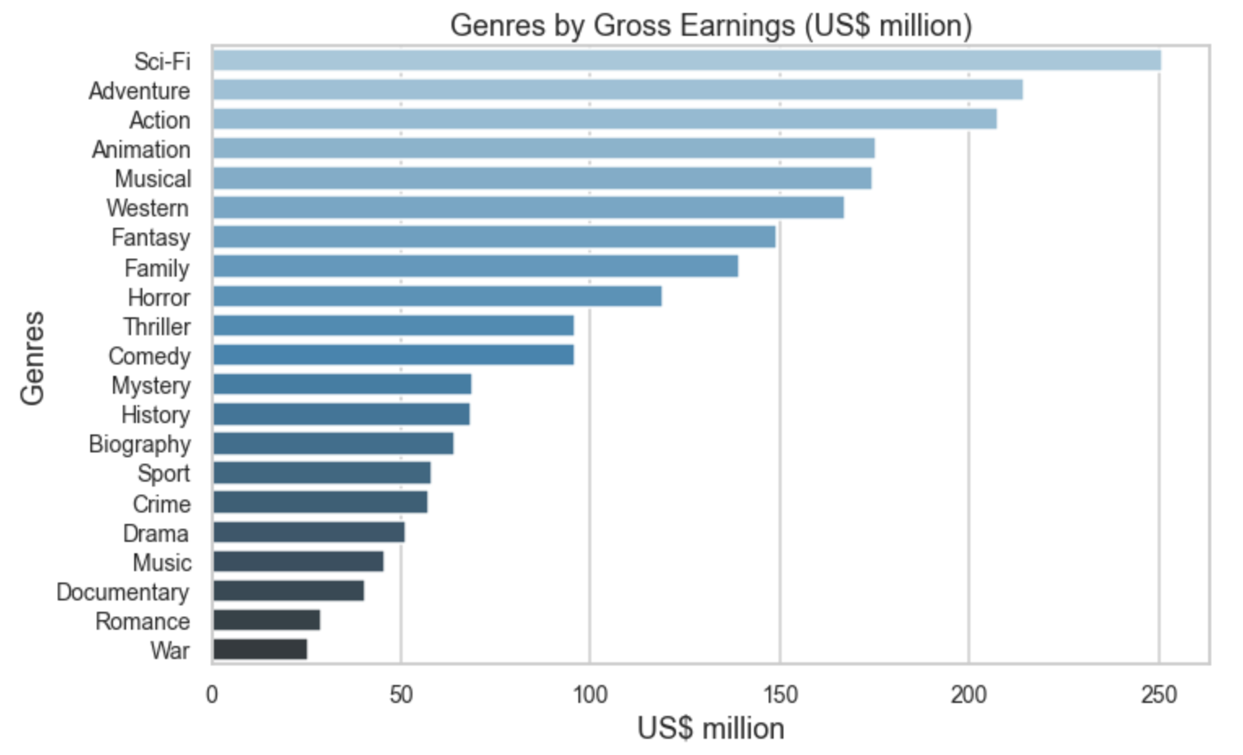
results
The top three genres by average gross earnings:
Sci-Fi ($251mil)
Adventure ($214mil)
Action ($207mil)

Slide 9
conclusions
For successful gross earnings, Tenné should produce Sci-Fi, Adventure, and Action movies
For successful audience ratings, Tenné should produce Musical, Sci-Fi, and Animation movies
Create Sci-Fi movies. Between 2013 and 2018, 492 movies were produced, and only 29 of those movies were Sci-Fi.
Next Steps
Analyze more recent data
Analyze streaming data
Analyze demographics of movie-makers and movie-watchers

