Slide 1
Housing Sale Price Analysis in King County, WA
Rebecca Frost-Brewer
April 22, 2022

Slide 2
Overview
Business Problem: Emerald City Realtors need to provide prospective home sellers with guidance on how to improve the value of their home prior to listing, including the predicted increase in value expected based on improvements to features
Business Question: What features of their home can prospective home sellers change or improve to increase the value of their home, and by amount could this increase be specific to certain features?

Slide 3
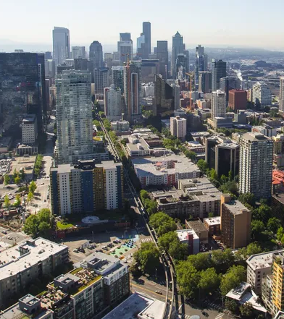
Business and Data Understanding
Stakeholder: Emerald City Realtors
Data: King County House Sales dataset encompassing housing sales of 2014 and 2015, with 20 features related to the homes’ sold
Business Value: Data-drive recommendations will be valuable to Emerald City Realtors because they will help prospective home sellers confidently ascertain how they can improve the value of their home, and if the investment is worth the cost

Slide 4
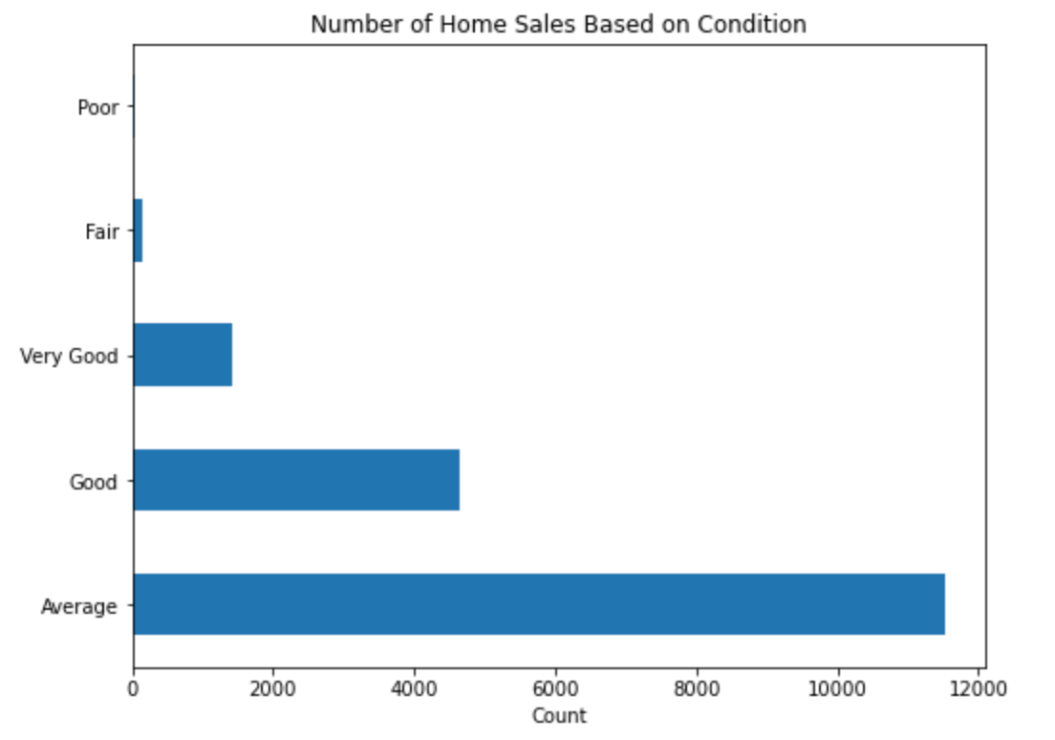
Exploring the Data

Slide 5
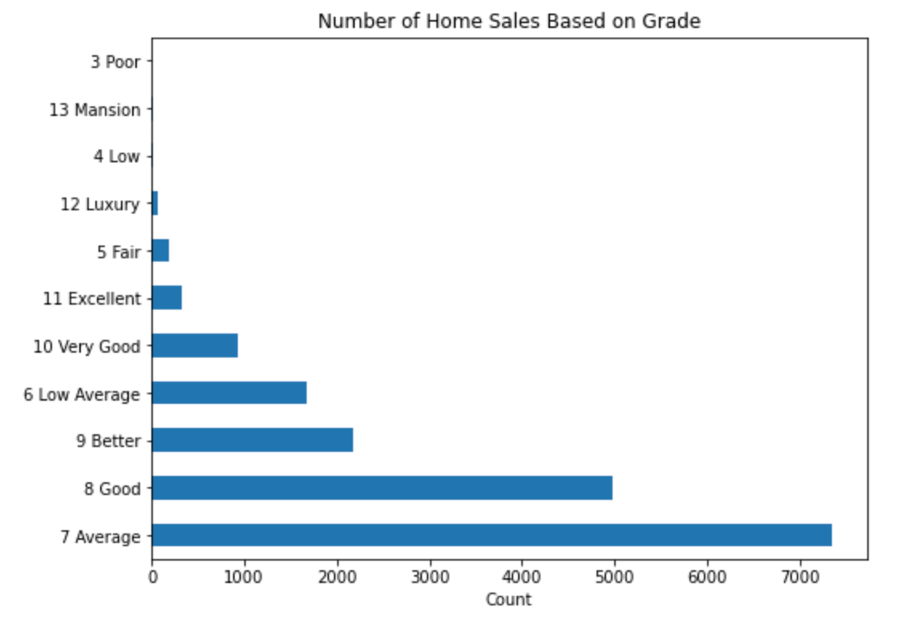
Exploring the Data

Slide 6
Modeling
Linear regression allows us to convey a linear relationship – such that we can observe a one unit increase in X results in a one unit increase in Y
In this business case, using regression models allows for us to determine how sale price is impacted by different features and to what degree
Building complex models with multiple features allows for us to be able to make more accurate, data-driven predictions

Slide 7
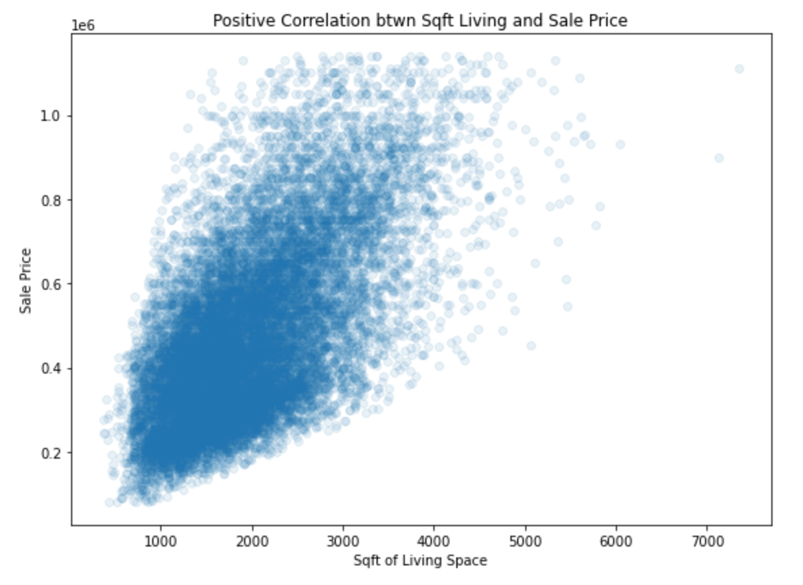
For Example

Slide 8
Regression Results
In our final model, all features have a statistically significant linear relationship with sale price
While holding all other variables constant:
The addition of a bathroom increases sale price by $29,020
The addition of one floor level increases sale price by $41,040
Improving a home's condition from Average to Very Good increases sale price by $38,810
Improving a home's grade from Better to High Quality increases sale price by $82,180

Slide 9
Recommendations
Improve the grade of your home from Better to High Quality, which is predicted to increase the sale price by $82,180
Adding an additional bathroom to your home is predicted to increase its sale price by $29,020
Each additional square foot of living space is predicted to add 81.12 dollars to the sale price; a 600-square foot addition would be predicted to increase the sale price by $48,672

Slide 10
Limitations
In our final model only explains 57.5% of the variance in the data
The Mean Absolute Error (a performance metric) is 106248.25, which means our predicted values may vary from actual values by as much as $106,248.25
Notes:
Add plot with bathrooms
Add plot with price difference between different grades
Both help drive home message

Slide 11
Next Steps
Collect more recent sales data for more accurate representation of the market
Investigate influence of zipcode on sale price

Slide 12
Thank You

