Slide 1
Predicting Customer Churn
Rebecca Frost-Brewer

Slide 2
Overview
Business and Data Understanding
Modeling
Evaluation
Recommendations
Next Steps

Slide 3
Business and Data Understanding
Problem: Better predicting when SyriaTel’s customers will soon churn.
Solution: Finding predictable patterns using a classification model will benefit SyriaTel's business practices to minimize customer churn.
Data: Includes 21 features (both categorical and continuous and 3,333 data points from SyriaTel related to its customers and their accounts and churn information

Slide 4
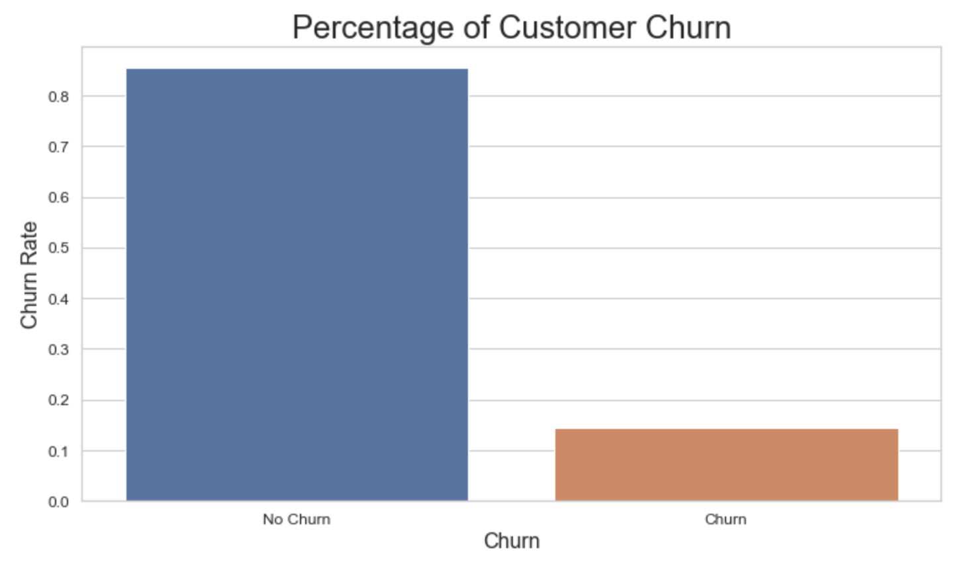
% of Customer Churn
14.5% of the customers in this dataset have churned

Slide 5
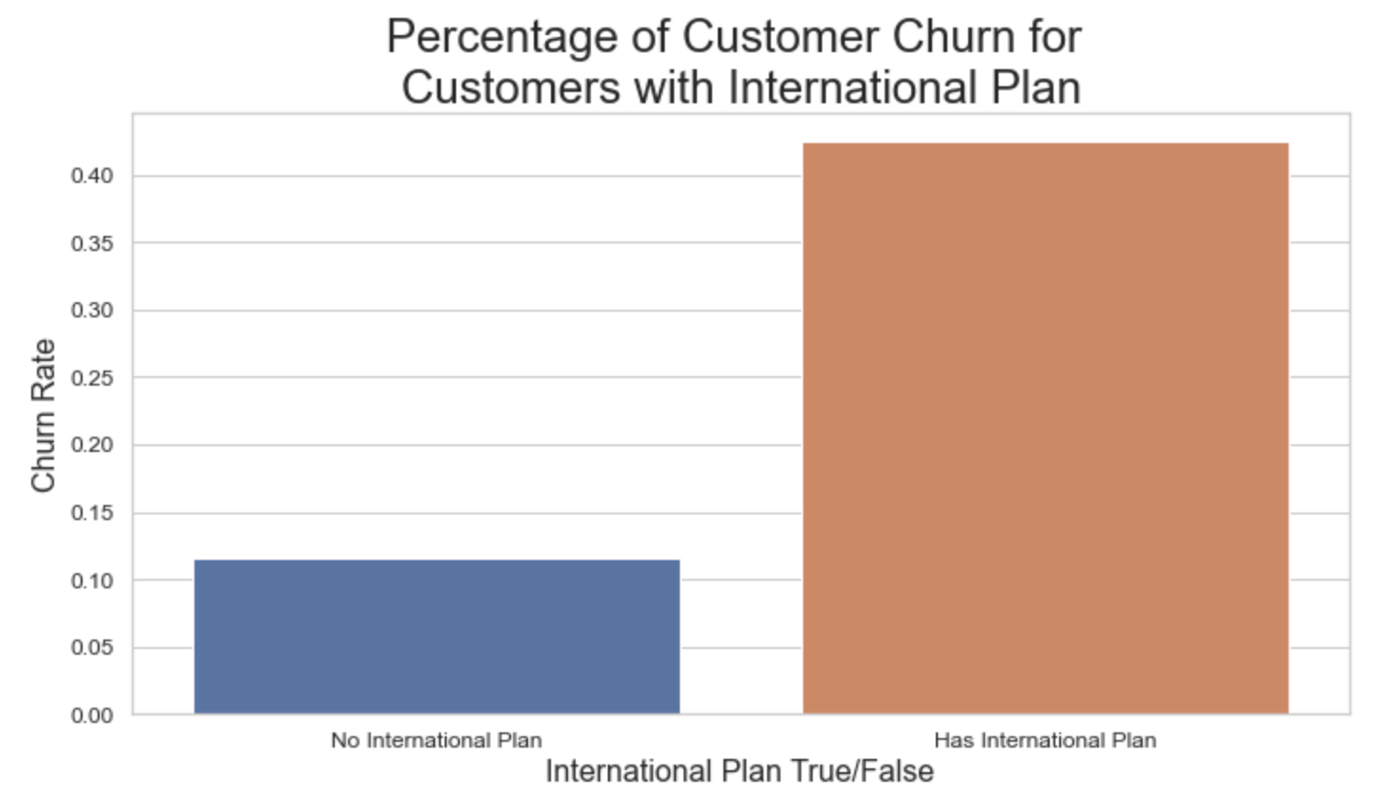
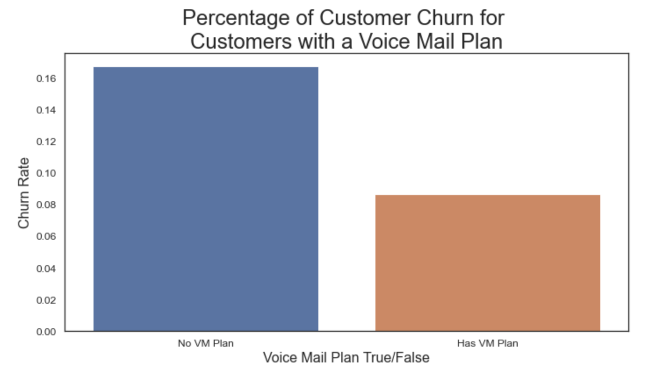
Features
42% of customers with an international plan churn
17% of customers without a voice mail plan churn

Slide 6
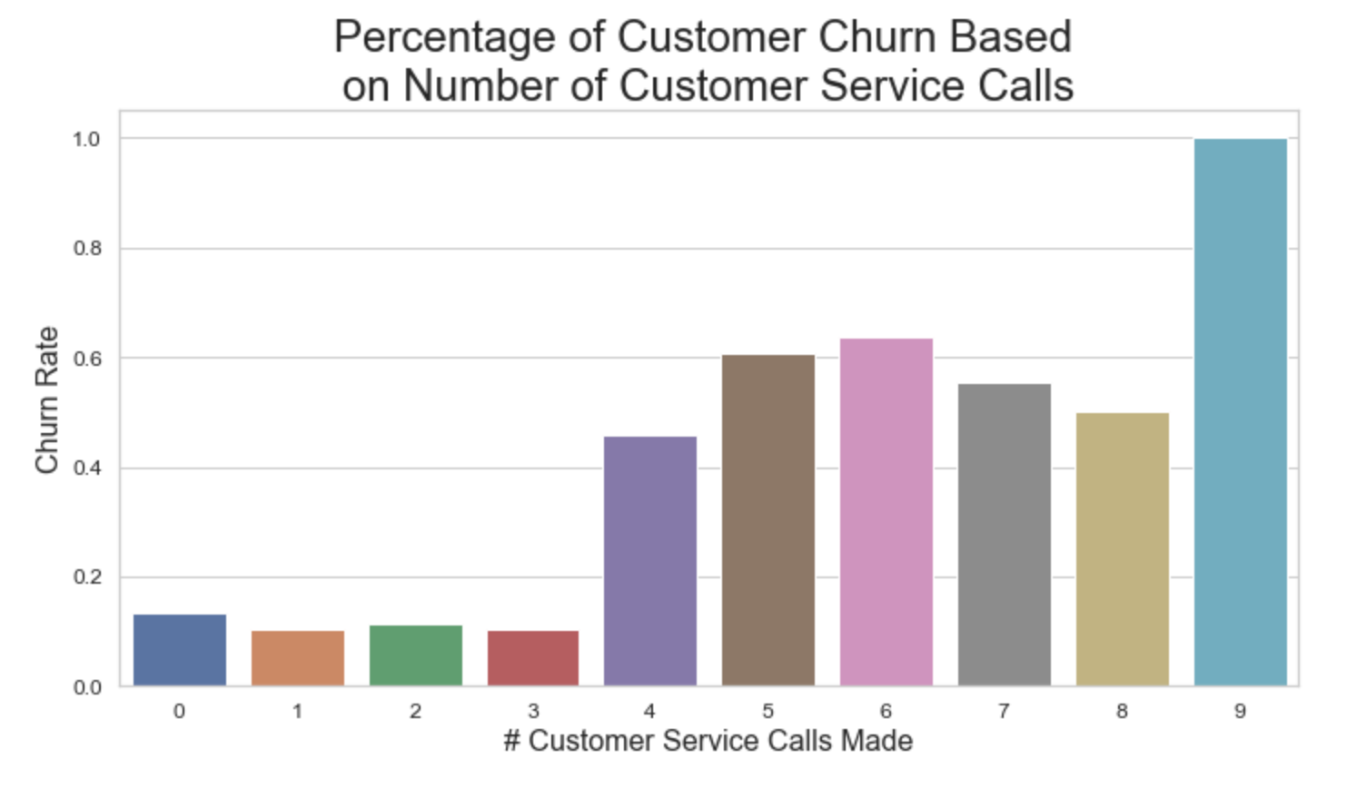
Customer Service
Customers who call customer services four or more times have a higher churn rate than those who call fewer than four times

Slide 7
Modeling
Used a type of machine learning algorithm called Classification, which is the process of predicting the class of given data points
In this case, the “class” is customer churn – whether a customer will leave SyriaTel
Out of the five different algorithms evaluated in this project, the best performing model used an eXtreme Gradient Boosting (XGBoost) algorithm, which provides best-in-class performance among other classifiers

Slide 8
Evaluation
Performance metric: F1-score, which combines two classifier metrics:
Precision measures what percent of the model’s predictions were correct
Recall measures what percent of the positive cases were caught correctly
F1 is the harmonic mean of the model’s precision and recall scores
F1-score values range 0-1, with 0 as the worst value and 1 as the best value
The closer the F1-score is to 1, the more perfect the model is classifying samples

Slide 9
Evaluation
The final tuned XGBoost model achieved an F1-score of 0.94
The most important features influencing the model:
the number of calls the customer made to customer service*
whether the customer has a voice mail plan
the total number of minutes used per day
whether the customer has an international plan*
the total number of international calls made
Both bolded features were also influential in other models evaluated

Slide 10
Recommendations For Future Work
Provide a larger dataset with greater number of customer information and dates of data collection (to ascertain timeframes)
Further Analysis of Feature Importance: International plans, voice mail plans, calls to customer service
Evaluate Customer Service: Conduct customer service surveys for more information on why customers are calling
Conduct industry benchmarking to determine how voice mail and international plans compare to competitors

Slide 11
Thank You
Questions?
Rebecca Frost-Brewer frostbrewerr@gmail.com

