Slide 1


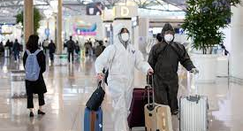


Group5project : Ray, Jack, Makintha, Simona
Covid-19 - Data Assessment

Slide 2
Table of Contents
1. Introduction
2. Breakdown of categories
3. Thesis
4. How we did this
4.1 Data sourcing
4.2 Data mining
4.3 Tools
4.4 Visuals
5. Future work
6. Conclusion

Slide 3
1. Introduction
Our project name will simply be referred to as: Covid-19 - Data Assessment: group5project
Why Covid-19 ?
There’s been almost no one left untouched by this disease, whether that be through restrictions, or having the disease itself.
Justification for research:
To help governments create appropriate socio-economic policies arising from the effects of Coivid-19.
Our Research questions :
1. What is the impact of Covid-19 on Australia?
1.1. What is the specific effect of Covid-19 on the macro-economy of Australia?
Acknowledgement :
Scope of data:
The sheer size of the macro-economy meant we needed to decide on specific areas of measurement.
The project scope will therefore cover the effects of Covid-19 and its impact on several categories.
Limitations of Data:
This will not cover all industry sectors, it will not cover every country either.
Period of data covers: 2018-current

Slide 4
2. Break down of categories …
Covid-19 infections
Unemployment rates
Human population movement : travel
Mining, oil and gas sector performance

Slide 5
3. Hypothesis
What we hope to show with our data is the below hypothesis:
Covid-19 had a significant negative effect on areas of:
Economic performance (mining, oil and gas)
Unemployment rates
Human population movement (travel)

Slide 6
4 + 4.1 Data Sourcing
Data Sources:
•John Hopkins Covid19 data
•ABS
•Australian Digital Boundary Geojson data

Slide 7
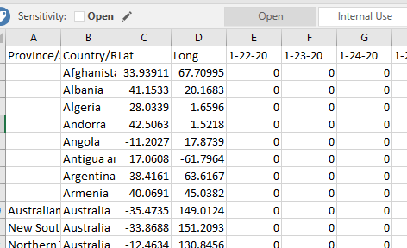
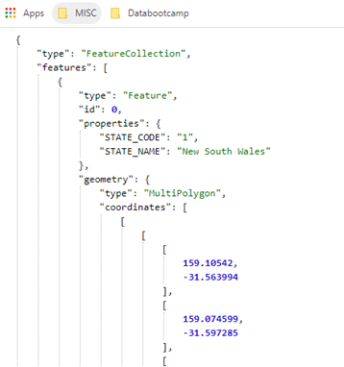
4.2. Data Mining
The data were taken by downloading the csv data. The Geojson data however, is taken by making API calls

Slide 8
Tools and Modules Used:
Github
Jupyter Notebook
Modules of python:
Pandas
Matplotlib
Numpy
Folium
Scipy
Our own functions

Slide 9
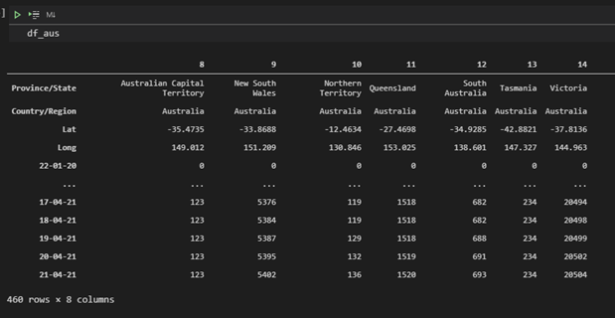
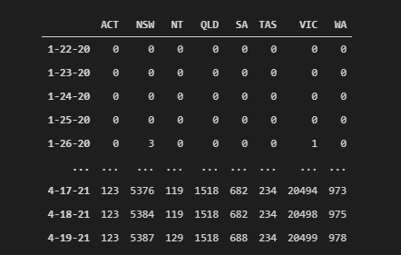
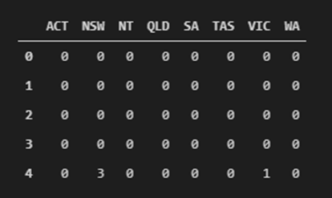
Data Wrangling, and Cleaning

Slide 10
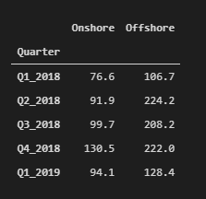
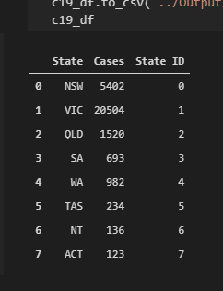
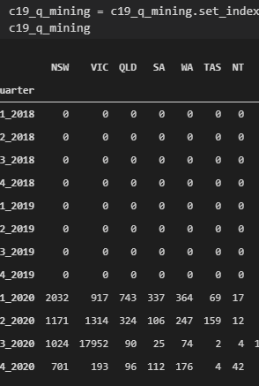
Final Data before Visualization

Slide 11

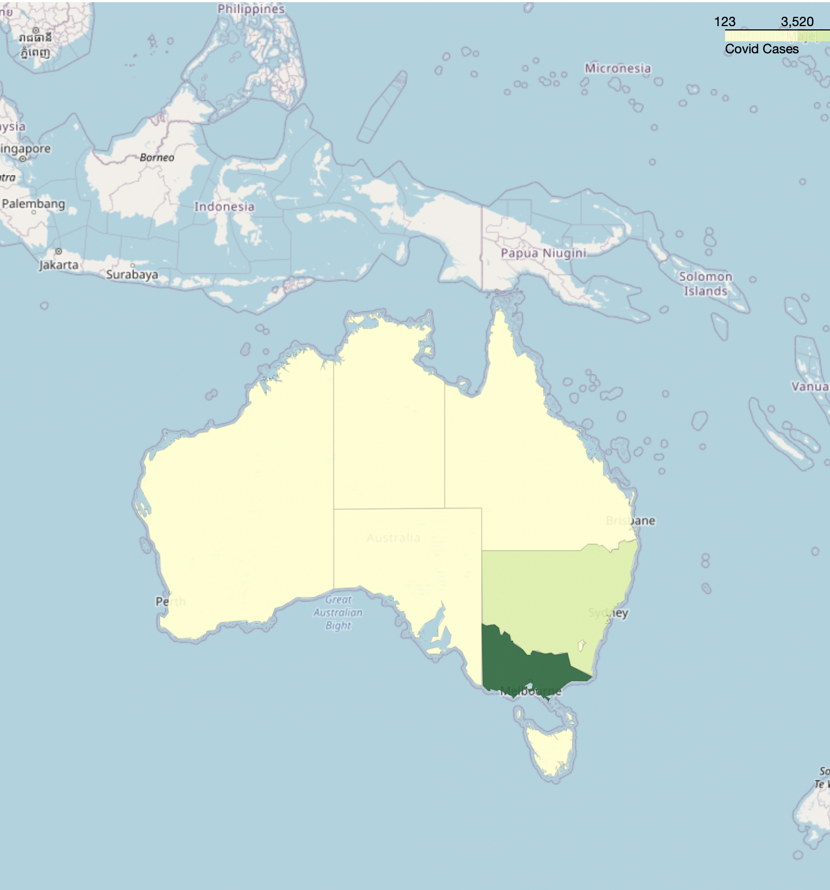
Covid-19 Cases from Up to March 2021
4.4 VISUALS:
API – Generated Choropleth Map

Slide 12
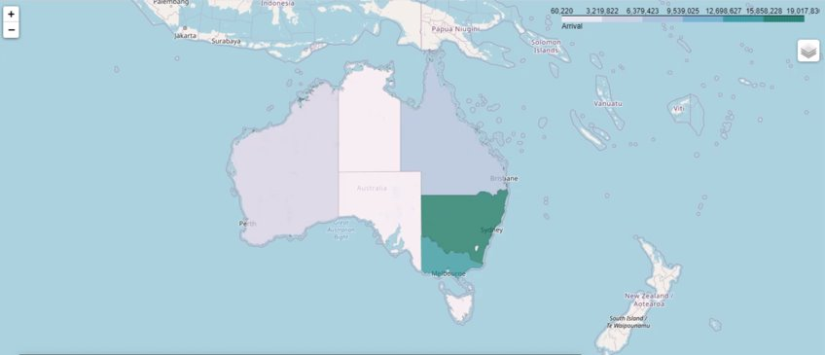
Choropleth Map for Number of Arrival in Australia (2018 - March 2021)

Slide 13
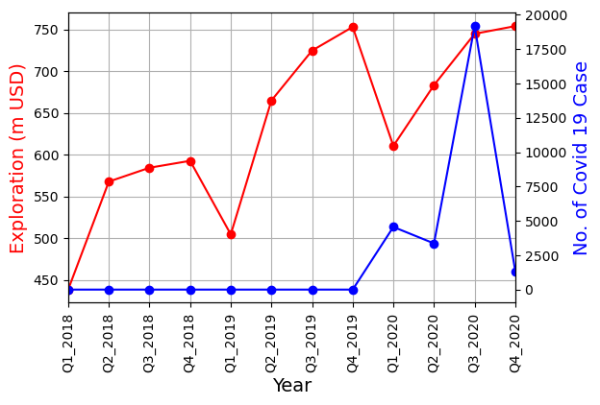
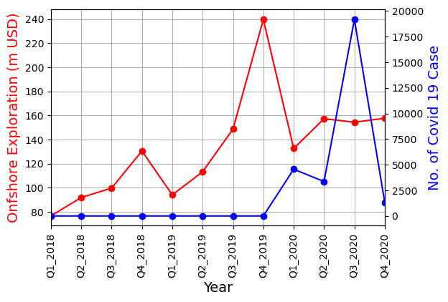
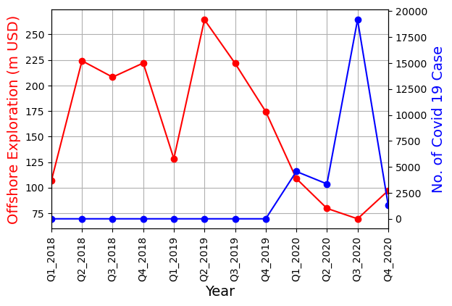
Cases vs Mining and Petroleum (Australia)

Slide 14
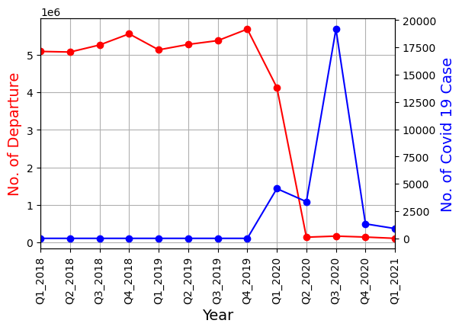
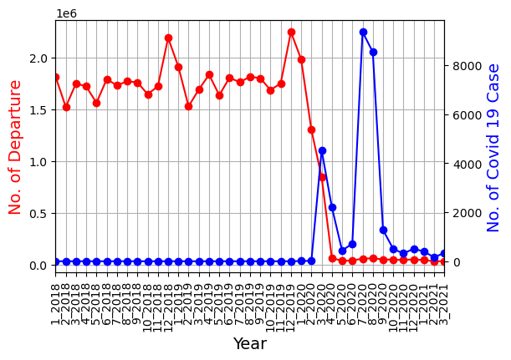
Cases vs No. Of Departure

Slide 15


Cases vs No. Of Arrival

Slide 16
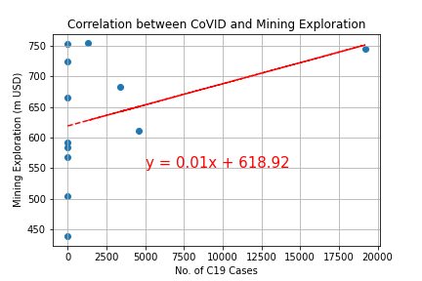
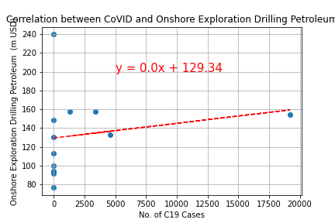
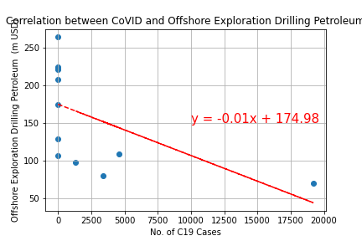
r-value ~ 0.37
P-value ~ 0.24
r-value ~ 0.19
P-value ~ 0.54
r-value ~ -0.56
P-value ~ 0.059
Correlation Plots (Mining and OnG Industry)

Slide 17
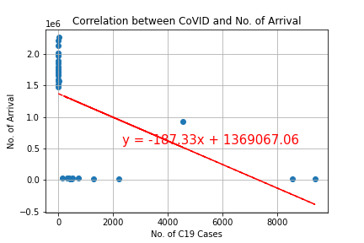
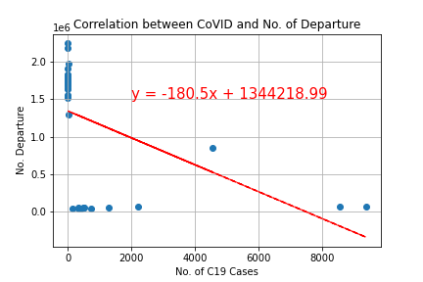
Correlation Plots (travel)
r-value ~ -0.46
P-value ~ 0.0027
r-value ~ -0.46
P-value ~ 0.0028

Slide 18
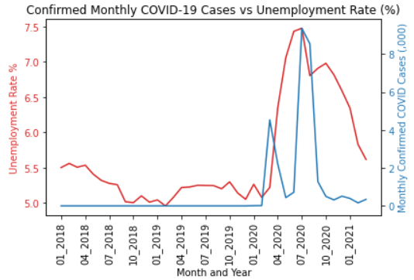
Cases vs Unemployment (Australia)
Impact of monthly confirmed cases of COVID-19 on unemployment rate
The x variable = confirmed cases/1000
The y variable = unemployment rate
Visible trend shows as cases increase, so does unemployment.

Slide 19
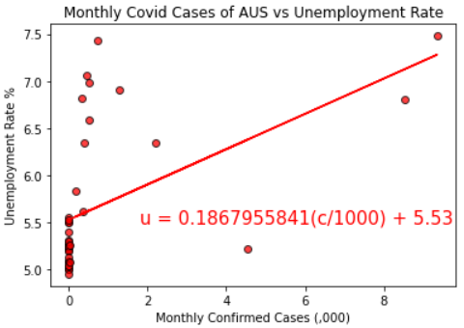
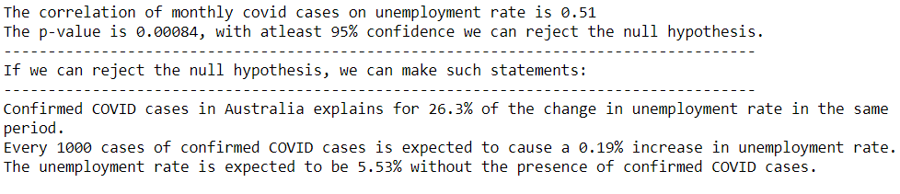
Cases vs Unemployment (Australia)

Slide 20


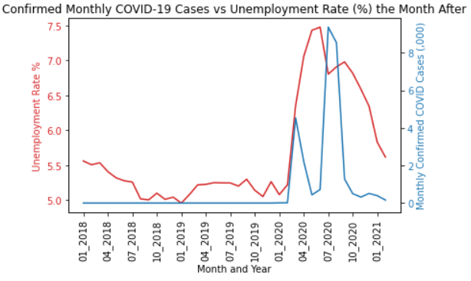
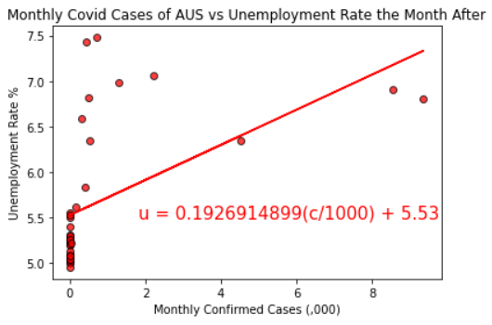
Lag Effect?
R-square = 0.26
VS
R-square = 0.28

Slide 21
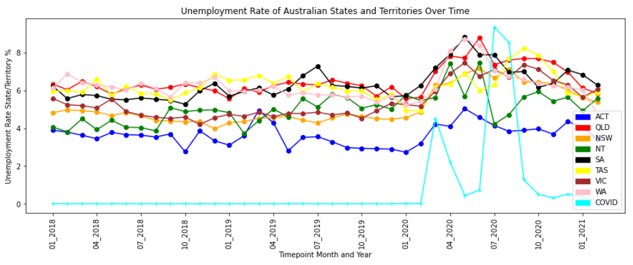
Cases vs Unemployment (State)

Slide 22
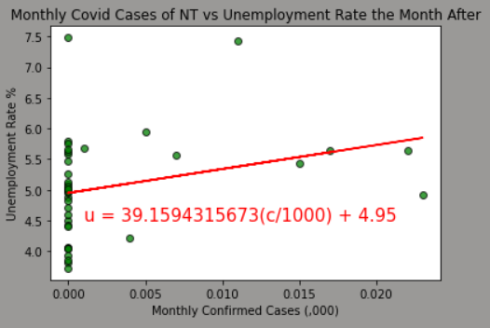
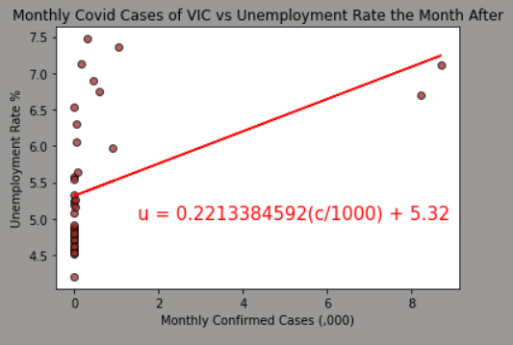
Future Work
Low R-square values – how to improve regression?
Need more time? Need multivariate regression?
Australian Proxy
Country Proxy(USA/China/Japan)
Correlation is 0.28. weak positive correlation.
p-value = 0.08297, cannot reject Ho
Hike in unemployment effected by VIC instead?
Correlation is 0.45. Moderately positive correlation.
p-value = 0.00477

Slide 23
Conclusions
There is a positive correlation between unemployment and CoVID19
There is negative correlation between travel/tourism and CoVID19
No evidence of correlation between mining/petroleum sector and CoVID19

